Slide 1
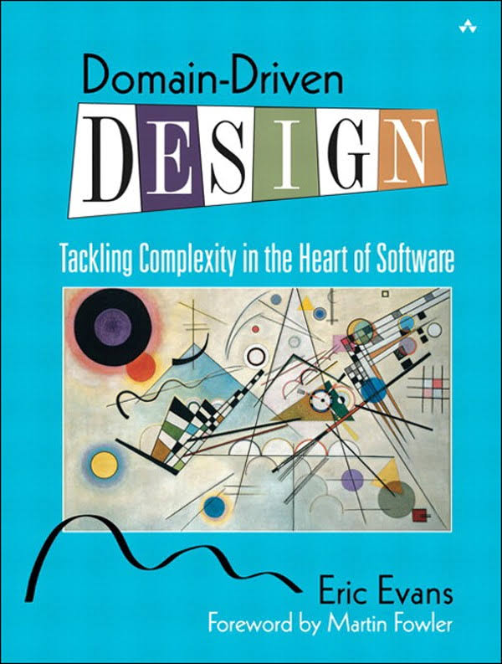
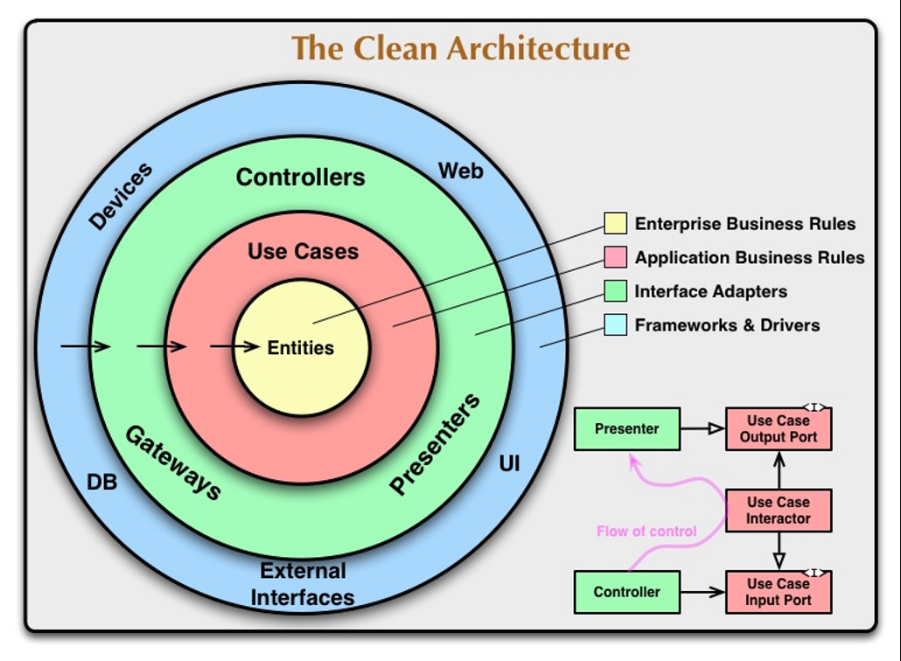
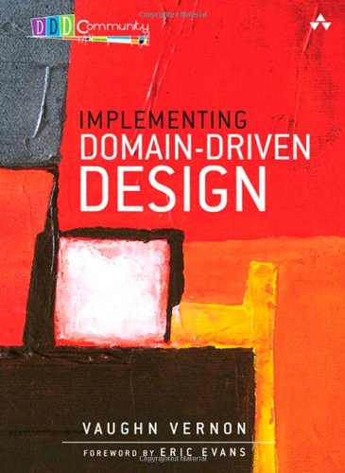
DomainDrivenDesign();
TackLıng COMPLEXITY IN THE HEART OF SOFTWARE

Slide 2
Problems of Enterprise Software
Maintenance, as software grows.
Mixing application logic and domain logic.
Monolithic code base.
Mixing infrastructure and business code, makes hard to switch technology.
Testability
«Any fool can write code that a computer understand. Good programmers write code that humans can understand.»
Martin Fowler

Slide 3
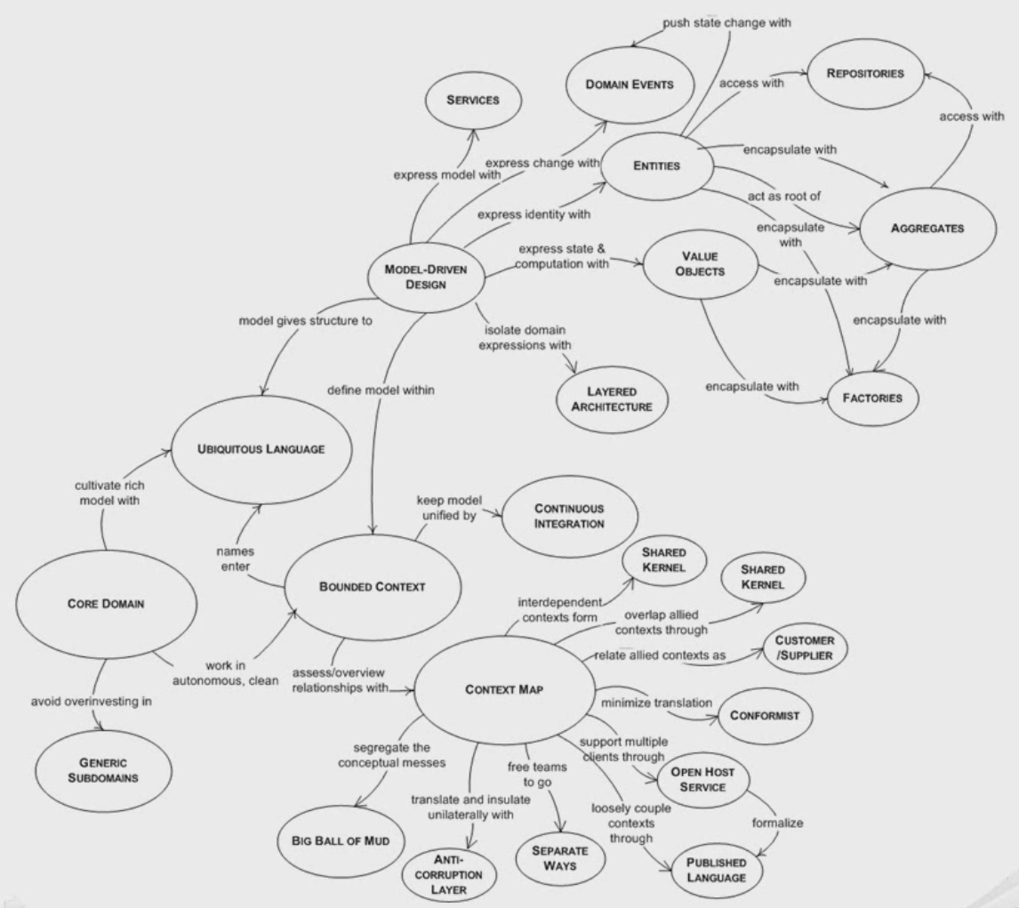
Solution Approaches
Principles
SOLID
Seperation of Concerns (SoC)
Don’t Repeat Yourself (DRY)
Patterns & Practices
Layering
Dependency Injection (DI)
Domain Driven Design (DDD)
Test Driven Development (TDD)

Slide 4
Domain Driven Design
Overall
Ubiquitous Language: Code should be based on the common language!
Bounded Context / Microservices
Building Blocks (Patterns, Elements) of DDD
Domain: Entity, Aggregate, Value Object, Repository, Domain Service, Domain Event, Policy
Application: Application Service, Data Transfer Object, Unit Of Work
Infrastructure: Persistence
Presentation: MVC…
Supporting
Dependency Injection
Validation, Authorization, Auditing

Slide 5
Discussions
Persistence Ignorance
Not Database Driven Design, but Domain Driven Design!
Bounded Contextes
Entities should not be re-used between contextes even they represent same database table.
Aggregate Roots
Responsible for it’s own validity and integrity.
Can refer other Aggregates by only reference (by their id).
Should go over aggregate root to access an aggregate.
Should be retrieved as a whole object (including collections) from repository (or support lazy load).
Applications
Create application layer per application (UI).

Slide 6
Discussions
How to manage domain exceptions?
Don’t mix presentation logic, application logic and domain logic.
Where to implement validation: UI validation, DTO validation, business validation.
Application Service vs Domain Service
Write Model - Read Model / Reporting
DDD is mostly for changing the state, not reporting!

Slide 7
Contact
http://volosoft.com
http://halilibrahimkalkan.com

