Slide 1
Delhi Metro Analysis – Project Report
By: Akash Chauhan
November 2025
An in-depth data analysis of Delhi Metro ridership, revenue, and ticket trends.

Slide 2
1. Introduction
Delhi Metro, India’s largest and busiest rapid transit system, connects millions daily across the NCR.
Purpose of the Study:
- Explore Delhi Metro’s ridership data to extract patterns and insights.
Objectives:
• Understand travel behavior and ticket usage.
• Identify high-traffic stations and routes.
• Analyze fare, distance, and ridership correlation.
• Recommend improvements for efficiency and satisfaction.

Slide 3
2. Dataset Overview
Dataset includes trip, fare, and ticket details of Delhi Metro passengers.
Key Columns:
- From_Station, To_Station
- Ticket_Type (Smart Card, Tourist, Token)
- Fare, Distance, Passengers, Date
Libraries Used: Pandas, NumPy, Matplotlib
Steps: Data cleaning, transformation, and visualization.

Slide 4
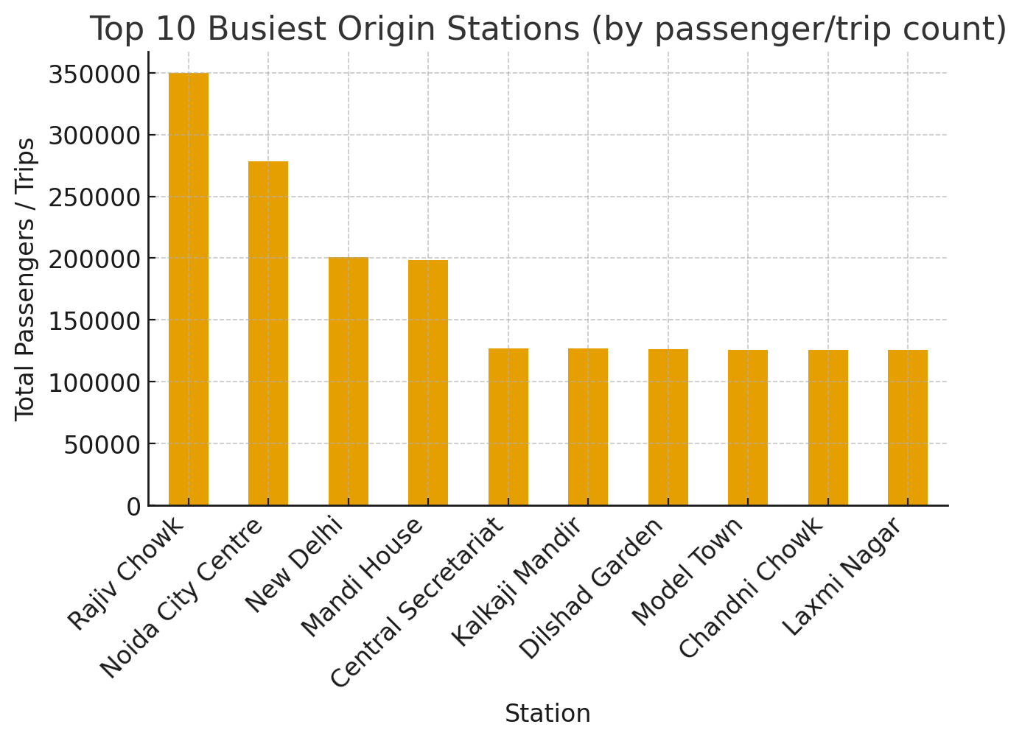
Top 10 Busiest Stations

Slide 5
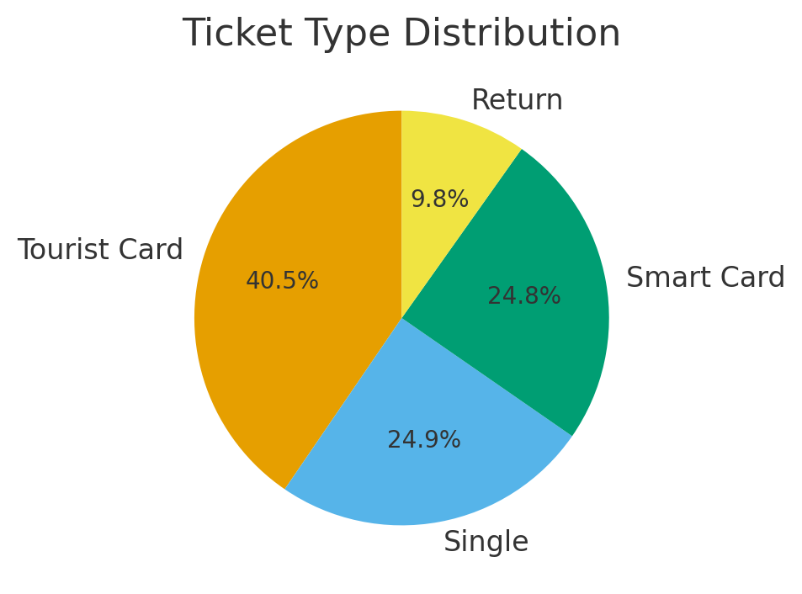
Ticket Type Distribution

Slide 6
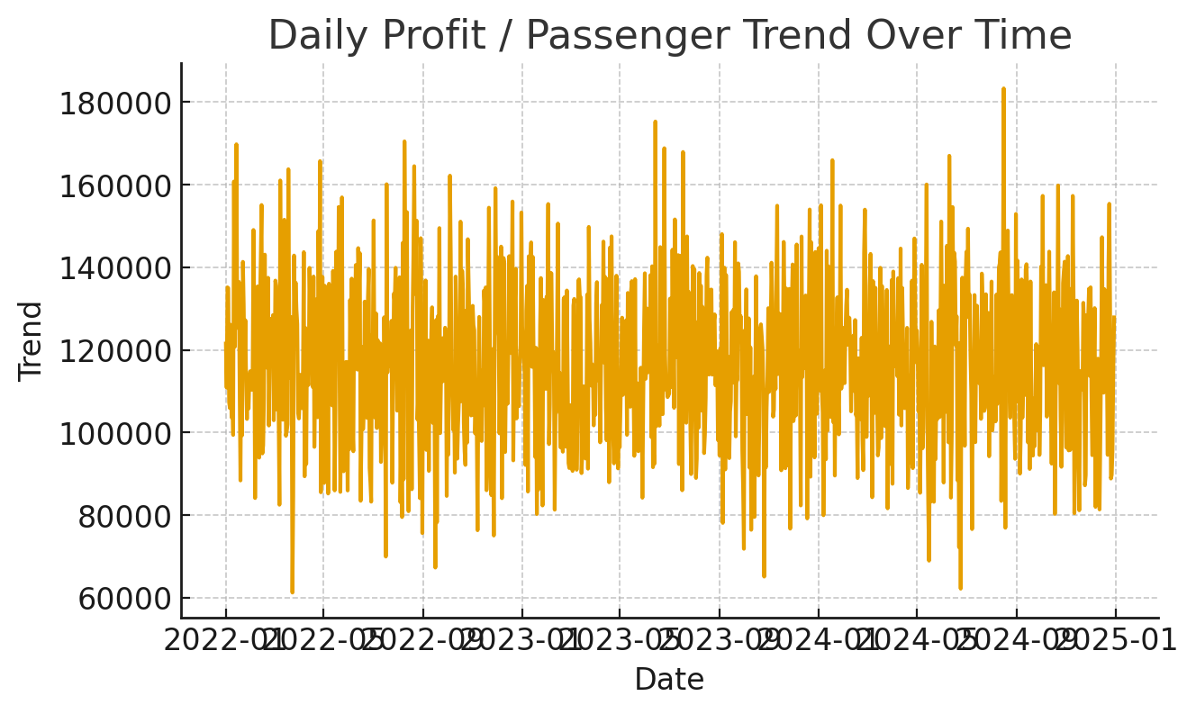
Profit / Passenger Trend Over Time

Slide 7
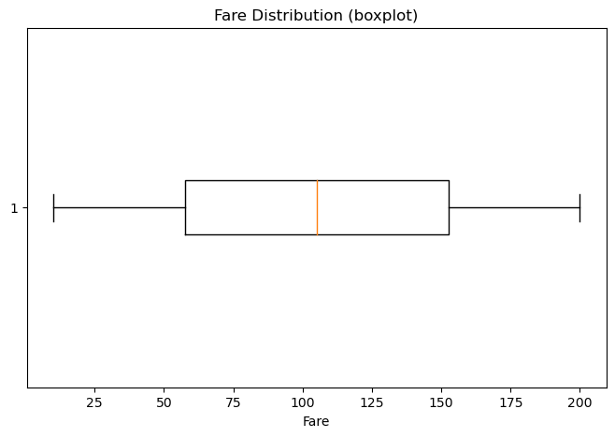
Fare Distribution (boxplot)

Slide 8
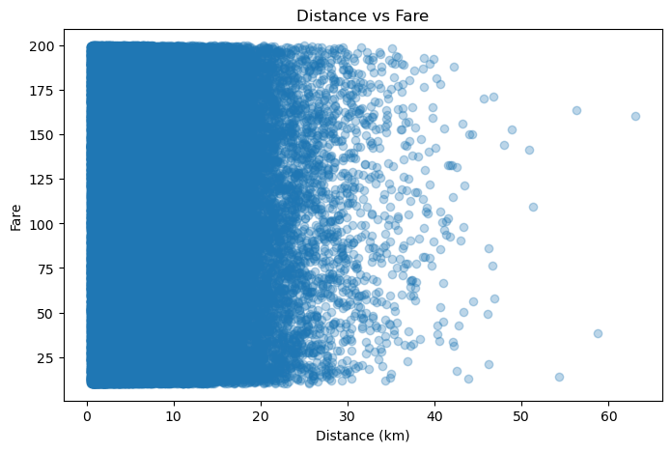
Distance VS Fare

Slide 9
5. Key Insights
1. Smart Card users dominate ridership patterns.
2. Tourist ticket usage peaks on weekends and holidays.
3. Rajiv Chowk and Kashmere Gate are major interchange hubs.
4. Stable fare trends show efficient pricing.
5. Fare increases linearly with distance.
6. Demand surges during winter and festive seasons.

Slide 10
6. Recommendations
• Increase frequency during peak hours and festivals.
• Use AI models for ridership forecasting.
• Expand digital and QR-based ticketing.
• Offer off-peak discounts to balance loads.
• Enhance tourist packages and travel experiences.
• Apply data analytics for station planning.

Slide 11
7. Conclusion
Delhi Metro efficiently manages huge commuter traffic with consistent revenue and fare structures.
Data shows Smart Card dominance, stable trends, and clear weekday peaks.
With predictive analytics and digital innovation, Delhi Metro can further enhance reliability and passenger satisfaction.

Slide 12
References
• Dataset: delhi_metro_cleaned_Dataset.csv
• Tools: Python (Pandas, NumPy, Matplotlib)
• Jupyter Notebook: Delhi_Metro_Project.ipynb
• Report & Analysis: Yash Vardhan

