Slide 1




INTRODUCTION
GRC IN CYBERSECURITY
The decisions, responsibilities and checks behind effective security.
G
R
C
GOVERNANCE
RISK
COMPLIANCE
Security tools need clear direction and oversight
GRC • CYBERSECURITY TEACH-BACK
1 / 8
Notes:
Start with a question: We hear about firewalls and passwords, but who decides what the organization must protect and who is responsible? That is where GRC comes in. GRC stands for Governance, Risk and Compliance. It may be less visible than a security tool, but it shapes the decisions behind that tool: the policy, the resources, the owner and the checks. Today we will use road safety to make the idea familiar, then see how Care Access Navigator puts it into practice.

Slide 2
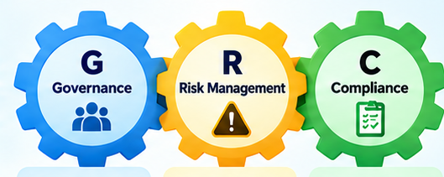

THE BASICS
WHAT IS GRC — AND WHY DO WE NEED IT?
Governance sets direction. Risk guides priorities. Compliance checks requirements.
WHY IT EXISTS
Clear policies explain expectations. Named owners follow through. Risk reviews guide where time and money go.
G Who makes the rules?
R What could go wrong?
C Are requirements met?
STRUCTURE + ACCOUNTABILITY
GRC • CYBERSECURITY TEACH-BACK
2 / 8
Notes:
Governance sets direction and accountability. A policy is an agreed expectation, such as who may approve access. Risk management asks what could prevent us from achieving our goals, how serious it could be and what response makes sense. Compliance checks whether we meet the requirements that apply, including laws, contracts and internal policies. These functions overlap and inform each other. For example, a repeated problem may show that a policy needs to change. GRC gives the organization a consistent way to make those decisions.

Slide 3

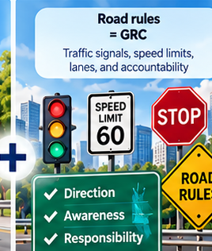
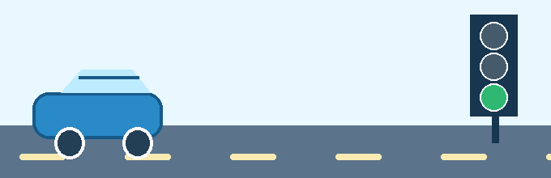
EVERYDAY ANALOGY
A GREAT CAR DOES NOT GUARANTEE A SAFE ROAD
Ask the audience: “Would you feel safe without traffic rules?”
ADVANCED SAFETY TECHNOLOGY
RULES + RESPONSIBILITY
Best technology + no rules = still unsafe
GRC • CYBERSECURITY TEACH-BACK
3 / 8
Notes:
A modern car may have excellent brakes, cameras and airbags. Those features help, but a safe journey also depends on road rules, responsible driving and maintenance. Imagine an intersection with no agreed right of way. Better brakes alone do not solve the coordination problem. In cybersecurity, technical safeguards also need direction and oversight. The analogy has limits: traffic rules come from authorities, while an organization sets its internal policies within applicable requirements. The useful connection is that technology and responsible decisions work together. Ask the group: Which part of a safe journey depends on people rather than the car?

Slide 4
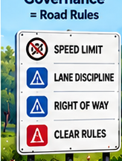
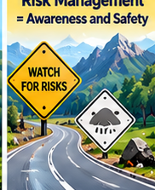
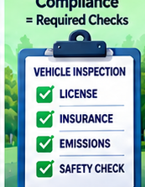
CONNECT THE ANALOGY
G, R AND C THROUGH ROAD RULES & SIGNS
Direction, informed choices and evidence work together on the same journey.
GOVERNANCE
RISK MANAGEMENT
COMPLIANCE
Rules of the road
Warnings and safe driving
Required inspections
Set policy and assign responsibility.
Assess danger and choose a response.
Check requirements and keep evidence.
GRC • CYBERSECURITY TEACH-BACK
4 / 8
Notes:
Governance: a transport company sets expectations, appoints responsible drivers and defines who maintains the vehicles. Risk: heavy rain increases the chance of a collision, so a driver slows down, changes route or postpones the journey. The response should match the likelihood and potential harm. Compliance: check the licence and required vehicle records, and verify that the applicable rules are followed. Requirements vary by jurisdiction and vehicle. A completed checklist does not make every journey safe; the driver still needs to watch changing conditions. At work the same pattern is policy, informed action and verification.

Slide 5
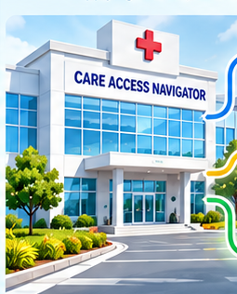



YOUR CAPSTONE EXAMPLE
CARE ACCESS NAVIGATOR: GRC IN A HOSPITAL
A simulated healthcare access scenario connects policies to IAM controls.
GOVERNANCE
Decide who needs access and who approves it.
RISK
Identify where access could remain after staff leave.
COMPLIANCE
Review termination procedures and supporting evidence.
WHO CAN VIEW A PATIENT RECORD?
IAM ENFORCES ACCESS • Keycloak + Entra ID
GRC • CYBERSECURITY TEACH-BACK
5 / 8
Notes:
Care Access Navigator is a healthcare simulation with synthetic users and a mock electronic health record application. Governance decides which roles need access and who approves it. Risk management asks where an account could retain access after someone leaves. Compliance reviews the relevant termination procedure and its supporting evidence. Entra ID manages workforce identity, while Keycloak brokers application authentication. In the documented leaver test, Entra access was removed but the Keycloak account needed a separate manual disable. That observation became a specific GRC issue. No unauthorized EHR access was observed, and there were zero active Keycloak sessions at the recorded snapshot. Source: supplied project documentation, sections 1–3.

Slide 6
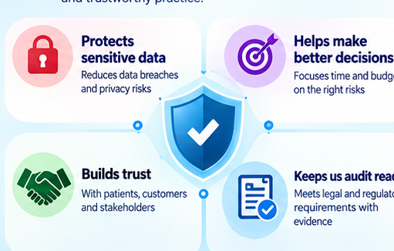


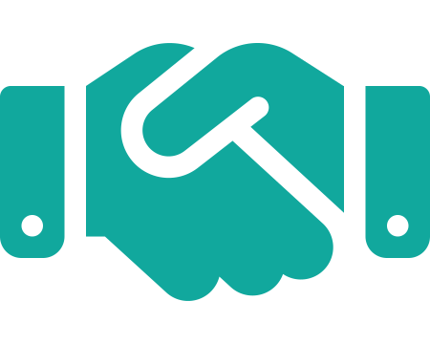

THE BIGGER PICTURE
WHY IS GRC IMPORTANT?
Good oversight connects daily actions to business priorities.
Protect information and services
Prioritize the most serious risks
Make responsibilities visible
Demonstrate what actually works
A policy needs an owner. A risk needs a response. A claim needs evidence.
GRC • CYBERSECURITY TEACH-BACK
6 / 8
Notes:
The value of GRC is the quality of decisions and follow-through. It helps us protect information and keep services operating, compare risks before spending limited time or money, and make responsibility visible. It also helps us distinguish a safeguard we have merely planned from one we have tested. This matters across industries: a hospital protects patient information, a hotel needs dependable booking operations, and a manufacturer needs safe, reliable equipment. Ask: If a policy exists but nobody owns its implementation, what is missing? Accountability. Now let's see how we organized that work in the capstone.

Slide 7
CISO ASSISTANT CONNECTS THE GRC WORK
Care Access Navigator: operational evidence becomes a record the team can review.
Microsoft Entra ID
→
Keycloak
→
Mock EHR
Workforce account
Application sign-in
Protected application
Test observations and the JML evidence PDF
Manual upload and linking
CISO ASSISTANT
Risk assessment
Controls and evidence
Findings and actions
What needs attention?
What supports the review?
What must happen next?
7 / 8
Notes:
CISO Assistant is the GRC workspace alongside the identity systems. This diagram separates their roles. Entra ID and Keycloak perform identity and access functions for the mock application. We run tests and collect the results. In the documented workflow, the JML evidence PDF was uploaded into CISO Assistant and linked to the manual control and selected requirement assessment. We recorded the risk and the improvement work there as well. This is integration through a documented evidence and review workflow. The supplied record does not establish an automatic log feed or automatic access changes from CISO Assistant. The benefit is that someone reviewing a risk can find its supporting information and follow the action needed. JML means joiner, mover and leaver, or the employee lifecycle. Source: supplied documentation, sections 3–5.

Slide 8
FROM AN ACCESS GAP TO A CLEAR ACTION PLAN
Recorded project status: 3 November 2026. Synthetic lab scenario.
OBSERVATION
Keycloak needed a separate manual disable.
RISK DECISION
Current risk: High. Decision: reduce the risk.
REQUIREMENT CHECK
Termination procedures: Partially compliant.
FOLLOW-UP
Confirmed finding. Automation and tests planned.
Value: one traceable story from evidence to responsibility and improvement.
8 / 8
Notes:
Here is the actual story the tool helps us tell. The leaver test found that the Keycloak account stayed enabled until a separate manual action. The current risk is High in the imported CISO Assistant matrix. The manual procedure is documented, but the focused termination requirement remains Partially compliant. The finding is High severity and Confirmed. Automated downstream disablement is planned and still needs implementation and tests. A Low target risk is a future expectation, not achieved risk reduction. This result applies to one requirement and does not establish overall HIPAA compliance. The practical improvement is visibility: we can connect the observation, its evidence, the assessment and the outstanding work.
OPTIONAL 90-SECOND DEMO: Open CAN-RA-001 and R02. Say: Here is the risk we recorded. Show the linked manual control and JML PDF: Here is our current procedure and evidence. Open CAN-AUD-HIPAA-001 and the termination requirement: Here is our assessment. Open CAN-FIND-001 and planned CAN-CTRL-JML-002: Here is the work still to do. End on the action-plan view and read the actual status. The source describes these relationships; final relationship checks include user-reported confirmation, not an independently fetched database audit.
Close: GRC gives us a disciplined way to decide, act and verify. CISO Assistant makes that work easier to follow. Source: supplied documentation, sections 6–12.

