Slide 1

Second Semester Monthly Update — Akhila Ch
6-Month Cohort Program • End of Semester 2
From a beginner Python mini project to a clear Cybersecurity path, an IAM/GRC capstone plan, and stronger portfolio readiness.
Today:This is about so far what I explored, what I chose, what I prepared, and what I will build next.
Second Semester Monthly Update • Overview
Notes:
Good morning everyone. This monthly update covers my progress at the end of Semester 2. I will walk through my Python mini project, cybersecurity track research, IAM/GRC role selection, the Care Access Navigator capstone plan, and my portfolio preparation.

Slide 2
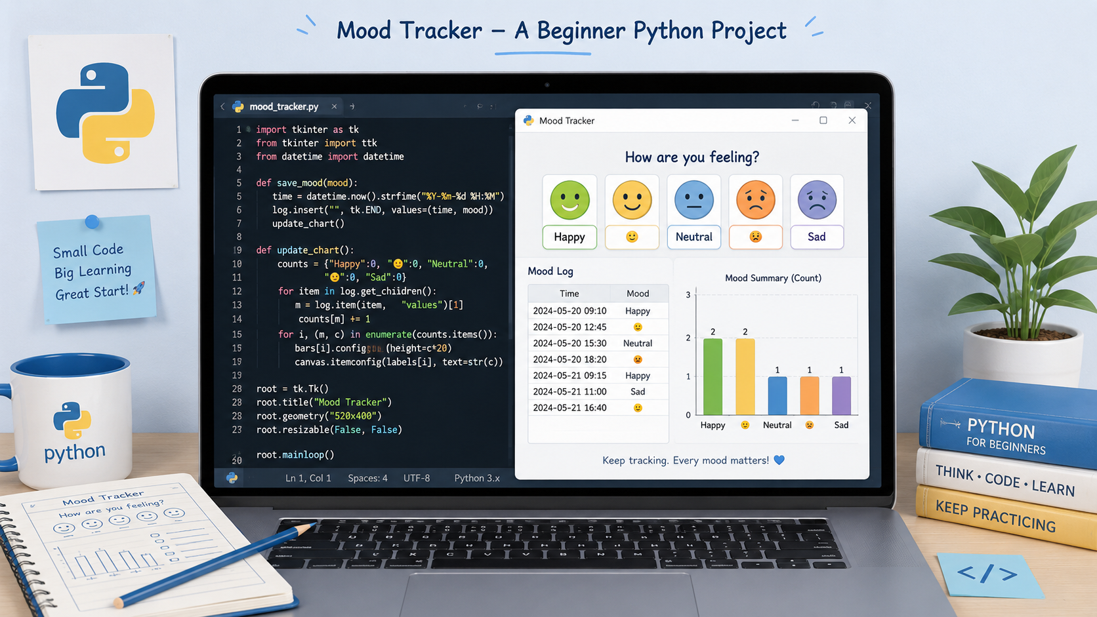
BEFORE WEEK 1
MoodBuddy Built in Python
Mini project: simple beginner Python emotion tracker
• Built a simple beginner Python program to track emotions and mood entries.
• Practiced basic coding logic, user input, and organizing mood-related data.
• Used the mini project to move from learning Python concepts to building something practical.
Simple beginner Python program: emotions, entries, and a mood summary
Takeaway: MoodBuddy was a beginner Python project, not a mobile or web app.
Second Semester Monthly Update • MoodBuddy
Notes:
Before Week 1, I built MoodBuddy, a Python mini project for emotion tracking. It helped me practice coding logic, user flow, and project structure. The most important outcome was that I entered Semester 2 with a project-building mindset.

Slide 3

WEEK 1
Cybersecurity roles I explored
Blue Team: SOC Analyst • Incident Responder • Threat Hunter
Red Team: Penetration Tester • Vulnerability Analyst • Ethical Hacker
Other paths: IAM Analyst • GRC Analyst • Security Analyst
Choosing My
Cybersecurity Path
Role research, market exploration, and GitHub foundation
• Compared Cybersecurity with Backend Web Development and chose the Cybersecurity track.
• Explored job demand, growth, key tools, and beginner skill expectations.
• Researched roles across Blue Team, Red Team, and IAM/GRC pathways.
• Started learning Git, GitHub, and terminal basics.
Tools used: ChatGPT • Claude • NotebookLM • CyberSeek • Indeed
Outcome: I narrowed my options and found a direction that fits my strengths and interests.
Second Semester Monthly Update • Week 1
Notes:
In Week 1, I researched which track fit my goals best. I compared cybersecurity and backend web development, studied roles and the job market, learned what tools are needed, and started Git, GitHub, and terminal basics.

Slide 4
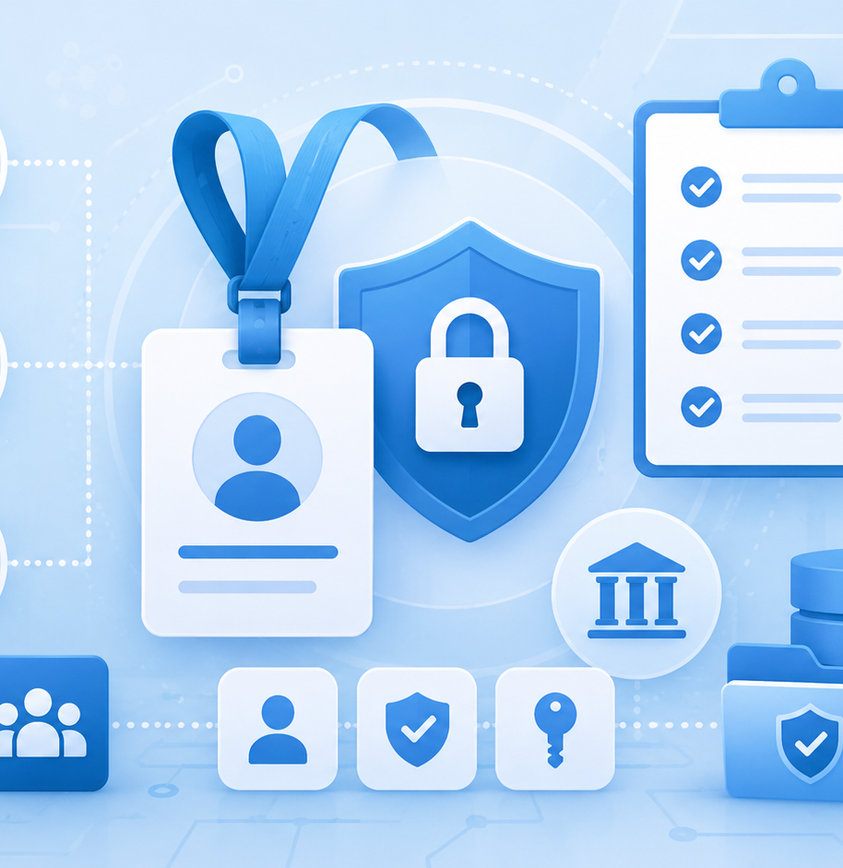
WEEK 2
Role Direction: IAM + GRC
Why IAM Analyst became the right fit
• Finalized IAM Analyst as my primary Cybersecurity role direction.
• Explored GRC concepts such as governance, risk, compliance, controls, and documentation.
• Connected IAM and GRC to my earlier experience in Salesforce Admin and Business Analysis.
• Learned more about GitHub, Schoology resources, project documentation, and project board planning.
Why it fits: IAM/GRC brings together access, process, risk, controls, and clear documentation.
Second Semester Monthly Update • Week 2
Notes:
During Week 2, I finalized IAM Analyst as my role direction and explored GRC. I chose this because it connects well to my previous Salesforce Admin and Business Analyst experience and to my strengths in documentation, troubleshooting, data analysis, and organized problem solving.

Slide 5
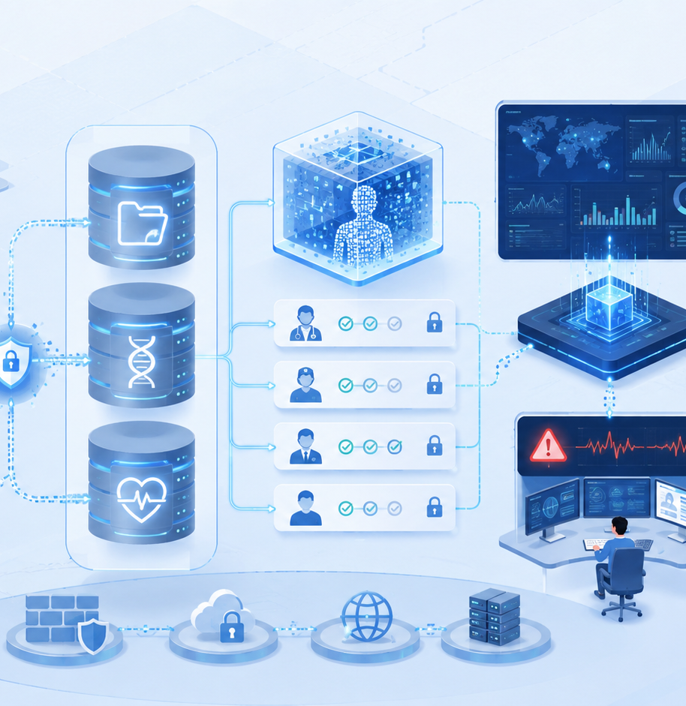
WEEK 3
Capstone Project Finalized
Care Access Navigator: IAM + GRC in healthcare
• Selected Care Access Navigator as my healthcare Cybersecurity capstone project.
• Focused on access management, incident monitoring, and simulated ePHI protection.
• Began the project design documentation and uploaded progress to GitHub.
• Created a 12-week Monday.com plan and explored beginner certifications like Google Cybersecurity and CompTIA Security+.
Project story: secure access, monitor risk, document evidence, and communicate clearly.
Second Semester Monthly Update • Week 3
Notes:
In Week 3, I finalized Care Access Navigator as my project. The project demonstrates healthcare access management, incident monitoring, and GRC concepts using simulated ePHI. I started project documentation, uploaded work to GitHub, and built the Monday.com project plan.

Slide 6
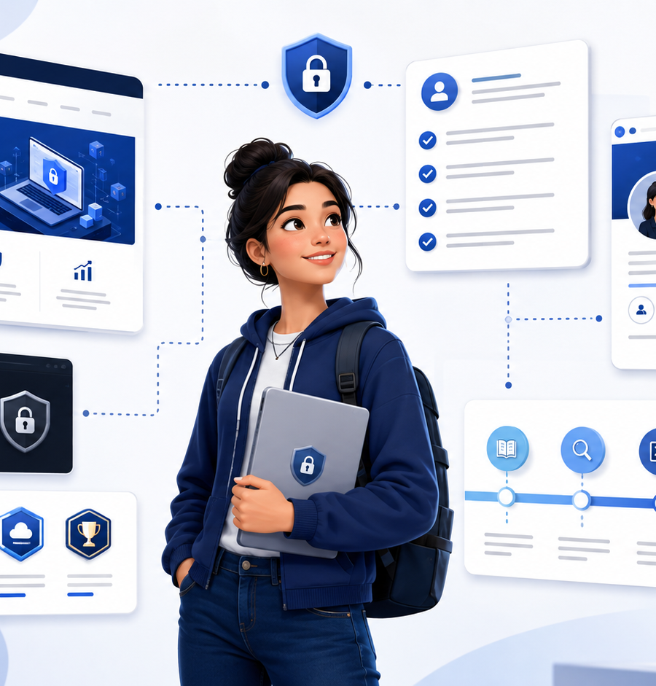
WEEK 4
Ready for Project Execution
Documentation, portfolio, résumé, LinkedIn, and networking
• Refined the Care Access Navigator documentation around IAM and GRC responsibilities.
• Completed the Monday.com 12-week board and received educator approval.
• Started my GitHub Pages portfolio and continued improving my GitHub workflow.
• Worked on LinkedIn, résumé building, and networking as preparation for the capstone and certifications.
End-of-semester result: my project foundation is approved and I am ready to begin building.
Second Semester Monthly Update • Week 4
Notes:
In Week 4, I refined my project documentation and the Monday.com board was approved. I also became more comfortable with GitHub, started GitHub Pages portfolio work, improved my LinkedIn, and participated in résumé and networking activities.

Slide 7
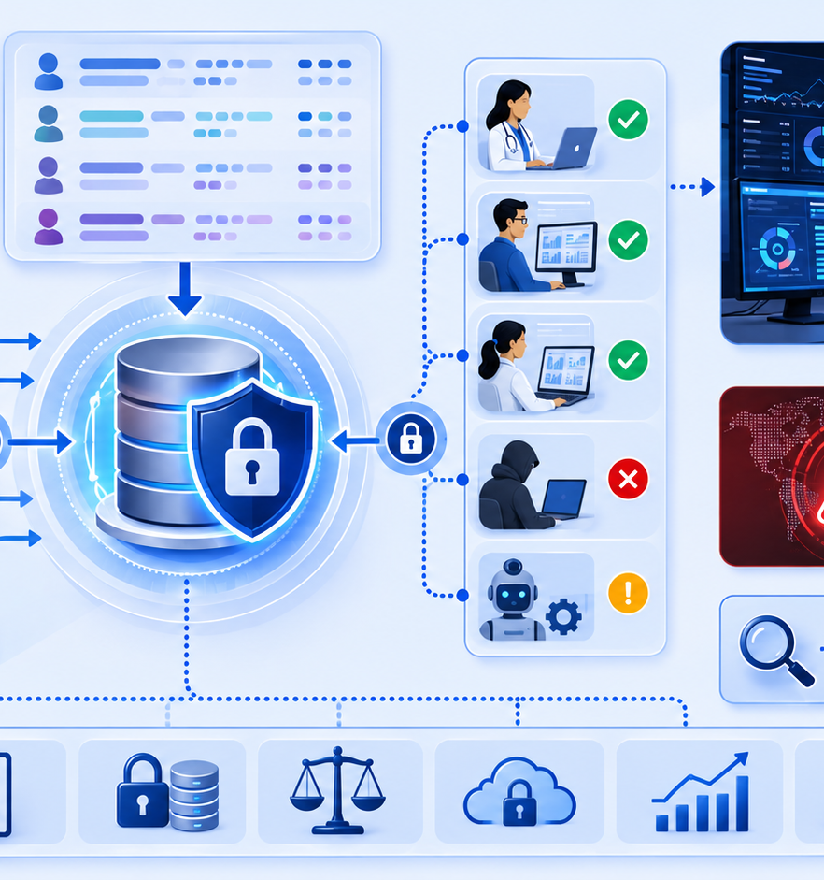
NEXT PHASE
Semester 3 Focus
Turning planning into execution
• Begin the 12-week Care Access Navigator implementation.
• Build skills in IAM, GRC, GitHub, command line, and security tools.
• Continue preparing for beginner certifications such as Google Cybersecurity and CompTIA Security+.
• Keep strengthening my portfolio, LinkedIn, résumé, and professional networking.
Second Semester Monthly Update • Next Steps
Notes:
My next focus is to begin the 12-week Care Access Navigator implementation, continue learning IAM and GRC tools, prepare for certifications, and keep improving my portfolio, LinkedIn, résumé, and networking. Thank you.

Slide 8
CLOSING
Thank You
Questions, feedback, and suggestions are welcome.
Thank you to my fellow students, educators, and staff for your support throughout Semester 2.
I am excited to begin the Care Access Navigator capstone and continue growing in Cybersecurity.
GitHub
IAM
GRC
Portfolio
LinkedIn
“Ready to move from research and planning into hands-on cybersecurity project work.”
Semester 3: Ready to Build
Second Semester Monthly Update • Thank You

