Slide 1

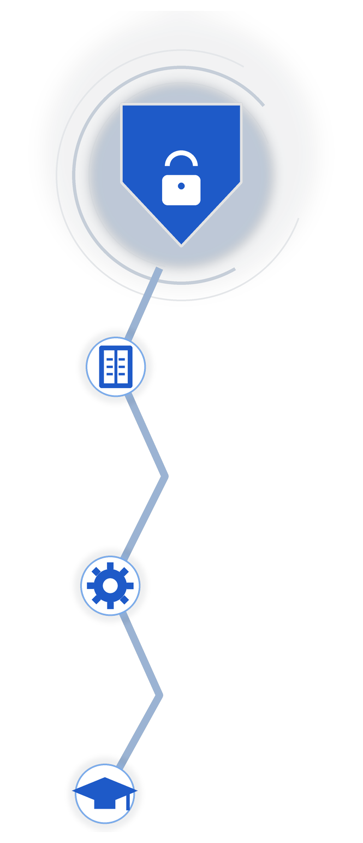

Care Access Navigator for HRMC
Semester 4 • Week 2 Status Update,Week 6 of Capstone Project
Sep 21 – Sep 24, 2026
IAM and GRC Analyst
By Akhila Ch
Cloud Security 1 • Risk Management 1 • Identity and Access Management

Slide 2
Monday
Course tasks aligned with the Care Access Navigator project
WHAT WAS EXPECTED ?
Work on assigned course tasks and align them with the project. Continue completing previous Monday board items.
WHAT WAS DONE ?
Completed and submitted Risk Assessment Techniques and Risk Evaluation Methods on Schoology. Continued slow but steady progress on project access, roles, and configurations. Job boards also went live on monday.com.
↘
↙
09/21/2026
MONDAY
WHAT NEXT ?
Continue closing pending Monday board tasks, organize project work, and move forward with IAM configuration.
WHAT I LEARNT..
Built stronger understanding of Risk Management concepts and how course work connects with project responsibilities.
↗
↖
Care Access Navigator for HRMC • Semester 4 • Week 2
Akhila Ch

Slide 3
Tuesday
Risk Management submissions and IAM implementation activity
WHAT WAS EXPECTED ?
Finish project-side configuration while balancing Cloud Security tasks, Keycloak, and Microsoft Entra ID work on Azure.
WHAT WAS DONE ?
Submitted Risk Mitigation Planning and Risk Communication on Schoology. Participated in the Cloud Security 1 IAM implementation activity. Started Professional Competencies / 360 Feedback Assessment.
↘
↙
09/22/2026
TUESDAY
TUESDAY
WHAT NEXT ?
Continue project configuration and improve time management to balance coursework, project setup, and assessment forms.
WHAT I LEARNT..
Expanded learning on Risk Management, Cloud Security design, architecture concepts, Keycloak, and Microsoft Entra ID.
↗
↗
↖
↖
Care Access Navigator for HRMC • Semester 4 • Week 2
Akhila Ch

Slide 4
Wednesday
Architecture Design, security patterns, and teach-back
WHAT WAS EXPECTED ?
Work through Cloud Security 1 tasks and connect Architecture Design and Security Patterns with actual project implementation.
WHAT WAS DONE ?
Started Cloud Security 1 Architecture Design and Security Patterns task. Delivered a teach-back on Workload Identity Federation. Completed self-assessment form.
↘
↙
09/23/2026
WEDNESDAY
WEDNESDAY
WHAT NEXT ?
Catch up on Cloud Security tasks and aim to complete initial configuration and setup this week.
WHAT I LEARNT..
Learnt to focus on job search and market readiness while also reflecting on competencies for self-improvement.
↗
↗
↖
↖
Care Access Navigator for HRMC • Semester 4 • Week 2
Akhila Ch

Slide 5
Thursday
Risk Management implementation and continued project progress
WHAT WAS EXPECTED ?
Submit final Risk Management task, provide status update, and continue Cloud Security and IAM configuration work.
WHAT WAS DONE ?
Submitted Risk Management Implementation. Prepared status update and continued planning for Keycloak and Microsoft Entra ID configuration.
↘
↙
09/24/2026
THURSDAY
THURSDAY
WHAT NEXT ?
Apply for jobs, continue peer assessment forms, finish Cloud Security pending tasks, and progress IAM setup.
WHAT I LEARNT..
Learnt technical concepts from coursework, gained insights from peers’ project updates, and continued working toward overall progress.
↗
↗
↖
↖
Care Access Navigator for HRMC • Semester 4 • Week 2
Akhila Ch

Slide 6
Thank You
Thank you peers, educators, and dae team for the continuous guidance and great support throughout.
Looking forward to learning many more things and moving towards overall progress!
Akhila Ch • Semester 4 • Week 2

