Slide 1


Care Access
Navigator
for Healthline Regional
Medical Center (HRMC)
End of Semester 5 Update
Compliance 1 and Incident Response 1
Akhila Chennamaneni
IAM and GRC Analyst
Semester 5 Oct 12–Nov 5, 2026
Notes:
Care Access Navigator is a healthcare IAM and GRC capstone for the simulated Healthline Regional Medical Center. This update covers Semester 5 achievements, the two completed courses, independent learning with CISO Assistant, the MVP demonstration, and remaining work before project completion. Source: supplied Semester 4 presentation and current user update.

Slide 2
Semester 5 at a glance
Coursework, a new GRC tool and an industry-facing MVP demo
2
1
MVP
Courses completed
New tool incorporated
Project showcased
Compliance 1
Incident Response 1
CISO Assistant
GRC assessment tracking
Technology, cybersecurity
and software professionals
Current priority: evidence, cleanup and capstone completion
Care Access Navigator · Semester 5 · Oct 12–Nov 5, 2026
2
Notes:
This semester I completed Compliance 1 and Incident Response 1. I learned CISO Assistant and incorporated it into Care Access Navigator to organize governance analysis and track assessment work. We also held an MVP demo and presented our project to professionals across technology, cybersecurity and software. The project remains in progress while I strengthen evidence and documentation. Course completion and MVP participation are reported by the presenter. No specific industry feedback or course grades are asserted.

Slide 3
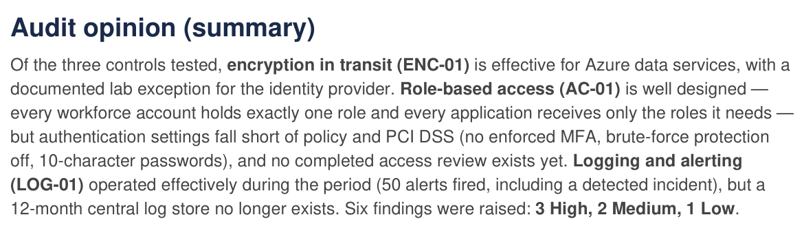
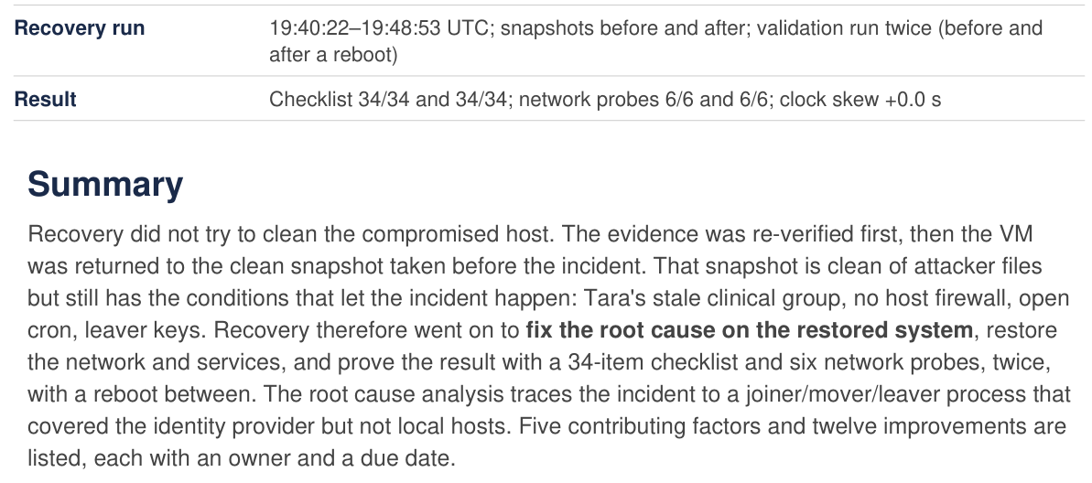
Course tasks and documented results
Project work documented across 5 Compliance and 6 Incident Response tasks
Compliance 1
Incident Response 1
HIPAA and PCI DSS assessment
3 controls audited, 6 findings recorded
3 simulated incidents investigated
Recovery: 34/34 checks, 6/6 probes
Policies, audit evidence and
remediation tracking
Wazuh detection, containment,
evidence handling and a playbook
Audit report excerpt, 13 Oct 2026
Recovery report excerpt, 3 Nov 2026
Care Access Navigator · Semester 5 · Oct 12–Nov 5, 2026
3
Notes:
The attached README.md and README(1).md are relocation notices. Followed their Semester_5 course paths to the current public GitHub repository Akchrao/dae_6mon_coh2_AC. Compliance README lists five task PDFs: fundamentals, program development, auditing, documentation/reporting and legal/ethical implementation. Frameworks named: HIPAA and PCI DSS v4.0.1. Task 3 audit report, fieldwork 13 October 2026, tests AC-01, LOG-01 and ENC-01. Six findings are recorded: 3 High, 2 Medium and 1 Low. These are an audit snapshot, not a claim of current closure. Task 4 documents the compliance tracker and evidence/register/reporting approach. Left screenshot is an unaltered rendered excerpt of the Task 3 audit opinion, page 1.
Incident Response task READMEs 1–6 document environment setup, detection/analysis, containment, digital evidence management, documentation/reporting, and post-incident recovery. Three lab incidents cover leaver access, mover access and unauthorized sudo entitlement. Task 5 documents a Markdown playbook, a SQLite/CLI incident tracker and an incident report. Task 6 reports 34/34 recovery checks plus 6/6 network probes both before and after reboot, on one lab host. Right screenshot is an unaltered rendered excerpt from Task 6 page 1. The recovery lab uses QEMU and Debian as stand-ins for the VirtualBox/Parrot rubric. This is a documented lab exercise, not production patient data or a live reassessment of every capstone control. Keycloak project findings remain separate from host-recovery results. No alert totals are quoted because the Task 2 README total does not reconcile with its subtotals.
Sources:
https://github.com/Akchrao/dae_6mon_coh2_AC/blob/main/Semester_5/Compliance_1/README.md
https://github.com/Akchrao/dae_6mon_coh2_AC/blob/main/Semester_5/Compliance_1/Care_Access_Navigator_Compliance1_Task3_Compliance_Auditing.pdf
https://github.com/Akchrao/dae_6mon_coh2_AC/blob/main/Semester_5/Compliance_1/Care_Access_Navigator_Compliance1_Task4_Documentation_Reporting.pdf
https://github.com/Akchrao/dae_6mon_coh2_AC/blob/main/Semester_5/Incident_Response_1/task6_post_incident/Care_Access_Navigator_IR1_Task6_Post_Incident.pdf
https://github.com/Akchrao/dae_6mon_coh2_AC/tree/main/Semester_5/Incident_Response_1

Slide 4
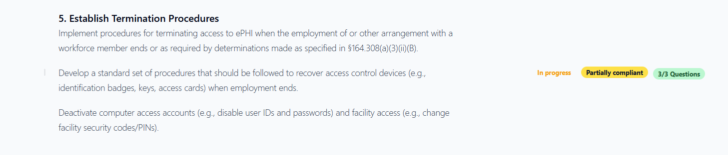
Learning how to learn
CISO Assistant: GRC assessments for Care Access Navigator
1 Explore
2 Integrate
3 Review
Learned GRC workflows
and assessment tracking
Linked IAM evidence to
controls and findings
Used summaries to track
assessment progress
Leaver case: partial compliance recorded, remediation still planned
Care Access Navigator · Semester 5 · Oct 12–Nov 5, 2026
4
Notes:
CISO Assistant provides the GRC analysis and tracking layer for Care Access Navigator. I learned the tool by exploring its assessment workflows and applying them to an existing project case. In the leaver test, Entra access was removed, but the Keycloak account remained enabled until manual disablement. I documented the evidence, linked the existing control, assessed the risk, and recorded a finding. CISO Assistant helps summarize assessment status and follow remediation. This is evidence-based GRC integration, not a claim of live automated synchronization with IAM platforms. CAN-FIND-001 is High and Confirmed. The focused termination-procedures assessment is partially compliant and in progress. Automated downstream deprovisioning remains planned and untested. The test does not prove unauthorized EHR access. Screenshot source: supplied Care Access Navigator CISO Assistant End-to-End GRC Documentation, Appendix A2.

Slide 5
Bridging gaps and planning Semester 6
Capstone completion comes first, followed by career preparation
Current gap | Next action
Missing or scattered evidence | Link test results to controls and rubric criteria
Redundant project data | Remove duplicates and organize final records
Open findings and documentation | Retest remaining gaps and finish the project report
One semester left: professional readiness
Profile
GitHub
Certification
Interviews
Résumé and portfolio
Open source
Study and practice
Project demo practice
Care Access Navigator · Semester 5 · Oct 12–Nov 5, 2026
5
Notes:
The capstone needs stronger evidence coverage, better organization, removal of redundant or outdated data, and completed documentation. I will retain authoritative evidence, connect it to controls and rubric criteria, and validate remaining technical gaps before presenting them as resolved. The CISO Assistant leaver-remediation control remains planned until implementation and testing support closure. I intend to complete the capstone soon, with one semester remaining. The final semester will focus on professional profile and portfolio improvement, GitHub contributions to open-source projects, certification preparation and interview practice. These are planned next steps, not completed achievements. Source: current user update and supplied GRC documentation, outstanding-work section.

Slide 6

Thank You
Thank you to my peers, educators
and the DAE team for your guidance
and support throughout Semester 5
Questions and feedback welcome
Akhila Chennamaneni · IAM and GRC Analyst
Notes:
Thank the educators, peers and DAE team for their guidance and support. Invite questions about course learning, the MVP demo, CISO Assistant integration, and the path to capstone completion.

