Slide 1


IAM
GRC
Healthcare
Care Access
Navigator
Identity & Access Management + GRC for a simulated hospital
MVP demonstration
Akhila Chennamaneni
Aspiring IAM & GRC Analyst
dae 6-Month Cybersecurity Program | October 2026
Notes:
TIME: 10 sec.
SAY: "Good afternoon. I'm Akhila Chennamaneni, and this is Care Access Navigator, my capstone for the dae six-month cybersecurity program."

Slide 2



The program and the project
dae 6-Month Adult Cybersecurity Program
7 courses, one capstone
Care Access Navigator
HealthLine Regional Medical Center
Cybersecurity Basics
Network Security
Protect simulated patient data (ePHI)
Cyber Threats & Vulnerabilities
Cloud Security
Entra ID
Keycloak
Azure
Risk Management
Compliance
Wazuh
Python
Tableau
Monday.com
GitHub
Docker
Incident Response
Notes:
TIME: 30 sec.
SAY: "The dae program is a six-month, cohort-based adult program. Instead of separate assignments, every course added a layer to one project: Care Access Navigator, for a fictional hospital called HealthLine Regional Medical Center. I came from Salesforce administration and business analysis, where I managed user access and security models, so identity and access management was a natural next step."
CHECK: confirm cohort/program wording with your instructor if you want to name the cohort.

Slide 3








The problem, and what the MVP proves
Too much access
Movers keep old access
MVP success criteria
IAM
Done
Monitoring
Access that never ends
Leavers can still sign in
Done
Incident response
Done
No proof
No record of who approved what
GRC
Done
Reporting
Dataset ready
Notes:
TIME: 45 sec.
SAY: "Healthcare organizations hire, transfer and terminate staff constantly. If access doesn't follow those changes, people end up seeing patient data they shouldn't. Three failures cause most of the trouble: too much access, access that never ends, and no proof. My design document set five MVP criteria, and today I'll show evidence for each one."
HONESTY NOTE: Reporting is 'dataset ready'. The Tableau dataset is built from real evidence; say the Tableau workbook is the final step if it isn't published yet.
DIAGRAM IF ASKED: semester_3/Care_Access_Navigator/02_Diagrams/01_Architecture/CAN_DGM_Network_Topology_Care_Access_HRMC_v0.1.png

Slide 4
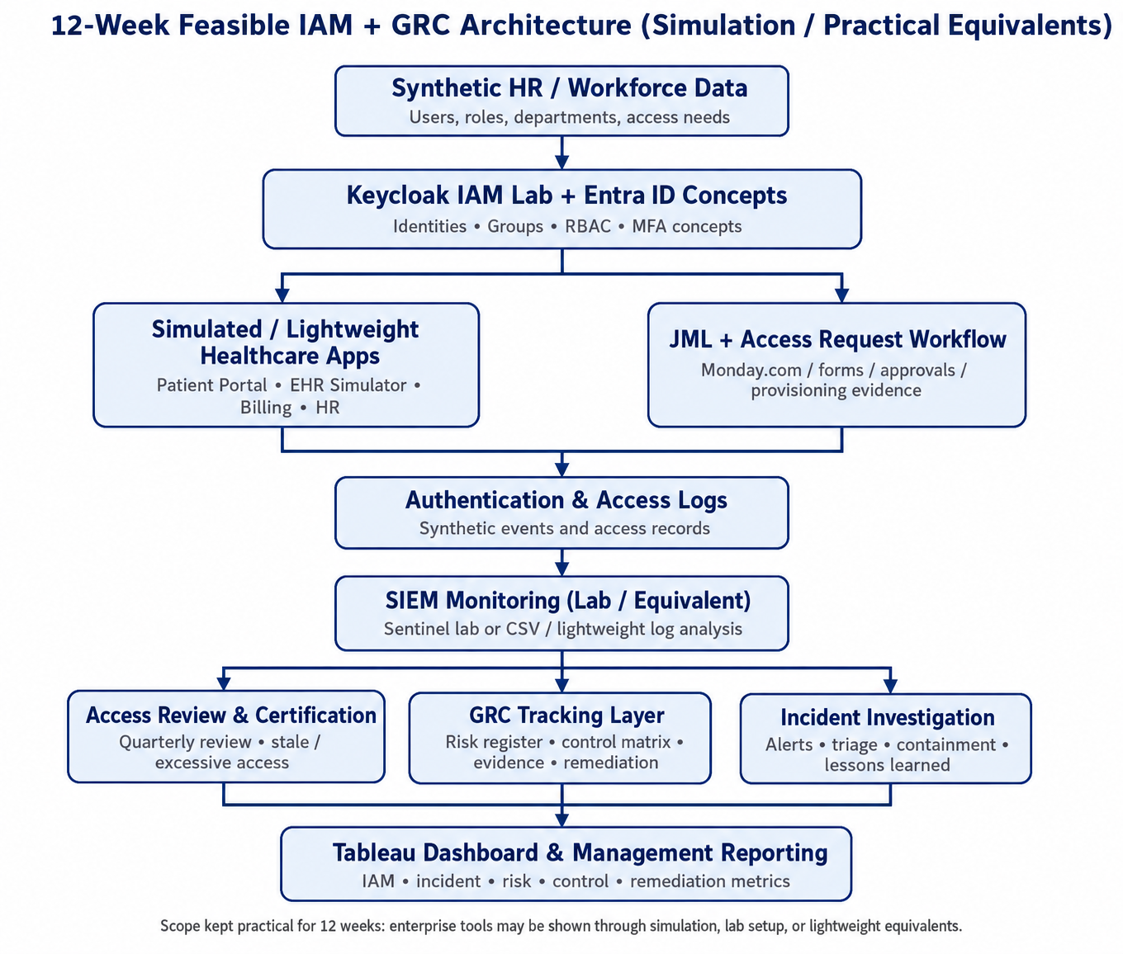

Architecture: from design to build
Built with
Identity
Entra ID + Keycloak (OIDC)
Apps
4 scoped app clients
JML
Tickets + can_iam.py
SIEM
Wazuh 4.9.2 + Azure alerts
GRC
Risk register + 14 control tests
Reporting
Tableau KPI dataset
Project Design Document, section 7
Notes:
TIME: 40 sec.
SAY: "This is the architecture from my design document. Workforce data feeds the identity layer, identities reach the healthcare apps through role-based access and the JML workflow, every sign-in and change is logged, the SIEM watches those logs, and three activities, access review, GRC tracking and incident investigation, feed one management dashboard. On the right is what I actually built for each layer. Where the design said 'Sentinel or a lightweight equivalent', I ran a real Wazuh manager and kept Azure alerts for the cloud side."
SOURCE: Care_Access_Navigator_Project_Design_Documentation_IAM_GRC.docx, section 7 (diagram).

Slide 5
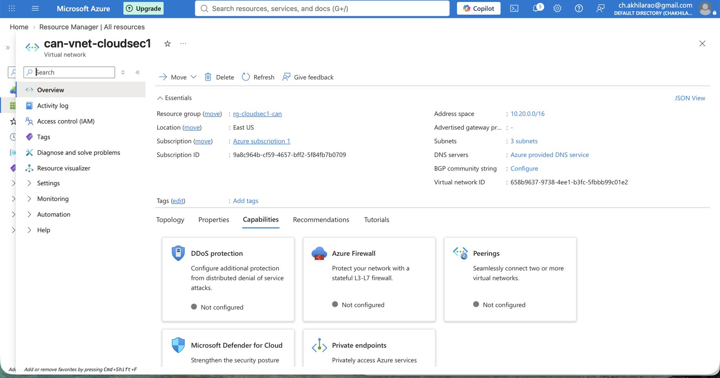
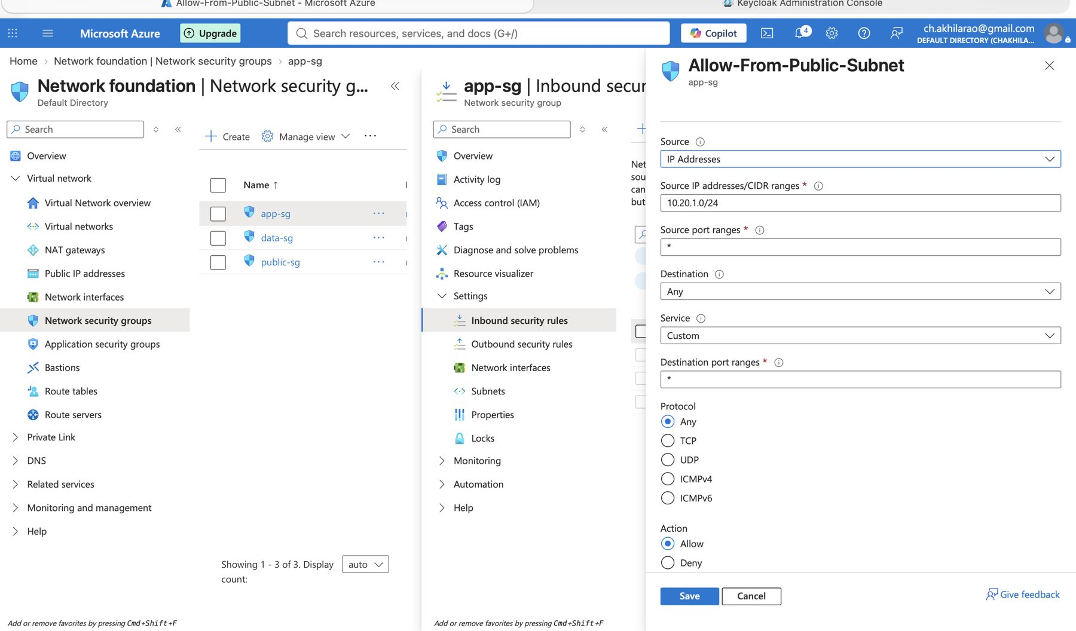
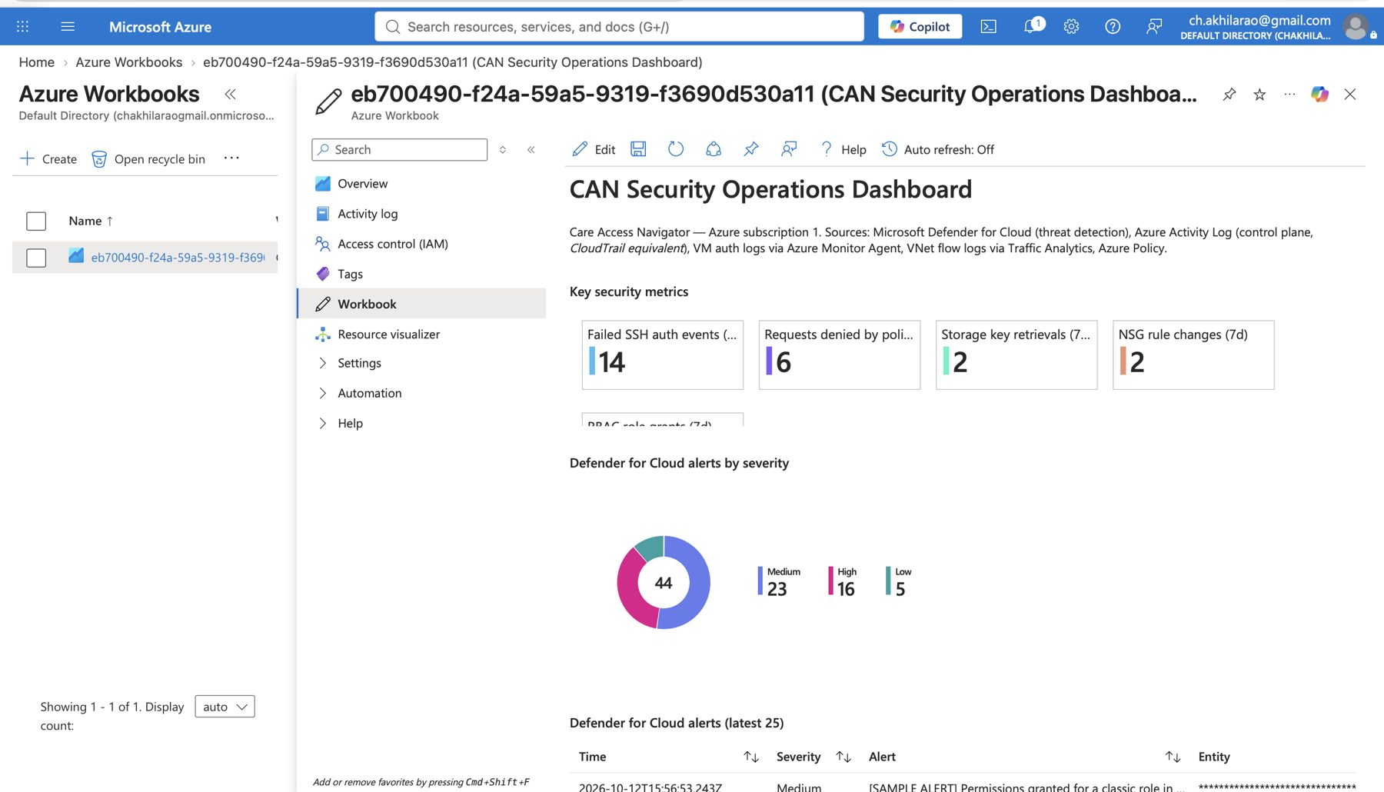
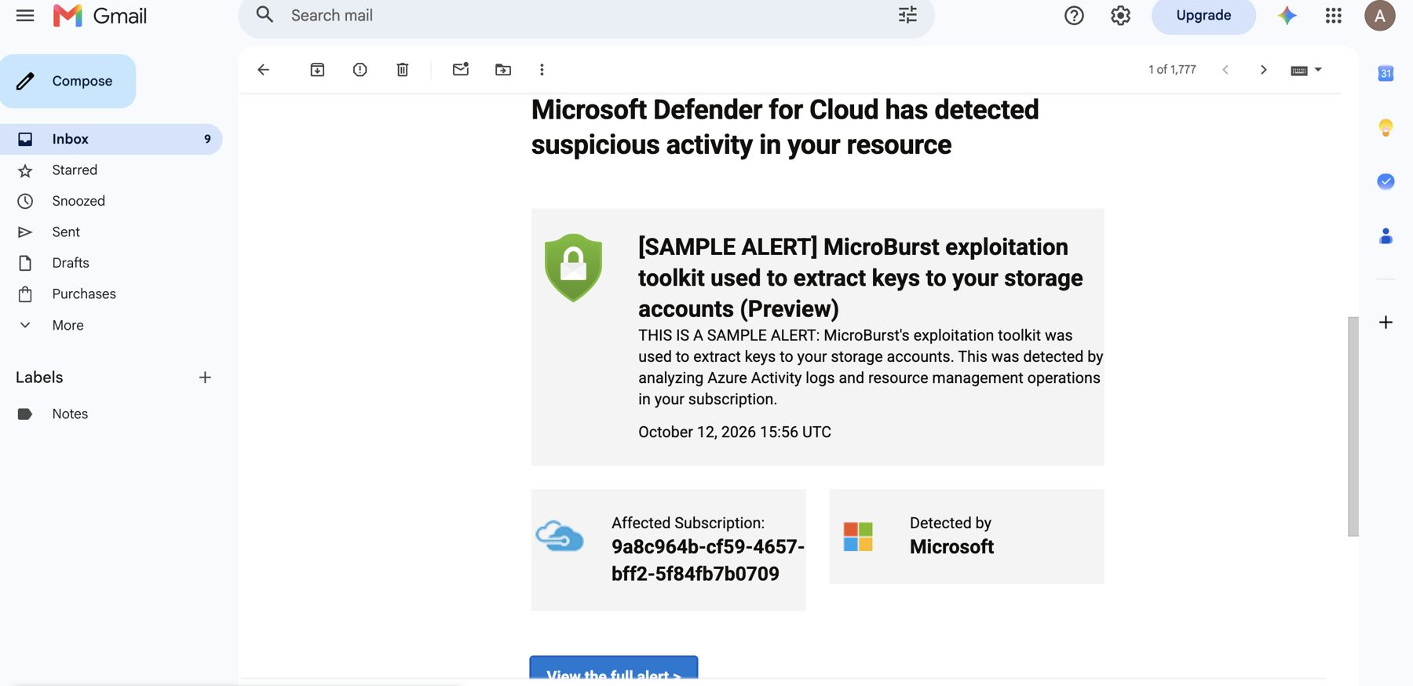
Cloud foundation on Microsoft Azure
3
NSGs
Bastion
Segmented VNet (10.20.0.0/16)
NSG rule: app tier
admin access, no public IP
50
Defender alert to SecOps
alerts in 30 days
SecOps workbook
Notes:
TIME: 30 sec.
SAY: "Everything runs in Azure. The virtual network is split into subnets with three network security groups, so the app tier only accepts traffic from the public subnet. Admins connect through Azure Bastion, so workloads have no public IP. Alerts from Defender for Cloud and the activity log go to the SecOps team. 50 alerts fired in 30 days, including a real incident on October 8th that I contained and recovered."
NOTE: The alert email shown is a Defender SAMPLE alert. The real incident is INC-20261008-01 (rogue NSG rule + storage key listing + SSH brute force, closed 20:28).
SOURCE: cloud_security_1/ screenshots; tableau_dataset/azure_alerts_30d.csv, incidents.csv

Slide 6
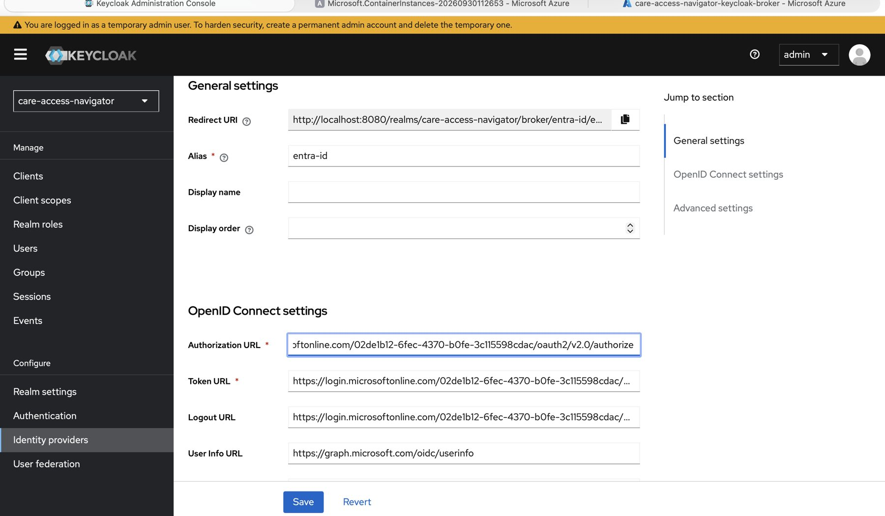
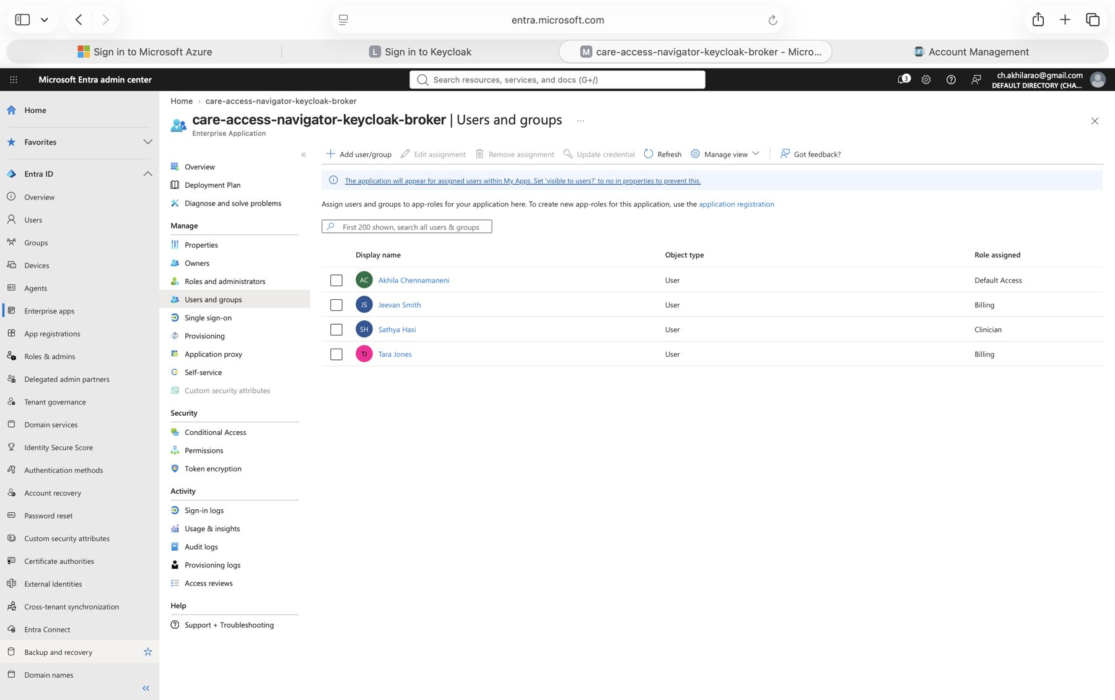
Federation and RBAC: scoped access
EHR Simulator
Patient Portal
clinician
nurse
clinician
nurse
Billing App
HR App
billing
hr
it-support
Keycloak trusts Microsoft Entra ID (OpenID Connect)
security-analyst: monitoring only
One user, one role
Entra app-role assignments
vendor: time-bound, end date required
Every app client: fullScopeAllowed = false
Notes:
TIME: 45 sec.
SAY: "Here's the federation: Keycloak trusts Microsoft Entra ID over OpenID Connect, so staff sign in once with their hospital identity. In Entra, each user gets exactly one app role, which is my RBAC model. Keycloak maps that role into one of seven realm roles. The key least-privilege control is on the app side: every Keycloak client has full-scope turned off, so the Billing App can never receive a clinician role. RBAC is the method; least privilege is the goal."
LIVE OPTION: Keycloak > Identity providers > entra-id; Entra > Enterprise apps > care-access-navigator-keycloak-broker > Users and groups.
SOURCE: cloud_security_1/Keycloak-CAN Authorization Page.png, jml-evidence/JML-07, compliance_1/audit-evidence/E-AC-01_keycloak_users_roles.txt

Slide 7


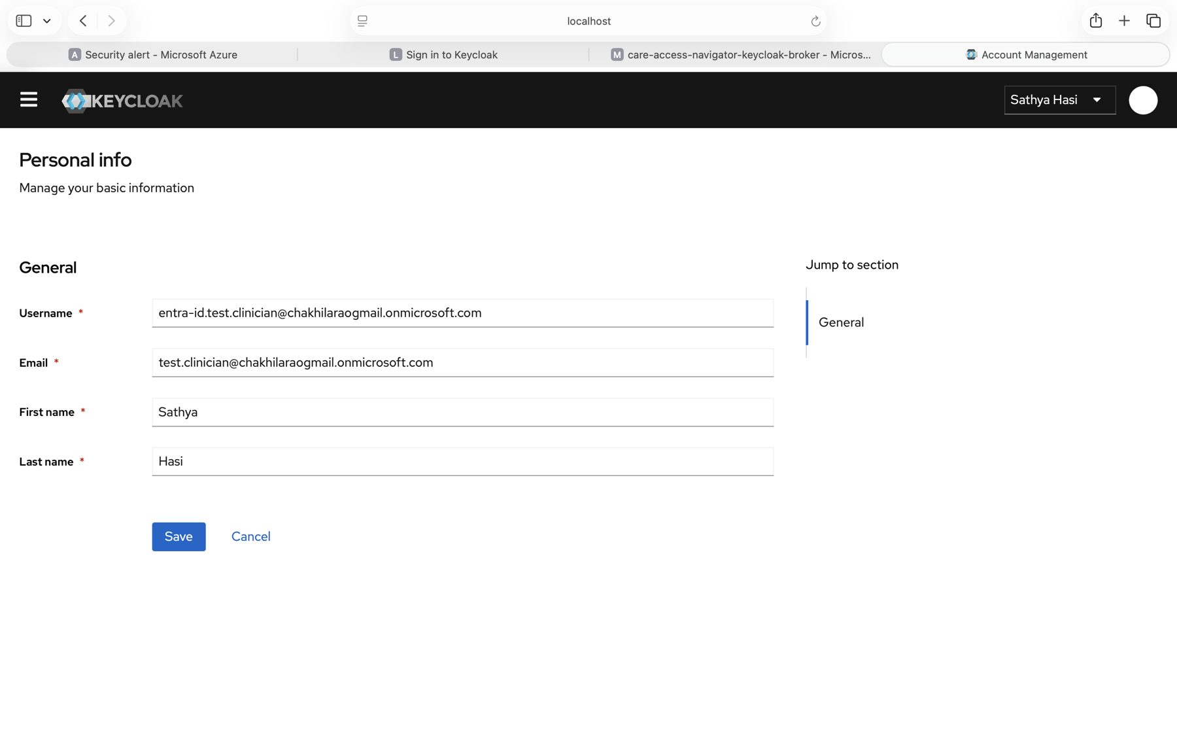
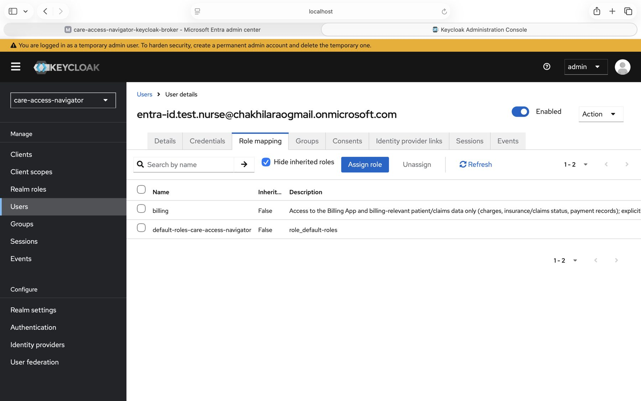
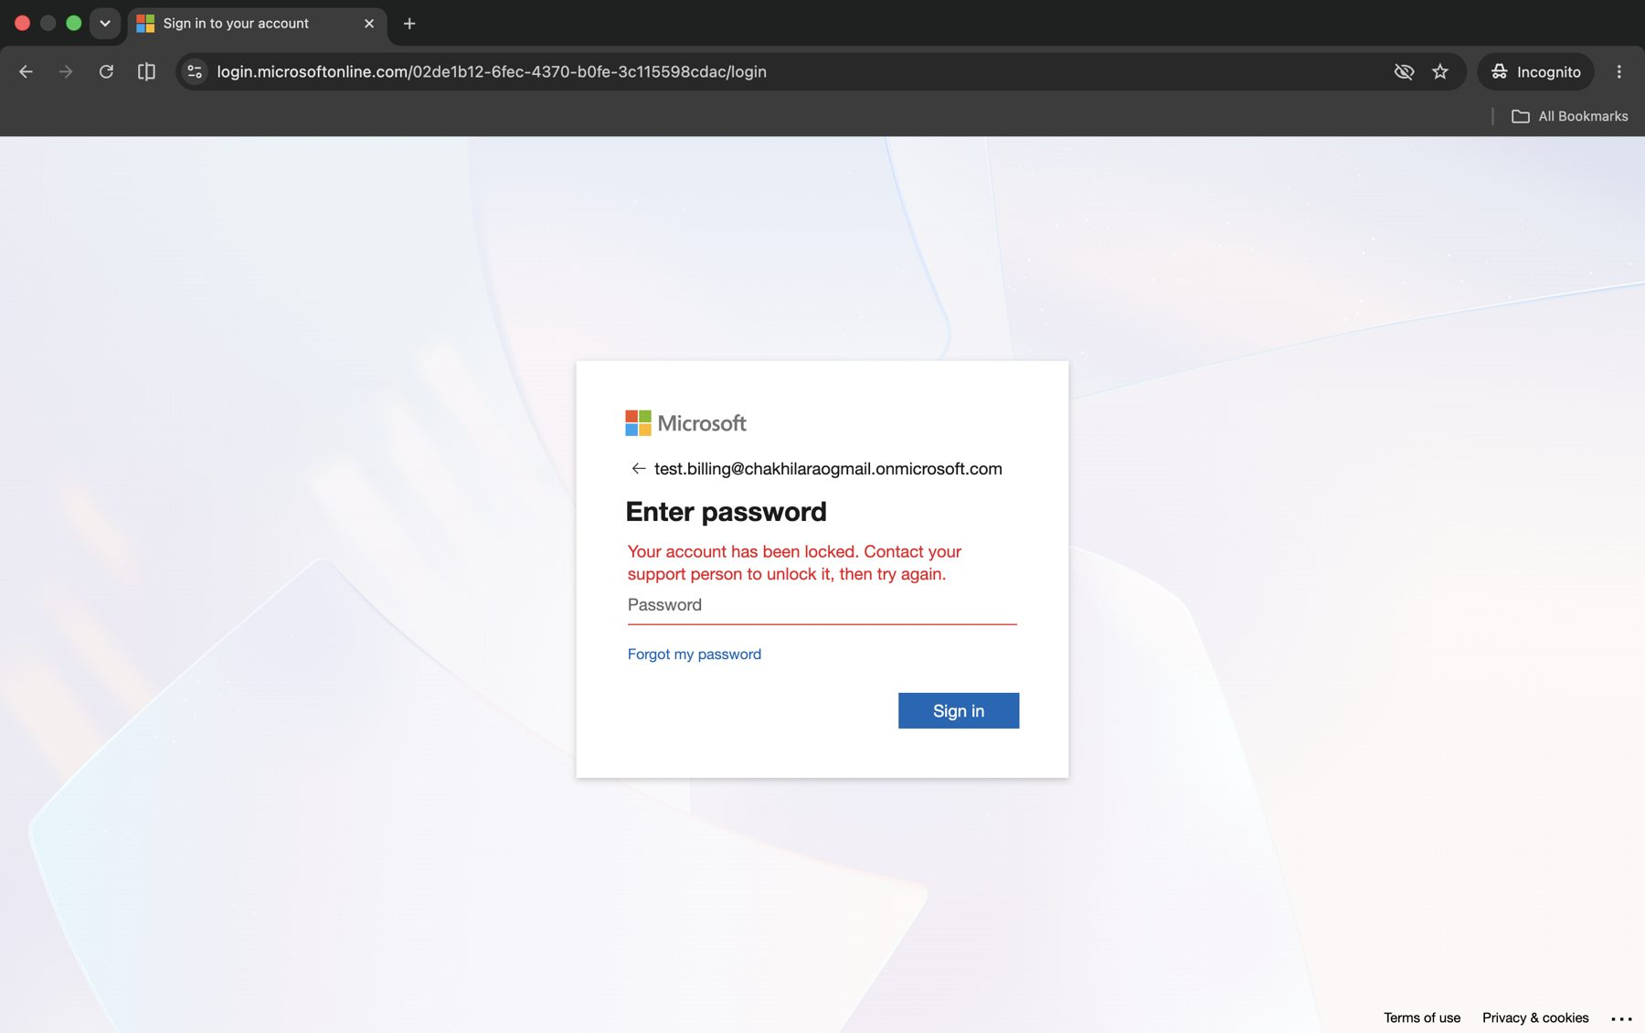
Joiner, Mover, Leaver: one live lifecycle
Access request flow:
Request + business reason (ticket)
Manager approval
IAM checks role catalogue
Provision 1 Entra app role
Verify: sign-in + audit log
JOINER Sathya Hasi
MOVER Tara Jones
LEAVER Jeevan Smith
Ticket REQ-2026-0101
Ticket CHG-2026-0201
Ticket TERM-2026-0301
JML-04: first sign-in, no account → Clinician
JML-08: Keycloak role Nurse → billing only
JML-13: enabled → disabled, sign-in refused
16:23
Account created, no app role
17:21
Nurse role removed first
18:13
Entra account disabled
16:46
Clinician role assigned
17:23
Billing role added
18:15
All sessions revoked
16:57
MFA methods registered
17:26
All sessions revoked
18:17
Billing role removed
17:10
Keycloak role: clinician
17:41
Re-sync: billing only
~18:28
Keycloak disabled (kept)
Policy §4.3 met: leaver ~15 min | mover 20 min | 19 SHA-256-hashed evidence files
Notes:
TIME: 90 sec (LIVE if possible: Entra > Enterprise apps > care-access-navigator-keycloak-broker > Users and groups, then Incognito sign-ins).
SAY:
- REQUEST FLOW: "Every change starts as a ticket with a business reason. The manager approves, I check the role against the approved role catalogue, provision exactly one Entra app role, and verify with a sign-in and the audit log."
- JOINER: "Sathya's account existed at 16:23 but had no app role, so she could open nothing. At 16:46 the approved ticket assigned Clinician. At her first sign-in, Keycloak created her account automatically with exactly one role. No account was created by hand."
- MOVER: "For Tara's transfer, order matters. I removed Nurse first, added Billing, then revoked her sessions. At her next sign-in, Keycloak's FORCE sync replaced nurse with billing, so access is replaced, not added on. That stops privilege creep."
- LEAVER: "Jeevan was fully cut off in about 15 minutes. Entra blocked him immediately. Keycloak isn't notified automatically, so disabling the Keycloak copy is a documented manual step. I disabled rather than deleted the account to preserve the audit trail HIPAA expects."
- EVIDENCE: "Every step is evidenced three ways, and all 19 files are SHA-256 hashed."
IF ASKED: JML-14 (18:25) still shows the Keycloak copy enabled; JML-12 shows it disabled at ~18:28.
POLICY: CAN-POL-AC-001 §4.3: new access needs manager approval; removal by end of day on termination, within 5 business days of a role change (Compliance 1 Task 2).
SOURCE: capstone_next_steps/jml-evidence/JML-LOG.csv, JML-05, JML-09, JML-14, JML-15

Slide 8
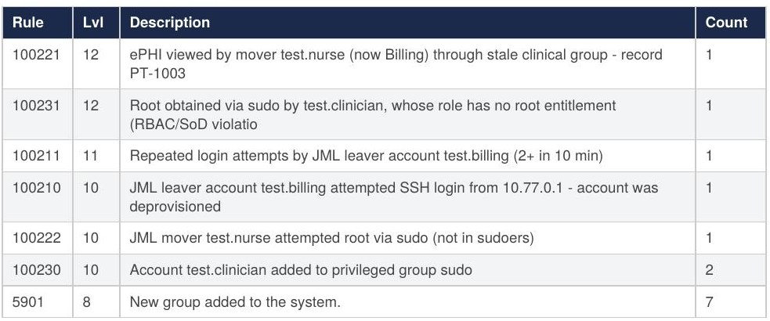
Log analysis: Wazuh finds the JML gaps
Tara Jones
Opened PT-1003 via old group
Sathya Hasi
Got sudo with no ticket
Jeevan Smith
SSH tries after leaving
SEV-1 Critical
SEV-2 High
SEV-3 Medium
688
alerts
7
high (level 10+)
<1 s
log to alert
Wazuh alerts by rule (IR1 Task 2)
Notes:
TIME: 40 sec.
SAY: "Next, I asked: what if the JML process isn't complete everywhere? I ran a real Wazuh 4.9.2 manager and replayed activity for the same three people on a Linux host. Wazuh caught three incidents, all within a second of the log line. The key design choice: Wazuh's built-in rules treated these as normal noise. My custom rules use lists that mirror the JML register, so Wazuh knows Tara is now Billing and Jeevan has left."
SCOPE NOTE (say confidently): Real Wazuh manager in Docker; Parrot OS replaced by a Debian container because I have no admin rights. Documented in ADR-SIEM-choice.
SOURCE: incident_response_1/task2_log_analysis/evidence/analysis/

Slide 9
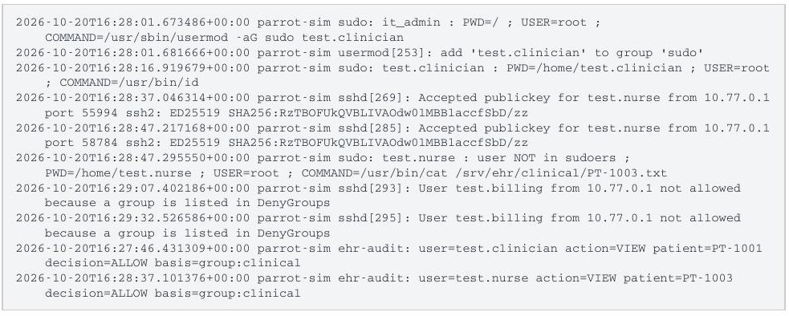
Incident: a leaver tries to come back
Detect
SSH as leaver denied (rule 100210)
Correlate
Mac log + packet capture + sshd
Contain
Remove SSH key, block shell
Raw auth.log + ehr-audit.log
Root cause
JML stopped at the identity provider. The Linux host kept its own keys and groups.
Eradicate
Revoke key, update checklist
Recover
Re-test: login refused
Notes:
TIME: 45 sec.
SAY: "Let me walk through one incident end to end. A day after Jeevan left, someone tried to SSH in as him twice. Both attempts were blocked, but his SSH key was still authorized. Because of NAT, the server only saw 10.77.0.1, so I correlated the Mac's own log and a packet capture to find the real source. I followed NIST SP 800-61: contain, eradicate, recover, then verify. The alert was rated High, so it was triaged right away. After investigation the incident is SEV-3 Medium, because no access was gained."
HIPAA NOTE: With real ePHI, Tara's incident (005) would trigger the HIPAA four-factor breach risk assessment (45 CFR 164.402).
SOURCE: Care_Access_Navigator_IR1_Task2_Log_Analysis.pdf §6-8, timeline_inc_a.csv

Slide 10
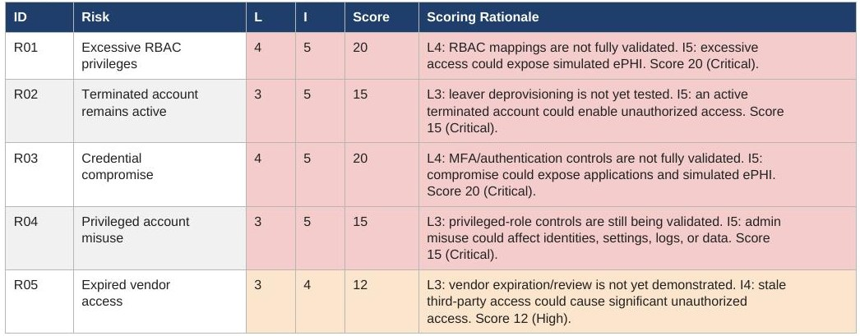
Risk assessment and access review
Risk register (Risk Management 1)
Access review AR-2026-Q4: 6 of 9 accounts flagged
4
1
1
3
Privileged, no MFA
Vendor, no end date
Access past end date
No issue
Notes:
TIME: 45 sec.
SAY: "I scored each risk as likelihood times impact on a 5 by 5 scale. On the left is my risk register from Risk Management. On the right, you can see how the controls I just demonstrated lowered every score. The leaver control brought R02 from 15 to 5, and that's Jeevan. Three risks stay High until MFA is enforced. Below is my access review: nine accounts checked, six flagged, including four privileged accounts without MFA and a vendor whose access had already expired."
HONESTY NOTE: Access review rows come from the replica test run of can_iam.py. Rerun on the live lab before the demo if you can.
TREATMENT: "Every top risk is treated by mitigation. The one thing I accepted is the lab identity provider running over HTTP: it is a logged exception with a compensating control and a 12-month maximum, per the exception procedure in my compliance program."
FRAMEWORKS: NIST CSF 2.0 PR.AA / DE.CM; ISO 27001 A.5.15-5.20.
SOURCE: risk_management_1/..._Criterion_2_Risk_Assessment_Techniques.pdf p6; tableau_dataset/risks.csv, access_review_AR-2026-Q4.csv

Slide 11
Governance: policy, controls and audit
Audit findings
F-01 MFA not enforced
F-02 Lockout off
F-03 Short log retention
F-04 Weak passwords
F-05 Review not signed
F-06 Lab IdP on HTTP
Control → framework → evidence
AC-01 Access
HIPAA 164.308(a)(4)
E-AC-01
Policy CAN-POL-AC-001
LOG-01 Logging
HIPAA 164.312(b)
E-LOG-01
ENC-01 Encryption
HIPAA 164.312(e)(1)
E-ENC-01
100%
Leavers disabled same day
57%
Control pass rate (target 90%)
3
Open High findings
3
Residual High risks
Notes:
TIME: 40 sec.
SAY: "Governance starts with a written policy: CAN-POL-AC-001, owned by the Security Officer and approved by the Compliance and Privacy Committee. Each control traces to that policy, to HIPAA and NIST, and to an evidence file. I tested 14 controls: 8 passed, 5 failed, and 1 is a documented exception. The access controls passed. Users hold only their job role, and Entra assignment is required. The failures are MFA, lockout, log retention and review sign-off. Each finding maps to a HIPAA Security Rule or PCI DSS requirement and has an owner and a date. These KPI tiles are the management summary: the leaver KPI is green, and pass rate and MFA are what I'm fixing next. The same data is prepared as a Tableau dataset, and my Azure workbook shows the live cloud metrics."
IF ASKED 'Is this HIPAA compliant?': "It's mapped to HIPAA Security Rule safeguards. I don't claim certification."
OPTIONAL: Show cloud_security_1/Cloud_Security_1:SecOps_Dashboard.png (Azure workbook: 14 failed SSH auth events, 6 denied requests, 44 Defender alerts).
SOURCE: tableau_dataset/control_tests.csv, audit_findings.csv, kpi_definitions.csv

Slide 12



Challenges, lessons and next steps
Challenge
How I solved it
Next step
What I learned
Azure vCPU quota
ACI + Bastion
Instructor sign-off
JML must reach every system
No admin rights
Wazuh in Docker
Endpoint agent
Test on a copy first
Keycloak misses leavers
Manual disable step
SCIM automation
MFA + SAML pending
Tested on a replica
Run on live lab
Adapt, then document
Break-glass not built
Designed in policy
Build + alert rule
Notes:
TIME: 45 sec. Pick two rows to talk through. Not on the slide: the Apple Silicon (arm64) image rebuilt for amd64, and the leaver SSH key left on the Linux host (covered on the incident slide). Also next: CISO Assistant as the GRC platform, publish the Tableau dashboard, 12-month log retention (F-03).
SAY: "Not everything went to plan. Azure's vCPU quota blocked virtual machines, so I used container instances with Bastion and network security groups, and rebuilt my image for the right CPU architecture. I don't have admin rights, so I ran a real Wazuh manager in Docker. The biggest lesson came from my own incident: Keycloak and Linux hosts don't hear about a leaver automatically, so the identity lifecycle has to reach every system. Next, I'll enforce MFA and lockout, automate deprovisioning, build the break-glass account, and bring in CISO Assistant."
Q&A PREP:
- How do you know the leaver's access is gone? Entra disabled, sessions revoked, role removed, Keycloak disabled (JML-12), sign-in refused (JML-13).
- Why simulate the Linux host instead of Parrot OS? No admin rights. It's a real Wazuh 4.9.2 manager with the same rules and alerts (ADR-SIEM-choice).
- RBAC vs least privilege? RBAC is the method (roles); least privilege is the goal (minimum access).
- Is this HIPAA compliant? Mapped to HIPAA Security Rule safeguards; no certification claimed.
- What about emergencies? Break-glass is defined in policy §4.9 (logged, alerted, reviewed within 1 business day); building it is a next step.
BEFORE YOU PRESENT: Record a backup video of the JML slide live; keep Entra, Keycloak admin and an Incognito window open; use test accounts only and never show passwords; stop Azure ACI after recording.

Slide 13




Thank you
To the dignitaries and industry experts
for your valuable presence and insights.
To the dae team and my peers
for your continued support, guidance and encouragement.
GitHub
github.com/Akchrao
LinkedIn
akhila-chennamaneni
Scan to view the project repository and connect with me
Questions?
Akhila Chennamaneni | Care Access Navigator
Notes:
SAY: "Thank you to the dignitaries and industry experts for your valuable presence and insights, and to the dae team and my peers for your continued support, guidance and encouragement. The QR codes link to my GitHub, where the project and evidence live, and to my LinkedIn. I'm happy to take questions."
LINKS: https://github.com/Akchrao | https://www.linkedin.com/in/akhila-chennamaneni-228651236/

