Slide 1


Care Access Navigator
for Health Line Medical Center (HRMC)
Capstone Project
IAM and GRC Analyst
by Akhila Ch.
Semester 4 · Week 3
Sep 28 – Oct 1
Weekly Status Update

Slide 2
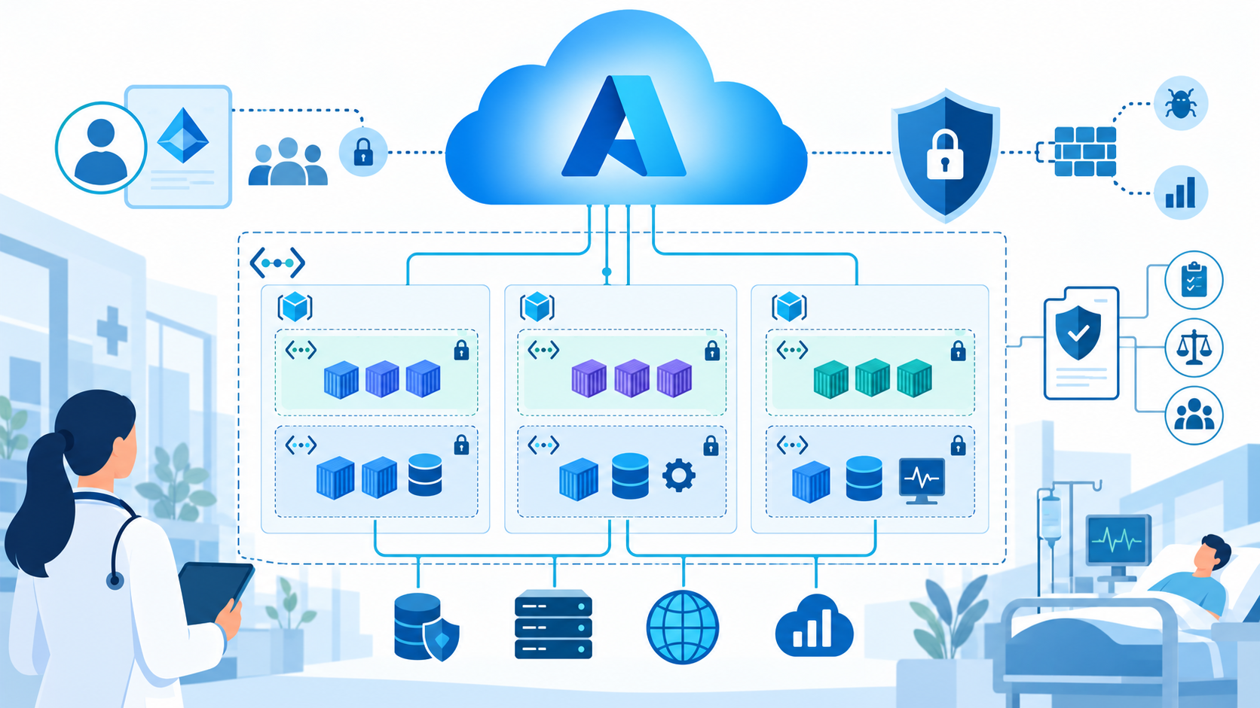
Weekly Snapshot
Progress summary for Cloud Security 1 and the Care Access Navigator capstone
M
Monday–Tuesday
✓
Assessment
ID
Wednesday
Worked on Cloud Security 1 Task 2 and Task 3, using the capstone project as the reference scenario.
Completed the 360 Power Assessment for Workforce Competencies.
Finished Task 4: IAM implementation and federation between Keycloak and Entra ID.
Main theme this week
• Connected coursework to the HRMC care-access use case
• Built confidence with Azure, Entra ID, resource groups, and cloud networking
• Identified deployment blockers and continued troubleshooting container placement in Azure VNet
Semester 4 · Week 3 · Sep 28 – Oct 1, 2026
02

Slide 3
Cloud Security 1 Progress
3 of 6 course tasks completed so far
1
2
3
4
5
6
Done
Done
In progress
Done
Next
Next
✓
Completed focus
!
Current blocker
→
Remaining
Task 2: Cloud Architecture Design & Security Patterns. Task 4: IAM implementation with Keycloak and Entra ID federation.
Task 3 deployment ran into Azure container-in-VNet failures. Working through configuration alternatives.
Tasks 3, 5, and 6 remain: infrastructure protection, compliance/governance, and security operations/incident response.
Semester 4 · Week 3 · Sep 28 – Oct 1, 2026
03

Slide 4
Monday & Tuesday: Architecture + Infrastructure Security
Course tasks were framed around Care Access Navigator for HRMC
2
Task 2 completed
Designed secure cloud architecture patterns around Azure networking, segmentation, and identity-aware access.
3
Task 3 in progress
Worked on cloud infrastructure security and container protection; encountered Azure container deployment failures inside the virtual network.
↻
Workaround path
Reviewing resource group, virtual network, subnet, permissions, and deployment configuration options to complete the task.
Semester 4 · Week 3 · Sep 28 – Oct 1, 2026
04

Slide 5

Wednesday: IAM Implementation Completed
Federation between Keycloak and Microsoft Entra ID
Why it matters for the capstone
• Supports secure identity federation for healthcare users
• Strengthens authorization design for Care Access Navigator
• Connects IAM coursework with real capstone requirements
• Builds the foundation for identity lifecycle and governance work
Cloud Security 1: 3 / 6 tasks completed
Semester 4 · Week 3 · Sep 28 – Oct 1, 2026
05

Slide 6
Next Work: For Thursday Tasks 3, 5, and 6
Planned focus for the remaining Cloud Security 1 requirements
3
Task 3: Infrastructure & Containers
5
Task 5: Compliance & Governance
6
Task 6: SecOps & IR
Finish Azure container deployment; harden cloud infrastructure; document secure Dockerfile, Docker settings, scanning results, and serverless IAM/network isolation.
Map configurations to a framework such as CIS, NIST, HIPAA, or PCI DSS; build gap analysis and policy enforcement evidence.
Configure centralized logging, alerting, monitoring dashboards, and test an incident response playbook.
Semester 4 · Week 3 · Sep 28 – Oct 1, 2026
06

Slide 7
Capstone Direction + Lessons Learned
A
Authorization
L
Identity Lifecycle
G
Incident Response + GRC
Continue defining access decisions for healthcare users, roles, and protected application resources.
Work on joiner, mover, and leaver concepts for safe user provisioning and deprovisioning.
Simulate incident response, then extend into governance, risk, and compliance concepts.
What I learned
• Azure resource groups and cloud networking are the foundation for secure deployments
• Entra ID and federation concepts are central to IAM in healthcare applications
• Deployment failures are part of learning cloud configuration and troubleshooting
• IAM and GRC controls must be documented clearly with evidence
Semester 4 · Week 3 · Sep 28 – Oct 1, 2026
07

Slide 8
Thank You
Thanking my peers, educators, and the DAE Team for their relentless support and encouragement.
Looking forward to learning deeper concepts and building wider reach in IAM and GRC.
Care Access Navigator · HRMC Capstone

