Slide 1
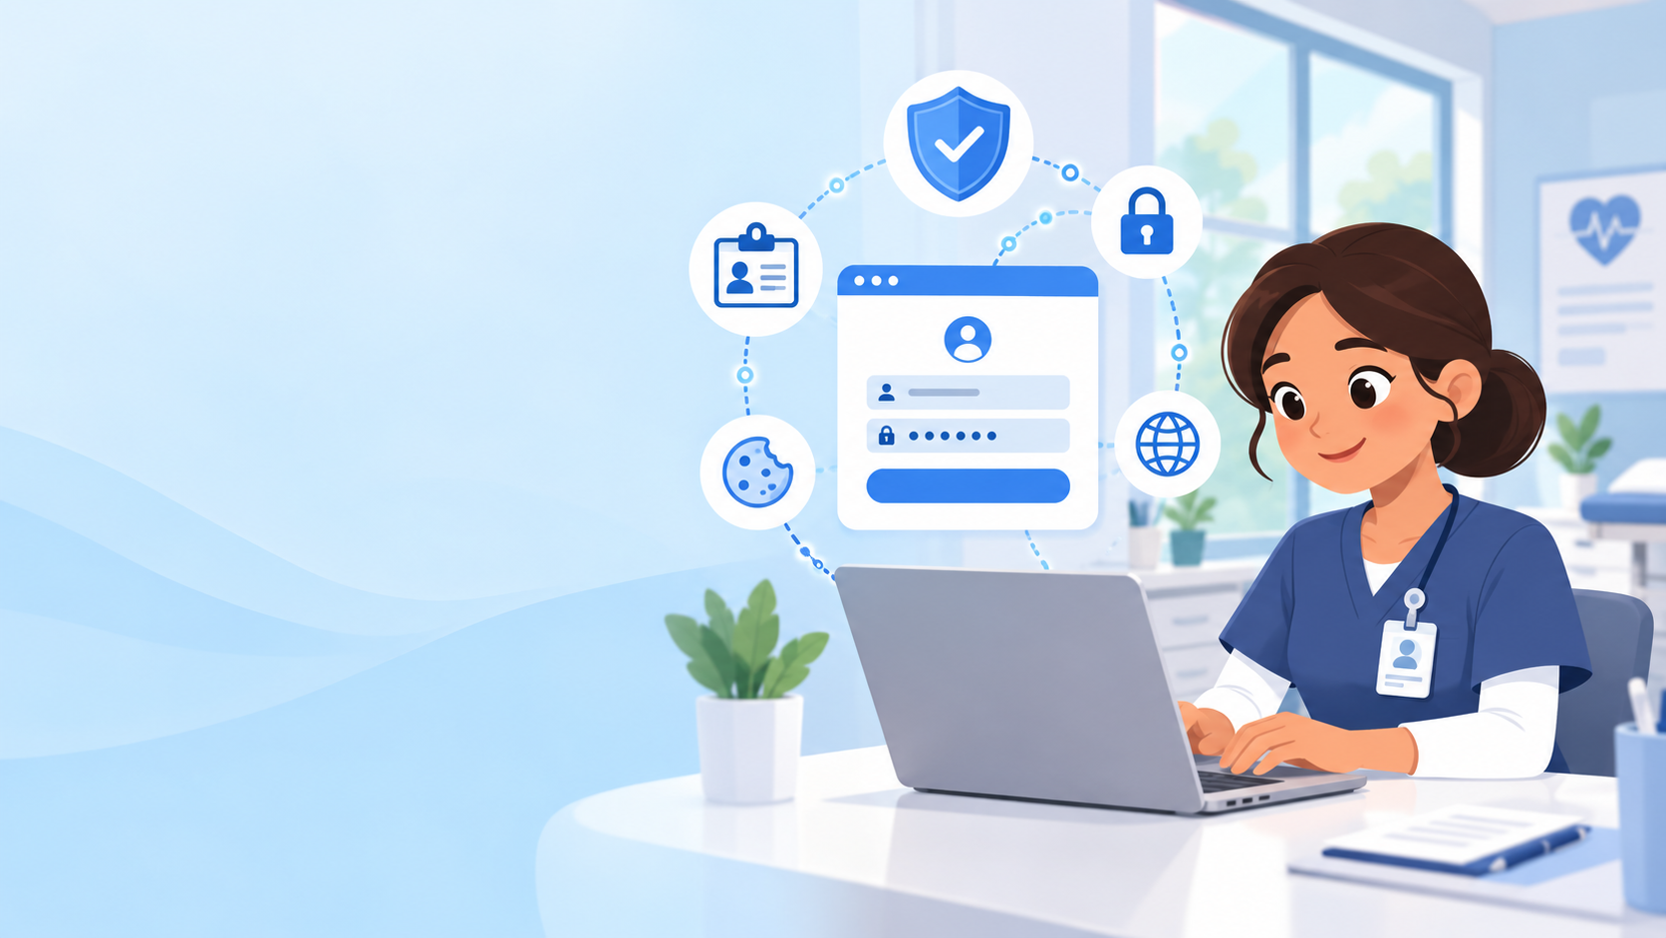
Session Token Hijacking
A simple teach-back using a Care Access Navigator example
Core idea: stolen token = borrowed login proof
Let us see what it is, how attacks happen, and the best ways to prevent and respond.
Notes:
Start by saying: Today I am explaining session token hijacking in simple terms. I will connect it to the Care Access Navigator use case and a daily life analogy.

Slide 2
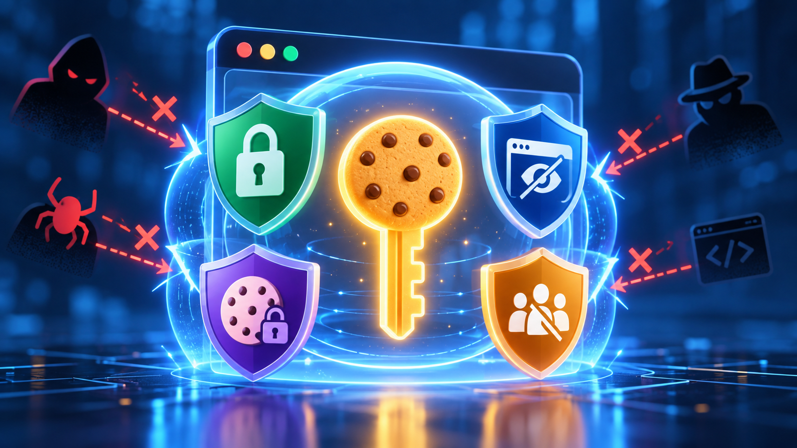
What is a session token?
A token is a temporary proof that says “this user already logged in.”
1. User logs in
2. Website gives a token
A session token works like a short-term digital ID card. The browser sends it back with each request so the website does not ask for your password again and again.
Important: the token is not your password — but while it is valid, it can act like proof that you are logged in.
Simple definition
Notes:
Explain that the token is a convenience and security object. The site trusts the token after login.

Slide 3
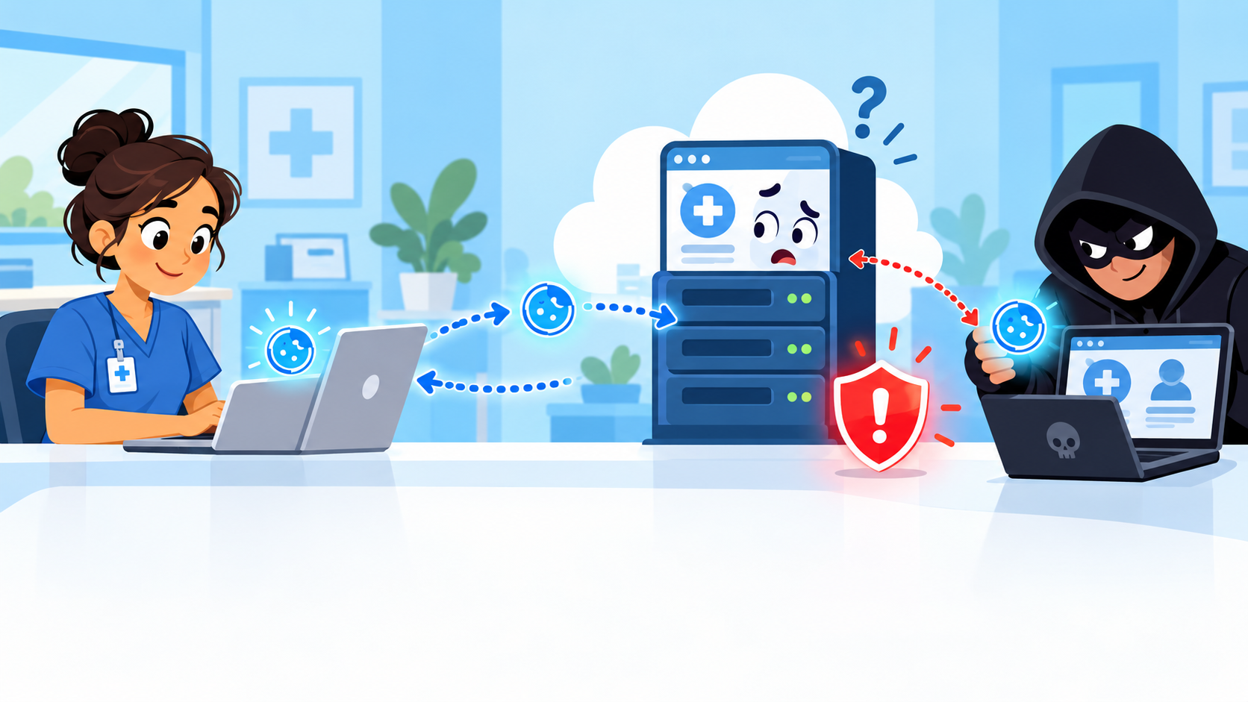
What happens in Session token hijacking ?
A stolen token can act like an already-approved login pass.
1
Real user logs in
Care Access Navigator proves identity once using login and MFA.
2
22
Token is accepted
The browser sends the token with requests so the system remembers the session.
3
Attacker reuses it
If stolen, the token can make an attacker look like the trusted user.
Simple meaning: stealing a valid login token and using it to impersonate the real user.
Simple explanation

Slide 4
Care Access Navigator example
How this matters in a healthcare workflow.
Navigator logs in
Token is created
Navigator opens tasks
Patient data appears
Session stays active
In a Care Access Navigator-style system, the session token can allow access to patient workload, appointment tasks, participant records, and care coordination details while the user is signed in.
If a token is stolen, the attacker may look like a trusted navigator session to the application.
Healthcare use case
Notes:
Connect to Care Access Navigator: the token protects workflow access after login. If it is hijacked, the attacker may appear to be the logged-in navigator.

Slide 5
Impact in the Care Access Navigator context
Why this is more serious in healthcare systems.
🔐
Unauthorized access to sensitive data
Patient records, contact details, appointment history, care tasks, and internal notes may be exposed.
📝
Incorrect actions under a real user’s name
An attacker could view, change, or complete tasks as if the navigator performed the action.
🏥
Trust and compliance risk
Healthcare workflows depend on confidentiality, audit trails, and correct user attribution.
Important: session token protection is patient data protection.
Risk framing
Notes:
Emphasize patient impact and operational risk: the problem is not just technical; it can affect privacy, trust, and accuracy.

Slide 6
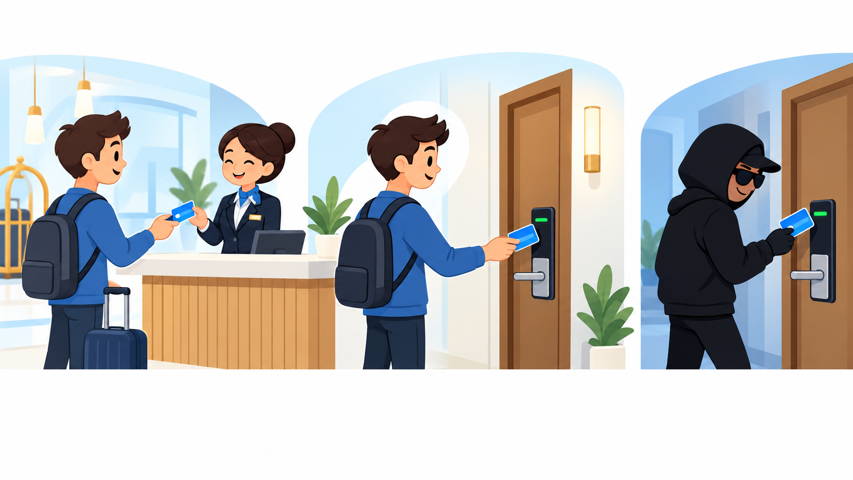
Daily analogy: Hotel key card
A session token works like a room key card after check-in.
Daily life comparison
Password = check-in
1
You show ID at reception once to prove who you are.
2
Token = room key card
After check-in, the card opens your room without showing ID again.
3
Hijacking = stolen card
If someone steals or copies it, the door may open as if they are the guest.
In terms of Cybersecurity, revoke the old session and issue a new one — like deactivating a lost room key.
Analogy

Slide 7
Common attack scenarios
How a token can be stolen or abused.
🧩
1. Malicious browser extension
💻
2. XSS on a vulnerable site
🖥️
3. Public/shared computer
A bad extension or compromised browser can try to read or abuse session data.
Injected scripts can run inside the page and attempt to steal or misuse session context.
A user forgets to log out; the next person may continue the active session.
🎣
4. Phishing or fake login flow
📡
5. Unprotected network traffic
⏳
6. Weak session handling
The user is tricked into a page or app that captures login/session information.
If traffic is not properly protected, tokens can be exposed during transmission.
Long-lived tokens or poor logout/invalidation give attackers more time to reuse tokens.
Remember: “The attack is not always about stealing the password — sometimes it is about stealing the already-approved login pass.”
Attack scenarios
Notes:
Walk through the six examples. Keep it simple and avoid technical depth unless asked.

Slide 8
Best prevention measures
Strong protection requires both application controls and user habits.
For developers / security teams
For users / navigators
✓ HTTPS/TLS everywhere
✓ Use MFA where available
✓ Secure + HttpOnly + SameSite cookies
✓ Log out on shared or public computers
✓ Short idle timeout + max lifetime
✓ Avoid suspicious links and extensions
✓ Rotate tokens after login and sensitive changes
✓ Keep browser and device updated
✓ Invalidate sessions after logout
✓ Do not share screens/tokens/cookies
✓ XSS protection and secure coding
✓ Report unusual account activity quickly
Preventive controls
Notes:
Present this slide as the practical checklist. Developers control token settings and users control safe behavior.

Slide 9
How to detect and manage token hijacking
Assume prevention can fail; monitoring and fast response matter.
🔎
Detect signs
New device or browser, unusual IP/location, impossible travel, abnormal task activity, sudden data downloads, repeated session changes.
🚨
Respond fast
Revoke active sessions, force password reset where needed, require MFA re-check, preserve logs, notify security team, review affected records.
🛡️
Improve controls
Shorten session lifetime, tune anomaly alerts, strengthen XSS defenses, review cookie flags, educate users with real scenarios.
Response goal: Make stolen tokens useless quickly.
Detection and response
Notes:
Make the response easy to remember: detect, revoke, investigate, improve.

Slide 10
Teach-back summary :
1
A session token is like a temporary digital ID card after login.
2
Session token hijacking happens when an attacker steals that token and reuses it to impersonate the user.
3
In a Care Access Navigator workflow, this could expose patient-related work, records, or tasks under a trusted user session.
4
The best defense is layered: secure cookies, HTTPS, shorter sessions, token rotation, logout invalidation, XSS protection, MFA, and user awareness.
5
If suspicious activity appears, revoke sessions quickly and investigate the affected account activity.
Session token hijacking : Steal token → Reuse token → Impersonate user
Closing slide
Notes:
Use this slide as the final spoken conclusion. Keep it slow and confident.

Slide 11
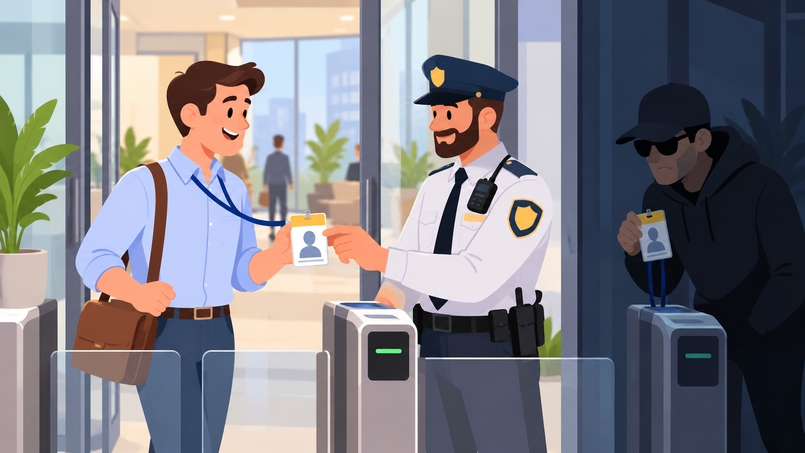
What is session token hijacking?
The attacker does not need the password if they can reuse the valid session token.
✅
Normal access
You log in and the website recognizes your session token as proof of authentication.
⚠️
Hijacked access
An attacker steals or copies the token and sends it to the website. The website may think it is still you.
Core risk: impersonation without knowing the user’s password.
Attack concept
Notes:
Use the copied badge analogy: if someone copies a badge and the door accepts it, they get in even if they are not the real person.

Slide 12
Daily analogy for non-technical audience
A session token is like a visitor badge or event wristband.
Daily life comparison
🪪
Password = proving identity at the front desk
You show who you are once, like signing in at reception.
🎟️
Token = badge you carry inside
After check-in, the badge lets you move around without re-checking your ID every minute.
🚫
Hijacking = someone uses your badge
If another person copies or steals the badge, doors may open for them as if they are you.
Analogy
Notes:
This analogy is powerful for non-technical people: the password is the first identity check; the session token is the badge used after that.

