Slide 1


Portfolio Pitch
IAM & GRC
Healthcare Cybersecurity
Completed Python foundation project + ongoing healthcare IAM/GRC capstone
Fresher / Beginner IAM & GRC Analyst Focus
Target roles: IAM Analyst • GRC Analyst • Healthcare security operations support
Notes:
Opening: I am an aspiring cybersecurity professional aiming for beginner-level IAM and GRC analyst roles in healthcare. This portfolio shows both what I have already completed and what I am actively building next.

Slide 2
CAREER POSITIONING
My direction: learn by building industry-relevant evidence
A portfolio story that connects programming foundations, healthcare security context, IAM workflows, and GRC evidence.
🐍
🏥
🛡️
Completed Foundation
Ongoing capstone
Role-ready story
MoodBuddy proves Python fundamentals: validation, JSON persistence, branching logic, and user-centered design.
Care Access Navigator simulates a healthcare IAM + GRC environment using synthetic data and security workflows.
Final deliverables translate lab work into evidence: RBAC matrix, JML workflows, access reviews, risk/control mapping, dashboards, and demo.
IAM + GRC Healthcare Cybersecurity Portfolio Pitch
02
Notes:
Positioning slide. The first project shows programming foundations. The capstone shows the IAM and GRC direction.

Slide 3

PROJECT 1
Completed project: MoodBuddy
A Python mood-tracking project demonstrating safe input handling, persistent user data, and clear program logic.
CORE USER VALUE
Track feelings → understand patterns
✓
What it does
Validates name and age, creates one record per user, and saves each check-in with timestamped history.
♥
Support logic
Tracks six emotions three positive and three negative and shows gentle warnings based on the mood type and number of times selected
⟳
Learning evidence
Demonstrates input validation, JSON file handling, functions, branching, and safe persistence.
IAM + GRC Healthcare Cybersecurity Portfolio Pitch
03
Notes:
MoodBuddy is my completed foundational project. It is not a medical tool. It demonstrates how I can translate a simple human problem into logic, data storage, and a clear user flow.

Slide 4
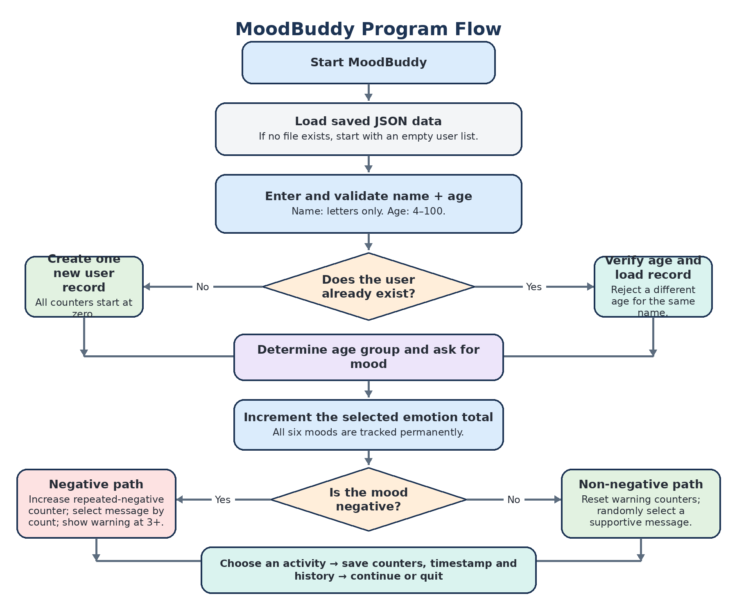
COMPLETED EVIDENCE
MoodBuddy: application logic & data flow
A professional process map for explaining how the completed Python project handles users, moods, counters, warnings, and saved history.
Technically speaking..
🔍
Input validation
Name, age, and menu choices checked before processing.
👤
User identification
Returning users are matched; duplicate/conflicting records are blocked.
💾
JSON persistence
Every check-in is saved with counters and timestamped history.
🧠
Conditional logic
Negative and non-negative paths drive support responses.
DIAGRAM STYLE: Lucidchart process-flow map
FIGMA USE: UI mockups only
IAM + GRC Healthcare Cybersecurity Portfolio Pitch
04
Notes:
Slide 4 represents the MoodBuddy application logic and data flow. Mention Lucidchart as the appropriate tool for the process-flow diagram. Figma would only be relevant for application UI mockups.

Slide 5

PROJECT 2
Ongoing capstone: Care Access Navigator (CAN)
Care Access Navigator is the project for IAM/GRC simulation for the Fictional Healthline Regional Medical Center (HRMC)using synthetic identities, workflows, monitoring, risk tracking, and reporting.
PRIMARY TARGET
CURRENT STAGE
IAM + GRC in healthcare
3 months complete / 3 remaining
Boundary: all identities, events, ePHI scenarios, logs, and evidence are simulated. No real patient or production data is used.
IAM + GRC Healthcare Cybersecurity Portfolio Pitch
05
Notes:
Introduce the capstone. Explain that this is a simulated healthcare environment, not a real patient system.

Slide 6
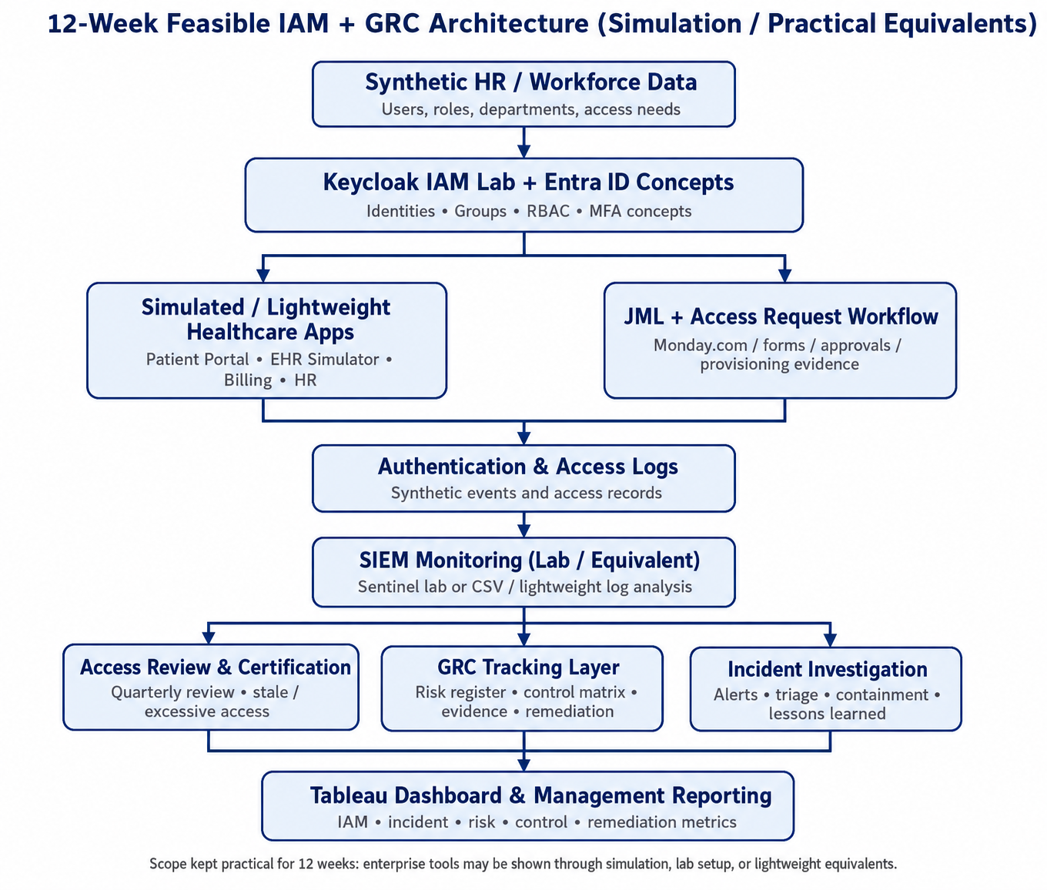
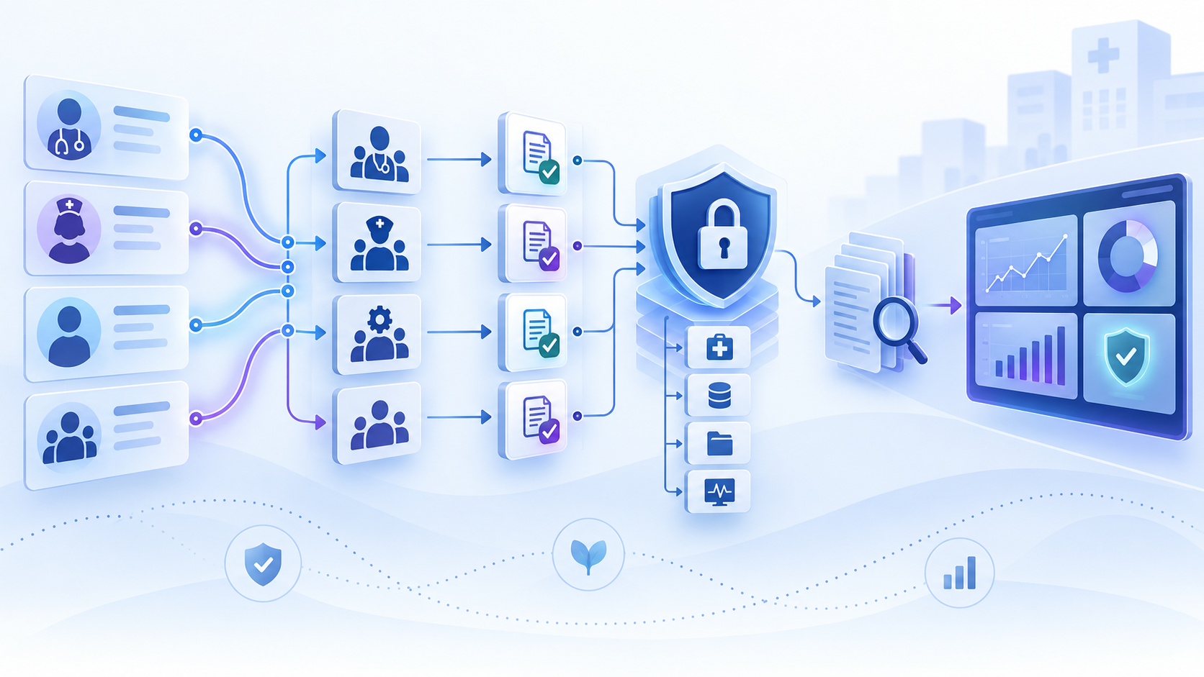
ARCHITECTURE
Care Access Navigator: architecture & flow
Original project flow diagram plus a professional architecture view for explaining IAM, access governance, monitoring, and GRC reporting.
Original project flow diagram
flow: workforce data → IAM lab → apps/workflows → logs → reviews, incidents, GRC → dashboard
Professional architecture view
Identities → Roles → Apps → Logs → Reviews / Incidents → Controls → Reporting
Diagram style: Lucidchart / healthcare IAM architecture
Lucidchart workflow diagram
Note: Figma is useful for UI mockups; Lucidchart is the stronger term for IAM/GRC architecture diagrams.
IAM + GRC Healthcare Cybersecurity Portfolio Pitch
06
Notes:
Slide 6 represents the Care Access Navigator target operating model. Mention Lucidchart as the correct tool for this kind of IAM/GRC architecture and workflow diagram. Figma is better for UI mockups, not architecture.

Slide 7
WHERE I AM NOW
Current progress: foundation is being built intentionally
The current work is focused on structure, lab boundaries, and evidence organization before identity-provider configuration starts.
Completed / started
Project folder structure, naming standards, lab boundaries, and initial documentation evidence.
Next build step
Integrate Keycloak and Microsoft Entra ID concepts; define users, groups, roles, and applications.
Validation focus
Prove least privilege, JML workflows, access approvals, and access reviews through screenshots and evidence.
Portfolio focus
Keep the scope beginner-feasible while making the story credible for IAM and GRC roles.
Project tracking on monday.com
IAM + GRC Healthcare Cybersecurity Portfolio Pitch
07

Slide 8
ROADMAP
Planned execution for the next 3 months
The remaining work moves from IAM configuration to evidence-based GRC reporting and a concise hiring-manager demo.
1
2
3
4
Identity foundation
IAM workflows
Monitoring + incident
GRC finish
Keycloak + Entra concepts, applications, users, groups, RBAC, MFA concept evidence.
JML, access request approvals, privileged access, vendor/service account scenarios.
Synthetic logs, detection use cases, ePHI-related suspicious access scenario, triage evidence.
Risk register, control matrix, HIPAA/NIST mapping, evidence index, dashboard, 5-minute demo.
Output goal: portfolio-ready proof, not only lab configuration
IAM + GRC Healthcare Cybersecurity Portfolio Pitch
08

Slide 9

IAM Analyst fit
How the capstone maps to beginner IAM responsibilities
👥
RBAC design
🔒
Least privilege
🔁
JML lifecycle
Translate healthcare job roles into access groups and permissions.
Show why each role receives only needed access.
Provision, move, and remove access with evidence.
✅
Access requests
🔎
Access reviews
⚠️
Monitoring support
Document justification, approval, provisioning, and verification.
Identify stale, excessive, mismatched, privileged, or expired access.
Investigate failed login, disabled-user, privilege, vendor, and ePHI access anomalies.
IAM + GRC Healthcare Cybersecurity Portfolio Pitch
09

Slide 10

CONTROLS, RISK, EVIDENCE
GRC Analyst fit
How the capstone maps to beginner GRC responsibilities
📋
Risk register
🧩
Control mapping
📁
Evidence index
Identify IAM/security risks, score likelihood and impact, assign owners, and track treatment actions.
Connect project controls to HIPAA Security Rule concepts and NIST-style control expectations.
Organize screenshots, logs, reviews, approvals, tests, and diagrams as audit-ready evidence.
🔎
Gap assessment
⚠️
Exception tracking
📊
Governance reporting
Find missing, weak, stale, or mismatched controls and document practical improvement actions.
Record accepted exceptions, compensating controls, due dates, and remediation ownership.
Translate IAM, risk, control, access-review, and remediation metrics into management reporting.
Portfolio evidence: Risk Register • Control Matrix • Evidence Index • Gap Assessment • Remediation Tracker • Management Dashboard
IAM + GRC Healthcare Cybersecurity Portfolio Pitch
10

Slide 11

WHAT HIRING MANAGERS CAN REVIEW
Final portfolio deliverables
A sanitized evidence package: architecture, IAM workflows, monitoring records, GRC documents, dashboard and Demo
🗺️
Architecture diagrams
Lucidchart IAM/GRC architecture, access lifecycle, incident flow, and data-flow diagrams.
🔐
IAM evidence
RBAC matrix, JML tests, access requests, access reviews, and screenshots.
📡
Monitoring evidence
Synthetic logs, detection use cases, triage notes, and incident investigation record.
⚖️
GRC package
Risk register, control matrix, evidence index, gap assessment, exceptions, remediation tracker.
📊
Dashboard + demo
Tableau/Excel dashboard and concise 5-minute walkthrough story.
IAM + GRC Healthcare Cybersecurity Portfolio Pitch
11

Slide 12
Closing pitch
I am building proof that I can think like an IAM + GRC Analyst
MoodBuddy shows my completed programming foundation. Care Access Navigator is my healthcare-focused capstone where I am converting IAM/GRC concepts into practical workflows, evidence, and reporting.
Thank you
IAM + GRC Healthcare Cybersecurity Portfolio Pitch
12

Slide 13
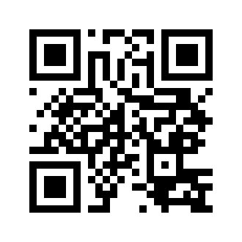
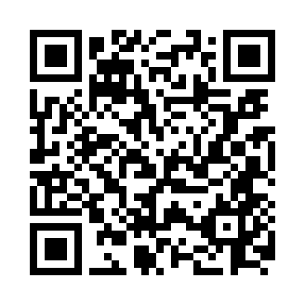
NETWORKING
Connect & portfolio
Scan to review project work and continue the conversation after the presentation.
GitHub Portfolio
LinkedIn Profile
Scan to view project code and portfolio evidence.
Scan to connect professionally.
linkedin.com/in/akhila-chennamaneni-228651236
IAM + GRC Healthcare Cybersecurity Portfolio Pitch
13

