Slide 1

SEMESTER 3 | WEEK 1 STATUS UPDATE
Care Access
Navigator
IAM + GRC Analyst Capstone Status Report by - Akhila Ch
Simulated fictional hospital: HealthLine Regional Medical Center (HRMC)
GitHub Portfolio
Capstone Launch
Project board
Week focus: define the environment, scope, requirements, risks, controls, and first architecture before technical implementation.

Slide 2
CARE ACCESS NAVIGATOR | SEMESTER 3 WEEK 1
overview
Week 1 narrative: from idea to visual blueprint
The capstone moved from portfolio setup and project launch into a structured IAM/GRC planning baseline.
1
2
3
4
MONDAY
TUESDAY
WEDNESDAY
THURSDAY
Capstone kick-off
Objectives + scope
Risk + compliance
Architecture + closeout
HRMC baseline, users, apps, business case, ePHI boundary
Requirements, priorities, tools and assumptions
HIPAA/NIST review, risk register, control objectives
Lucidchart blueprint, GitHub save, network and topologies concepts
Overall status: Week 1 established the planning foundation before detailed technical configuration. Work stayed focused on scenario, scope, requirements, risk, compliance, architecture, evidence, and presentation readiness. Documenting work on Monday.com Project board.
Portfolio thread: GitHub pages were refined in parallel, with final saves and evidence organization planned in the Thursday closeout.
HealthLine Regional Medical Center (HRMC) • Simulated / Non-Production • Synthetic Data Only
2

Slide 3
CARE ACCESS NAVIGATOR | SEMESTER 3 WEEK 1
Monday
Monday — Start capstone and define HRMC baseline
The week began by creating the simulated healthcare scenario and the first project baseline.
What was completed
HRMC baseline model
Continued building portfolio pages on GitHub.
Focus
Baseline definition
Started the Care Access Navigator capstone project.
People
Clinicians, nurses, billing, HR, IT, security analysts, vendors
Defined HRMC as a simulated hospital environment.
Systems
EHR, Patient Portal, Revenue Cycle, Workforce Management
Identified departments, users, applications, and business case.
Established the simulated ePHI boundary and synthetic-data rule.
Sensitive area
Synthetic patient information and patient-level access evidence
Rule
No real patient or production healthcare data
Monday takeaway: we established what is being protected, who needs access, which systems are involved, and where the simulated sensitive-data boundary exists.
HealthLine Regional Medical Center (HRMC) • Simulated / Non-Production • Synthetic Data Only
3

Slide 4
CARE ACCESS NAVIGATOR | SEMESTER 3 WEEK 1
Tuesday
Tuesday — Define objectives, scope and initial requirements
Day 2 turned the hospital baseline into a project plan and kept the capstone realistic.
Portfolio progress
Project baseline
Used TRAE / Agentic VS Code editor to update GitHub pages, improve features and edits, and move the portfolio pages closer to completion.
Objectives
RBAC, lifecycle, governance, monitoring, evidence, reporting
Scope
What is included and what is intentionally out of scope
Assumptions
Synthetic data, lightweight apps, 12-week feasibility
Requirements
Business, IAM, lifecycle, approval, ePHI, logging, GRC
Requirement priorities
Must
Synthetic data, users/roles, RBAC, JML, access review, logging/evidence
Should
Access request approval, vendor/privileged scenarios, monitoring, risk/control tracking
Could
Deeper Entra ID demonstration, automation, extra dashboards or incidents
Tuesday takeaway: scope and requirements prevent the project from becoming too large and define what the IAM/GRC demonstration must show.
HealthLine Regional Medical Center (HRMC) • Simulated / Non-Production • Synthetic Data Only
4

Slide 5
CARE ACCESS NAVIGATOR | SEMESTER 3 WEEK 1
Wednesday
Wednesday — Establish risk and compliance foundation
Day 3 connected project requirements to frameworks, risk examples, and control objectives.
Risk & compliance flow
Rules
Risks
Controls
Evidence
HIPAA + NIST CSF
What could go wrong
What should reduce risk
How we prove it later
Key work completed
Examples of risks identified
Reviewed HIPAA Security Rule and NIST CSF concepts relevant to identity, access, monitoring, incident response, and risk.
Risk
Plain-language example
Built the initial IAM/GRC risk register and preliminary control objectives.
Mover
Nurse moves to Billing but keeps old access
Continued creating matrices and started the Lucidchart diagram.
Leaver
Terminated employee account remains active
Started Schoology learning: Cyber Threats and Vulnerabilities.
Vendor
Vendor access remains enabled after end date
Monitoring
High patient-record access is not detected
Wednesday takeaway: every future control should trace back to a risk and a framework expectation—not just a tool feature.
HealthLine Regional Medical Center (HRMC) • Simulated / Non-Production • Synthetic Data Only
5

Slide 6
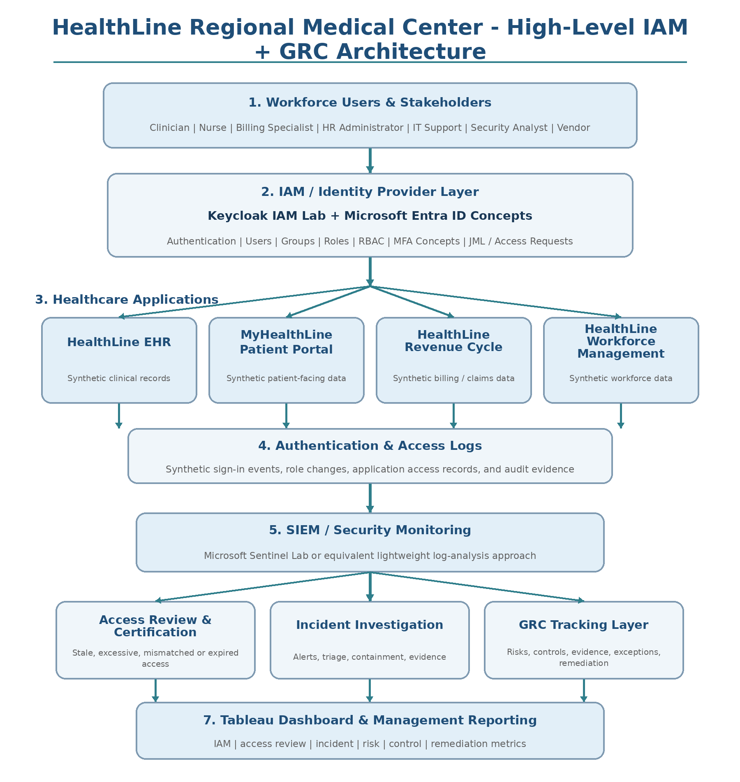
CARE ACCESS NAVIGATOR | SEMESTER 3 WEEK 1
Thursday
Thursday — Architecture, closeout and learnt about Networks and Topologies
Day 4 turns the week’s planning work into a visual blueprint and closes the loop through review and documentation.
Day 4 architecture target
Create the first high-level Lucidchart architecture showing the complete path from users and IAM into applications, logs, SIEM, GRC, and reporting.
Closeout step
Purpose
Finish architecture
Create/adjust the Lucidchart v1 and export it
Review week
Check Days 1–4 alignment and backlogs
Save to GitHub
Finalize artifacts and project evidence
Learn about Networks and Topologies
Learnt about Networks PAN,LAN,MAN,WAN.Also learnt about topologies Star,Tree,Mesh,Bus, Ring etc.
Present Status
Share weekly progress
Thursday takeaway: the architecture connects the week’s planning into one blueprint that can guide later IAM, monitoring, GRC, and reporting implementation.
HealthLine Regional Medical Center (HRMC) • Simulated / Non-Production • Synthetic Data Only
6

Slide 7
CARE ACCESS NAVIGATOR | SEMESTER 3 WEEK 1
capstone evidence
Skills demonstrated this week
The work shows both cybersecurity thinking and practical project execution.
IAM planning
Defined users, roles, access needs, ePHI boundary, lifecycle expectations
Security architecture
Created high-level environment flow across users, IAM, apps, SIEM, GRC, reporting
GRC analysis
Mapped risks, control objectives, evidence needs, remediation logic
Documentation
Maintained day-wise artifacts, glossary, Monday.com updates, and GitHub portfolio evidence
Week 1 evidence artifacts
Day 1 Environment Baseline • Day 2 Objectives/Scope/Requirements • Day 3 Risk & Compliance Foundation • Day 4 High-Level Architecture/Data Flow • GitHub portfolio updates • Monday.com status records
Professional value: these artifacts show traceability from business scenario → access requirements → risks → controls → architecture → reporting.
HealthLine Regional Medical Center (HRMC) • Simulated / Non-Production • Synthetic Data Only
7

Slide 8

Week 1 closeout
Ready for
status update for Week 1
One-sentence summary
Week 1 successfully established the Care Access Navigator planning baseline and prepared the project to move from documentation into controlled IAM/GRC implementation.
Next direction
Finalize GitHub evidence and artifact links
Confirm backlogs from Days 1–4
Prepare for IAM lab setup and user/group design
Clear baseline
Evidence saved
Risk Compliance and Architecture
Care Access Navigator • HRMC IAM + GRC Capstone

