Slide 1
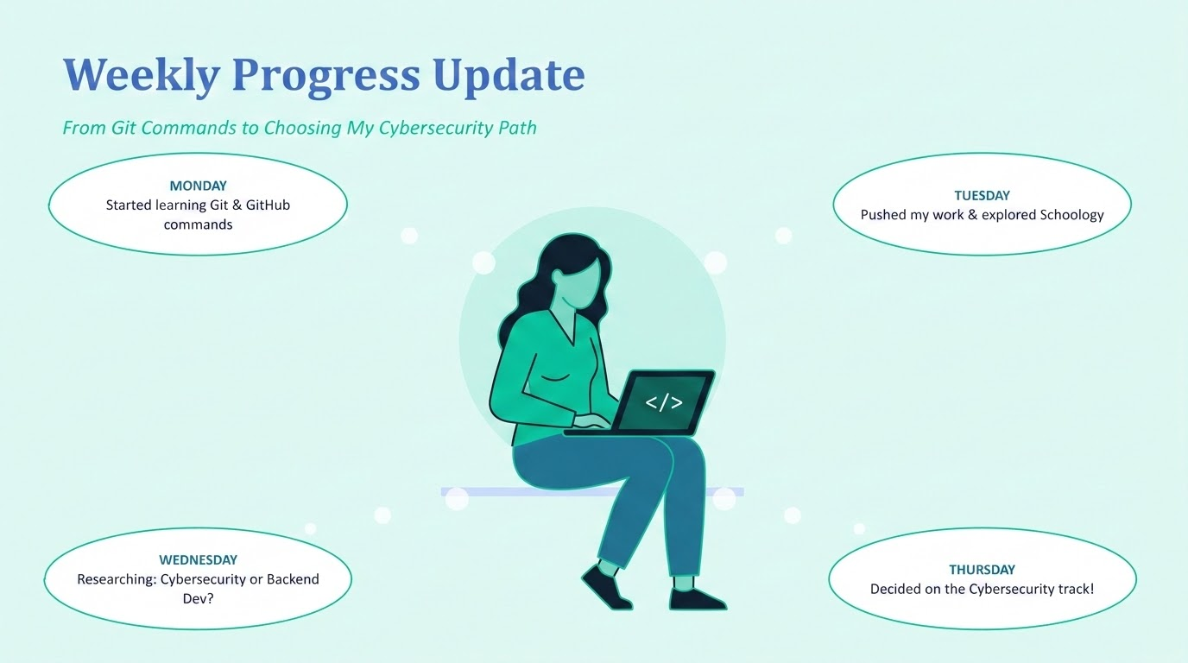

Slide 2


DAY 1 · MONDAY
Getting Started with Git
Some of the Commands I learned
Key Takeaway
git init
Set up a brand-new Git repository
git add
Today was about building the foundation: understanding how Git tracks every change I make, and how those changes get saved as a clear, versioned history of my work.
Stage changed files, ready to be saved
git commit
Save a snapshot of staged work with a message
git push
Upload local commits to GitHub
git status
These commands are now part of my everyday workflow for saving and tracking progress.
Check what's changed and review history
git ls -files
g
Used to list all tracked files

Slide 3



DAY 2 · TUESDAY
Pushing Progress & Navigating through Schoology
GitHub: Work Pushed
Schoology: LMS Basics
Pushed all progress made so far up to my GitHub repository
Explored how courses are structured inside Schoology
Repo now reflects the most current, up-to-date version of my work
Learned to navigate through modules and course materials
Getting comfortable with commit-then-push as a daily habit
Learned the steps to submit assignments correctly

Slide 4


DAY 3 · WEDNESDAY
Choosing My Track: Two Paths, One Decision
Cybersecurity
Backend Web Dev
Focused on protecting systems, networks & data from threats
Focused on building the server-side logic behind applications
Roles like security analyst, pentester, SOC analyst and many more
VS
Working with APIs, databases, and application architecture
Fast-growing demand for defenders across every industry
Strong focus on systems design and problem solving
Spent the day researching both paths to make an informed, confident choice.
Resources used Gemini Notebook LM, Chat GPT.

Slide 5








DAY 4 · THURSDAY
DECISION MADE:
Cybersecurity it is!
Now Exploring: Roles & Responsibilities
Security Analyst
Penetration Tester
Security Engineer
Incident Responder
Monitors networks & systems for threats
Simulates attacks to find weaknesses
Builds & maintains secure systems
Investigates & contains breaches
Cloud Security Engineer
Digital Forensics Analyst
Security Consultant
Cryptographer
Secures cloud infrastructure & services
Investigates devices & data after a breach
Advises organizations on risk & strategy
Designs systems that keep data encrypted
Researching each role and the day-to-day duties of it to decide which direction fits best.

Slide 6
Thank You
Looking forward to diving deeper into Cybersecurity next week.

