Slide 1
CSE 204 - INTRO TO Database Systems E-R Modeling
Joseph LEDET
Department of Computer Engineering
Akdeniz University
josephledet@akdeniz.edu.tr

Slide 2
Outline
How to use Entity–Relationship (ER) modeling in database design.
Basic concepts associated with ER model.
Diagrammatic technique for displaying ER model using Unified Modeling Language (UML).
How to identify and resolve problems with ER models called connection traps.
How to build an ER model from a requirements specification.

Slide 3
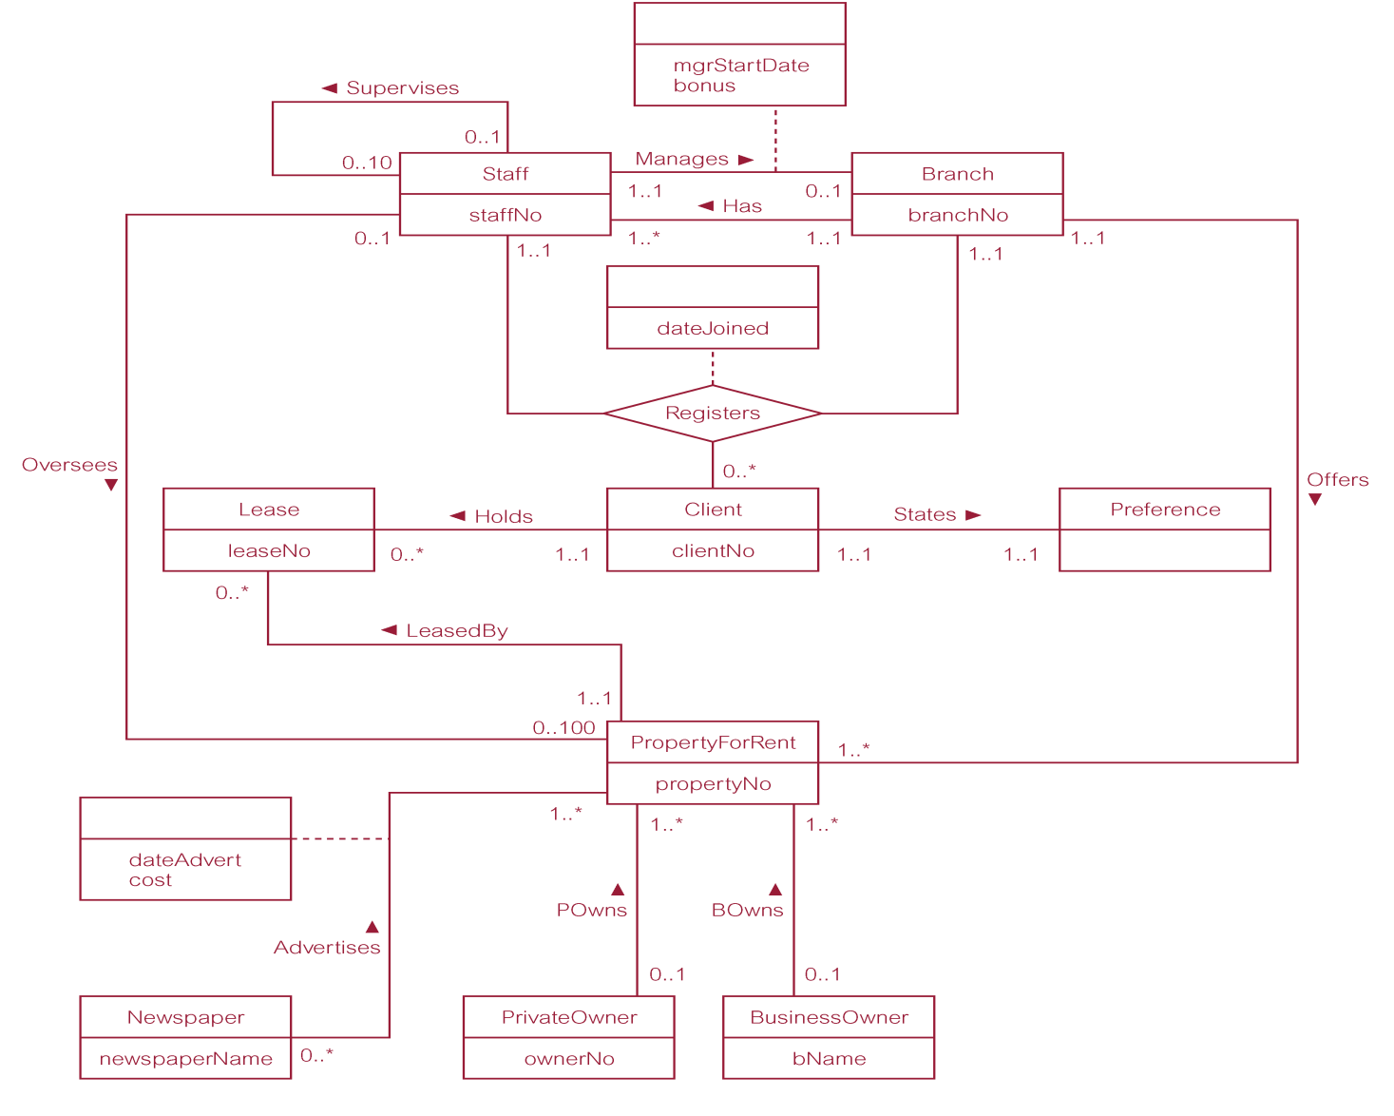
ER diagram of Branch user views of DreamHome

Slide 4
Concepts of the ER Model
Entity types
Relationship types
Attributes

Slide 5
Entity Type
Entity type
Group of objects with same properties, identified by enterprise as having an independent existence.
Entity occurrence
Uniquely identifiable object of an entity type.

Slide 6
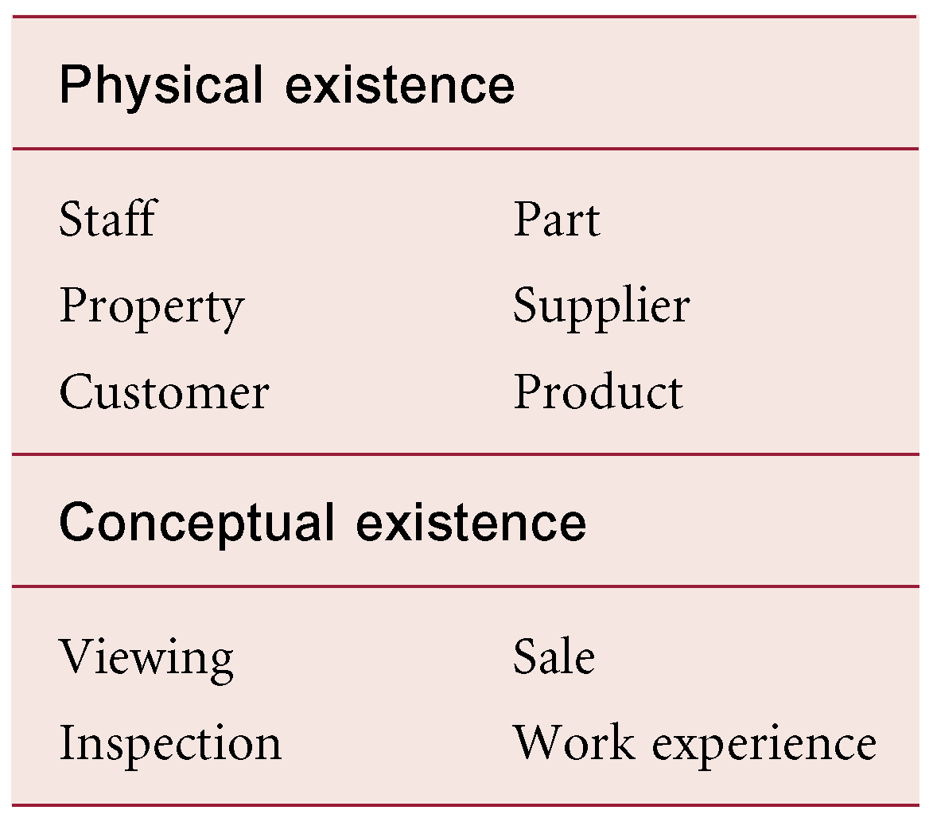
Examples of Entity Types

Slide 7
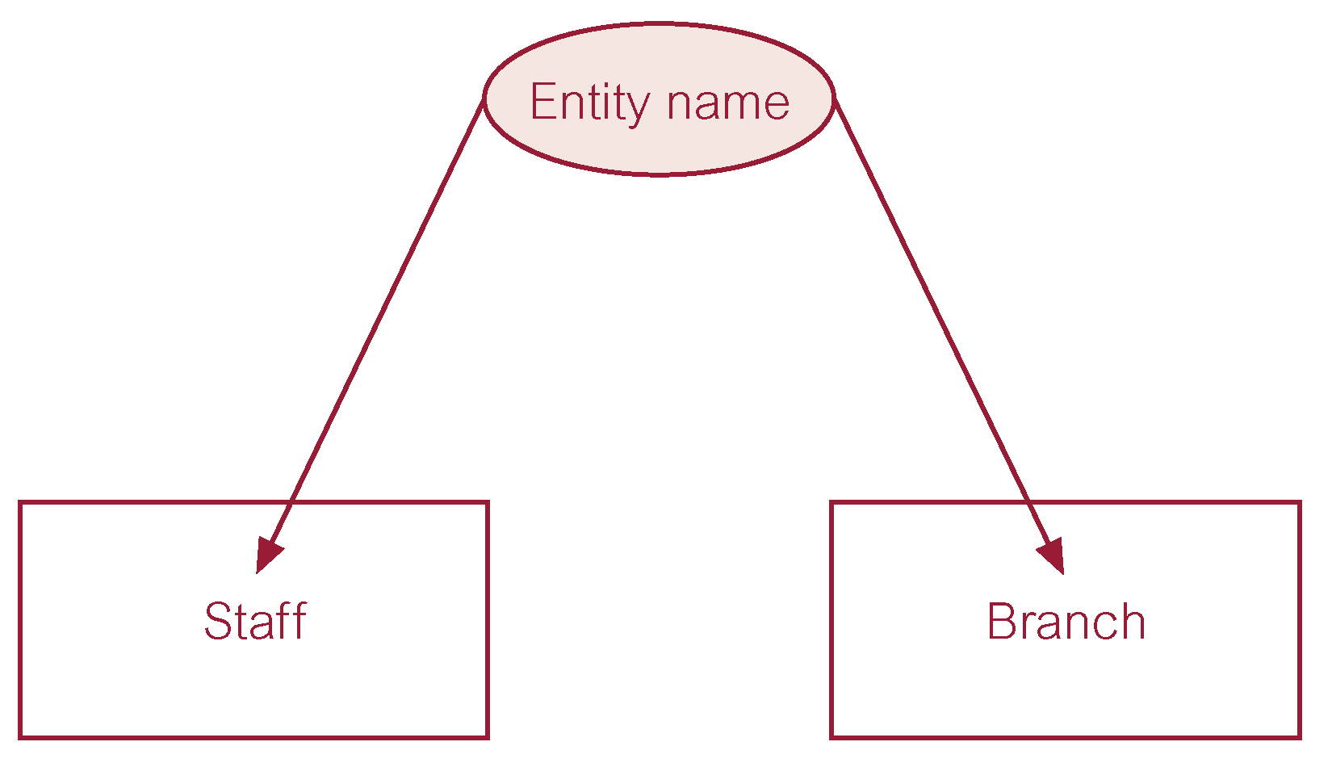
ER diagram of Staff and Branch entity types

Slide 8
Relationship Types
Relationship type
Set of meaningful associations among entity types.
Relationship occurrence
Uniquely identifiable association, which includes one occurrence from each participating entity type.

Slide 9
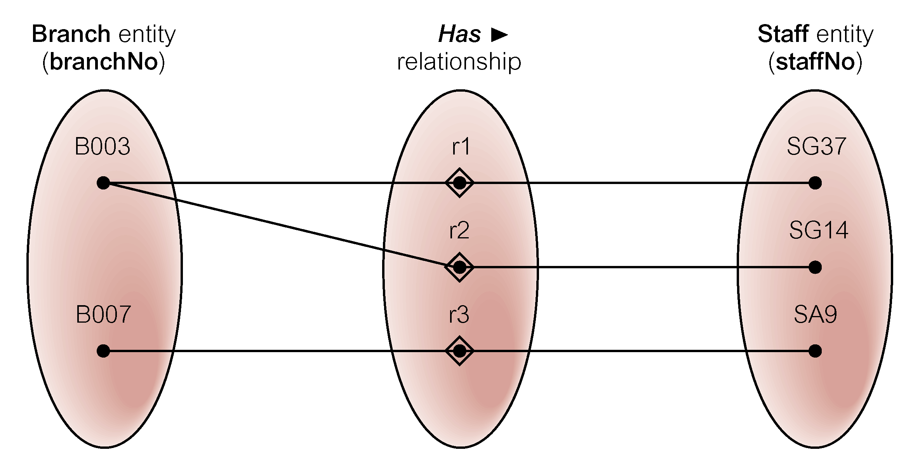
Semantic net of Has relationship type

Slide 10
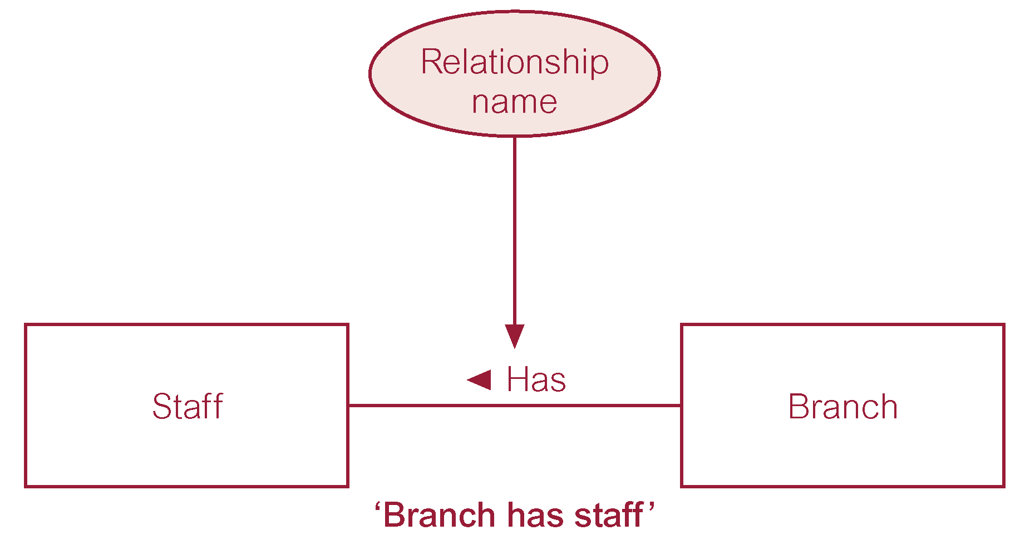
ER diagram of Branch Has Staff relationship

Slide 11
Relationship Types
Degree of a Relationship
Number of participating entities in relationship.
Relationship of degree :
two is binary
three is ternary
four is quaternary.

Slide 12
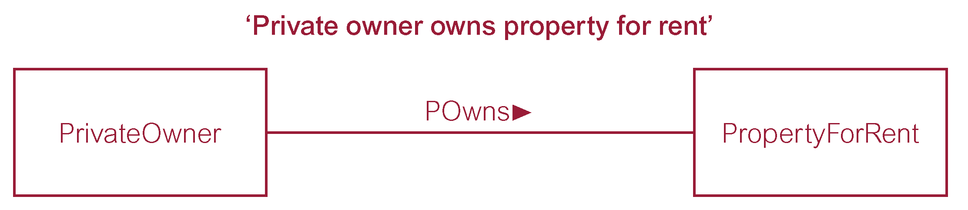
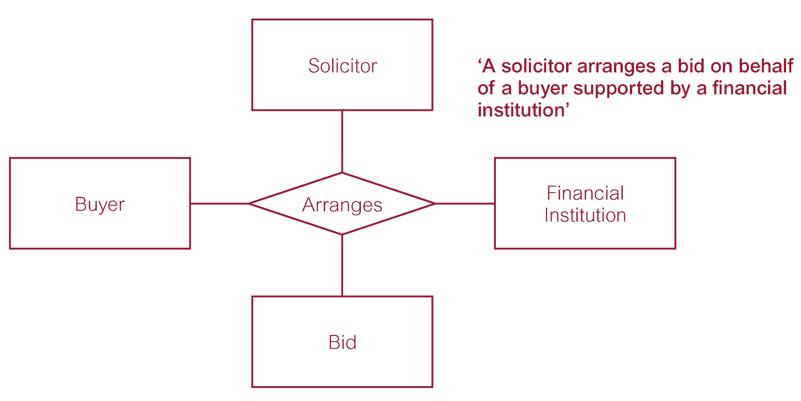
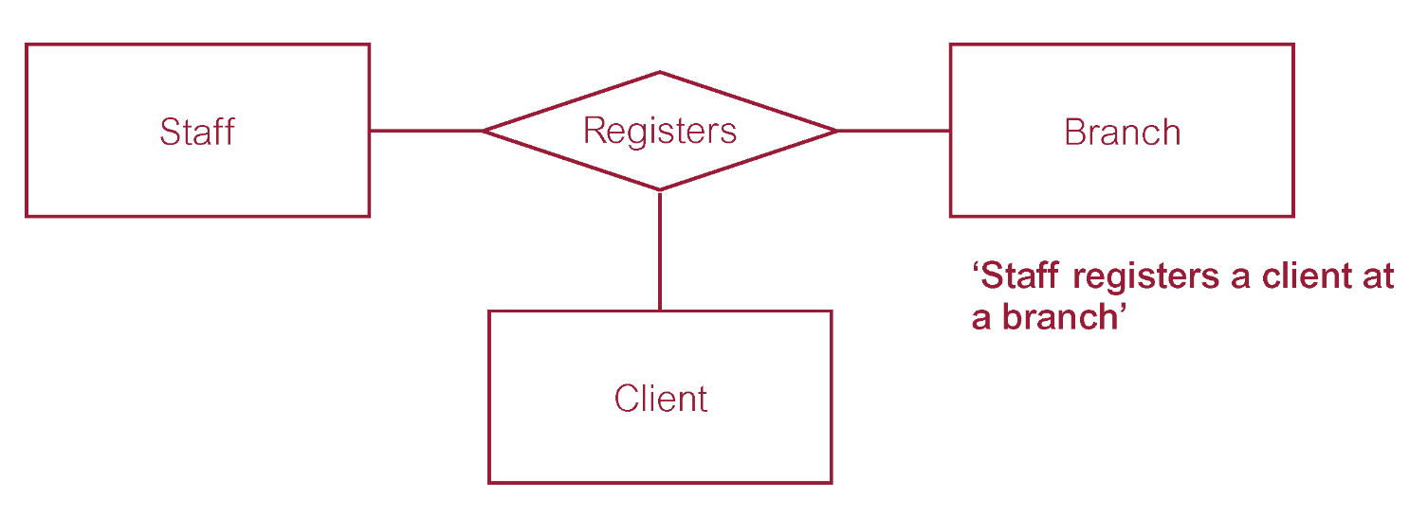
relationships

Slide 13
Relationship Types
Recursive Relationship
Relationship type where same entity type participates more than once in different roles.
Relationships may be given role names to indicate purpose that each participating entity type plays in a relationship.

Slide 14
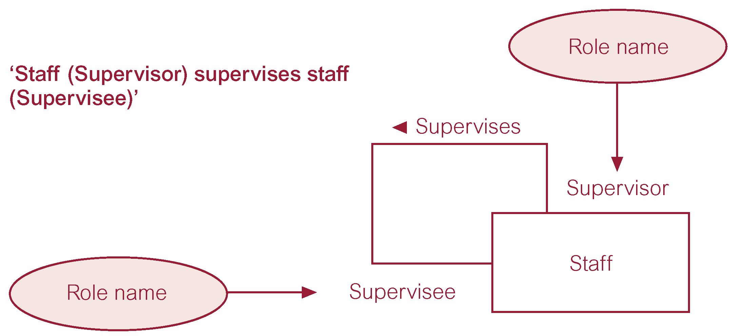
Recursive relationship called Supervises with role names

Slide 15
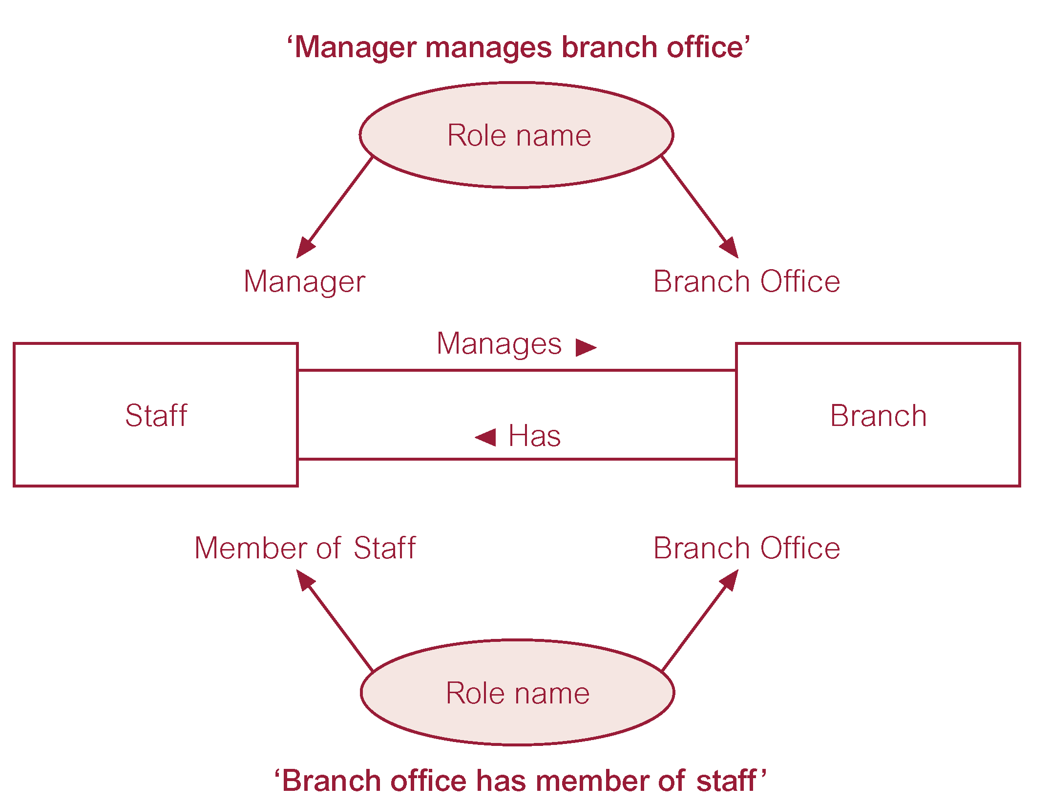
Entities associated through two distinct relationships with role names

Slide 16
Attributes
Attribute
Property of an entity or a relationship type.
Attribute Domain
Set of allowable values for one or more attributes.
Simple Attribute
Attribute composed of a single component with an independent existence.
Composite Attribute
Attribute composed of multiple components, each with an independent existence.

Slide 17
Attributes
Single-valued Attribute
Attribute that holds a single value for each occurrence of an entity type.
Multi-valued Attribute
Attribute that holds multiple values for each occurrence of an entity type.
Derived Attribute
Attribute that represents a value that is derivable from value of a related attribute, or set of attributes, not necessarily in the same entity type.

Slide 18
Keys
Candidate Key
Minimal set of attributes that uniquely identifies each occurrence of an entity type.
Primary Key
Candidate key selected to uniquely identify each occurrence of an entity type.
Composite Key
A candidate key that consists of two or more attributes.

Slide 19
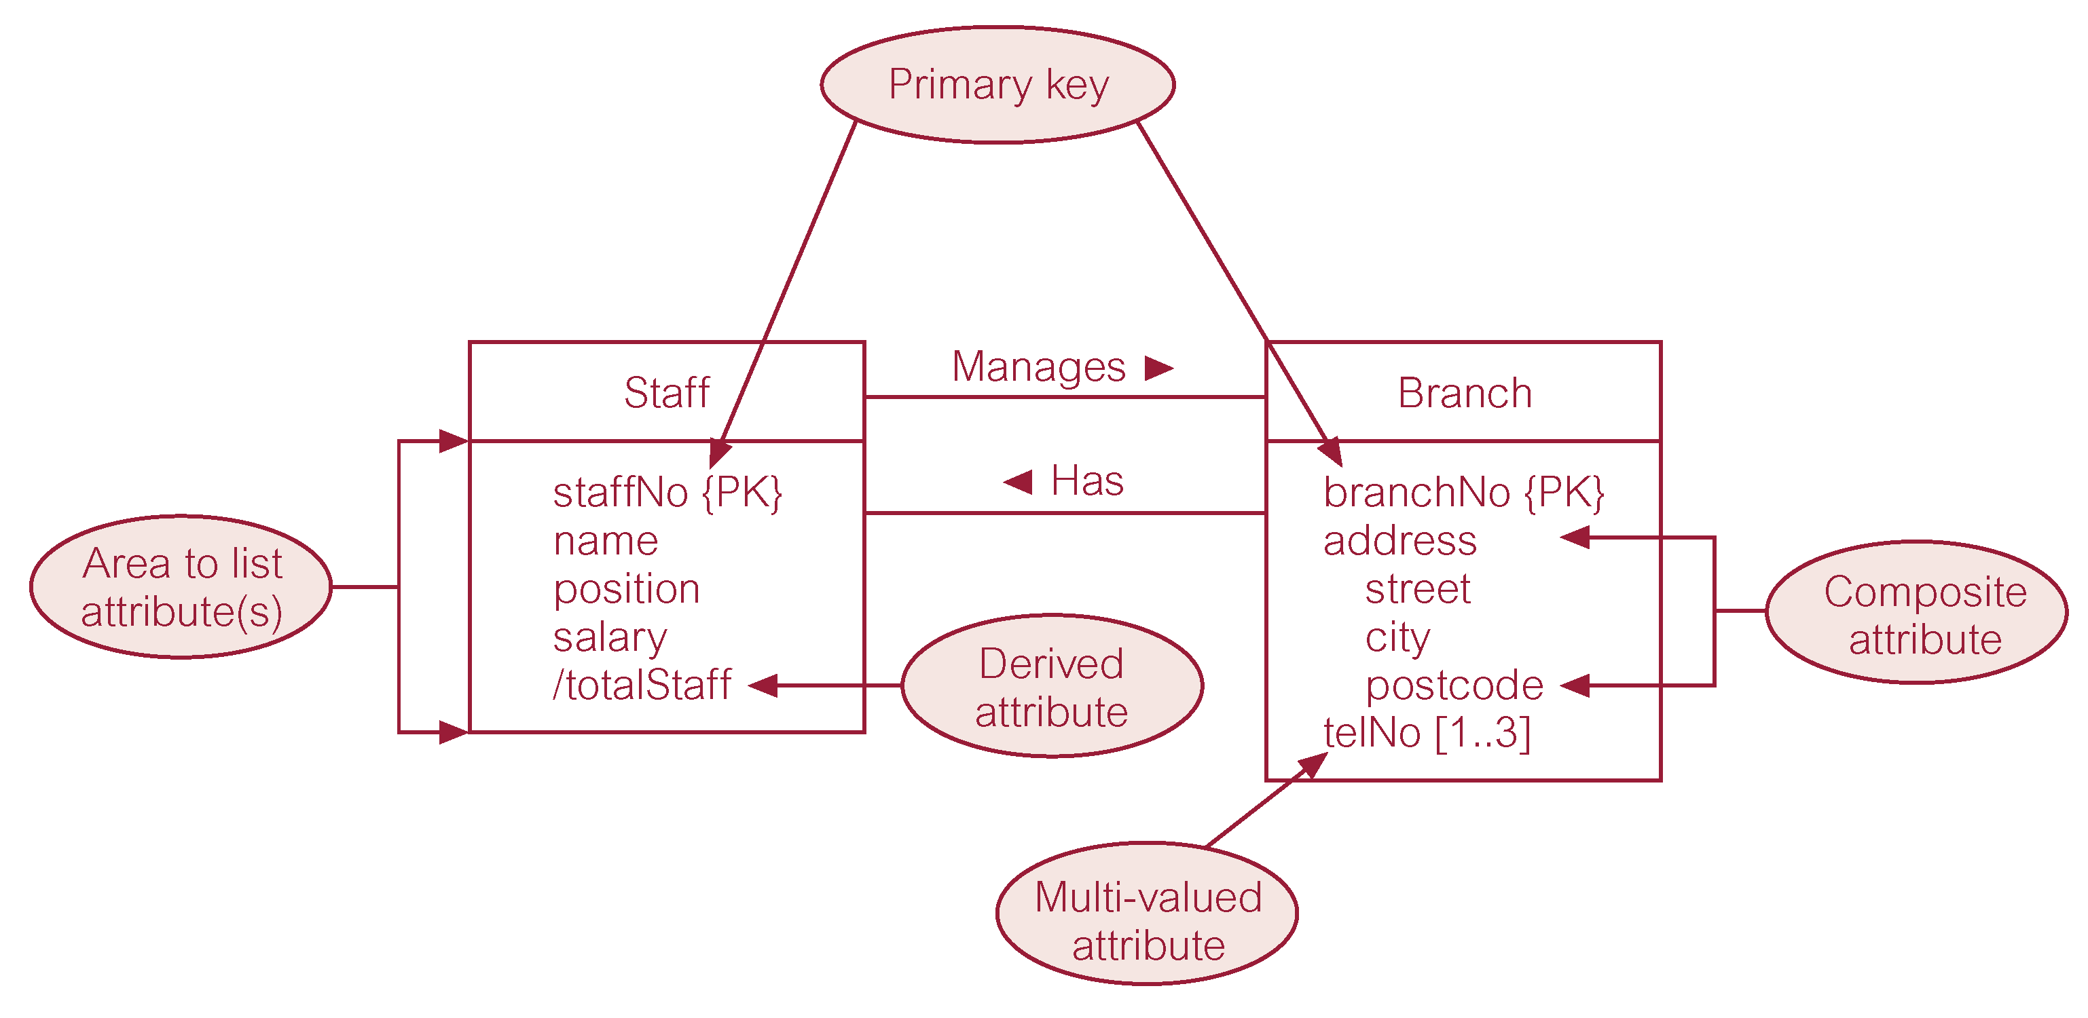
ER diagram of Staff and Branch entities and their attributes

Slide 20
Entity Type
Strong Entity Type
Entity type that is not existence-dependent on some other entity type.
Weak Entity Type
Entity type that is existence-dependent on some other entity type.

Slide 21
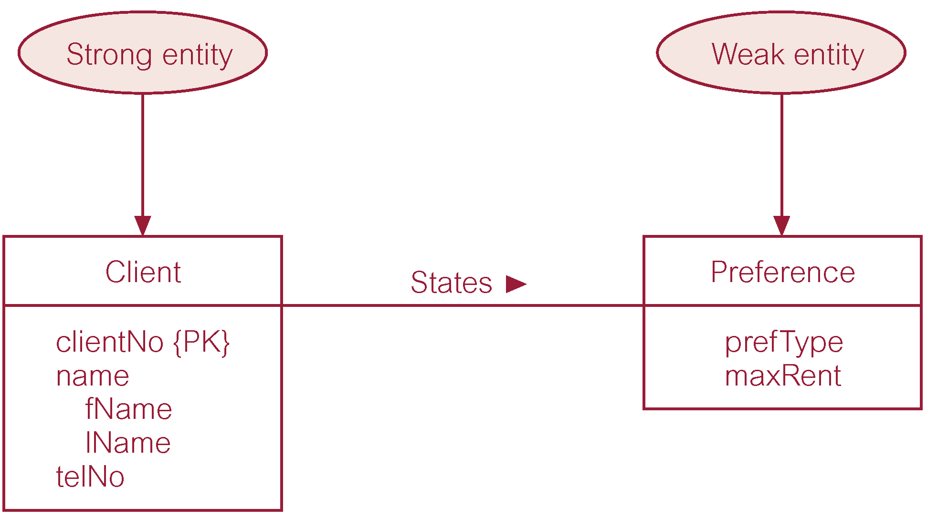
Strong entity type called Client and weak entity type called Preference

Slide 22
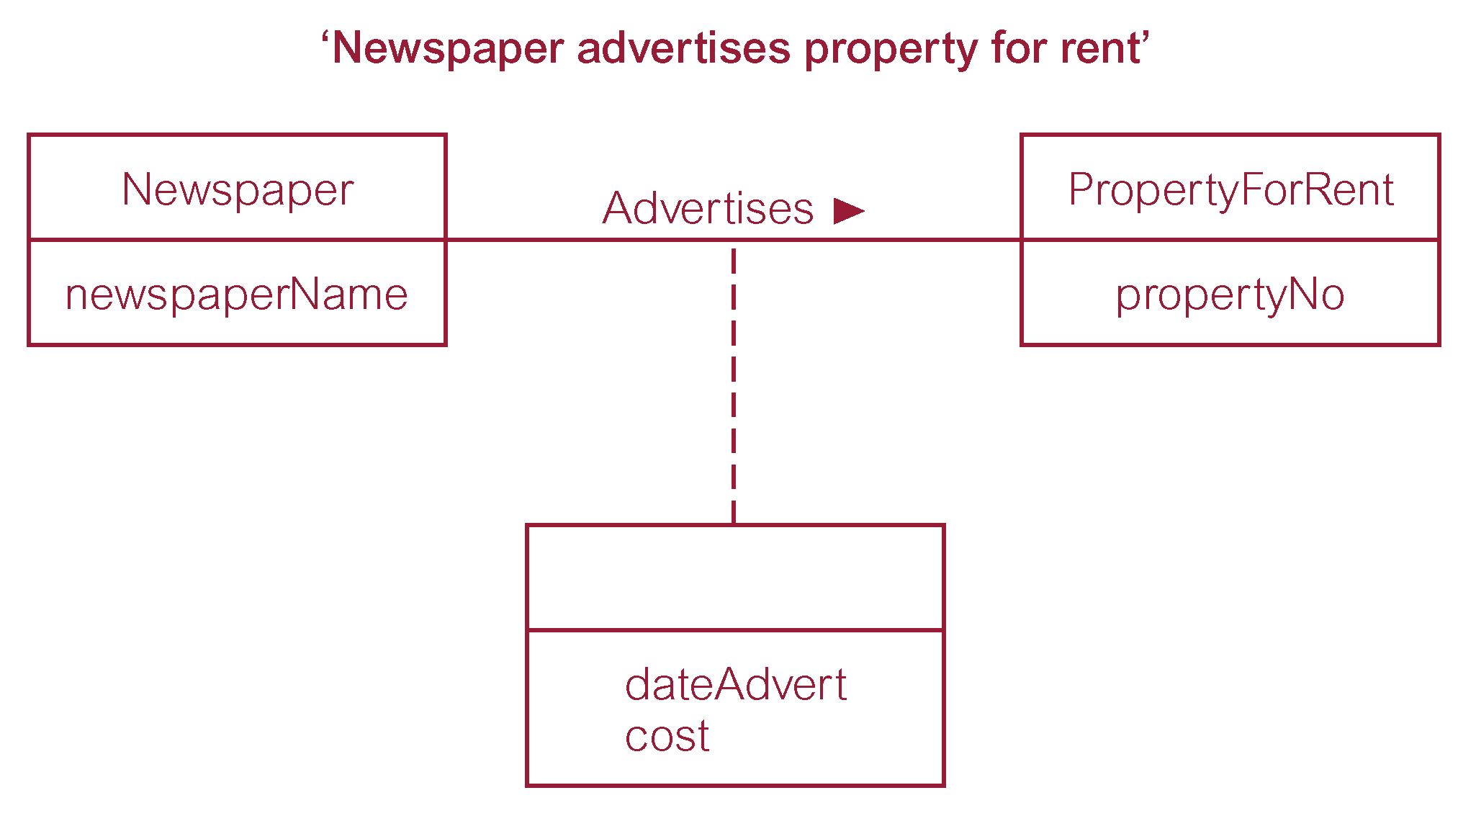
Relationship called Advertises with attributes

Slide 23
Structural Constraints
Main type of constraint on relationships is called multiplicity.
Multiplicity - number (or range) of possible occurrences of an entity type that may relate to a single occurrence of an associated entity type through a particular relationship.
Represents policies (called business rules) established by user or company.

Slide 24
Structural Constraints
The most common degree for relationships is binary.
Binary relationships are generally referred to as being:
one-to-one (1:1)
one-to-many (1:*)
many-to-many (*:*)

Slide 25
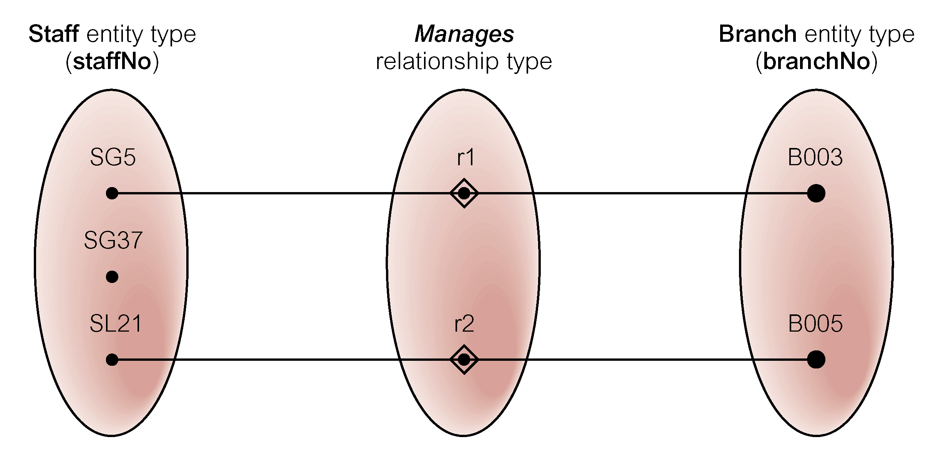
Semantic net of Staff Manages Branch relationship type

Slide 26
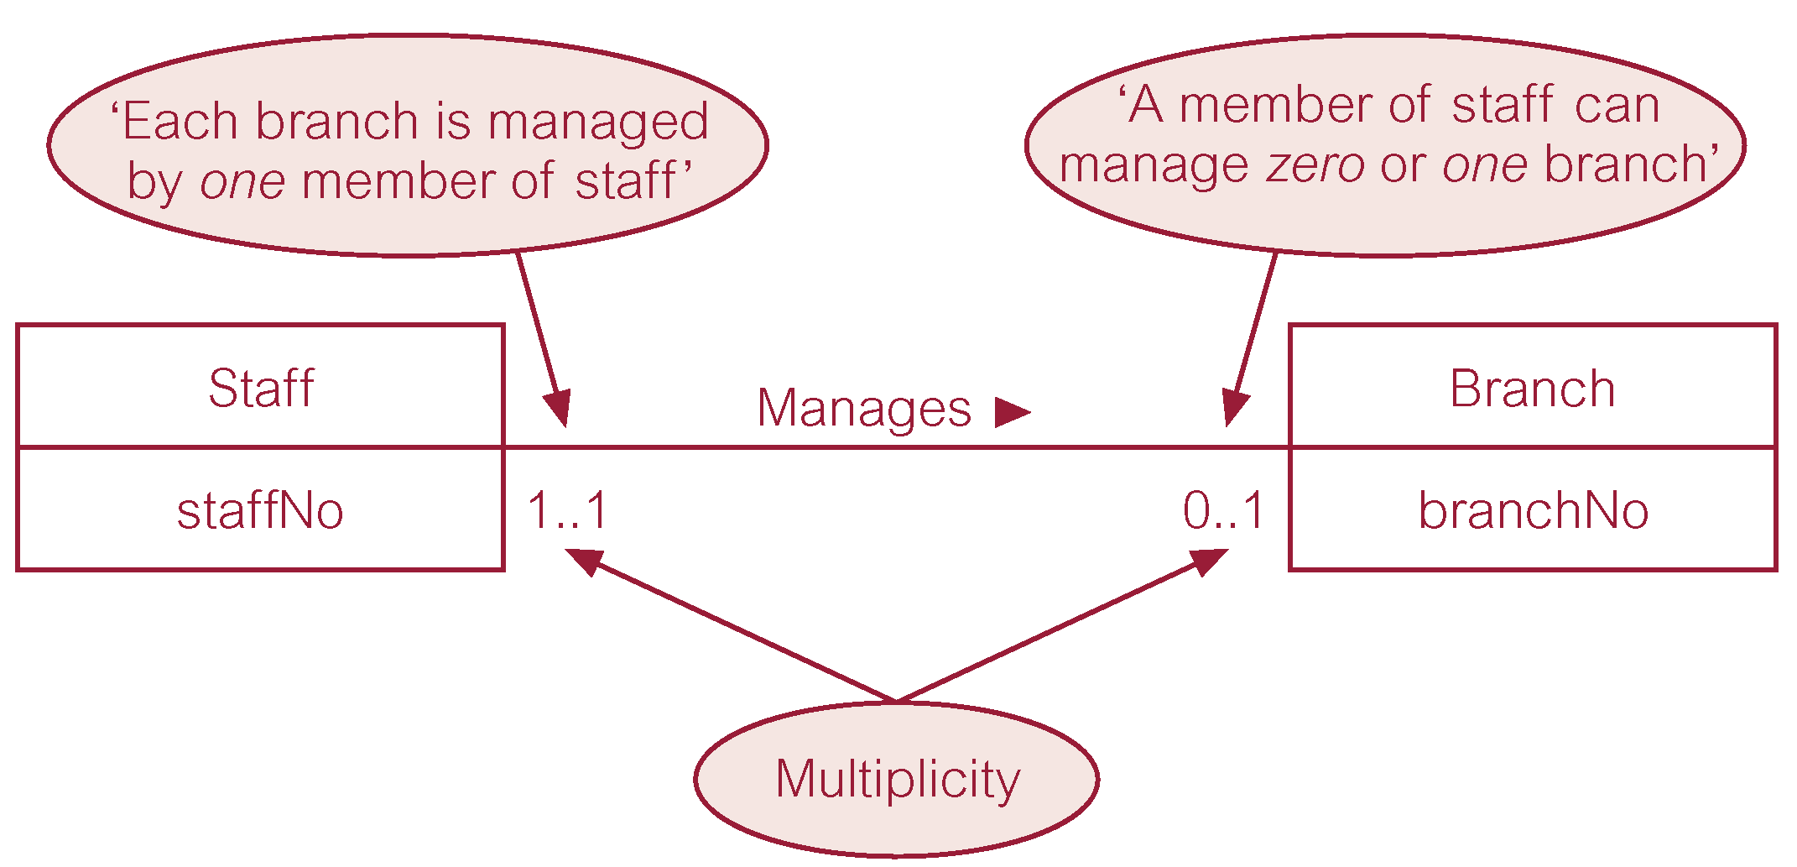
Multiplicity of Staff Manages Branch (1:1) relationship

Slide 27
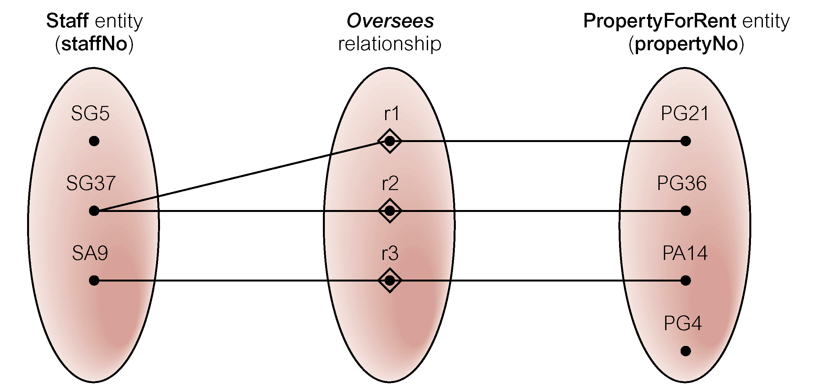
Semantic net of Staff Oversees PropertyForRent relationship type

Slide 28
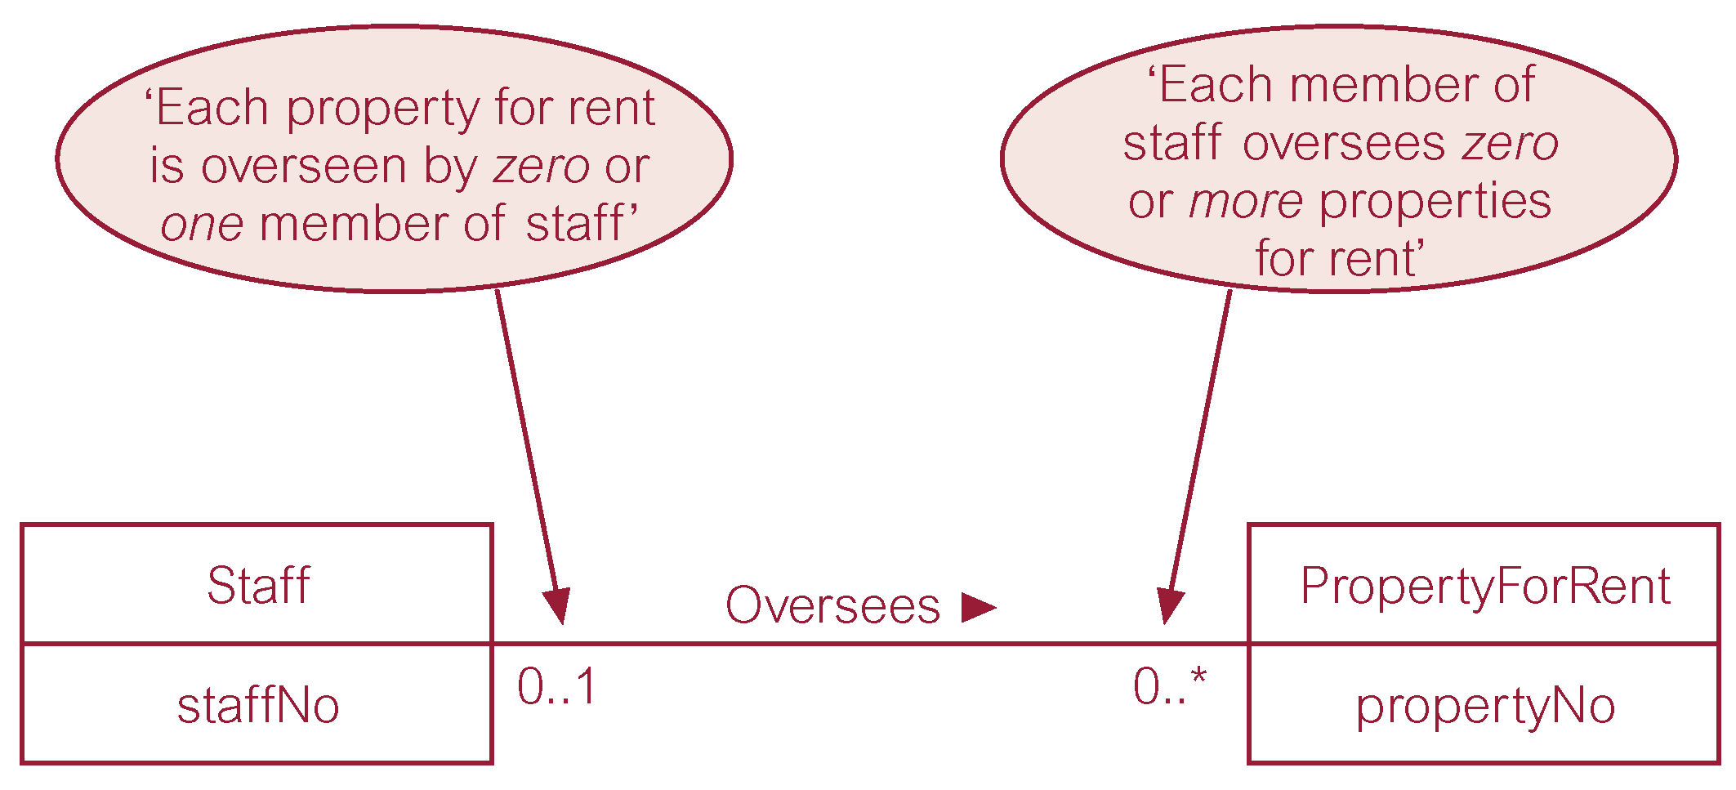
Multiplicity of Staff Oversees PropertyForRent (1:*) relationship type

Slide 29
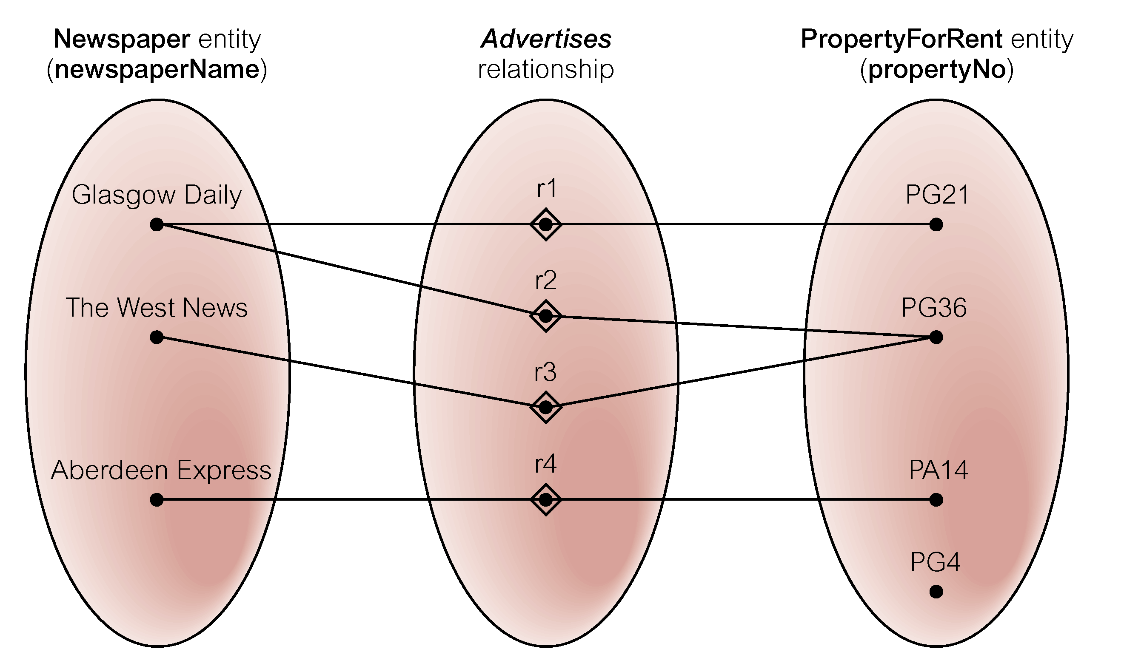
Semantic net of Newspaper Advertises PropertyForRent relationship type

Slide 30
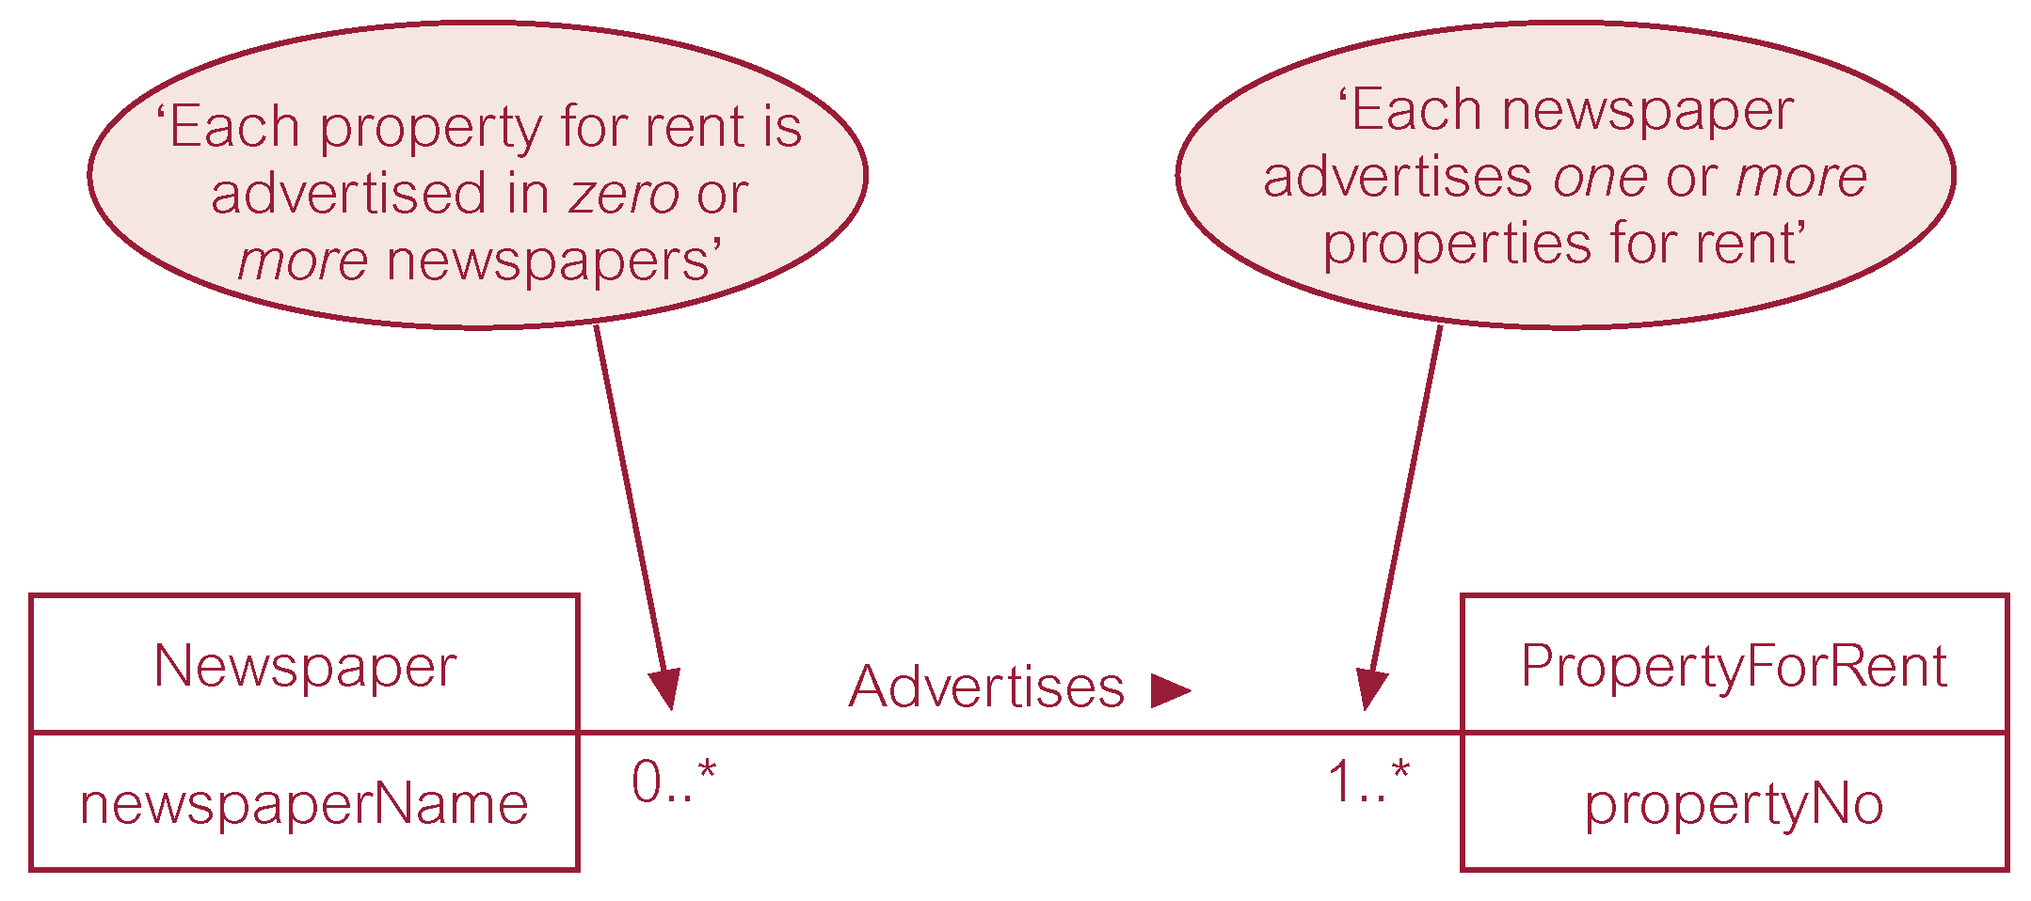
Multiplicity of Newspaper Advertises PropertyForRent (*:*) relationship

Slide 31
Structural Constraints
Multiplicity for Complex Relationships
Number (or range) of possible occurrences of an entity type in an n-ary relationship when other (n-1) values are fixed.

Slide 32
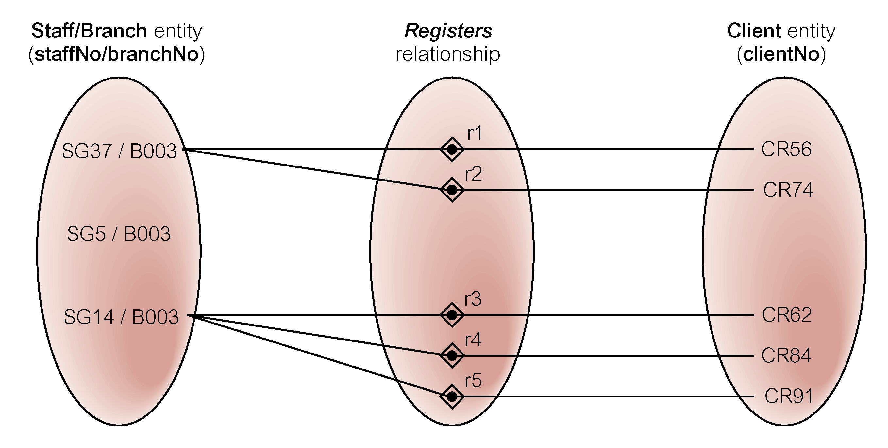
Semantic net of ternary Registers relationship with values for Staff and Branch entities fixed

Slide 33
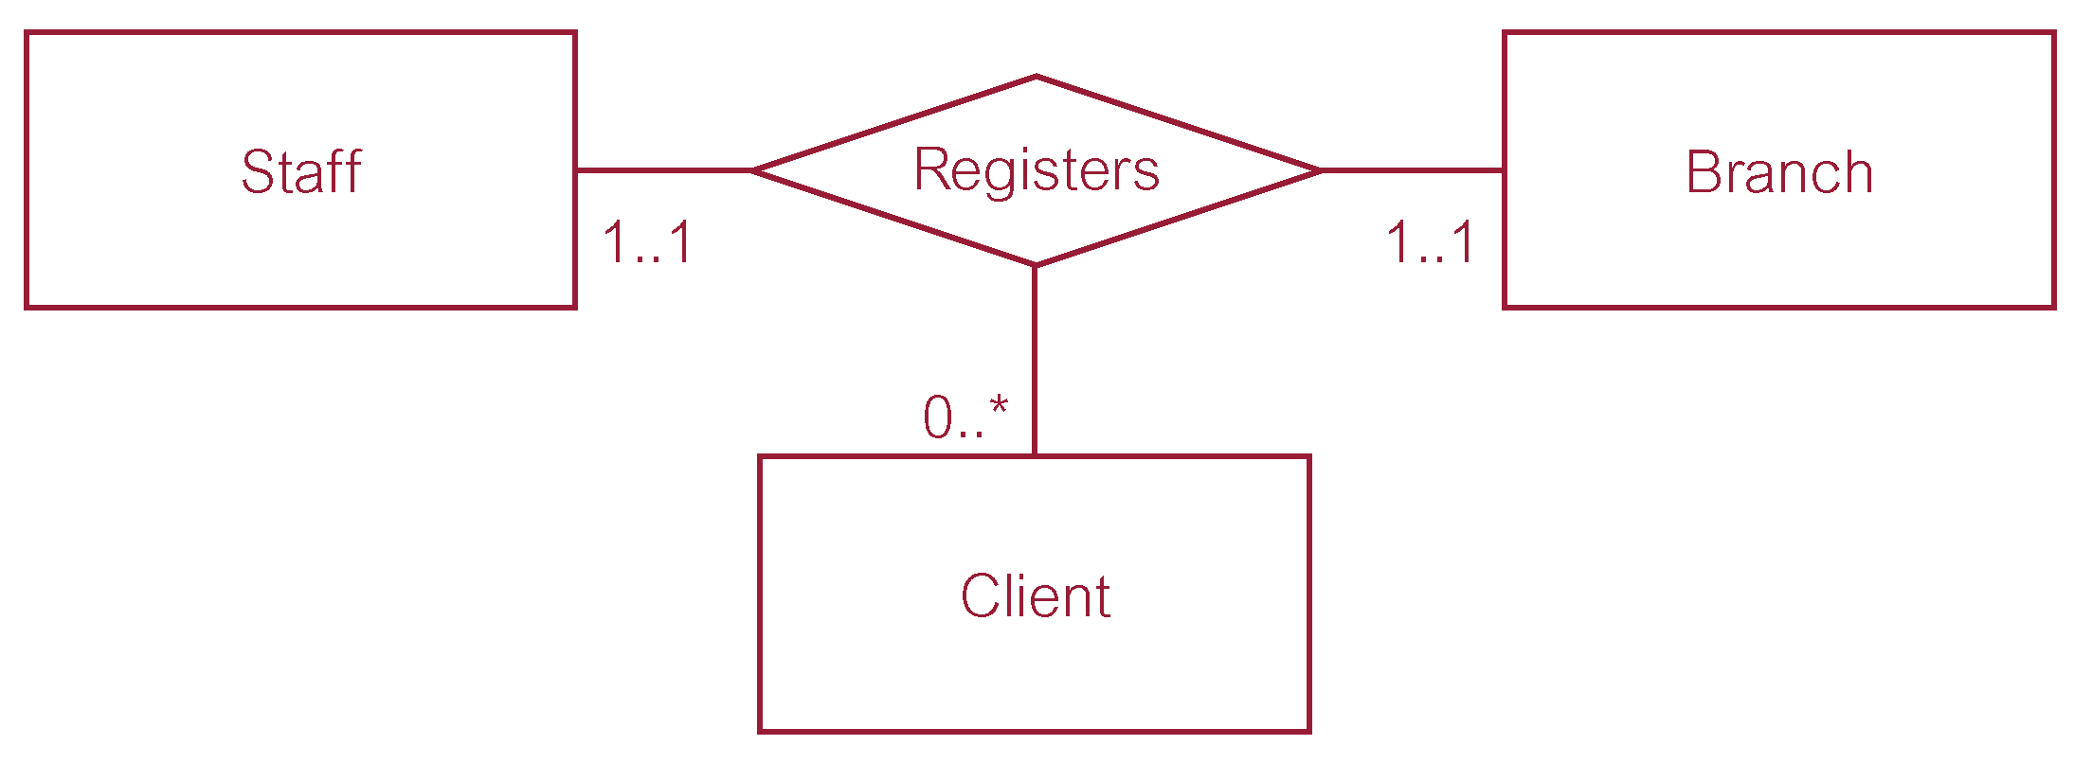
Multiplicity of ternary Registers relationship

Slide 34
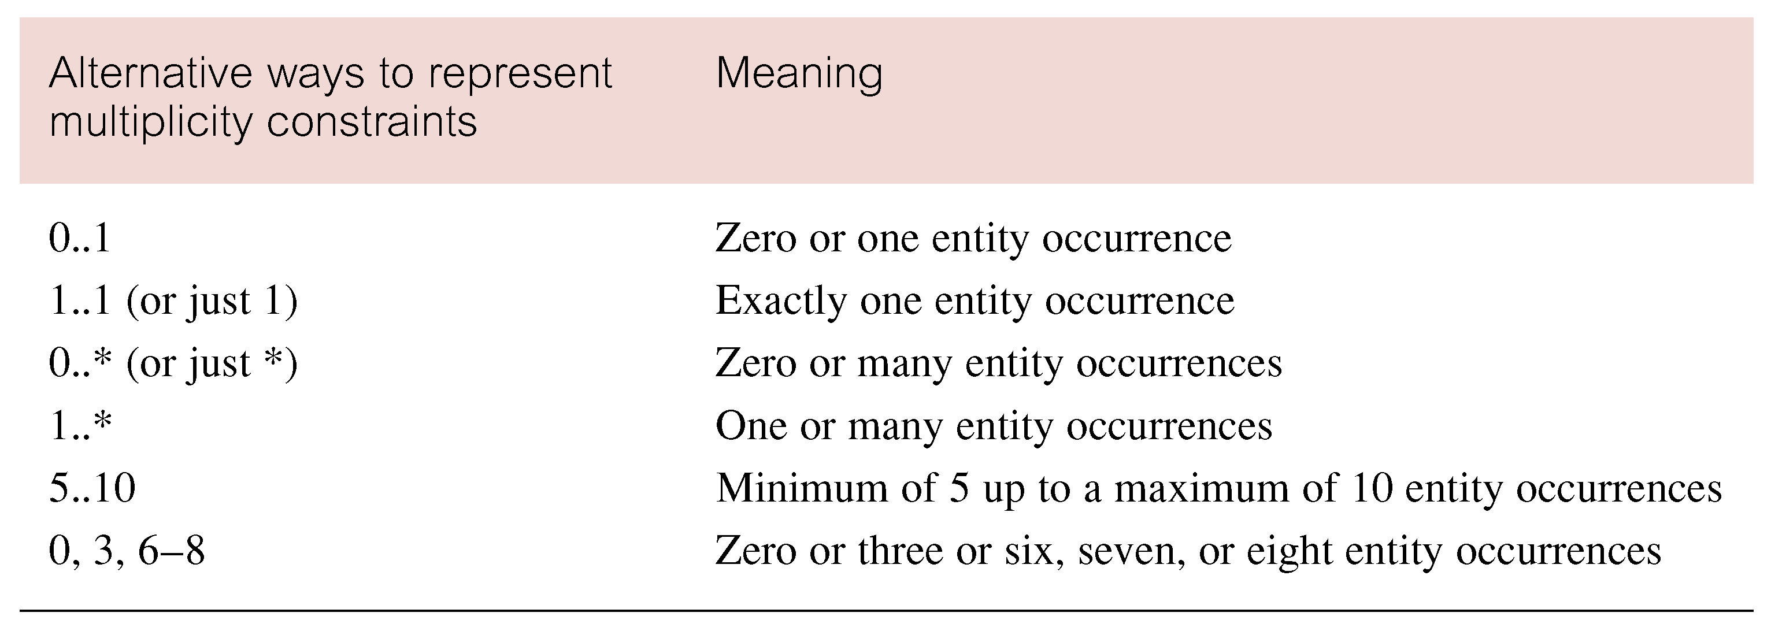
Summary of multiplicity constraints

Slide 35
Structural Constraints
Multiplicity is made up of two types of restrictions on relationships: cardinality and participation.
Cardinality
Describes maximum number of possible relationship occurrences for an entity participating in a given relationship type.
Participation
Determines whether all or only some entity occurrences participate in a relationship.

Slide 36
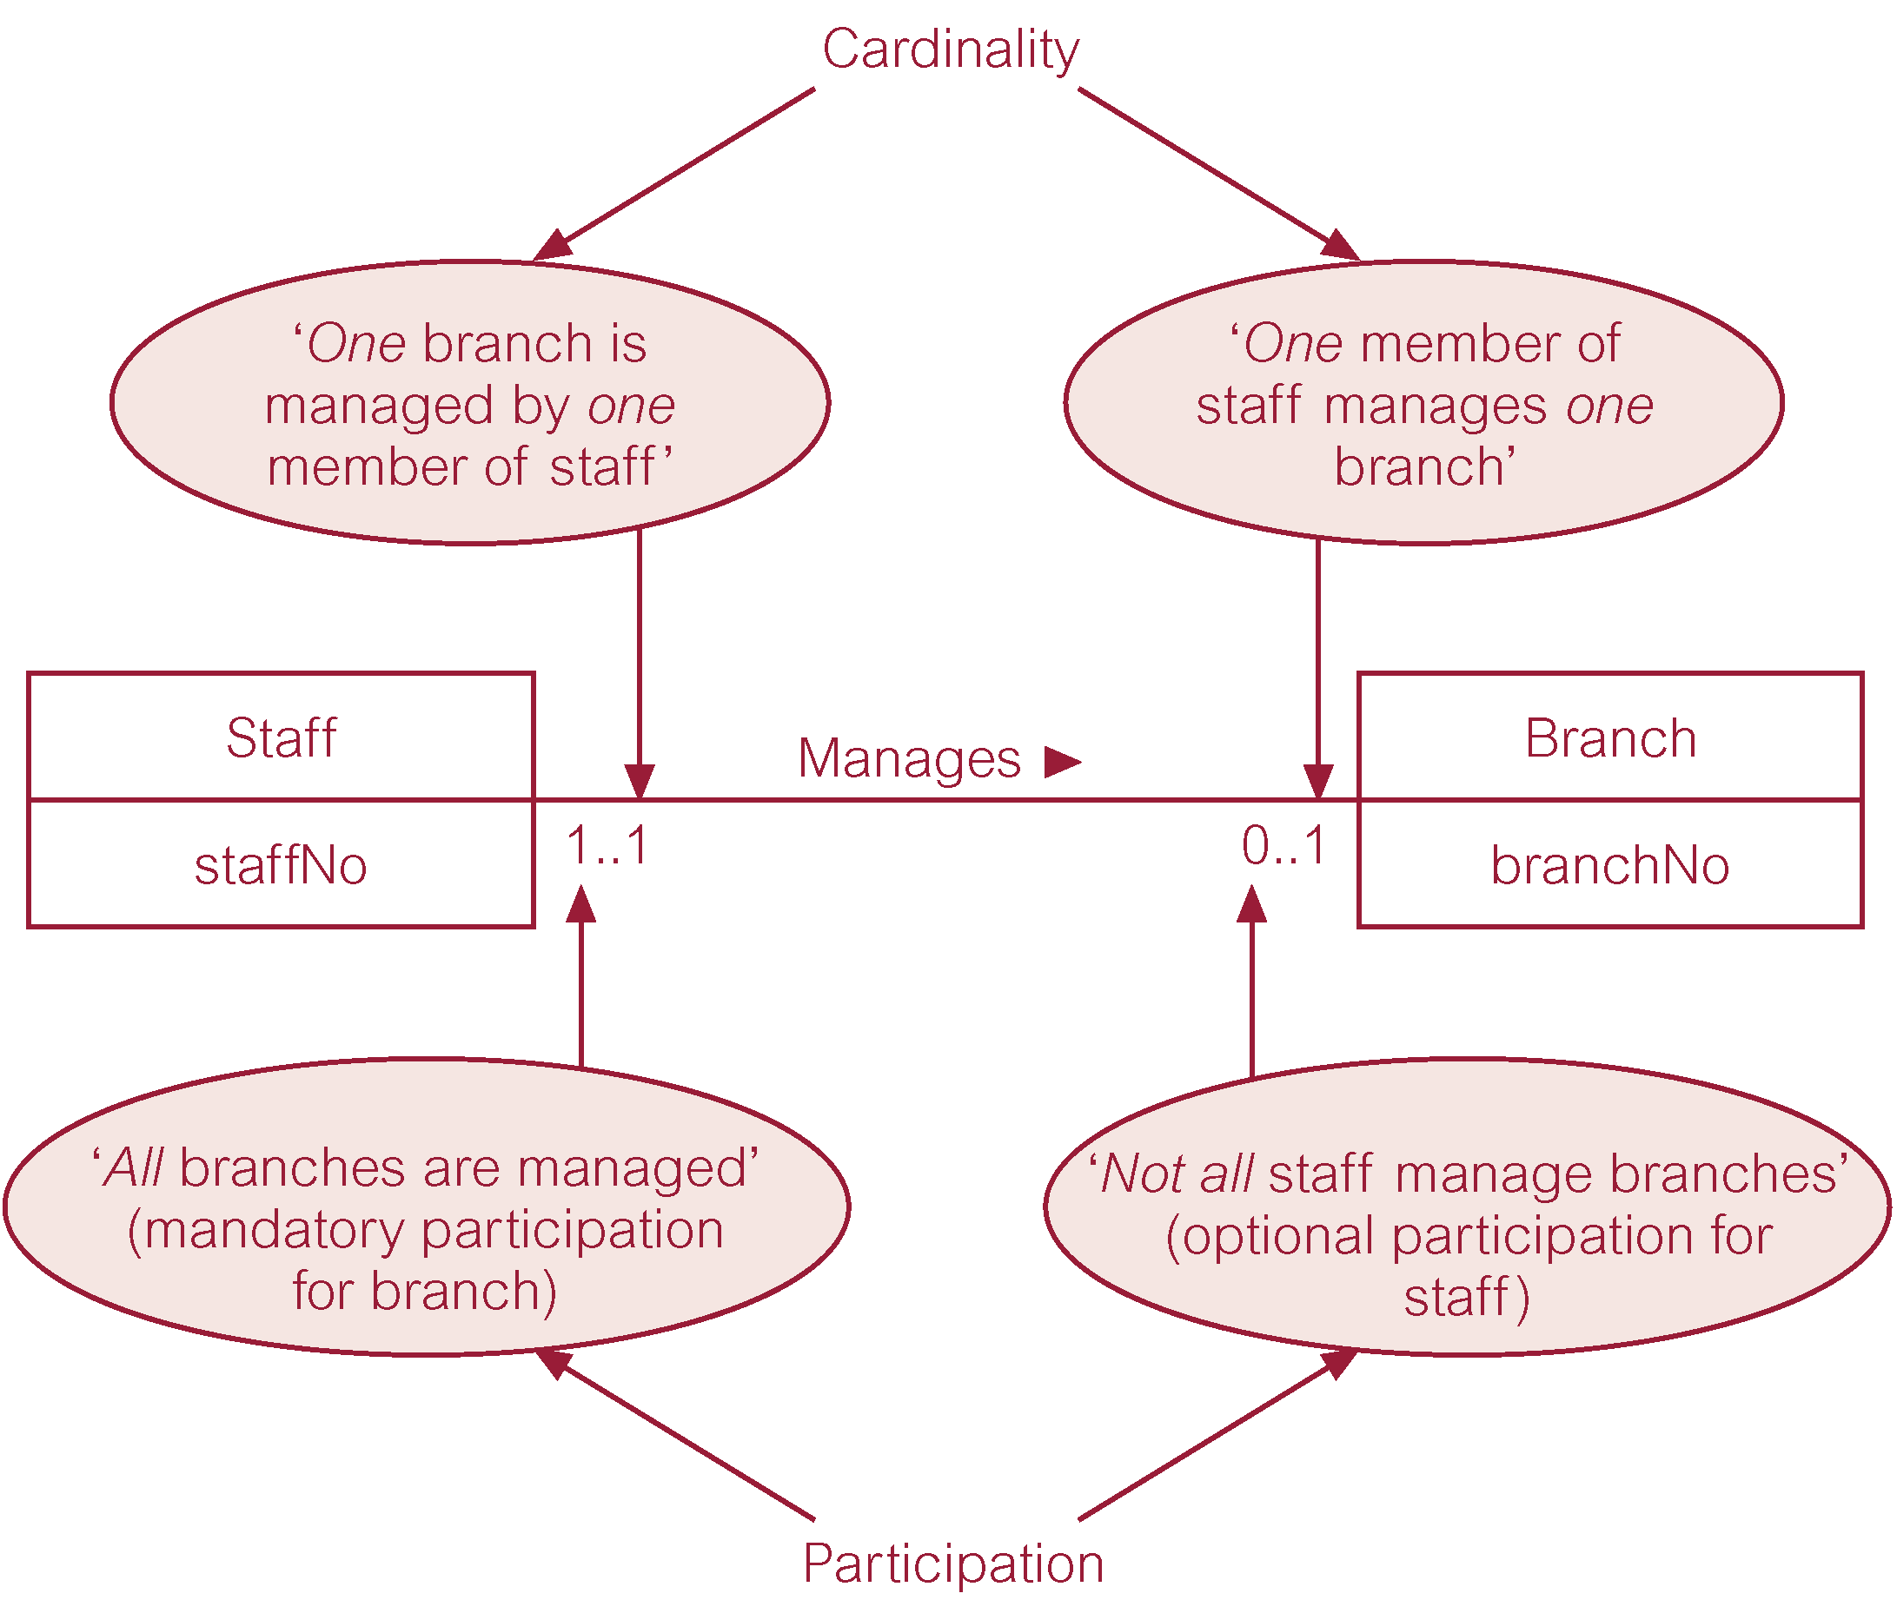
Multiplicity as cardinality and participation constraints

Slide 37
Problems with ER Models
Problems may arise when designing a conceptual data model called connection traps.
Often due to a misinterpretation of the meaning of certain relationships.
Two main types of connection traps are called fan traps and chasm traps.
Fan Trap
Where a model represents a relationship between entity types, but pathway between certain entity occurrences is ambiguous.
Chasm Trap
Where a model suggests the existence of a relationship between entity types, but pathway does not exist between certain entity occurrences.

Slide 38

An Example of a Fan Trap

Slide 39
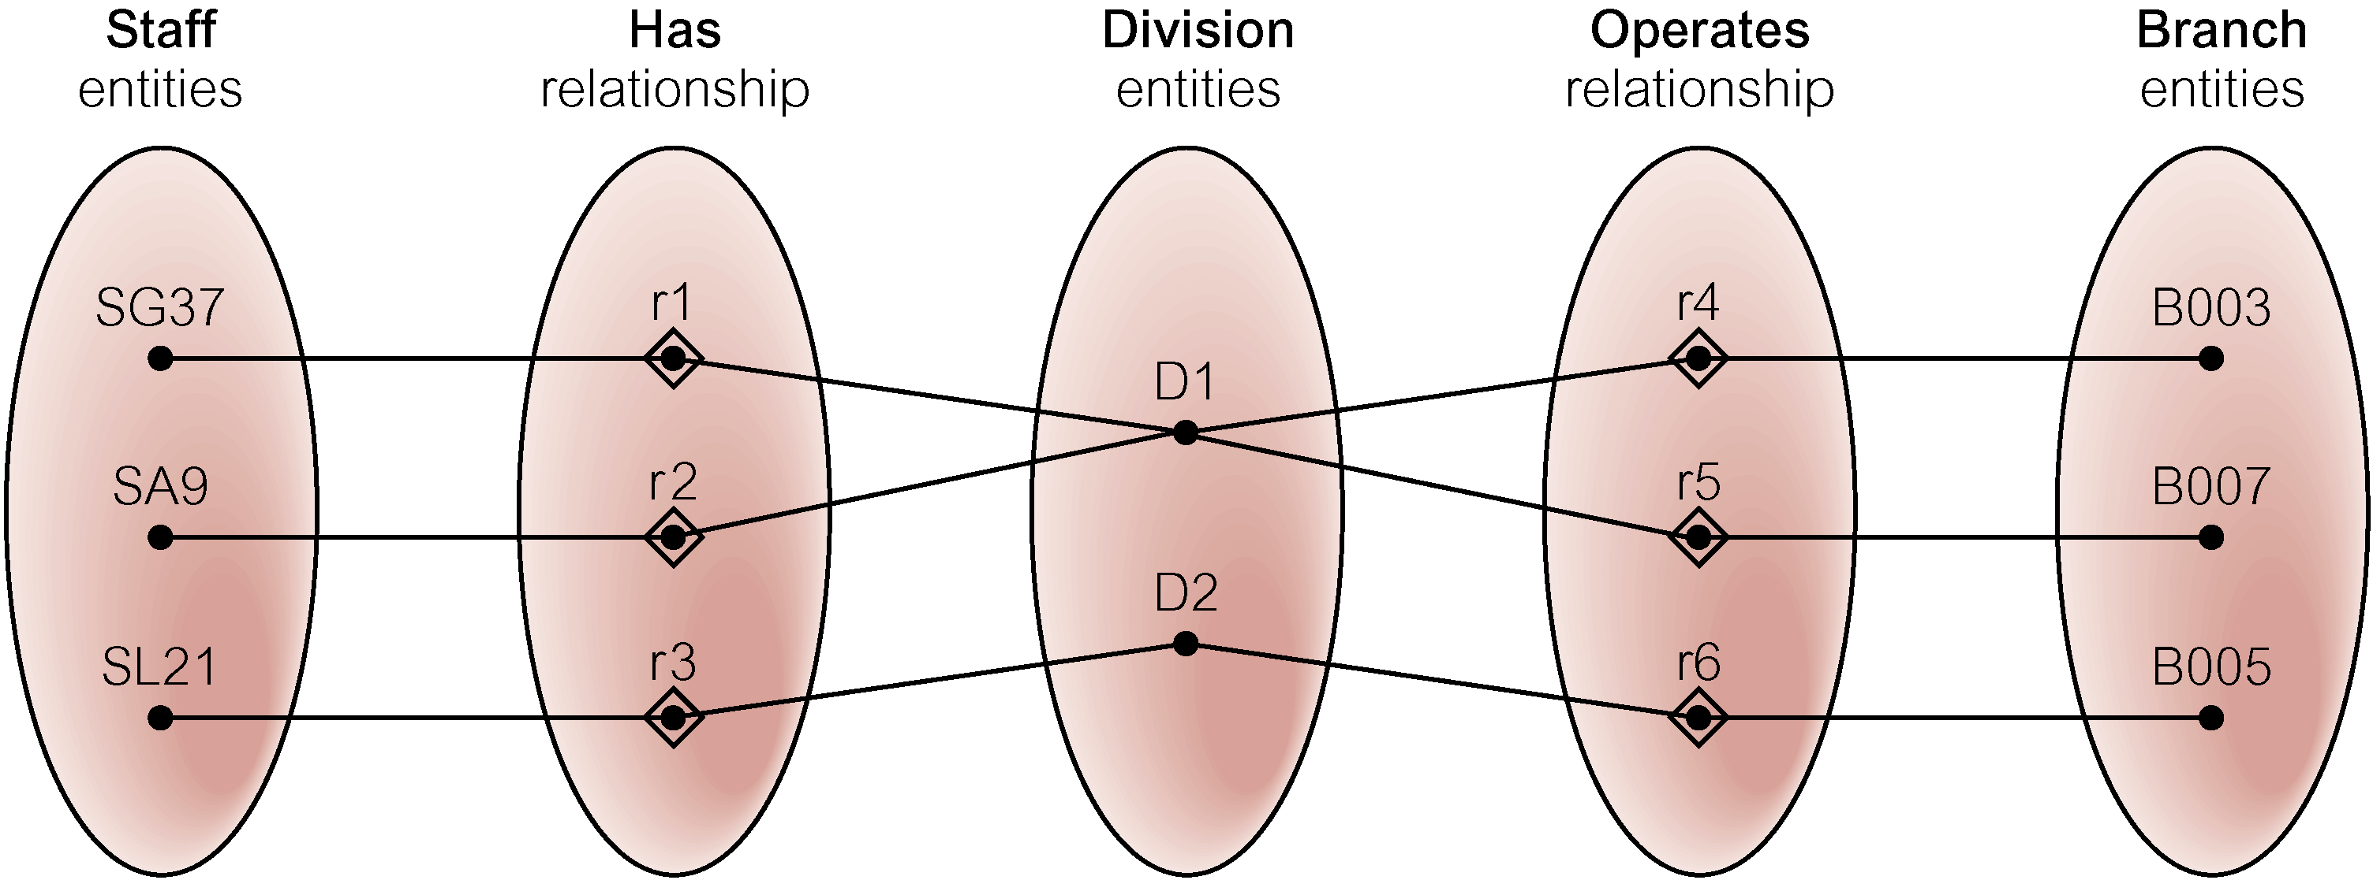
Semantic Net of ER Model with Fan Trap
At which branch office does staff number SG37 work?

Slide 40
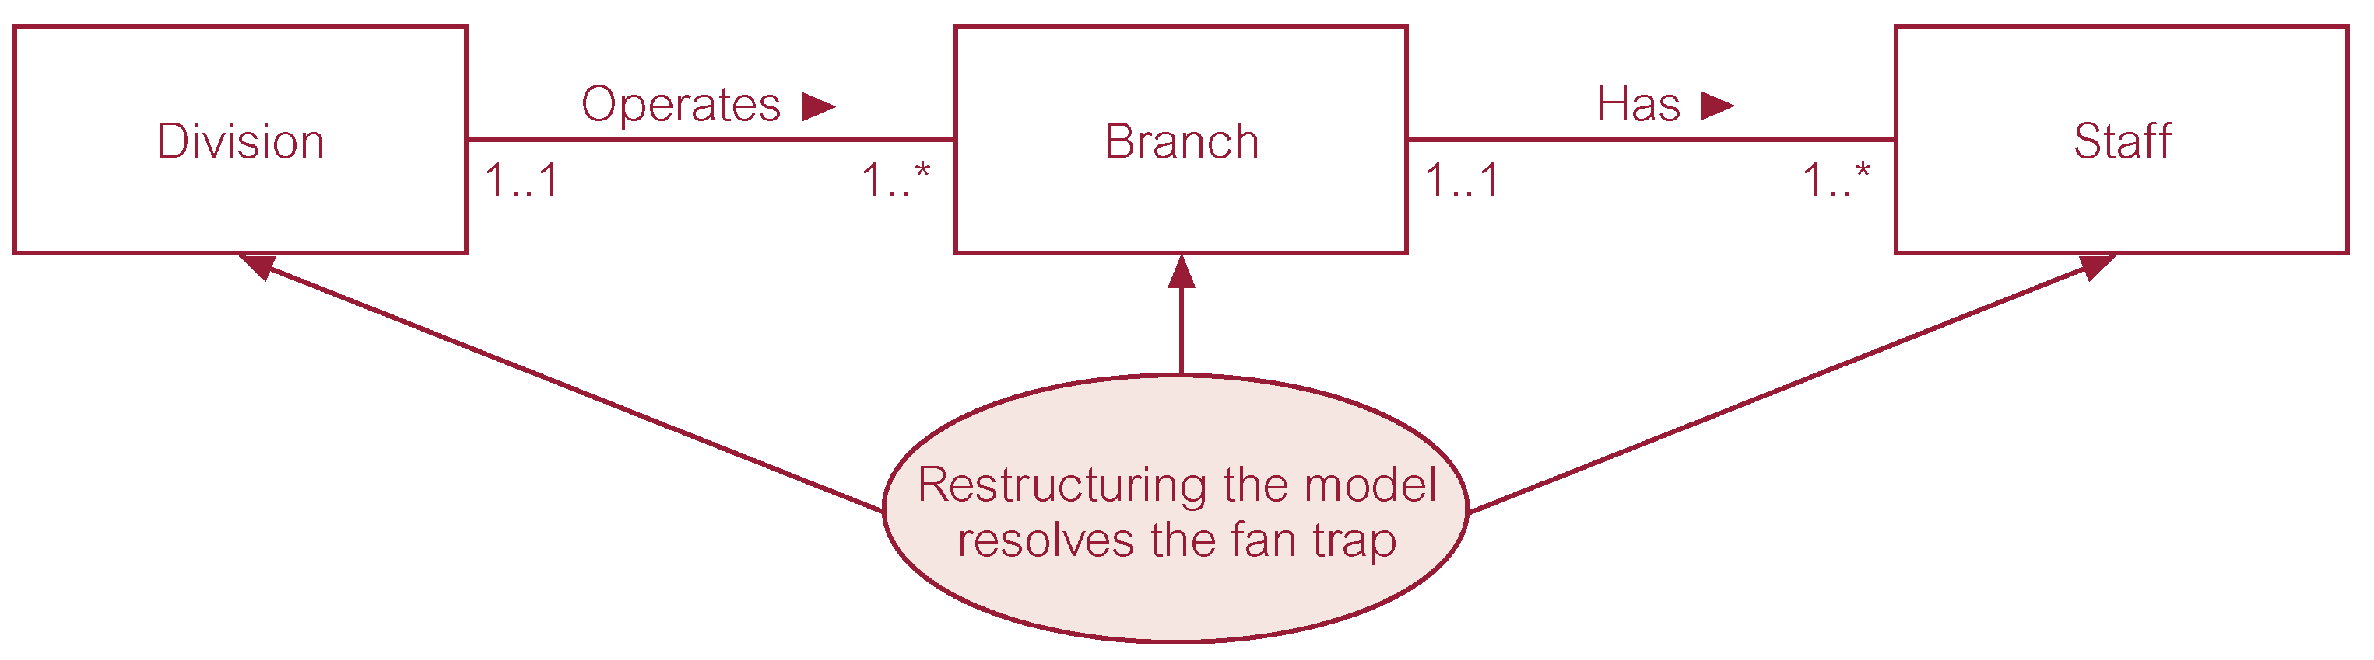
Restructuring ER model to remove Fan Trap

Slide 41
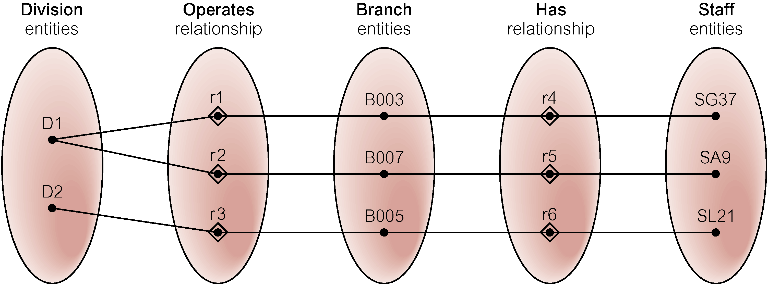
Semantic Net of Restructured ER Model with Fan Trap Removed
SG37 works at branch B003.

Slide 42

An Example of a Chasm Trap

Slide 43
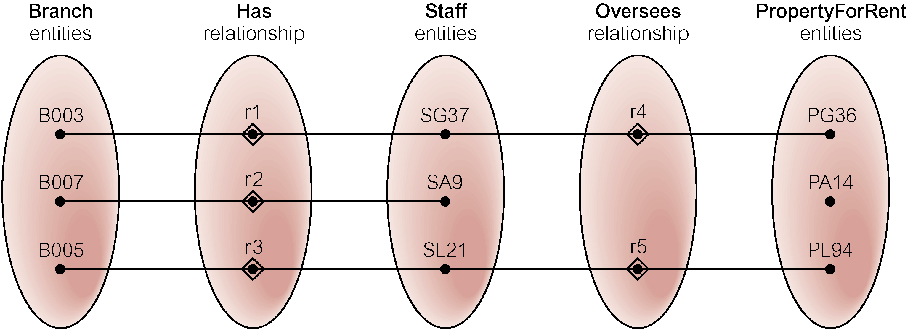
Semantic Net of ER Model with Chasm Trap
At which branch office is property PA14 available?

Slide 44
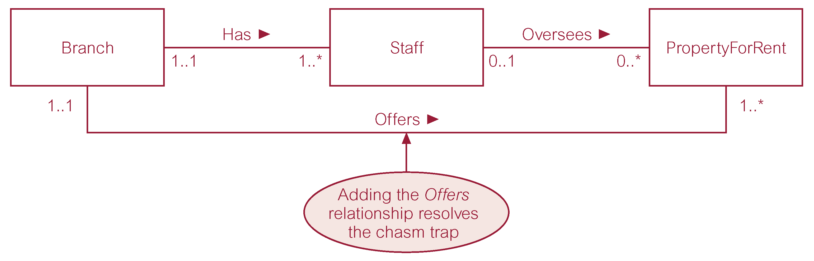
ER Model restructured to remove Chasm Trap

Slide 45
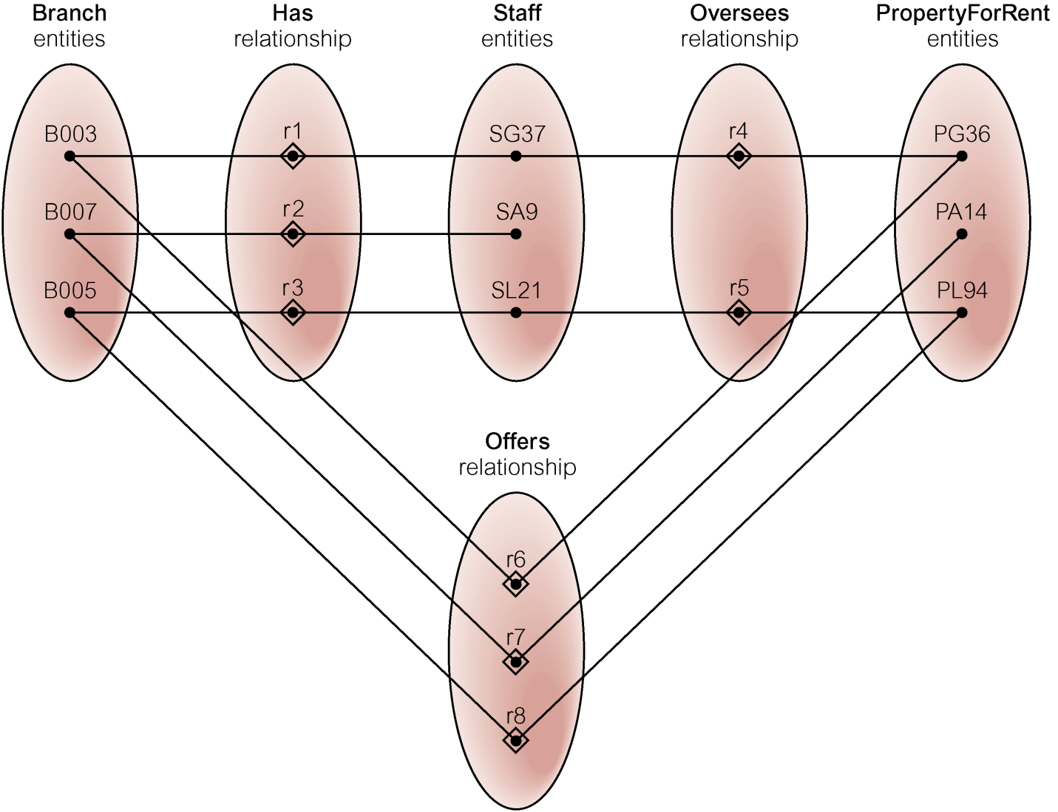
Semantic Net of Restructured ER Model with Chasm Trap Removed

Slide 46
Chapter 13 - Outline
Limitations of basic concepts of the ER model and requirements to represent more complex applications using additional data modeling concepts.
Most useful additional data modeling concept of Enhanced ER (EER) model is called specialization/generalization.
A diagrammatic technique for displaying specialization/generalization in an EER diagram using UML.

Slide 47
Enhanced Entity-Relationship Model
Since 1980s there has been an increase in emergence of new database applications with more demanding requirements.
Basic concepts of ER modeling are not sufficient to represent requirements of newer, more complex applications.
Response is development of additional ‘semantic’ modeling concepts.
Semantic concepts are incorporated into the original ER model and called the Enhanced Entity-Relationship (EER) model.
Examples of additional concept of EER model is called specialization / generalization.

Slide 48
Specialization / Generalization
Superclass
An entity type that includes one or more distinct subgroupings of its occurrences.
Subclass
A distinct subgrouping of occurrences of an entity type.
Superclass/subclass relationship is one-to-one (1:1).
Superclass may contain overlapping or distinct subclasses.
Not all members of a superclass need be a member of a subclass.

Slide 49
Specialization / Generalization
Attribute Inheritance
An entity in a subclass represents same ‘real world’ object as in superclass, and may possess subclass-specific attributes, as well as those associated with the superclass.
Specialization
Process of maximizing differences between members of an entity by identifying their distinguishing characteristics.
Generalization
Process of minimizing differences between entities by identifying their common characteristics.

Slide 50
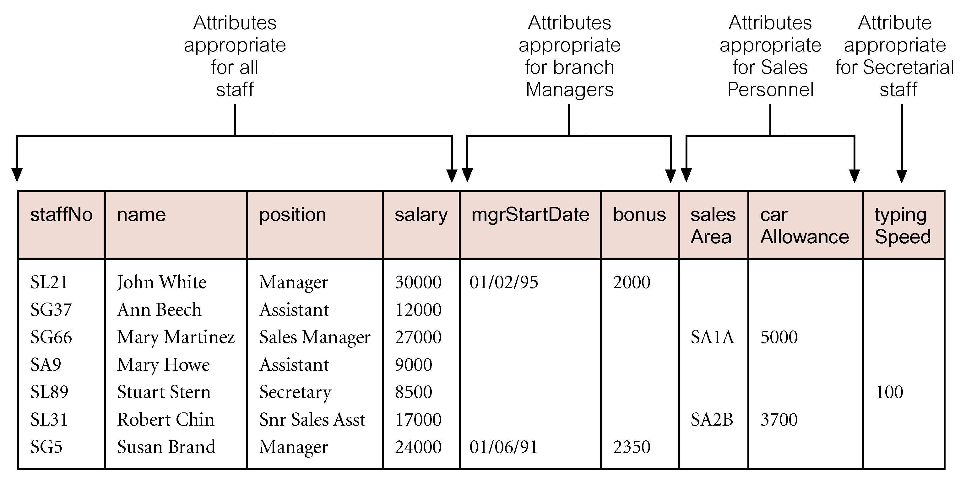
AllStaff relation holding details of all staff

Slide 51
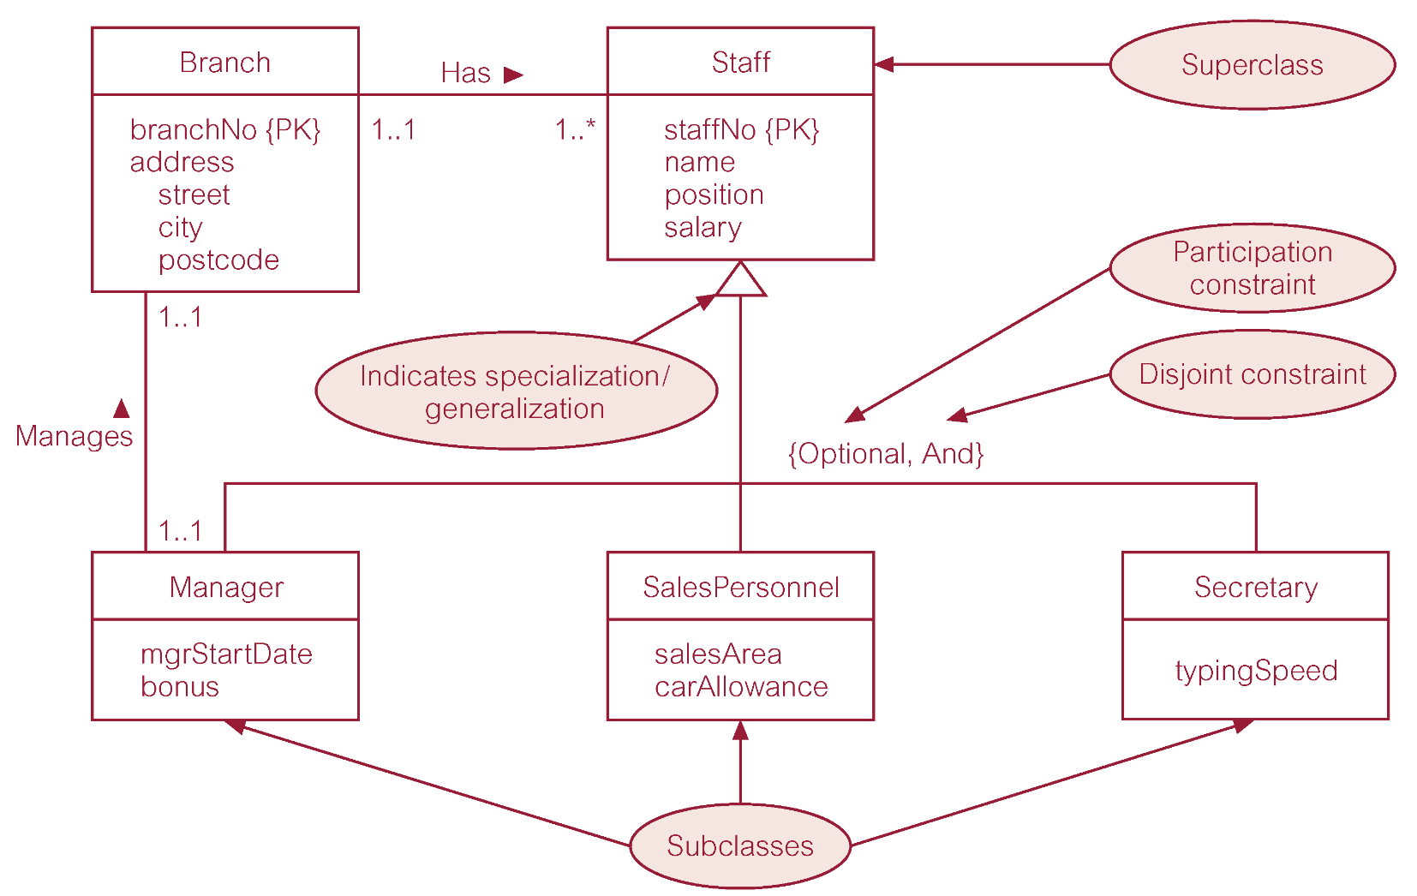
Specialization/generalization of Staff entity into subclasses representing job roles

Slide 52
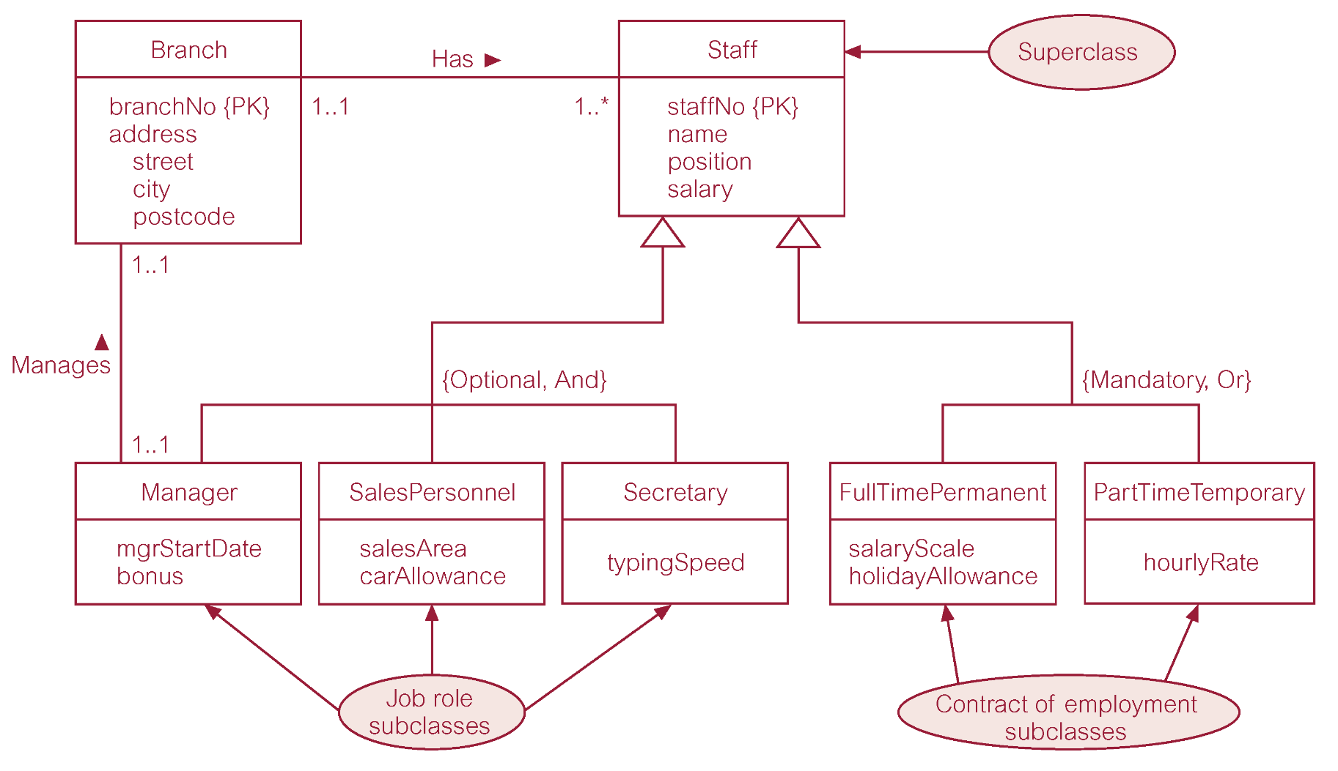
Specialization/generalization of Staff entity into job roles and contracts of employment

Slide 53
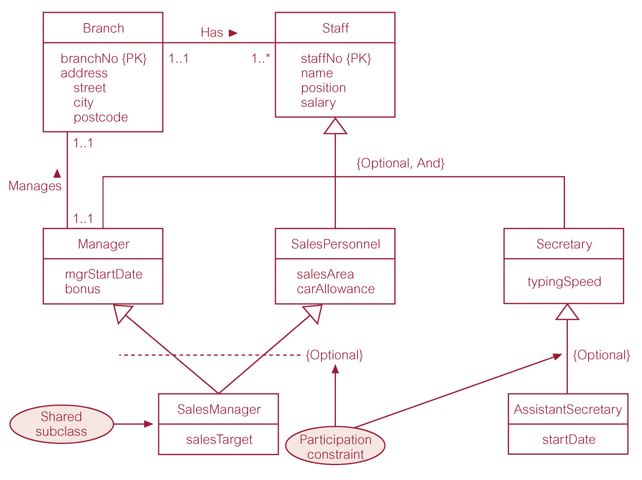
EER diagram with shared subclass and subclass with its own subclass

Slide 54
Constraints on Specialization / Generalization
Two constraints that may apply to a specialization/generalization:
participation constraints
disjoint constraints.
Participation constraint
Determines whether every member in superclass must participate as a member of a subclass.
May be mandatory or optional.

Slide 55
Constraints on Specialization / Generalization
Disjoint constraint
Describes relationship between members of the subclasses and indicates whether member of a superclass can be a member of one, or more than one, subclass.
May be disjoint or nondisjoint.
There are four categories of constraints of specialization and generalization:
mandatory and disjoint
optional and disjoint
mandatory and nondisjoint
optional and nondisjoint.

Slide 56
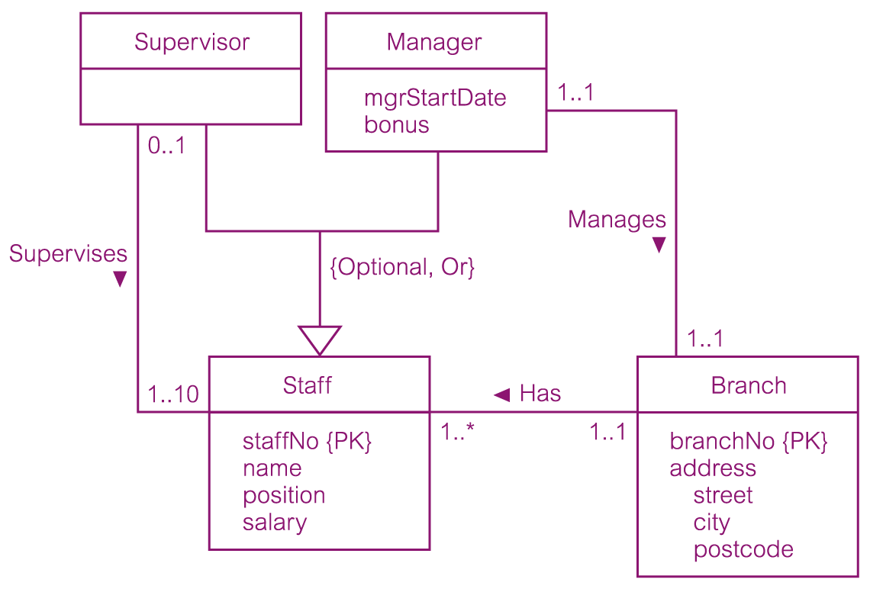
DreamHome worked example - Staff Superclass with Supervisor and Manager subclasses

Slide 57
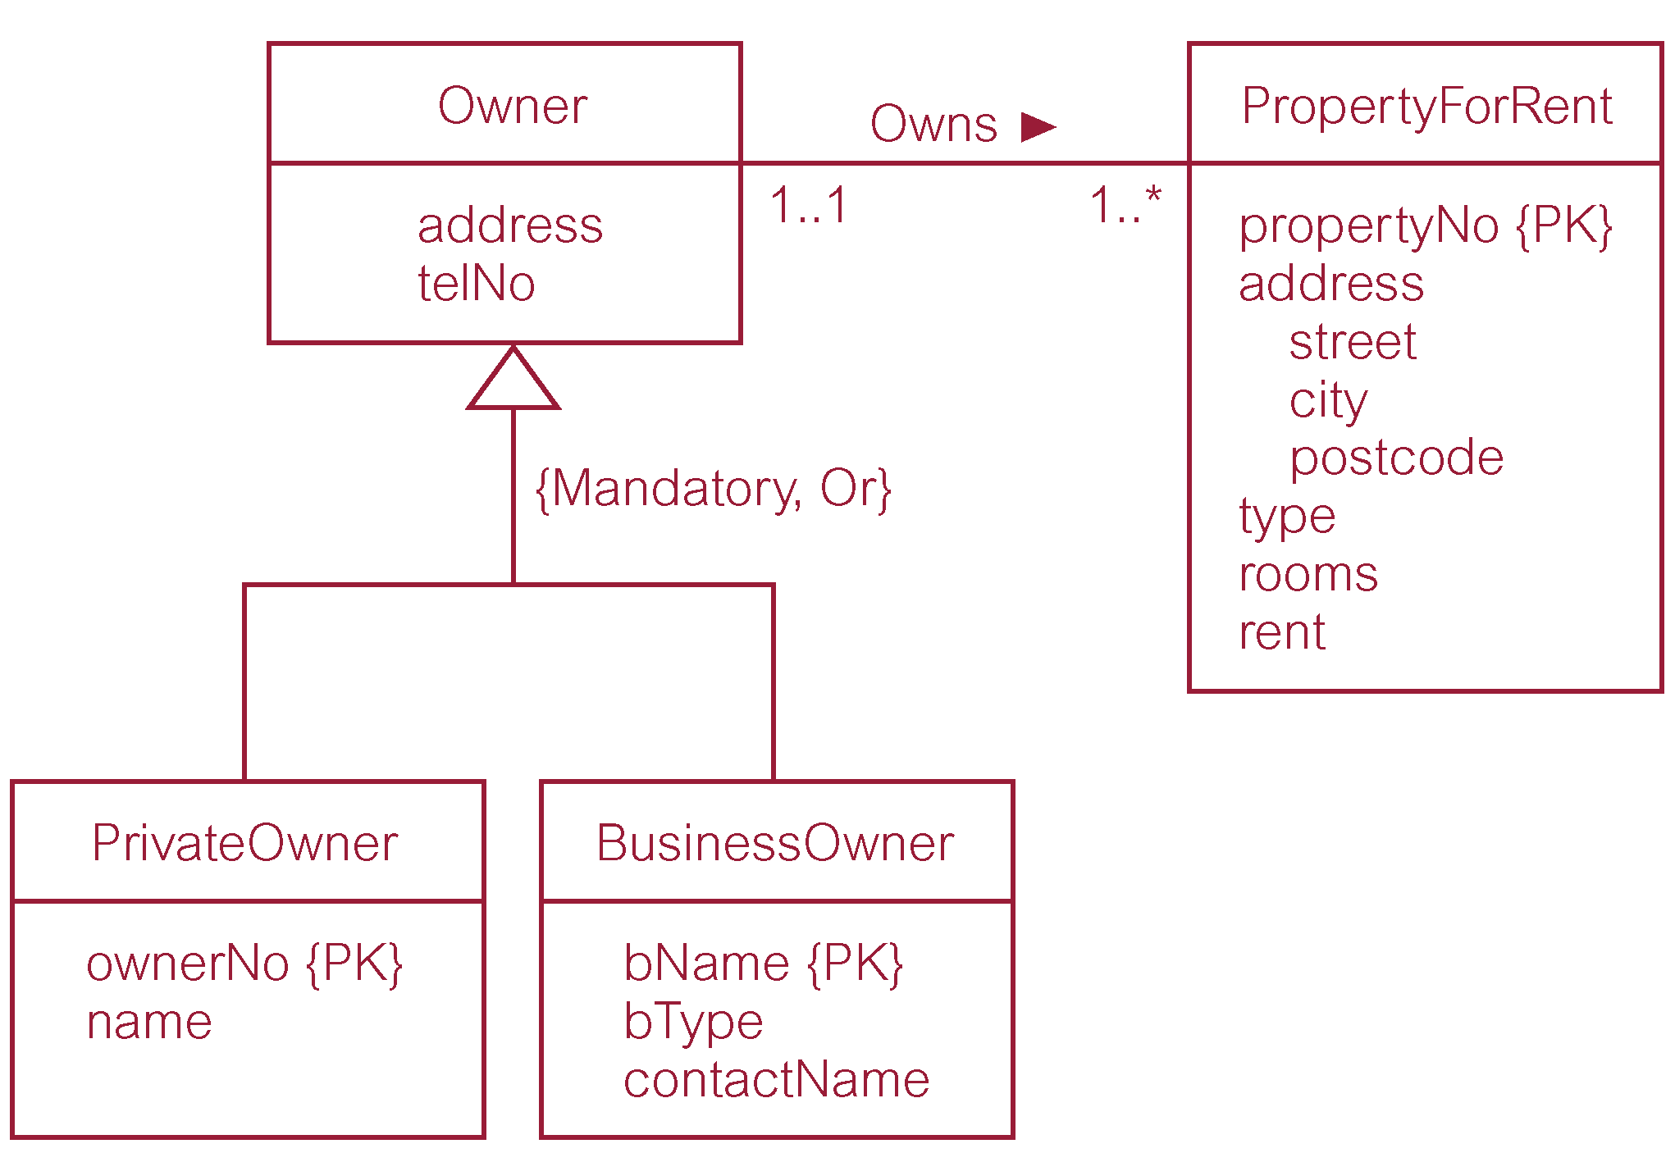
DreamHome worked example - Owner Superclass with PrivateOwner and BusinessOwner subclasses

Slide 58
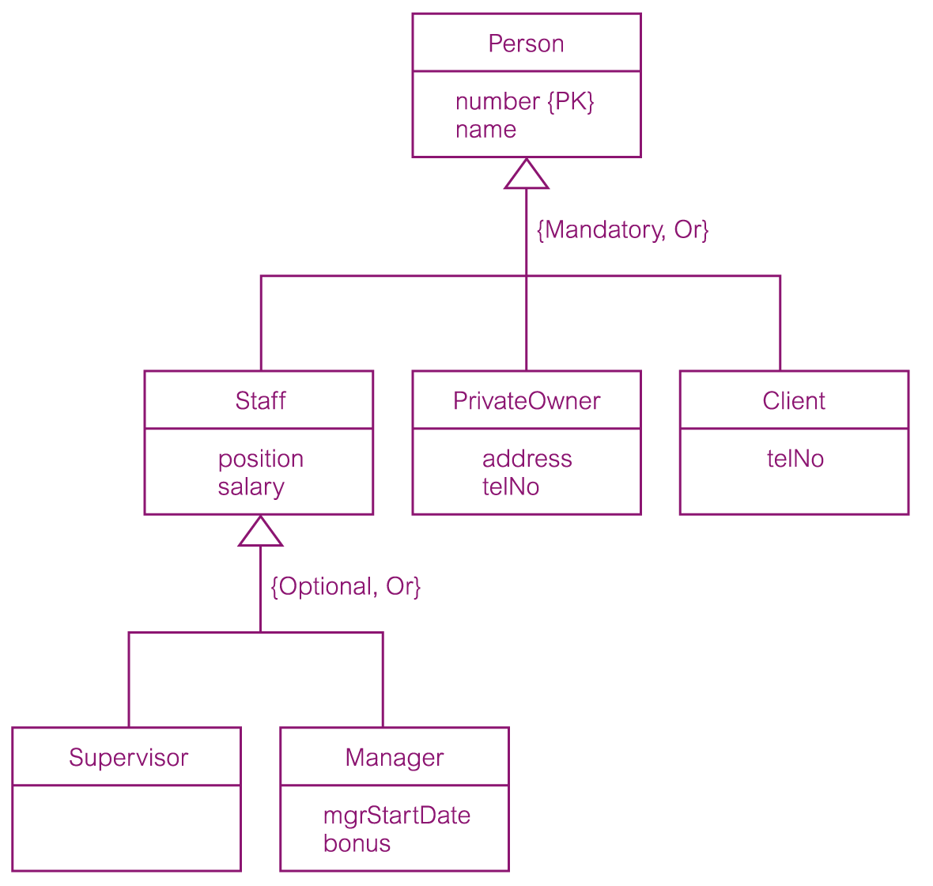
DreamHome worked example - Owner Superclass with PrivateOwner and BusinessOwner subclasses

