Slide 1
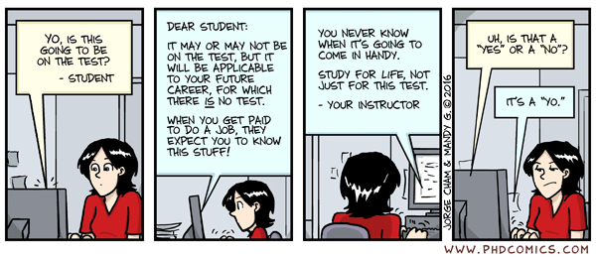
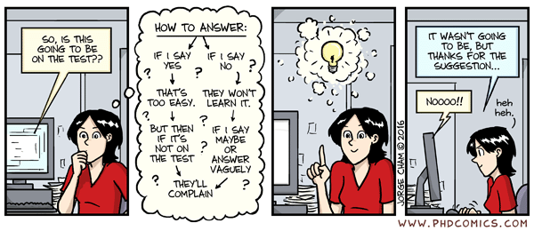
Comic of the day

Slide 2

CSE 204 - INTRO TO Database Systems Midterm Information
Joseph LEDET
Department of Computer Engineering
Akdeniz University
josephledet@akdeniz.edu.tr

Slide 3
DATE/TIME/LOCATION
Date
Friday 18-April-2025
Time
14:30 - 16:00
Location
YazLab 1, YazLab 2, YazLab 3

Slide 4
GRADING INFORMATION
100 points
Represents 20% of Final grade

Slide 5
Topics Covered
All topics discussed in class up to Week 7
Relational Model
SQL
DB System Development
DB Analysis
E-R Modeling
Normalization

Slide 6
Format
Short answer questions
Define important terms
Give Examples
Problems
Write SQL statements
Analyze an E-R diagram
Understand traps
Know how to normalize a dataset
Long answer questions
Explain important concepts

Slide 7
FINAL NOTE
Closed
Book
Notes
Phone
Computer
Electrical Devices
Mouth
Open
Mind
1 “Cheat Sheet” is allowed
Size A-4 paper (1)
Must be handwritten
Anything printed/photocopied will be taken

