Slide 1
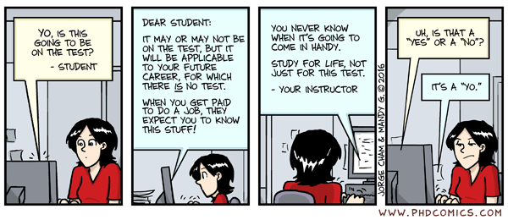
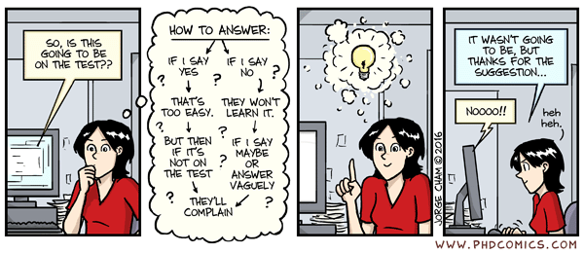
Comic of the day

Slide 2

CSE 102 - COMPUTER PROGRAMMING II Final Exam Information
Joseph LEDET
Department of Computer Engineering
Akdeniz University
josephledet@akdeniz.edu.tr

Slide 3
Outline
Exam format
Review material
Questions

Slide 4
DATE/TIME/LOCATION
Date
Friday 08-June-2022
Time
13:30
Location
Amfi3, Amfi4, BB04

Slide 5
GRADING INFORMATION
100 points
Represents 40% of Final grade

Slide 6
Topics Covered
All topics discussed in class
Everything from beginning of semester to Midterm Exam
Text
Generics
Data Structures
Sets and Maps
Efficient Algorithms
Topics from previous courses

Slide 7
Format
Quick Answer Questions
Multiple Choice
True/False
Matching
Program Flow
What is the output of a loop/method?
What is the return value of a method?
Will an Exception occur?
Implement a System/Class/Method
UML diagram
Write code

Slide 8
Multiple choice
What will be the value of the following expression?
1 + 2 * 3 + 4
11
11.0
13
13.0
None of the above

Slide 9
Multiple choice
The values passed to a method are called the method’s ______________.
return values
arguments (or parameters)
local variables
identifiers
iterators

Slide 10
True/False
always
A method must always return a value. -> false
The methods println() and next() are useful methods for displaying output to the screen and gaining input from the user and can be used in a program using the System.out and Scanner classes, respectively. -> true
!true -> false
i++ == ++i -> evaluates as false
++i == i++ -> evaluates as true

Slide 11
Matching
Item | Definition
1) /* | A. Logical AND
2) && | B. Begins a comment
3) // | C. Test for equality
4) = | D. Assigns a new value
5) ==

Slide 12
What is the output?
Able to tell what the value of a variable will be at various points
Able to tell program flow through
if-else statements
Loops
Exceptions
finally always executes
Able to tell the O complexity of a code segment

Slide 13
Short program fragment
Write a short fragment to do some task
Know how to
Write a method
Use recursion or iteration
Throw an exception
Use the methods (including constructors) of a parent class
Use a Set or a Map

Slide 14
Develop a System
Determine sub-problems
Analyze a UML diagram
Implement in Java code
Examples
A Map that accepts strings and birth months
A University that has Teachers, Students and Courses

Slide 15
FINAL NOTE
Closed
Book
Notes
Phone
Computer
Electrical Devices
Mouth
Open
Mind
1 “Notes Sheet” is allowed
Size A-4 paper (1)
Must be handwritten
Anything printed/photocopied will be not counted

Slide 16
Questions
[?]

