Slide 1
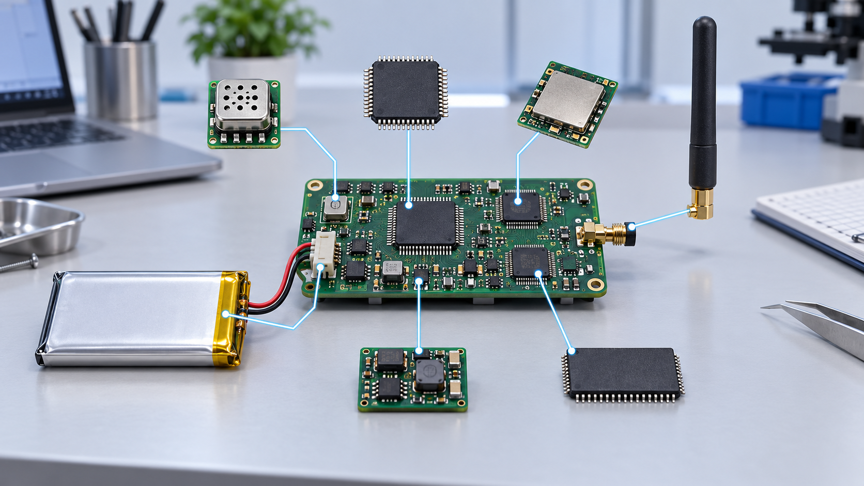
CSE 427 Wireless Sensor Networks
Week 1 — Introduction &
Hardware Anatomy
Instant Contiki 3.0
Cooja
VMware VM
Theme of the week: small devices, real-world uncertainty, and evidence-driven simulation.
CSE 4th Year • Wireless Sensor Networks • Week 1
01

Slide 2
BY THE END OF WEEK 1
Learning outcomes
Define a WSN and distinguish it from generic Wi‑Fi or cloud-only IoT.
Explain why WSN design is constrained by energy, memory, radio uncertainty, and deployment conditions.
Classify common WSN applications by reporting pattern and physical domain.
Draw and explain a mote hardware architecture.
Start a simple Cooja simulation in Instant Contiki 3.0 and identify basic windows.
Evaluation in Week 1 should check vocabulary, mental model, and tool readiness.
CSE 4th Year • Wireless Sensor Networks • Week 1
05

Slide 3
FOUNDATION AND CORE PROTOCOLS
Course distribution: Weeks 1–7
Week
Topic
Main focus
1
Introduction & Hardware Anatomy
WSN concepts, applications, mote architecture, Cooja setup
2
Radio & Physical Layer
Path loss, shadowing, fading, RSSI/LQI/PRR, IEEE 802.15.4 PHY
3
Energy
Radio states, idle listening, Energest, battery lifetime, harvesting
4
MAC I: Contention-Based
Hidden/exposed terminals, B-MAC, X-MAC, ContikiMAC, RI-MAC
5
MAC II: Scheduled & Hybrid
TDMA, graph coloring, TSCH, Orchestra, 6TiSCH, industrial MACs
6
Naming, Addressing & 6LoWPAN
Data names, IPv6 adaptation, compression, fragmentation, CoAP/MQTT-SN
7
Routing I: Collection & RPL
Collection trees, ETX, DODAGs, Trickle, storing vs. non-storing
The first half builds the protocol stack from hardware upward.
CSE 4th Year • Wireless Sensor Networks • Week 1
06

Slide 4
SUGGESTED CONTINUATION
Course distribution: Weeks 8–14
Week
Topic
Main focus
8
Routing II: Robustness & Mobility
Repair, multipath, mobility, opportunistic forwarding
9
Transport & Reliability
End-to-end vs hop-by-hop reliability, congestion, queues
10
Time Synchronization
Clock drift, synchronization protocols, timestamped sensing
11
Security Foundations
Threat model, cryptographic primitives, key management constraints
12
Secure WSN Protocols
Link-layer security, secure routing, jamming, node compromise
13
Data Processing & Edge Intelligence
Aggregation, compression, anomaly detection, edge decisions
14
Integration & Project Demo
Experiment design, reproducibility, final review, student demos
Later weeks connect protocols to reliability, security, data, and reproducible experiments.
CSE 4th Year • Wireless Sensor Networks • Week 1
07

Slide 5
HOW LABS WILL WORK
Course workflow: theory → simulation → evidence
S2
GW
R1
Cloud
S1
Theory: name the mechanism and its assumptions.
Simulation: create a controlled case in Cooja.
Measurement: inspect logs, packets, timing, and topology.
Reflection: explain what changed and why.
A simulation screenshot is not a result; an interpreted measurement is a result.
CSE 4th Year • Wireless Sensor Networks • Week 1
08

Slide 6

01
WSN mindset
A sensor network is not a normal network made smaller. It is computation attached to a physical environment.
CSE 4th Year • Wireless Sensor Networks • Week 1
09

Slide 7
DEFINITION
What is a Wireless Sensor Network?
A WSN consists of spatially distributed embedded nodes that sense, process, and communicate wirelessly.
Nodes are usually called sensor nodes or motes.
A sink, gateway, or border router collects data and connects the WSN to users or other networks.
Most WSN traffic is small, periodic or event-driven, and strongly constrained by energy.
Think of WSNs as measurement infrastructure, not as general-purpose mobile devices.
CSE 4th Year • Wireless Sensor Networks • Week 1
10

Slide 8
RELATED BUT NOT IDENTICAL
WSN, IoT, and cyber-physical systems
WSN: focuses on sensing and wireless embedded networking.
IoT: connects physical devices to Internet services and applications.
Cyber-physical system: digital computation monitors or controls a physical process.
A WSN may be part of an IoT or CPS architecture, but it can also operate locally.
WSN is often the field layer: where measurements are born.
CSE 4th Year • Wireless Sensor Networks • Week 1
11

Slide 9
FROM MOTE TO APPLICATION
Reference architecture
S2
GW
R1
Cloud
S1
sensor nodes
multi-hop forwarding
gateway / sink
application / cloud
The gateway is the translation point between constrained wireless networking and ordinary computing infrastructure.
CSE 4th Year • Wireless Sensor Networks • Week 1
12

Slide 10
MENTAL MODEL
The path of one measurement
A sensor samples a physical quantity.
The microcontroller converts, filters, or formats the value.
The radio sends a small frame to a neighbor or gateway.
Intermediate motes may forward or aggregate the value.
The sink exports the result to a database, dashboard, or controller.
Every step has an energy, delay, reliability, and security cost.
CSE 4th Year • Wireless Sensor Networks • Week 1
13

Slide 11
STUDENTS SHOULD USE THESE PRECISELY
Core vocabulary
Term
Meaning
Mote
Small embedded sensor node with computation and radio
Sink / gateway
Collection point or bridge to another network
Neighbor
Node reachable over a wireless link
Topology
Current connectivity and forwarding structure
Duty cycle
Fraction of time a component is active
Event
Physical condition that triggers reporting
Precise vocabulary prevents “node, server, sensor, router” soup.
CSE 4th Year • Wireless Sensor Networks • Week 1
14

Slide 12
WHY THE COURSE EXISTS
Constraint landscape
Radio loss
Scale
Energy
Memory
Deployment
Security
WSN design is multi-objective: improving one dimension often hurts another.
CSE 4th Year • Wireless Sensor Networks • Week 1
15

Slide 13
MOST IMPORTANT PRACTICAL LIMIT
Constraint 1: energy
The radio can dominate consumption, especially through idle listening.
Battery replacement can be impossible, dangerous, or more expensive than the node.
Sleeping saves energy, but increases latency and rendezvous complexity.
Energy optimization must preserve useful sensing, not merely silence the node.
A mote that never wakes has excellent lifetime and zero usefulness.
CSE 4th Year • Wireless Sensor Networks • Week 1
16

Slide 14
EMBEDDED REALITY CHECK
Constraint 2: small memory and CPU
RAM is used by packet buffers, routing tables, stacks, queues, and application state.
Code size matters because firmware must fit into limited program memory.
Cryptography, routing, and logging are not free on constrained motes.
Designers often prefer compact state machines to heavy abstractions.
Students should learn to ask: “Where does this state live?”
CSE 4th Year • Wireless Sensor Networks • Week 1
17

Slide 15
THE CHANNEL HAS OPINIONS
Constraint 3: lossy wireless links
Received power changes with distance, obstacles, antenna orientation, and interference.
Links may be asymmetric: A hears B, but B may not hear A reliably.
Packet delivery is probabilistic in the transitional region.
Routing decisions should rely on measured link quality, not only geometry.
Distance is a clue, not a routing metric.
CSE 4th Year • Wireless Sensor Networks • Week 1
18

Slide 16
EVEN STATIC NODES CHANGE
Constraint 4: dynamic topology
Nodes may fail, reboot, lose power, or be added after deployment.
A link can degrade because of people, vehicles, doors, weather, or interference.
Protocols must discover neighbors and recover without manual reconfiguration.
Frequent topology repair consumes energy and may destabilize routing.
Self-organization is not luxury; it is survival.
CSE 4th Year • Wireless Sensor Networks • Week 1
19

Slide 17
SMALL NODES, LARGE SYSTEMS
Constraint 5: scale and density
A protocol that works with 5 nodes can fail with 500 nodes.
Flooding, broadcasts, and global state become expensive quickly.
Dense deployments increase overhearing, collisions, and duplicate information.
Large networks need hierarchy, aggregation, suppression, or localized control.
Scalability means limiting who must know, hear, store, and forward what.
CSE 4th Year • Wireless Sensor Networks • Week 1
20

Slide 18
APPLICATION-DEPENDENT PRESSURE
Constraint 6: reliability, timing, and security
Environmental monitoring may tolerate delay and occasional missing values.
Industrial alarms may require fast and reliable delivery.
Actuation links need stronger safety and authentication requirements.
Security mechanisms add computation, bytes, state, and key-management complexity.
There is no universal “best WSN protocol”.
CSE 4th Year • Wireless Sensor Networks • Week 1
21

Slide 19
02
Application taxonomy
Classify the application before choosing protocols. Traffic pattern and physical domain shape the design.
CSE 4th Year • Wireless Sensor Networks • Week 1
22

Slide 20
TRAFFIC GENERATION
Taxonomy by reporting pattern
Pattern
Description
Example
Periodic
Sensor reports every fixed interval
Soil moisture every 10 minutes
Event-driven
Node reports when condition occurs
Smoke, vibration spike, intrusion
Query-driven
Application asks for data when needed
Current temperature of room 301
Hybrid
Combines periodic, event, and query behavior
Machine status + alarm + diagnostics
Reporting pattern determines duty cycle, latency, and buffer requirements.
CSE 4th Year • Wireless Sensor Networks • Week 1
23

Slide 21
WHERE WSNS APPEAR
Taxonomy by domain
Environmental monitoring: weather, forests, rivers, air quality.
Agriculture: soil moisture, irrigation, livestock, greenhouse control.
Industrial systems: predictive maintenance, vibration, process monitoring.
Buildings and cities: occupancy, lighting, traffic, waste, infrastructure.
Energy systems: smart meters, grid monitoring, renewable integration.
The same sensor platform can need very different protocols in different domains.
CSE 4th Year • Wireless Sensor Networks • Week 1
24

Slide 22
SLOW DATA, HARSH DEPLOYMENT
Example: environmental monitoring
Often periodic and long-lived: measurements every minutes or hours.
Main constraints: battery life, weather protection, sparse connectivity.
Latency may be relaxed unless the system detects hazards such as fire or flood.
Data aggregation can reduce redundant transmissions from nearby sensors.
Design goal: survive long enough to make trends visible.
CSE 4th Year • Wireless Sensor Networks • Week 1
25

Slide 23
MEASUREMENT MEETS ACTUATION
Example: smart agriculture
Soil moisture and temperature readings support irrigation decisions.
Nodes may be solar-powered and exposed to dust, water, and heat.
Fields can create sparse topologies with gateways placed at edges.
Control actions such as valves require stronger reliability than routine sensing.
A missed temperature value is annoying; a wrong valve command is a problem.
CSE 4th Year • Wireless Sensor Networks • Week 1
26

Slide 24
RELIABILITY MATTERS
Example: industrial and smart grid monitoring
Measurements can include vibration, current, voltage, temperature, and equipment state.
Interference and metal structures can make radio behavior difficult.
Safety and availability may matter more than minimum energy.
Security requirements increase because data can affect operational decisions.
Industrial WSNs are where “just send a packet” has many formalities.
CSE 4th Year • Wireless Sensor Networks • Week 1
27

Slide 25
DIFFERENT RISK PROFILE
Monitoring versus control
Monitoring
Control / actuation
Observe physical state
Missing data may be tolerable
Examples: temperature, humidity, vibration logs
Change physical state
Incorrect commands can cause damage
Examples: valve, relay, motor, alarm
The moment a sensor network controls actuators, security and safety stop being “extra topics.”
CSE 4th Year • Wireless Sensor Networks • Week 1
28

Slide 26
PUTTING THE TAXONOMY TO WORK
Mini case: greenhouse WSN
Periodic: temperature and humidity every minute.
Event-driven: report overheating or irrigation failure immediately.
Query-driven: operator requests current battery level or last 24-hour trend.
Control: actuator nodes open vents or start irrigation.
Gateway: forwards measurements to a dashboard and logs commands.
which messages need reliability, low latency, or authentication?
CSE 4th Year • Wireless Sensor Networks • Week 1
29

Slide 27
03
Mote hardware anatomy
A mote is a whole embedded system: sensing, computation, radio, memory, power, and physical interfaces.
CSE 4th Year • Wireless Sensor Networks • Week 1
30

Slide 28
HARDWARE OVERVIEW
What is inside a mote?
Sensor interface: converts a physical signal into data.
Microcontroller: runs the OS, application, and protocol stack.
Radio transceiver: sends and receives wireless frames.
Memory: stores code, buffers, tables, and measurements.
Power subsystem: battery, regulation, sleep states, and sometimes harvesting.
A mote is not “a sensor”; it is a constrained networked computer with sensors attached.
CSE 4th Year • Wireless Sensor Networks • Week 1
31

Slide 29
HARDWARE AS DATA FLOW
Mote block diagram
Memory
Sensors
ADC
MCU
Radio
Antenna
Power
Sensors create raw evidence.
The MCU decides when and what to transmit.
The radio and power subsystem dominate lifetime questions.
CSE 4th Year • Wireless Sensor Networks • Week 1
32

Slide 30
THE NODE’S TINY BRAIN
Microcontroller
Executes Contiki processes, drivers, protocol logic, and application code.
Controls sensors, timers, radio, LEDs, and peripheral interfaces.
Uses low-power modes when no task is ready.
Limited clock speed and RAM force careful C programming and bounded buffers.
The MCU is powerful enough for networking, not powerful enough for waste.
CSE 4th Year • Wireless Sensor Networks • Week 1
33

Slide 31
WHERE HIDDEN CONSTRAINTS APPEAR
Memory
Flash/ROM stores firmware and constant data.
RAM stores stacks, packet buffers, queues, neighbor tables, and routing state.
A single large debug string or packet buffer can matter on small motes.
Routing, fragmentation, and security all consume state.
In WSN programming, memory is a design parameter
CSE 4th Year • Wireless Sensor Networks • Week 1
34

Slide 32
FROM PHYSICS TO BITS
Sensors and ADC
Sensors translate physical phenomena into electrical or digital signals.
Analog sensors require analog-to-digital conversion.
Sampling may require warm-up time, calibration, filtering, and unit conversion.
Sensor accuracy, noise, and drift affect application trustworthiness.
A precise network cannot fix a badly measured physical value.
CSE 4th Year • Wireless Sensor Networks • Week 1
35

Slide 33
THE MOST DRAMATIC COMPONENT
Radio transceiver
Operates in transmit, receive, idle, and sleep states.
Reception and idle listening can consume major energy even without useful packets.
Packet success depends on link quality, interference, timing, and MAC behavior.
Radio settings affect range, energy, and coexistence.
Week 2 starts here: radio links are probabilistic
CSE 4th Year • Wireless Sensor Networks • Week 1
36

Slide 34
SMALL CHANGES, LARGE EFFECTS
Antenna and physical placement
Antenna orientation affects received power and link asymmetry.
Nearby metal, human bodies, walls, and enclosures can alter propagation.
Mounting height and line-of-sight matter in outdoor deployments.
Two identical motes can behave differently after installation.
Physical deployment is part of the protocol stack
CSE 4th Year • Wireless Sensor Networks • Week 1
37

Slide 35
BATTERY, REGULATOR, HARVESTING
Power subsystem
The power source may be a battery, USB supply, mains adapter, or harvester.
Voltage regulators add losses and minimum operating thresholds.
Battery capacity is not fully usable under all loads and temperatures.
Energy harvesting changes the problem from finite energy to variable energy income.
Week 3 gives equations of these.
CSE 4th Year • Wireless Sensor Networks • Week 1
38

Slide 36
NOT JUST SENSORS
Interfaces, debugging, and actuators
Interfaces include UART, SPI, I²C, GPIO, USB, and JTAG.
LEDs and serial output are useful for debugging but can distort timing and energy.
Actuators such as relays, motors, buzzers, and valves create physical consequences.
Debug visibility is excellent in simulation and harder on physical motes.
A flashing LED is useful, but it is still current draw.
CSE 4th Year • Wireless Sensor Networks • Week 1
39

Slide 37
WHAT STUDENTS WILL SEE
Mote platforms in old Cooja
Platform
Role
Sky / TelosB class
Classic Contiki/Cooja teaching platform using MSP430 + IEEE 802.15.4 radio
Z1 / Wismote
Other common WSN research platforms with different MCU/radio details
Cooja mote
Software-level simulated mote; useful but not identical to hardware emulation
Emulated Sky mote
Common Week 1 choice in old Cooja for observing firmware-like behavior
Use one reference mote type early; variety can come after students understand the tool.
CSE 4th Year • Wireless Sensor Networks • Week 1
40

Slide 38
PRACTICAL SIMPLIFICATION
Reference mote for Week 1: Sky mote
Sky/TelosB-style motes are common in legacy Contiki/Cooja examples.
They expose the idea of an MCU, radio, LEDs, serial output, and constrained memory.
They are suitable for hello-world, Rime examples, and many introductory simulations.
Do not assume numbers from Sky apply to every physical sensor node.
A reference platform is a teaching lens, not the whole universe.
CSE 4th Year • Wireless Sensor Networks • Week 1
41

Slide 39
HOW CONTIKI SEES THE MOTE
Hardware-to-software mapping
Sensors become drivers or platform-specific APIs.
Radio behavior appears through the network stack and MAC/RDC drivers.
Timers represent scheduled work and sleep-friendly waiting.
Serial output appears in the Cooja Mote Output window.
Compile targets decide which platform support is included.
The same C source can behave differently when the target platform changes.
CSE 4th Year • Wireless Sensor Networks • Week 1
42

Slide 40
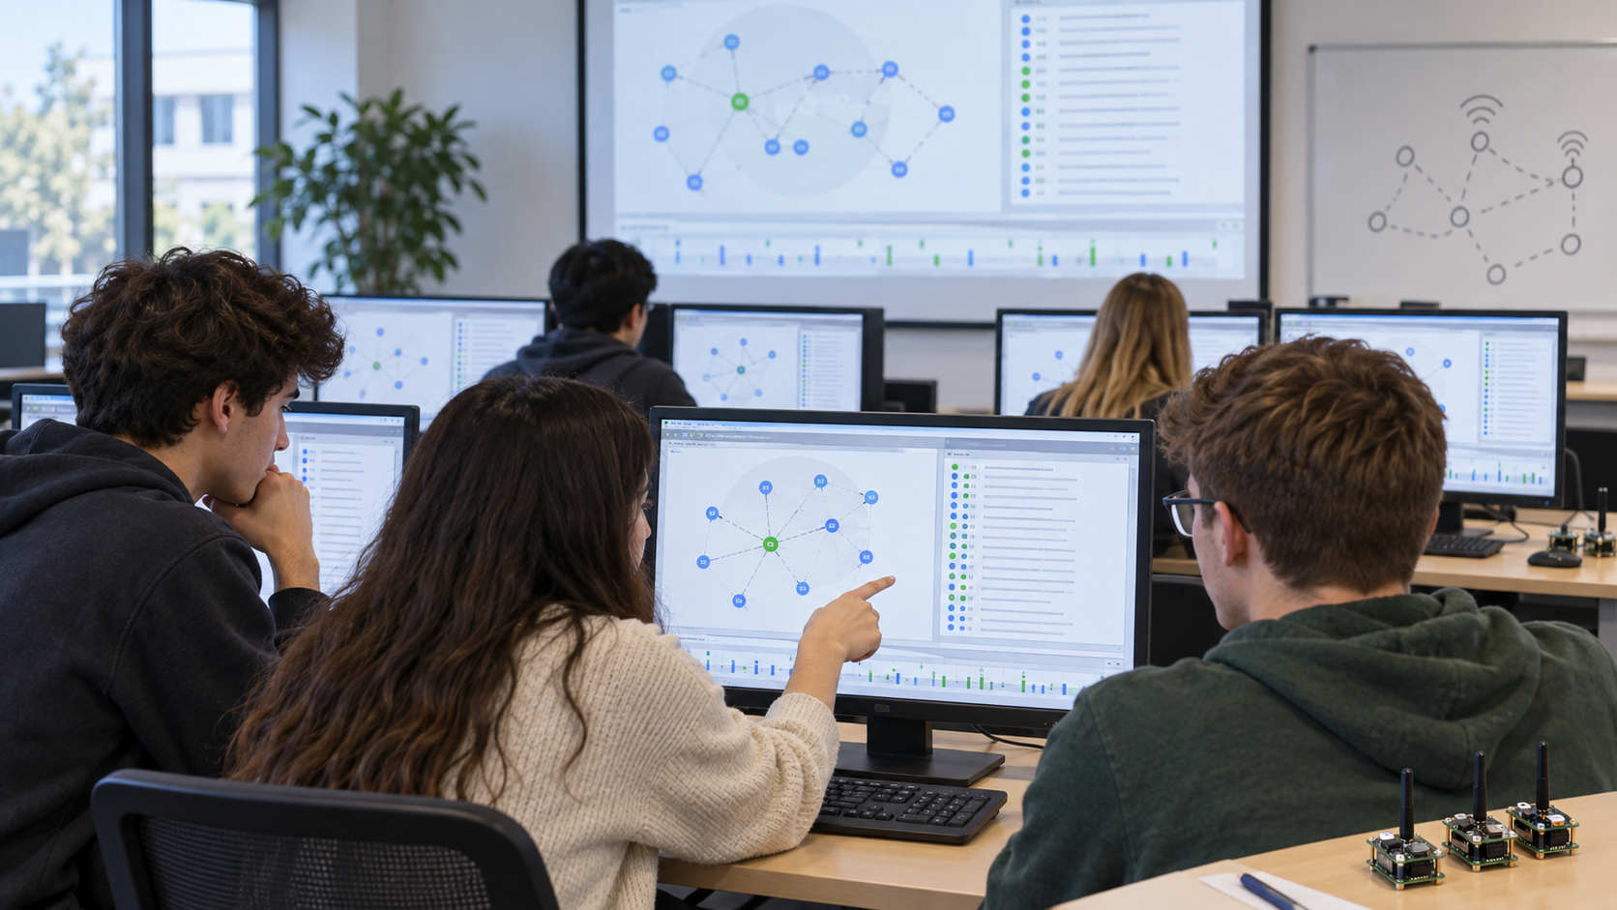
04
Contiki 3.0 + Cooja
For this course, the lab environment is the old Instant Contiki 3.0 virtual machine running in VMware.
CSE 4th Year • Wireless Sensor Networks • Week 1
43

Slide 41
LEGACY OS FOR CONSTRAINED DEVICES
Contiki OS 3.0 overview
Open-source operating system for small networked embedded systems.
Uses C applications, event-driven execution, and protothreads.
Includes networking stacks used in WSN teaching: Rime, uIP/uIPv6, 6LoWPAN, RPL examples.
Includes Cooja simulator under the Contiki tools directory.
In this course, say “Contiki 3.0” unless we explicitly compare with Contiki-NG.
CSE 4th Year • Wireless Sensor Networks • Week 1
44

Slide 42
WHY A VM IS USEFUL
Instant Contiki 3.0
Provides a preconfigured Linux environment with Contiki, Cooja, Java/Ant, and build tools.
Reduces setup differences across Windows, macOS, and Linux hosts.
Freezes old dependencies that may be difficult to reproduce on modern systems.
Makes lab instructions reproducible: same paths, same compiler behavior, same examples.
Legacy software is easiest to teach when the environment is frozen.
CSE 4th Year • Wireless Sensor Networks • Week 1
45

Slide 43
BEFORE FIRST LAB
VMware setup expectations
Students should import or open the Instant Contiki 3.0 VM in VMware.
Allocate enough RAM and CPU for a responsive GUI and Java-based Cooja.
Enable networking if downloads or package updates are required; otherwise keep an offline copy.
Use the same VM image for all students to avoid path and dependency mismatches.
Take a snapshot before modifying toolchain files.
The best debugging tool for Week 1 is a clean VM snapshot.
CSE 4th Year • Wireless Sensor Networks • Week 1
46

Slide 44
INSIDE INSTANT CONTIKI 3.0
Expected directory map
~/contiki/
├── core/ OS core and networking code
├── cpu/ CPU-specific support
├── platform/ Board/platform definitions
├── examples/ Starter applications
│ ├── hello-world/
│ ├── rime/
│ └── ipv6/
└── tools/
└── cooja/ Cooja simulator
Students should know where examples live.
Cooja is launched from the tools/cooja directory.
Platform files explain why the target matters.
Do not edit core files during Week 1 unless instructed.
Folder literacy saves more lab time than heroic terminal guessing.
CSE 4th Year • Wireless Sensor Networks • Week 1
47

Slide 45
BASIC COMMAND PATH
Launching Cooja in the VM
Use the VM terminal, not the Windows host terminal.
Wait for Java/Ant compilation on the first run.
If launch fails, record the exact terminal error before changing anything.
The Cooja GUI is the main environment for Week 1.
cd ~/contiki/tools/cooja
ant run
# Alternative, if a desktop launcher exists:
# double-click the Cooja icon inside Instant Contiki
Command discipline: path, command, error message. No “it did not work” reports.
CSE 4th Year • Wireless Sensor Networks • Week 1
48

Slide 46
SIMULATOR ROLE
What is Cooja?
Cooja is the network simulator included with Contiki.
It can run several simulated motes in one experiment.
Students can observe topology, mote output, radio events, and timing.
A simulation controls conditions that would be messy with physical nodes.
Simulation is useful for mechanisms, not a guarantee of physical deployment behavior.
Cooja gives visibility; real deployments give humility.
CSE 4th Year • Wireless Sensor Networks • Week 1
49

Slide 47
WINDOWS STUDENTS MUST RECOGNIZE
Cooja interface tour
Window
Purpose
Network
Shows mote positions and radio links visually
Mote Output
Displays serial/log output from motes
Timeline
Shows radio, LED, and execution activity over time
Simulation Control
Starts, pauses, and controls simulation speed
Radio Messages
Inspects transmitted packets when enabled
Ask students to point to each window before starting the lab task.
CSE 4th Year • Wireless Sensor Networks • Week 1
50

Slide 48
CHOOSE DELIBERATELY
Cooja mote types
Sky mote: common legacy choice for teaching and examples.
Cooja mote: faster software-level simulation, but less hardware-faithful.
Java mote: behavior implemented in Java, useful for special simulations.
Heterogeneous simulations can mix mote types, but Week 1 should stay simple.
For the first lab: use Sky motes unless the lab sheet says otherwise.
CSE 4th Year • Wireless Sensor Networks • Week 1
51

Slide 49
FROM EMPTY CANVAS TO RUNNING MOTES
First simulation workflow
File → New Simulation: give the simulation a clear name.
Motes → Add Motes → Create New Mote Type.
Choose a Contiki application from examples.
Compile for the selected mote type.
Add several motes and place them in the Network window.
Start simulation and inspect Mote Output.
The workflow is always: create mote type → add motes → run → observe.
CSE 4th Year • Wireless Sensor Networks • Week 1
52

Slide 50
MINIMAL CODE PATTERN
Hello World in old Contiki
# Example location
cd ~/contiki/examples/hello-world
# In Cooja, select the C source while creating
# a Sky mote type, then compile and add motes.
Purpose: verify toolchain and serial output.
Expected observation: each mote prints messages in Mote Output.
This lab is not about networking yet; it is about running firmware-like code.
Save the simulation after it works.
Do not start Week 1 with a complex RPL experiment. First, prove the simulator works.
CSE 4th Year • Wireless Sensor Networks • Week 1
53

Slide 51
PROCESSES AND PROTOTHREADS
Contiki programming model
PROCESS(example_process, "Example process");
AUTOSTART_PROCESSES(&example_process);
PROCESS_THREAD(example_process, ev, data)
{
PROCESS_BEGIN();
/* event-driven application logic */
PROCESS_END();
}
Processes are event-driven, not heavy desktop threads.
Protothreads provide blocking-looking code with low memory overhead.
Applications should yield control instead of spinning forever.
Timers are used to schedule future work.
Students do not need to master Contiki C syntax today, only recognize the structure.
CSE 4th Year • Wireless Sensor Networks • Week 1
54

Slide 52
SCHEDULED BEHAVIOR
Timers: the first useful Contiki mechanism
Timers allow periodic sensing without busy waiting.
Clock ticks are platform-specific; use Contiki time abstractions.
Periodic tasks should reset timers deliberately.
Later energy labs will show why busy waiting is expensive.
static struct etimer timer;
etimer_set(&timer, CLOCK_SECOND * 5);
PROCESS_WAIT_EVENT_UNTIL(etimer_expired(&timer));
Timer-based design is the bridge from Week 1 hardware to Week 3 energy.
CSE 4th Year • Wireless Sensor Networks • Week 1
55

Slide 53
NAMES STUDENTS WILL MEET LATER
Networking options in Contiki 3.0
Component
Role
Rime
Lightweight Contiki communication stack used in many old examples
uIP / uIPv6
IP networking support for constrained nodes
6LoWPAN
Adapts IPv6 to small IEEE 802.15.4 frames
RPL
IPv6 routing for low-power and lossy networks
RDC / MAC drivers
Control radio duty cycling and channel access behavior
Week 1 only introduces the map; later weeks inspect each component experimentally.
CSE 4th Year • Wireless Sensor Networks • Week 1
56

Slide 54
NOT JUST CLICK START
What students should observe in Cooja
How many motes are present and what program they run.
What each mote prints and when it prints it.
Whether motes are positioned within communication range.
Which radio medium model is selected.
Whether the simulation can be saved and reopened reproducibly.
A good lab report describes observations, not merely screenshots.
CSE 4th Year • Wireless Sensor Networks • Week 1
57

Slide 55
05
Week 1 lab plan
A short guided lab: open old Cooja, run a basic mote program, inspect output, and submit a reproducible observation.
CSE 4th Year • Wireless Sensor Networks • Week 1
58

Slide 56
WHAT THE LAB PROVES
Lab objectives
VMware and Instant Contiki 3.0 boot correctly.
Cooja starts from the terminal or desktop shortcut.
A new simulation can be created and saved.
A Sky mote type can be compiled from an example application.
Mote output can be read and connected to the running code.
The first lab is an environment validation lab disguised as a WSN lab. Useful trick.
CSE 4th Year • Wireless Sensor Networks • Week 1
59

Slide 57
FINAL SLIDE
Lab contents, deliverables, and links
Lab content
Useful legacy links
Boot Instant Contiki 3.0 in VMware and launch Cooja.
Create a new simulation; add Network, Mote Output, Timeline, and Simulation Control windows.
Compile a Sky mote type from hello-world; add three motes; run and inspect output.
Save the simulation and submit a screenshot plus a short worksheet.
Contiki OS GitHub
https://github.com/contiki-os/contiki
Contiki wiki
https://github.com/contiki-os/contiki/wiki
Cooja intro
https://github.com/contiki-os/contiki/wiki/An-Introduction-to-COOJA
Instant Contiki
https://sourceforge.net/projects/contiki/files/Instant%20Contiki/
Examples
https://github.com/contiki-os/contiki/tree/master/examples
Next week
Radio and physical layer: path loss, RSSI, LQI, PRR, link asymmetry, and IEEE 802.15.4 PHY.
Reminder: old Contiki 3.0 commands and paths are the source of truth for labs.
CSE 4th Year • Wireless Sensor Networks • Week 1
60

