Slide 1
Crime Detection And Prediction on Twitter
Presented by:
Akeel Farooq (11601768)
Sushmita (11613310)
Supervised by:
Mrs Shikha (Asst. Prof.)
SCHOOL OF COMPUTER SCIENCE & ENGINEERING
Lovely Professional University Phagwara, Punjab-144411

Slide 2
Contents
INTRODUCTION
STREAMING
ANALYZING STREAMING DATA
VISUALIZING ANALYSED DATA
SENTIMENTAL ANALYSIS
CRIME PREDICTION FROM TWITTER
WORKING WITH TWEET EXTRACTION
MODELS

Slide 3
1. INTRODUCTION
The Social networks and microblogging sites have become the unparalleled source of unstructured data.
People post real-time messages about their opinions on a variety of topics, discuss current issues, complain, and express their sentiment for products they use in daily life.
Many companies have started analyzing such massive amount of important data to get a sense of general sentiment for their product and/or services.This process provides on spot solution to make the user experience better.
But handling of data is painful , if it is at large scale.

Slide 4
So the challenge here is to build solutions which analyze the sources of data coming from various microblogging and social networks.
In this project, we take one such social network called Twitter to analyze and visualize various important metrics related to an event, product or service.

Slide 5
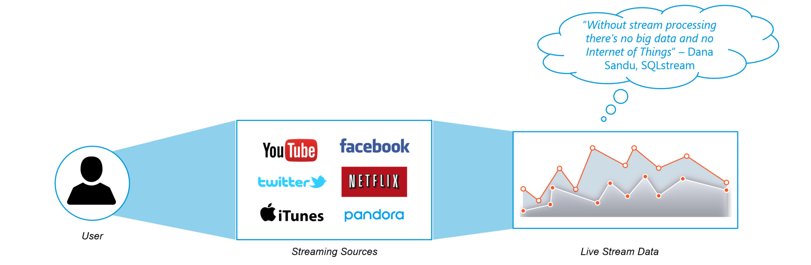
2. STREAMING
Streaming is a technique for transferring data so that it can be processed as a steady and continuous stream.
Streaming technologies are becoming increasingly important with the growth of the Internet. In our project we are using Spark streaming.

Slide 6
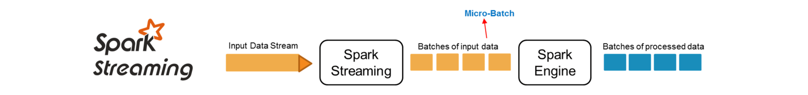
SPARK STREAMING:
Spark Streaming is used for processing real-time streaming data. It is a useful addition to the core Spark API. Spark Streaming enables high-throughput and fault-tolerant stream processing of live data streams.
The fundamental stream unit is DStream which is basically a series of RDDs to process the real-time data.

Slide 7
Spark Streaming Features:
Scaling: Spark Streaming can easily scale to hundreds of nodes.
Speed: It achieves low latency.
Fault Tolerance: Spark has the ability to efficiently recover from failures.
Integration: Spark integrates with batch and real-time processing.
Business Analysis: Spark Streaming is used to track the behavior of customers which can be used in business analysis.

Slide 8
Spark Streaming Includes:
COLLECTING DATA
REGISTERING APP
ACCESSING DATA
STORING DATA
PREPARING DATA
REMOVING STOP-WORDS

Slide 9
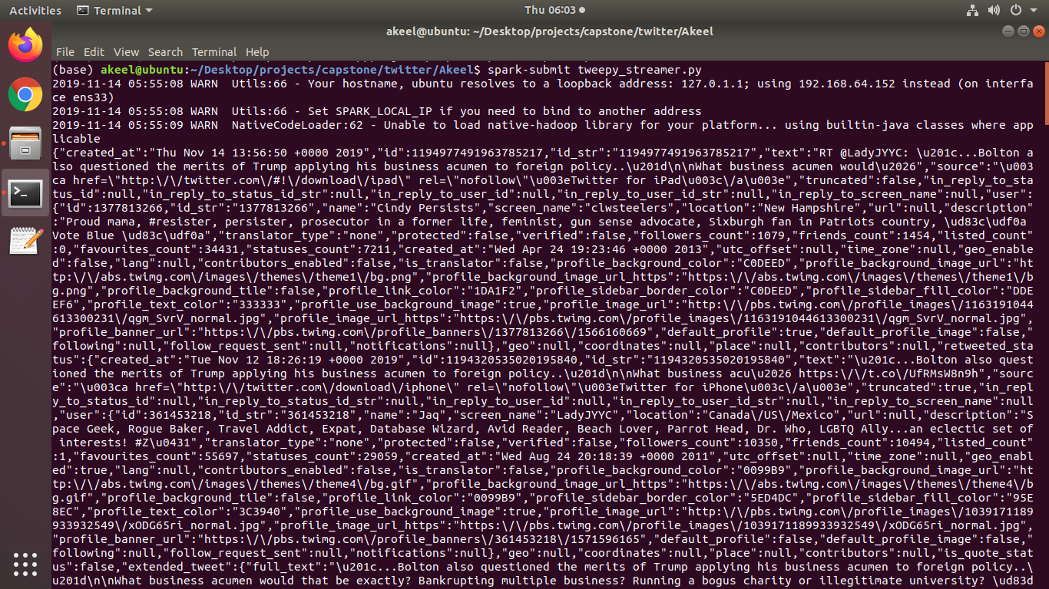

Slide 10
3. ANALYZING STREAMING DATA
Analysing streaming data is very important as it allows us to make real-time decisions on the basis of real-time data.
Streaming data analysis can be large in terms of data being generated so analysis of streaming data requires heavy computation resources.
In this project, we have analysed #realDonaldTrump hashtag.
Analyzing streaming data includes following steps:

Slide 11
1. TERM OCCURRENCES
For #realDonaldTrump streaming data, we have analyzed below most used term occurrences. This shows that “whitehouse” is tweeted most of time in approximately 100 live tweets.
2. BIGRAMS TERMS
Bigrams in this #realDonaldTrump data show that “white house” terms has been used most frequently together as its official residence of US president.
3. MOST USED HASHTAGS
Out of 200 live tweets below are the most used hashtags for #realDonaldTrump was #whitehouse.
4. MOST USED MENTIONS
Out of 200 live tweets below are the most used mentions for #realDonaldTrump. As we can see ‘@USPresident is the most active twitter account for this dataset.

Slide 12
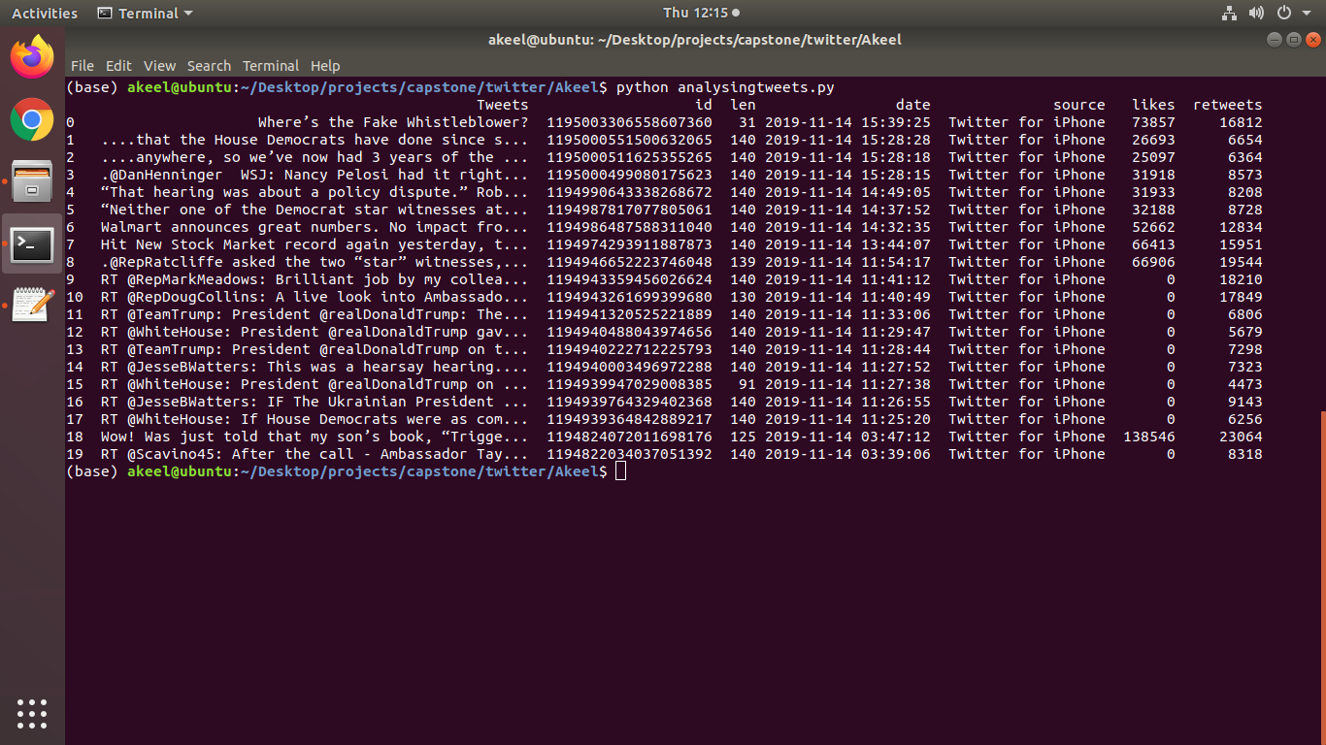

Slide 13
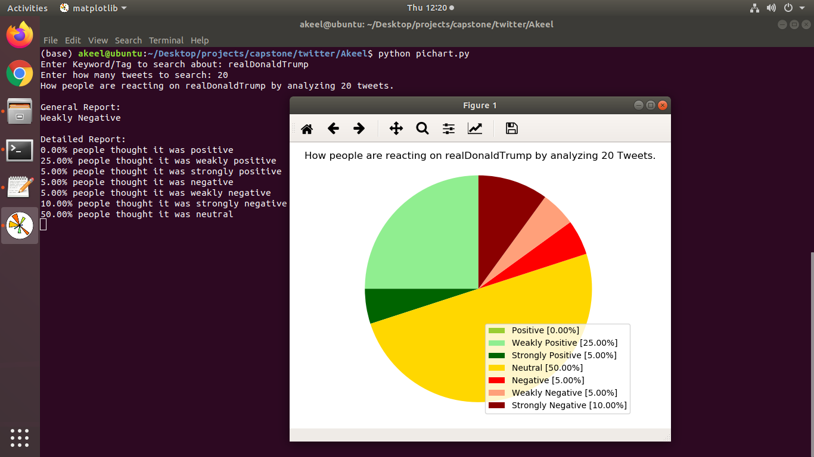
4. VISUALIZING ANALYSED DATA
Visualization of analyzed data includes represented of it pictorially as shown below:

Slide 14
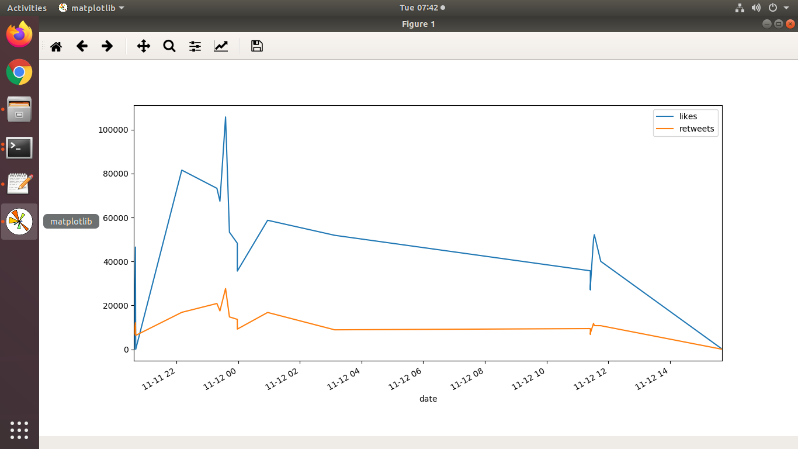

Slide 15

5. SENTIMENTAL ANALYSIS
Sentiment Analysis is the process of ‘computationally’ determining whether a piece of writing is positive, negative or neutral. It’s also known as opinion mining, deriving the opinion or attitude of a speaker.
Sentiment Analysis is a technique widely used in text mining. Twitter Sentiment Analysis, therefore means, using advanced text mining techniques to analyze the sentiment of the text (here, tweet) in the form of positive, negative and neutral.

Slide 16
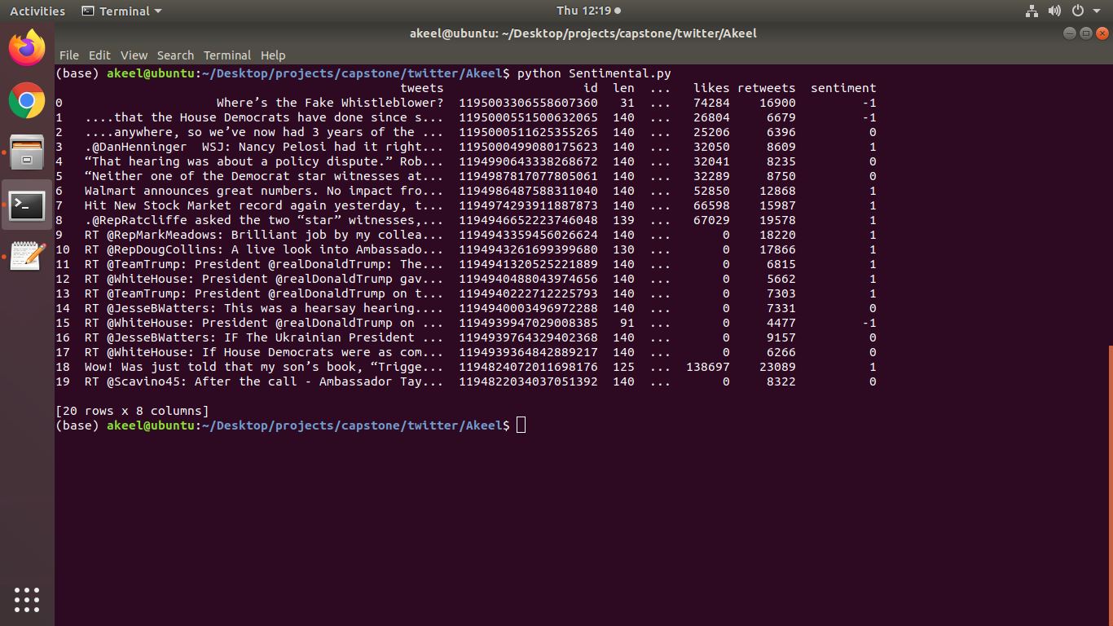
It is also known as Opinion Mining, is primarily for analyzing conversations, opinions, and sharing of views (all in the form of tweets) for deciding business strategy, political analysis, and also for assessing public actions.

Slide 17
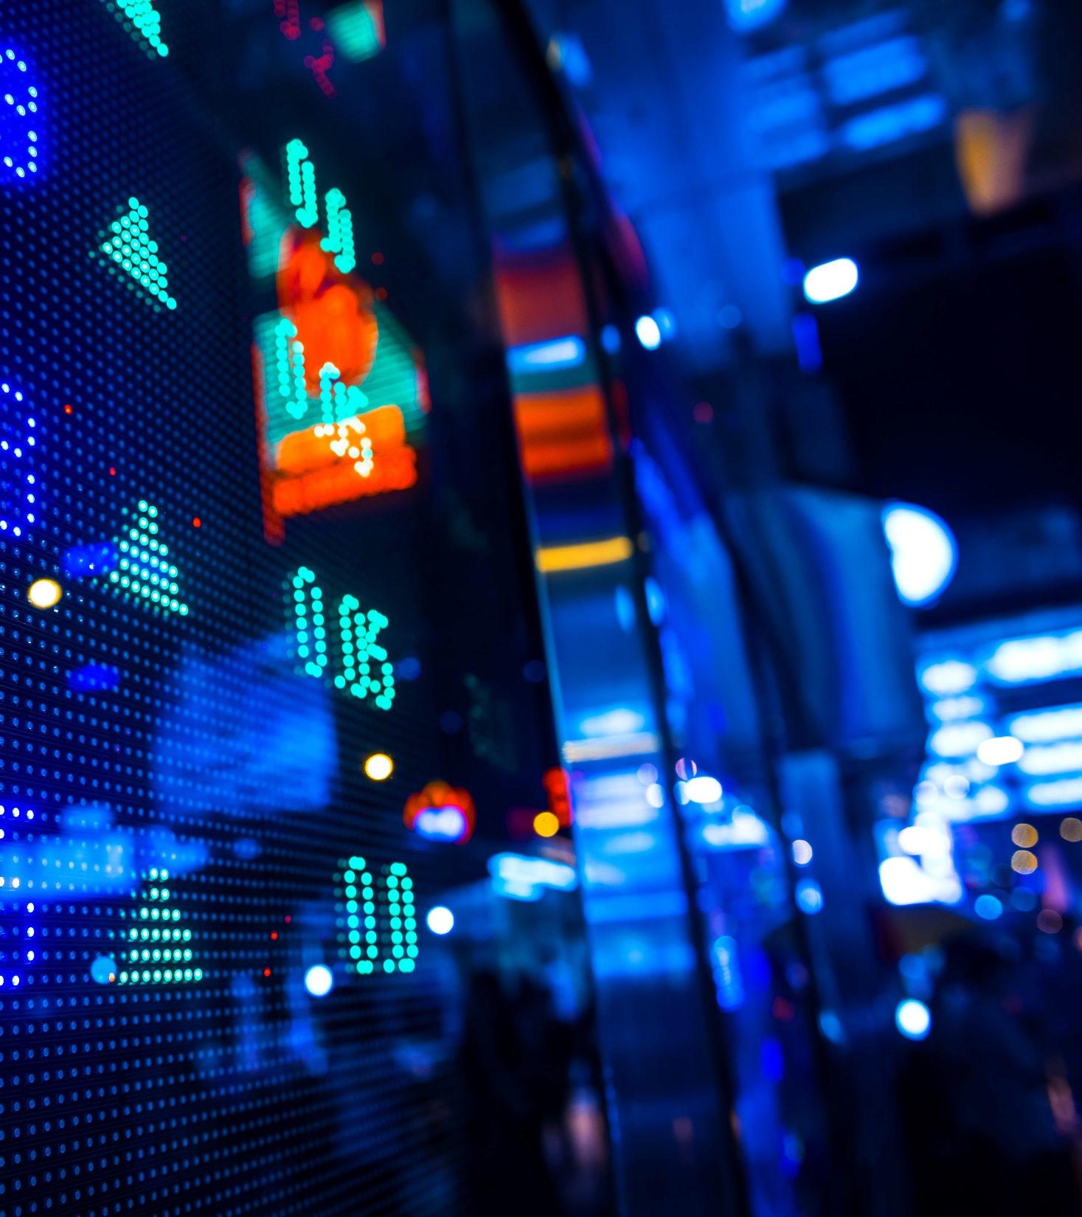
Crime prediction from twitter
Twitter sentiments analysis

Slide 18
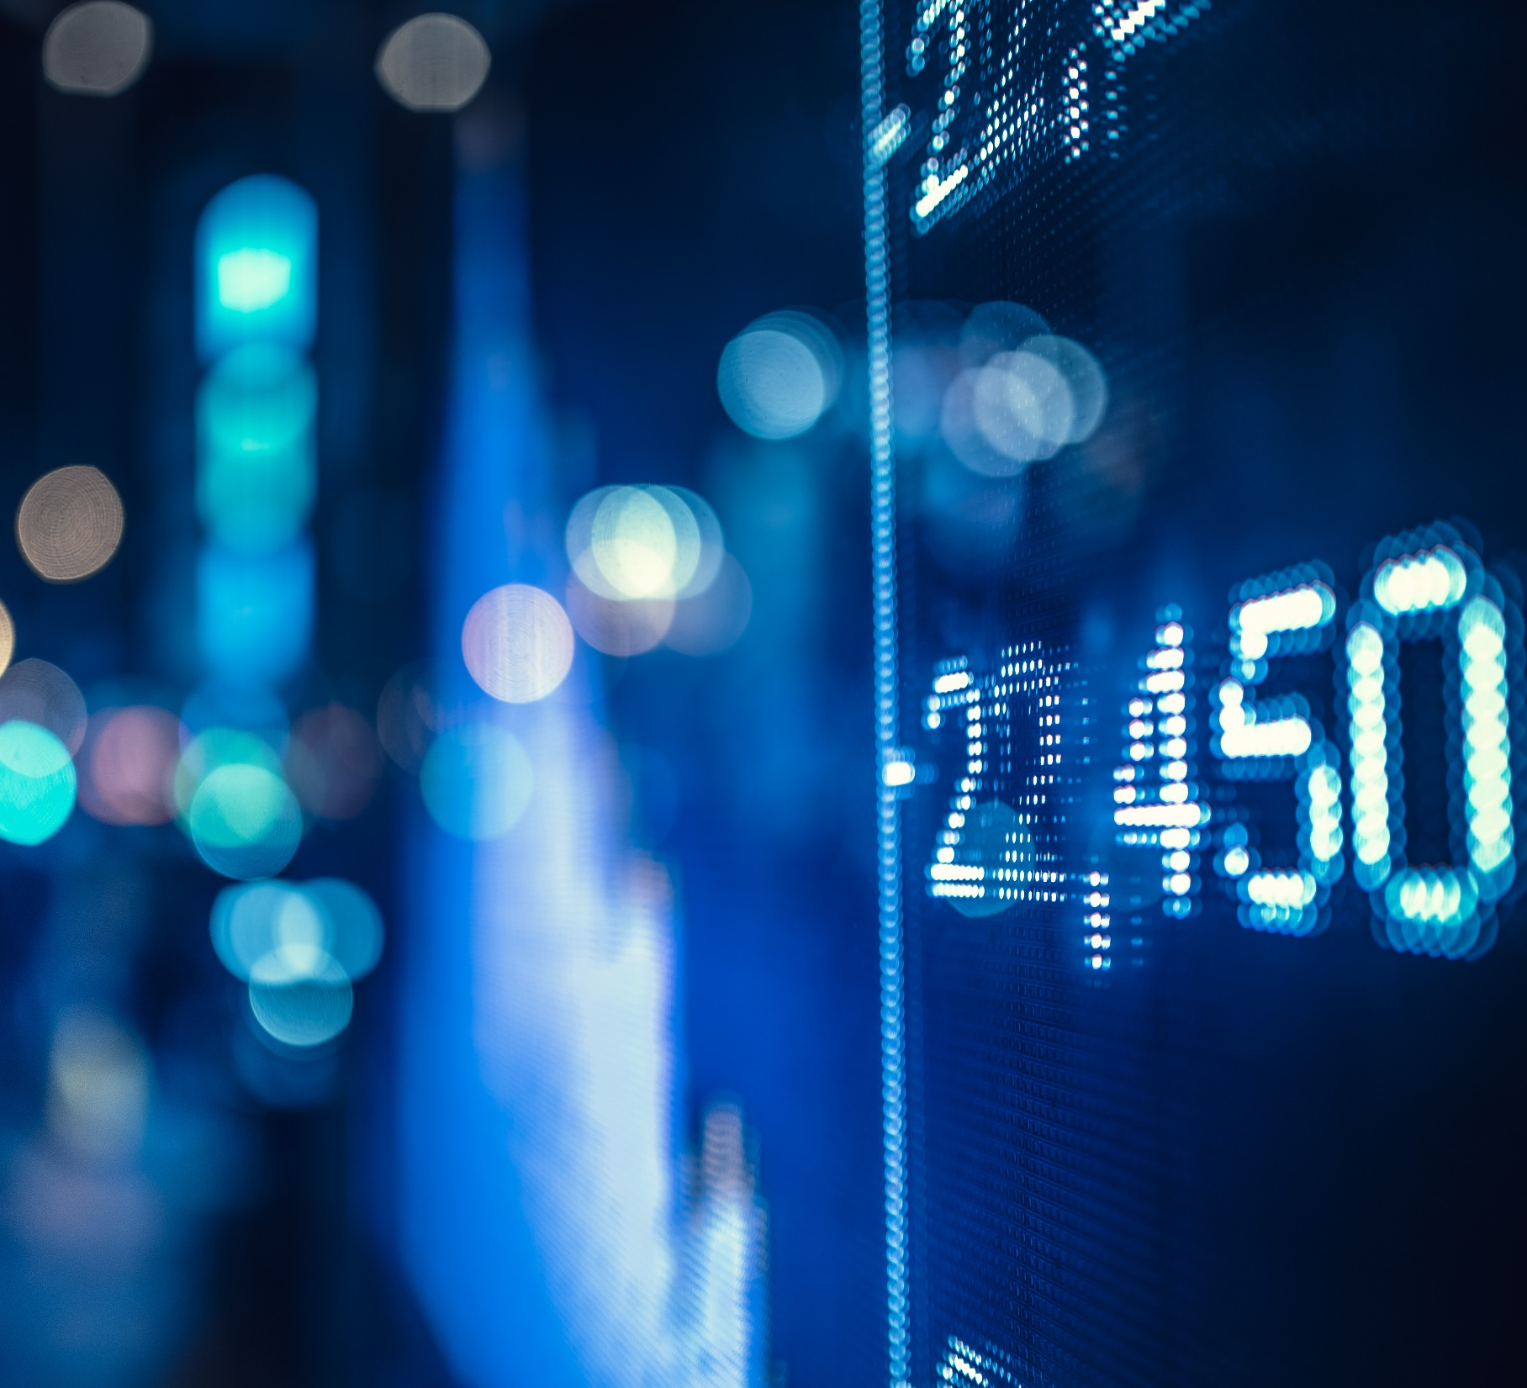
Need to know
Live data streamin
Predicting the tweet
Charts to show various user activites

Slide 19
Milestone
Tweets
Live tweets
Implementing various models
Tweets preprocessing
Model
Preprocessing
Optimization
Sentiment analysis

Slide 20
Working With Tweet Extraction
TWEEPY LIBRARY- TWITTER API
TOKENS AND SECURITY KEYS
PREPROCESSING- NLP, REGULAR EXPRESSIONS
HTML TAGS, SPECIAL CHARACTERS, STOPWORDS, DECONTRACTION
CLEANED TWEET DATA

Slide 21
MODELS
TFIDF VECTORIZER- TEXT--> NUMRICAL
LOGISTIC REGRESSION- PREDICT TWEET SENTIMENTS
WORDCLOUD- TRENDING WORDS
GUI USING TKINTER

Slide 22
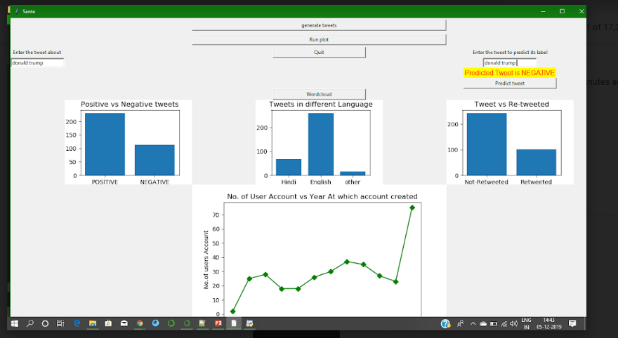

Slide 23
~~~~…… THANK YOU!

