Slide 1
Correlation

Slide 2
Relationships between Variables
Until now we have looked at the distribution of one value at a time.
Distribution shape.
Slicing variables into segments and comparing them or their effect size.
We can also look at the relationship between two variables:
Height and weight of people have some relationship – taller people are generally heavier, but there is wide variation.

Slide 3
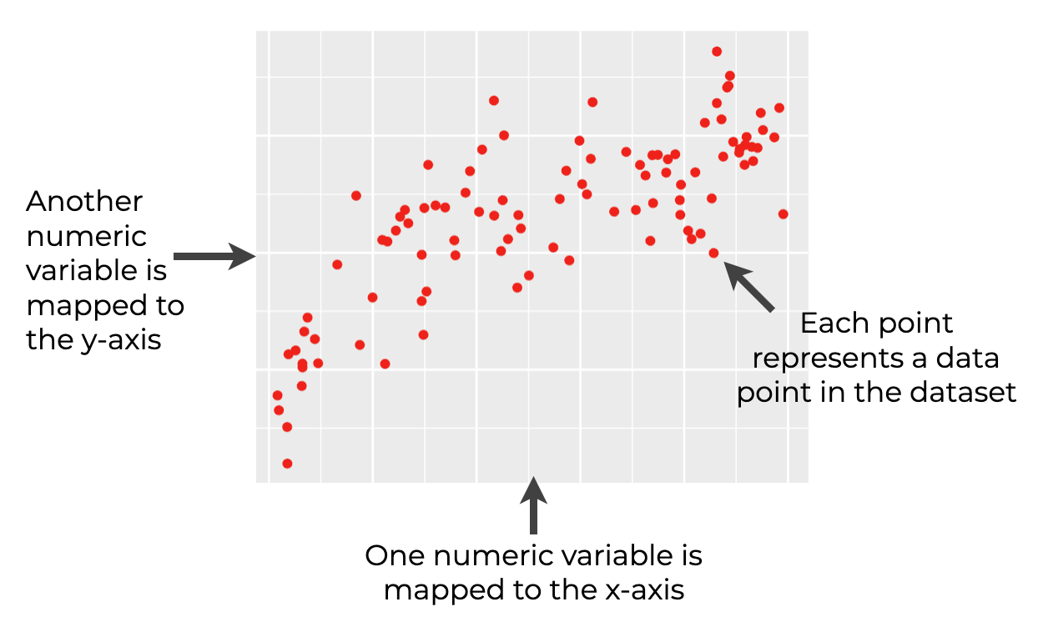
Scatterplot
Scatterplots are a simple tool for examining correlation graphically.
Book highlights some extensions:
Jitter – to make patterns more easily read.
Hexbin – sort of a 2d histogram.
See this in code in a minute.

Slide 4
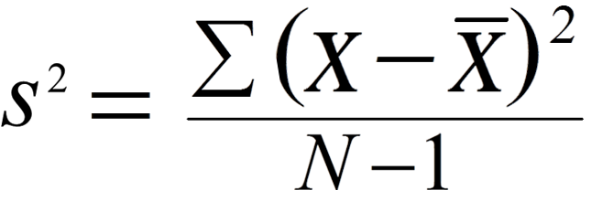
Variance
Recall – Variance is the average distance from the mean of a dataset.
Note: The n-1 is so sample, population uses n. The rationale is that if there is only n=1 in the sample, there is not variance. You need at least 2 values to have 1 variance.

Slide 5
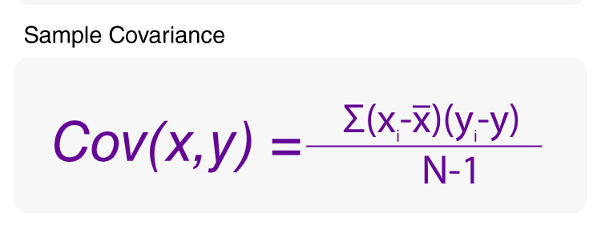
Covariance
Covariance is the average distance of the x-axis values times the y-axis value.
Can think of it as a 2 dimensional variance.
If positive – as X goes up, Y goes up.
If negative – as X goes up, y goes down.
Larger number, stronger relationship.

Slide 6
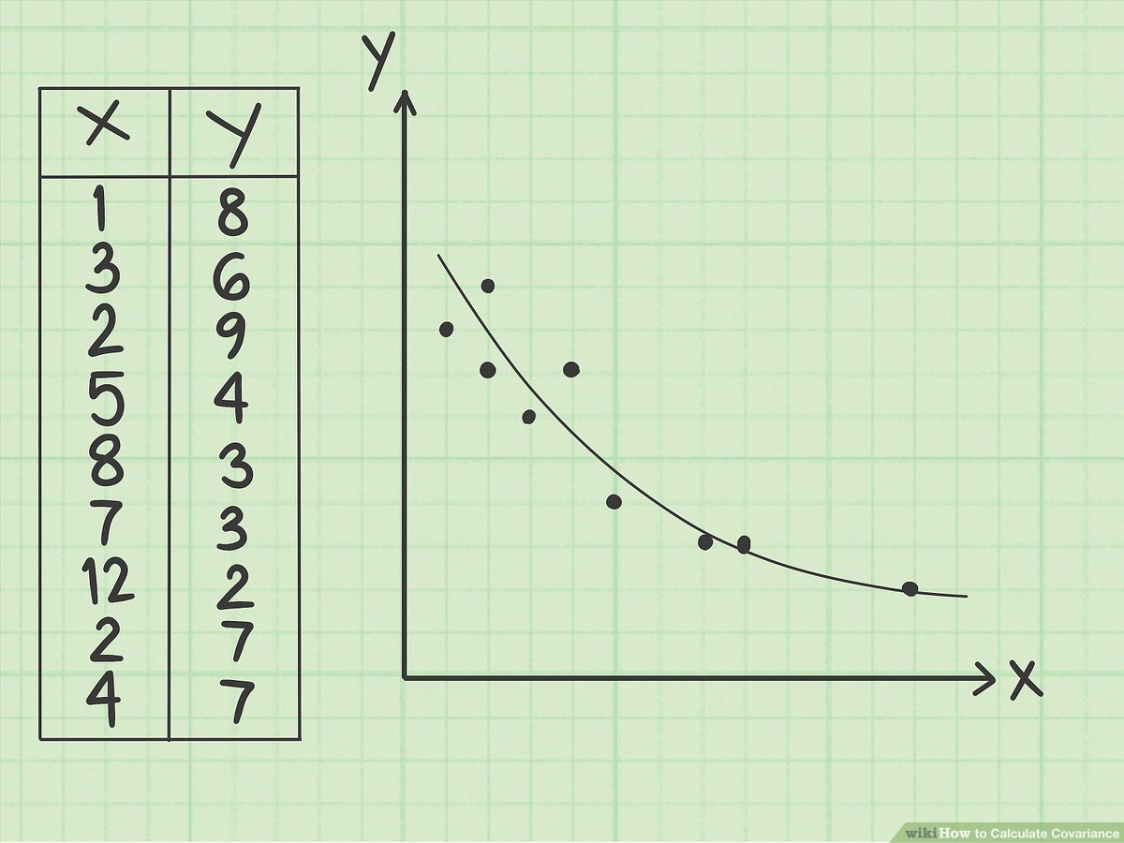
Variance and Covariance
Variance of X:
Mean is 4.89
Sum the distance of each dot on the x-axis from 4.89. Divide by n-1
E.g. 1-4.89, 3-4.89, 2-4.89….
Variance of Y:
Mean is 5.44
Sum the distance of each dot on the y-axis from 5.44. Divide by n-1
E.g. 8-5.44, 6-5.44, 9-5.44…

Slide 7
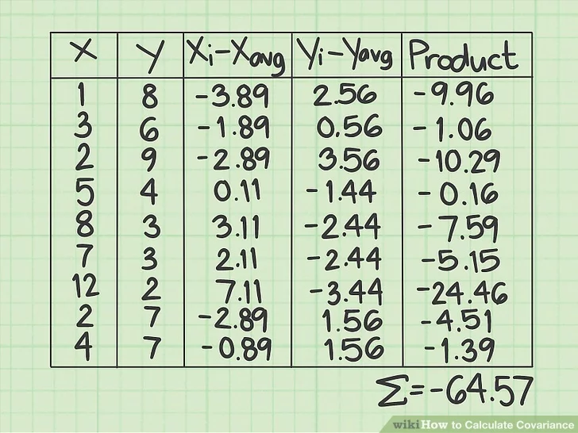
Covariance
Multiply the x-distance and the y-distance for each point.
Sum those values and divide by n-1.
Cov = -64.57/8 = -8.07
Meaning – as X goes up, Y goes down.

Slide 8
Covariance to Correlation
Covariance not directly used all that much:
The units are wonky – e.g. height vs weight is “pound-inches”.
Actual value dependent on original raw values.
Correlation is more widely used:
Measure strength or the relationship -1 to +1.
-1 or +1 indicate perfect correlation – for an increase in X, you can determine the change in Y.
Most values fall somewhere in between, 0 is no correlation, + is positive, - is negative.
Correlation is a measure of how closely tied changes in X are mirrored in Y.
Note: Perfect correlation doesn’t imply 1 to 1, the ratio can vary.

Slide 9
Pearson Correlation
There are a couple of different ways to measure correlation.
Pearson – the standard way.
Spearman – uses rank instead of values.
Divide covariance by the product of the X and Y standard deviation.
Normalizes so all values are -1 to +1.
Removes units.
Easier to understand with an image…

Slide 10
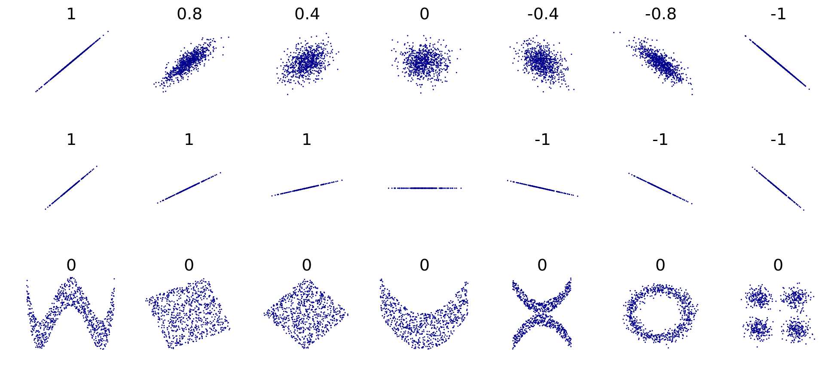

Slide 11
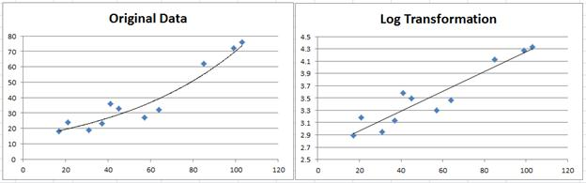
Non-Linear Relationships
Correlation calculations are more reliable with linear relationships.
One tool – transformations. Just like fitting distributions.
Another tool… different metric for correlation.
Complex non-linear correlations – packages with estimation algorithms.

Slide 12
Spearman’s Rank Correlation
Calculates the covariance of the ranks instead of raw values.
Similar (in spirit) to how median looks at average compared to mean.
E.g. the pictured point is ranked 5 in X (the 5th smallest right), and 7th in Y (the 7th lowest height).
More robust with relationships that are not linear, or have outliers.

Slide 13
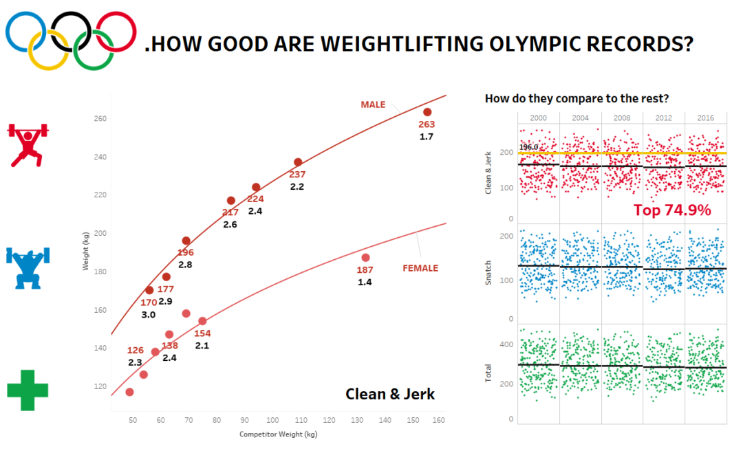

Slide 14
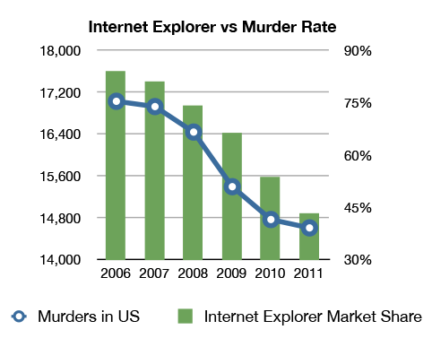
Correlation vs Causation
Just because something shows a correlation, even a strong one, doesn’t mean that one thing is causing another.
Correlation may be due to one thing causing another, shared root causes, or just random coincidence.
Note: chart may be a bad example, as using IE may make you homicidal.

Slide 15
Separating Correlation from Causation
We can easily calculate correlation; we need evidence to show causation.
Which happens first? Do things only occur in that order?
Pregnancies and newborns are correlated, one always happens first.
Controlled trial:
Clinical trials – change one variable (add a drug), watch outcomes (e.g. mortality).
Natural experiments – look for groups that have a difference. E.g. public smoking bans.
Less likely to give clean data due to infinite number of differences.
Domain knowledge and analytical sense – there isn’t causation until we know there is.

Slide 16
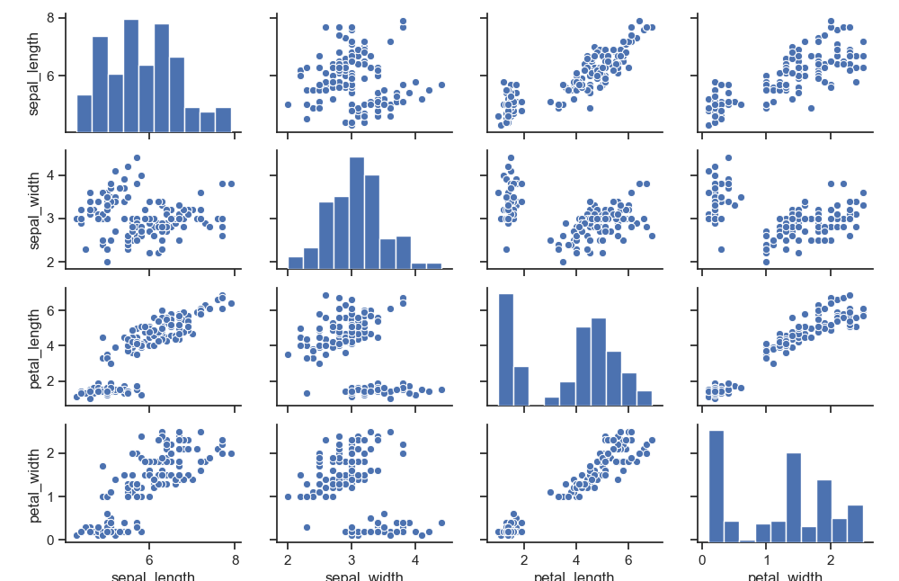
Data Exploration – Seaborn Pairplot

Slide 17
