Slide 1
Keeping of House
Quiz:
Corrections made for my mistakes, should be reflected in the grade now.
I updated the percentage ones to give %50 marks for percent vs decimal.
Test:
Guide on Moodle.
Theory, no calculations.
Today:
Error

Slide 2
Errors

Slide 3
Errors
When matching empirical data to analytical distributions our match is never perfect.
Each point is “off” the analytical distribution by some amount.
The less the total amount of “off” is, the more closely matched the distribution.
Predictions work the same way:
Predict what a value should be.
Measure our error.
Summarize these errors to estimate overall accuracy.

Slide 4
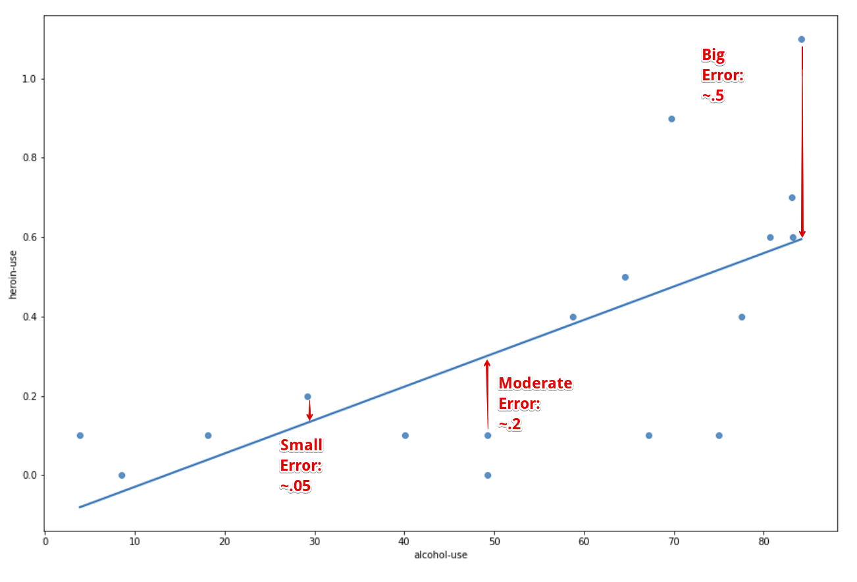
Residuals
A residual is how much one prediction is off from reality.
Each point in our data has its own residual – how “off” was the model vs that real value.
Subtract one from the other.
Here – LoBF is a prediction.
Next – Analytical model is a prediction.

Slide 5
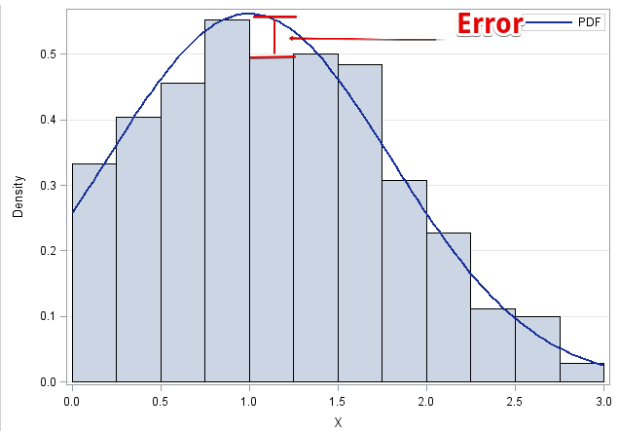

Slide 6
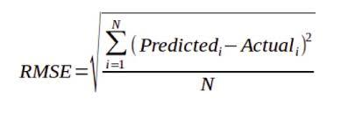
Summarization of Errors
If we have an expectation (analytical model, ML prediction, guess) and a true (empirical) value, we can calculate the residual.
When dealing with many points, a list of residuals is impractical.
We can summarize residuals into one measure of error.
There are several ways to summarize error, e.g.
MSE – Mean squared error. Square residuals and average them.
RMSE – Root mean squared error. Take the square root of MSE.
MAE – Mean absolute error. Average the absolute values of the residuals.
RMSE is the most common error measure for us.
Lower error amounts tell us that the model and the empirical are similar.

Slide 7
Why Squared?
The error measures either squared or took the absolute value of the residual.
Squaring does a couple of things:
Eliminates negatives. We get a measure of the magnitude. (MAE* also does this.)
Penalizes large residuals.
Having residuals that are small are good, even though they’ll never be perfect.
Having large residuals indicates massive misses.
MSE/RMSE tends to reward models without many large residuals.
Few large misses.
*Absolute values make for weird math, which is one reason it is less common.

Slide 8
R-Squared
R-squared is another measure of model quality.
Likely to pop-up if searching about this stuff.
We’ll deal with it later.
It is a measure of “how much” the model captures.

Slide 9
Errors
Moving forwards, error is a critical metric for us.
We want to build models to make predictions.
Error indicates how well we are doing.

