Slide 1
Basic Descriptive Stats

Slide 2
Stats! Stats! Stats! Stats! Stats!
The primary things that statistics gives us is a langue to describe data.
Descriptive statistics.
There are a few basic statistics that we’ve likely seen/used before.
These statistics allow us to describe one variable (feature) of data at a time.

Slide 3
Range
Minimum – smallest value.
Maximum – largest value.
Range – distance between the minimum and the maximum values.
Count (N) – number of records in dataset.

Slide 4
Average(s) – Measures of Central Tendency
We have 3 measures of average:
Mean – Add all values and divide by N.
Median – The value with 50% of other values above, and %50 below.
Mode – The most frequently occurring value.
“Average” normally means the mean, but we should be specific.
Median is very common is scenarios where there are outliers.
Why?

Slide 5
Measures of Dispersion
Measures of dispersion tell us how “spread out” the values are?
Are values tightly clustered or scattered over a wide area?
Variance – a measure of how “varied” the values are, i.e. are they clustered over a small range or distributed broadly.
Standard Deviation – the square root of variance. More commonly used for most analysis.

Slide 6
Single Variable Statistics
These simple stats help us describe data that we are dealing with.
When we look at distributions soon, knowing a distribution pattern and these basic statistics can allow us to describe our data very accurately with a small amount of info.
These are fundamental building blocks, we should be comfortable with each and what it means.
Note: each of these stats looks at one variable at a time, we haven’t looked at all at the relationships between them.

Slide 7
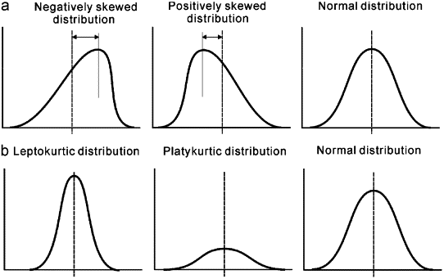
Distributions
These individual statistics are helping to build us up to looking at the distribution – a visual representation of the “shape” of the data’s distribution.

