Slide 1
Time Series Forecasting

Slide 2
Time Series Data
Time-series data is data that progresses over time.
E.g. gas prices, stock prices, temperature, etc…
The basis of predictions, or forecasts, is by looking at patterns in the data.
Time-series data has a few parts that our forecasts try to separate:
Trend – are we going up or down as time progresses.
Seasonality – do we have regular waves, such as seasonal sales.
Cyclicality – do we have larger waves, spanning several seasons.
Irregularity – how much variation is there that doesn’t fit into the above.
The models generally try to decompose each of these, measure each, and recombine them to create projections.

Slide 3
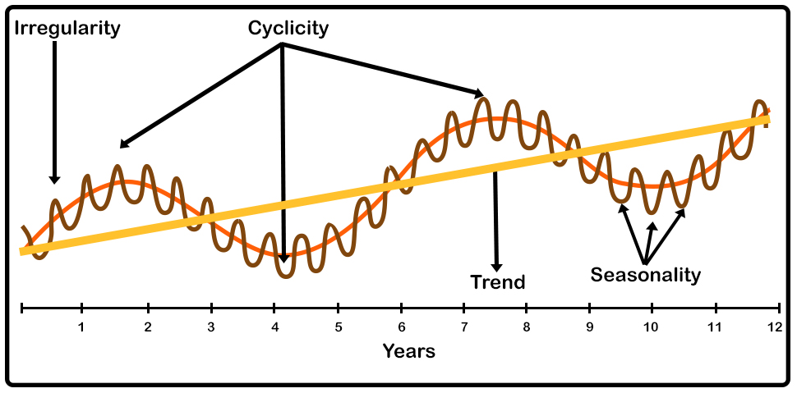

Slide 4
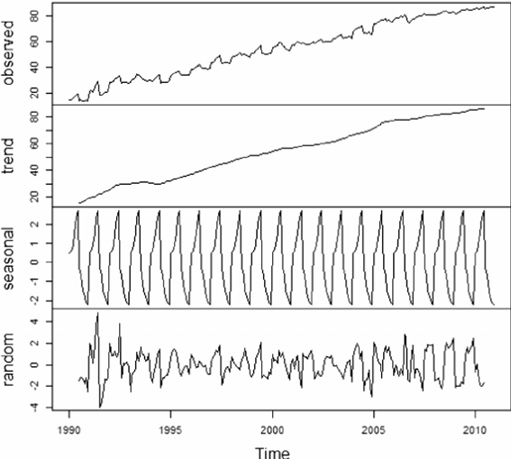
Time Series Components
The basic idea is that if we can extract each component of the time series’ variation, our model can more easily project each.
Example plots:
Trend – linear increase.
Seasonality – predictable waves.
Random – “other” variation.
Note: different models may capture slightly different components.

Slide 5
Exponential Smoothing
Exponential smoothing is one of the simplest forms of time series forecasts.
Weighted averaging with a smoothing term.
Trends and seasonality can be either Additive or Multiplicative:
If every December we sell 10,000 more apartments than we do in November, the seasonality is additive in nature. However, if we sell 10% more apartments in the summer months than we do in the winter months the seasonality is multiplicative in nature.
Can also incorporate:
Trends – are we moving up or down over time.
Cyclicality – are there seasonal patterns.

Slide 6
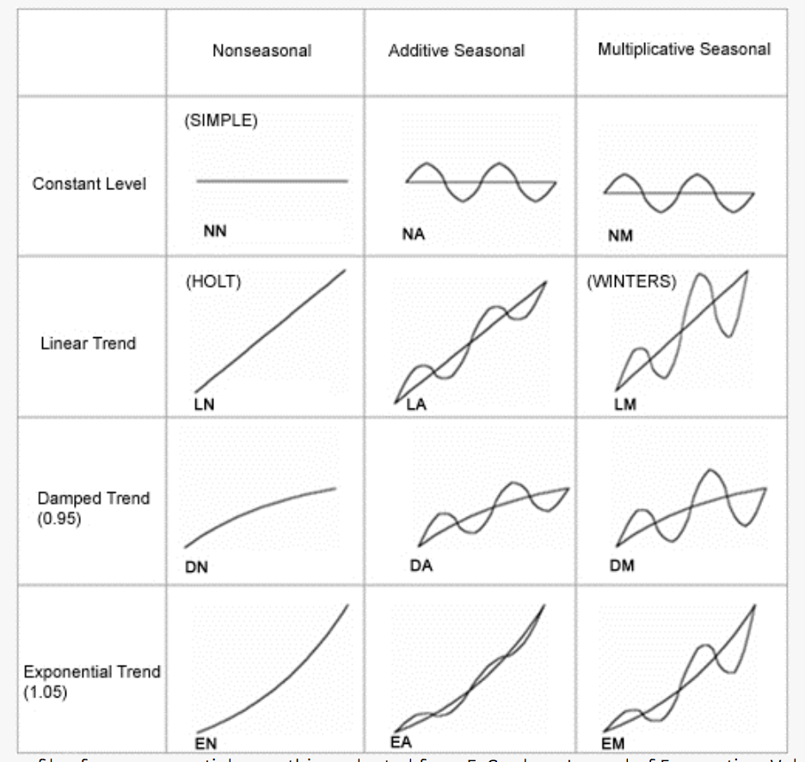

Slide 7
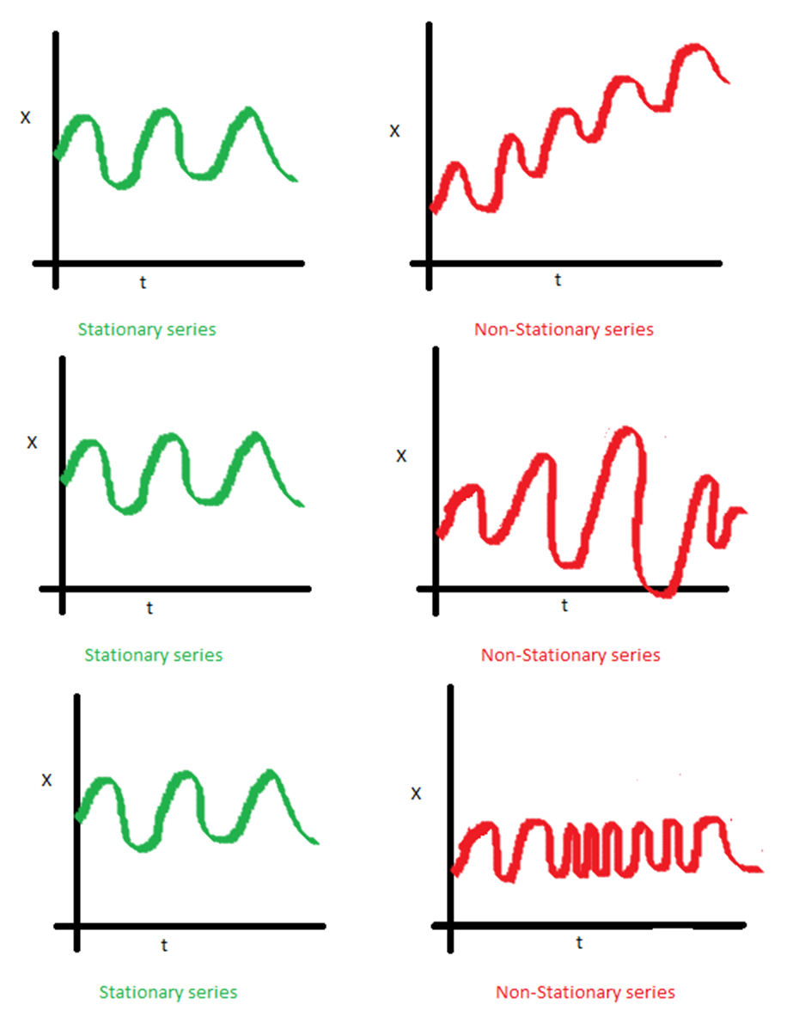
Stationary
A time series being stationary means that its major stats (mean, std) are not changing over time.
We can transform data to make it stationary:
Differencing.
difference(T) = observation(T) – observation(T-1)
.diff() in code.
Other transformations (e.g. log). We won’t cover this stuff in detail.
We generally need to make a time series stationary, or provide arguments for it to be made stationary.

Slide 8
ARIMA
ARIMA is a common time series model, it has 3 parts:
AR (p) – Autoregressive. Regresses on its own prior or lagged values. In other words, it predicts future values based on past values.
I (d) – Integrated. Observes the difference between static data values and previous values. The goal is to achieve stationary data that is not subject to seasonality.
MA (q) – Moving Average. A moving average.
Uses differencing to become stationary – removes seasonality.
Doing this part manually is for context, we have tools to do it for us that we’ll leverage.
We don’t need to know how to do this process in depth, we’ll use the library tools.

Slide 9
Creating ARIMA
D term - Augmented Dickey Fuller test.
P < .05 for significance test is normal cutoff.
P and Q Terms from autocorrelation and partial autocorrelation graphs.
Next page…
If in doubt, default to lower values first.

Slide 10
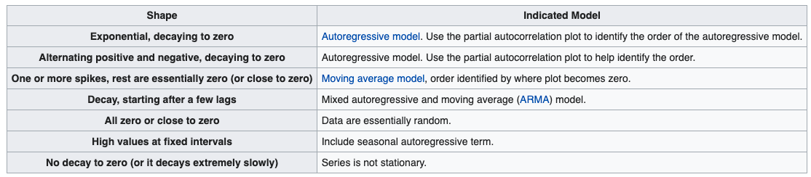

Slide 11
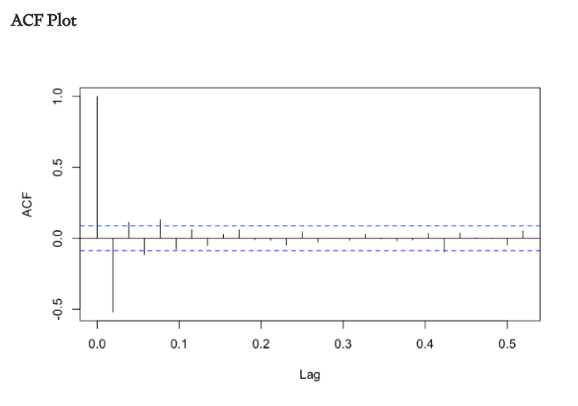
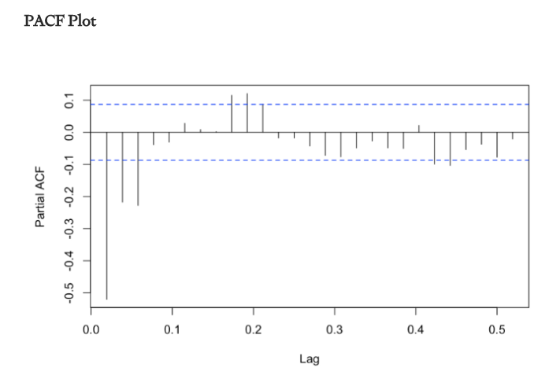
AR – 0 MA – 1

Slide 12
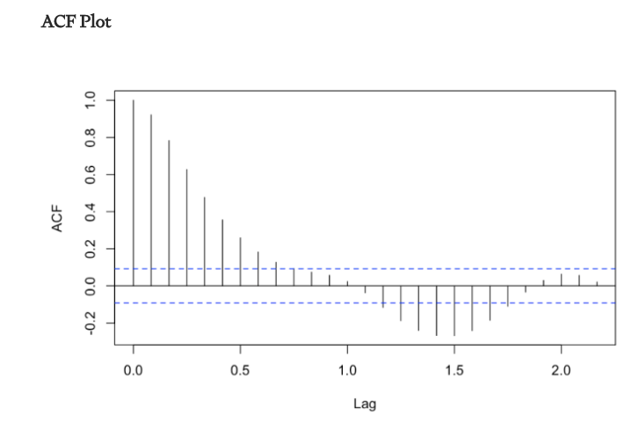
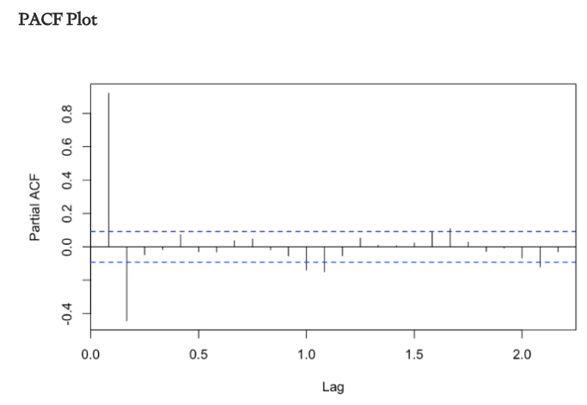
AR – 1 MA – 0

Slide 13
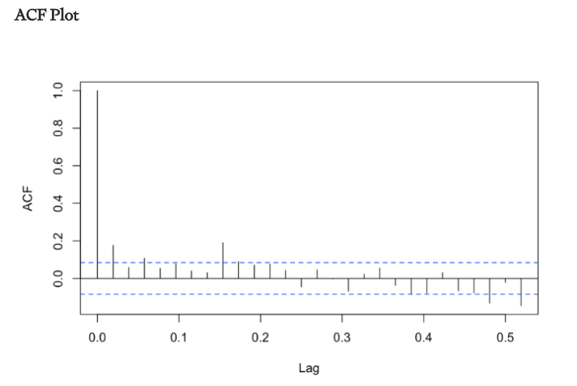
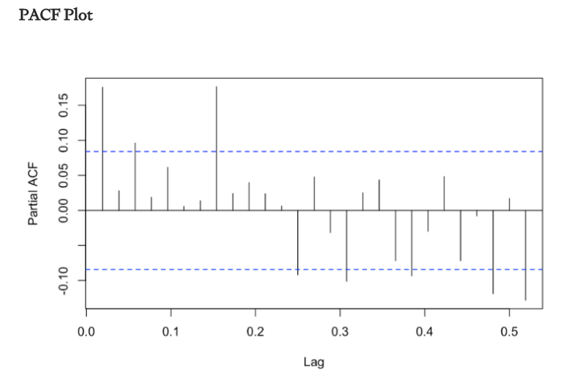
AR = 1 MA = 1

Slide 14
Implementation
Sktime is a wrapper that packages time series functionality, largely from statsmodels, into a sklearn-ish format.
Statsmodels documentation is not the best.
Statsmodels code is structured quite differently.
Allows us to do basic time series at a higher level, much more easily.
ARIMA details previously can be replaced with AutoARIMA.
Key notes:
Train-test split is now normally just the last X records are test data.

Slide 15
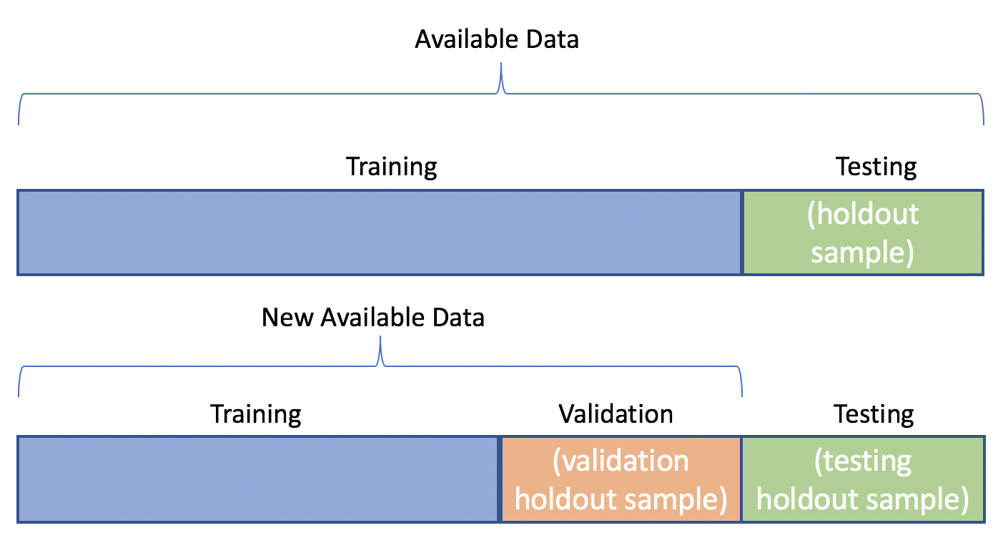
Data Splits in Time
The idea of a train-test split is different in a time series scenario.
Randomized selections don’t make sense.
The “end” is the test data, normally.

Slide 16
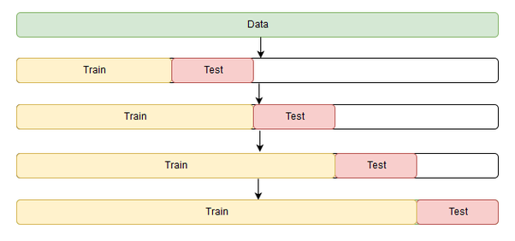
With Cross validation
With cross validation, we need to do a similar split, but moving over time.
If there’s a trend that we haven’t captured, that’ll impact things with drift here.

Slide 17
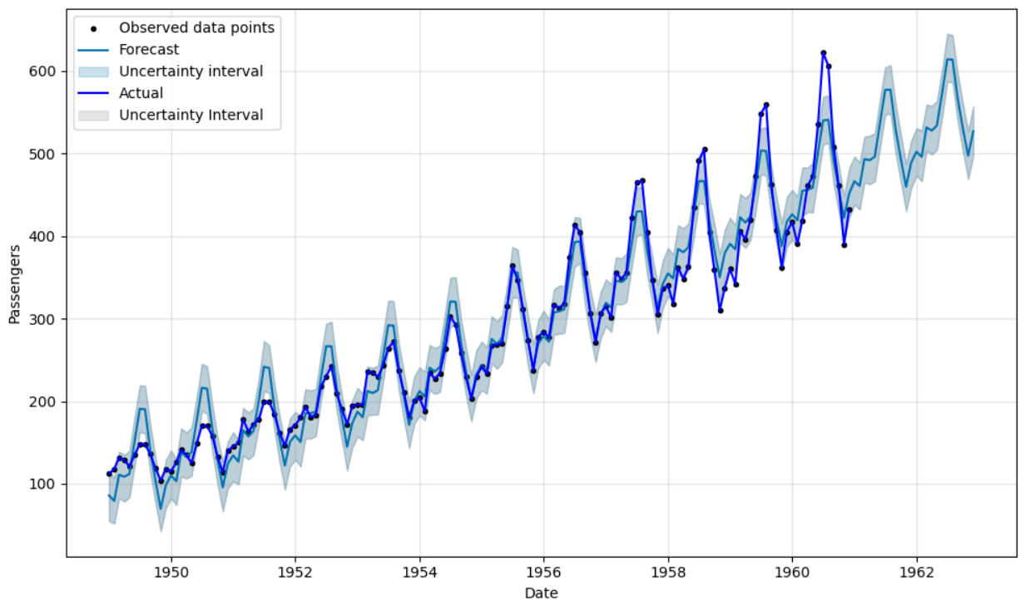

Slide 18
ARIMA-d Up
The ARIMA model type is a ‘basic’ one – a more elaborate moving average.
I.e. it is ‘pure stats’ and is an old way of making these projections.
Pros:
Simple, transparent, generally less overfitting/variance error.
Single digits of number of weights trained during fitting.
Cons:
Potentially too simple, not adaptable to variable scenarios.
Low capacity to adapt – too much bias error, especially in complex scenarios.

Slide 19
Smarter Time Models
Modern models have much more capability than a simple ARIMA one.
Large numbers of weights can capture less frequent or obvious patterns.
In some cases (neural networks) models can learn things like the ARIMA patterns themselves.
Their capacity to learn is much larger - they have more weights, can learn complex patterns.
Similar to a large tree vs a linear regression – more flexible in learning and adapting.
Rare events, ‘special’ times like holidays, longer cyclical patterns, etc…
Much of the flexibility in the tools that helped language models also help here.
These models tend to work and interact more similar to what we’re used to (or NN-style).

Slide 20
Facebook Prophet
Facebook Prophet is a library that is well setup to handle common time-series problems:
Handles events such as holidays, including custom lists.
Can be set to anticipate change points, e.g. product launches.
Provides useful things like plotting and cross validation.
Can handle additional regressors.
We can use a Prophet model much like the above models, with slightly different syntax.
There are several other libraries that handle time-series data similarly.
Modern implementations are based on recurrent neural networks (RNNs) or transformer based neural networks.
Neural networks well suited to sequential data. Seen with language models.

Slide 21
Additional Regressors
Much like a classification or regression we can have multiple features.
With a time-series we can add more regressors (using Prophet).
The regressors must exist for the data that we’re predicting.
E.g. if we are using the barometric pressure to predict the temp next week, we need to have that pressure value as an input.
This is the main drawback to adding regressors to time series models – we don’t know them.
We can make a forecast for those values, or construct regressors that can be known in advance (e.g. average past 3 days of barometric pressure.)
Many times, even if these regressors add more info, we don’t have a way to create a model that properly captures that info properly. Simple may be better.

Slide 22
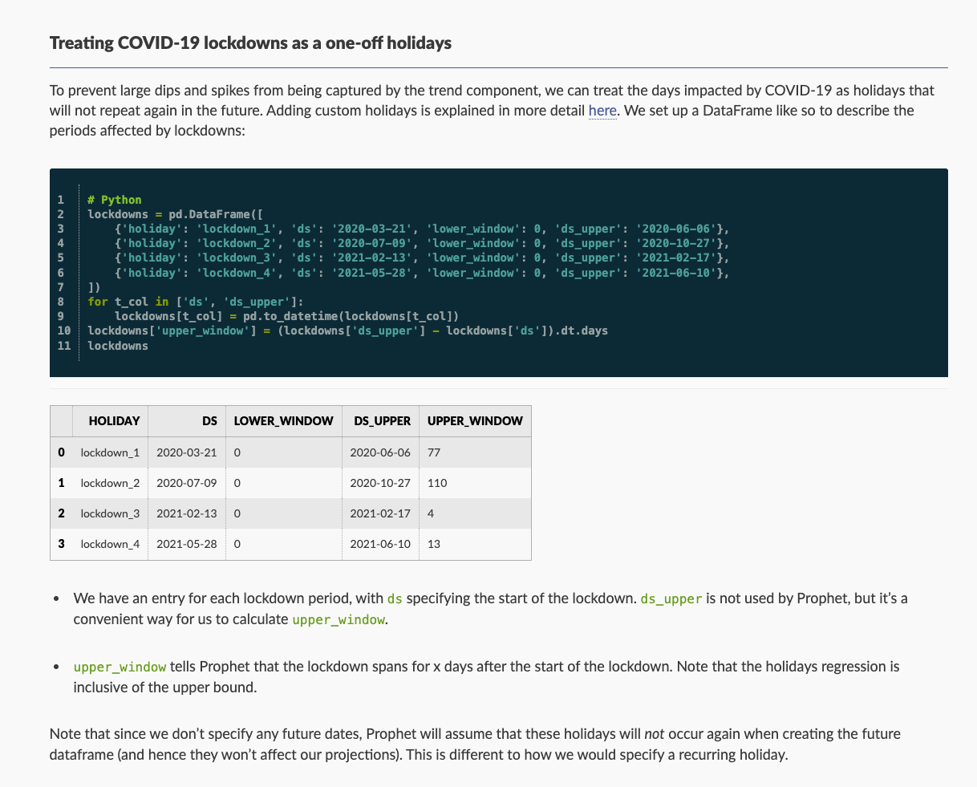
Other Considerations
Advanced models can also handle one-off events, like COVID.
The prophet API is generally setup to make this mostly pretty simple.
There are a bunch of similar options, mostly in a user friendly setup.

Slide 23
Determining a Time-Based Model
The approaches with time series modelling differ greatly – averages, regression, NNs…
Data processing becomes more open ended in some ways:
Time values may be transformed many ways – binned, time since last, duration, etc…
Framing of the problem is flexible, and requires domain and technical knowledge.
Some problems may be framed in different ways.
A CC fraud model may look at time of day, time since last purchase, or both as features.
A “crime predictor” could be a regression that predicts #crimes/day as a target, or a time series that predicts the same thing, just oriented differently.
Feature selection here tends to be much more critical than with regression/classification.

Slide 24
Time Series Conclusion
Sequential or time-series data requires a slightly different approach to predictions.
Simple models only have one value, and we attempt to make a model that captures its patterns.
Larger models require some ad-hoc dataset construction to make sense.
Time-series often requires different, and more, data prep before we can model.
Rule-of-Thumb – start with a simple model, and complexity if needed.
Time-series models are rapidly developing with language/translation and other generative models.
Any time there’s a direct dependence on “the last time”, these ideas apply.

