Slide 1
Housekeeping
Today:
Images and image recognition.
Logistic regression.
Gradient descent with a bit more detail.

Slide 2
Logistic Regression and Classification

Slide 3
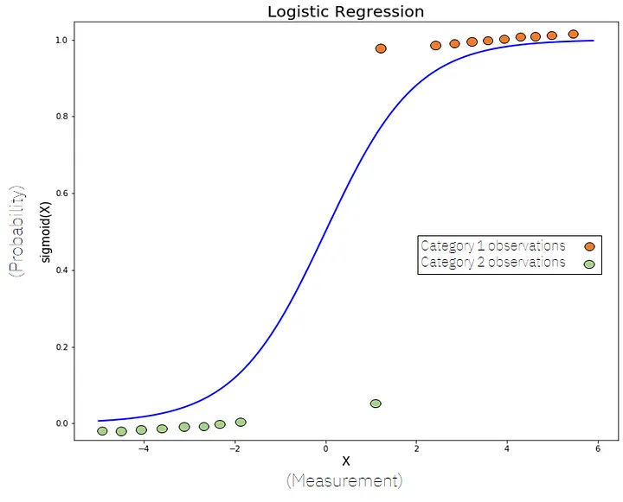
Classification
Classification puts records into groups.
We examined logistic regression through the logit function.
The model doesn’t directly predict the label, it predicts the probability of that label, then translates that to an output.

Slide 4
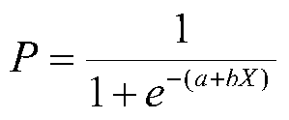
Classification and Gradient Descent
Our classifying models produce a class as their label – usually 1 or 0.
The internal calculations produce a probability:
The probability of a 1 occurring.
The “closeness” of our predicted probability to the true value is our loss.
Just like in a linear regression, we:
Set the weights (still the slope and intercept, but the logit arranged ones)
Observe the cost of the model.
Use gradient calculations to “attribute” the cost (error) to the weights.
Update the weights to move “downwards” on the cost curve.
Repeat until stopped or optimal.

Slide 5
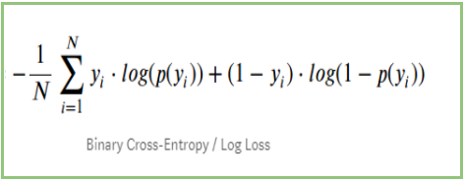
Cost in Classification
Regression gradient descent used MSE to measure cost.
Classification gradient descent has different cost calculations.
For binary classification, we use log-loss:
Average log of the “correctness”.
A.k.a. binary cross-entropy.
Like MSE looks at closeness to correct in regression, this does in classification.
Not accuracy based, closeness of prediction based.

Slide 6
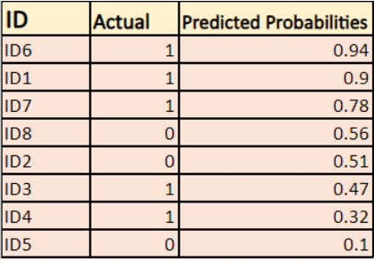
Step 1 – Model Predicts

Slide 7
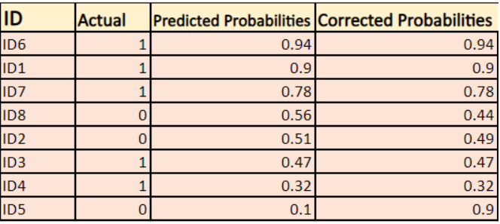
Step 2 – Correct Probabilities

Slide 8
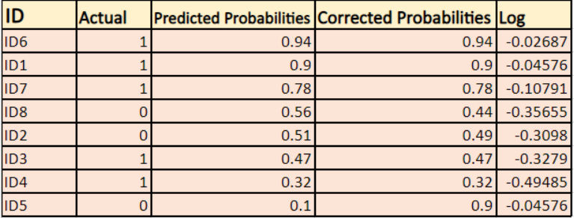
Step 3 – Take Log

Slide 9

Step 4 - Tally

Slide 10
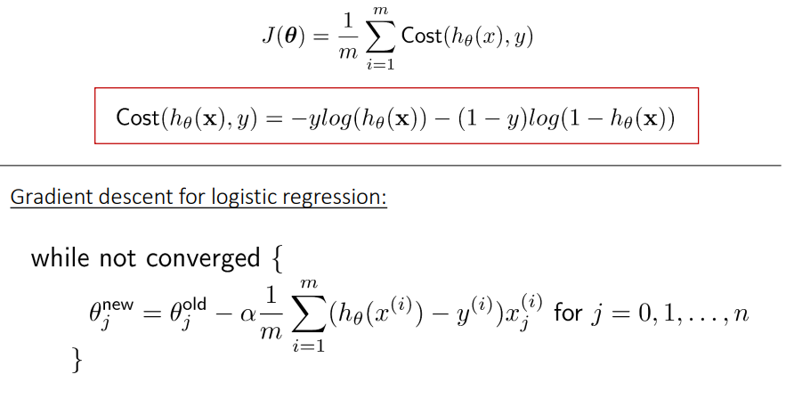
Step 5 – Gradient Descent Update Weights

Slide 11
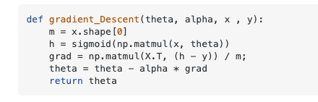
Gradient Descent – One step
Theta = weights. (e.g. slopes and intercept).
Alpha = learning rate. (HP)
X,y, = features, target.
H = post activation prediction value.
The result of the current model’s prediction.
Grad = gradients:
Matrix multiplication, this is the partial derivative step.
The calculus magic part – cost with respect to weights.
We take the total cost (error), and ”assign” responsibility to weights by this step.
Weights are then updated to lower the overall cost, the next round will predict with the new weights…
FYI for now, becomes more important to understand with neural networks.

Slide 12
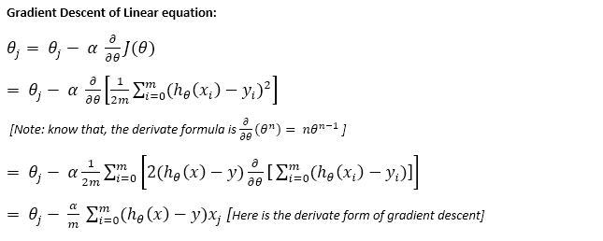
Step 5 – Gradient Descent Update Weights

Slide 13
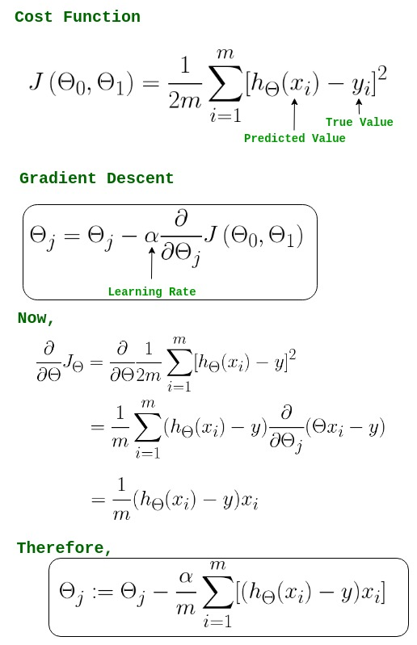
Step 5 – Gradient Descent Update Weights

Slide 14
Classification and Gradient Descent
The process of gradient descent

Slide 15
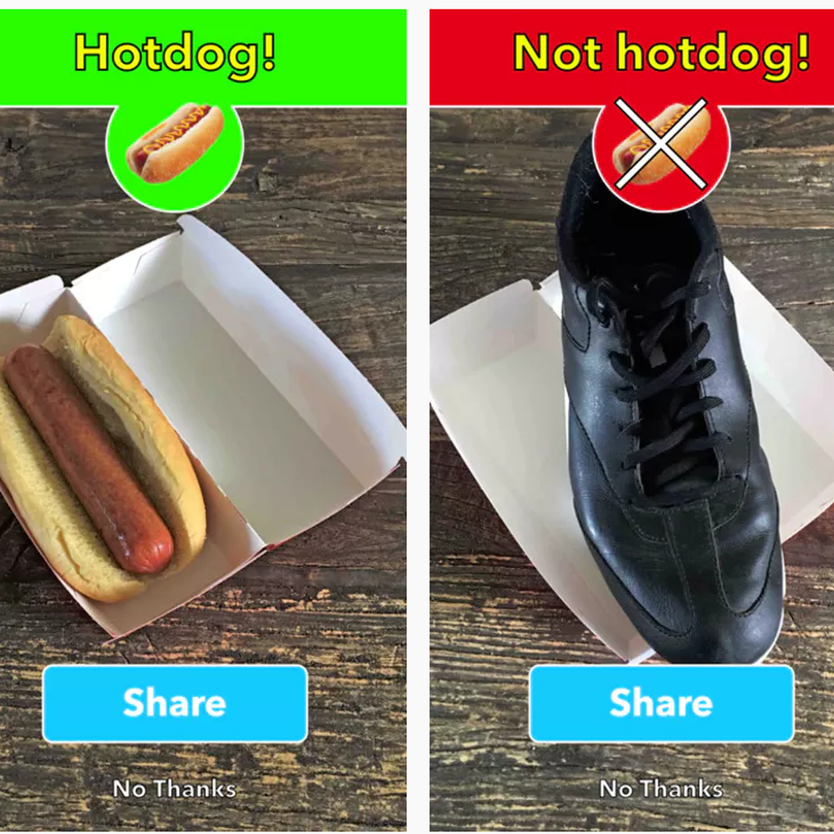
Multi-way Classification
Many problems aren’t simple A/B, e.g. image recognition.
We can also classify into an arbitrary number of classes.
The approach we’ve used only works two ways, so we have a few approaches...

Slide 16
Multiway Classification
One vs rest/all:
One classifier is created for each class.
Every record is tested for each class, yes/no, one by one.
One vs one:
One classifier for each pair of classes.
Selects class by looking at which one wins the most votes.
Multinomial:
A score for each class is calculated.
The highest score class wins.

Slide 17
Multiple Class Classification
Multinomial classification is the one from the previous page that is different.
Rather than yes/no, multinomial (as it is also known) classifiers say “which one”.
Involves a multi-step process:
Set the weights for the model.
Generate the logits for each class.
Use “Softmax” to translate the logits to probabilities.
Use ”Cross Entropy” to calculate the loss.
Use gradients to “attribute” loss back to weights.
Adjust weights and repeat.

Slide 18

Step 1 – generate Logits
The outcome of the internal logistic regression calculation is the logit.
Note – not the outcome label.
In a binary classification, our error is just the distance from the true value – 1 or 0.
Only one value (and compliment) is needed.
In a multinomial classification we have several logits – one per outcome class.

Slide 19
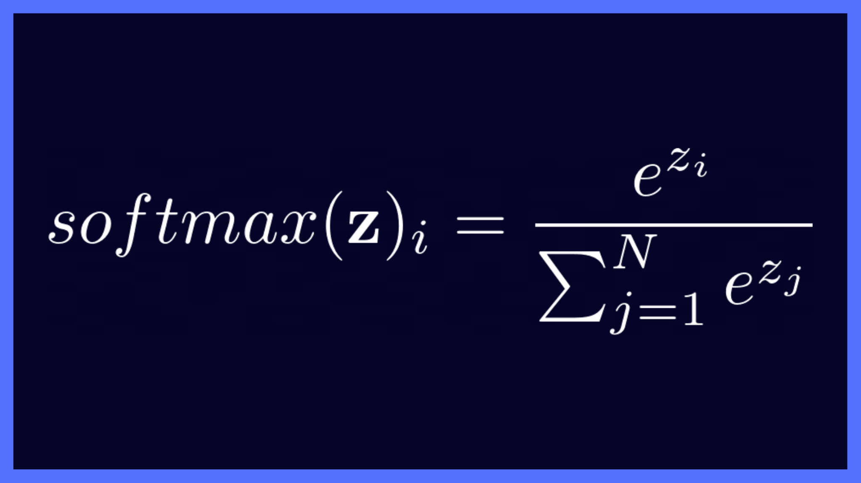
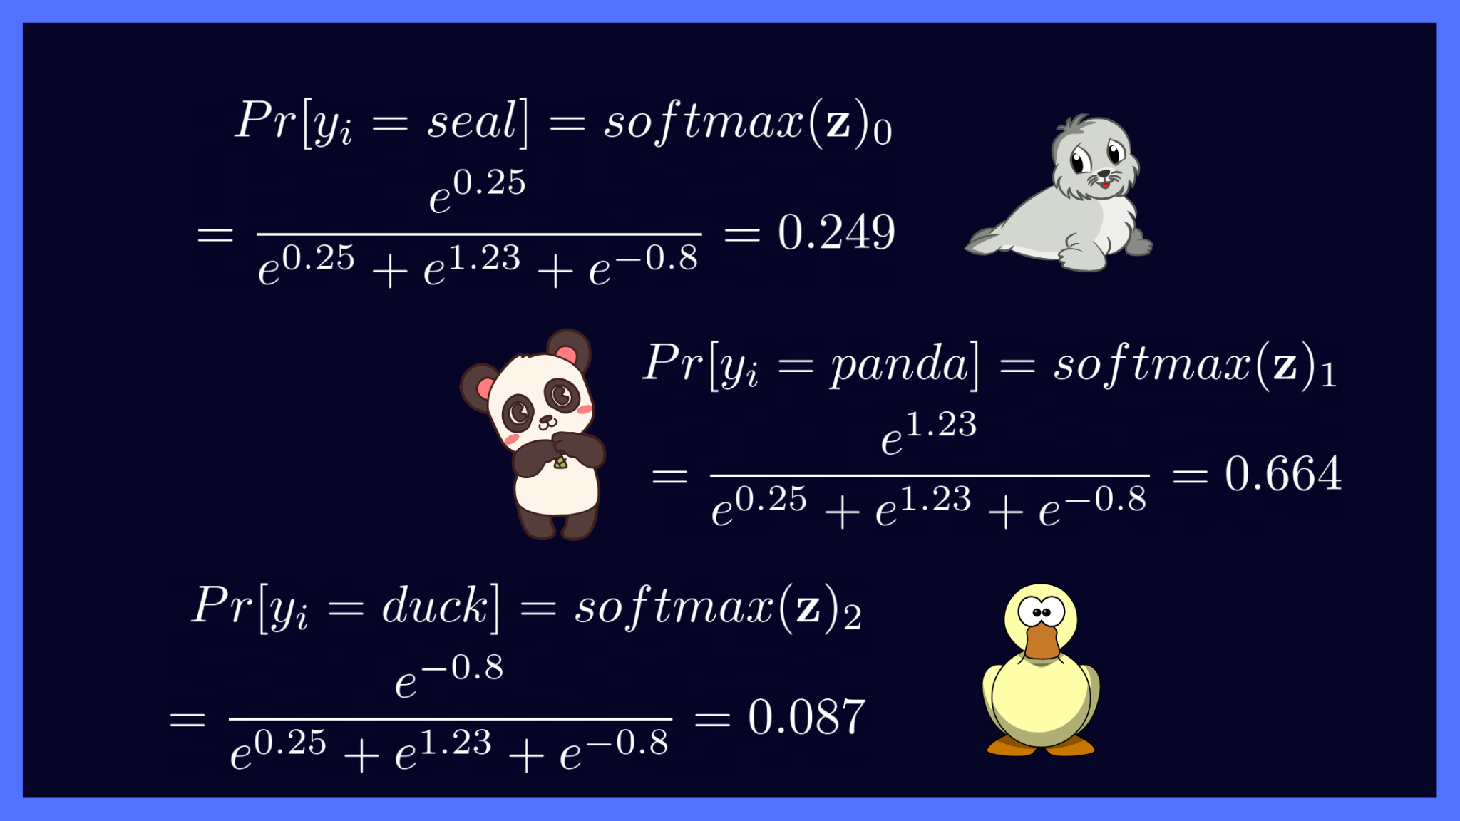
Step 2 – Softmax
The softmax function takes those logits and translates them to probabilities.
All probabilities sum to 1 – we are not assigning multiple labels.
The most likely outcome is the label.
The softmax (and sigmoid) are also known as activation functions.
This will matter with neural networks.
Sigmoid took the logit and produced binary probs, softmax takes the logit and provides multiclass probs
In the image, .25, 1.23, and -.08 are the outputs of the model.

Slide 20
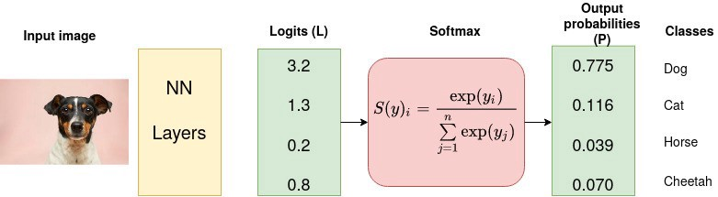
Softmax Example (Replace NN with Log. Reg.)

Slide 21
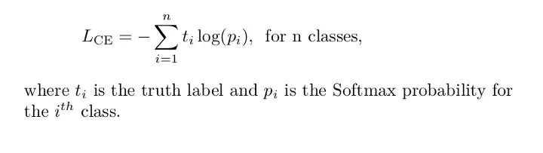
Step 3 – Labeling: Cross Entropy
Cross entropy is probably the most common loss function used with multiple classification.
Cross entropy is the multiple class version of log-loss.
One the loss is calculated we can gradient descend as normal.

Slide 22
Conclusion
Logistic regression introduces us to a few things:
Alternate cost functions – depending on the scenario, we can switch between cost calculations.
Multiple class predictions – processes mostly the same, but the prediction processing is different.
In sklearn, regularization (L2) is enabled by default.

