Slide 1
Housekeeping:
We’re almost done! Things left and scheduling:
Exam – Dec 9. Theory and answering questions. No submission of code.
Hypothesis testing, estimates, regression/classification, data prep/exploration, etc…
Assignment 4 – Dec 2. One (larger) logistic regression problem.
Project – Dec 13. Open ended exploration and prediction.
In groups, so the work can be divided.
Take a look, we can discuss next time in more detail.
Quiz 3 – I’d probably cancel this (the school wants LOTS of small assignments), if you want to do it, I can open it up for you.
Today: More logistic regression and imbalanced data. (027)
Other remaining classes: Bayes and probability, time series basics, notes on CLT. (All not directly needed for pred. mod.)

Slide 2
Classification and Imbalanced Data

Slide 3
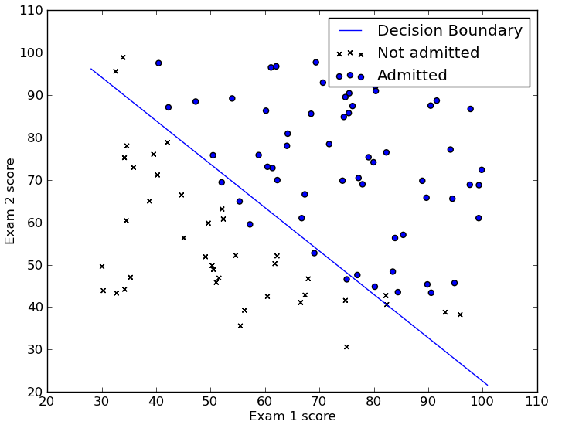
Classification and Logistic Regression
We recently looked at logistic regression, let’s go back and take another look at it.
Logistic regression (and all classifiers) aim to split the data into two (or more) groups, called classes.
E.g. customer/not-customer, True/False, 1/0
We can visualize this with a dataset with 2 features.
E.g. Predict admission from two test scores.
The model here is the line, rather than being a best fit like a regression, it acts to separate class A from class B.
Logistic regression is a linear model, so we can only make a line to classify the data.
The line is our decision boundary.

Slide 4
Finding the Line – Descend that Gradient
In linear regression the “least squares” calculates m and b directly.
Our line (the model) that divides the two classes was generated by the gradient descent process we mentioned:
Make a prediction for the model’s values (2 slopes and intercept in this one).
Check the error with those values.
Use some calculus to attribute the errors to the original terms (y = m1*x1 + m2*x2 +…)
Adjust each term to get a bit less error.
When the error hits the lowest point, whatever the slope and intercept is at that point is the values we need for the model. Y = m1*x1 + m2*x2 + b
Just like linear regression, these values are all we need for a model (with more math).
Note: the error here is not accuracy of predictions, it is the distance between prediction percentage and reality.

Slide 5
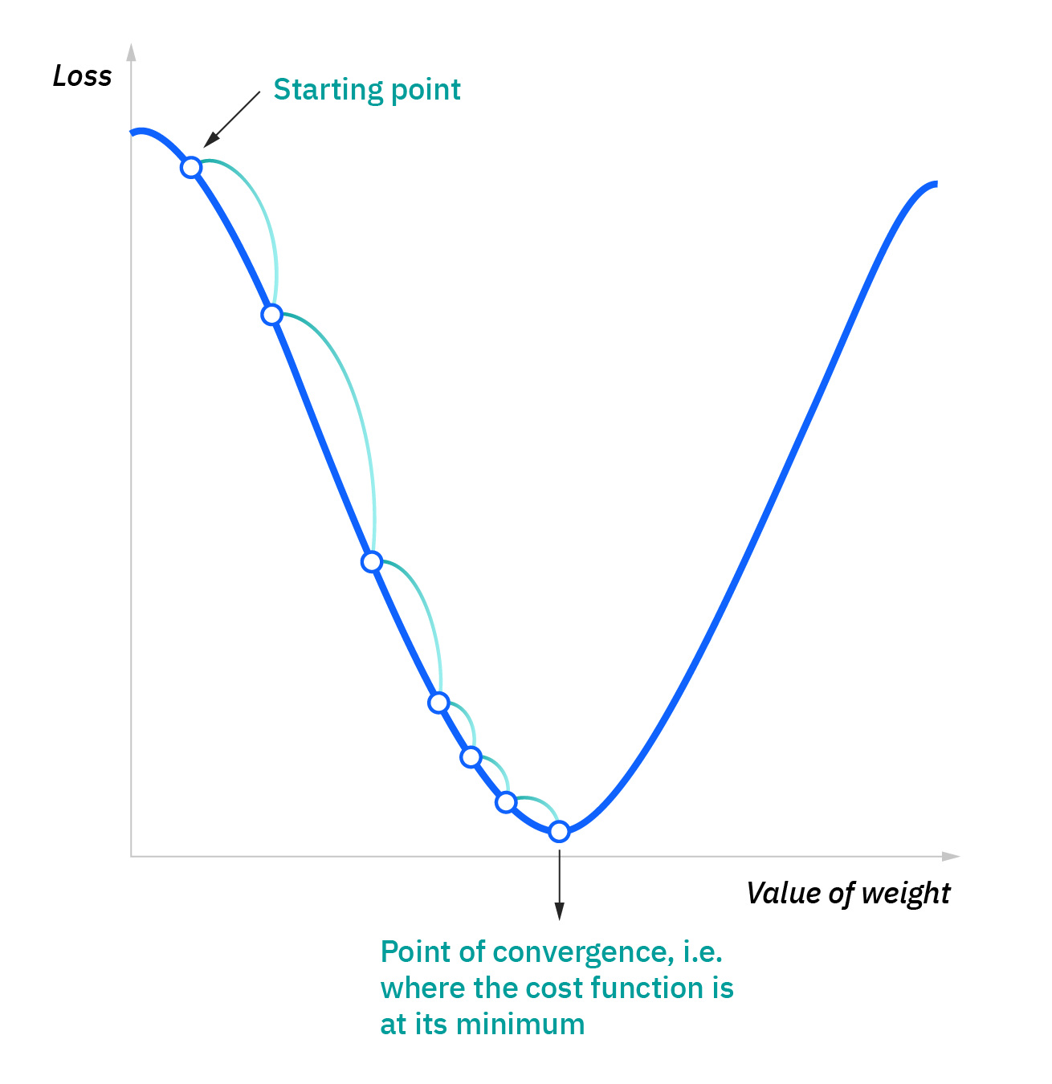

Slide 8
Animation with Linear Regression

Slide 9
Gradient Descent
This gradient descent process is one that is very common, not just for logistic regression.
When we can’t directly calculate the “answers” like we can in linear regression, we do something like this – repeated guess and test as we progress towards the answer.
The starting values don’t really matter for the end result.
Different algorithms have different methods (sometimes controllable by an argument) that generate a starting point of values (slopes and an intercept).
The starting guess is intended to reduce the rounds needed to find the answer.
This is mainly relevant for efficiency – when processing large amounts of data, saving rounds of calculation can really add up.

Slide 10
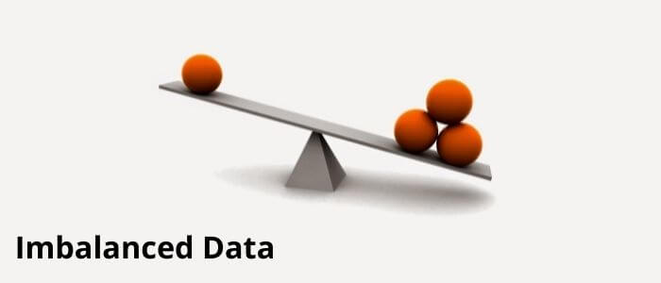

Slide 11
Imbalanced Data
On common issue with classification is that it is possible to have radically different number of samples in each of the classes.
E.g. credit card fraud – most things are not fraud.
This imbalance can present an issue, as our models generally want to be as accurate as possible.
If you predict False for every credit card transaction, you’ll miss all the fraud, but you’ll score north of 99.5% accuracy.
Each gradient descent loop looks to make the predictions more accurate, if the data is imbalanced, we can be “pulled” in that direction. The majority class “dominates”.
In a credit card example, we may get lots of false negatives. Many frauds are missed.
One method to combat this is to look at other error metrics like recall, precision, and F1...

Slide 12
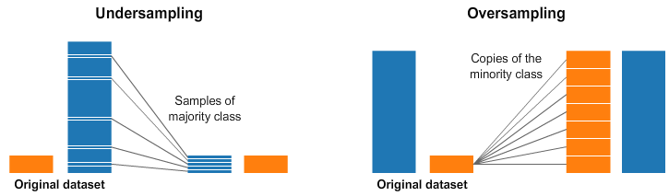
Data Resampling
Another thing we can do is manipulate the data, to make it less imbalanced.
We change the training dataset to be less “true to life” but to be better at “training a model”.
Analogous to if you studied for a diploma exam by looking at test prep material rather than the class material. You aren’t studying the “real” stuff, but you are using something that will prepare you better for what you care about – test performance. Or test data performance.
There are two basic approaches to this:
Undersampling – reducing the amount of the majority class.
Oversampling – increasing the amount of the minority class.

Slide 13
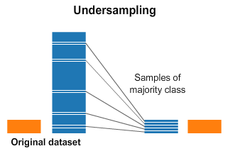
Undersampling
An undersample takes only some sample of the majority class, so there is more balance.
Most simple way is to just randomly select X records from the majority class.
Other algorithms use smarts to determine which to remove.
Tomek pairs, in the code example, removes some of the majority records that are “closest” to the decision boundary.

Slide 14

Oversampling
Oversampling is to reproduce the minority class records multiple times to improve the balance.
Most simple way is to just include the minority data multiple times.
i.e. random oversampling with replacement.
Smarter algorithms can generate “similar” data based on what is in the minority class.
SMOTE in the code example, creates interpolated (between) data records from the original.

Slide 15
Imbalanced Learning
We have a package that can handle most of the imbalanced stuff for us – imblearn.
This package provides functions that can do the resampling, that are in the same format as the sklearn stuff:
Using them is easy, as they perform like things we are used to.
We can incorporate them into things like pipelines, to make it easy.
Imblearn has lots of resampling algorithms that we can try.
Some are combined – eg. Oversample to generate new data, then under sample to “clean” it.
You likely don’t have imblearn installed.
Try running a code cell with “!pip install imblearn” and it will install it. (if you have pip)
“!conda install imblearn” (and “!conda install pip”) should do it if you don’t.

Slide 16
Process and Results
Having a more balanced dataset will generally help build better models.
Effects are not very predictable in most cases, must try and see results.
When oversampling we are inventing new data, that can introduce error.
When undersampling data we are removing data, that can introduce error.
When dealing with imbalanced data, we can include this in our prep steps:
E.g. clean data, remove outliers, select features, encode categorical, resample data, rescale data, etc….
We are focusing on the end result here – we are going to see if changing the dataset gives us a better model.

