Slide 1
Keep da House
Today – Review classification tree, pipelines, imputation, column transformer.
Workbook 003 – not in the stat’s subfolder anymore.
Read the trees chapter in the text on Moodle (Introduction to Machine Learning with Python)
To this point… We should be ok with.
The basic steps/structure of a sklearn process to create and evaluate model.
Prepare data, clean, setup for model, construct pipeline, train, evaluate.
Evaluation – RMSE/R2 for regression, Accuracy/”other” for classification.
Adjusting hyperparameters to make things work/work better (non-systemically).
Basic concepts – train/test data, grad. desc., predictions, loss/cost, ”purity” (from tree).
Now - basics stay the same, we look at diff models, their details, and new tools slowly.
Assignment #1 – Ignore the EDA part. Tree part due 10th?

Slide 2
Pipelines

Slide 3
TodaY
Quick revisit on trees and pruning.
Pipelines.
If time, grid searches, hyperparameters, cross validation part 1.

Slide 4
Pipelines
Most data requires some preprocessing before modelling:
Categorical data usually needs to be encoded.
Numerical data usually needs to be scaled.
Creating long series of steps to prep data can be cumbersome.
Sklearn’s pipeline can simplify and condense data prep into one function.
Create a “pipe” where each step of prep and modelling is specified and executed together:
Fit the data to the pipe instead of the model.
The model is the last step of the pipe, the prep steps are listed in order.
In production usage, we want to make the data prep process well defined, pipelines help.

Slide 5
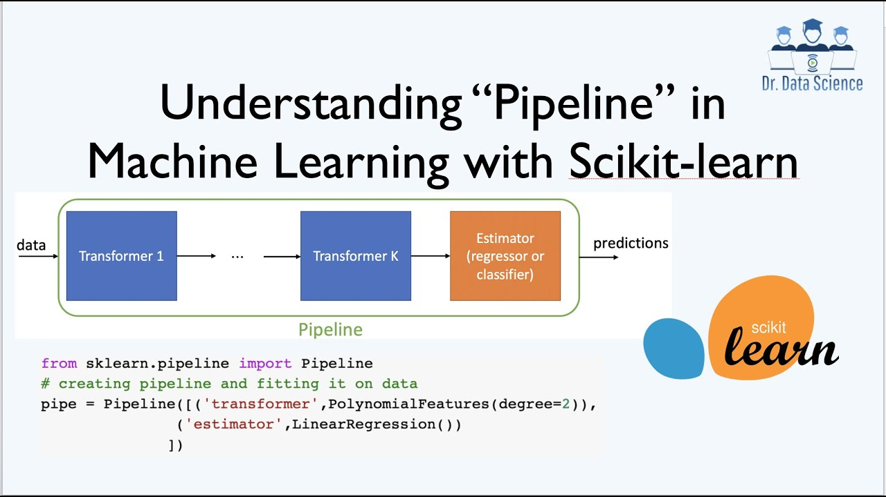

Slide 6
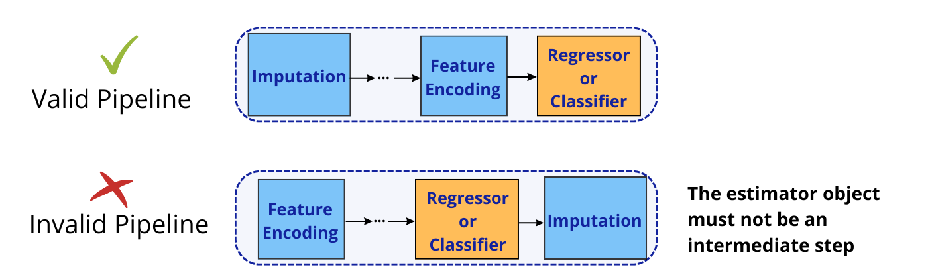
Using Pipelines
Pipelines can contain most or all of our prep steps.
Makes code easier to read and maintain.
Can create custom transformers (later in course) to apply other transformations.
Pipelines can be stitched together to make almost any data pipeline.

Slide 7
Sklearn Transformers
Many/most steps that we feed data through in sklearn are “transformers”.
This is a special label for sklearn objects that do some processing step to data.
Includes prep steps such as imputation or scaling.
Includes “estimators” or a predictive model, normally as the last step.
Transformers have two key methods that are called automatically in a pipe:
Fit() – this “trains” the transformer on the data. E.g. for scaling, it establishes the scale.
Transform() – this applies whatever transformation has been “learned” to the data.
Fit_transform() – this does both in one step.
E.g. a minmax scaler will establish the range with fit, and rescale the data with transform.

Slide 8
Pipelines and Transformers
The transformer universe makes it very easy to build data pipelines.
Pipelines generally don’t require us to “call” the steps, just list them in a pipe.
The entire ecosystem of sklearn is setup to use these in the correct way.
These transformers all extend a couple of classes that define how all transformers work.
There is standardized inputs/outputs, so we can interchange transformers.
We can make new transformers, as long as we follow the rules.
With pipelines, we can avoid dealing with data specifically, and only use the steps, generically.
More robust, reliable, testable, and deployable.

Slide 9

What if we Need to Do different Prep Steps?

Slide 10
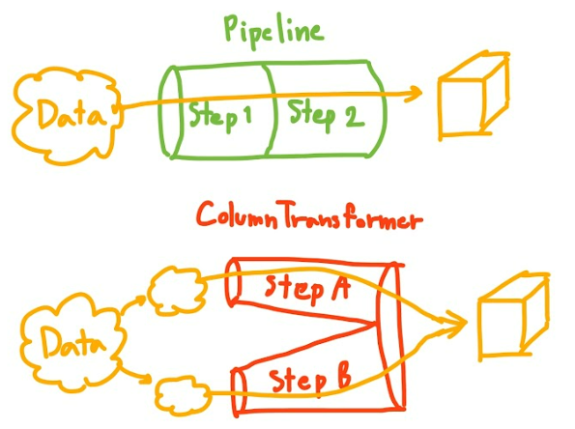
Column Transformer
Column transformers are like a platform that allows for different paths:
Do one set of preparation steps for numeric columns.
Do another set of steps for categorical columns.
Potentially add more branches to deal with different features differently.
The steps inside are the same as with a pipeline.
They are pipelines!!
“Passthrough” is used when nothing is needed.

Slide 11
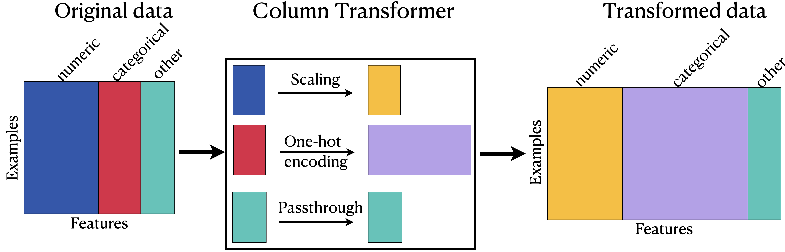

Slide 12
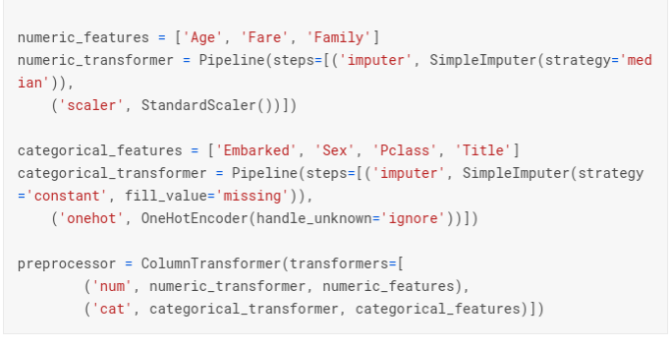
Column Transformers in Code
Each column transformer is like a slightly more complex pipeline.
Specify which columns should take this path, the steps, and a label.
We create one pipeline per “path”.
The CT combines the pipes.
This can be arbitrarily complex.
The “handle unknown” is often needed for messy data.

Slide 13
Building Column Transformer Pipelines
Column transformer and pipeline code is simple, but can get messy.
Steps to keep things straight:
Which different paths are needed, make a pipe for each. (Often numeric + categ.)
List columns and filter into which path they belong to.
Create column transformer that combines the paths, and specifies the columns for each.
If using multiple branches (try not to), minimize the steps that are separate. E.g. if we are imputing two different ways, separate that, then combine the features and continue the rest.
Once the pipeline is made, it becomes easy to rerun – critical for testing hyperparameters to make our model better.

Slide 14
Imputation

Slide 15
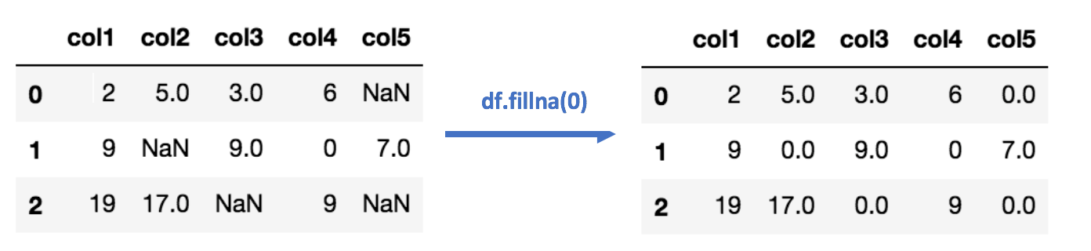
Filling in the Blanks - Imputing
One of the most common data pipeline steps we use is imputation.
Imputation is filling in any missing values in our data.
Common when we have data that is hard or expensive to collect, but has blanks.
E.g. there might be random blanks on a census, but we don’t want to lose all data.
Correct imputation requires some domain and goal knowledge to do well.

Slide 16
Imputation Options
There are several different options of how to impute:
Delete – if a value is missing, delete the row. This is the “safest” as we don’t invent data, but we can potentially lose lots of data if we have many empty values.
Mode – replace with most frequent. This is common in categorical columns.
Mean/median – replace with an average. This is common with numeric columns.
“Default” – replace with some specified value. If we have some known default value.
Which one is best depends on the circumstances.
Median tends to be better than mode when dealing with outliers.
There are several imputation transformers, and several parameterized options in each.

Slide 17
Real Imputing
Imputation is important because it allows us to keep useful data, even if incomplete.
Think of Statistics Canada – broad data, but likely not perfectly complete.
Some census questions may be blank, or consciously unanswered.
Getting more/new data is difficult and expensive to impossible – census runs at a set interval.
Scrapping entire rows (likely a full person’s responses) means data loss is severe.
We can (often) make a better model by keeping data with imputation, rather than keeping data 100% correct.
This isn’t super intuitive, but the fake data lets us keep more real data, which may be better.
Imputation can also be smarted, with more advanced techniques.
E.g. impute income based on job, city, age, etc… rather than ‘dumb’ average.

Slide 18
Imputation Concerns
When doing something other than deleting, we are creating fake data.
This might be common than you think in machine learning.
Our goal isn’t accurate data, it is whatever data makes an accurate model.
We need to make sure we aren’t inventing data that will ruin our model.
This will depend on the distribution of the data and missing values.
We don’t usually want to impute “too much” data, though that limit varies.
Around 10% missing should trigger some concern.
The more “random” the data is, the less likely our imputation is to be accurate.
As data grows, odd patterns can emerge with imputation.
There are occasional papers showing accurate prediction with 80%+ missing values. Rare.

Slide 19
Smarter Imputation
We’ll look at this when we do unsupervised learning in more detail.
Real imputation often uses “smarter” methods to determine what to impute.
Machine learning models can “learn” the expected values for a column.
We can impute a “smart” value for that row of data, rather than a generic average.
Model can predict the expected value to impute.
E.g. for census income data, rather than inserting a median for a missing income, that can be predicted based on job, location, age, etc…
We are still inventing data, but with more logic behind it.
Our imputation will be “dumb” – we don’t have the domain knowledge.

Slide 20
Imputation Wrap
Imputing values is very common in our pipelines.
A default of dropping missing values is usually good, as empty spots will cause errors.
If we have a need or reasoning to impute further, we can use another imputer.
If we are creating data, we want to be careful and monitor the impact.
Performance on actual test data.
Amount of data generated.
Does the distribution change pre-post imputation?
If there is a “critical” feature, imputing it may not make sense.
I.e. if one feature is really important, we may skew results if we impute it.

Slide 21
Data Prep Steps
In all cases, we need to do some steps to prepare our data for a predictive model.
The exact steps needed will vary, depending on data and ultimate goal:
Commonly - outliers, missing values, actual errors, rescaling, encoding.
The target is always nearly the same:
X data containing feature set. All values on the same scale, which implies encoding.
Y data containing one column of target.
Pipelines and column transformers are tools that can package several steps together.
The pipeline effectively “becomes” the model, in terms of usage.
Most or all of the data preparation steps can be “built into” the model, via a pipeline.

Slide 22
Pipelines and Prep
Pipelines are series of steps that are applied to whatever data goes through it.
Steps can include many “transformers” – such as encode or impute, as well as models.
Column transformers split/combine different pipelines, and send data down one.
The column transformer contains several pipes, as well as a list of columns to put in each.
These can be combined infinitely to take data from its incoming state into our goal.
If new data comes in, that we need to predict, now we can just feed it to the model.
Makes code much more maintainable, easy to use, and reliable.
Use them, it makes things easier.

