Slide 1
Housekeeping
Today:
Review of distributions, example of applications (don’t need to memorize, for demo).
Multi-variable statistics.
Correlation.
Scatter plots.
Line of best fit.
Intro to errors, residuals, and real predictive models.
That’s REAL PREDICTIVE MODELS!!!!
Test – average around 80.

Slide 2
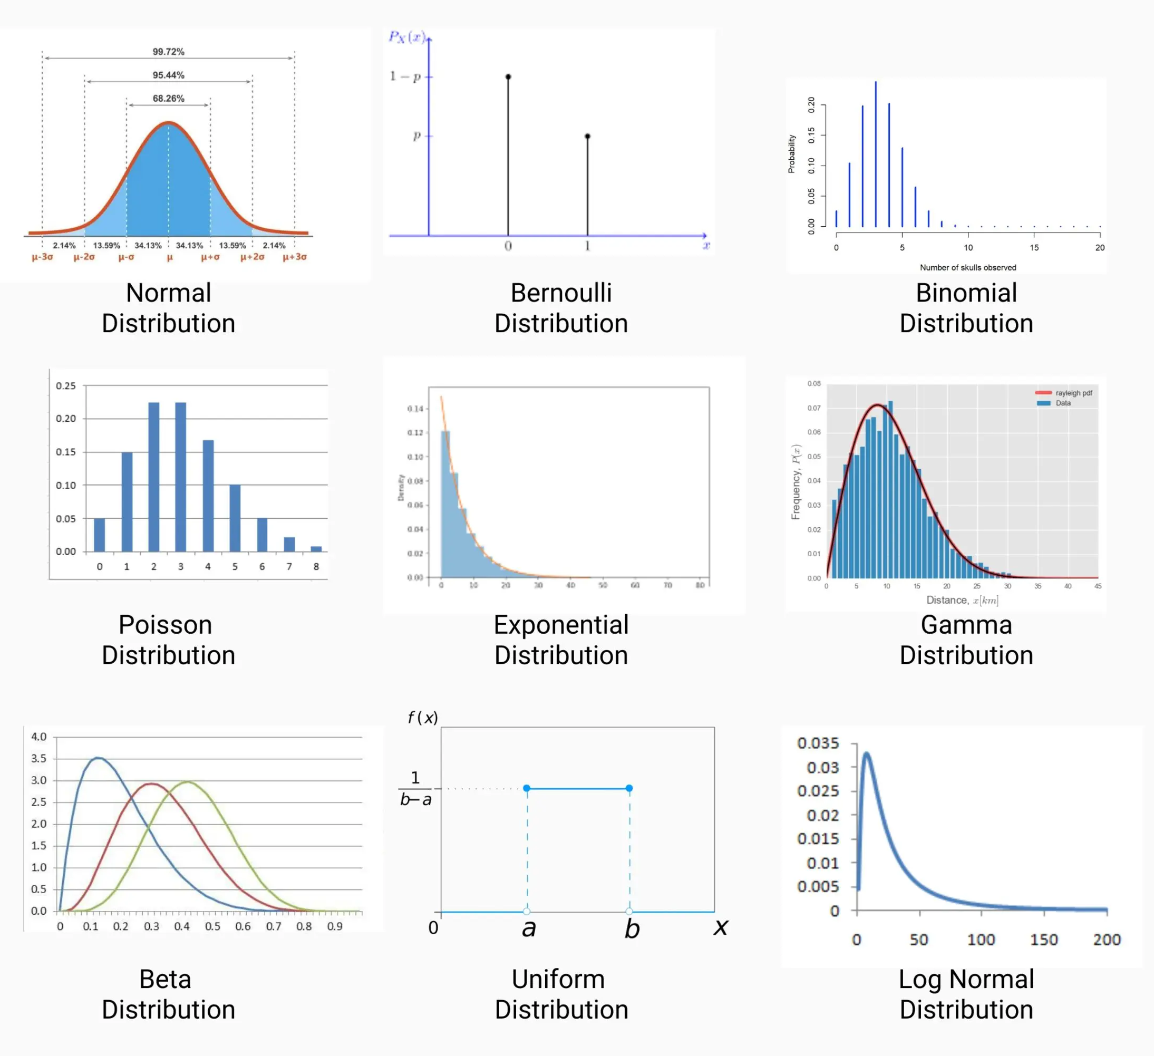
Distributions – Remember them!
Recall the idea of a distribution – the ‘shape’ of any variable over its range.
Helps us understand where our data lies – grouped tightly, spread, random, normal, etc…
We use mainly to understand the data.
Statisticians can use them for other purposes as well.
This is mostly for context.

Slide 3
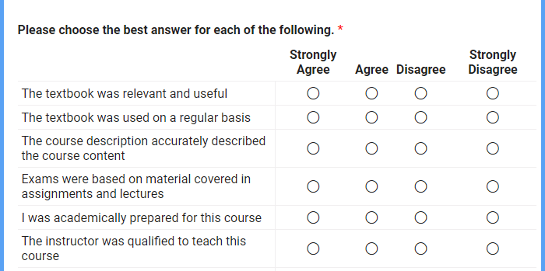
Using Distributions – in Reality
I’ve done one thing that directly involves basic stats for a real use.
Course evaluations at ATB (the bank).
Course evaluations were a mess, we improved by:
Standardizing questions (e.g. “the location was good”, ”the instructor was effective”, etc…)
Standardizing scale on a 4 pt scale.
This led to data that could be consolidated into a dataset:
Each row is one response.
Each column is one value/feature/variable:
Some are demographic categorical – instructor, location, course, etc…
Some are numerical scores – each question response.

Slide 4
Course Evals
A goal was to use course evaluation to evaluate instructors.
Problem – scores are virtually always between 3.45 and 3.55
No matter the subset slice taken.
Cause – most people pick 3 or 4 (4 or 5 on a 5pt scale), semi-randomly:
The number of 3s and 4s dominate outliers (low scores) in calculating mean/median.
Bad scores were hard to separate from good scores, since so many responses were “high average”.
I.e. if people randomly pick 3 or 4 will overwhelm the low scores in the averages.
Solution – identify “bad” scores by looking at distribution of scores < 3.
If bad scores are even between 1s and 2s, the score is probably OK.
If bad scores are clustered around 1, that is probably an issue.

Slide 5
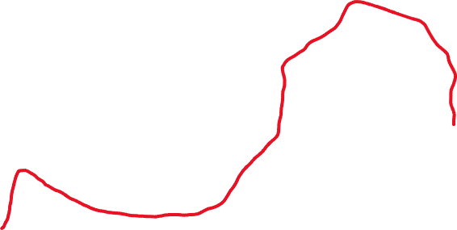
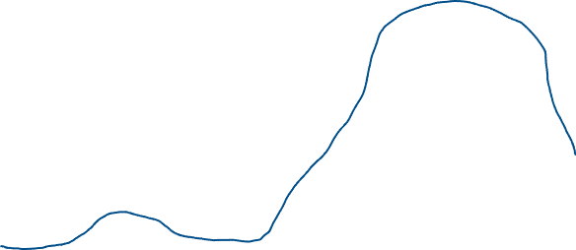


Slide 6
More Distributions
We can use our knowledge of distributions to do estimations for the population.
E.g. survey 1000 people on how they will vote, and project that for the nation, accurately.
If we know (i.e. we’ve decided visually or by a test) that data follows some distribution, then we know its general shape.
For a normal distribution if we have the mean and std, we can know the whole shape.
Other distributions are similar, may require a slightly different input.
So if we have a sample, and we want to know for the population.
Calculate the mean and standard deviation for the sample we have.
Generate a ‘fake’ (analytical) distribution with those properties.
Use what we know about the normal distribution to draw conclusions.

Slide 7
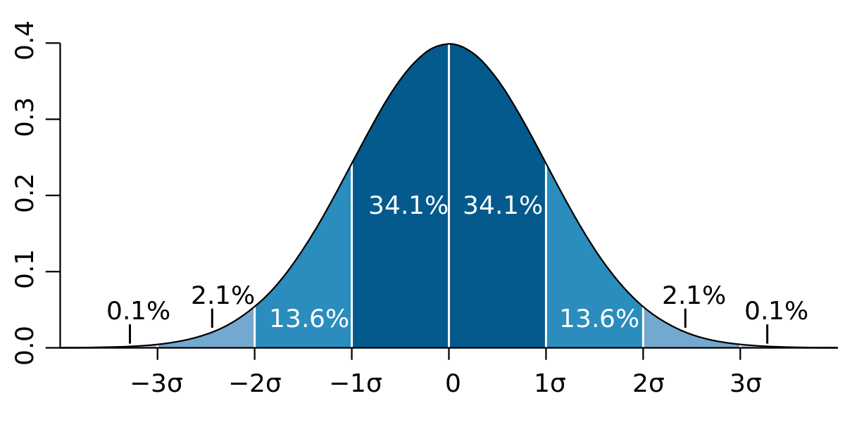

Slide 8
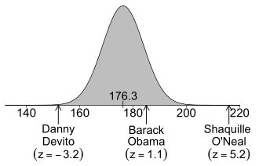

Slide 9
Correlation

Slide 10
Relationships between Variables
Until now we have looked at the distribution of one value at a time.
Distribution shape.
Slicing variables into segments and comparing them or their effect size.
We can also look at the relationship between two variables:
Height and weight of people have some relationship – taller people are generally heavier, but there is wide variation.
Correlation is the relationship (or dependence) between two variables.
As one variable changes, it tells us something about the other variable.

Slide 11
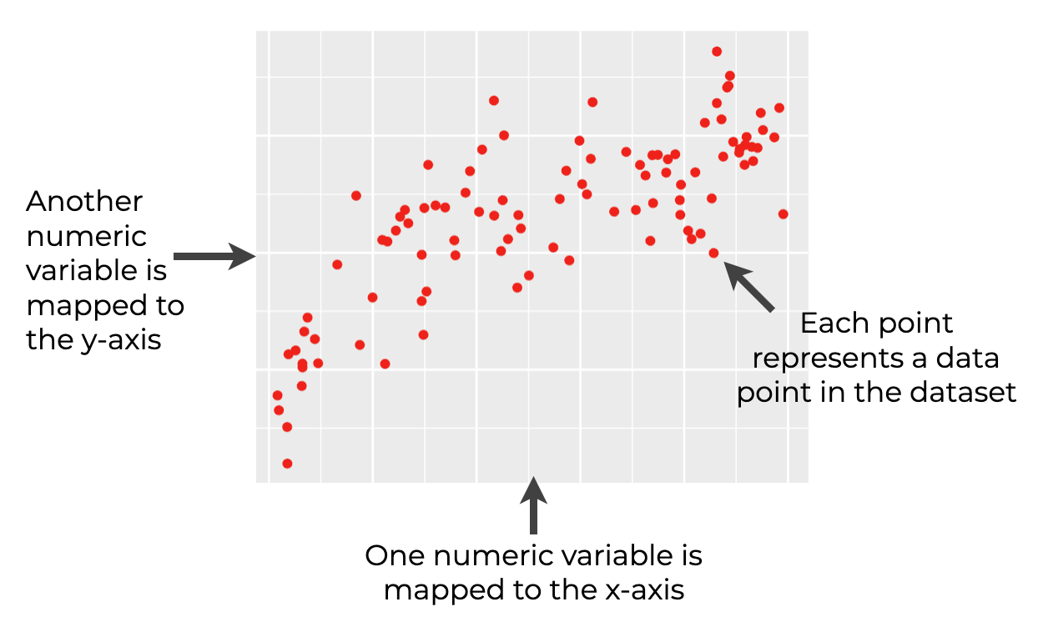
Scatterplot
Scatterplots are a simple tool for examining correlation graphically.
Book highlights some extensions:
Jitter – to make patterns more easily read.
Hexbin – sort of a 2d histogram.
See this in code in a minute.
The more the data “forms a line” the higher the correlation is.

Slide 12
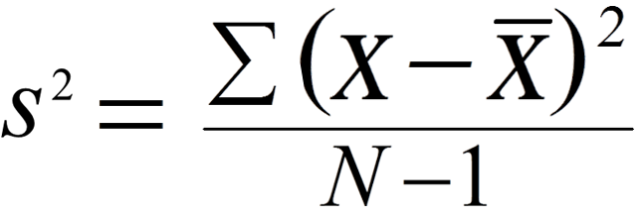
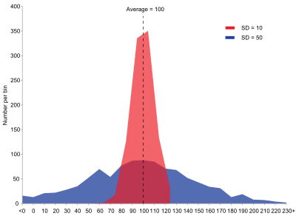
Variance
Recall – Variance is the average squared distance from the mean of a dataset.
Large variance = spread data.
Small variance = condensed data.
Note: The n-1 is so sample, population uses n. The rationale is that if there is only n=1 in the sample, there is not variance. You need at least 2 values to have 1 variance.

Slide 13
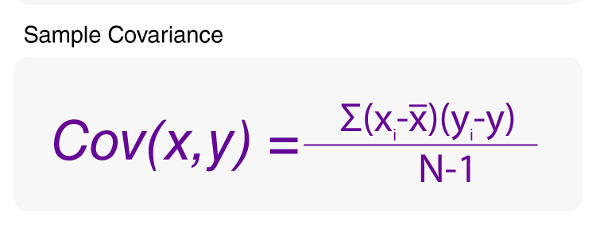
Covariance
Covariance is the average distance of the x-axis values times the y-axis value.
Can think of it as a 2 dimensional variance.
Distance from mean on X axis.
Distance from mean on Y axis.
If positive – as X goes up, Y goes up.
If negative – as X goes up, y goes down.
Larger number, stronger relationship.

Slide 14
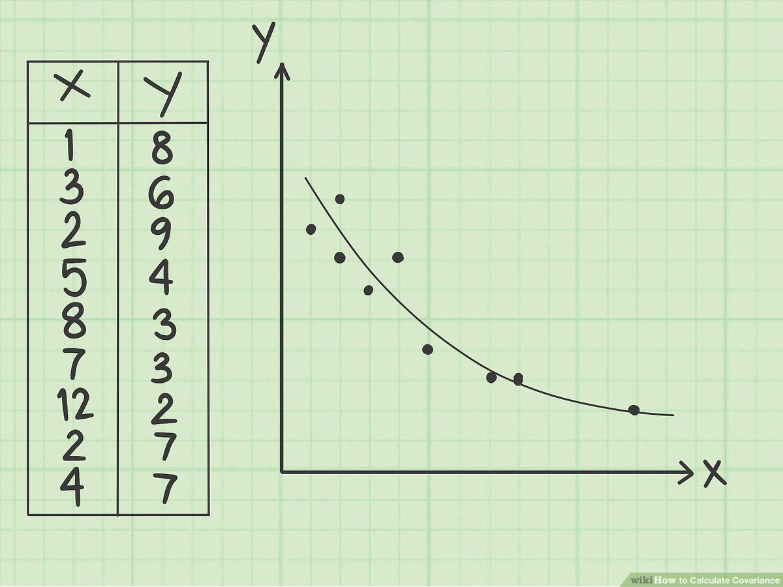
Variance and Covariance
Variance of X:
Mean is 4.89
Sum the distance of each dot on the x-axis from 4.89. Divide by n-1
E.g. 1-4.89, 3-4.89, 2-4.89….
Variance of Y:
Mean is 5.44
Sum the distance of each dot on the y-axis from 5.44. Divide by n-1
E.g. 8-5.44, 6-5.44, 9-5.44…

Slide 15
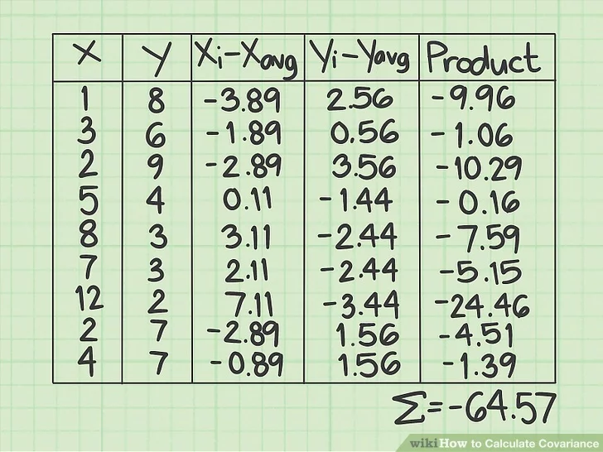
Covariance
Multiply the x-distance and the y-distance for each point.
Sum those values and divide by n-1.
Cov = -64.57/8 = -8.07
Meaning – as X goes up, Y goes down.

Slide 16
Covariance to Correlation
Covariance not directly used all that much:
The units are wonky – e.g. height vs weight is “pound-inches”.
Actual value dependent on original raw values.
Similar issues with variance compared to standard deviation.
Correlation is more widely used:
Measure strength or the relationship -1 to +1.
-1 or +1 indicate perfect correlation – for an increase in X, you can determine the change in Y.
Most values fall somewhere in between, 0 is no correlation, + is positive, - is negative.
Correlation is a measure of how closely tied changes in X are mirrored in Y.
Note: Perfect correlation doesn’t imply 1 to 1, the ratio can vary.

Slide 17
Pearson Correlation
There are a few different ways to measure correlation.
Pearson – the standard way (from the book).
Spearman – uses rank instead of values.
Pandas and scipy have correlation calculations.
Divide covariance by the product of the X and Y standard deviation.
Normalizes so all values are -1 to +1.
Removes units.
Easier to understand with an image…

Slide 18
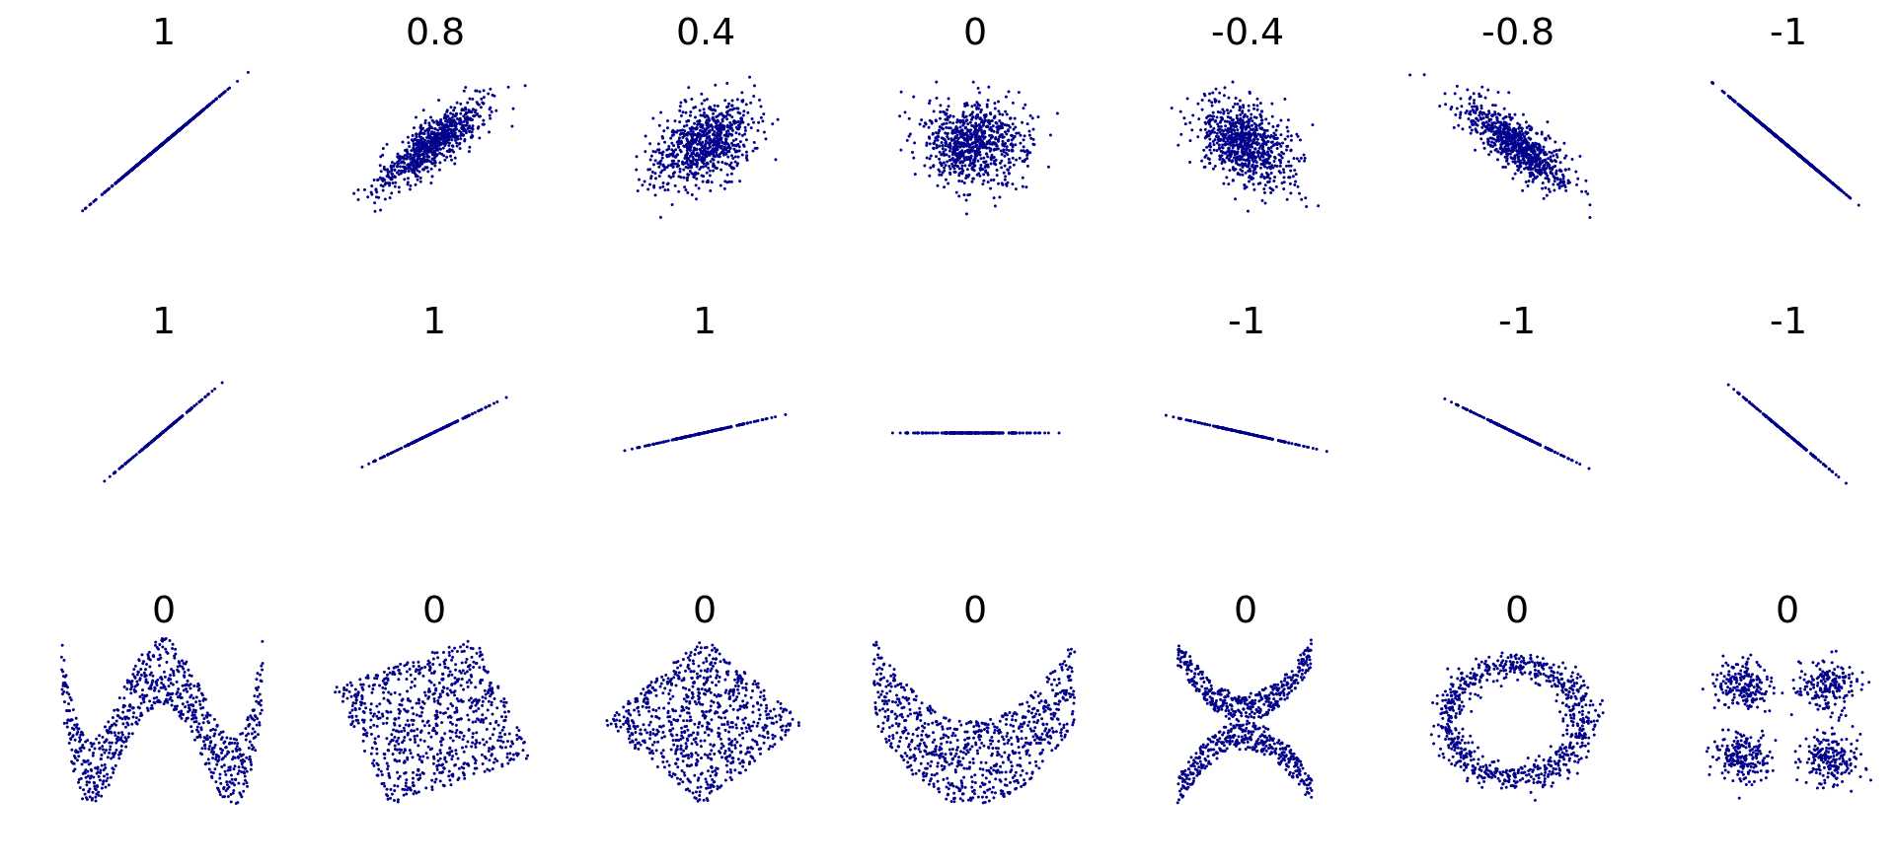

Slide 19
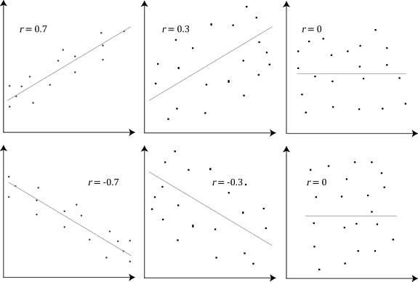

Slide 20
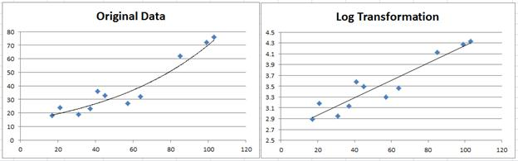
Non-Linear Relationships
Correlation calculations are more reliable with linear relationships.
The Pearson correlation is a linear relationship. Modeling a curve with a line loses some information.
Tools to deal:
Transformations.
Different metric for correlation.
Complex non-linear correlations – packages with estimation algorithms.

Slide 21
Spearman’s Rank Correlation
Calculates the covariance of the ranks instead of raw values.
Similar (in spirit) to how median looks at average compared to mean.
E.g. the pictured point is ranked 5 in X (the 5th smallest right), and 7th in Y (the 7th lowest height).
More robust with relationships that are not linear, or have outliers.

Slide 22
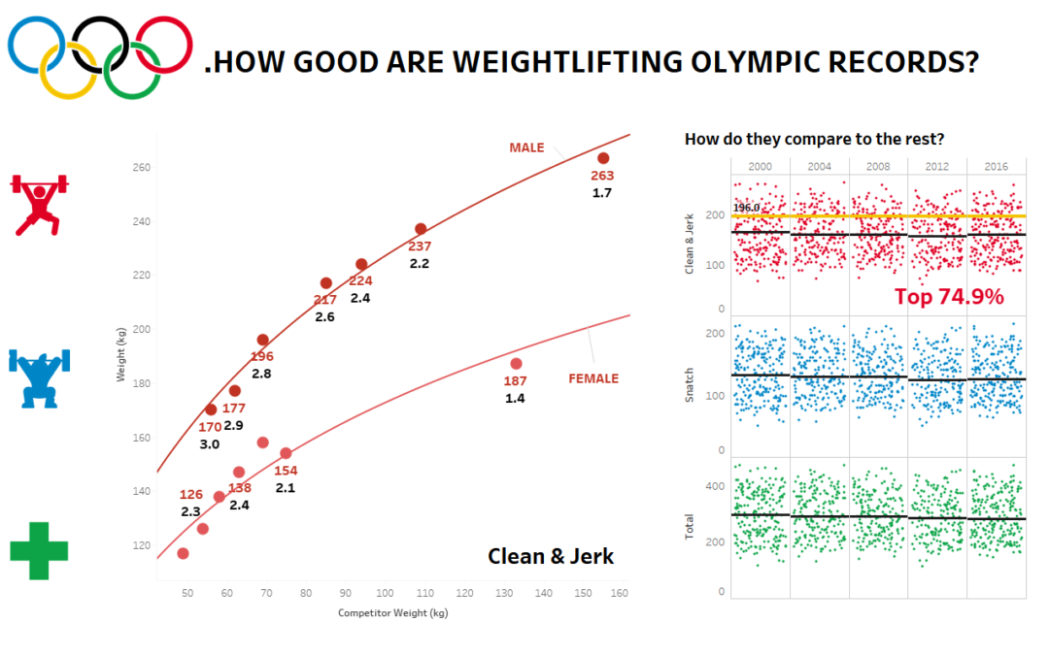

Slide 23
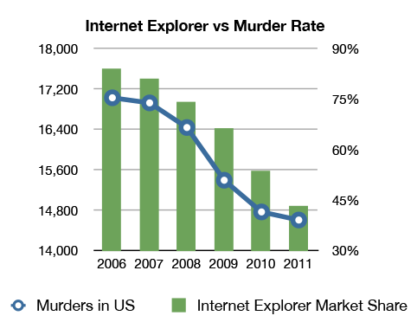
Correlation vs Causation
Just because something shows a correlation, even a strong one, doesn’t mean that one thing is causing another.
Correlation may be due to one thing causing another, shared root causes, or just random coincidence.
Note: chart may be a bad example, as using IE may make you homicidal.
Plot internet usage vs anything that changed over the 2005 to 2015 time periods.

Slide 24
Separating Correlation from Causation
We can easily calculate correlation – it’s just math; we need evidence to show causation.
Which happens first? Do things only occur in that order?
Pregnancies and newborns are correlated, one always happens first.
Controlled trial or experiment:
Clinical trials – change one variable (add a drug), watch outcomes (e.g. mortality).
Natural experiments – look for groups that have a difference. E.g. public smoking bans.
Less likely to give clean data due to infinite number of differences.
Domain knowledge and analytical sense – there isn’t causation until we know there is.

Slide 25
Correlation in Code
Demonstrating and calculating correlation is pretty easy in practice.
For now, we can normally just identify correlation visually.
Sneak peek – why do we care about correlation in ML:
We generally want features to be correlated with the target. (Feature tells us about target).
We generally want to avoid features that are highly correlated with each other.
If two things have a correlation of 1, that means they “give” the model the same info.

Slide 26
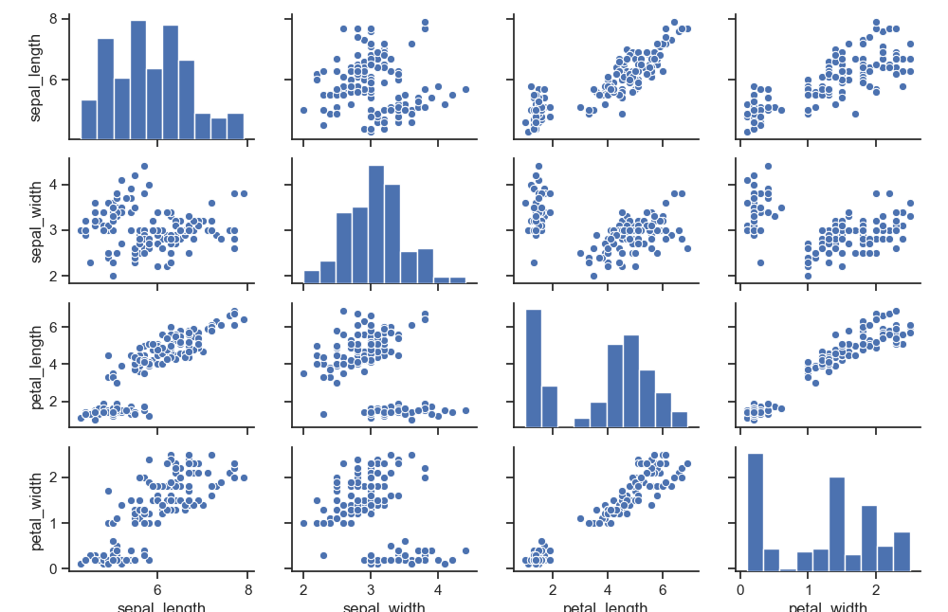
Data Exploration – Seaborn Pairplot
We can learn a lot with one graph:
Histogram distributions.
PDF distributions.
Scatterplot for correlations.
“Slice” data by other variable.

Slide 27
