Slide 1
Loops
They go Around

Slide 2
Housekeeping
Questions?
Today:
Slides and using github repositories.
Review – walkthrough grade example.
Loops (P4E chapter 5)
Lab 1:
It is very simple.
Workshop in Moodle – peer evaluation.
Functions – we’ll do it in detail next class. The examples from last time are transferable.
Reading files – link on Moodle, try reading and adapting. We’ll do more next time. (P4E ch7)
.readlines() is a way to do it easily.

Slide 3
Loops are Fun!
Loops are another core piece of logical control.
Loops repeat some block of code until some condition is met.
Loops allow us to write some action in a block of code, then do that over and over as many times as needed.
E.g. increase the price of this list of products by 10%
Commonly used to do something a preset number of times, or do something to every item in a data structure.
Conditional statements branch, loop statements “branch” back to the start of a block.

Slide 4
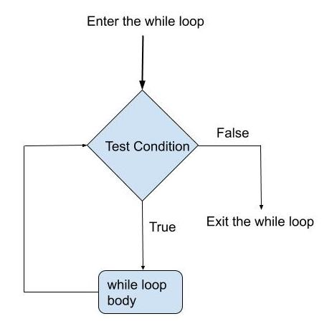
While Loops
While loops are the simplest type of loop.
Check a Boolean test in our condition.
If it is true, do the body of the loop, then repeat the test.
If it is false, exit the loop and go on to whatever is below.
Often paired with a counter.
E.g. i < length as condition. i =+ 1 at the end.
Note: the test is performed first, so there could be 0 executions.

Slide 5
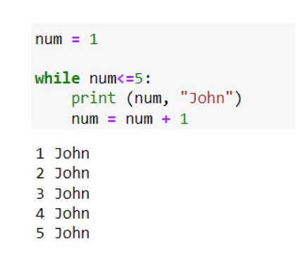
While Loop Syntax
The structure of a while loop is very similar to an “if”.
Indentation denotes the body of the loop.
While loops require that you manage the condition on your own.
Print statements that tell you which execution you’re in are helpful to debug.
Loops can be Infinite, or non-terminating, so make sure your condition makes sense.
If there’s a counter, make sure it updates.

Slide 6
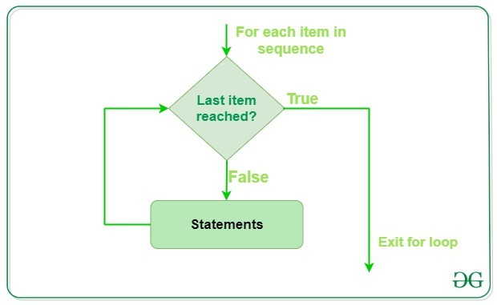
For Loops
For loops are another common loop type, probably the most common in DS.
For loops are normally done to items in a data structure.
“For each item in this list, do this stuff”.
Since we will end up dealing mostly with big stacks of data, this makes sense for us.

Slide 7
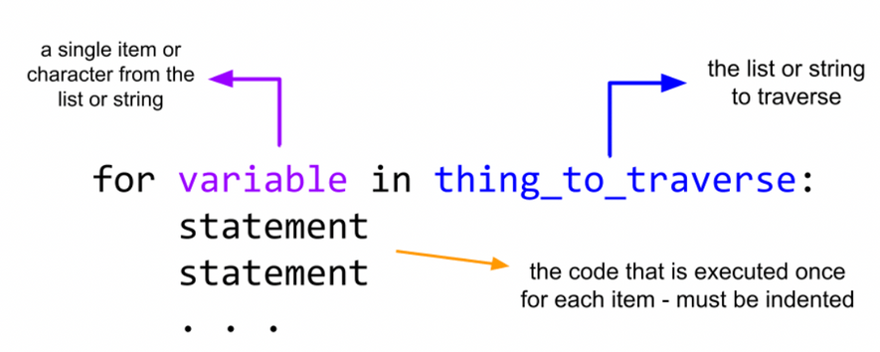
For Loop Syntax
For loops “grab” items one by one from some data structure.
We then do the body to the item that we grabbed. Repeat.
The data structure itself can be anything that is “Iterable”
I.e. capable of returning its items one by one.
Lists, strings, and tuples are all iterable. Many data structures in Python are, making them largely interchangeable.
Slightly different syntax from other languages.

Slide 8
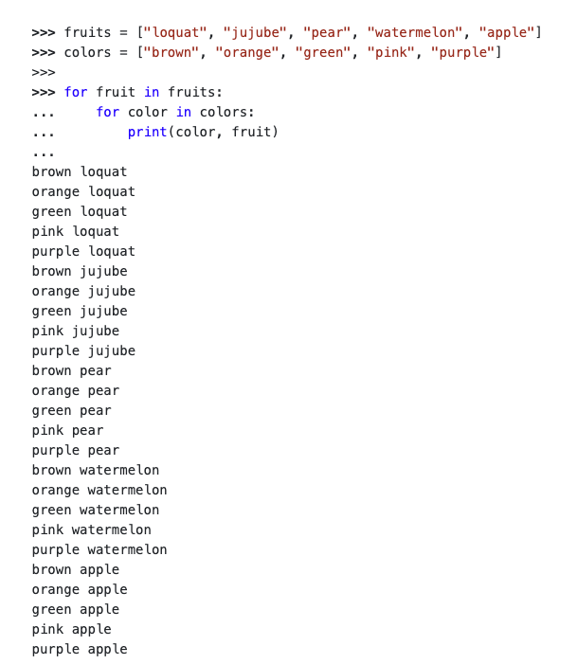
In Code
Here’s a nested example in code.
Each for loop declaration specifies:
The data structure we’re looping over (after the “in”).
The name of the specific object we grab each time (before the ”in”).
We do the thing in the body.
We don’t need to manually update a counter (unless we need it for something else).
The loop manages progress automatically.
One less thing that can fail.

Slide 9
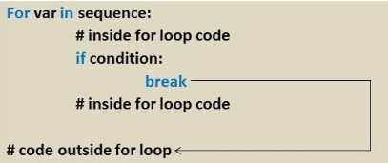
Loop Control Statements
These aren’t super critical right now.
There are also a handful of loop control statements that are less common.
Break – stop the loop’s operation.
Pass – do nothing and go to the next iteration. Often seen with unimplemented features.
Continue – skip the current iteration and continue looping.
These statements are less common but can be very useful on occasion.
Can provide one-off differences from the normal condition of the loop.
“If some special case, then override the loop condition”.

Slide 10
Loop Concerns
Loops can also introduce errors to our code pretty easily.
Some common concerns that we should think to test for are:
Correct number of executions - +/- 1, first and last items captured, infinite execution.
Print statements are the easy way to debug.
Print loop number, key values, other things that matter.
Can be every loop, every X loops, or some critical values like first/last.
Nested loops especially can explode in run time.
One of the few things we really need to consider for efficiency.
Particularly when we have large machine learning datasets.

Slide 11
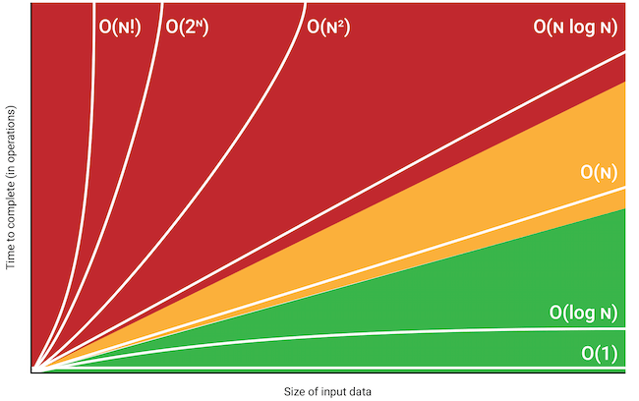
O-Notation
O Notation or Big O Notation is a way to express a rough estimate of speed of an algorithm.
Algorithm – set of steps to achieve a goal.
We don’t need to memorize this, but it is a good way to start to consider efficiency when we are looping over massive things many times.
Care mainly with large data sets, such as NN.
O(1) – it take the same time no matter what.
O(n) – it take the same time for each item.
O(n2) – it takes time times time. Nested linear.
O(2n) – it takes time to the time. Find all subsets.

Slide 12
Looping Back
Loops are another tool that will be ubiquitous for us.
Loops allow for automatic repetition and completing actions over entire sets of objects.
Looping can potentially introduce some concerns:
Execution time can run away.
Conditions can be erroneous, especially around edge cases.
We have different types of loops, depending on what we’re doing.
“For” looping through all of something.
“While” looping until some condition you define.

