Slide 2
Inheritance
It Ruins Society!

Slide 3
Inheritance
We have used classes to make objects that can hold information and abilities.
Sometimes we have classes of things that are very similar or have overlapping qualities.
For example, in an LMS like Moodle there are many classes:
Some are normal in-person classes.
Some are online virtual ones like this.
These classes share lots of things (id number, time, semester) but differ in others (room, sharing URL, etc..)
We could make classes that model these objects, and they would be very similar.
Programmers are lazy, and repeating code is bad – there must be a better way.

Slide 4
Hierarchy
We can approach this problem by looking at objects in a hierarchy.
In-person and virtual classes are both classes.
In-person and virtual classes are not really the same type of thing.
We have a type of thing, a Class, that has some features.
Time, instructor, semester, course…
We have two other types of things, ILT and Virtual, that are subtypes of a Class.
Each one is a class, yet each one is a different object.
We say that an ILT class extends, is a child of, or inherits from the Class object.

Slide 5
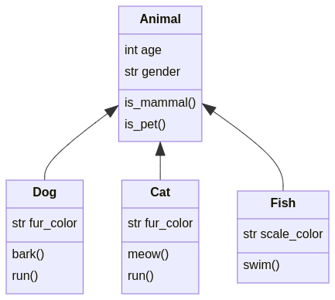
In the Animal Kingdom

Slide 6
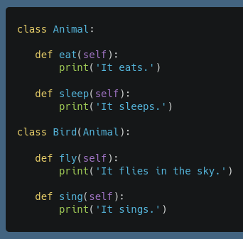
Inheritance
In programming, this hierarchical relationship is inheritance.
We can make a class that inherits some other class:
The original is called the parent class, the new one is a child.
Our new class is everything the parent is, along with whatever else we want to add or change.
Inheritance is indicated by putting the parent class in the class signature.
An Animal can eat and sleep.
A bird can eat, sleep, fly, and sing.
A bird “is an” animal.

Slide 7
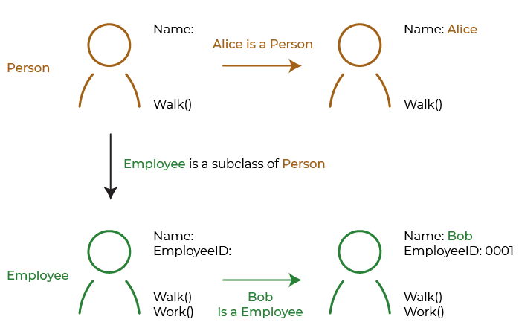

Slide 8
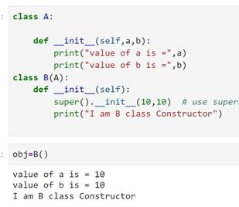
Construction and Super()
When creating an object we call the constructor to set the initial state.
State is what the object “is” - mainly setting the instance variables.
When creating a child object, we have a 2 (or more) step process:
Make the parent.
Add the child parts.
I.e. when we create a “Cat” we are making an animal, and adding cat stuff on like meow().
The super() function call will go call the method in the parent.
Super is an inheritance specific special method that will find “this method” in the parent.
Super can also be called in other methods, and will call the parent version directly.
In a constructer we usually super(), then set any child specific attributes.

Slide 9
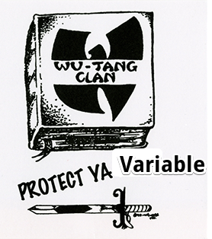
Protected Attributes
Inheritance is also the place where the third type of variable is used.
Public (normal) variables are available outside classes.
Private variables are only available within a class (nominally).
Protected variables are available within a class and its subclasses.
Like private variables from the outside, and normal variables from the subclass perspective.
For example, consider employees at Air Canada (more or less actually true):
Employees have normal attributes like name, ID, etc…
“Flight Crew” (pilots and flight attendants) add additional security permissions and ‘protected’ clearance information.
Pilots add even more private information for security clearance.
The lesser clearance level information for pilots is visible to the Pilot object, but hidden to the outside world.

Slide 10
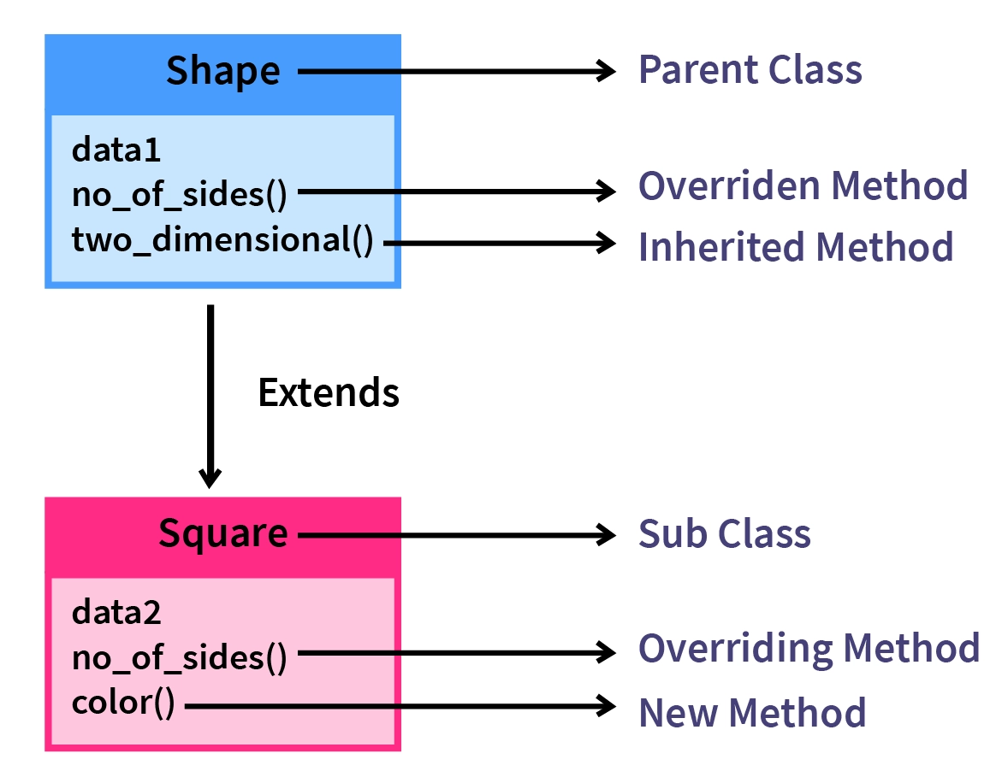
Method Overriding
Like with operators and string functions, child classes can override their parent’s methods.
If declared, the child methods will take precedence.
If the child doesn’t provide a method, the interpreter will look up the chain until it finds a match.
We can change or redefine behavior for a child:
We’re used to this for “generic” things like eq, str, add, etc…
Any other method that a parent class provides can be overridden in the same way.

Slide 11
Polymorphism
When we redefine methods to work differently for different objects we are using a concept called polymorphism.
Polymorphism is the theory that a single interface can act differently with different types.
E.g. adding strings and adding integers is the same interface, different actions.
In Python, this touches on the idea of the Duck Test.
Everything is an object, and we often inherit from base classes, and we have weak types.
Methods and operators can be overridden to redefine actions for each object.
So, it is a duck as long as it can do all the duck stuff. Or if it looks and quacks like one.
Or, an object is a certain type as long as it is never asked to do something it can’t.
E.g. if we read a value from a CSV into a variable and print it, that var could be string or float.

Slide 12
Conclusion (for Now)
Inheritance is a key building block of object-oriented programming.
There are several ‘extensions’ to this simple inheritance that we’ll look at later.
Classes can inherit from multiple other classes.
Syntactical “sugar” to make things more streamlined.

