Slide 1
Recursion

Slide 2
Recursion

Slide 3
Factorial!!!!!!!!
Factorials are the easiest and most common example of recursion.
Factorials are indicated by an exclamation point in math.
The factorial function gives an answer of ”all the integers >=1, up to the number, multiplied by each other”.
E.g. 5! = 5 * 4 * 3 * 2 * 1
3! = 3 * 2 * 1
We can also think of it as a nested stack of factorials:
5! = 5 * 4!
= 5 * 4 * 3!
3! = 3 * 2!
This makes it a great recursion candidate.

Slide 4
Stack
Once concept that recursion touches on is the “stack”.
The stack, or “call stack”, is roughly a stack of function calls that a program needs to do.
Every function call that is called gets put on the stack.
The program executes them one-by-one.
The stack is a Last In First Out (LIFO) data structure, the most recent addition is run first.

Slide 5
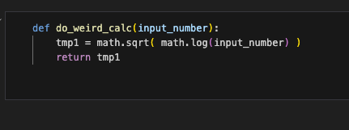



Simple stack Example
Suppose we have this function, a weird calculation.
When the function is called, it goes on the stack to be executed (each one is a “stack frame”).
During execution, the sqrt function is a new call, and goes on the stack to be executed.
During that execution, the log function is a new call to be executed.
All 3 functions will be on the stack prior to finishing.
The stack executes thing LIFO, so it starts with the log.
As things are executed they are taken off the stack.

Slide 6
Stack my Recursion
The stack is something we rarely (especially for DS in Python) think about.
If doing lower-level code, this is something that is more of a consideration.
Recursion can generate many additions to the stack.
Our simple example generated 3 function calls on the stack.
Each recursion round generates it’s own function call, at a minimum.
E.g. factorial(1000) would stack 1000 function calls on said stack.
There is a possibility for “stack overflow”, or too much stuff in the stack.
Each call of a function c

Slide 7
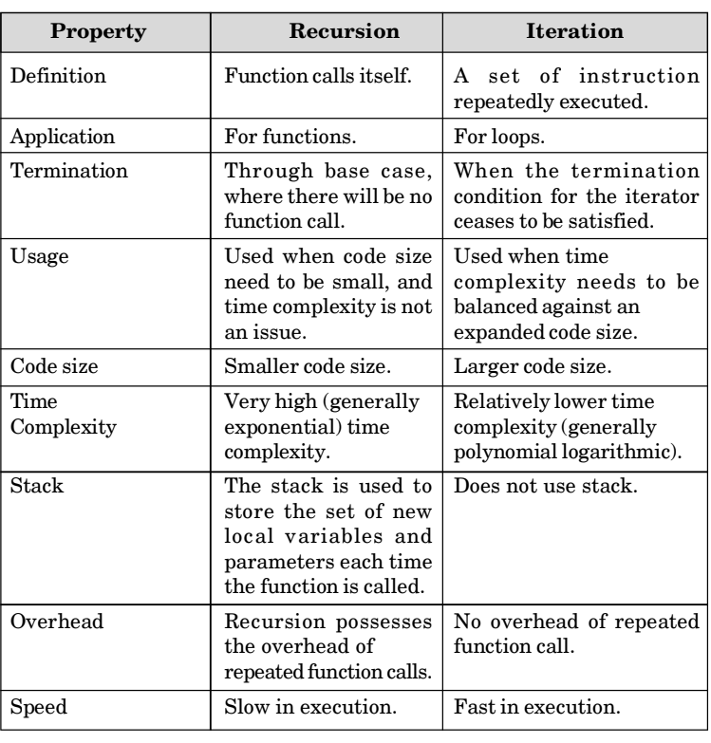
Recursion vs Iteration (loops)
Recursion is another tool to accomplish the same tasks as recursion.
We don’t really need to do recursion, sometimes it just makes more sense.
Each has positives and negatives.
Recursion is usually slower and more resource intensive.
Recursion can make the structure of the code easier for some problems making it easier to understand.

Slide 8
So… Do I use it?
In general, if recursion makes more sense to you in a given scenario, use it.
The choice is more driven by making sensible/clear code than objective performance in most cases.
If you are dealing with massive numbers of rounds of recursion or very complex calculations, recursion’s resource requirements might pose an issue.
If a problem breaks down into smaller versions of itself, consider recursion.

