Slide 2
Visualizing Stuff
We’ve been making visualizations.
Generally, each chart shows 1+ related piece of info.
Data density refers to adding more info, usually via pre-attentive attributes.
We can select chart type to suit data/what we want to show.

Slide 3
Combining Visualizations - Dashboards
In many cases, we want to see several pieces of information together.
Dashboards let us make a ”web-page” with several vis’.
We can add the ability to interact between sheets.
  Filters that can apply to all sheets.
  Actions to highlight/filter/other stuff.

Slide 4
More Combinations
Dashboards are very well suited to business-y scenarios.
  Want to monitor a bunch of aspects of running a store – sales, profit, sick days, stock, etc…
Communicating information on some topics may not fit that format as well.
Think about information revealed in investigative reporting or a documentary.
  We don’t get a massive dashboard of info up front.
  We are walked through a series of things to look at.
  The author builds a story that shows us info in way to make see what they intend.
~add “order” as one of the things we can use to communicate info.

Slide 5
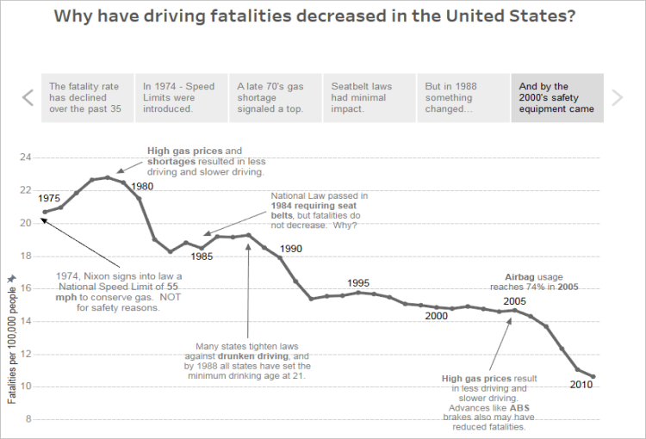

Slide 6
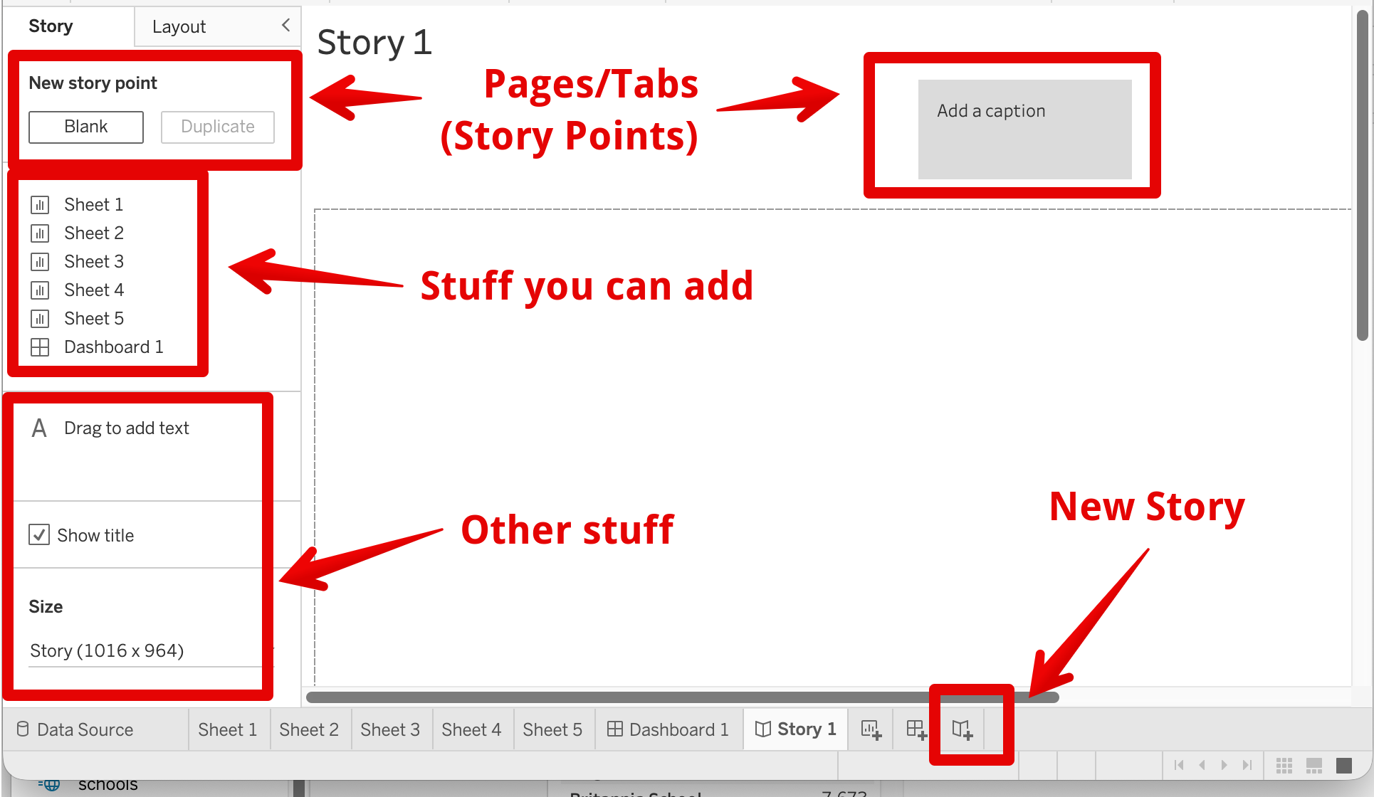
Tableau Stories
In Tableau stories are another container, similar to dashboards.
Can create pages, or story points.
Each can hold some premade ”thing” – sheet or dash.
We can add some new things – buttons, multiple sheet revisions.

Slide 7

But, why?
Can use a story to build a more complex “path” for user.
  Guide user page by page on what to learn.
  Just like how an article/doc will show/hide info at times.
We can show a reader things in a certain sequence.
  Build tension for a big reveal.
  Show someone the relationships between things.
Can also allow for flexible paths with links/buttons.
Think of it like an essay – overall you want to show X (thesis), and use paragraphs A,B,C… to show aspects of X.

Slide 8
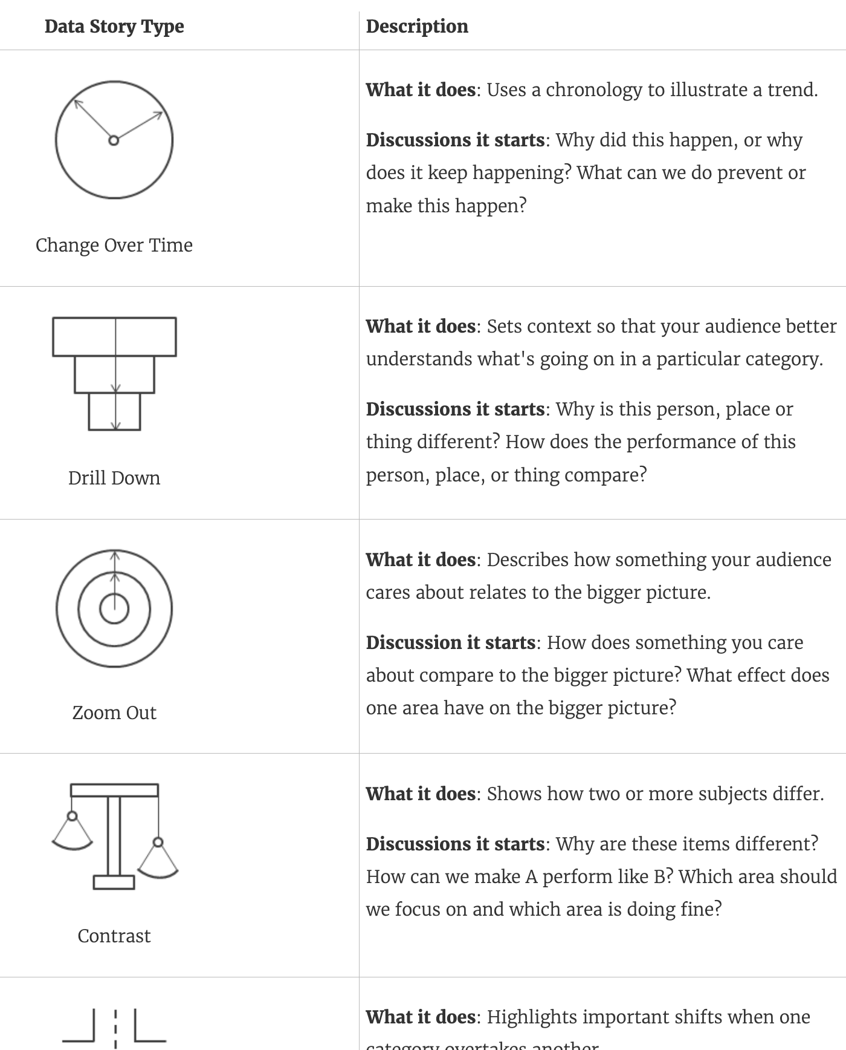
How to do it well
There are several storytelling techniques that we can utilize.
  https://help.tableau.com/current/pro/desktop/en-us/story_best_practices.htm
These techniques help make something that is clear and interesting.
  Help people build some connection.
  Give a familiar format that makes sense.
It is usually a good idea to follow one of these.

Slide 9
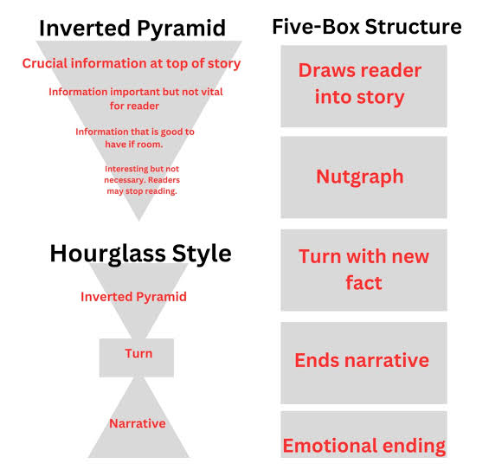
Just Write a Story!
The idea is the same as narrative journalism.
  Attract the reader to the story.
  Present the info in some (flexible) way.
Think of yours in the same way.
  You want to show a reader something (real world*).
  To know that, they need to see a,b,c,d…
  Based on that, you should do/think…
The last step is loose – we may be showing user a specific thing (most profit), or giving them info they can use (crime rates).

Slide 10
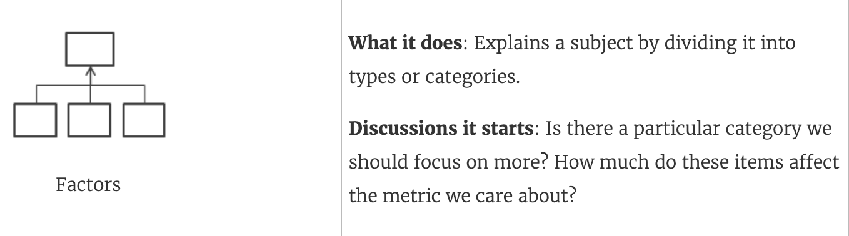
So… A process
To make a story, we can consider a few things.
What information do I need to show the user. (Thesis)
  Should be able to summarize as something like “which countries pollute most?”.
To have someone learn that, what do they need to see? (Paragraphs)
  E.g. I may need energy usage, co2 emissions, km driven, pollution, energy generation type.
  For all of those things, what is the best way to show it (same as before).
How can a structure a story – storytelling techniques, a ‘hook’, how to conclude.
  E.g. for emissions maybe I’ll structure it as factors.
  What would make someone who cares about this topic look at our story.
  To end it, are we making/implying a conclusion, or giving some info?

Slide 11


This example uses at least 2:
Change over time.
Factors that impact.

Slide 12
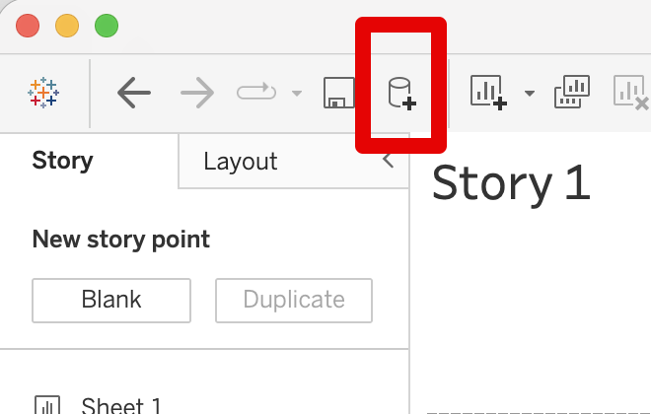
Data Combinations
Stories are often well suited to multiple datasets.
  We may need to include data from different sources, on different aspects.
The same rules/process/logic applies to joins as before.
We are more likely to need unjoined sources.
  E.g. we have data on air pollution, water pollution, particulate emissions in diff sources.
  This is easy, we just can use unjoined sources on the same sheet (same dash/story is fine).
You’ll need to think of “what would be good to know here” and then look for sources.
  I can help, especially if you have odd data processing needs that are beyond you.

Slide 13
New Actions

Slide 14
What will you need to do with stories
You’ll have to use stories in two places – the 3rd assignment and the project.
Project – a big story done in groups.
  You’ll choose some large/broad topic, and create a story on it.
  There should be several aspects examined, each in their own sheets/dash.
  They should combine into one coherent story, probably following a storytelling technique.
3rd assignment – a smaller, solo, version of above:
  You need to make a story on some topic.
  This is a great practice run, and a good use of discarded project topic ideas.

Slide 15
Conclusion
Stories are useful for anything larger or requiring several pages.
Story structure is a new tool we can manage/manipulate:
  Storytelling technique(s) used.
  Ordering and number of story points.
  How to draw conclusions.
  New features like buttons and linking.
A good story mirrors journalism – longform or a documentary.
  How do we draw interest from the audience.
  What do we need to show them (and how best to do it).

