Slide 1
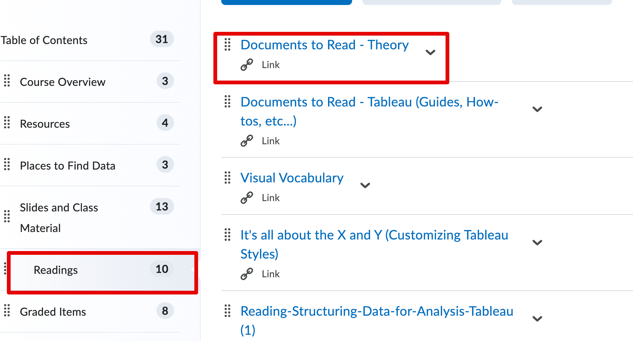
Housekeeping
More visualization intro stuff.
Review preattentive attributes.
Look at visual analytics being used.
Tableau Pubic and Visual Vocabulary.
Looking for Data.
Loading outside data to Tableau.
There are a couple of Documents to read.
Start doing the warm-up exercises soon if you haven’t, doing stuff without direction is a little different and you want to get used to that early.

Slide 2
Visualization

Slide 3
A Picture is Worth a Thousand Words Which of These Two is Easier to Understand?

Slide 6
The Power of Visualization
Visualizations (charts, graphs, etc) can make data easier to consume.
Lower friction – the reader should have to expend as little effort as possible.
The amount of data, and its importance to business are skyrocketing.
Faster computers + Better software tools + Larger databases + Need to understand lots of data quickly = Modern visualization.

Slide 8
Why Visualize
The goal of visualization is to use graphical elements to make data more understandable.

Slide 9

https://www.youtube.com/watch?v=5Zg-C8AAIGg

Slide 10
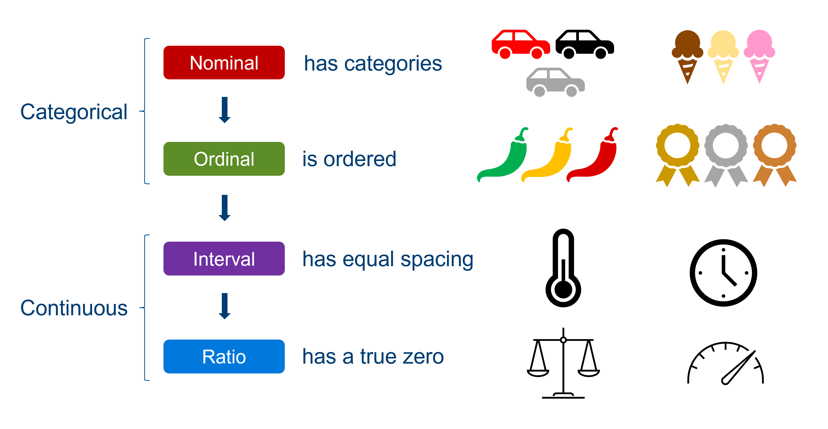
Interlude – Data Types
Have data of two basic types.
Continuous.
Categorical.
If it makes sense on a number line, it is numerical.
How Tableau treats each differs.
Cat – group data for each value.
Num – calculate this for each group.
Othe division less important.

Slide 11



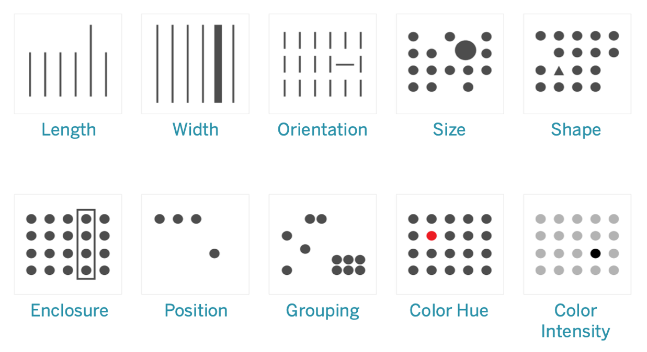
Worth 1000 Words? Why? preattentive Attributes

Slide 12
preattentive Attributes
Our brains evolved being able to process certain visual things almost automatically.
A caveman needs to see if a tiger is hiding in some leaves, or he’s dinner.
Pre-attentive attributes are things that we notice with a low cognitive load.
Understand more, think less.

Slide 13
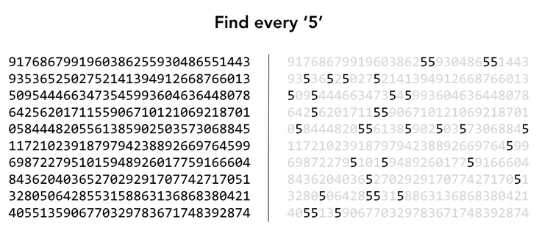
Shading/Color Intensity

Slide 14
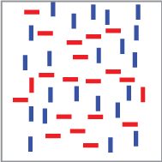
Color and Orientation

Slide 15
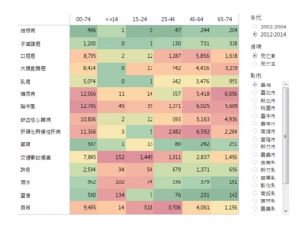
Color – We don’t even need English!

Slide 16
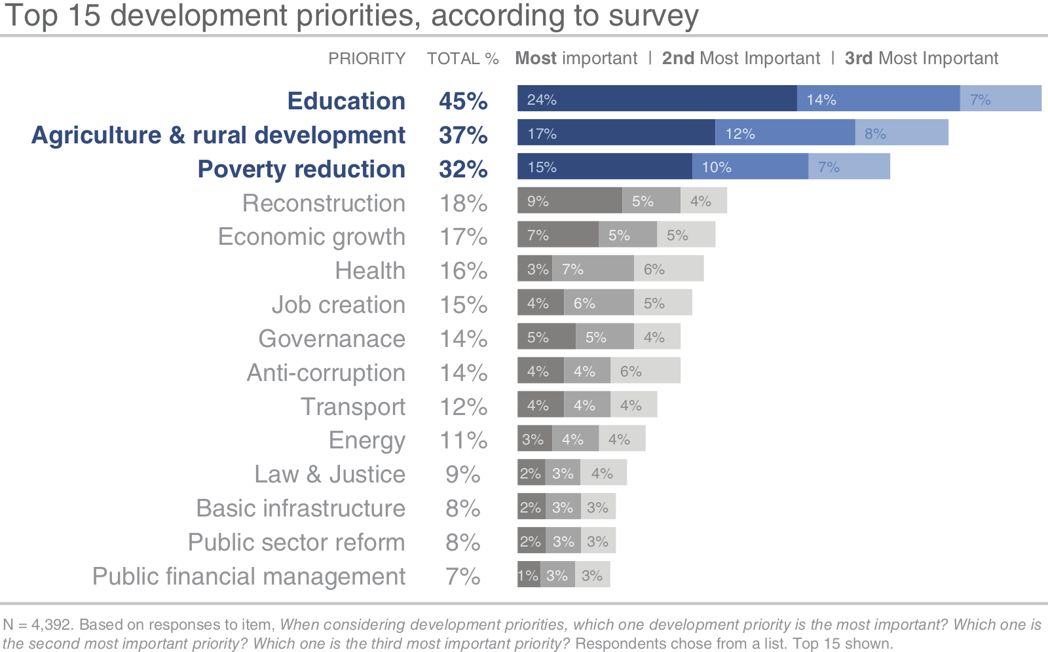
Length and Color Intensity

Slide 17
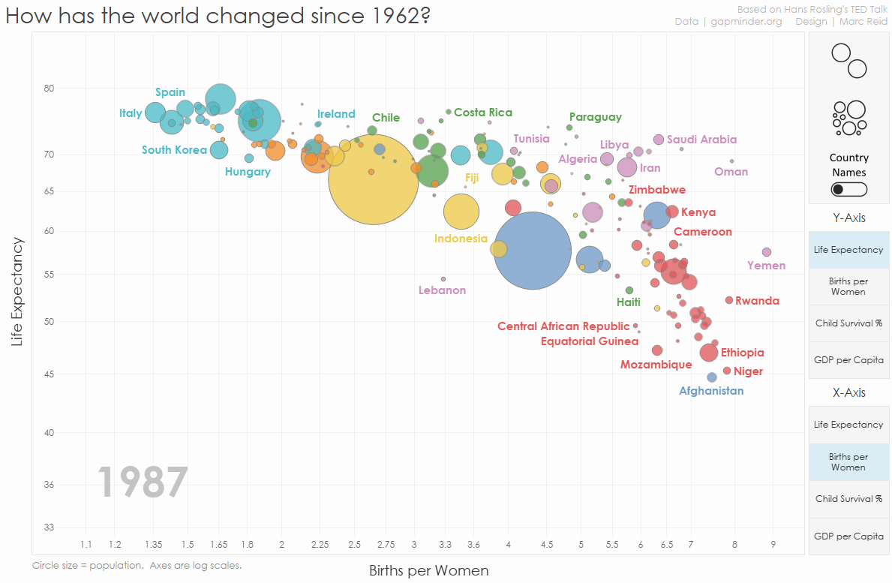

Slide 18
Wow, That one had a lot of Attributes
Pre-attentive attributes allow us to make visualizations denser.
Adding more data to one visualization.
Since we process them automatically, the thought required doesn’t increase.
It does, but less than if someone had to ‘fully’ think about it.
The previous visualization shows two metrics – life exp. and children/woman.
What does size show?
What does color show?
Both add more data, without adding more complexity.

Slide 19
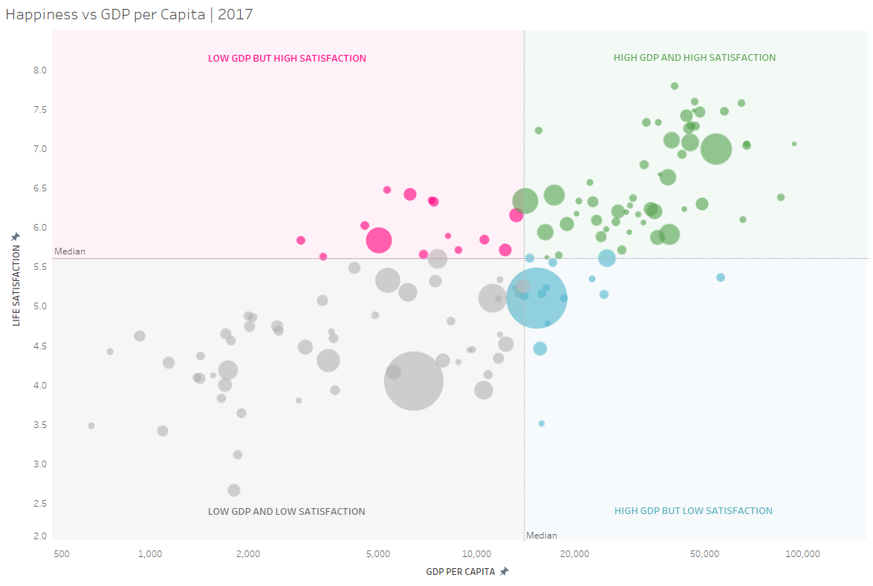
Visual Density
Visualization tools allow us to add density.
The same number of charts, more info communicated.
Position.
Size.
Color
Shape and pattern.
All convey meaning.

Slide 20
Being Dense
We want visualizations to be:
As dense as is practical (too much can be cluttered/confusing).
As clear as they can be.
This is a balancing act, depends on audience, data, charts, etc…
Tableau allows for some helpers:
Use actions to hide/show data based on interactivity.
Use filters or parameters to customize view.
Dense visualizations can allow for fewer total needed…

Slide 21
Really, Really, Dense
One real life example is from when I used to work at ATB.
We made many reports on people in training.
Progress, marks, when they’ll be done, number of people, etc…
Every region needed this data, but they wanted slightly different variations.
Different progress calculations, different info fields, etc…
These differences were small, the all wanted “who is in training and progress”.
Solution – build one ‘everything’ report and show/hide parts based on user.
One report has all the data.
Different views serve different customers.

Slide 22
Common Visualizations
Visualization is an open ended, creative field.
Designers are constantly experimenting on new ways to display data that are more clear, more interesting, more dense, etc…
There are some types of classic visualization that are most common and are at the core of visualizing data.

Slide 23
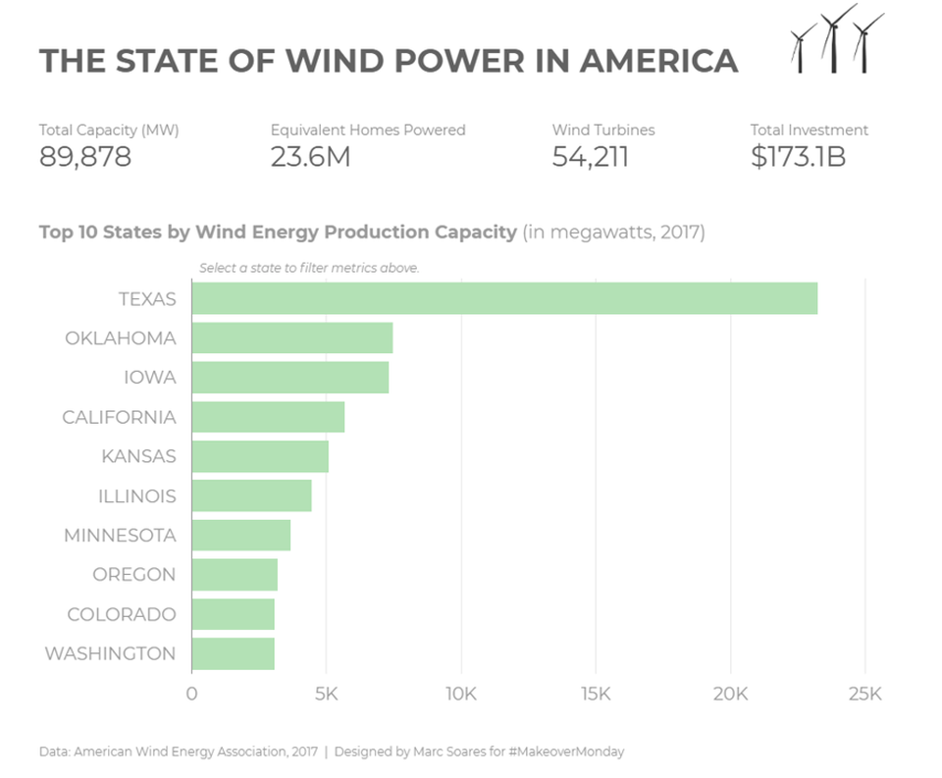
Bar Chart
Good for comparing quantities.

Slide 24
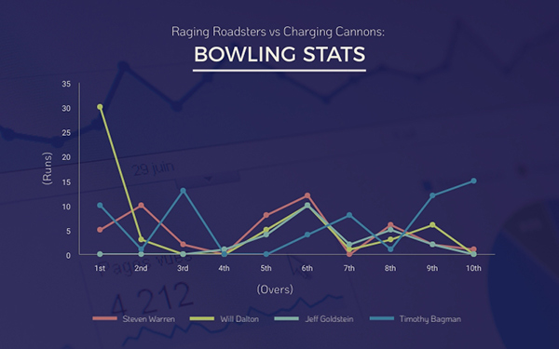
Line Chart
Good for showing trends over time.

Slide 25
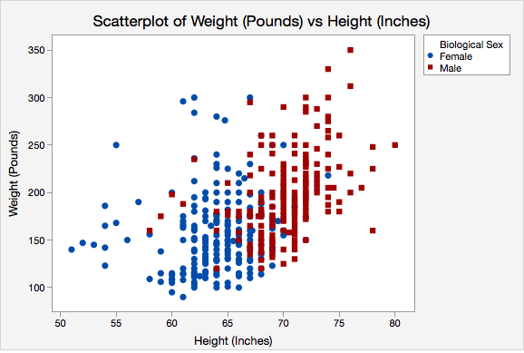
Scatter plot
Good for showing relationships.
Easy to add more data (sex).

Slide 26
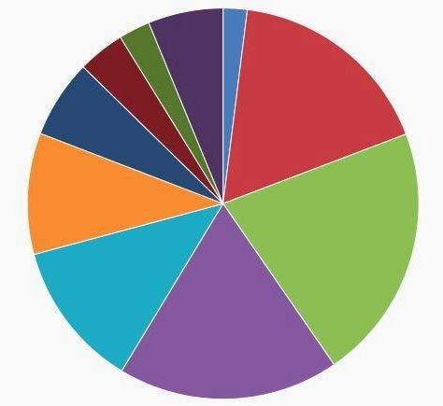
Pie Chart
Just kidding! Don’t use a pie chart.
It is hard for humans to accurately compare the slices.
Use something else, like a bar chart, or….

Slide 27
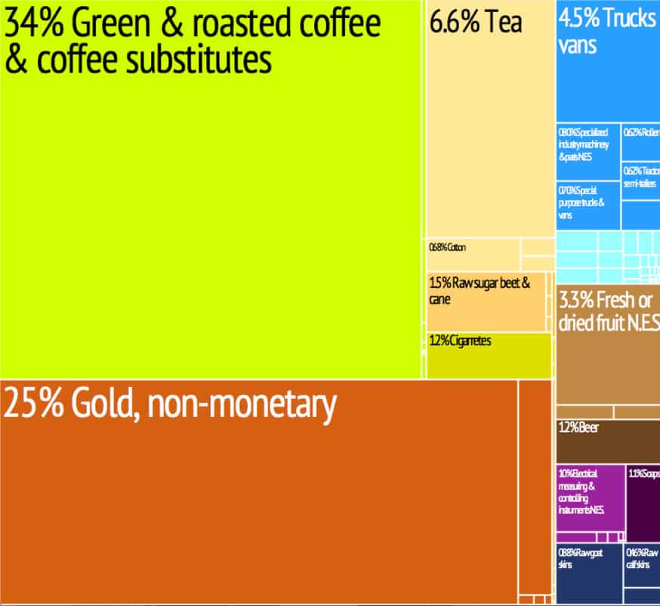
Treemap
Does a pie chart’s job, but it is easier for people to compare rectangle sizes.

Slide 28
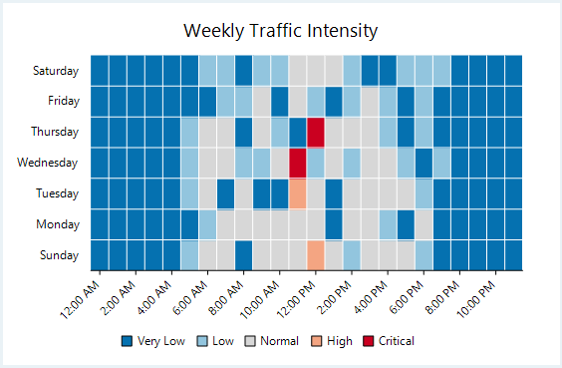
Heatmap
Good for showing values at an intersection.

Slide 29
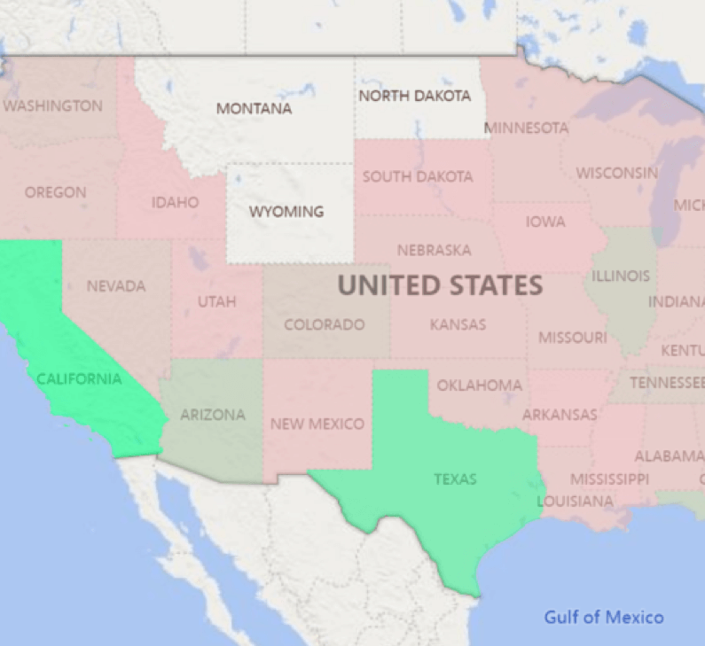
Filled Map
Good for showing one value in a region/area.

Slide 30
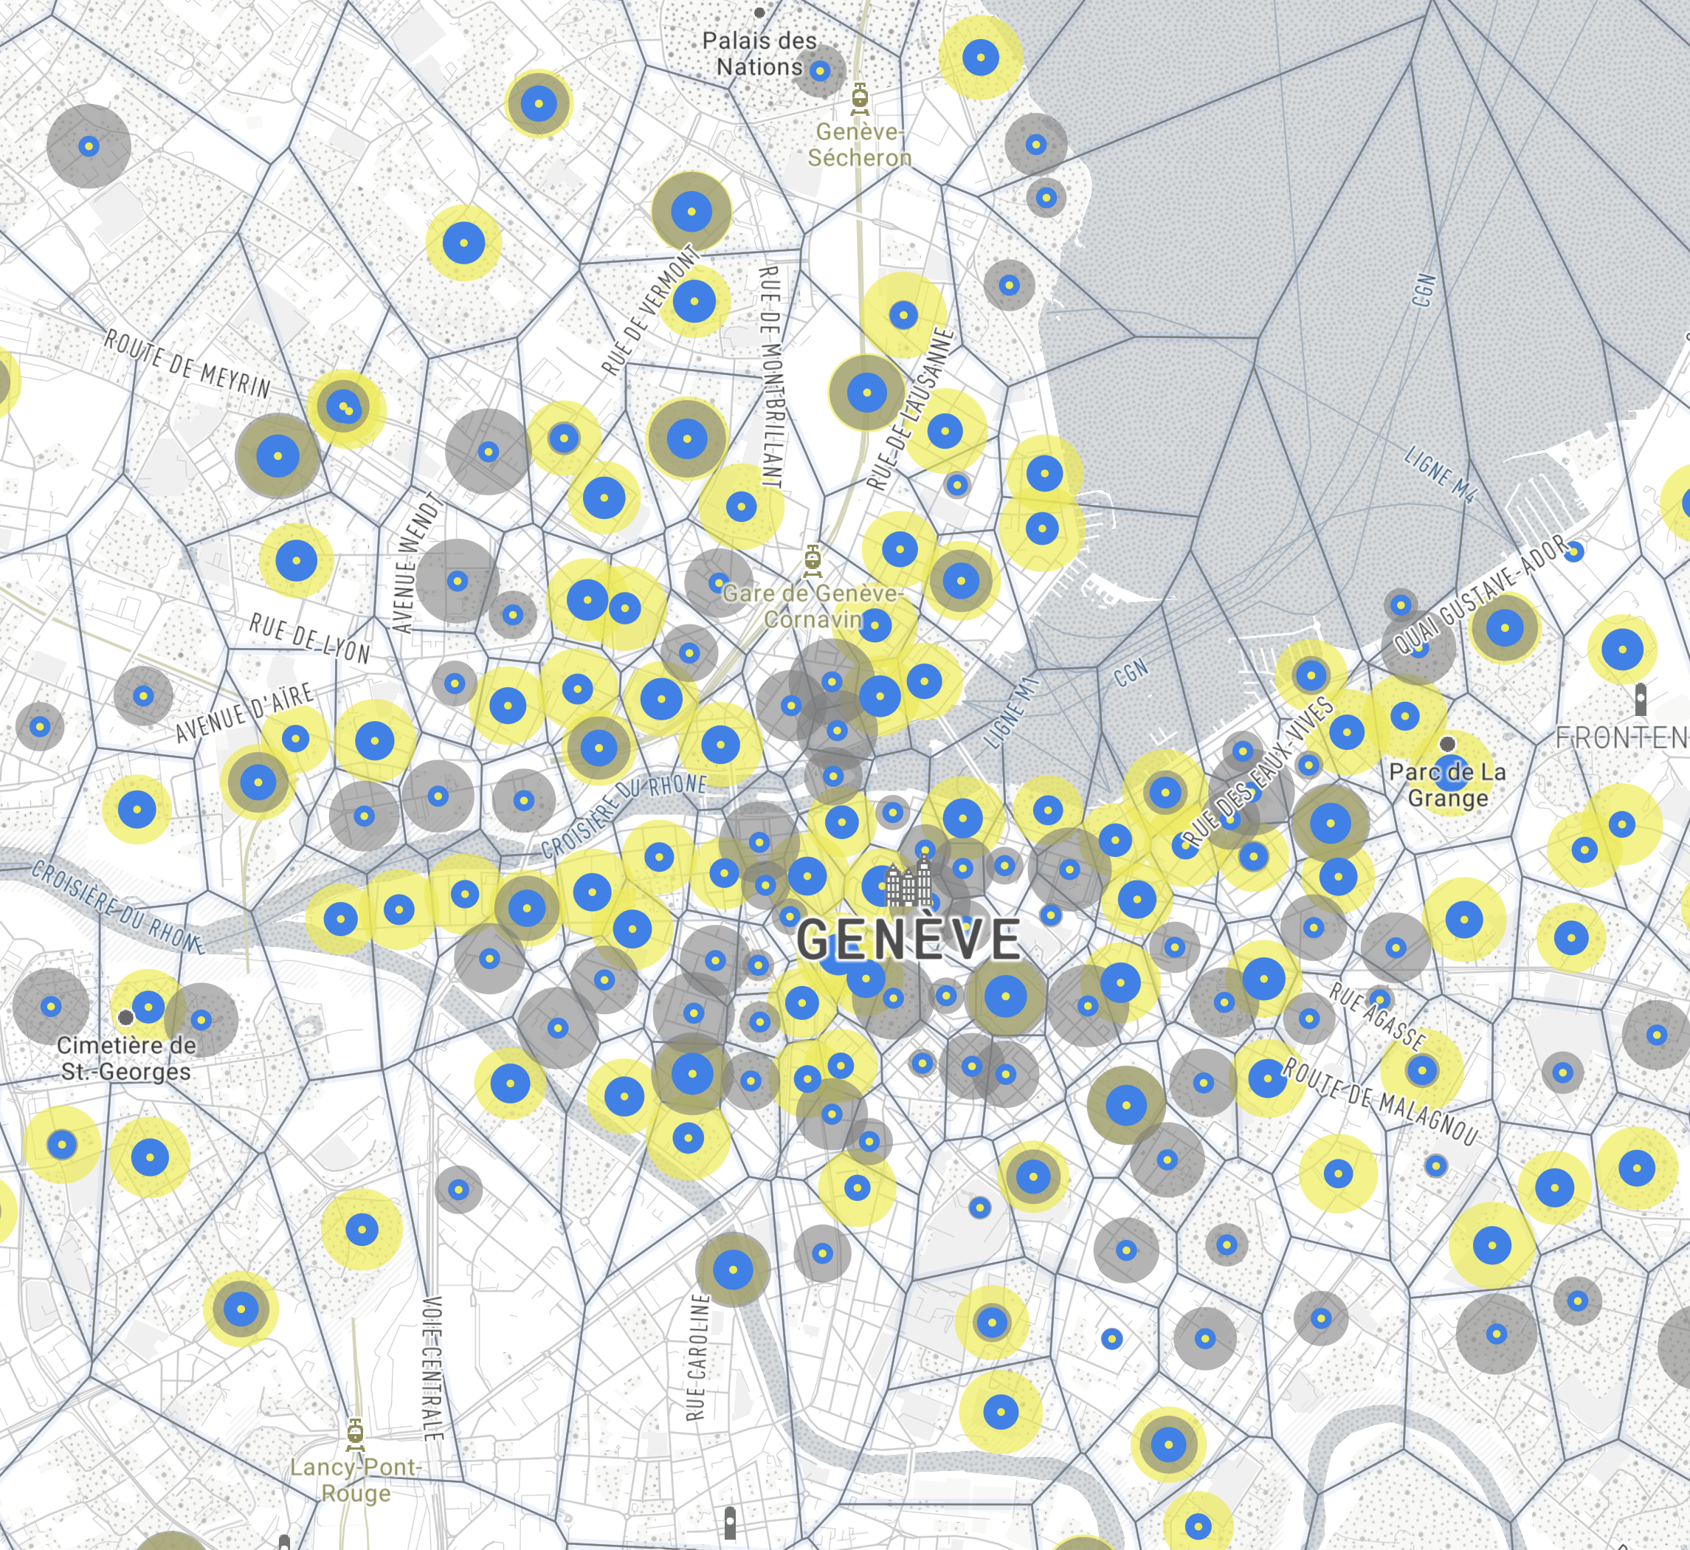
Point Map
Good for showing geographical locations.

Slide 31
So many charts…
There are a nearly unlimited number of charts, variations, and derivatives.
Choosing the correct chart makes your data understandable.
Choosing a bad chart makes things more confusing.
The internet has many guides to help….
Simple rule – if someone new is looking at my chart, does it make sense?

Slide 32
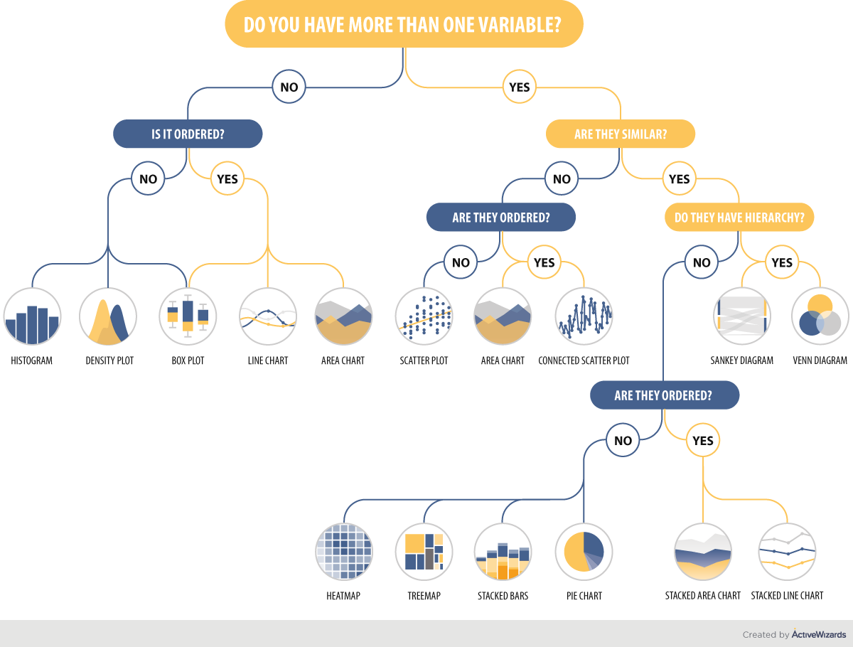

Slide 33
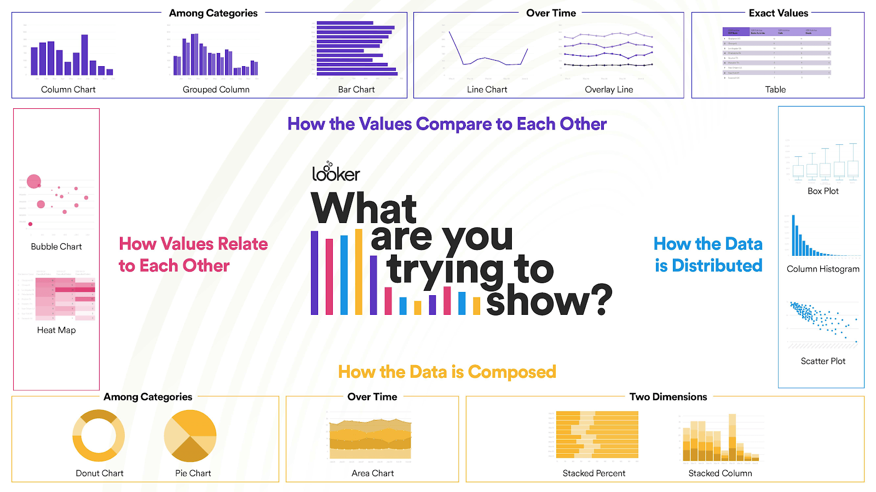

Slide 34
Visual Vocabulary
Brightspace has a link to a visual vocabulary.
This is a good reference to check for chart styles to try.

Slide 35
See Different!
Visualization isn’t just to see data better, it also allows us to see data differently!

Slide 37
WE know Stats!!!! Let’s Analyze!
Mean of X – 9 for all sets.
Mean of Y – 7.5 for all sets.
Variance of X – 11 for all sets.
Variance of Y – 4.1 for all sets.
Correlation between X and Y - .8 for all sets.
Linear regression – y = .5x +3 for all sets.
They’re the same!!!!!!!!!!!!!!!!!!!!!!!!!!!!!!!!!!!!!!!!!!!!!!!!!!!!!!!!!!!!!!!!
So......

Slide 38


Slide 39

What if we chart them?

Slide 40
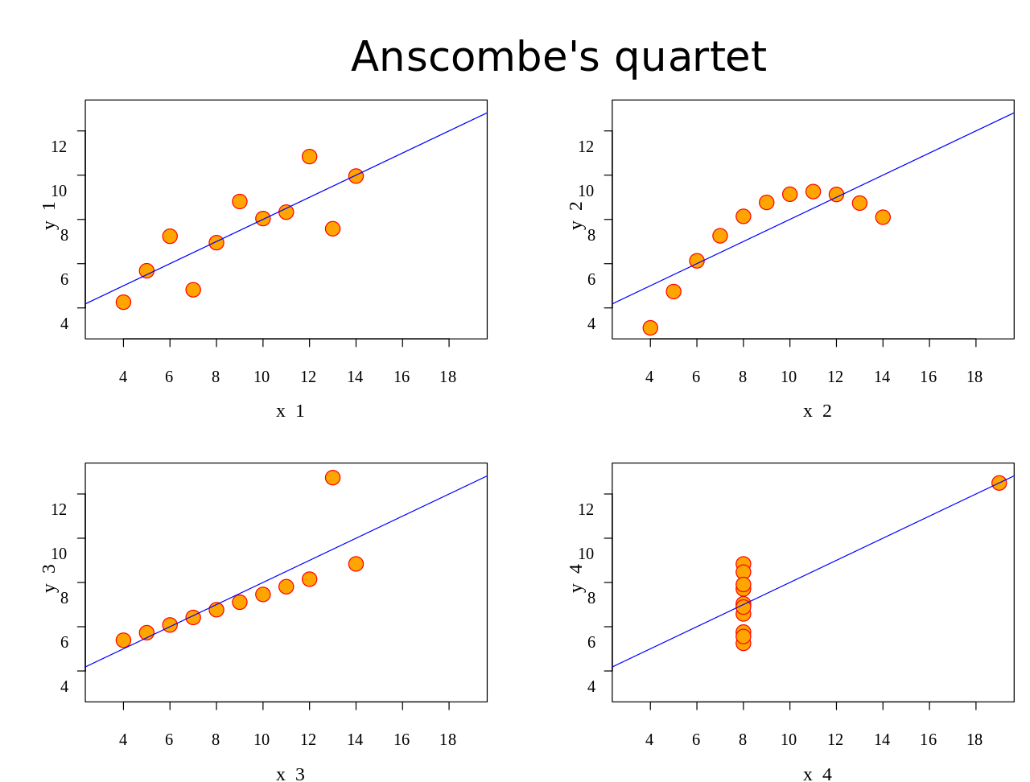
Same, Same. But Different

Slide 41
Visual Analysis Hits Different
Analyzing data visually can expose valuable information that is hard or impossible to see otherwise.
The larger our analytical toolkit is, the more we can tackle.

Slide 42
Real Life example – Enter John Snow

Slide 43
The one from the 1800s…
In the 1800s cholera was a problem in London.
No one understood how diseases work yet, no germ theory.
RFK Jr. was in charge of health policy back then too.
People in SoHo (currently rich/fancy) were dropping dead from cholera.
Most people got their water from pumps, and carried it home.
Enter our hero…

Slide 44
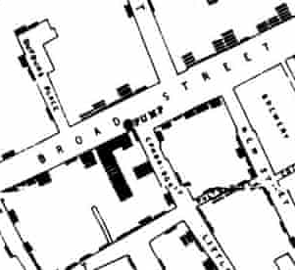
Snow Mapped deaths
Each little dash is a dead person.
Two places had no deaths – a brewery and a workhouse.
The brewery gave its workers beer (GoT style)
The workhouse had a private water supply.

Slide 45
Results
Deaths were centered around the neighborhood water pump.
The two locations without deaths didn’t drink the pump water.
So, the problem might be the water from the pump.
Problem: Diaper juice was leaking into the pump’s water supply.
Solution: Data visualization.

Slide 46
Challenge
Try to make something like this with world indicators.
Compare all countries.
Include more info in attributes.
Make sure it is readable.

