Slide 1
[Telling a Data Story]
[Presenter Name] | [Presenter Title]
[Date] | [Contact Info (social media, email, etc.)]
Note to instructor:
For online adaptation, consider:
Add audio to desired slides
Add contextual information to captions for desired slides.
Notes:
Title Slide

Slide 2
Telling a data story (Read through ch9 this week).
  Think about design.
  Compile visualizations into a coherent unit.
Sample Assignment Practice:
  We have a dataset and a goal.
  Choose and make vis’ to target that.
  Look at what I chose and why.
  Talk/questions about the logic of it.
Along the way, we need to learn a few things.
    This is to be expected for most people, you may need to learn something new to do what you want.
  Interactivity with actions.
  Date data and types.
  Some basic calculations and data manipulation.
Housekeeping:

Slide 3
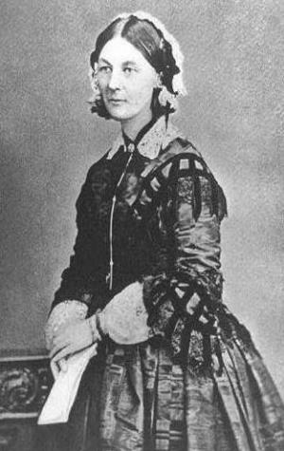

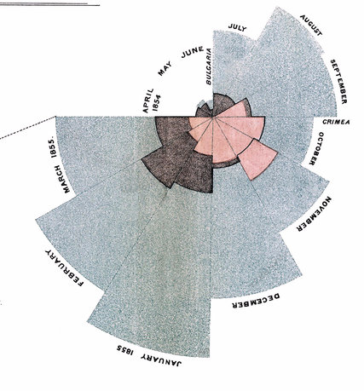
Florence Nightingale (1820-1910)
Notes:
https://www.sciencemuseum.org.uk/objects-and-stories/florence-nightingale-pioneer-statistician
2020: 200th birthday!
Remind students of Florence Nightingale’s story and John Snow from the beginning of the course.
Discuss her work. What important questions did she ask? How did asking those questions help solve a problem?
She investigated her great questions and created compelling stories that helped policy makers make better choices.

Slide 4
Table of Contents/Agenda
Storytelling Process
Dashboard Definition
Makeover Example
Redesign Activity
Slide 4
Slide 12
Slide 15
Slide 19
Notes:
Table of Contents

Slide 5
Storytelling Process

Slide 6
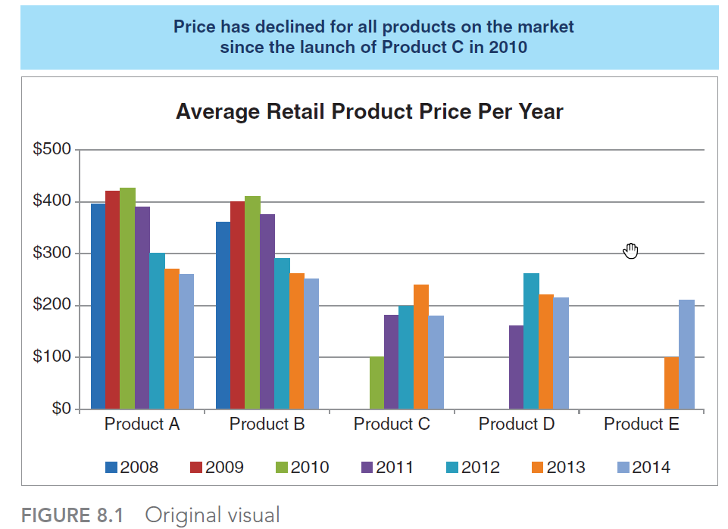
Data Storytelling Process
Viz Makeover
Context
Appropriate Display
Eliminate Clutter
Draw Attention
Design
Story
Notes:
Refer to students’ reading.
Have them discuss how this visualization can be improved when we consider the steps in the storytelling process.
Context: Who? What? How? Why?

Slide 7
Data Storytelling Process
Context
Appropriate Display
Eliminate Clutter
Draw Attention
Design
Story
Notes:
Time Series so line would be more appropriate

Slide 8
Data Storytelling Process
Context
Appropriate Display
Eliminate Clutter
Draw Attention
Design
Story
Notes:
Time Series so line would be more appropriate
Make each product type have a line over time.

Slide 9
Data Storytelling Process
Context
Appropriate Display
Eliminate Clutter
Draw Attention
Design
Story
Notes:
Eliminate Clutter

Slide 10
Data Storytelling Process
Context
Appropriate Display
Eliminate Clutter
Draw Attention
Design
Story
Notes:
Draw attention

Slide 11
Data Storytelling Process
Context
Appropriate Display
Eliminate Clutter
Draw Attention
Design
Story
Notes:
Note changes in alignment and text

Slide 12
Data Storytelling Process
Context
Appropriate Display
Eliminate Clutter
Draw Attention
Design
Story
Notes:
Review Cole’s story section: “Let’s consider this progression. We started off by telling our audience
the structure we would follow. I can imagine the voiceover in
the live presentation could further set the plot before moving to the
next slide: “As you all know, there are five products that will be our
key competition in the marketplace,” then building the chronological
price path that those products followed. We can introduce tension
in the competitive landscape when Products C, D, and E significantly
undercut existing price points at their respective launches. We can
then restore a sense of balance as the prices converge. We end with
a clear call to action: the recommendation for pricing our product.
By drawing our audience’s attention to the specific part of the story
we want to focus on—either by only showing the relevant points or
by pushing other things to the background and emphasizing only the
relevant pieces and pairing this with a thoughtful narrative—we’ve
led our audience through the story.”
From page 203: ”To be competitive, we recommend introducing our product below
the $223 average price point in the $150−$200 range”

Slide 13
Dashboard Definition
Notes:
Let’s look at the elements of storytelling.

Slide 14
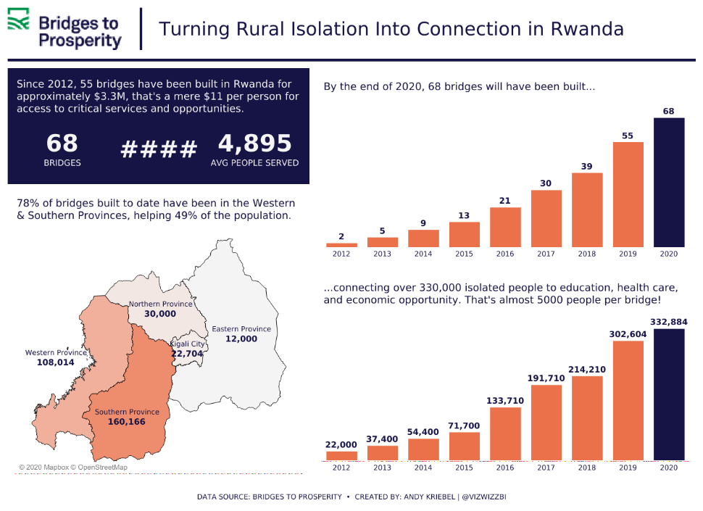
Dashboards
Notes:
Tableau definition: A dashboard is a collection of several views, letting you compare a variety of data simultaneously. For example, if you have a set of views that you review every day, you can create a dashboard that displays all the views at once, rather than navigate to separate worksheets.
https://help.tableau.com/current/pro/desktop/en-us/dashboards.htm
Notice how Andy’s dashboard tells a story.
From Makeover Monday. Can mention to students the opportunity to participate
https://www.makeovermonday.co.uk/. The original to this dashboard can be found here: https://bridgestoprosperity.org/global-work/rwanda/
Andy’s makeover: https://public.tableau.com/de-de/profile/andy.kriebel#!/vizhome/MakeoverMondayWeek4-BridgestoProsperity/MM2020W4

Slide 15
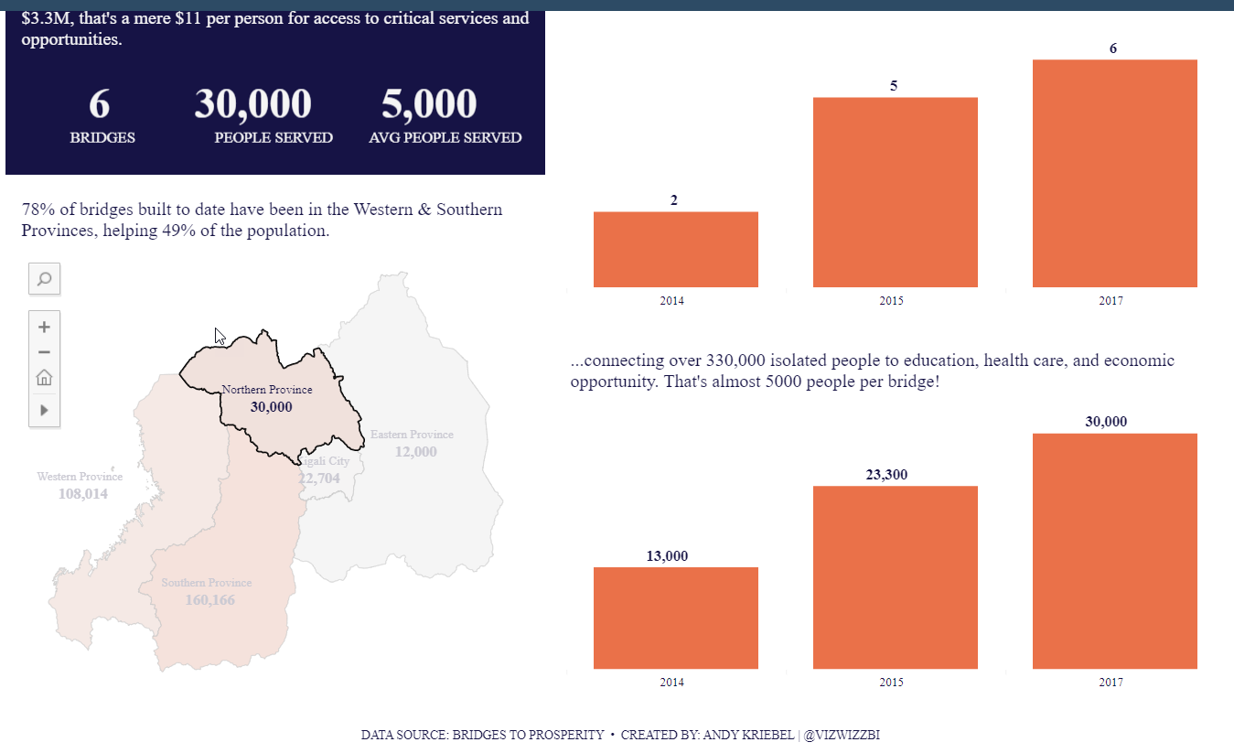
Interactivity
https://public.tableau.com/views/MakeoverMondayWeek4-BridgestoProsperity/MM2020W4?:display_count=y&:origin=viz_share_link
Notes:
https://public.tableau.com/profile/andy.kriebel#!/vizhome/MakeoverMondayWeek4-BridgestoProsperity/MM2020W4
Have students interact with the Dashboard.
What questions can you ask and answer?

Slide 16
Makeover Example
Notes:
Let’s look at the elements of storytelling.

Slide 17
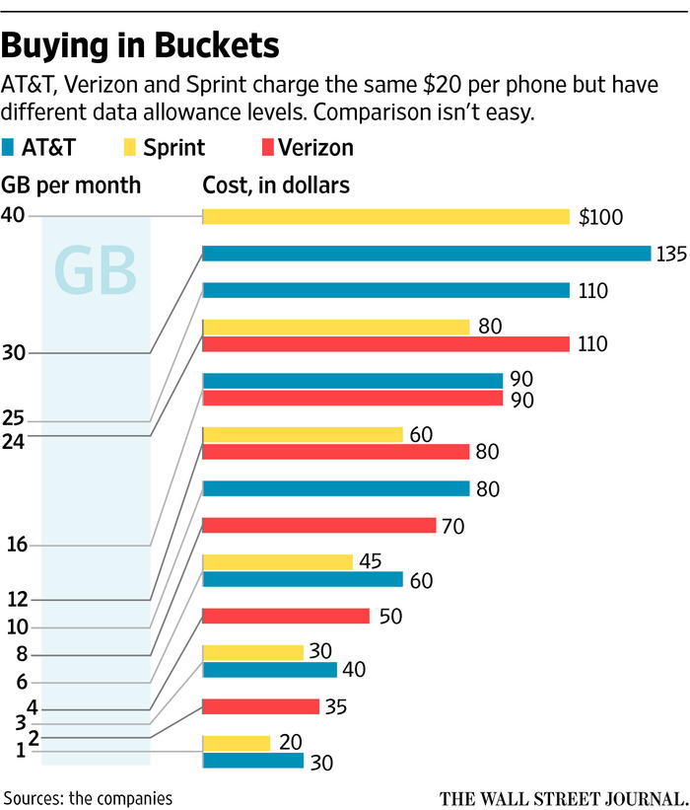

Let’s
Re-Design!
Notes:
Example from The Wall Street Journal.

Slide 18
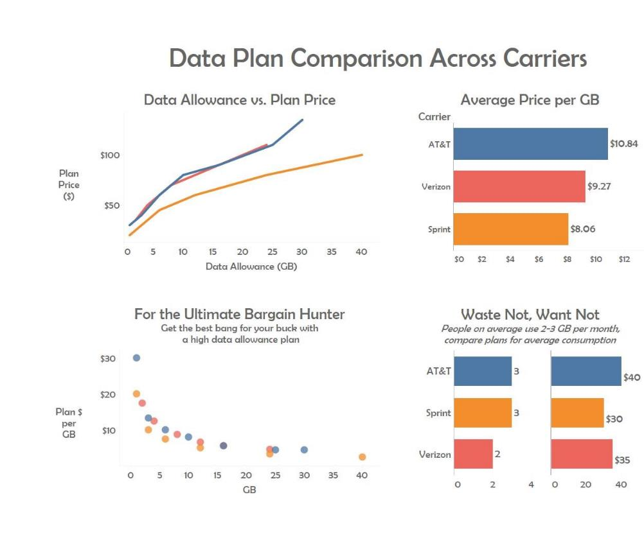

Notes:
Here is a redesign done by Angie Chen, a student at the University of Cincinnati. Angie has color coded the three carriers, keeping color consistent throughout all of the charts. The chart on the top left shows the pricing trend of the plans as the data allowance goes up. We can see that AT&T and Verizon have a similar trend, but Sprint has a clear distinction. When calculating the average price per gigabyte, Sprint also comes in the lowest. In the bottom left corner, the dots show the price of each plan at the various levels of gigabytes. This makes it easy for a bargain hunter to pick the lowest dot at whatever data plan level they would like to see. At 30 gigabytes, a user might choose AT&T, but at most other levels they would be best with Sprint. The bottom right hand chart calculates the plans based on average consumption for users.
Notice the dashboard title, the chart titles and subtitles throughout. Angie could take this a step further and give you the punchline.

Slide 19
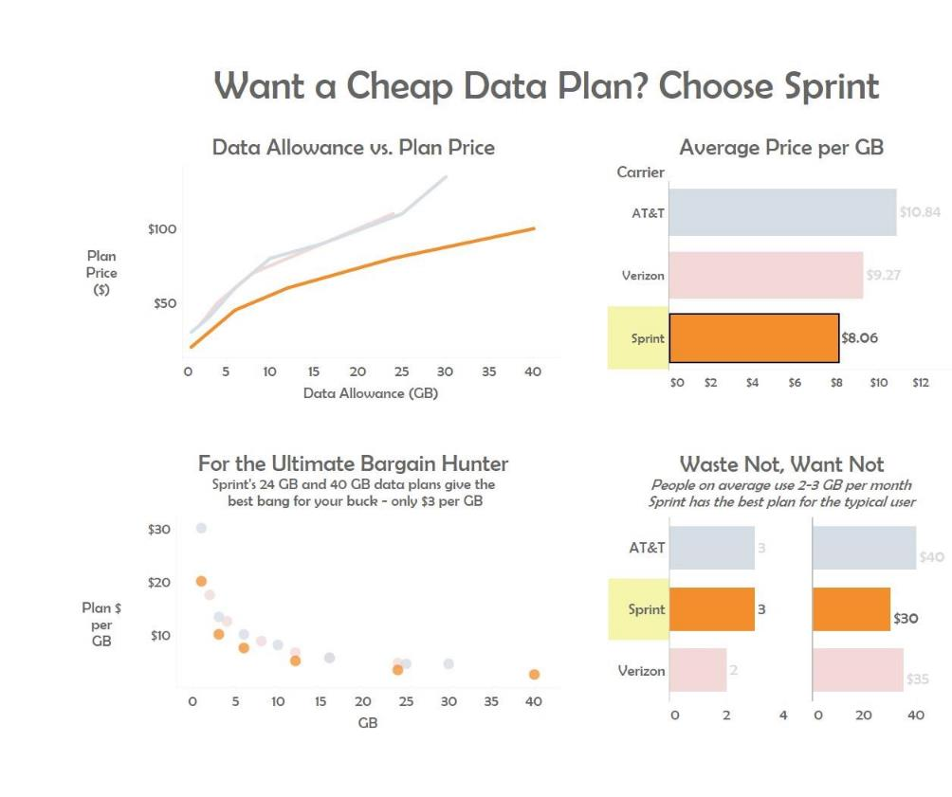
Notes:
In this version, she sets up the question and then answers it. And by highlighting the carrier, it’s easy to see where Sprint lines up versus the other carriers and why it’s the best choice for the cheapest plan.

Slide 20
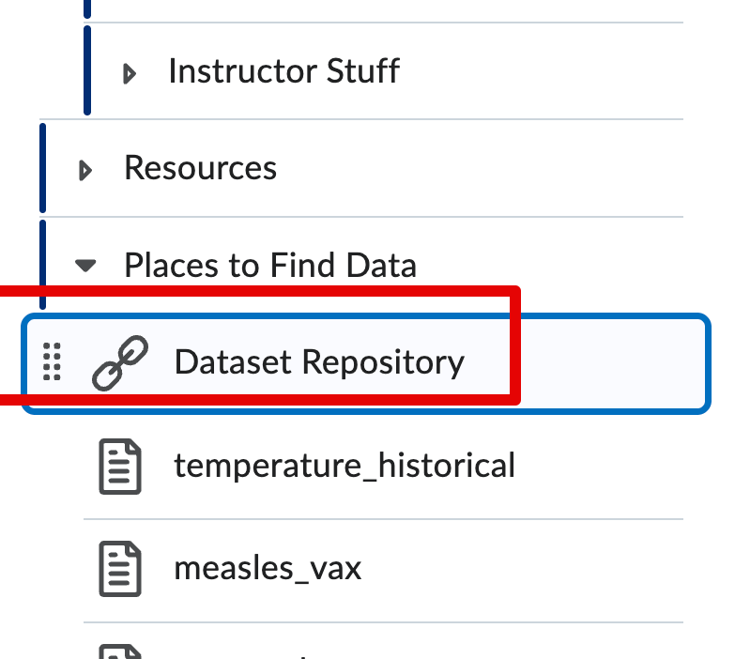
Inside the Dataset Repository link there’s a rat_sightings.csv.zip file.
  You’ll need to unzip it.
We are newly hired rat czars in NYC.
We need to show and overview of the prob.
  ~What is the current status with rats and what do we think will happen next (6-18 months).
There are many potential ‘answers’:
  Different aspects may be focused on (d.k.).
  Different charts may be used, and attributes utilized.
  Different combinations may be assembled.
Start: look at data, what useful info can we show.
  Then: what values are needed, what chart type to try.
Let’s do it!

Slide 21
Learning Stuff Along the Way
Tableau has many, many things that it can do.
  Way more possibilities than we can memorize, it is open ended.
All of you will do different visualizations that need different skills.
We want to get to a point where we can pick up skills as we need them.
  E.g. I need to make this map look like that, how can I do it?
You want to take the same approach:
  What you want to communicate will dictate how it should look/work.
  If you want something that you don’t know how to do, research it.
  Most things are relatively simple, some may be hard and require pre-req skills.
We’ll encounter a few today, and practice looking up solutions.

Slide 22
Redesign Activity
Notes:
Section Header

Slide 23
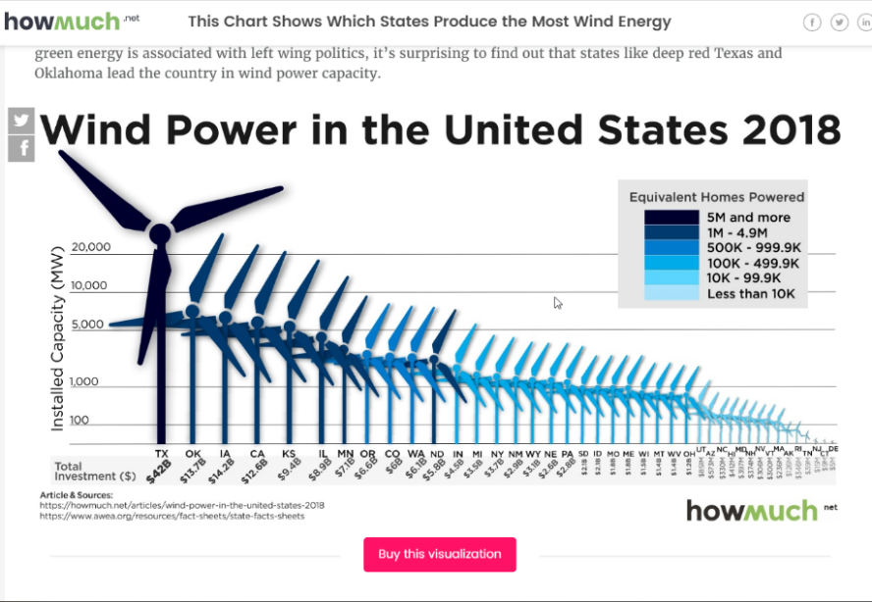
How would you redesign?
https://howmuch.net/articles/wind-power-in-the-united-states-2018
Notes:
https://howmuch.net/articles/wind-power-in-the-united-states-2018
Remind students of the good chart/bad chart activity they completed in Module 9. We now layer concepts of design and story to redesign.

Slide 24

Follow Knaflic’s storytelling process
Context
Appropriate Display
Eliminate Clutter
Draw Attention
Design
Story
Notes:
Cole Knaflic shared in her video from Tableau Conference 2019 the importance of working with pen and paper.
She also advised to brainstorm, edit, gain feedback, and iterate.
Activity Instructions:
--On you own brainstorm ideas on how you would remake this visualization. Work to apply the concepts we have covered in our course so far.
--In pairs or small groups, discuss your ideas and give feedback. Did you choose the same ideas?
--As a small team or in pairs, decide on a plan to remake the visualization.
--Discuss as a class. What changes should be made?
Adaptation for online learning:
Suggestion A: Consider assigning paired or small group video meetings..
Suggestion B: This activity can be expanded into a peer review activity, assignment, or contest. Using your LMS, students can share with their peers and determine best ideas.

Slide 25
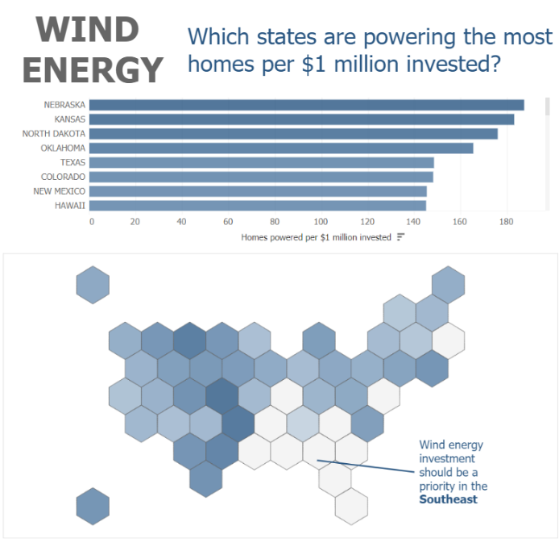
Makeover
Notes:
Have students open Tableau file and interact. What do the tool tips show? Does the viz address the ideas that they had in the activity?
Introduce the concept of hex map (to inspire for more advanced topics)

Slide 26
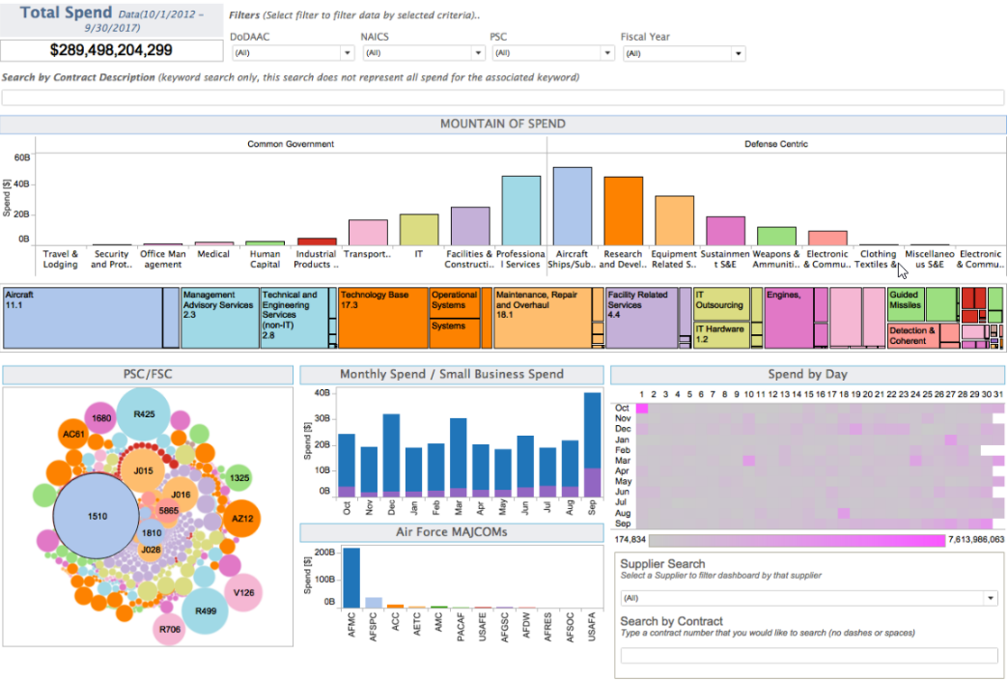
Redesign
Notes:
Cole Knaflic shared in her video from TC19 the importance of working with pen and paper.
She also advised to brainstorm, edit, gain feedback, and iterate.
On you own brainstorm ideas on how you would remake this visualization. Work to apply the concepts we have covered in our course so far.
In pairs or small groups, discuss your ideas and give feedback. Did you choose the same ideas?
As a small team or in pairs, decide on a plan to remake the visualization.
Discuss as a class. What changes should be made?

Slide 27
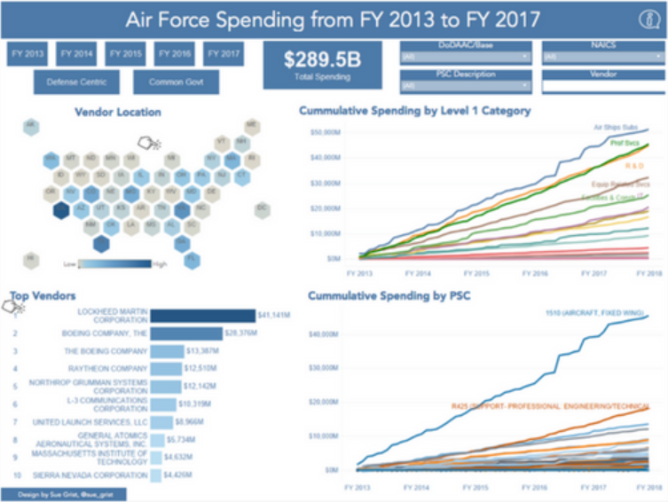
Redesign
Notes:
Have students open Tableau Air Force Spending file and interact.
Does the viz address the ideas that they had in the activity?
What do the tool tips show? Note the use of viz in the tooltip when you over state.
Point out the number of sheets compared to the first one.
Cole’s contest winner on redesign: Blog posts:
https://www.linkedin.com/pulse/creating-defense-centric-tableau-demo-sue-grist/
http://www.storytellingwithdata.com/blog/2018/7/24/swdchallenge-recap-your-choice-makeover

Slide 28
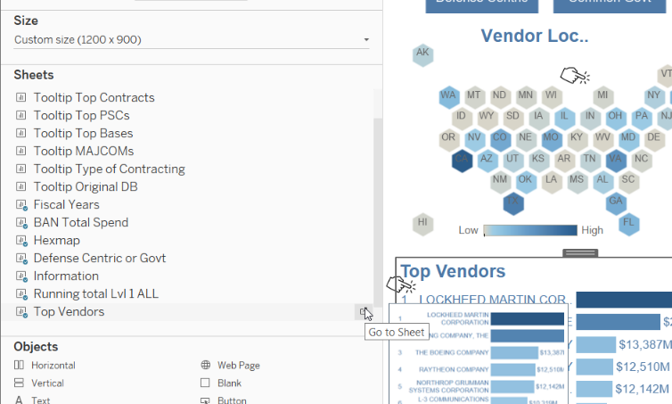
Redesign
Notes:
Go to top venders sheet by clicking icon to right of sheet name.
Point out the many filters that create the interactivity. Inspire for more advanced study!

Slide 29
Notes:
Tableau Logo

