Slide 1
Housekeeping
Today:
Color (chapter 4).
Map types
Data type review and grouping/aggregation review.
Intro to Maps exercise (Intro to maps zip file in repository).
If anyone wants to try to make an account at mapbox.com and see if it is still possible to make a free account, that’d be amazing and your classmates will love you forever.
Try to use H&M dataset to display something. (Might use for data cleanup example soon).

Slide 2
Color

Slide 3
Color in Visualization
Color is a primary feature in visualizations.
Most visualizations can have color added pretty easily.
We can encode, or represent data from variables via color:
Numeric variables can be represented with a gradient.
Categorical variables can be represented with different colors.
Color is one of the most prevalent preattentive attributes.
We have preexisting understanding of many color things – red/green, dark/light, etc…
We notice color quickly and our brain categorizes/orders based on it.

Slide 4
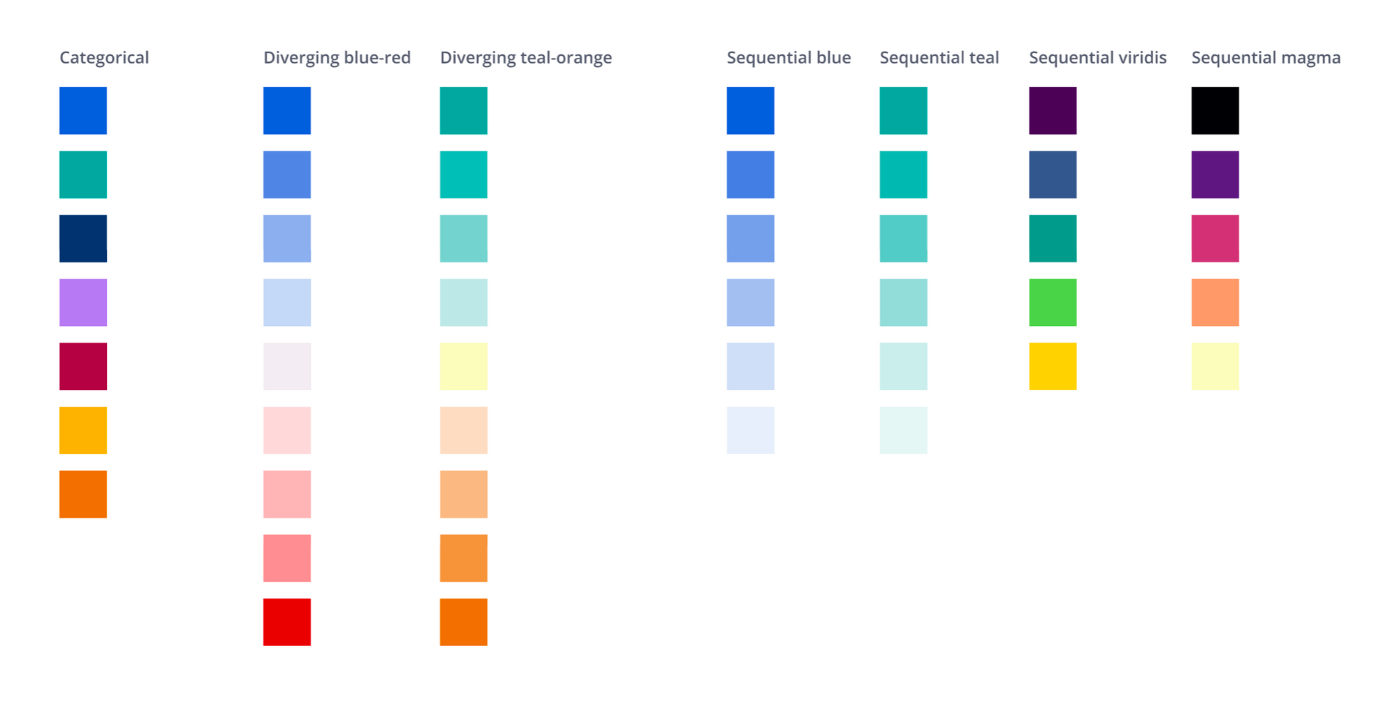

Slide 5
Scales and Color Choices
Color choice and visual design is a massive area of study.
We don’t need to be experts, but we need to be competent.
Think – we want to convey some info, does adding color make that clearer.
Always ask this.
Two main things that we use color for:
Differentiation – showing different categories with different colors. E.g. province map.
Gradient – showing progress of a numerical value over a range. E.g. crime map.
Gradients can be both diverging and sequential, roughly – is there a middle?

Slide 6
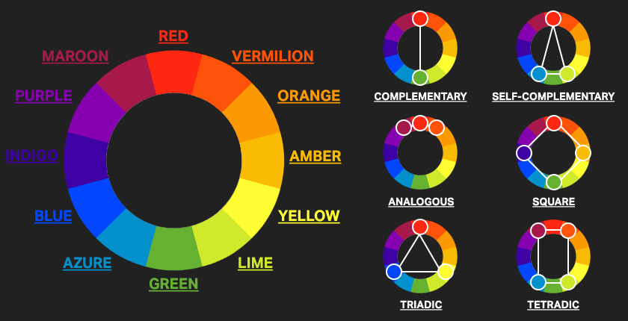

Slide 7
Tableau Helps us Out here…
The default color schemes that Tableau assigns are generally good.
Some things to pay attention to:
If there’s more than one chart with the same data, make sure color is consistent.
If something’s categorical, limit number before assigning color.
If the data is discreet vs continuous it’ll get colored differently, you may need to adjust.
Some cases for departing from defaults:
Preexisting meaning for a certain color scheme – e.g. sports teams, politics.
Style guidelines demand – e.g. fitting into a larger visual thing, such as a drawing.
Internal consistency – we don’t want the same thing represented by several colors.
Clarity – always must ensure it clearly conveys the intent, so if it doesn’t, change it.

Slide 8
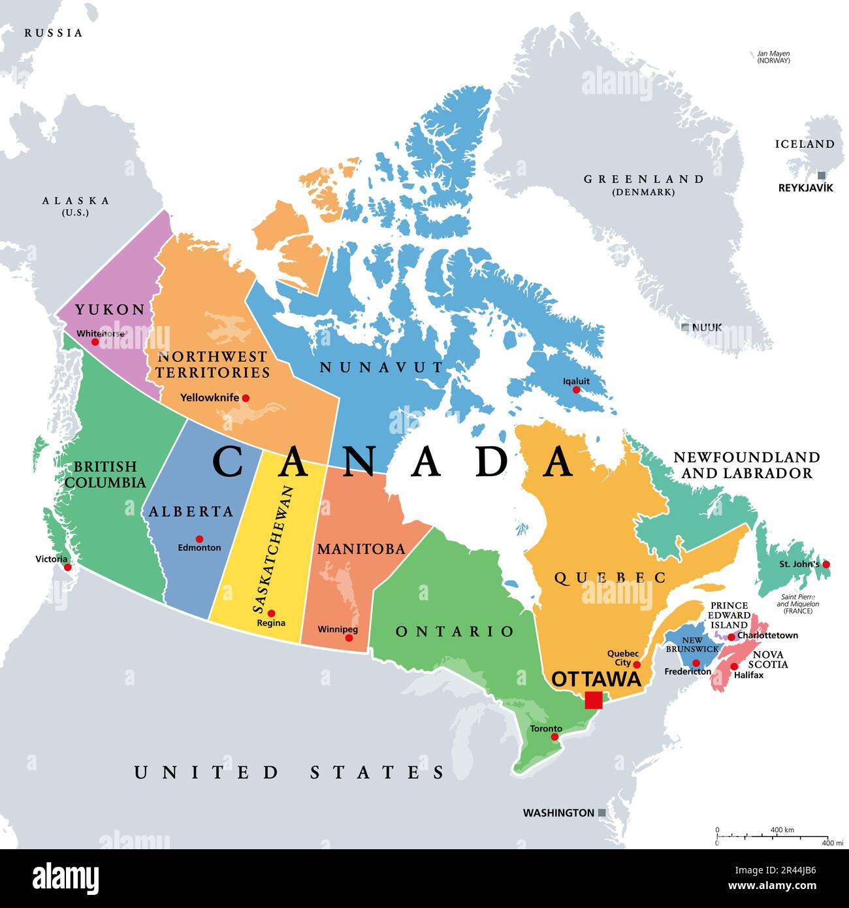
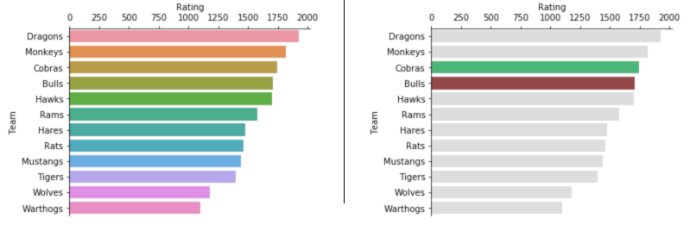
Think about what Color is For
Colors obviously differentiate things, but think about it deeper.
What, specifically do you want a reader to be able to get from a chart?
Sometimes color can be targeted at it directly.
Example - emphasis on one thing, or a subset of things.
”Other” groups for coloring might make sense.
The color group can be made dynamic with actions.
Use color purposefully.
Always ask – is it clear? Does it help?

Slide 9
Discreet vs Continuous
One key consideration in color is discreet vs continuous data.
Discreet – takes on only certain specific values.
Continuous – takes on any value in a range.
This relates to another, slightly broader, division in data:
Categorical – groups, labels, or descriptors.
Numerical – measurements.
These aren’t a perfect match (we can have a discreet numerical value) but they are close.
Most commonly – discreet value of a number, like shoe size.

Slide 10
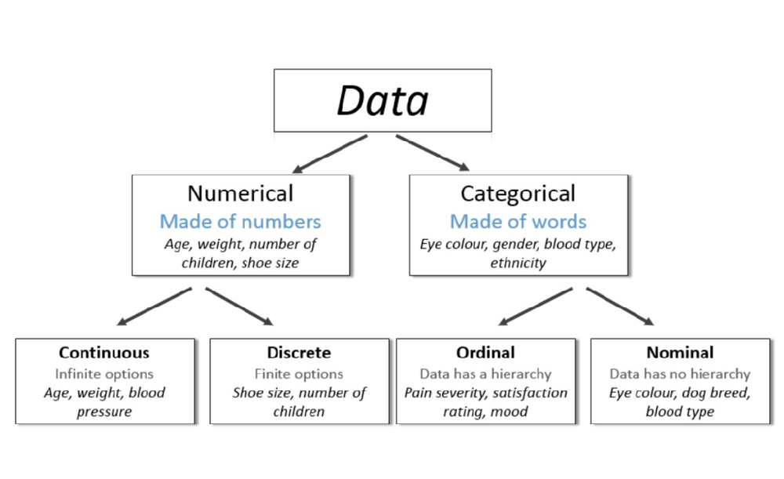

Slide 11
Discreet vs Continuous in Tableau
In Tableau we have two types of variables:
Dimensions – discreet values.
Measures – continuous values.
Tableau usually identifies these correctly, but not always.
We can manipulate the way Tableau interprets the type as needed.
Right click -> options for discreet/continuous and measure/dimension.

Slide 12
Less Formally…
There is some possibility for confusion, especially with discreet number values.
In general…
If it makes sense on a number line, it is a continuous value.
If we want to ”group by” something, it is a discreet value.
We are often (usually??):
Dividing (segmenting, grouping) data into groups by some categorical value.
For each of those groups, calculating some aggregate value – sum, count, mean, etc…
E.g. divide census data by province, calculate avg wage. Divide student data by major, calculate number of students. Group covid tests by occupation, calculate infection rate.

Slide 13
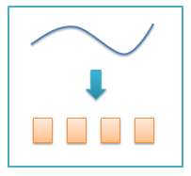
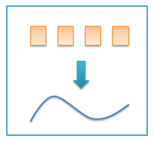
Translation between Discreet/continuous
Binning: numerical to categorical.
Encoding: categorical to numerical.
E.g. your GPA goes from continuous (percents) to discreet (letters) back to continuous GPA number, before being averaged.
Used regularly-ish in data science.
For us – does either help us represent what we want better?
E.g. if we are looking at career success of middle class residents, it may make more sense to bin income and use that.
E.g. banks loan based on credit score category, not number.

Slide 14
Aggregation
Aggregation is a general term for combining things – in this case many rows of data.
An aggregation just summarizes many values in on value.
We can use this one value to ‘represent’ that group in analysis.
Aggregate values include mean, median, count, min, max, std dev, sum.
When aggregating categorical, just count based things for aggregation.
Often (usually??):
Divide data up into subgroups using some dimension(s).
Calculate an aggregate value for each group.
Compare those values to learn something actually useful.

Slide 15
Focus (excessively) on the “per” part of Groups (Granularity)
When grouping data, focus on what each group is.
E.g. if you want to know the profit, what do you want to know the profit for?
This is usually implicit and easy to ignore in normal conversation.
E.g. ”profit” for a store you work at could mean many things.
Most likely, per location, per year -> implicit understanding.
Per store, per quarter?
Per store, per department, per year? (Different from per department, per year).
Per week, per store?
This is one of the most overlooked things – be explicit and excessively detailed.

Slide 16
Maps (and Color)
One common usage of colors are maps.
We can map stuff whenever we have either:
A set of locations – latitude and longitude.
A set of geographical regions – city, state, province, country.
We can map some other stuff (like neighborhoods) but that requires more:
Spatial data files (~data defining geographical things).
Joins

Slide 17
Discreet Values – Discreet Colors
When dealing with discreet values, we can color code with arbitrary colors.
Color itself has no meaning, only to differentiate.
If a color is used in multiple places, we want consistency.

Slide 18
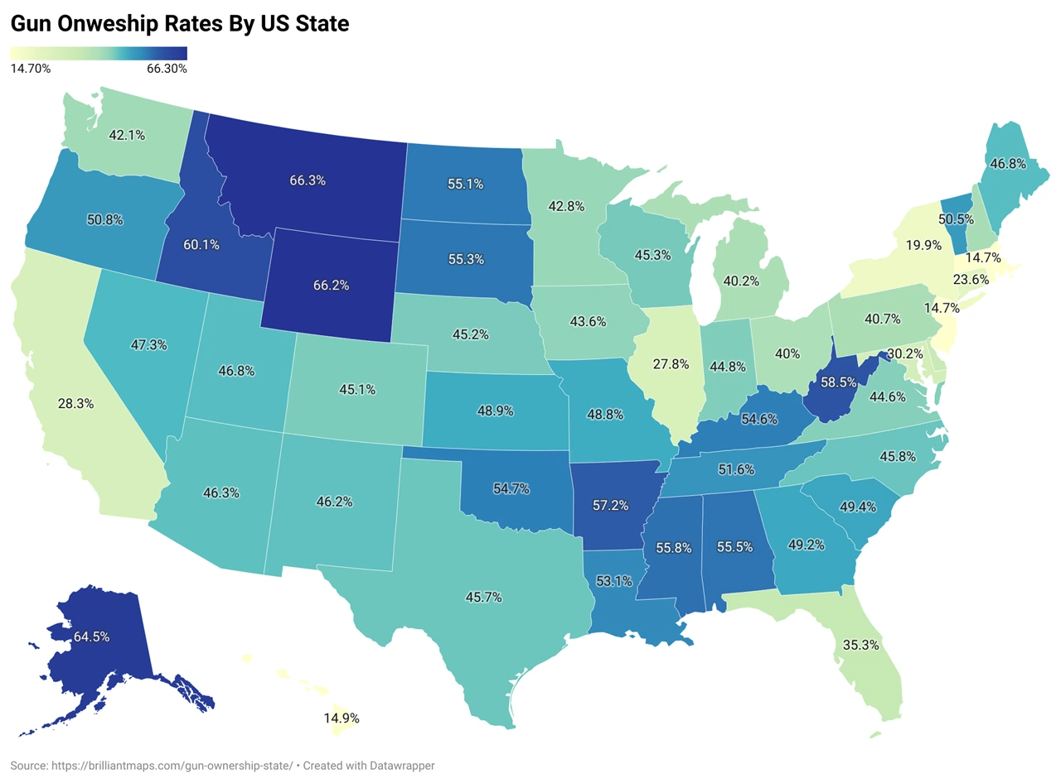
Continuous Values – Color Scales
With continuous values, we can use a scale to represent the value.

Slide 19
TabMaps
Mapping is generally pretty easy in Tableau, as long as a few requirements are met:
To make a filled map, your data must have a region (state/prov/country)*.
To make a point map, your data must have latitude and longitude (or point).
*You can do some translation here if joining with other spatial files, more later.
Mapping data is usually identified correctly, but you may need to fix:
Right click menu from the variable has options to change interpreted type.
Lat/lon – may need to manually label them.
State/Province/Country – may need to separate parts, label, or correct missing data interpretation.
Neighborhoods, regions, areas – not filled mappable, unless you add another spatial file.
If using City data, pay attention to this if you want to map something like a ‘hood or ward.

Slide 20
Colorblindness
When choosing color schemes we want to consider colorblindness.
Red/green tends to be the most common issue.
Note for things like financial data – things with red/green also have brackets or negatives to be clear.
Default color schemes in Tableau (blue/orange) is colorblind friendly.
Even outside of colorblind concerns, color schemes should be clear:
Don’t have colors that are hard to see/differentiate.
Don’t accidentally imply things with colors (red=bad, green=good, darker=higher, same color=same thing, etc…)

Slide 21
Color and Concerns Adding Density
Color is a common thing we can change to add some density to a chart.
Most chart types can have another metric added to the color.
Commonly: use a color to show a continuous value on something like scatter plot mark.
Ensure the color scheme you pick makes sense and is clear.
Depart from known–good color schemes with caution.
Using color is good, except for where it is bad!

Slide 22
Conclusion
Color is a primary tool in visualization.
We can use it in several way to embed information.
Categorical label, diverging gradient, sequential gradient.
Color also has common meaning.
Red is stop, green is go, blue is water…
Color is easy to add to virtually any mark.

