Slide 1
Housekeeping
Today:
Chapter 3 – coordinate systems. Short and pretty simple.
Database structure basics – part 1 of 2. Datasheets, tables, structure, keys.
Reading: Structuring data for analysis.
Dashboards:
More dashboarding, in an assignment-y way.
More data cleanup and using some data exploration skillz.
Actions and interactivity.
Filters and such.

Slide 2
Coordinate Systems and Axes

Slide 3
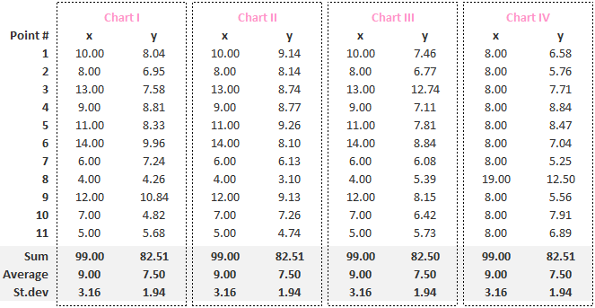
Anscombe Quartet
Anscombe’s Quartet is a nerd famous set of data sets.
Each data set (x/y) has the same:
Sum.
Mean
Standard deviation.
Correlation.
One would assume the data sets are very similar.
But…

Slide 4
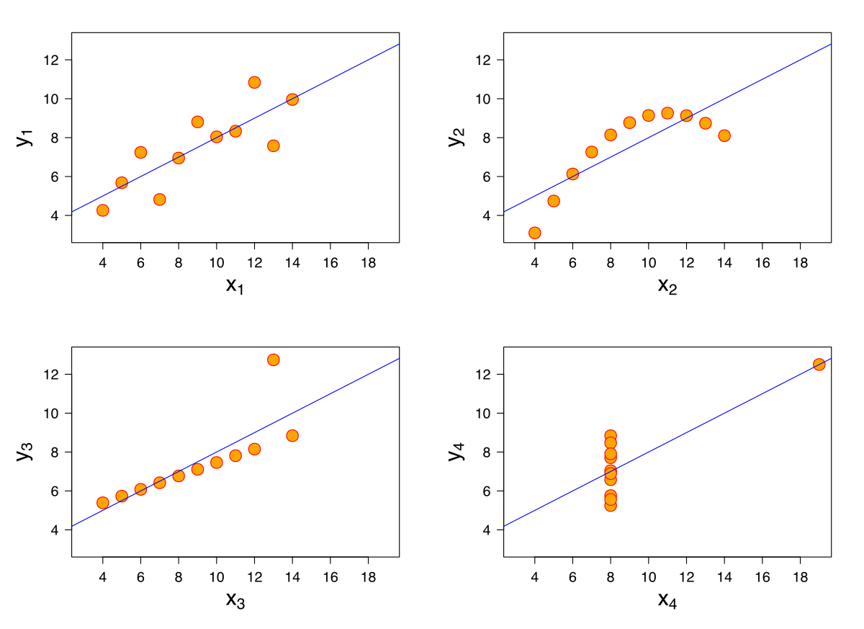
But if We Visualize them

Slide 5
What is Going on Here? Chaos!
We have a lot of data.
We can analyze that data in many different ways.
The type of analysis we do will change what we can learn from our data.
Visual analysis is powerful because it can help us see things that are difficult otherwise.
To analyze data well (like if this was your job):
We need a toolkit of analytical tools, of which visualization is an important one.
We need to ensure we present data in a way that allows us to see what we care about.

Slide 6
Encoding vs Decoding
Encode.
We have a bunch of data to analyze and sort through.
We will create a visual representation of that in our charts – encoding.
Decode.
The reader will look at our visualization to get the information – decoding.
We want to make sure that they get what we intended.
We also want to make that as easy, or friction free, as possible.
We translate data into charts, the reader transforms charts into info/knowledge.
The better we are, the better this works.
Also don’t want to accidentally encode info - order, size, shade may convey meaning.

Slide 7
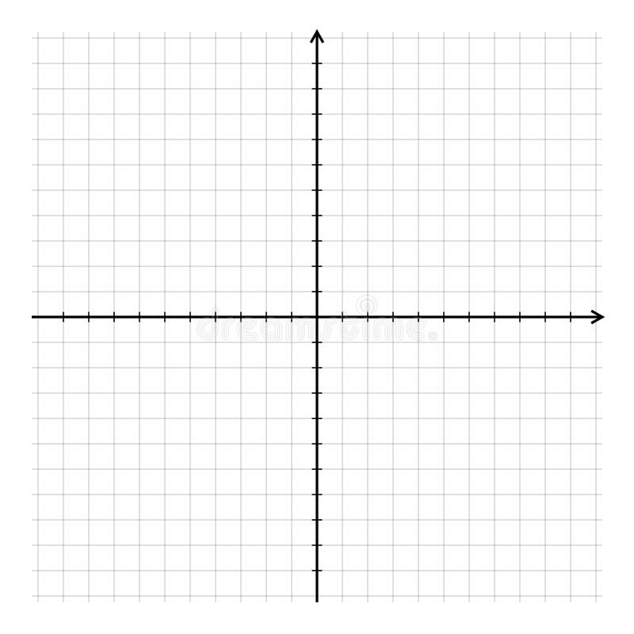
Coordinate Planes
One of the foundational ideas of graphing is the coordinate plane.
Allows us to define exact position in 2D (x,y).
We can plot pretty much anything here.
We can define the positions arithmetically.
Tableau works by creating planes and plotting points on them.
Often this is transparent to us – e.g. bar graph or map.
In more complex examples, we can manipulate it to do things like curves.

Slide 8
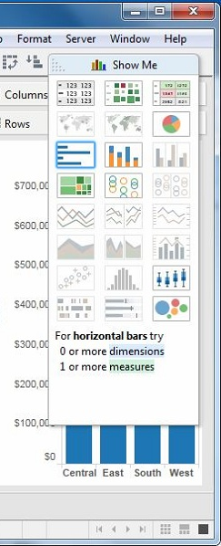
Styles Make Charts
Each chart style uses the plane to display results differently.
Different charts are good at different things.
Different charts need different values (type and number) to work.
“When I read this, do I get that?”
In Tableau, the Show Me changes chart types all-at-once:
We can reformat our data into a totally new style.
Tableau makes assumptions, it may make mistakes.

Slide 9
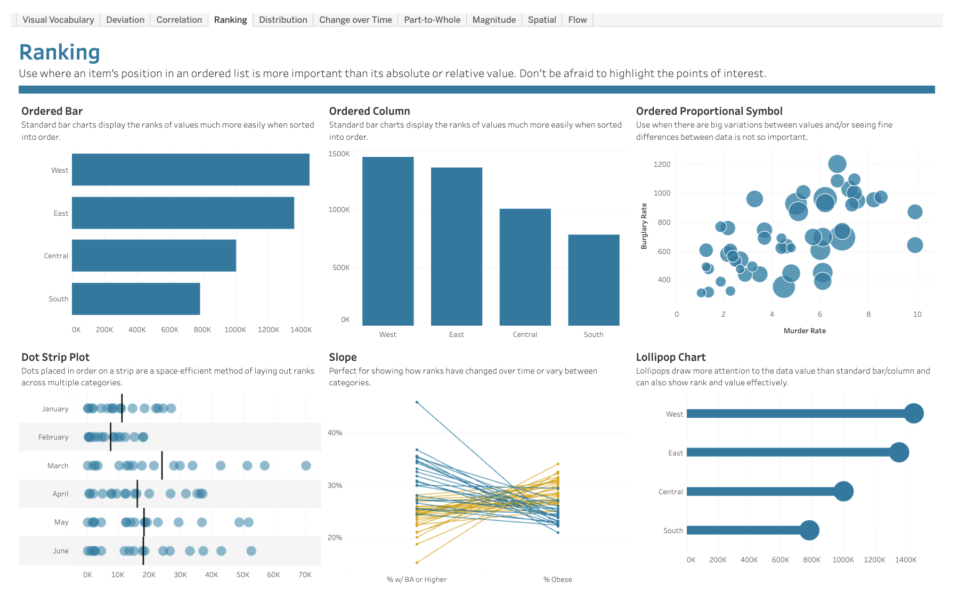
Visual Vocabulary
There’s a link on Brightspace to a visual vocabulary.
This gives an example of good chart types to display certain things you may want to show.
These are good starting points – you can change anything, but these are examples of what we know works well.

Slide 10
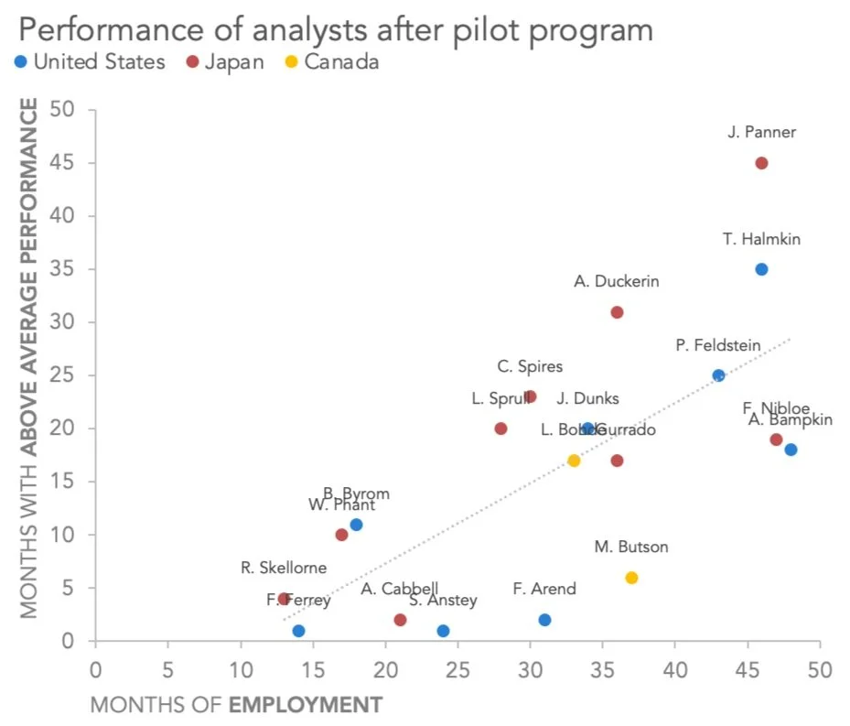
Scatter Plots
Scatter plots are the most coordinate plane-ish type of plot.
Scatter plots are most commonly used to show relationships between numeric variables.
Scatter plots easily allow other attributes to add density:
We can use shape/color/size/pattern to encode other data in addition to position.
This makes a plot more dense – same # of charts, more information.

Slide 11
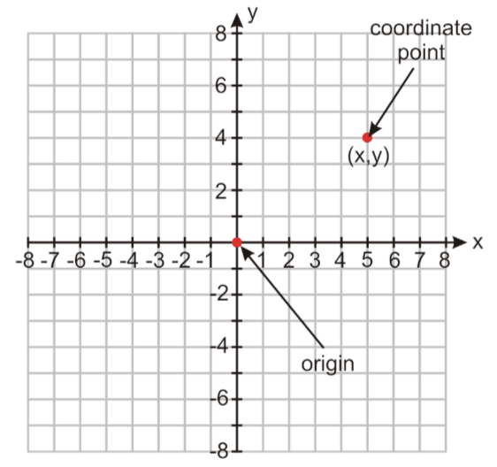
Scatter Plots are Simple!
Scatter plots are very simple, yet powerful.
Generally, we just use quadrant 1.
Require two numeric measures.
One is X, one is Y. (Whatever you pick maps to these).
Think – if one is categorical, what is the result?
Can show relationships between variables.
Basis of predictive analytics – linear regression (best fit).

Slide 12
Using Coordinate Planes
Coordinate planes are useful for visualization because we can encode any position.
I.e. we have a specific number (x,y) for any point on the plane.
We can position things at any point.
When plotting, Tableau generates and uses these positions to plot stuff (sometime invisibly).
E.g. the x (or y) is used with a number to generate the length of bar charts.
A line chart is a bunch of points, connected.
With a coordinate plane as a background, we can create pretty much any chart.
We are showing values, the plane gives a visual representation of value, we can choose any way to visualize our values on the plane.
Different chart types or styles just maps the data on the plane differently.

Slide 13
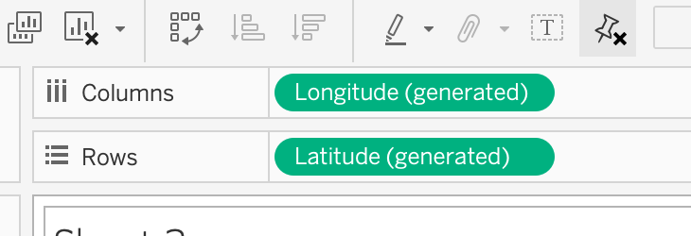

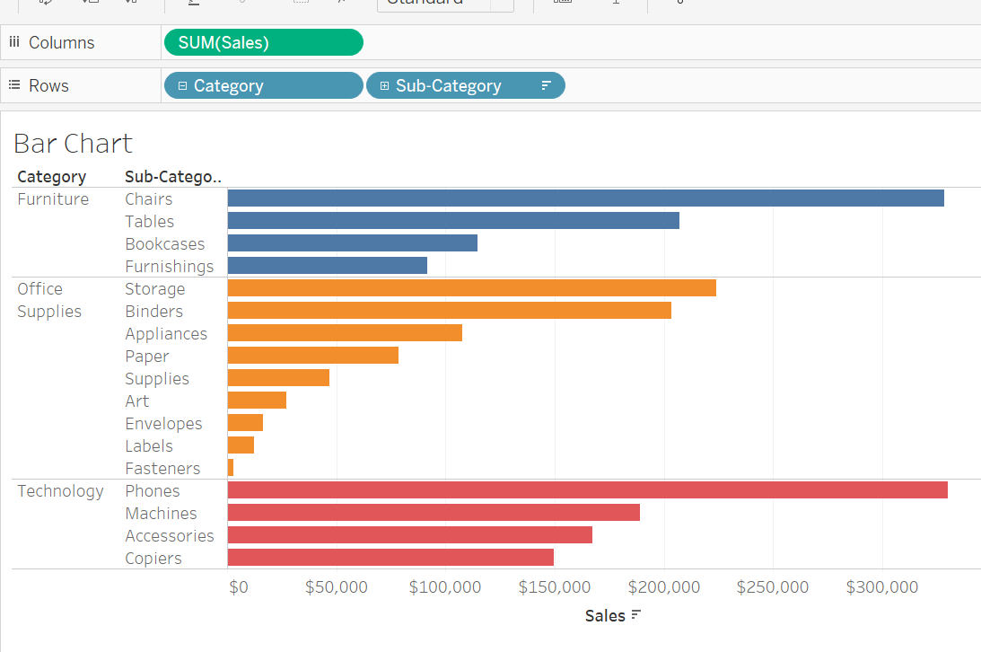
the Shelf
Whatever is in the shelf will be mapped to the x and y axis.
Columns will be the X axis. If there’s an independent variable, it should probably be here.
Rows will be in the Y axis.
Other charts are similar – things are scaled (num) or grouped (cat) along that axis.

Slide 14
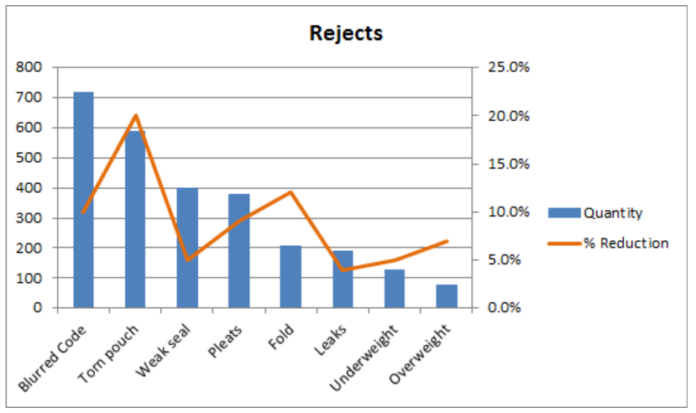
Coordinate planes Behind the Scenes
We can sometimes layer charts on top of each other.
The coord. Plane is the same, just reused to draw more than one chart.

Slide 15
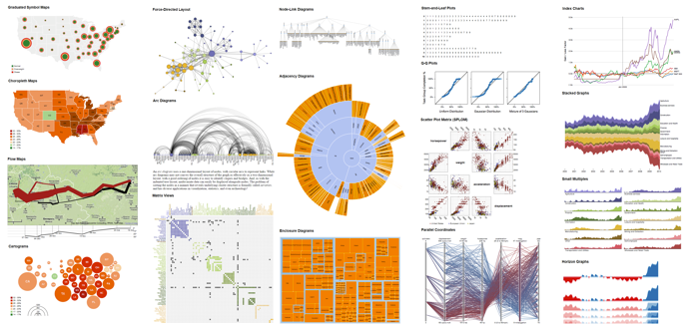
Data Density
Data density is the amount of data contained in one visualization.
Density of information is one key benefit of modern visualization tools.
We can pack one plot full of lots of data.
Primary tools are color/shape/size/pattern of marks.
Use interactivity in modern tools to make things even better.
Pop-up/out things like tooltips that appear conditionally.
Plots that change to show more detail dynamically.
Ability to drill down/roll up to different levels of detail.
Note: this is different than the density of data inside a plot.

Slide 16
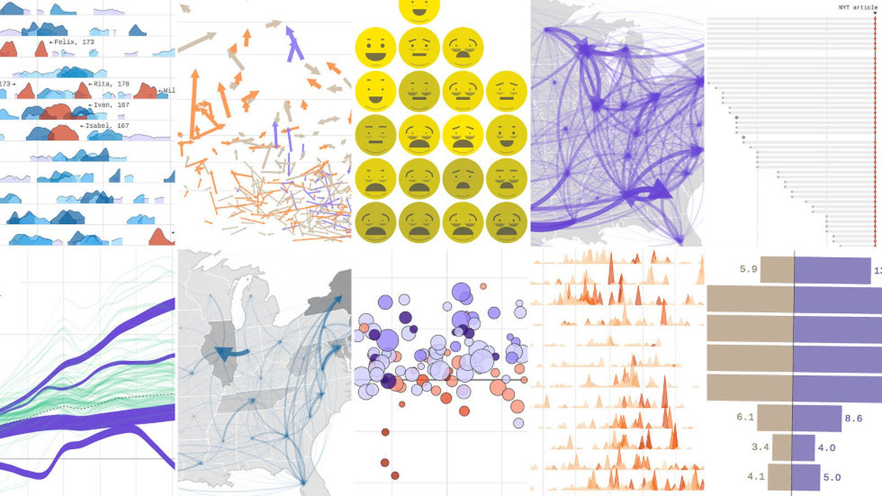

Slide 17
Density Concerns
The concerns against adding density are pretty practical.
Relevance – we don’t want to add data that is irrelevant to the user.
Clarity – depending on the chart, we can comfortably accommodate only a certain amount.
Usability – whatever additional data we add should be usable, i.e. someone can get the benefit of reading that information.
Does adding density make it easier to consume than adding another chart?
Make things as dense as they can be while being easy to consume, and no denser.
Visualizations for ‘specialization’ may be more dense, and require more knowledge.
Visualizations that are seen once, by the public, or without context are less dense.

Slide 18
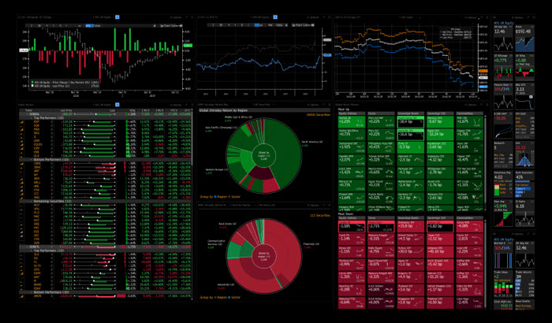
Bloomberg Terminals – Dense, but with Training

Slide 19
Non Scatter Plot Plane uses

Slide 20
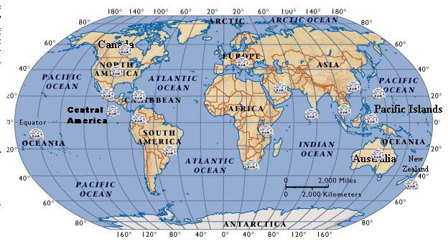
Coordinate Planes and Mapping
Mapping is a special example of a coordinate plane.
Latitude and longitude are x and y values.
Origin is equator and prime meridian.
In Tableau, maps are images of earth on a plane.
The map is just a picture or image.
There are specific lat/lon to plot it in place.
Points drawn on it are just like a scatter plot.

Slide 21
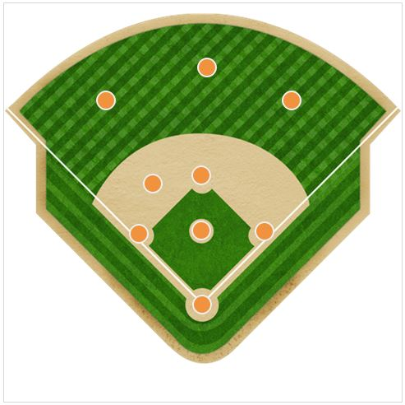
Remixing my Maps
This adds flexibility in a few ways:
Anything can be the background to a map, as long as someone can locate it via lat/lon.
We can use anything ‘as a map’ and position points anywhere on a background.
Many fancy Tableau things use these ideas to customize mark position.
Use a custom image as a background to a scatter plot.
Define or calculate custom x,y positions for points to align them on the plot.

Slide 22
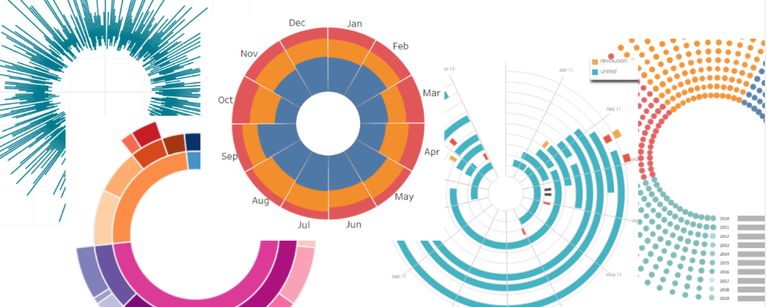
Crazier with Coordinates
Making complex things in Tableau often involves manipulating things on the plane.
Every mark has some x,y coordinates based on some variables.
That mark will show at the x,y location by default.
We can do things to transform those actual values into other location, for plotting.
We commonly see curves done with trigonometry.
Take the original x,y values, do a trig calculation (sin/cos), get a new coordinate for the mark.

Slide 23
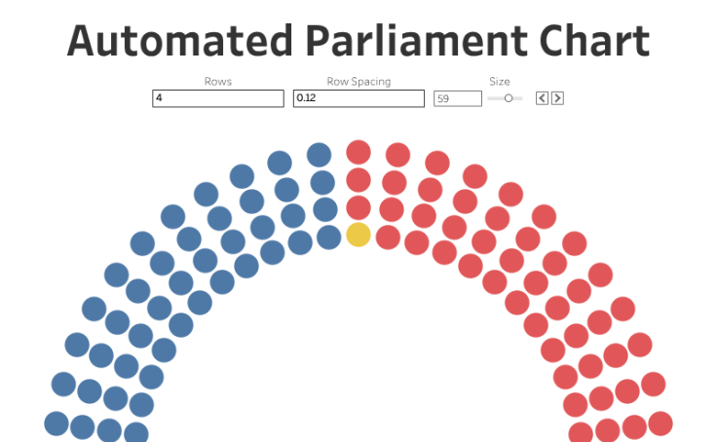
Example – Parliament Chart
Each block is one mark, and it has an x and y coordinate set.
Each mark is one representative in parliament in this case.
X and y are transformed through trig to create new x and y.
These new values are what are actually plotted.
These are in a curve due to the trig-ness of the calculation.
This type of thing isn’t easy to do off the top of your head.
May require manual, custom data to be added.
We can follow guides and adapt to our data.
Trying to adapt things to yours is a very good way to get good.

Slide 24
Chart Axis
Our axis define the scale and layout of a coordinate plane.
Tick marks show intervals:
Major tick marks are typically labeled.
Minor tick marks are not.
Right click -> edit in Tableau. If not available, you don’t have an axis…
Hint: what does a scatter plot require?

Slide 25
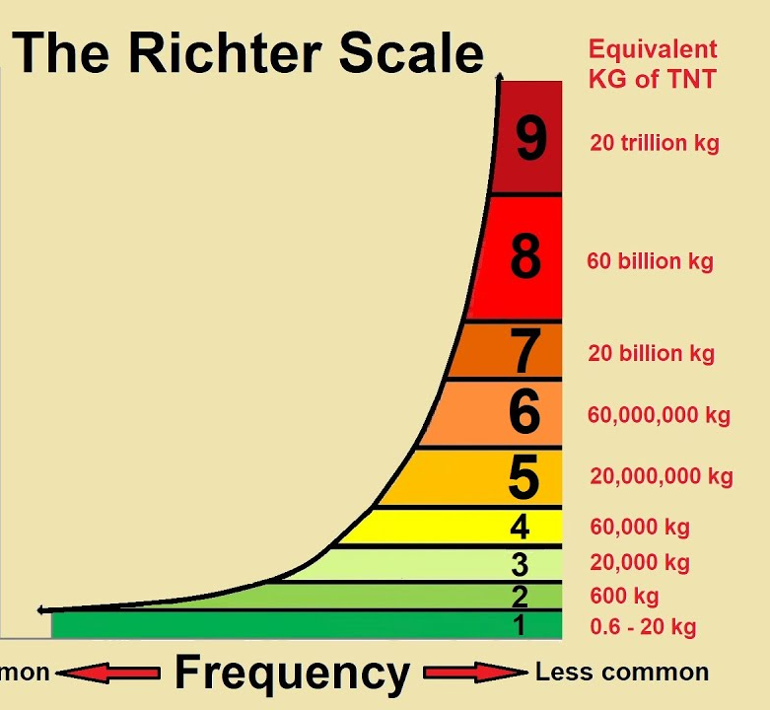
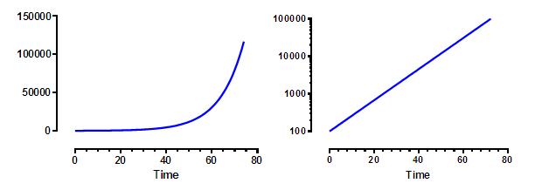
Axis Scales
Sometimes the scales on an axis are transformed from linear.
Common changes:
Reversed.
Logarithmic – shows linear with exponential data.
In Tableau – right click on axis to edit details.

Slide 26
Conclusion
Coordinates are a foundational feature that define visualizations.
We can use coordinates to place items in an exact spot – defined by data or custom.
Alignment, scale, and comparison all flow from coordinates.
We use coordinates to encode information.
E.g. the

Slide 28
Datasheets, Databases, and Data Structure

Slide 29
Structure of Data
Many things in the data world are interoperable because things follow a set structure.
You can open any text file in any text editor as long as the file is the correct type.
In Tableau, we can load data from many sources as long as it is in the correct format.
For data, most structured data is stored in relational database tables.
Any* program can manipulate the same data.
E.g. Brightspace writes your grade data down after the semester, another system (peoplesoft?) reads that data to put you on academic parole, the honor roll, or let you graduate.
An individual table/extract is a datasheet.
This is what we load in Tableau.
Looks like a spreadsheet wall-o-numbers.

Slide 30
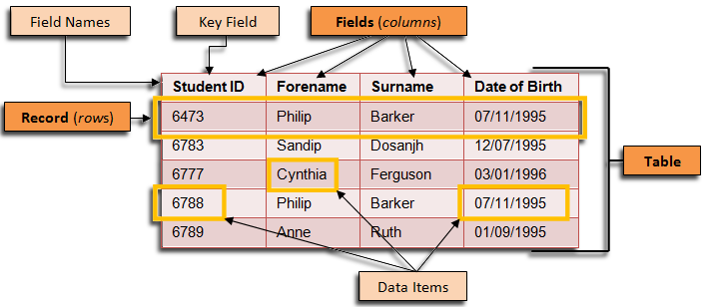
A Table of Data
RDBs look like this.
Should be familiar...
May be thousands of tables.
Table (sheet) is a list of a thing (an entity).
Each row is one instance of that thing.
Each column is one value (var) tracked about the thing.

Slide 31
Relational Databases
Database that stores data using an entity-relationship model.
Entities are the “business objects” we want to track. E.g. Customers, sales, products, employees, etc…
Relationships are the interactions between those entities. E.g. a customer makes a purchase, an employee fills a role, etc…
A database will have many tables, one per entity (“thing”).
Students, customers, products, purchases, etc…
There can be connections (joins) to model reality.
Customer makes purchase, employee assigned laptop, etc…

Slide 32
Three Basic Components of a Relational Database
Tables – data organized into sets of columns (fields) and rows (records).
Fields – these are the columns that contain descriptive information about the observations in the table (including primary and foreign keys).
Records – these are the rows in a table; each row, or record, corresponds to a unique instance of what is being described in the table.
A typical ‘enterprise’ database may have hundreds or thousands of tables.
The things we directly use are usually a combination of data that would be in many tables.

Slide 33
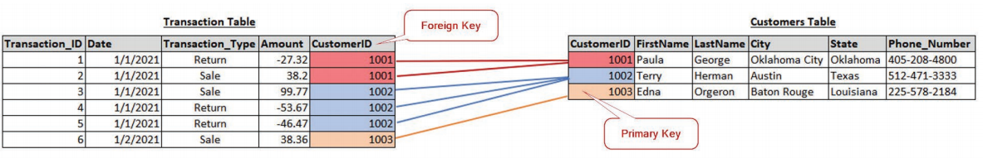
Primary Keys and Foreign Keys
Keys (unique identifiers) facilitate joining (connecting) different entities together.
The key (usually) allows for us to join data when the key matches.
E.g. We join data from Students and Registrations using the student ID on both.
Primary Key – Unique identifier in each table, Transaction_ID in Transaction Table; CustomerID in Customer Table
Foreign Key - Exist to create relationships or links between two tables

Slide 34
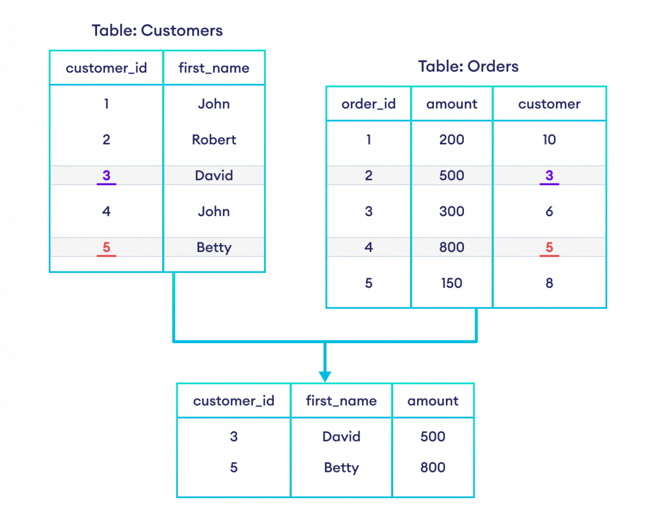

Slide 35
Using our Keys
The keys are the key to connecting entities.
Entity-relationship structure requires dividing data.
Each “thing” is stored in its own table.
Relationships are how those entities are joined.
Keys allow us to connect entities correctly.
We can look up the part of the other table to connect.
E.g. your transcript is looking up your ID from the “registrations” table. The foreign key in that table is the ID.
We find the student, then look up all the matching courses you’ve registered in and completed.
Joins are possible without connecting keys, but more rare.

Slide 36
In Practice…
In most cases, in real life usage, we will have some central database (a data warehouse).
Many systems that generate data (sales, website, HR, etc…) will dump data in.
There is an ETL process (later) to move the data in.
This warehouse is effectively a central repository of all data.
When doing analysis, we connect to that warehouse and slice out what we need.
Join together the tables that hold the parts we care about.
Slice out the relevant columns that are useful.
This is more or less what we get in many Kaggle downloads.
Setting up the starting point of the data is often/usually work, not just adding a csv!

Slide 37

RDB Data Dictionaries and ER Diagrams

Slide 38
Documenting a Database
With small and simple datasets we can often gain an understanding by looking at it.
E.g. much of what we use in Tableau.
With large databases, that’s less practical.
Databases may contain thousands of tables.
There can be thousands more relationships.
Each table can contain 10s to 100s or more fields.
On system I used had a 900+ page document describing it. That wasn’t a super large DB.
We need things to help us understand the DB.
Data dictionary.
Entity-relationship diagram.

Slide 39
Data Dictionaries
Data dictionaries provide an explanation of what is in a dataset.
Typically include information on:
Data types. (Number, string, date, etc…)
Context/description on what each variable is.
Rules on content (length, format, etc…)
DB “details” – keys, default values, “is required”, etc..
The data dictionary helps someone using data to understand that data more easily.
This is often, but not always, on the download page in Kaggle/CoE/etc…

Slide 40
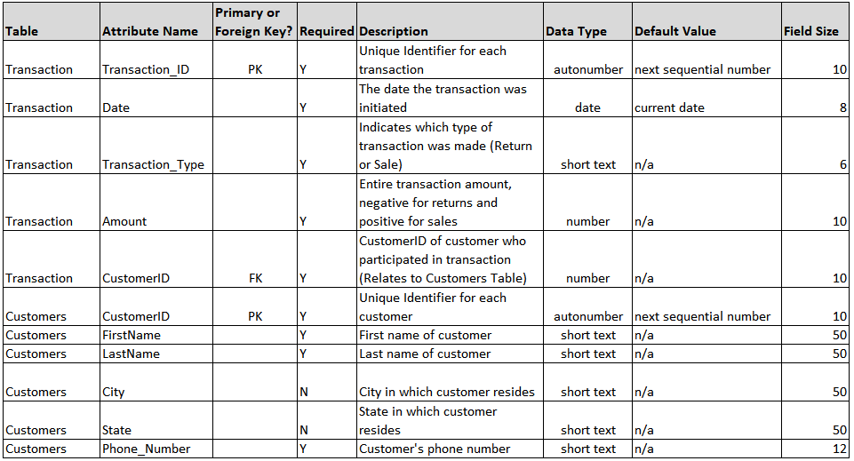

Slide 41
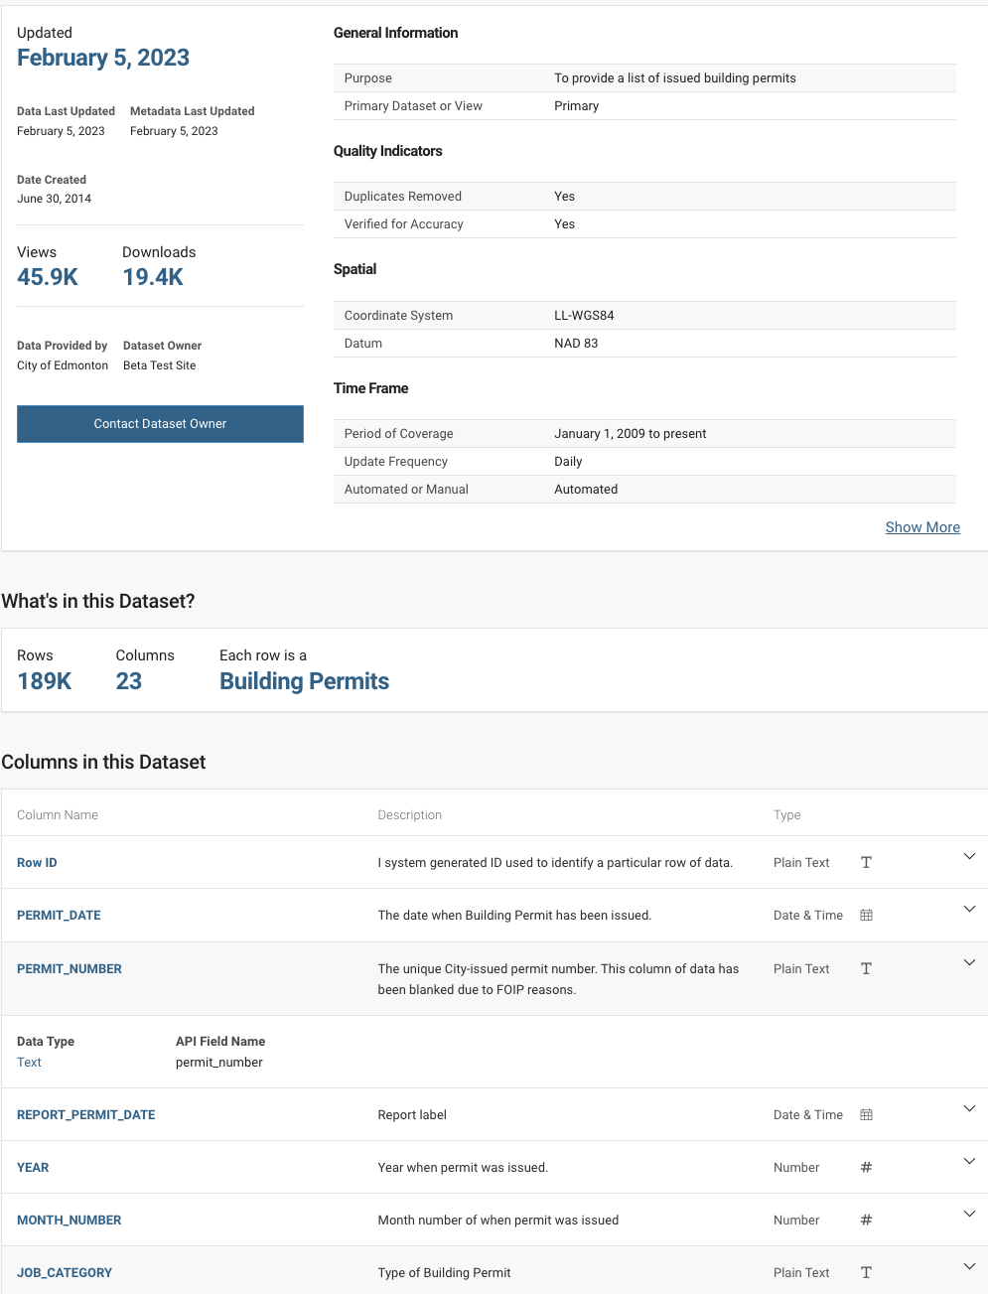

Slide 42
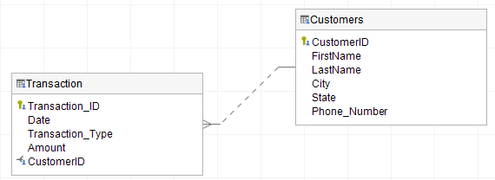
Example of Relational Database Diagrams - ER Diagram
ER (Entity-Relationship) Diagram – graphical representation of an information system, illustrating relationships among people, objects, places and events within that system

Slide 43
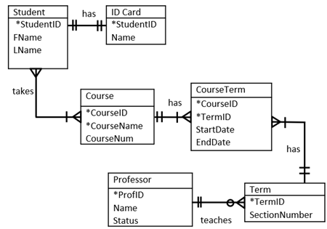

Slide 44
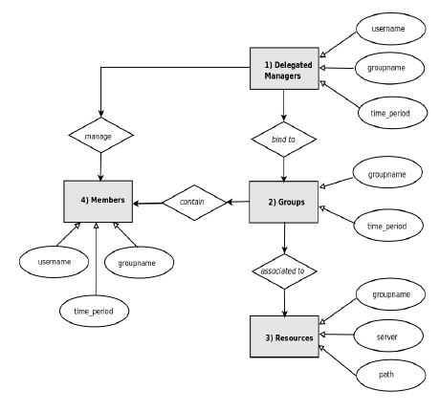

Slide 45
ERD Stylez
There are a lot of different styles of ERDs.
Some show fields in each table, some don’t.
Some have a diamond for the relationship between entities, some don’t.
The core thing is that they all show the entities, and relationships between them. Everything else can be varied.

Slide 46
What do I need with an ERD?
Entity relationship diagrams are extremely common when dealing with databases.
We don’t need to be an expert in them, but we should know:
How to interpret an ERD, at a high level.
How to take an ERD and understand it with the help of time and the ability to research.
An understanding of relationships, as that is really important in joining data.
When using “new” data, we need to gain an understanding of it to use it.
As we try to join data sources together, this becomes important.
Next week we’ll do some joining…

Slide 47
Conclusion
Understanding the structure of our data is important.
If you want/need to use non-curated data sources, you’ll need to be able to navigate.
You’ll need to prepare and connect to data.
Joining data tables to get all the data you need is common.
Get some practice reading the documentation, checking data, and seeing if it adds up…

Slide 48
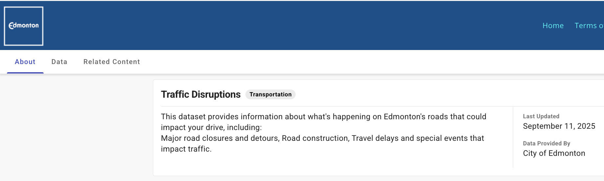
Traffic Disruptions
We’ll use some data on traffic disruptions in Edmonton.
Going in, I am going to assume that I want to the impact of construction.
I’m not 100% certain on the exact thing to look at, I’ll figure it out while exploring.
Start with where/when do disruptions happen and adjust.
Data is in repository or CoE site – read the dictionary if you have a moment.
What is it tracking, what is each row, what information is contained.
This is a smaller and simpler assignment like process.
This is realistic – I know broadly what I want, but I don’t know the details and I’m not totally sure yet that it’ll work out; I may need to adjust or change after starting.
Good practice* – download “bylaw infractions” and try to communicate some finding.

