Slide 1
Housekeeping
Today:
  Data manipulation and olap.
  Grouping aggregation quick practice.
Some quiz-like exercises that you may want to try as practice. People find this hard, so you may want to get some work in early-ish.
  Link in quizzes section on Brightspace, sample solutions in sheets.
These ideas are pretty important, but it is normal for people to find it to have widely differing levels of difficulty and practice needed.
If you want help or feedback on assignment stuff, use the end of class to ask.
  It is very normal to hit places where you’re unsure, if not you probably need to try harder.

Slide 2
Data Manipulation and OLAP

Slide 3
Introductory Case: Retail Customer Data
Catherine is a marketing manager at Organic Food Superstore.
She would like to use the company’s marketing dollars to market a new line of Asian-inspired meals to college-educated millennials.
She has acquired a representative sample.
Catherine will use the data for the following tasks.
  Identify Organic Food Superstore’s college-educated millennial customers.
  Compare profiles of female and male college-educated millennial customers.

Slide 4
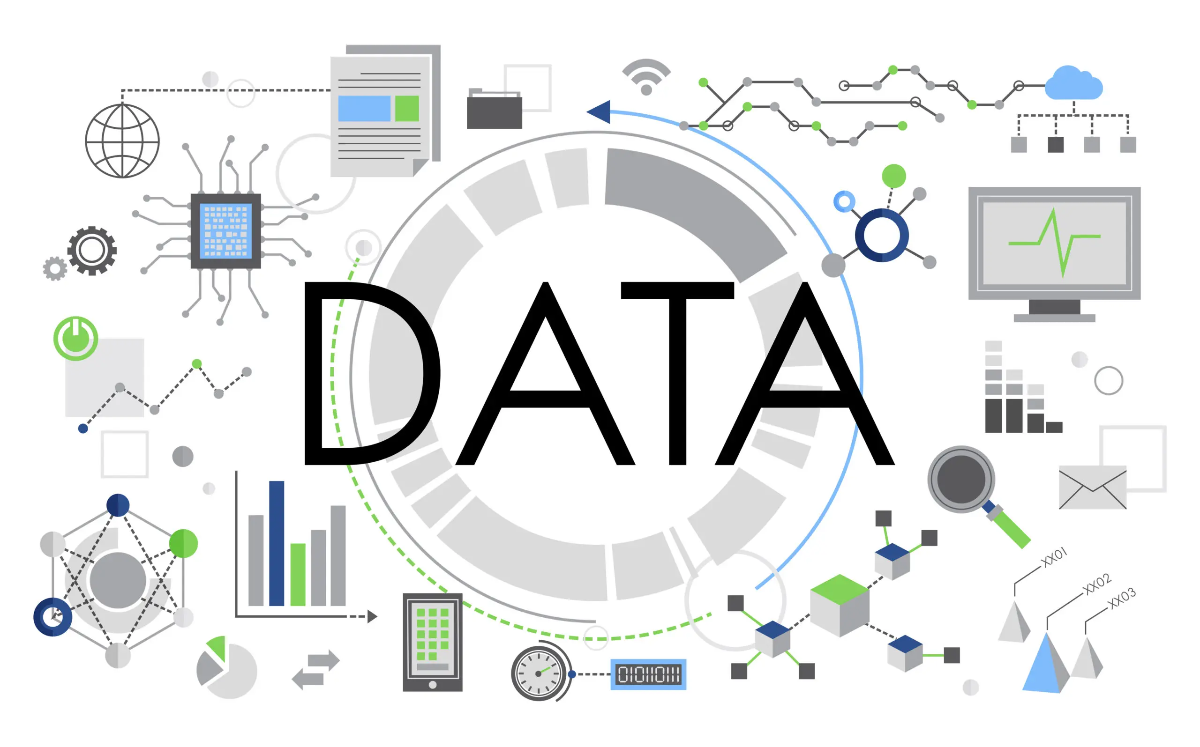
Data, you love it!

Slide 5
Data Management
The increasing volume and variety of data compel organizations to spend large amounts of time and resources gathering, cleaning, and organizing data before performing any analysis.
As the amount of data grows, the need and difficulties involving data wrangling increases.
The inability to clean and organize big data is among the primary barriers preventing organizations from taking full advantage of business analytics.

Slide 6
Data Management
Analytics professionals no longer rely solely on the corporate IT department for data retrieval and preparation.
  I.e. you can’t expect data in the nice csv style we normally use, you would need to make that dataset yourself.
50% to 80% of their time is spent collecting and preparing unruly data before analytics can be applied.
They have to become more self-reliant and possess the necessary skills for data wrangling and analysis, broader skill sets than just statistics.
This allows organizations to address business problems much more quickly.

Slide 7
Data management
The first, and most important, thing you do as an analyst* is manage data.
  No matter how good at tableau/ML/AI you are, you need data.
  50%-80% of time is spent collecting and preparing unruly data before analytics can be applied.
  We have lots of data, usually from several sources.
  IT is often becoming less involved, you need to get and organize data yourself.
    Even people using accounting/hr/marketing tools directly who aren’t data analysts.
Data typically covers many, sometimes millions, of dimensions (different variables).
  In each thing, we only care about a handful.
  We need to set the data up to give us the pieces we need before we can visualize.

Slide 8
Wait, I’m an analyst? Probably.
In many, many, many cases, interacting with data directly is likely in your office job.
  Most reporting from most enterprise systems (erp, hris, crm, finance, etc…)
    Usually some tableau-ish web tool, but worse, to extract data.
    I used to do corporate reporting, most of what most people did was wrong.
  Manipulating data in excel will be easier with data skills.
The underlying data is almost certainly in this format, it helps to understand it.
  E.g. I did LMS (like Brightspace) administration, I also created reports, understanding the data made the administration part make more sense.
  The broad ideas are near universal (in relational databases).

Slide 9
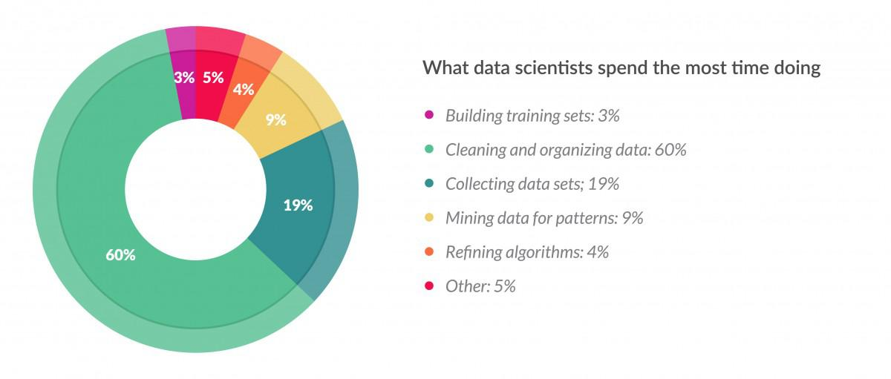
What do DS do?

Slide 10
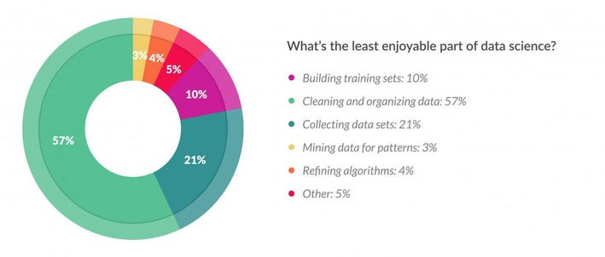
What do DS Like?

Slide 11
Data Management
Data wrangling is the process of retrieving, cleansing, integrating, transforming, and enriching data to support subsequent analysis.
Transform raw data into a format that is more appropriate and easier to analyze.
There are several objectives.
  Improve data quality.
  Remove errors or improper data.
  Reduce time/effort required to perform analytics.
  Reveal the true intelligence in the data.
For us, we often need to clean data, and sometimes need to join it.

Slide 12
Data Management
Data management is a process that an organization uses to acquire, organize, store, manipulate, and distribute data.
A database is a collection of data logically organized to enable easy retrieval, management, and distribution of data.
Most organizations have adopted a database approach for storing and managing data.

Slide 13
Remember the Database
The most common db used in organizations is the relational database.
  Consists of one or more logically related data files called tables or relations
  Each table is a two-dimensional grid
    Rows: records or tuples
    Columns: fields or attributes, characteristics of a physical object, an event, a person
  A collection of related fields makes a record, which represents an object, event, or person
A database management system (DBMS) is a software application.
  Defining, manipulating, and managing data
  Examples: Oracle, IBM DB2, SQL Server, MySQL, Microsoft Access

Slide 14
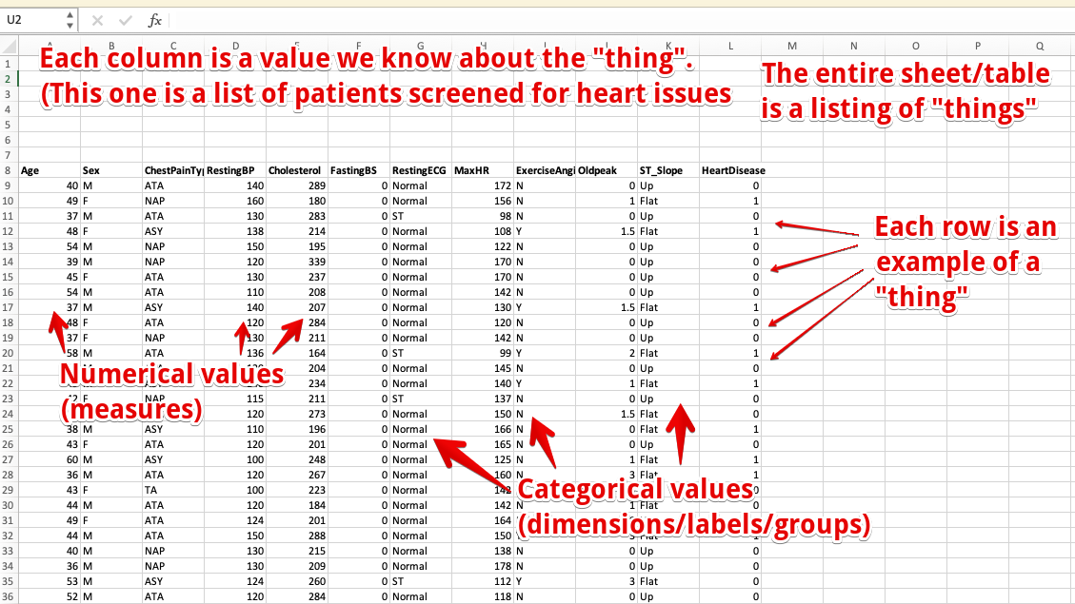
Database, Datasheet, and Tableau

Slide 15
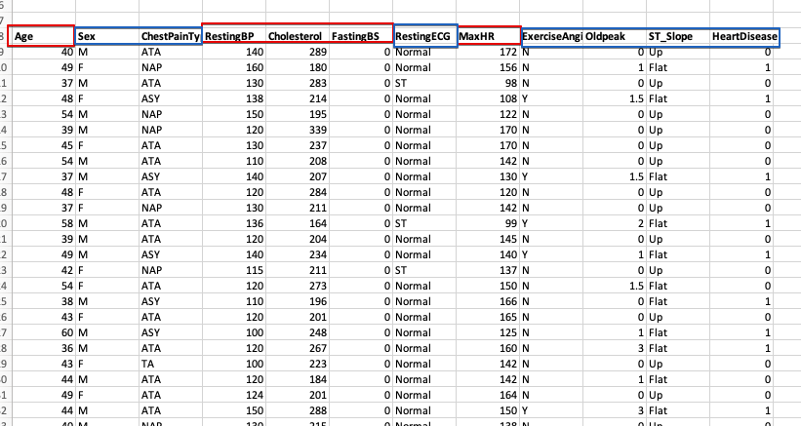
Database Tables
Each table is on one “thing”.
Each row is one of those things. (An instance)
Each column is something we know. (A feature / variable)

Slide 16
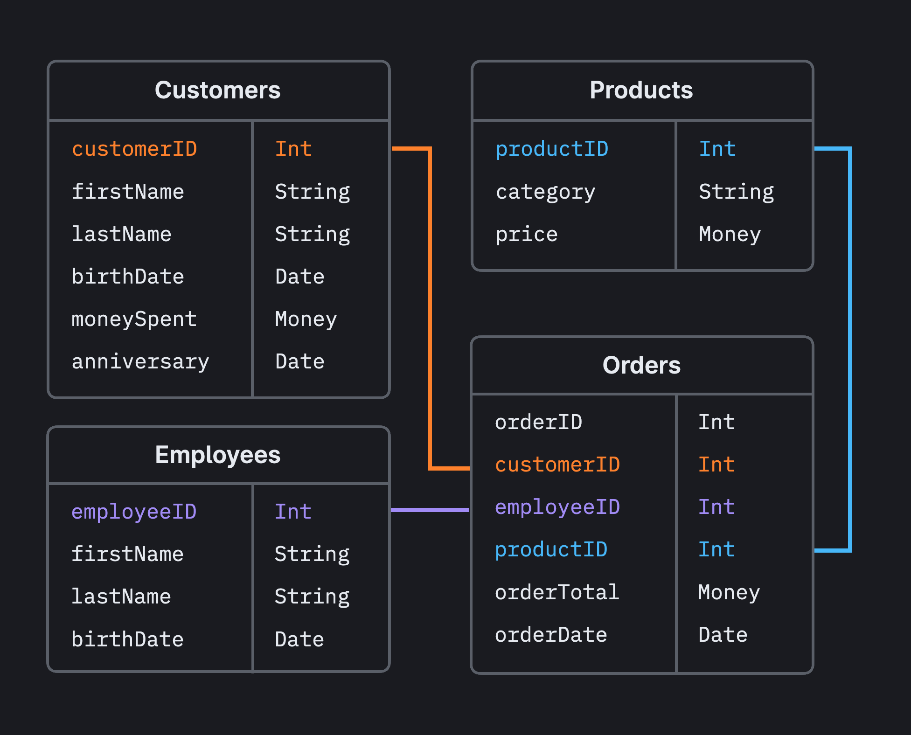
Real DBs
Real databases can have thousands of tables.
  Each table is on datasheet on one thing.
In databases, every table (entity) has a key.
  Primary key is unique ID, like an ID number.
  Key in joining (connecting) tables.
  E.g. get a list of students for course 2210a06 reads a list of student ids from the ”registrations” table, and grabs the names from the student table, when the student ID (the key for students) matches.

Slide 17
Why do we do this?
The reason that most data is stored in this way is efficiency.
Data only exists in one place, no contradictions or ambiguity.
  E.g. an address field per customer, vs addresses in each order as free text.
  This saves storage space at a very large scale, and updates are only one field change.
Access can be managed, logged, and even reversed.
  Permissions can be assigned, each change can be logged in order, can rollback.
Easier to use, at scale, even if not obvious.
  A db I regularly used for an LMS had a documentation PDF over 900 pages.
  Each individual report only needs a handful of tables, so we can select and ignore the rest.
  The way we connect the entities together lets us answer different problems.

Slide 18
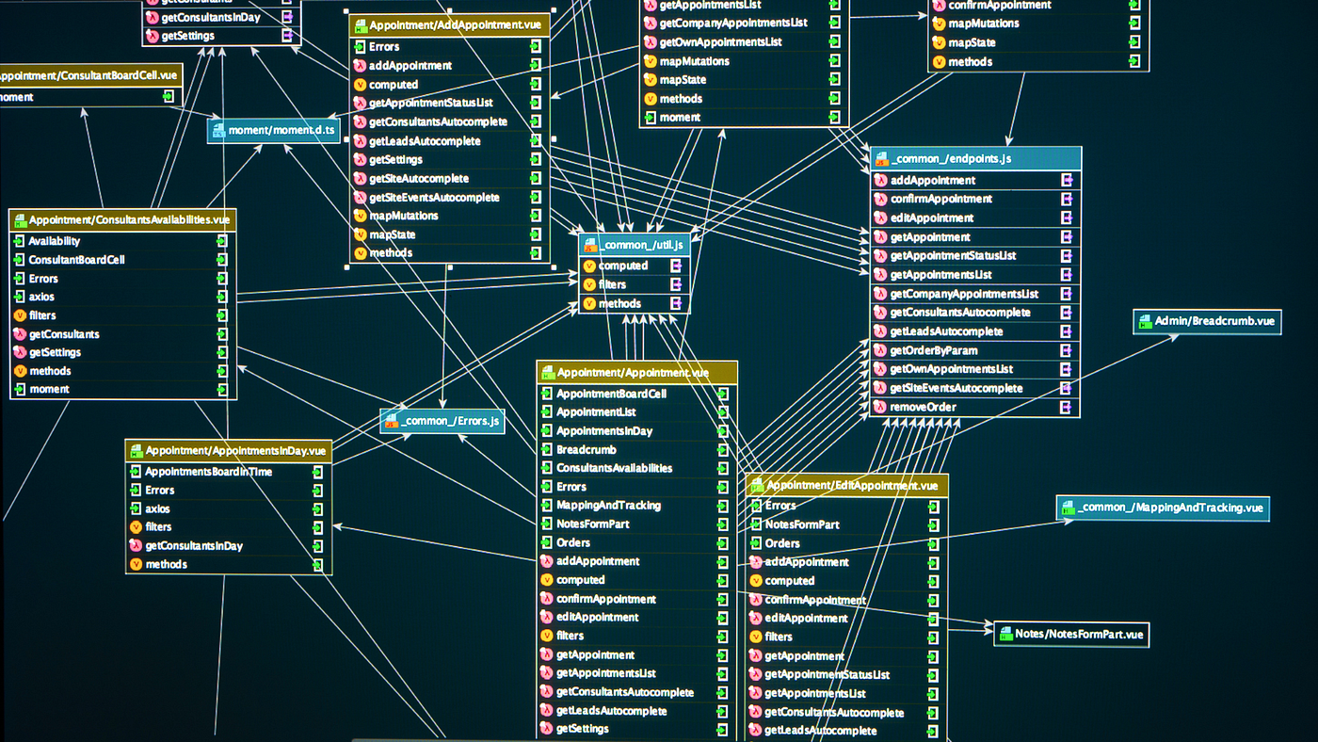

Slide 19
Dimensionality
The data we analyze is usually high-dimensional.
  There are many dimensions, or attributes.
  Can have thousands (or more) columns.
Data warehouses at an org amalgamate data.
  E.g. Google has many dimensions of data on its users – apps uses, map locations, search history, gmail, docs, flight searches, etc…
  All data being integrated enables analysis – e.g. store compares product sales to demographics of the area.
More dimensions -> more potential.
  High dimensional data allows all modern AI related stuff to work.

Slide 20
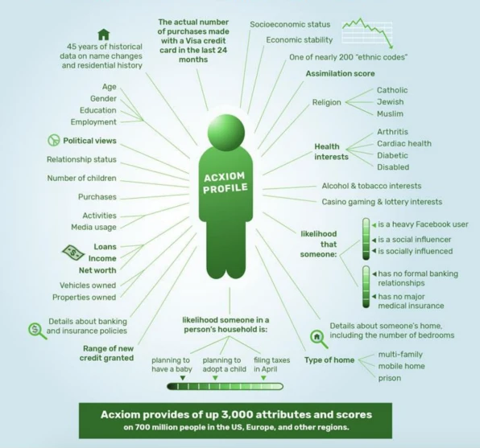

Slide 21
Manipulating Dimensions - OLAP
OLAP – OnLine Analytical Processing.
How data is manipulated for analysis.
  “Slicing and dicing” data to get what we want.
  Drilling down to get details, rolling up to get totals.
  Pivoting to group data into subsets.
Tools to cut down high-dimensional data and make it usable.
OLAP is something you need to know the theory of.
Understanding what’s happening in OLAP operations makes doing tableau easier.

Slide 22
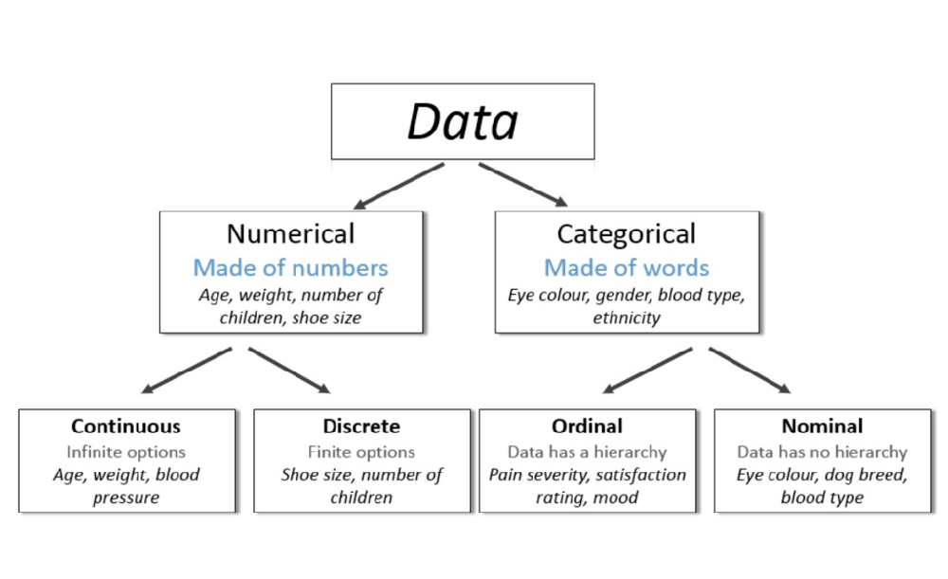

Slide 23
Discreet vs Continuous in Tableau
In Tableau we have two types of variables:
  Dimensions – discreet values.
  Measures – continuous values.
Tableau usually identifies these correctly, but not always.
We can manipulate the way Tableau interprets the type as needed.
  Right click -> options for discreet/continuous and measure/dimension.

Slide 24
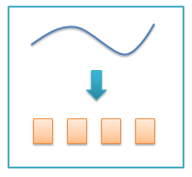
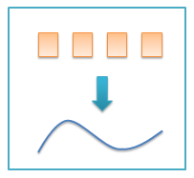
Translation between Discreet/continuous
Binning: numerical to categorical.
Encoding: categorical to numerical.
E.g. your GPA goes from continuous (percents) to discreet (letters) back to continuous GPA number, before being averaged.
Used regularly-ish in data science.
For us – does either help us represent what we want better?
  E.g. if we are looking at career success of middle class residents, it may make more sense to bin income and use that.
  E.g. banks loan based on credit score category, not number.

Slide 25
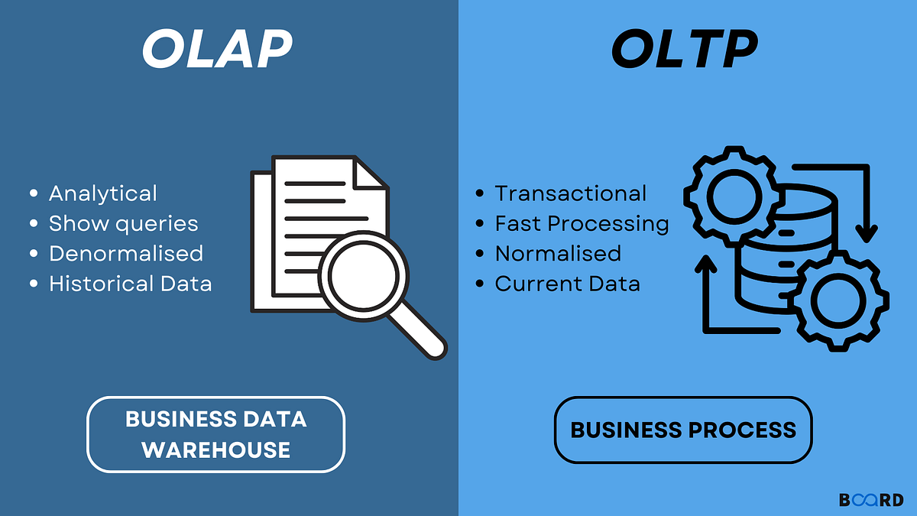
But First, OLTP
OLAP is contrasted to online transaction processing.
OLTP is what is happing to live data.
  We sell something, that creates info in db.
OLTP generates data into db, OLAP gets it out to analyze.
Normalized – separate tables for speed.
Denormalized – combined for analysis.
  What we normally get in tableau.
  Info from many sources.

Slide 26
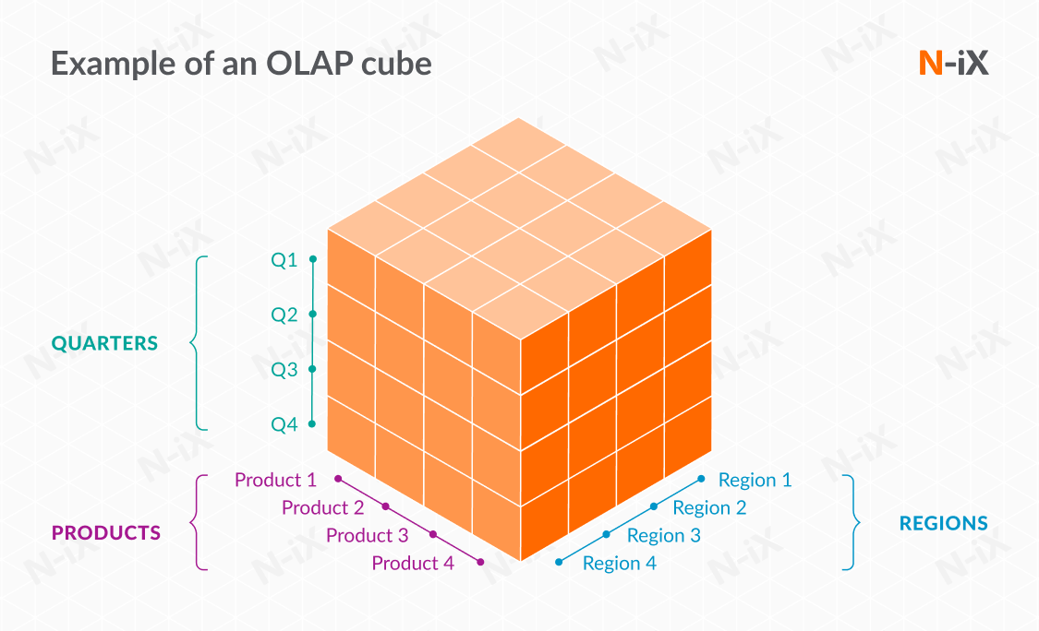

Slide 27
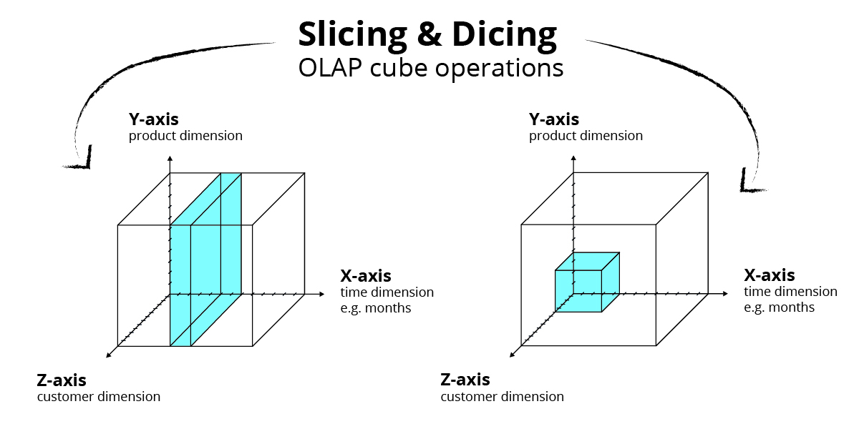

Slide 28
OLAP and Tableau
Tableau is doing these operations behind the scenes to our data:
  Slicing/dicing – filtering data to use.
  Aggregating/disaggregating – drilling down to details and rolling up for summaries.
  Pivot – grouping the data (usually by categorical var)

Slide 29
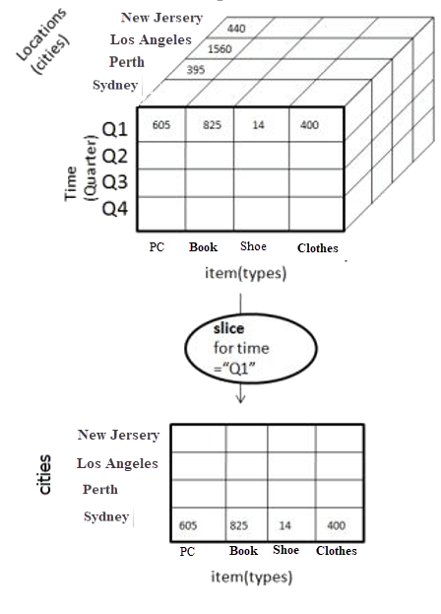
Slice/Dice

Slide 30
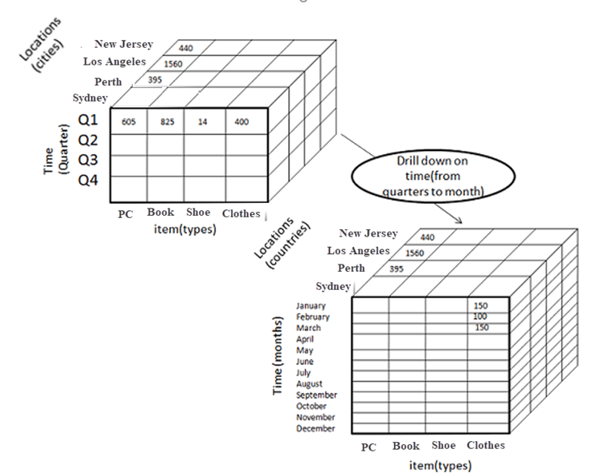
Roll-Up/Drill-Down

Slide 31
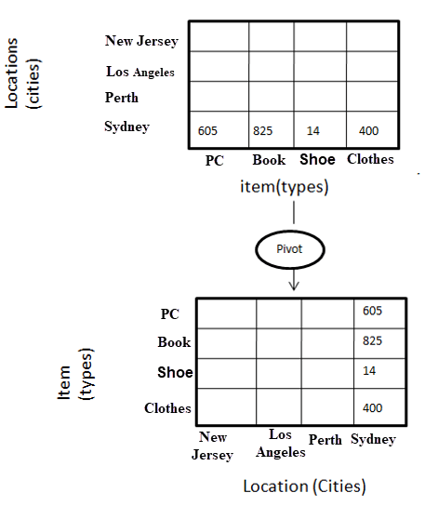
Pivot

Slide 32
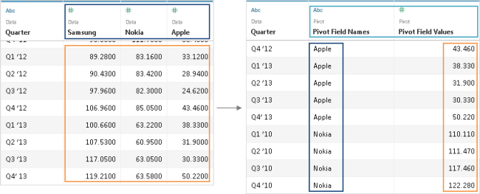
Pivot (Most often – horizontal years)

Slide 33
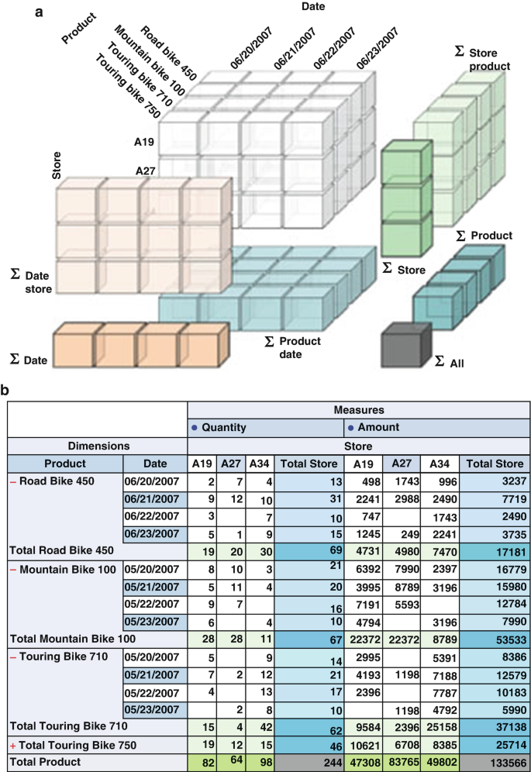
Data Manipulation
Each time we move things around in Tableau, this is what happens to data.
Process:
  What fields do we need (slice).
  How should it be organized (pivot).
  At what level of detail should we see it (drill/roll).
  What visualization style shows this result.

Slide 34
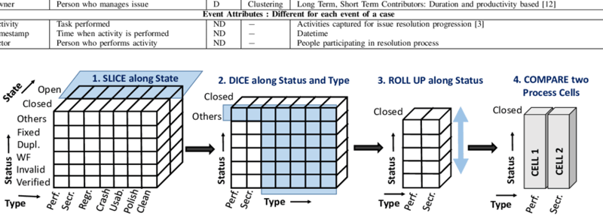

Slide 35
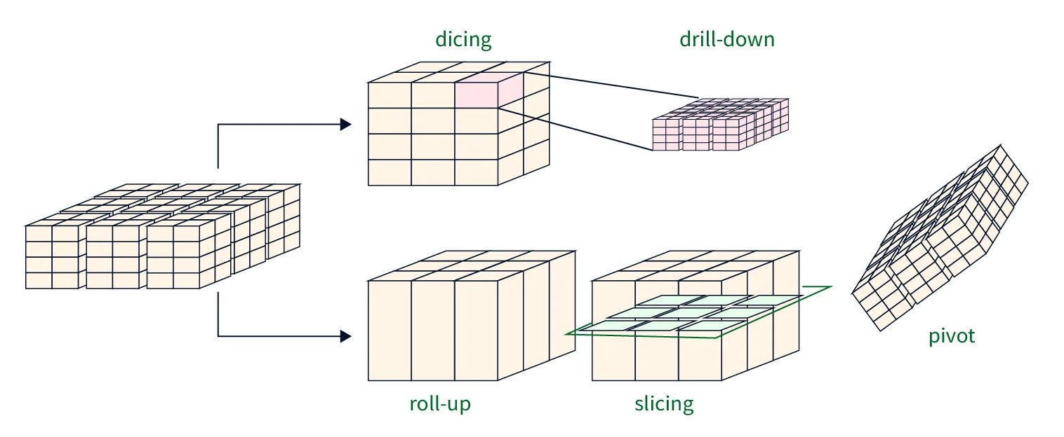

Slide 36
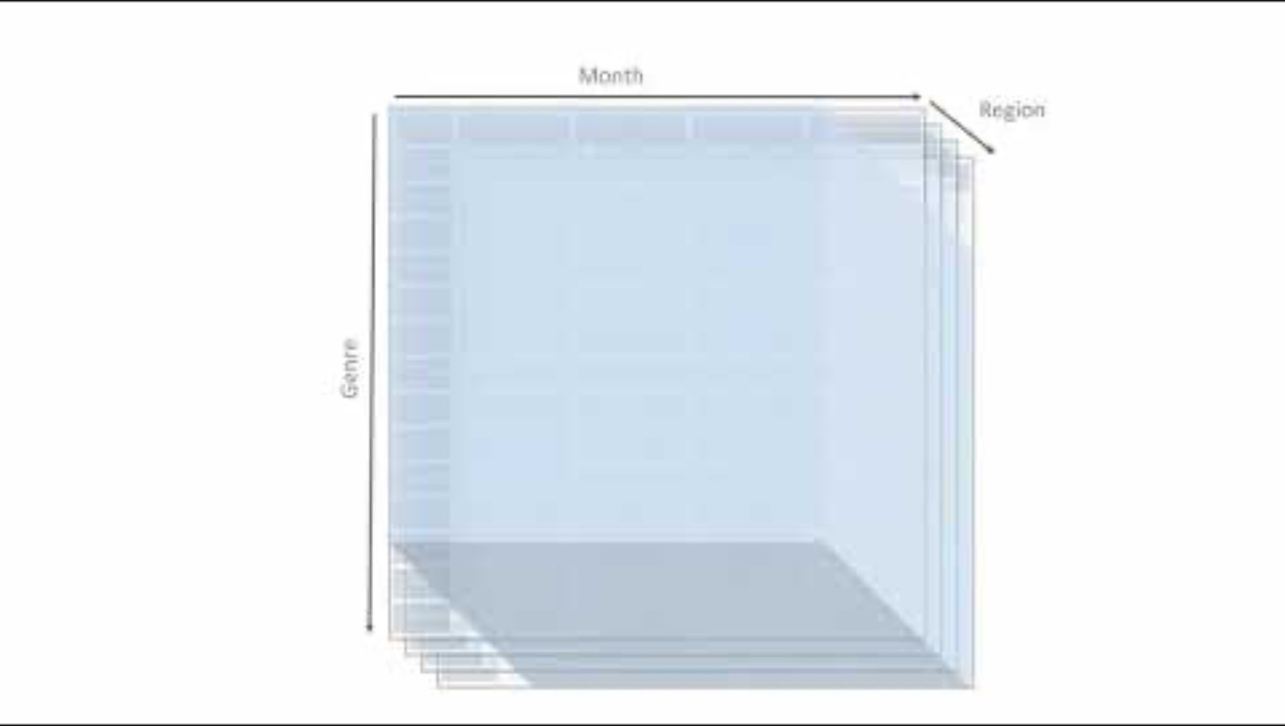
Notes:
https://youtu.be/5GOjioIcs8g

Slide 37
Visualizing these Amounts
Chapter 6 shows some detail on visualizing amounts.
  Overall it is pretty simple, bar-ish types of charts.
Some things to consider:
  Level of detail needed – do we need a number, readable point, or is a color good enough?
  Type of mark – think about options, especially with long bars. Where is the eye directed?
  Grouped bars – what order of grouping makes sense, how does it read?
  Density of data – color can represent another dimension, or it can reinforce.
If we are showing an amount, what allows that to be read.
If we are showing a comparison, what type of comparison, and how can we see it.

Slide 38
Tableau Aggregation
The same concepts work in Tableau.
  When we add data we can connect tables together.
  We select variables and create ourselves an olap cube of data.
  When using data we slice/group all data by dimensions*, then aggregate or calculate some value for each different value in that dimension.
  We use measures and dimensions to ‘control’ mark attributes (color, size, etc…).
This makes managing data and getting correct answers much easier in practice.

Slide 39
Data in Tableau
By default, all data is included in the results.
  If we add value, the mark will reflect all data in sheet.
  We get an aggregation for all measures by default.
  We get an empty group for dimensions (abc’s).
Each dimension in the shelf slices and/or dices data.
  Instead of all data being in one (or some) mark, we split that data into smaller groups, then calculate.
  These can be layered, or perpendicular (dice).
  Each value in the dimension gets it own agg.
Filter is same idea, but removing data.

Slide 40
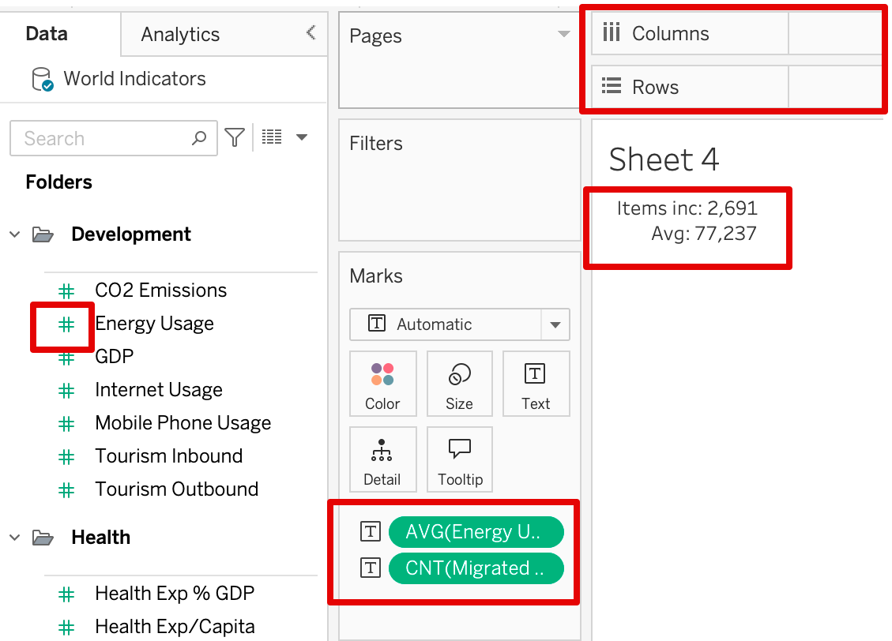
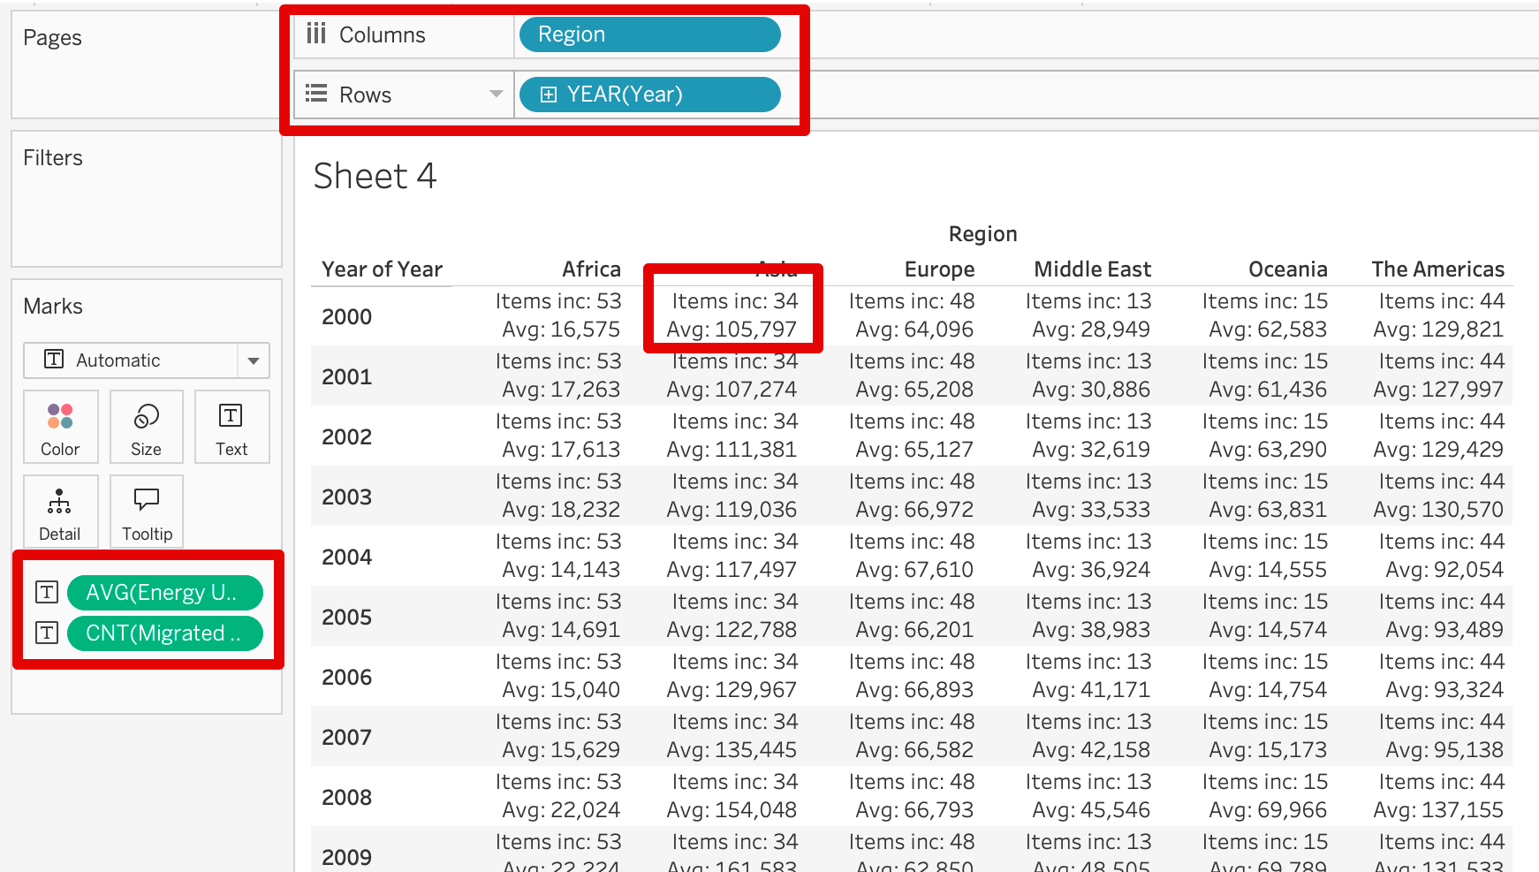
In Tableau – Aggregate and slice

Slide 41
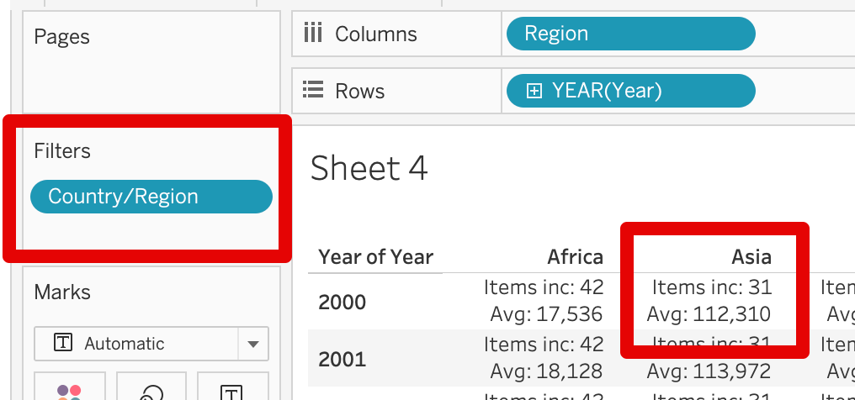
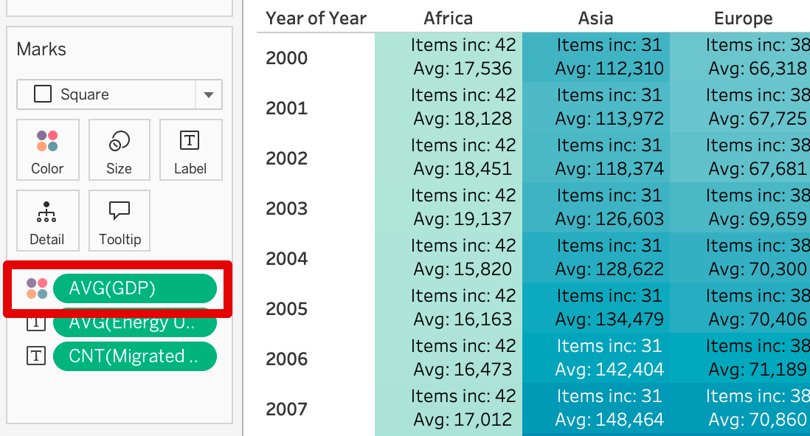
Filter and Mark attributes

Slide 42
If you need to make something…
Which values do I need to do this? How to slice/dice, what to filter, what to agg?
  Check for dimension/measure at this point, you may have to adj, especially dates.
How should my answer be calculated, or ”what do I want per?”
  What are we calculating, usually an aggregation (count, average, etc…)
  What are we calculating that per? Per country, per year, per country-year, per reg.-country-year…
  You need to be really specific, especially if more than one dim, or date.
  Listing it off will* list every dimension used in the chart.
  Not being specific here is one of the largest single mistakes that people make.
How do I present the data – chart type, location of dims, mark style, etc…
  We can try different things to communicate the info we just decided on (vis. Voc.).

Slide 43
This is boring, but it always works
Every single question or visualization you ever need to make can be “answered” with this.
It does require that you be very specific.
  More than most people are used to.
  You can’t leave any context unsaid, or anything unspecified, you need to be exact.
Don’t worry about visualizations until the “what exactly am I showing” is sorted.
  The two are independent.

Slide 44
Conclusion
Being able to think about manipulating and segmenting data makes things way easier.
  It takes practice since it isn’t really intuitive to most.
Focus on identifying exactly what you need, in detail:
  What specifically am I calculating?
  What is that calculated ‘per’? This will tell you how the data needs to be organized.
  What is included/excluded?
  The above three things will list out the variables you need to use.
After the small example, there’s practice questions for y’all.
  These are similar (though easier) to the upcoming quiz, it is good to practice.

