Slide 1
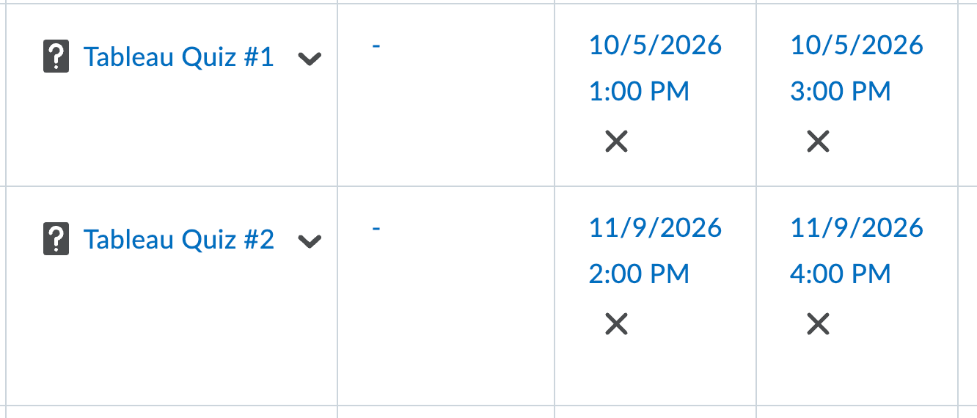
Housekeeping
Describing data and basic stats.
  Describing one variable.
  Describing two variables.
  Stats-y plots to explore each.
Splitting and comparing groups.
Basic relationships.
Probably a simple calculation.
Overview of assignment #1 - not urgent, but good to start considering.
Next time – ch3 and coordinate planes.
Correction – I had quiz dates interfere with holidays, so I moved them.
  If this is an issue for you, let me know.
  Both quizzes are using Tableau to find answers in data, we’ll talk about the first more next week.

Slide 2
Review
Up to now, you should know/be able to:
  Basics of data analysis – data/info/knowledge, types of analytics.
  Basics of using data – datasheet format, columns (features/variables), type (cat/num).
  Basics of visual analytics – using a data source to generate charts/graphs showing useful info.
In making those charts:
  Basics of Tableau – load data, make sheets/dash, create charts, use marks cart to customize.
  Some analysis of chart types and using preattentive attributes intelligently.

Slide 3
DO some Stuff!
You should be able to do all (or virtually all) of the practice assignments, you should.
Assignment 1 – get started early!
  Select some data on a topic that you know something about.
  See if you can use that to generate some useful insights using Tableau charts.
  Work on chart type, style, preattentive attributes to help make Tableau page nice.
  The communication is the important part, your vis’ need to say something useful.
  The goal isn’t to “make some charts” the goal is to communicate useful info via some charts.
Your first tries will probably suck, badly, that’s normal and expected.
  Try to create, ask yourself/friends/me “does this make sense”, improve from that.
  You want to iterate – try, evaluate, stick with it or try something else.

Slide 4
Summary Measures

Slide 5
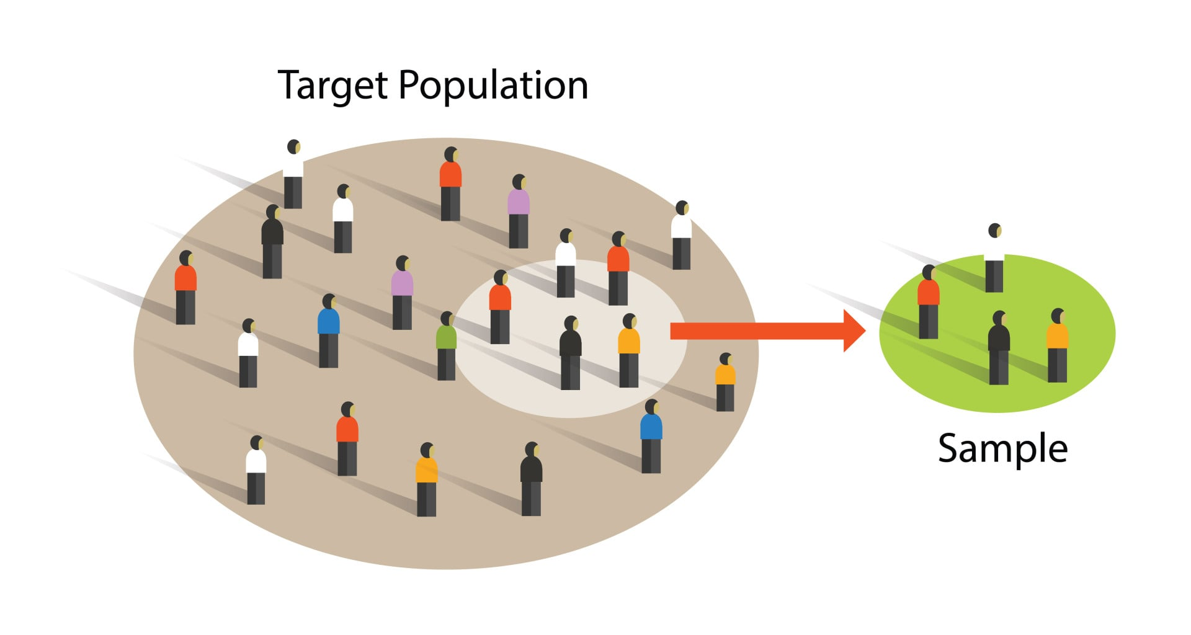
Populations and Samples
The first description of data is the idea of a POPULATION and a SAMPLE.
  Population = all the data.
  Sample = some subset of data that we use to analyze.
  Population is all the data for our scope, not always every person alive.
In general, we take a sample of data, analyze it, and extrapolate to the population.
  E.g. a political poll surveys ~1k people, and projects for the entire populace.
  In reality, we often can’t get data for an entire population.

Slide 6
Samples
We want samples that are large and match the population as a whole.
  Both of these things mean that our analysis will project for the entire population.
  Conclusions we can draw from our analysis are better if a sample is:
    More representative of the population.
    Larger.
Samples will allow us to predict for a population better when the value is less variable.
  If the value we are looking at is more constant, we need less data to project it.
  Predicting tomorrow’s gas price is easier if there isn’t a war or economic crisis.

Slide 7
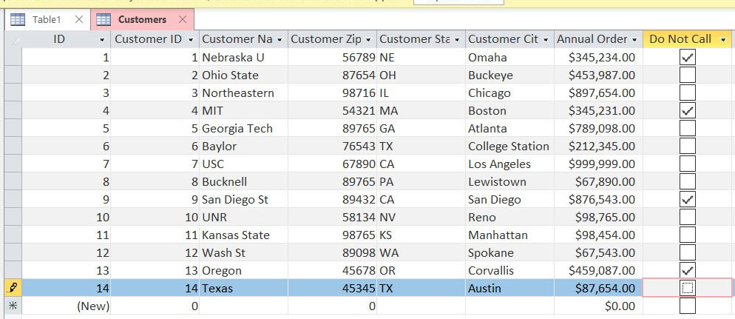
Datasheet Format
We’ve also seen that data is organized in a specific way:
  Each datasheet/table is a listing of a bunch of examples of something – players, students, purchases, cars, etc...
  Every row is one instance (one example of the thing).
  Every column measures exactly one value we track on the thing (categorical or numeric).
This is standardized across most database-y systems.
  A ‘real’ database stores many of these tables to make up everything an organization tracks.
  We can replace data source easily, and things still work.

Slide 8
Describing one Variable
First, we can look at describing one value at a time.
Remember, in Tableau:
  Blue variables, listed first, dimensions – categorical (groups, labels, non-numeric).
  Green variables, listed last, measures – numeric (measurements, values, works on num line).

Slide 9
Measures of Location
One key thing to understand about data is where it is located, or centered.
  One of two things needed to define a normal distribution.
We have 3 main measures for location, the averages:
  MEAN – The “average”, values added and divided by count.
  MEDIAN – Value in the middle. (50% above, 50% below)
  MODE – Most frequent value.
Depending on scenario, any of which may be useful.
  E.g. When looking at income, the median is less impacted by really rich people.
In a true normal distribution, all these measures are equal.

Slide 10
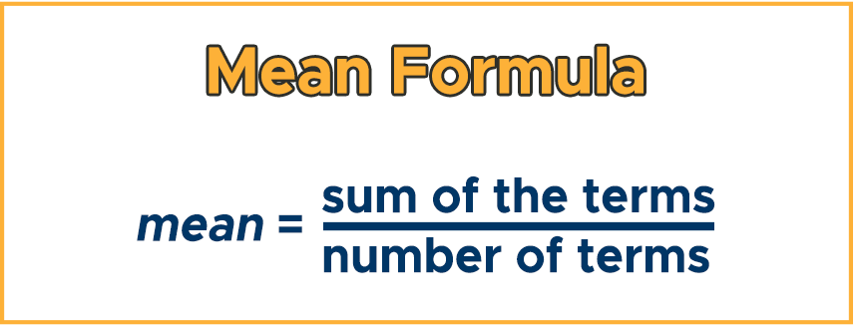
Mean
MEAN is what we normally think of as the average.
  Sum of values, divided by count of values.
Can be very impacted by outliers (very high/low values).

Slide 11
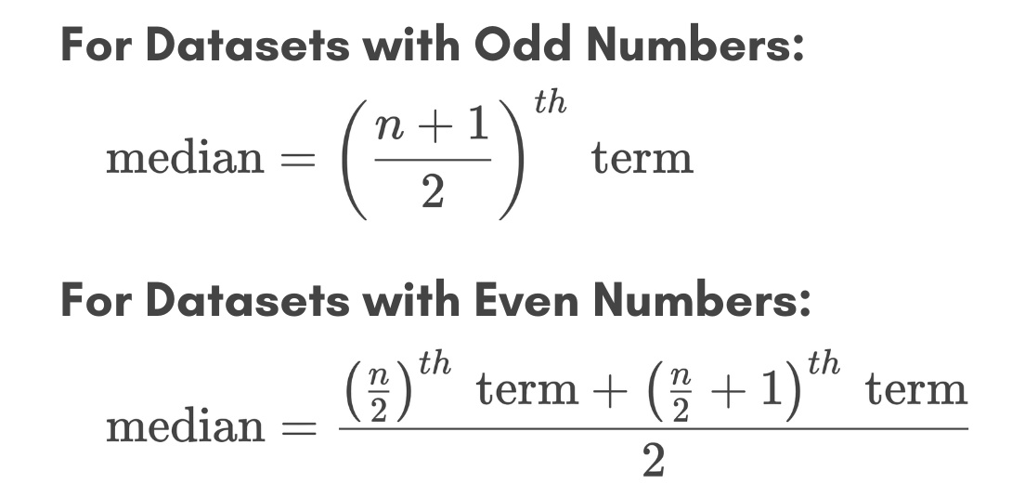
Median
The median is the value “in the middle” – half of values are above, half below.
The median is more resistant to outliers (more on this later).
Commonly used when we have data like income – with large values that would impact the mean drastically.

Slide 12
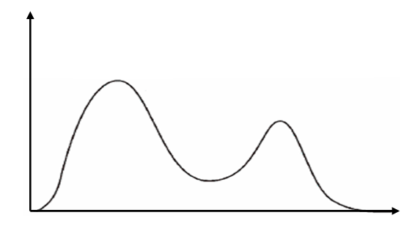
Mode
MODE is the most frequently occurring value.
Most useful if data is discreet – can only take on certain values.
Pops up with distributions in terms such as BIMODAL, distributions that have 2 peeks.
Note – with continuous data, the mode might not have much meaning. E.g. with grades that are to 2 decimal places (59.23%, 81.04%, etc…) even if the values are tightly clustered, we won’t see the exact same value repeated often.

Slide 13
Range
Rage is the distance from minimum to maximum values in a dataset.

Slide 14
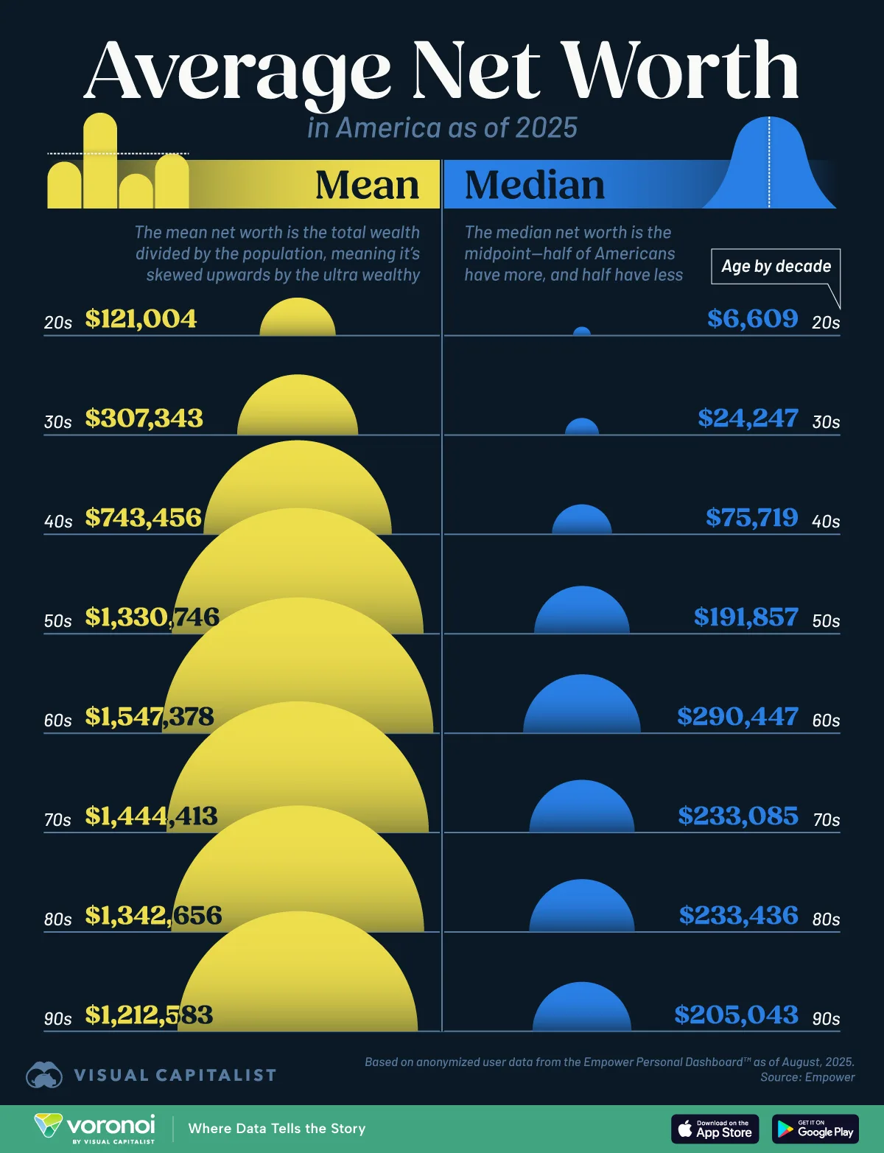
Locations in tableau
Mean, median, and mode functions.
Summary choices when adding measures to charts.
Reference lines.
Note: for many/most “real life” population wide values, we often want to use the median as the “average”. Think of something like income, the oligarchs of the world drag up the mean substantially. The median is a more meaningful measure for most cases.

Slide 15
Measures of Dispersion
Measures of dispersion give us an idea of how spread out our data is over its range.
  Highly dispersed data has values more evenly distributed.
  Non-dispersed data is more clustered (usually near the mean).
The main measure of dispersion is the STANDARD DEVIATION, which is made from the VARIANCE.
One of the other measures needed to define a normal distribution.
  If we know the mean and standard deviation, we know what a normal distribution looks like.
  In real life (beyond scope) – collect a sample, measure mean/std for the sample, create a normal distribution with that mean/std, use the new normal distribution to represent the population, that estimation process also gives us expected error in our generalization.

Slide 16
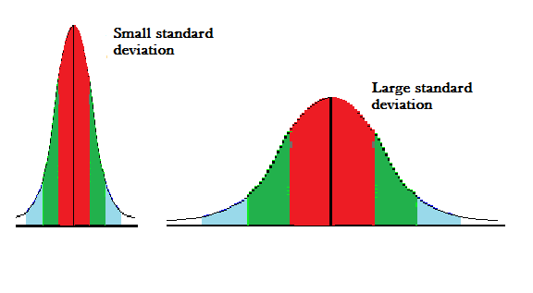

Slide 17
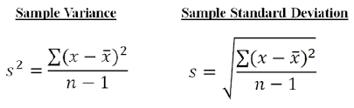
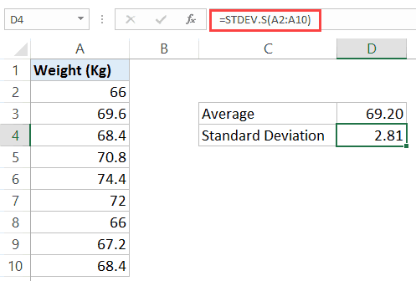
Standard Deviation and
Variance
Variance is the avg of the squared distances of values from the mean.
  The squaring negates less/greater and penalizes small “misses” less.
  High variance data has values far from the mean, low variance indicates they are closer.
Standard deviation is the square root of the variance.
  We normally use the standard deviation.
  On the same scale as the original data, while variance is a large number.
  ~ How far we expect the average value to be from the mean.

Slide 18
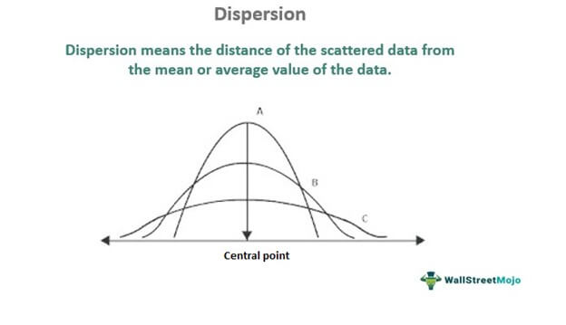
Dispersion

Slide 19
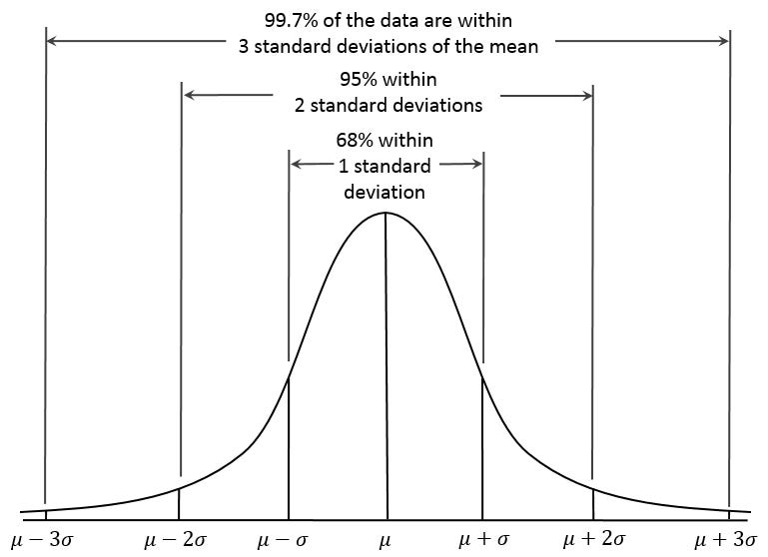
If the data is normal, we know things…
Distributions often have ‘tools’ premade.
  I.e. create calculations/rules based on properties of the distribution.
For normal data, we have many.
If we know mean and std we can calculate many things for normal dist.
Other distributions have some.

Slide 20
Dispersion in Tableau
Dispersion can be seen in a histogram, box-and-whisker plot, or others.
Dispersion can be measured with the standard deviation or variance functions.
  We normally use the standard deviation.
Be aware of outliers.

Slide 21
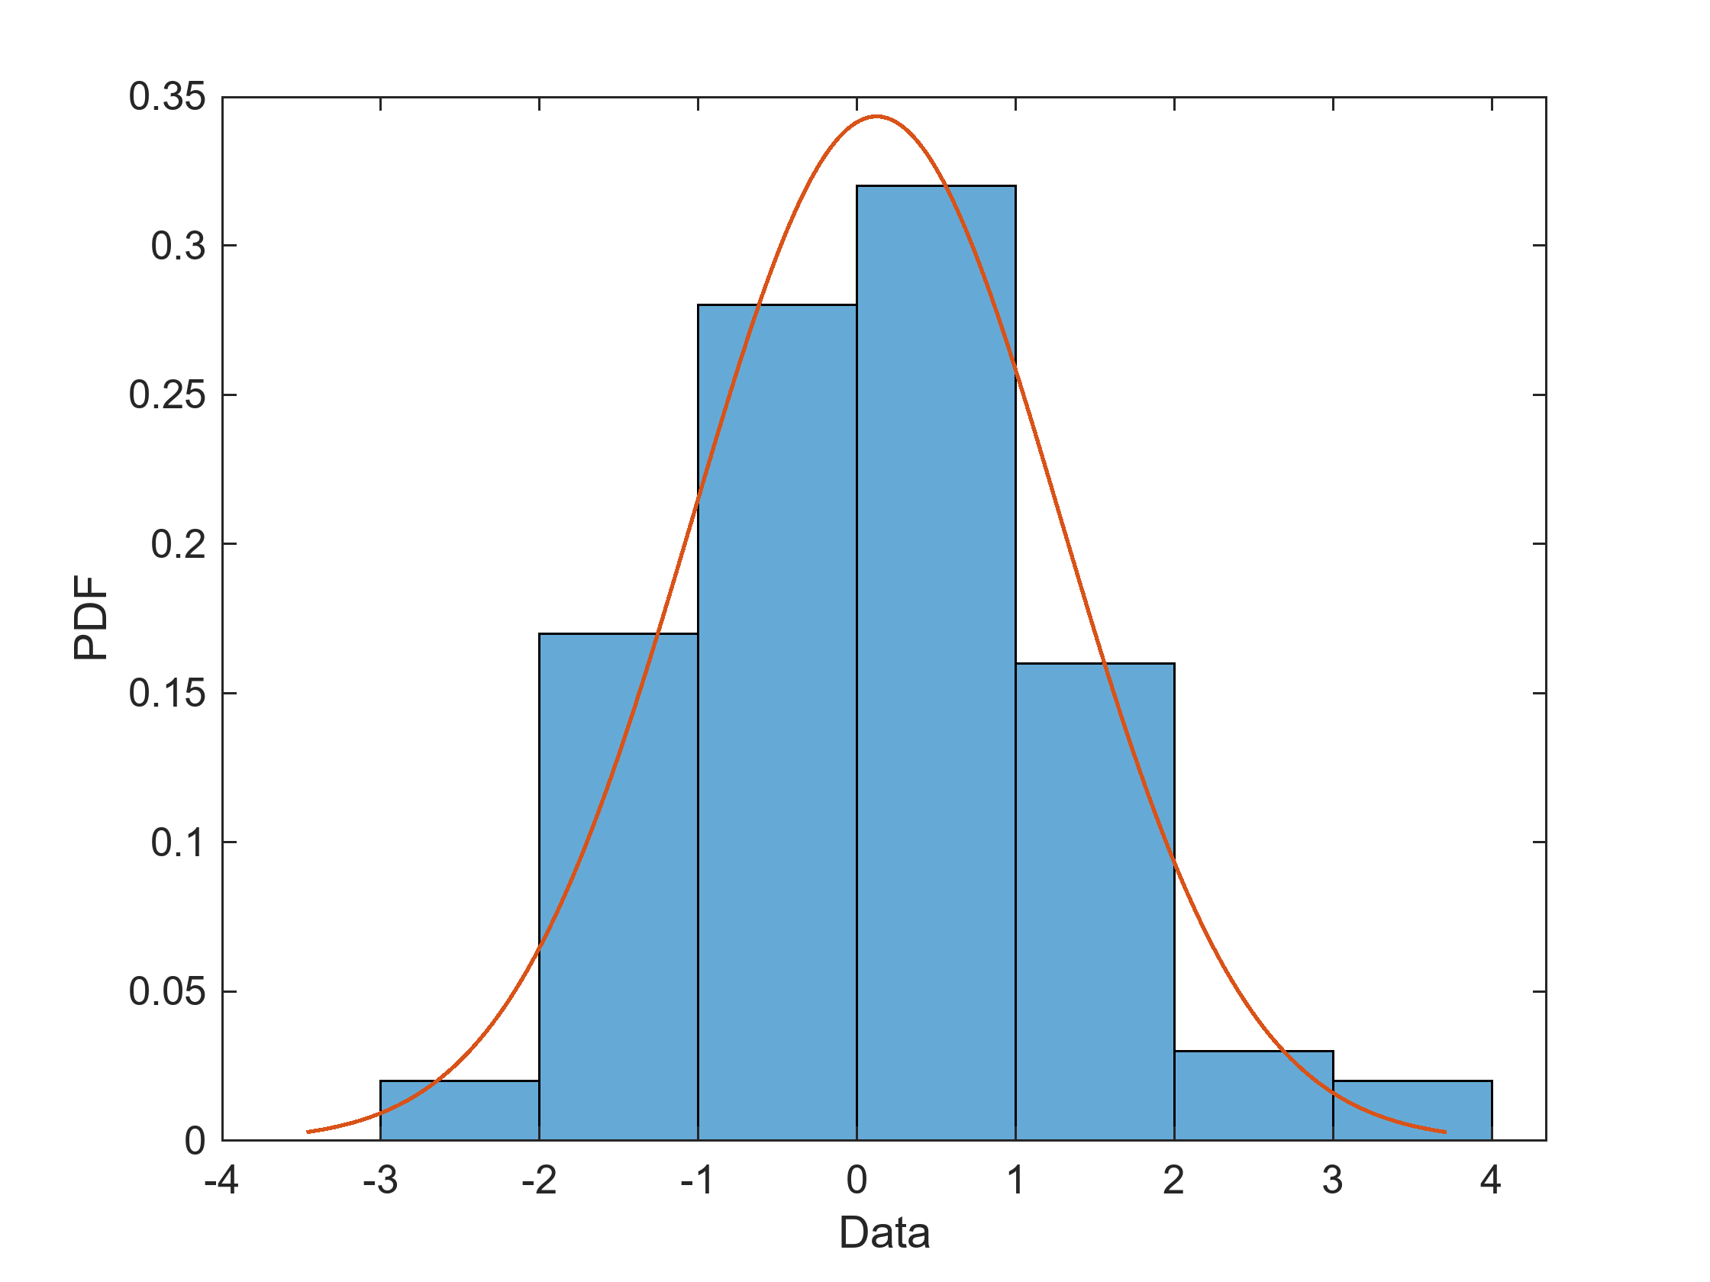
Distributions
The distribution of data describes its “shape”.
  Data is distributed over the RANGE – the minimum to the maximum value.
  Range tells us the limits, distribution describes the pattern
Knowing the distribution can help us know how to treat our data.
When generalizing from samples, we “lean on” what we know about a distribution to help the extrapolation.

Slide 22
Normal Distribution
The NORMAL DISTRIBUTION is perhaps the most common distribution.
  Also known as a bell curve.
A large percentage of data will follow a normal, or normal-ish, distribution.
  E.g. sizes of animals, people’s height, etc…
The normal distribution has a bunch of properties and tools that are premade/pre-calculated for any data that is normal.
  Analyzing normal data is often easier.
  We can TRANSFORM data to make it normal, for easier analysis.
Lots of data follows a normal distribution, but we can’t just assume it all does.

Slide 23
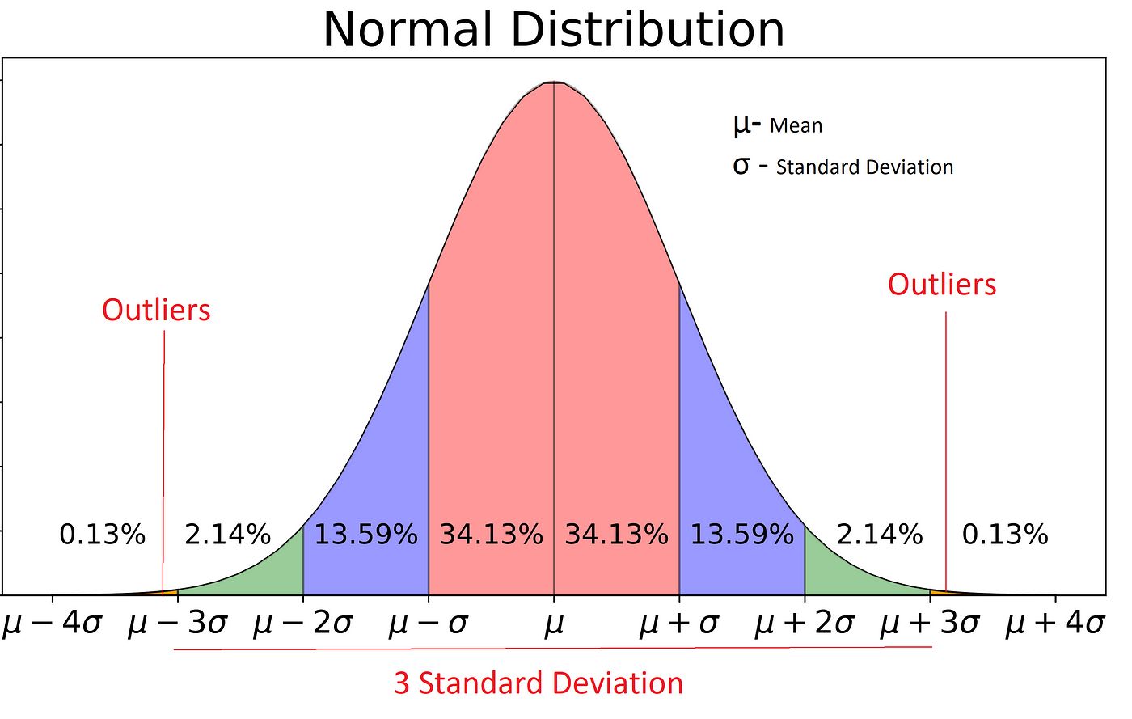

Slide 24
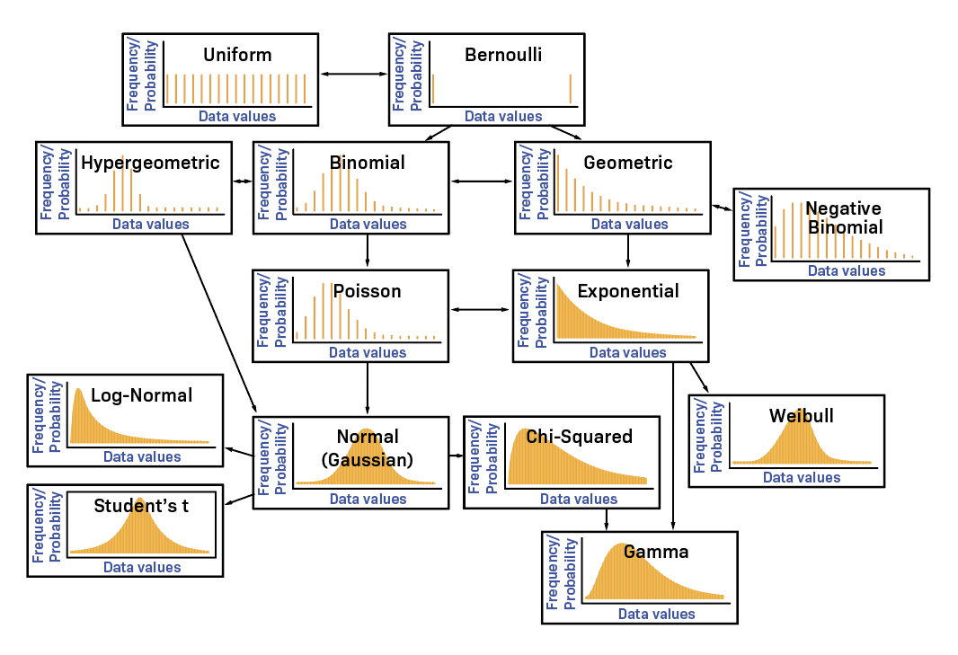

Slide 25
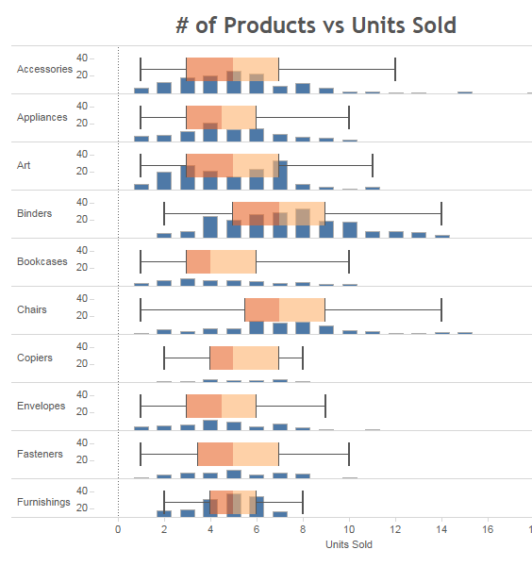
Distributions in Tableau
Histograms and box-and-whisker plot are good at showing distributions.
  Histograms are great for 1 variable per chart.
  Box-and-whisker can show several at once.
Each shows the same data, in slightly different ways.
The main reason we need to understand different distributions is to know if something is normal or not.

Slide 26
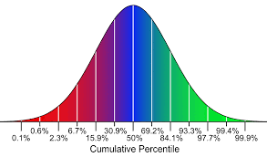
Percentiles
PERCENTILES indicate how far “up the scale” a value is.
  What percentage of records is this value greater than?
Works the same as the median, the median is the 50% percentile.
  Also less impacted by outliers, like the median.
  The median is the value a record needs to be greater than 50% of records.
Commonly used in rankings:
  E.g. the top 5%-10% of GPA in some states is guaranteed entrance in state colleges.
  There might be variation on curriculum/test difficulty from year to year, but the top 5% can be assumed to be similarly capable every year.

Slide 27
Percentiles in Tableau
Tableau can calculate our percentiles easily:
  “What percentile is this value in?” – Table calculation -> percentile.
  “What value do I need to be in this percentile” – Measure -> percentile -> choose cutoff.

Slide 28
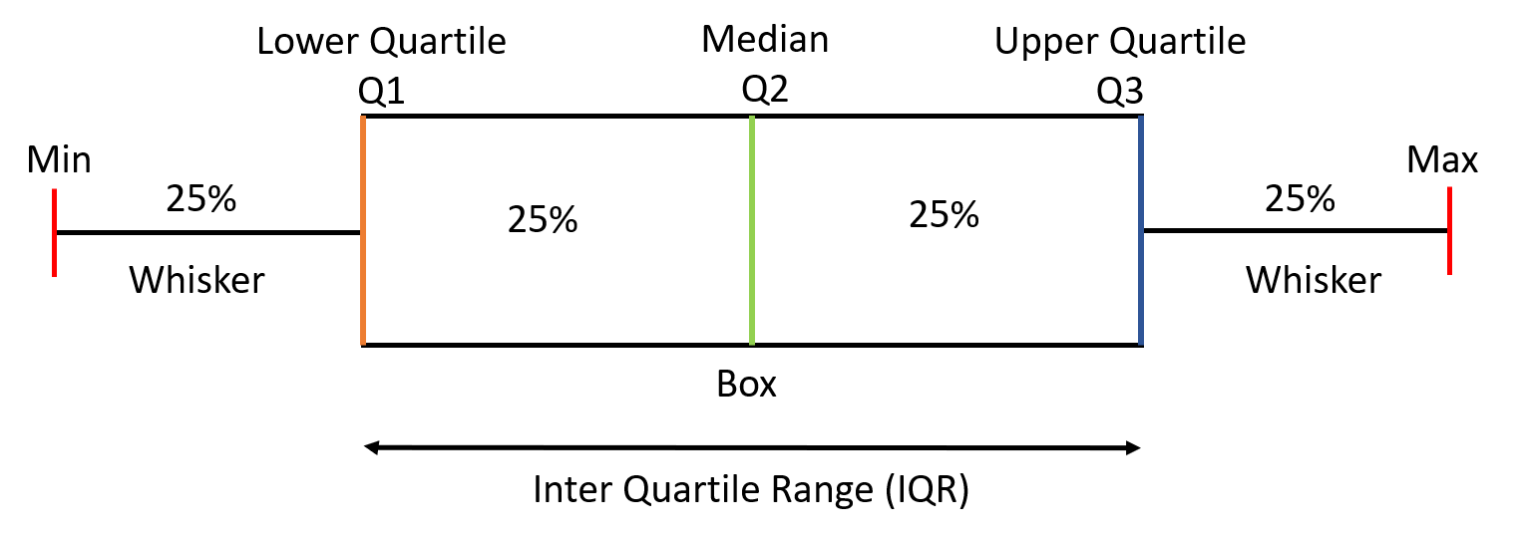
Interquartile Range
One way the percentiles are commonly applied is the IQR.
IQR gives us the range of the middle 50% of the data.
  A “typical” representative of the dataset.
Frequently used in real world/social science applications.
  Measures dispersion of the middle.
Can be an outlier filter (e.g. q1 – 1.5*iqr to q3+1.5*iqr).

Slide 29
Housekeeping
Stats – finish chapter 3.
  Review basic stats – location, dispersion, distribution, range.
  This will be the cutoff for the first test, which is a week from Wed.
Tableau: Parameters
  “madden_23…” dataset.
  Taking input from users.
  Dynamic charts.
  Comparing distributions (group and compare)
Tableau Quiz practice rounds – we’ll look at some solutions for the 1st next time, bring Q’s.

Slide 30
Basic Description of data….
Where is it located.
How spread out is it.
What’s the shape.

Slide 31
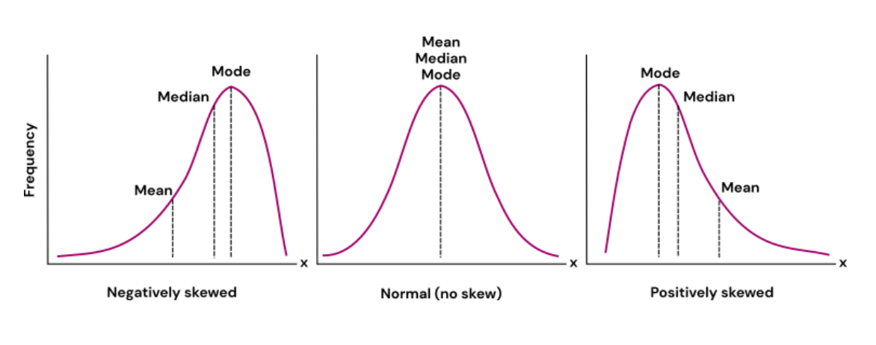
Location and Range

Slide 32
Dispersion

Slide 33
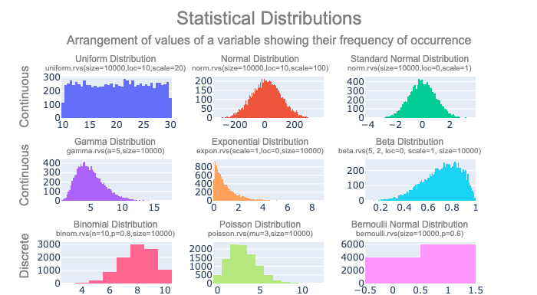
Distributions

Slide 34
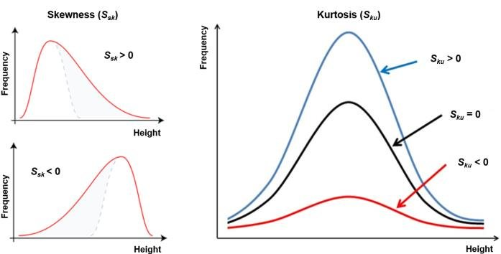
Skewness and Kurtosis
SKEWNESS indicates if a distribution is skewed, or shifted, in one direction or another.
  Skew tells us if the distribution is “stretched” in one direction or the other.
  +/- refers to the part “stretched” on a graph.
KURTOSIS is an indication of the “concentration” of the data around the mean.
  Can also be thought of as “steepness”.
  High kurtosis means most values are tightly clustered around the mean.

Slide 35
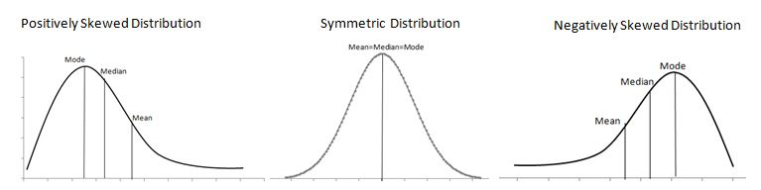
Skew and Kurtosis in Tableau
Skew and kurtosis are things that we largely detect by eye.
  There are calculations, but they are well beyond our scope.
A histogram is the easiest way to see the skew and kurtosis.
  We need to be attentive to the bin size.
These two are descriptors that we can use to talk about data, we won’t use them in any calculations.

Slide 36
Outliers
OUTLIERS are values that are too high or too low, that we may want to remove.
Outliers are things that can throw off our analysis.
  E.g. if we are predicting if someone will repay a loan, and one value is “net worth”, having Bill Gates be part of the dataset probably doesn’t help us – he’s so rich he has nothing to do with “regular” folks.
Removing outliers always depends on DOMAIN KNOWLEDGE – knowing about the actual topic of the data.
  Keeping or removing outliers depends on what we are doing.
For us, we probably want to remove things that are clearly outside of the pattern.

Slide 37
Variable Scaling
This is a bit of a side note, relating more to other analysis, but we should be aware.
One common technique in data analysis is to RESCALE data.
  Take data from its original range, and remap it to a new range.
Normalization – map data to a range between 0 and 1.
Standardization – map data so the mean is 0, and the std is 1.
This can often make data easier (or better suited) to analyze.
  E.g. when making predictions, values that are large (e.g. net worth) may “overpower” values that are small (e.g. age). Rescaling all variables eliminates that.

Slide 38
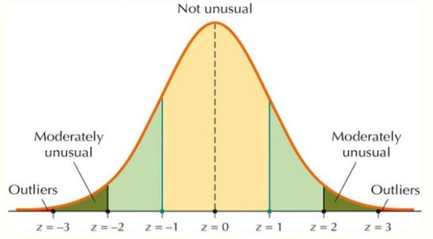
Normal Data Outlier Filters
One common way to find outliers is to filter by z-score, or standard deviations from the mean.
We can set a limit of X standard deviations for acceptable values.
  3 is a common limit, ~.02% of data.
  Limit is highly scenario dependent.
This can be automated, if processing large amounts of data.

Slide 39
Outliers in Tableau
Outliers in Tableau can be detected in many ways, histograms and box-and-whisker plots among them.
Outliers can be removed with a filter.
  Can use “apply to” to share an outlier filter over many sheets.
What to do with outliers, and what qualifies as an outlier, is always a judgment call.

Slide 40
Relationships in Data
All the previous looks at data are describing one variable at a time.
We can also look at the relationships between variables.
  Think about height vs. weight, those two things have some relationship to each other.
One variable can also inform our expectations on another variable.
  Basis of some predictive analytics.

Slide 41
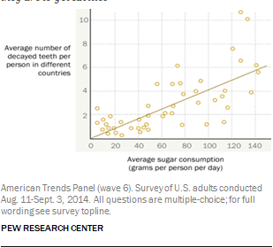
63% of Americans Can Read this, can you?

Slide 42
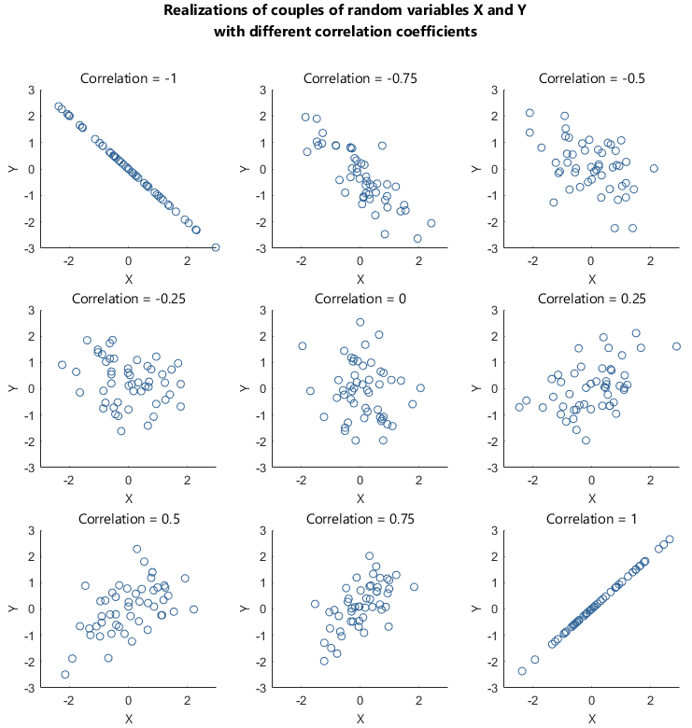
Correlation
The main way we can examine the relationship between variables is by looking at their CORRELATION.
  Correlation tells us ”how much X tells us about Y”.
Correlation is between -1 and 1, the farther from 1, the stronger the correlation.
  Unit/scale independent.
R2, a measure commonly used in predictive analytics, is the correlation squared.
  Range of 0 to 1, higher is more correlated.
  “How much of Y is explained by X?”

Slide 43
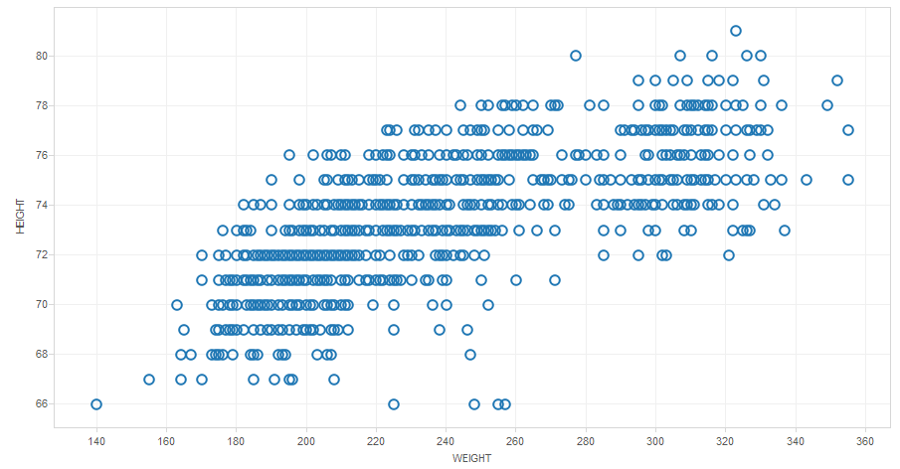
Correlation in Tableau
The easiest way to look at correlation is a scatter plot.
  One variable on each axis, one point per record.
  Trend lines will give us R2.
The “tightness” of the points inform us about the correlation.
Extends to linear regression (best fit) and predictive analytics – using X to predict Y.
Be clear on what each point represents in Tableau.

Slide 44
WhY Visualize?
We can calculate many metrics to examine data.
Why bother with charts and graphs?

Slide 45
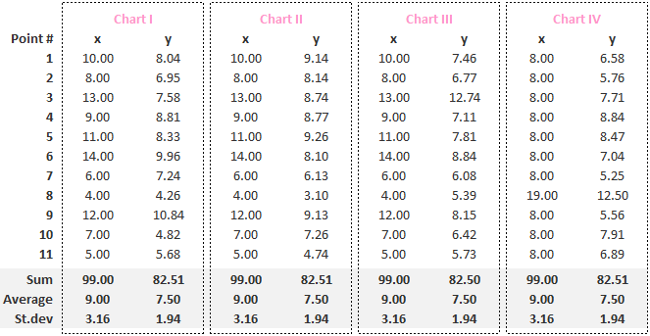
Anscombe Quartet
Anscombe’s Quartet is a nerd famous set of data sets.
Each data set (x/y) has the same:
  Sum.
  Mean
  Standard deviation.
  Correlation.
One would assume the data sets are very similar.
But…

Slide 46
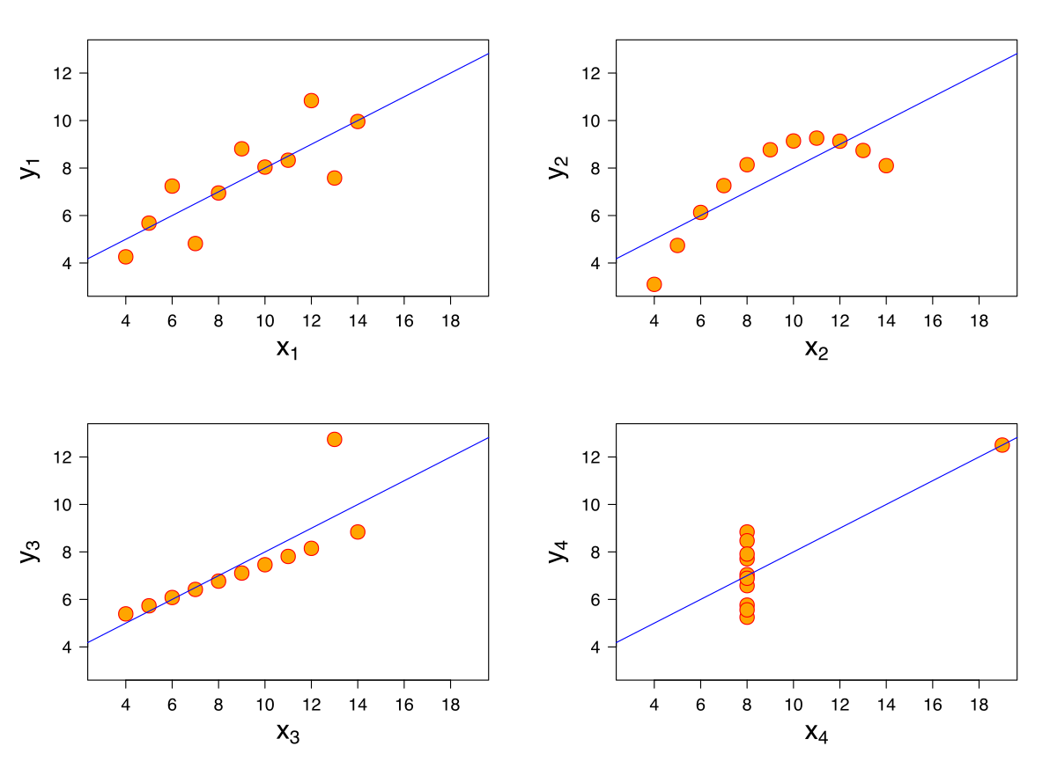
But if We Visualize them

Slide 47
Visualization to the Rescue
Examining data in different ways leads to different insights.
For some things, looking at them visually may help reveal more…
In the Anscombe’s Quartet:
  Arithmetically these data sets all look identical.
  Graphically they are totally different.
  Depending on what we need, which method is most useful can vary.
  Think of calculating water usage vs shoe size…
Depending on what we want to show/see/examine, chart design differs.

Slide 48
Conclusion
Understanding what our data looks like, and how to describe it, helps substantially in using data, especially when sharing with others.
Knowing things like distributions can also give us a tool set of things we can use on our data.
  Statistical patterns in the data are the building blocks of making predictions from the data.
Statistical descriptions aren’t things that we constantly need to “use”, but they are important.
  When making projections, knowing distributions is key.
  When preparing data for other analysis, the other measures can help us.
  Communicating with others about data is easier with shared language.
  Tl;dr this stuff matters and is useful, but it isn’t always obvious why/where – it expands the toolkit.

Slide 49
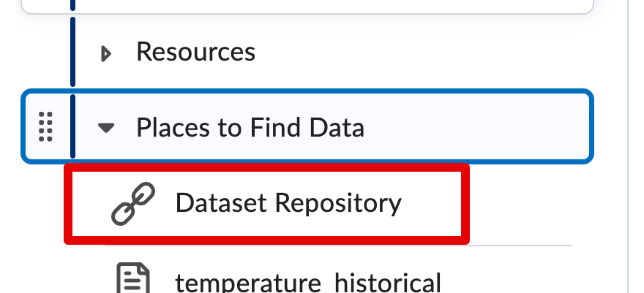
Let’s do Some Stuff!
Focus on examining the data in Tableau.
  Distributions – what does the data look like, what’s its shape?
  Relationships – does one variable have a relationship with another?
  In Tableau – histograms, box and whisker, scatter plots, and maybe much more!
Athletes.csv.zip
  In the repository link.
  We need to unzip before using it (for most, probably just double click).
  We also need to clean it up a bit to be useful.

Slide 50

