Slide 1

Housekeeping
Today:
  Read ch15, but we won’t cover all now.
  Spatial data. (ELECTION… data files)
  Granularity and LOD (fixed) calculations.
  Direct map layering.
  Make an election map!
The thinking behind the fixed stuff is important for complex things.
  Always think of “per” – one value per… person, item, year, customer per day, etc…
Also – a assignment-ish example using spatial joins, for however much time is left.

Slide 2
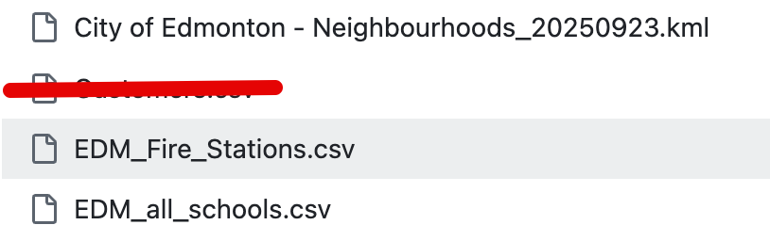
Assignment Like Example
We are shopping for a house.
We know we want to be close to schools and fire stations.
Some stuff we need:
  Spatial joins, join calculations, multiple joins, and multiple map layers.
  Parameters to get user info.
  Calculations to connect things together, especially transforming data.
  Spatial calculations.
  Adding interactivity to all of that.
We won’t get to final style/polish, but we can make the logic for a good assignment.

Slide 3
Last Assignment
Biggest common issues:
  What should I read from something? I.e. you have some charts, but if I read them, do I actually learn what you intended?
  What does this chart mean? How the value you get from a chart relates to other stuff should be pretty clear.
If you think I marked yours incorrectly, make your argument.
  It is inheierently a somewhat subjective evaluation, maybe I didn’t get it.
  You have to make a material argument (e.g. mine is better on category X for reasons A, B, and C), you can’t just say “I thought it is good” or “I tried really hard”.
  People win pretty regularly.

Slide 4
Spatial Data and LOD Calculations

Slide 5
Mapping Stuff
To now we have two basic ways of mapping stuff:
  If we have a latitude and longitude, we can map specific points.
  If we have a region (country, state, etc…) we can map a filled map.
What if we want to bridge the two?
  Is this house in this neighborhood?
  How far are two points from each other?
To do so we need a special set of files and functions – Spatial Functions and Data.

Slide 6
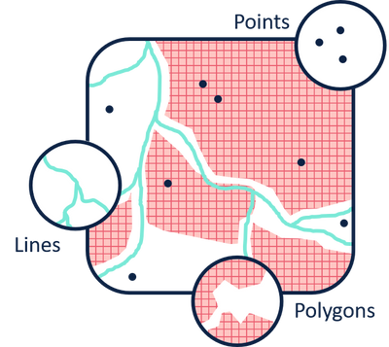
Spatial Data
Spatial data is basically data about geography, or the stuff on a map.
Spatial files.
  Define the boundaries of some area (e.g. neighborhood).
  E.g. the spatial file for Edmonton neighborhoods defines the “outline” of each neighborhood.
We need to join with our structured data to do something useful.
  The structured data has some attribute denoting an area (e.g. neighborhood).
  The spatial file has two (important) columns – that attribute and the “geometry”
  The geometry defines an outline of each area, in latitude and longitude coordiantes.

Slide 7
Adding Spatial Data
Once the spatial file is joined and loaded, we can use the geometry like any other region field in Tableau, such as Country or State.
  The things where we can build filled maps without doing anything special (country, state, province) have these spatial boundaries defined internally, because they’re so common.
  This process is still happening, it is just seamless to us.
We can make filled maps of whatever regions the spatial file defines.
The end result of the join is that the data now has an attribute that defines, on a map, where that region lies.
For “public” things like neighborhoods, regions, etc… searching “WHAT_I_WANT kml” or “WHAT_I_WANT shp” will likely find a result.

Slide 8
Spatial Functions
Once the data is properly setup, we can do lots of useful things quite easily.
  GIS – geographical information systems are a family of SW that do this for real.
In Tableau, we have several functions and capabilities.
  Functions are very similar to set theory operations.
  These functions will handle the math automatically for things like curvature of earth.
Doing geographic “math” is simple if the data is setup for us up front.

Slide 9
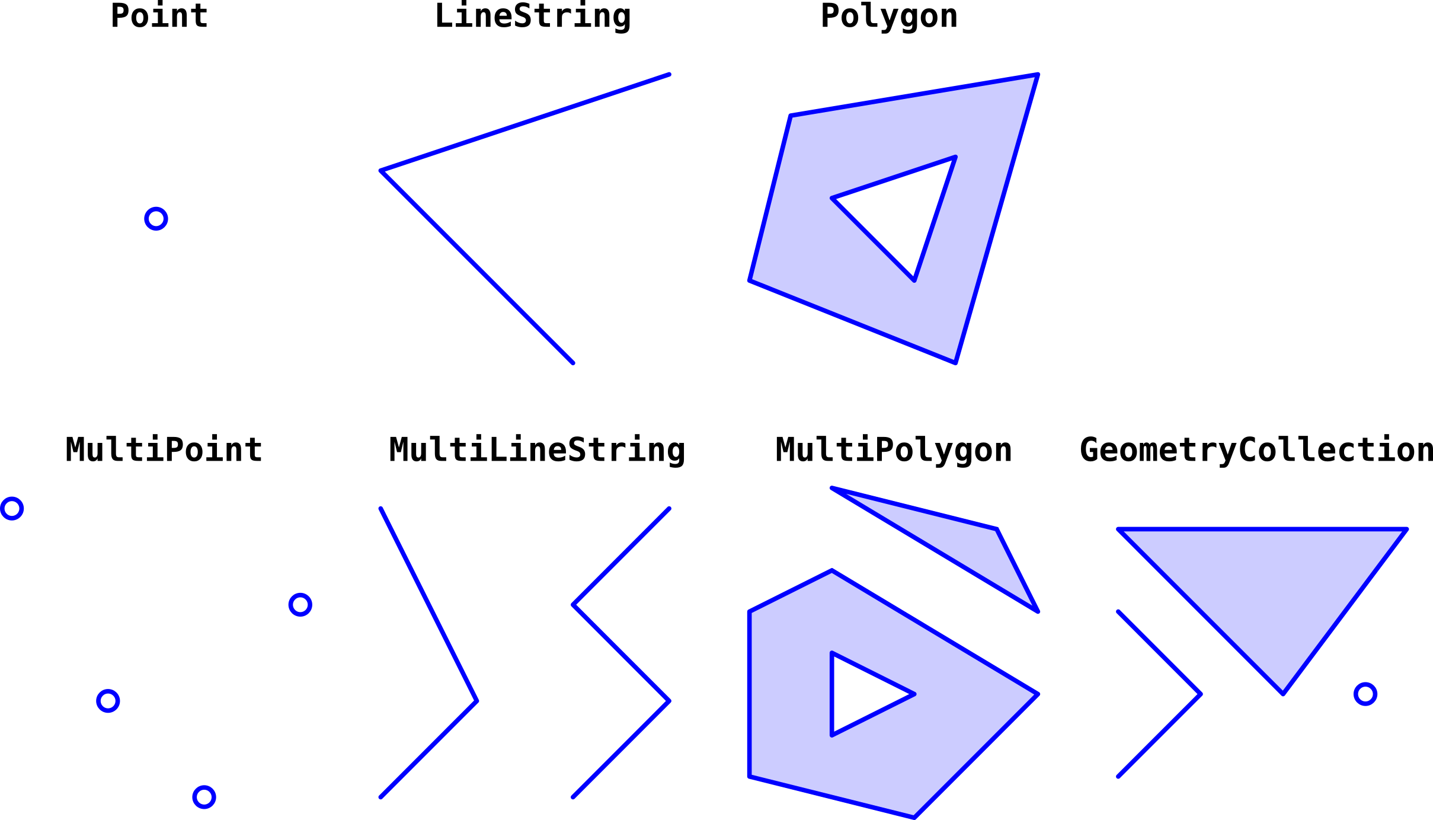
Spatial Data Types

Slide 10
Spatial Areas
The geometry field is basically the outline of some region or space on a map.
Once we have the areas defined, we can easily calculate with them:
  Is there intersection of two areas?
  Is a point in an area?
  How large is an area?
These geometry attributes can be mapped just like state/country in Tableau.

Slide 11
Points
Points in spatial data are, well… points on a map.
Points are a special datatype that are constructed from lat/lon:
  We can make a point with the Makepoint function if we have latitude and longitude.
  The point data type is basically lat/lon + a ”type” that we don’t care about.
  Points allow all the other spatial functions like distance to work correctly.

Slide 12
Lines
Lines are paths that connect two spatial points.
Math using points, such as distance, will automatically figure out earth curvature.

Slide 13
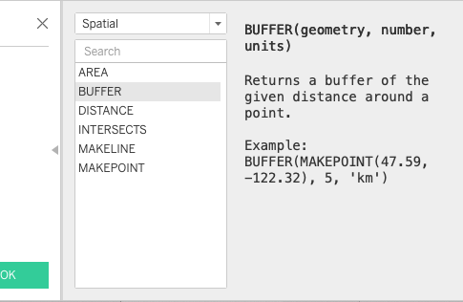
Functions in Tableau
We can do basic spatial analysis with the simple toolset in Tableau.
  Distances.
  Mapping regions.
  “Is in”.
  Intersection.

Slide 14
Spatial Joins
We can also join two spatial files together in Tableau using the “intersects” operator.
  Joins “on” where spaces on a map overlap each other.
Not super important for us, unless we run into a scenario where it is needed.
Used when we have overlapping geographic things:
  We can look at a point and determine what neighborhood it is in as well as which electoral ward.
Can layer multiple regions on one map, for more advanced analysis.

Slide 15
Fixed Calculations

Slide 16
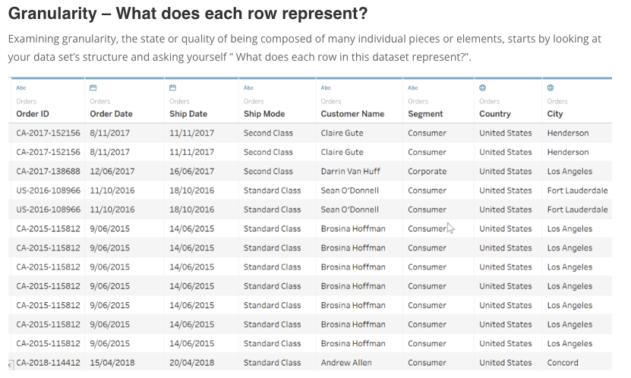
Granularity
When dealing with data and aggregations we can think of things in terms of the granularity.
The granularity is “how fine” the data is:
  Per person, per product, per region, per school, etc…
Each aggregation changes the granularity.
  Adding/removing a dimension changes the number of groups.
  Everything is recalculated as the granularity changes.
Some functions allow us to control this.
Think of the “per” when describing data…

Slide 17
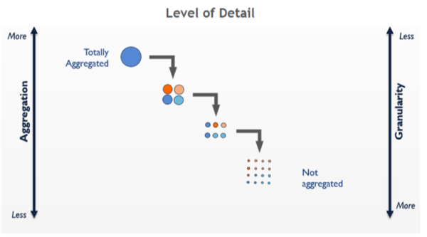

Slide 18
Note – Think About it
This granularity matters, and we need to consider it:
  Just adding a value to a vis probably doesn’t do what we need.
    I.e. just adding “profit” doesn’t ensure profit is calculated in the way we need.
  Getting correct values requires thinking about it.
You want to be excessively explicit:
  Every value is (technically) per something…
  Say it out before building.

Slide 19
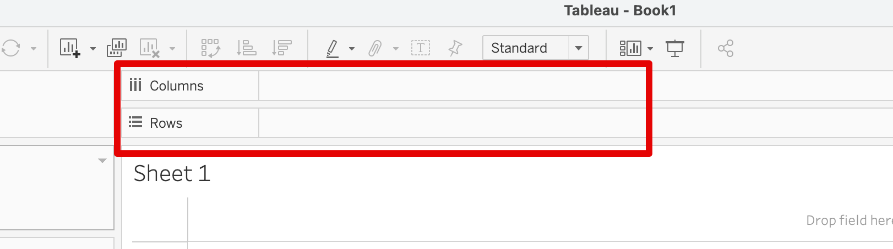
Granularity and Tableau
Generally, each dimension in the shelf will ‘split’ the data.
If we have several, we get multiple ‘pers’:
  E.g. average sales per product per store per day.
Make sure that the aggregation you want is what you get.

Slide 20
Level of Detail Calculations
Everything in a visualization is automatically impacted by grouping.
What if what we want to show differs?
Level of detail calculations allow us to separately control the grouping.

Slide 21
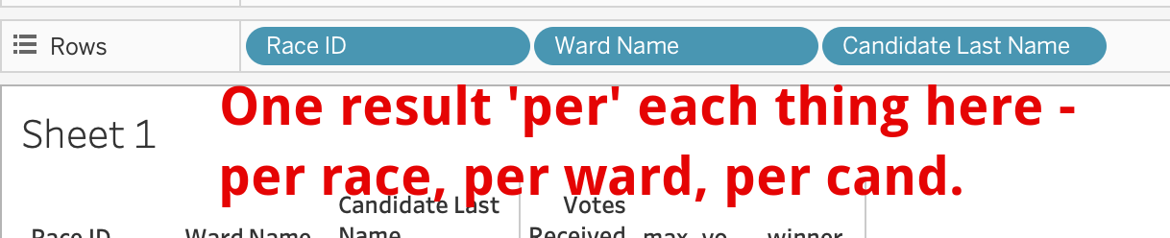
Fixed Calculations
Fixed allows us to do groupings and aggregations that are fixed.
Normally when we add things to Tableau, we have some aggregation and some grouping based on whatever is in the visualization.
If we want a calculation based on a grouping that isn’t in the visualization, we have an issue.
Fixed defines a specific calculation:
  Create one group for each value in this dimension.
  Generate this aggregation calculation for each of those groups.
  These values are totally unimpacted by the grouping in the visualization.

Slide 22
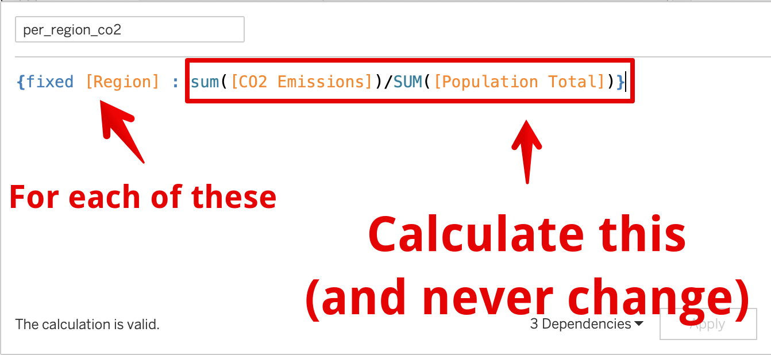
Fixed Usage
Fixed can give us something to compare to.
  I.e. we can tabulate the the most votes per riding.
E.g. If we want to see who is above or below the average sales per salesperson for each region
  we can define that average using fixed
  that value isn’t impacted by adding or removing data to the visualization.
  We could add/remove individual salespeople from the vis without breaking things.
These things are fixed no matter the grouping/splitting of data.

Slide 23
Include/Exclude
Include and exclude are similar-ish functions to fixed.
  Include will tell Tableau to aggregate by something.
  Exclude will tell Tableau to not-aggregate by something.
Include can force some aggregation in all cases.
  E.g. force something to average differently.
Exclude can force something to not be aggregated in all cases.
  Exclude some value from being aggregated by specific values.
I find these more confusing vs just using fixed, but that’s just me.

Slide 24
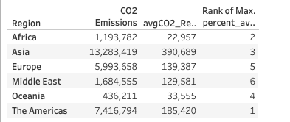
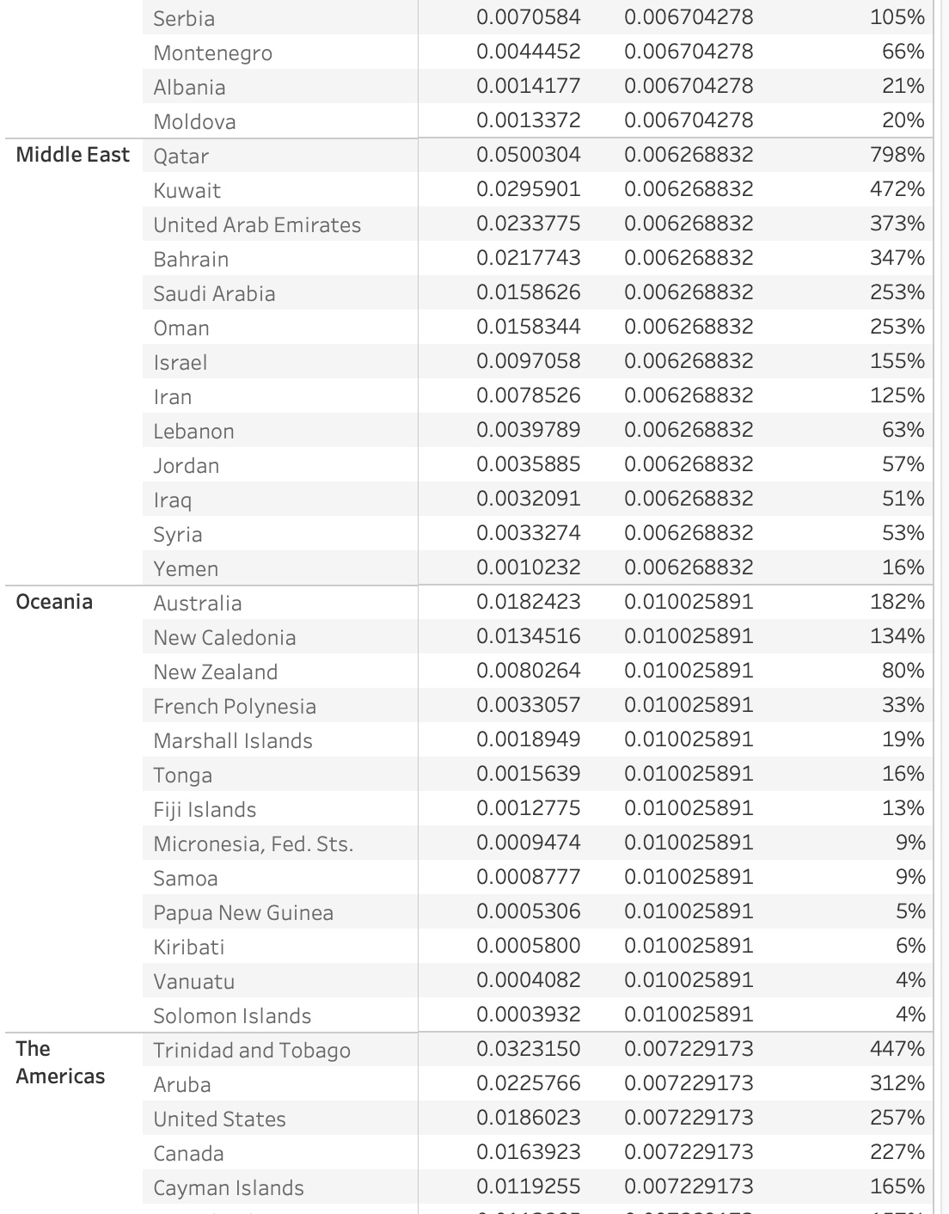
Warmup
Using the World Indicators dataset.
Can you make a list that shows:
  Each country.
  Their CO2 emissions per person.
  The percentage of the AVERAGE CO2/per for that REGION
  Think about exactly what’s calculated!
Part 2:
  Can you modify it to show this ranking. This is ranked by the largest percent of the average, as shown to the side.
  Editing the table calculation will enable a preview that will help.

Slide 25
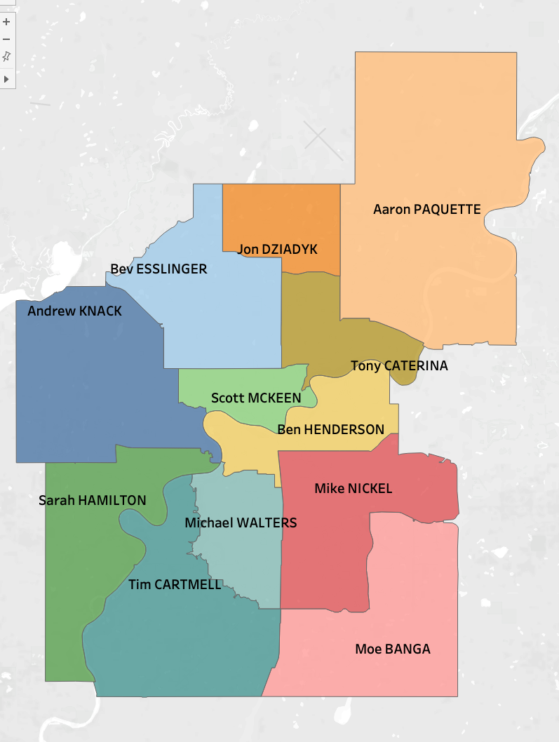
Goal:
Winners of each council election on a map of their ward.
We have a csv of voting results by voting location and a spatial file for electoral wards.
Take a few mins and think about how first, it may not be obvious.
  Generate a list of each ward’s winner.
  Is your list “durable” i.e. if you change which dimensions are in the vis, does it hold?

Slide 26
Election Logic
What is the largest number of votes for each race?
What is the total number of votes for each candidate?
Is each candidate’s votes equal to the max for their race?
The first two we can do with some fixed calculations. The third is just a comparison.

Slide 27
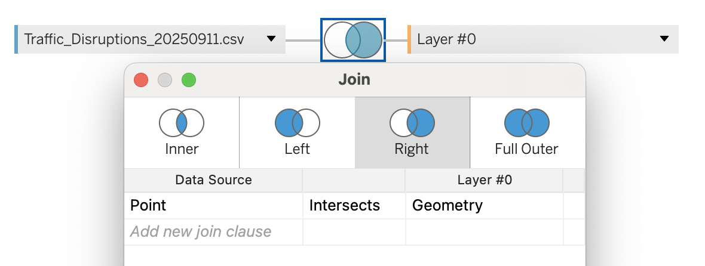
Traffic Disruptions Per Neighborhood
Try to do a join based on spatial data – it is easy.
  We have a list of things that happen at a location – traffic disruptions.
  We have a list of regions – neighborhoods.
Combine these.
  Join a point intersecting with the geometry.
  Neighborhoods in repository, traffic (or any other thing) is on open data.

Slide 28
Singapore
Join: makepoint(latitude, longitude) intersects Geometry.
Map properties as well as the areas.
Plot each property with a 1km buffer around it.
Note: this ended up being a lot slower on the second PC I tested this on than I had budgeted, so if you have a slower computer it might be really annoying. I’ll find a smaller example later…

