Slide 1
Some Stuff
Today’s stuff:
Comparisons (more selecting, customizing, and comparing) in tableau.
KPIs and more parameter usage.
Tableau extensions and a radar chart.
Assignment:
Think of some ideas, look for data, and start to explore what you can do with it…
Start with simple, then look at improvements – more complex charts, adding animation/actions, adding density with color/size/shape, etc…

Slide 2
Comparison and KPI

Slide 3
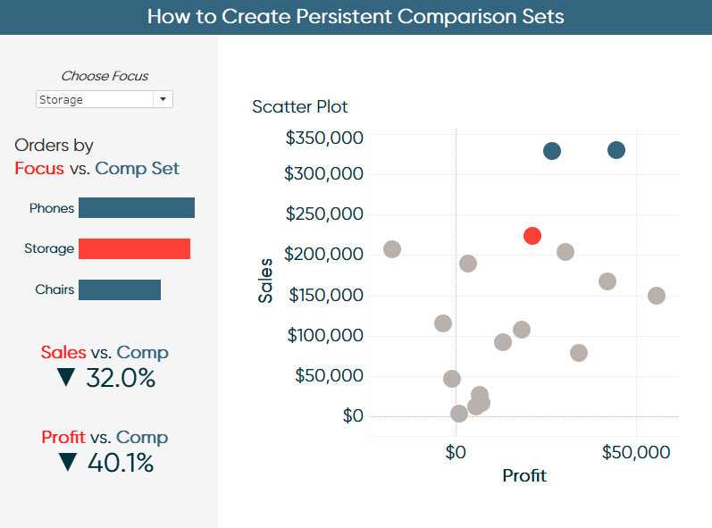
Compare things
One important tool of visualizations is to allow comparison.
We can let users customize some details.
Tableau can recalculate things on the fly.
On ‘business’ dashboards, this is common.
Focus on one store/product/department.
Facilitates KPI – key performance indicators.
Identify core values, monitor them.

Slide 4
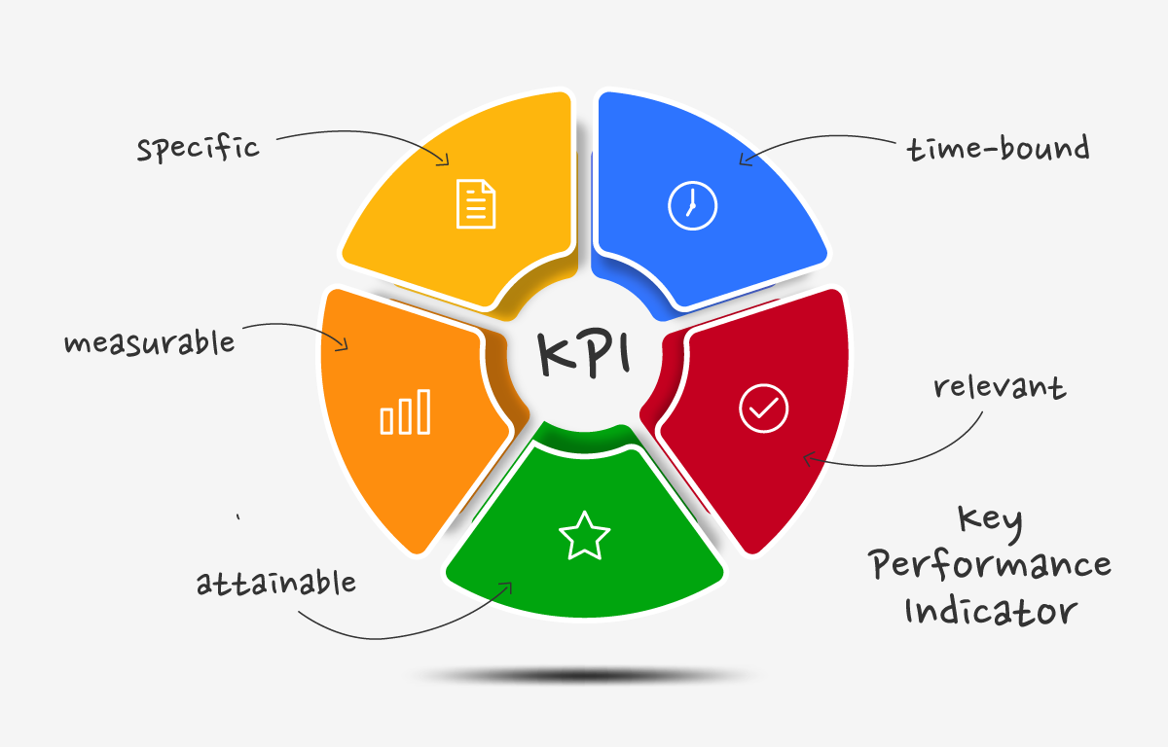
Key Performance Indicators
KPIs are metrics that organizations identify as being critical for success.
Specific – we can know definitively if we acheive it.
Time bound – we have limits on when it can occur.
Measurable – it is objective.
Attainable – it is realistic to achieve.
Relevant – it matters to success.

Slide 5
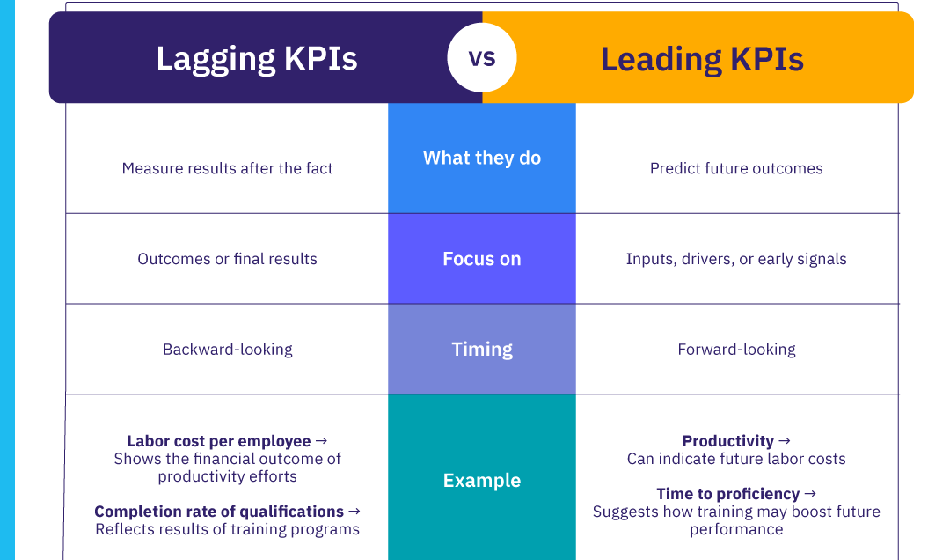
Leading vs Lagging
KPIs can be leading or lagging.
Leading:
An indicator that something will happen.
Store traffic indicates future sales.
Lagging:
An indicator something has happened.
Conversion rate on web visitors to buyers.
Both ultimately guide behavior (ideally).

Slide 7
Developing KPIs
KPIs will differ depending on organization and circumstances.
The goal is to, as best as possible, summarize the performance of the org in a few values.
I.e. if these metrics look good, we are doing well.
Broad consideration – financials are included, but not the only thing.
Customer opinion, job applicant quality, social media mentions, supplier limits, etc…
Stakeholder consultation – ‘success’ for different departments may be different.
The process of identifying KPIs can help reveal this*.
Relevance (again) – easy to measure != important. Important things may be hard to measure.

Slide 8
Thresholds
Another factor that we often consider with KPIs is a threshold.
Criteria for what value signals good/bad limits.
E.g. gauges in car – red line is the RPM threshold, temperature range.
Simplify analysis by focusing only on cases where there’s an issue.
Real life example – banker training at ATB.
We had many people in a ~6 month long otj training program.
Need to monitor number of trainees, pacing, etc…
Threshold – green/yellow/red light indicator for pace based on # of course items complete and major milestones.
Greens don’t need interventions, yellow need subtle, red is concern.

Slide 9
Process

Slide 10
This process isn’t always that easy
Beyond profit/sales, many companies have no clue what matters.
Especially large corporations where departments are far separated from sales.
Many departments have metrics that were picked arbitrarily.
Working on reporting on metrics often results in you determining what they are.
Managers are attached to what they already achieve.
Example – I revised compliance training (e.g. anti money laundering) assignment and reporting for ATB. The compliance people didn’t know what they needed to report, just reported the numbers that they had.
We can use some other analytics tools to help a little….
This usually requires domain knowledge and usually many meetings.

Slide 11
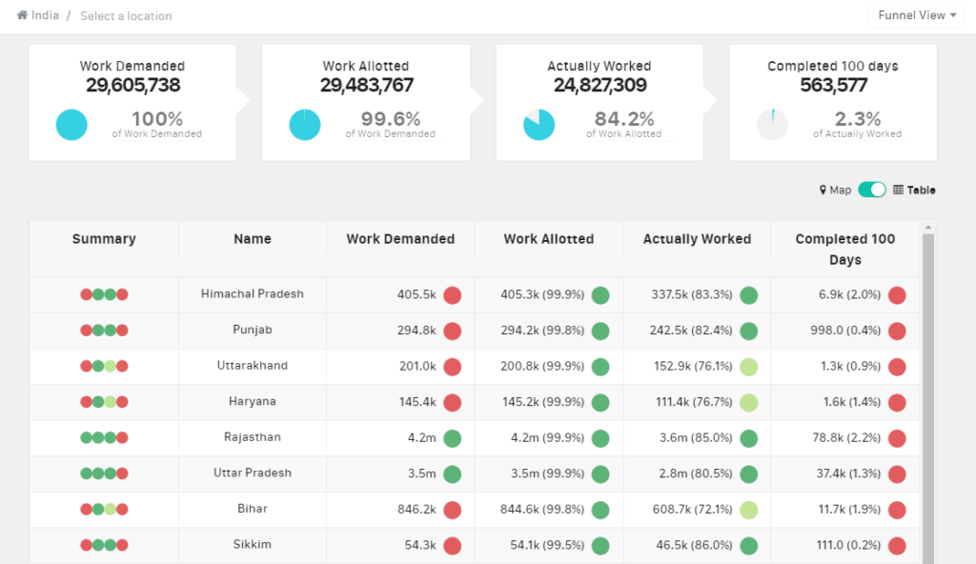
Make Me Metric!
Metrics can be constructed by math and data we have.
E.g. can calculate “sales per hour” for a salesperson at a store.
If you watch sports, many advanced metrics are examples (WAR, BPM, etc…)
Metrics also serve to simplify analysis.
The calculation combines the impact of several factors.
We only need to look at the metric to monitor.
Real – call center (1st call res rate, calls/hr, escalation rate, etc…)
Limited by relevance of metric – it is hard to summarize an entire business into one number.

Slide 12
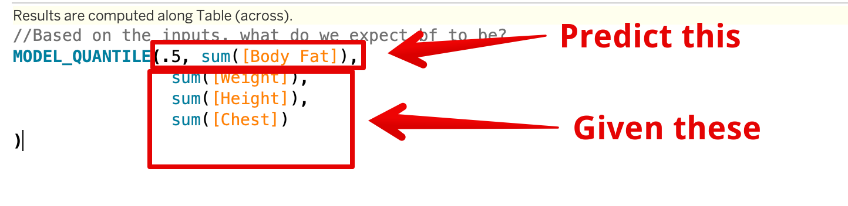
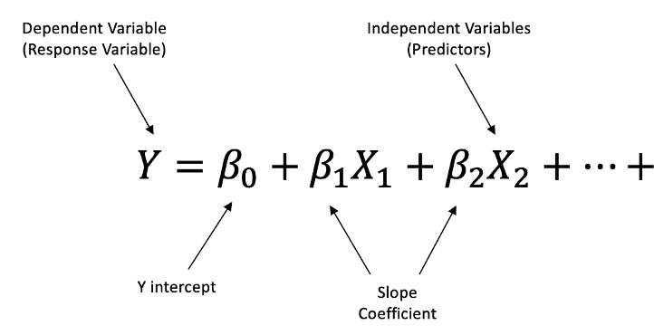
Regression and variable Importance
Regression models (we’ll do more soon on this):
We have several inputs, use them to predict output.
E.g. know loan applicant info, use past loans to predict good/bad risk.
When doing this, we can extract variable importance:
Recall, each regression is a weighted combo of inputs.
“loan risk” is weighted combo of “income”, ”age”…
If we make model of sales/profits, with metrics as inputs, coefficients are relative importances.

Slide 13
Regressing your KPIs
So, assume your chain of burger joints has an overall goal of “profits”.
There are several potential KPIs that you consider for each store:
Sales, material cost, rent, # of employees, size, etc…
Build regression with profit as target and all inputs as features.
Resulting model tells us how important each input is.
This isn’t perfect, it is limited by the quality of the data.
Do the inputs matter, or are we missing something that impacts profit?
Can we make a metric that actually captures a ‘thing’ – e.g. “coolness” for brands.

Slide 14
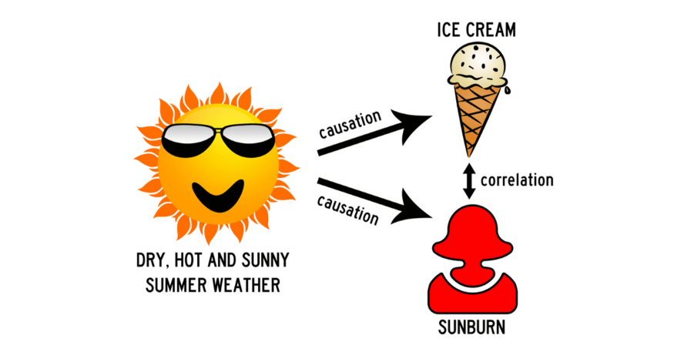
Detecting the Cause

Slide 15
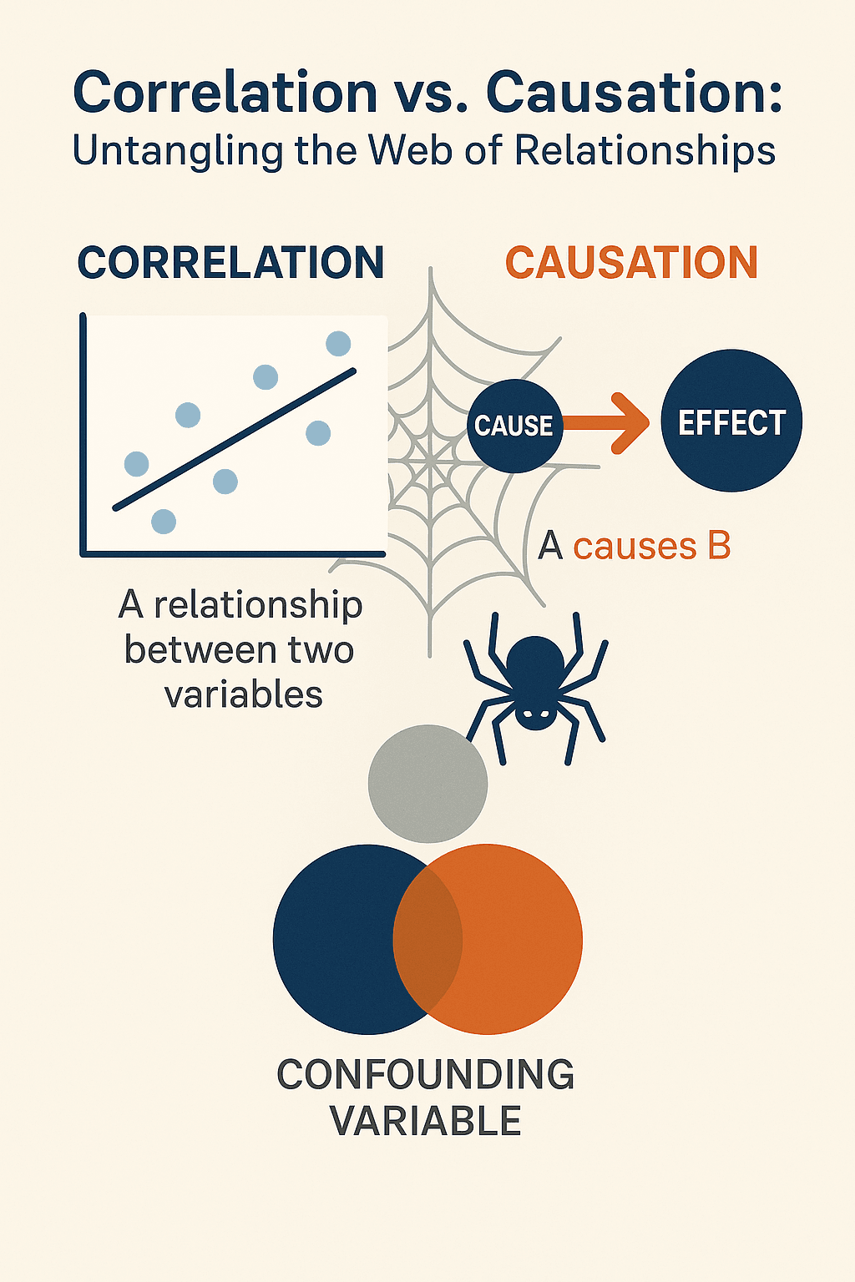
Causation Analysis
Diagnostic analytics is the branch that we often skim over.
We observe something happening and want to know why.
Two things happening together doesn’t mean one caused the other.
Correlation is very easy to measure, but may not matter.
Coincidences, other impacts, of shared causes may occur.
Causation analysis is a branch of analytics that tries to prove causation.
If we can spot causes, we can embrace or avoid in advance.
Focusing on markers that happen earlier is an advantage.
Causal analysis is hard, there are a few simple-ish examples…

Slide 16
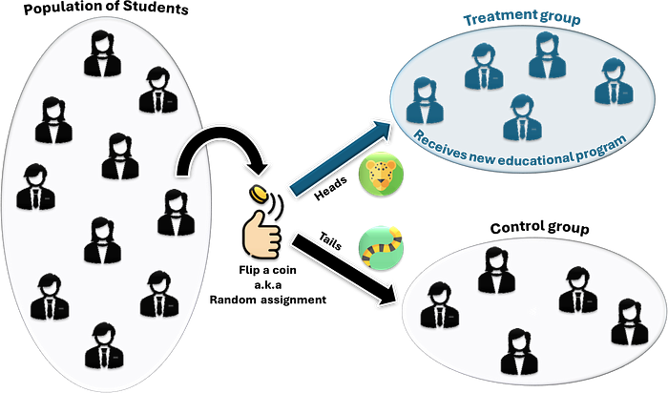
Causal Inference – did this Cause that?
Sequencing – if Thing A always occurs directly before Thing B.
With time-based data we can track this on a massive scale easily.
E.g. Amazon can track if suggesting products yields sales over billions of examples.
A/B testing – change one variable, observe results.
This is something that is made much easier with online business.
Change one variable, like which ad is shown, and measure results, like click rate.
If everything else is controlled, can draw inference from the change.

Slide 17
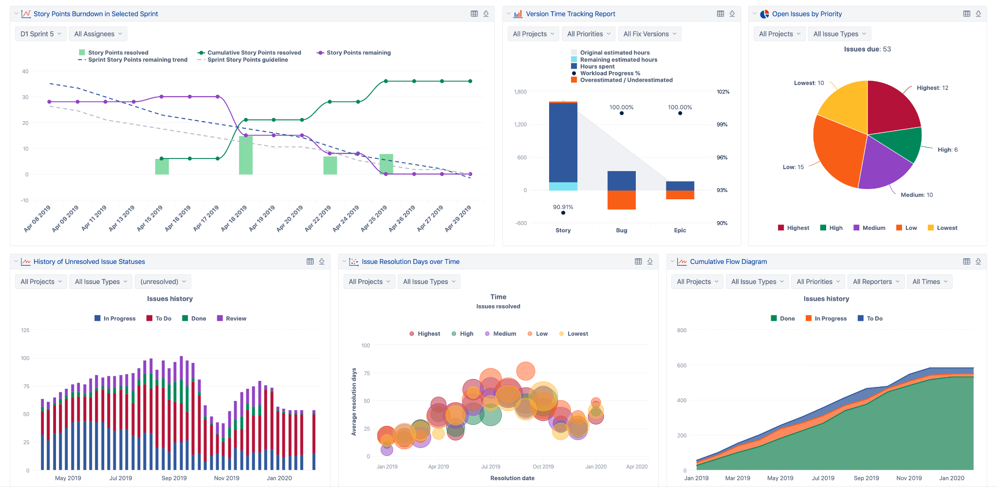
KPIs and Dashbaords
Modern dashboards are an easy way to show KPIs to users.
Can make one dashboard and allow tailoring.
Parameters, filters, interactivity….
E.g. at ATB we used to make ~15 different reports on the same thing for different areas. Change to 2 base reports with options.

Slide 18
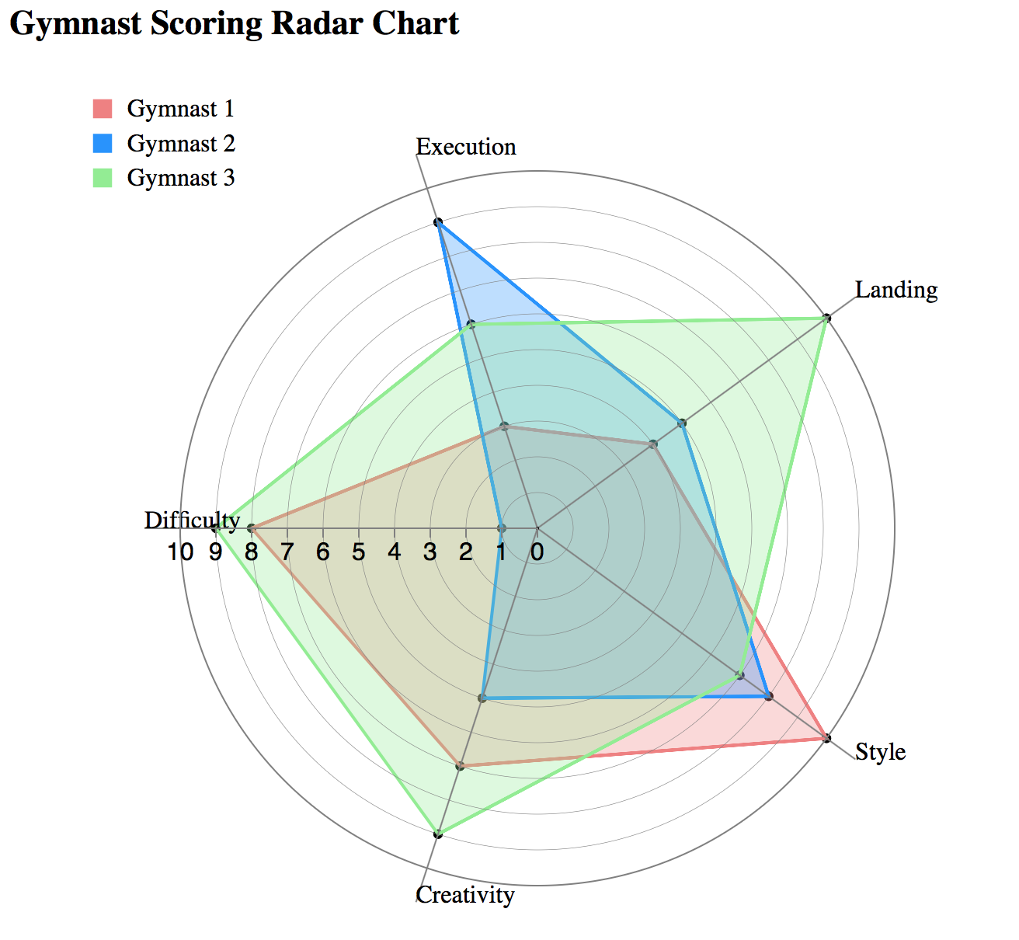
In Tableau…
In Tableau, we can calculate almost any metric via a calculation.
We can manipulate the customizations with:
Parameters.
Filters.
Interactions.
Some other tools – groups and sets, can help splitting “care vs. not care”.
Lastly, extensions…. Let’s try some.

