Slide 1
Introduction to Visualization

Slide 2
Visualization
The main focus of this course is on visualization, but what is it?
Visualization is communication of information or knowledge from data, using visual tools.
Charts
Graphs
Maps
Etc…
We are simply trying to communicate things, just using charts instead of words.
You could examine store sales data and write a paragraph to explain the results to the manager.
You could use store sales data to generate visualizations to explain the results.

Slide 3
Data – It Matters
Analytics is built upon our ability to collect data.
Often massive amounts of data.
Data can be in many forms
Text, spreadsheets, videos, images, etc…
The amount of data in the world doubles every two years or less.
Analytics seeks to make sense of this data.
Amazon can track its customer’s location, payment method, purchase history, search history, potentially media consumption… how can they use this?
Part interesting, part innovative, part horrifying.

Slide 4
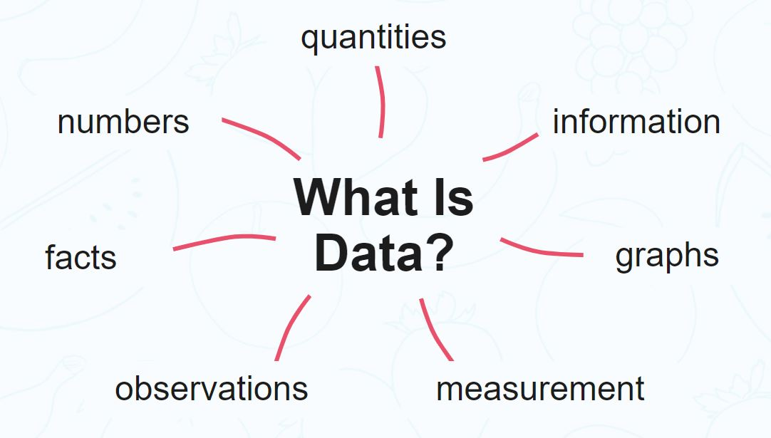
What is Data?

Slide 5
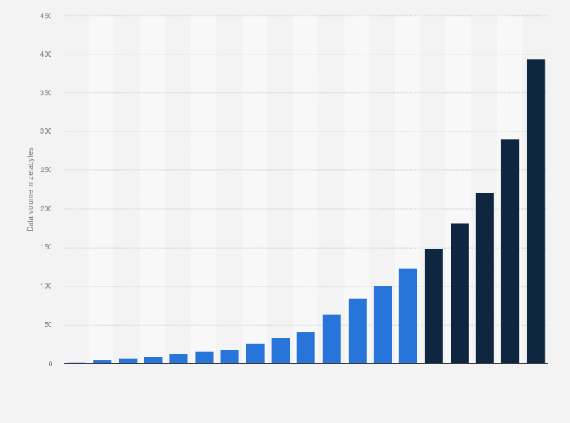
We keep Getting More Data, More Quickly
The amount of data we have is growing.
The rate at which data is generated is growing.
Every smart device – phone, watch, appliances, cars, machines…
AI pumping out junk.
The more we measure, the more we can know.
Orgs can measure things in great detail.
Is that data relevant?

Slide 6
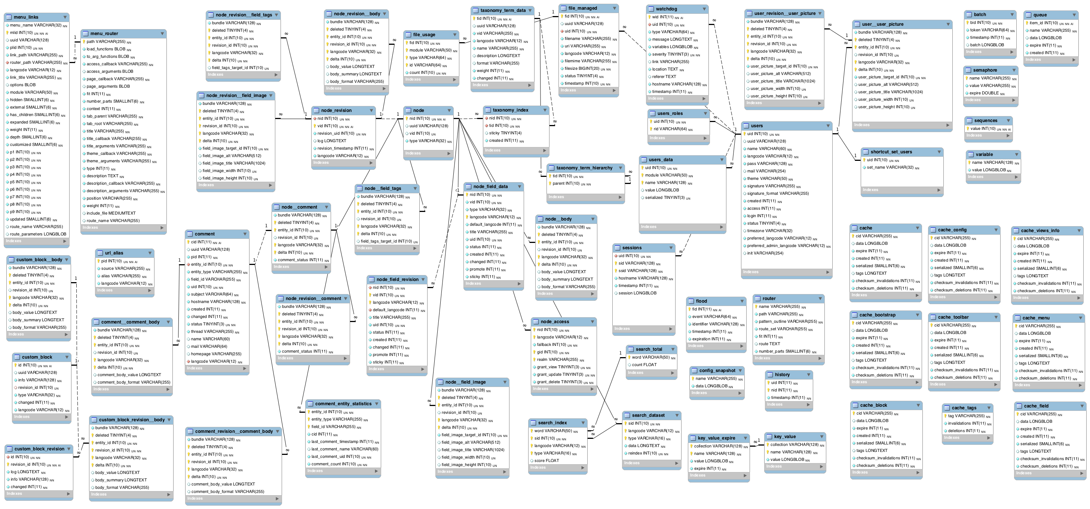
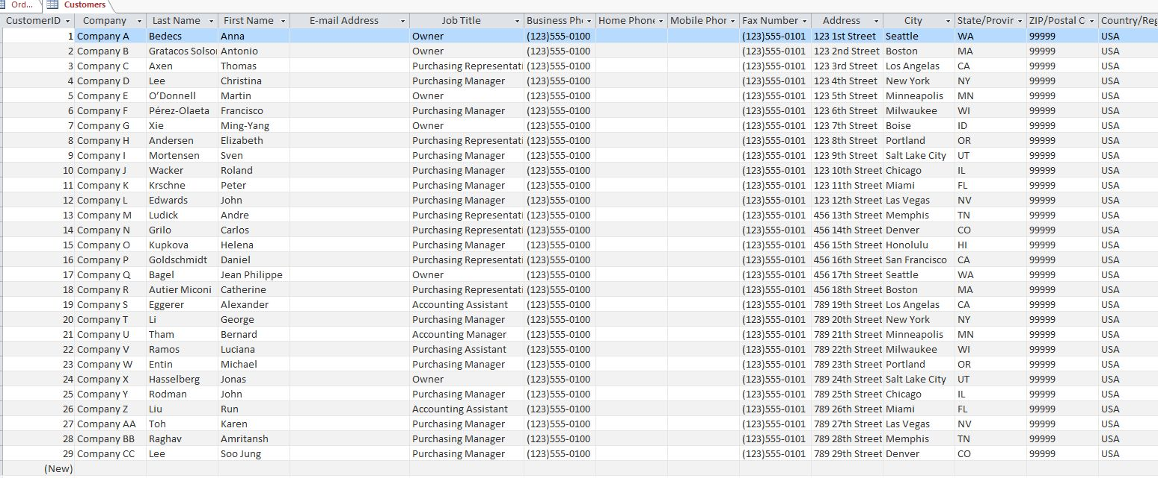
Data – We kind of hAve Too Much
Large orgs can have billions of rows of data in thousands of DB tables.

Slide 7
Visualization to the Rescue!
Reading tables of data is slow, hard, boring, and error prone.
Looking at pictures is easier and more fun.
We can use visualization to help us learn from our growing data sources.
We have a massive amount of data on what we did and what happened.
We hope to make sense of that so we can do better in the future.

Slide 8
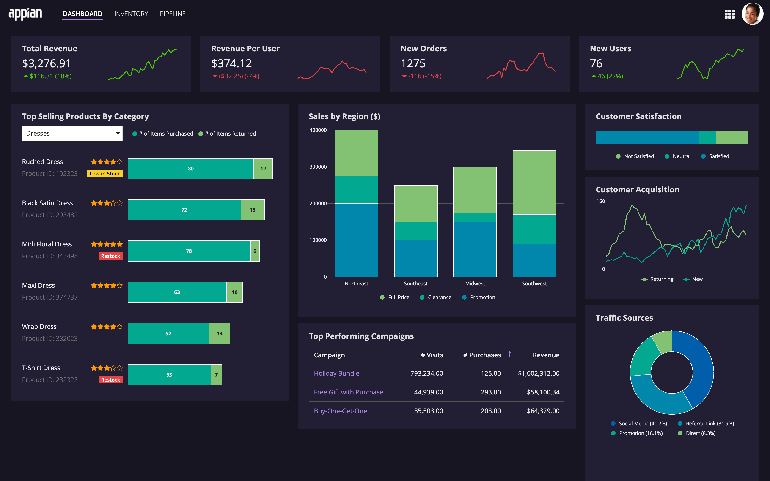

Slide 9

Reducing Friction
The reason to want to do this is to make information easier to digest.
We have lots of data to consume and it is increasing in importance.
It’s hard to keep all relevant data for Amazon or GM in your head.
We can try to reduce the friction of consuming data.
Friction is the excess work needed to consume data.
E.g. reading spreadsheets, needing to remember things, flipping pages, etc….
We want to make visualizations that present what people need, in the easiest format that lets them consume it without difficulty.
We will summarize the data and present the important bit conveniently.

Slide 10
Making Use of Visualizations
We have a large amount of data.
We can potentially use it to make better decisions.
People need more than just raw data to make smart decisions.

Slide 11
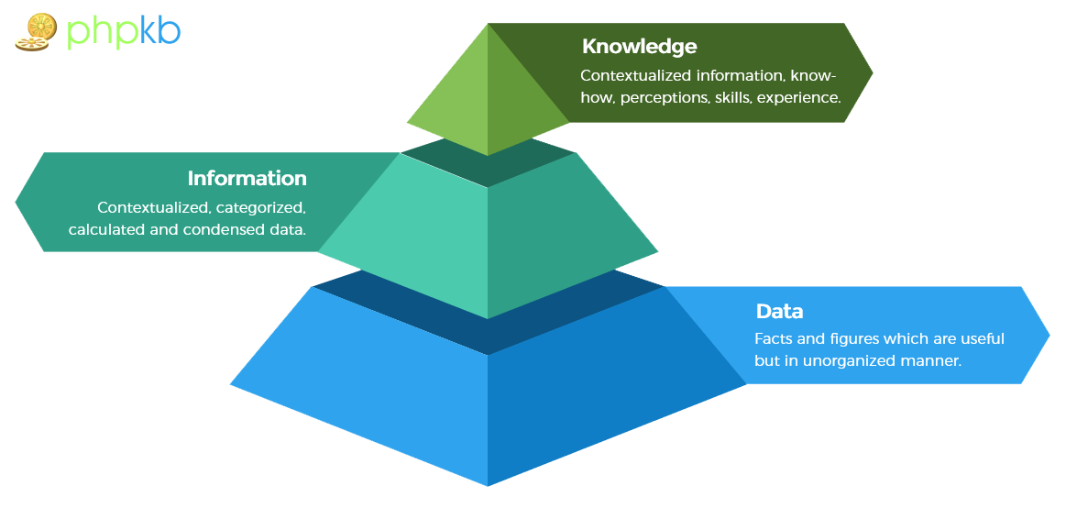

Slide 12
Data->Info->Knowledge
2124656000 – This is a piece of data.
$ 2,124,656,000 or 212-465-6000 – These are pieces of information, we’ve added context (meaning). The data is now a phone number or account balance.
“Qualified for a loan*” or “from NYC” – This is knowledge – what the data means for our actions.
*Roughly, this would be one factor.

Slide 13
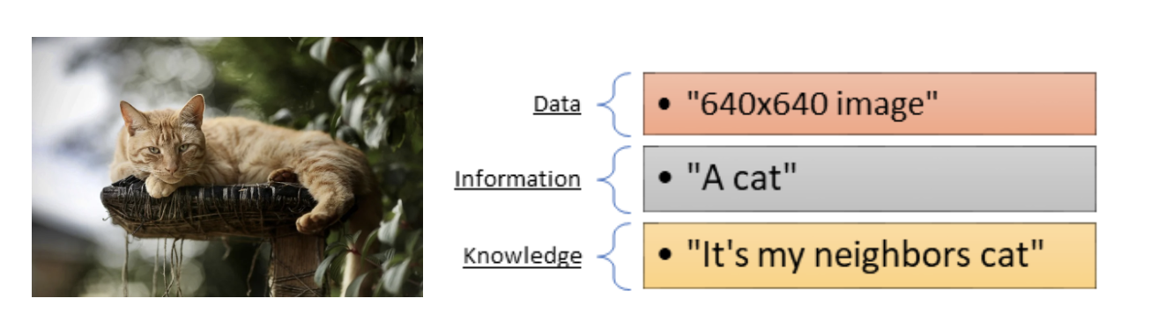
Example

Slide 14
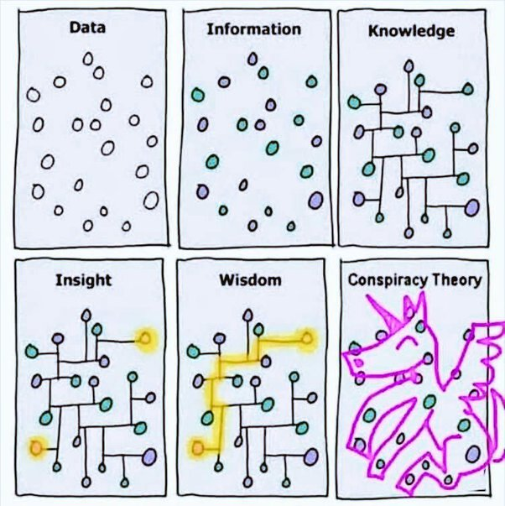

Slide 15
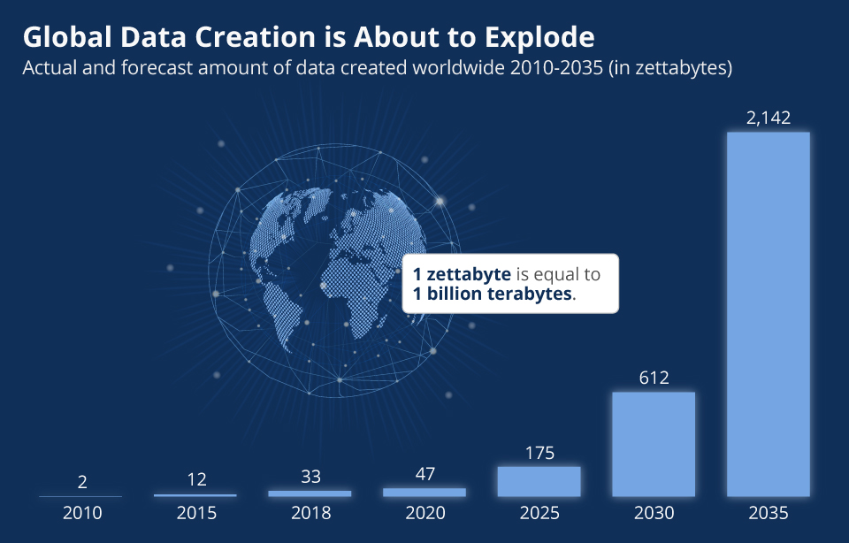

Slide 16
Mo’ Data
Our ability to collect data is exploding.
Nearly every device that “does something” collects a stream of data now. Watches, phones, smart cars, ring doorbells, thermostats.
The value of data is increasing.
Being able to react to data correctly can lead to much better decisions.
Using data is increasingly hard.
There’s lots of data, coming from many sources, quickly – hard conceptualize.
Challenge is to navigate and use data to extract useful information.

Slide 17
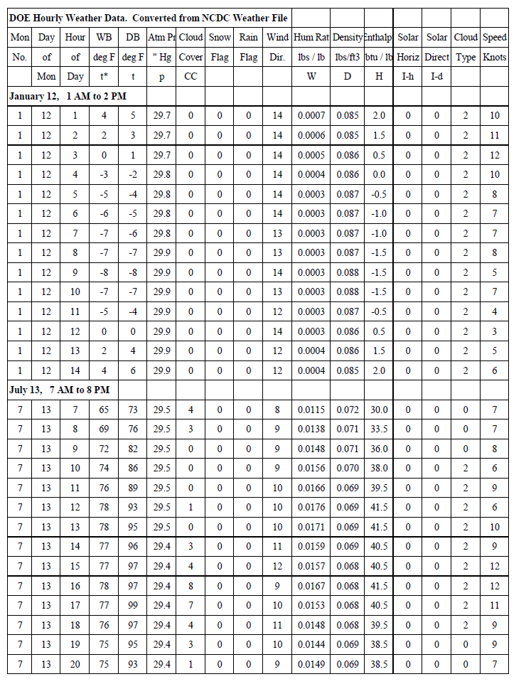
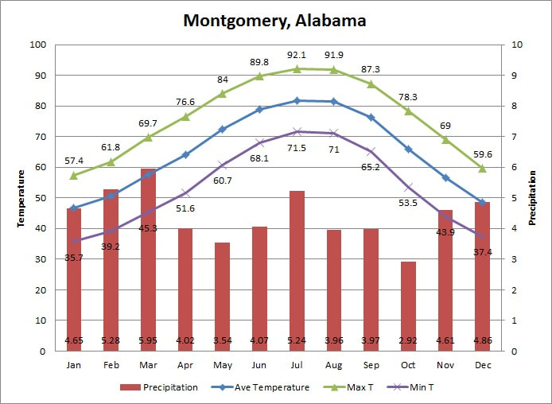
From Data to Knowledge
We have or can get a large amount of data.
If we analyze it correctly, we can use it to make smart decisions.

Slide 18
In Tableau…
We are using Tableau as a tool to find, extract, and display useful knowledge from our data.
Our data will be about something.
There are things that we want to know, use the data to show that. E.g. highest selling by product.
Making predictions. E.g. use data on loans to estimate who will pay.
The visualization should show the info/know that the data contains.
Each of these takes the original data and uses it.
We choose type/style to communicate best.

Slide 19
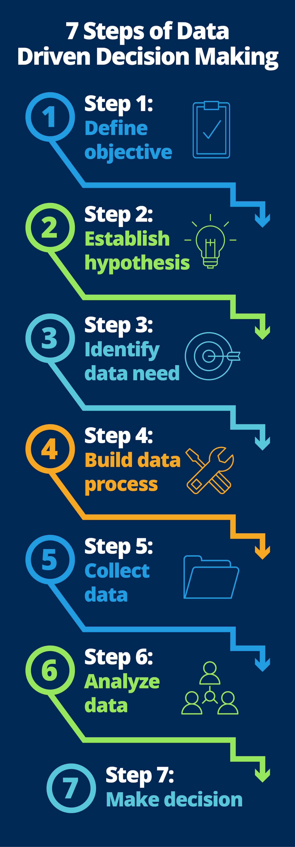

Slide 20
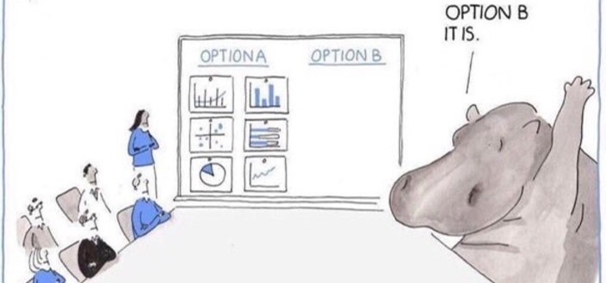
Data Over HIPPOs

Slide 21

What Analysis Can we Do?

Slide 22
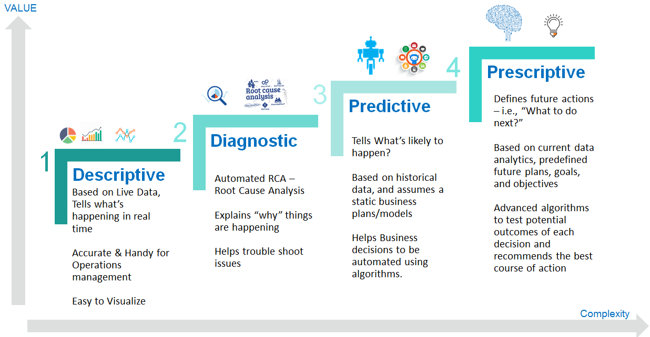
Analytic Types

Slide 23
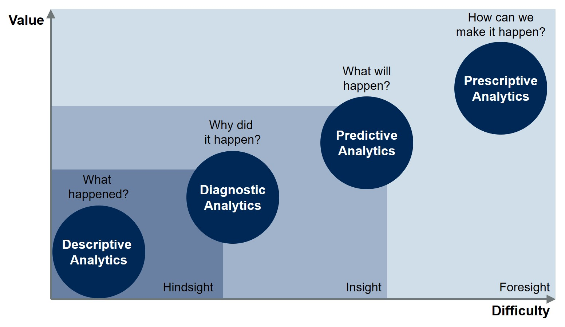
Put Simply…

Slide 24
Types of Analysis
A source of data can be used for several types of analysis, depending on goal.
We can summarize results and make a model to predict future outcomes.
Climbing the ladder leads to analysis that is generally more comprehensive.
Many/most companies are at or near the bottom.
Modern AI and related tools are built on predictive analytics.
Our work lives 95%+ in descriptive – what happened.

Slide 25

A (Brief) History of Visualization

Slide 26
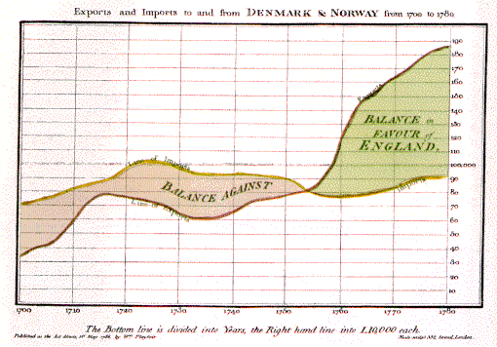
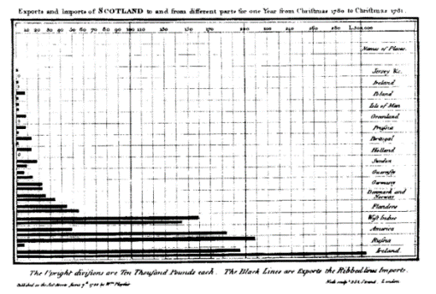
Late 18th – Early 19th Century
William Playfair (1759-1823)
Scottish engineer and political economist⁵
Founder of graphical methods of statistics
Developed new designs and improved existing methods to provide “systematic visual representations of his ‘linear arithmetic.’”⁶
Created the time-series line graph, bar chart, and pie chart.⁷
Images used under the Wikipedia Creative Commons license. http://www.wikipedia.com
Notes:
William Playfair (22 September 1759 – 11 February 1823) was a Scottish engineer and political economist, the founder of graphical methods of statistics.

Slide 27
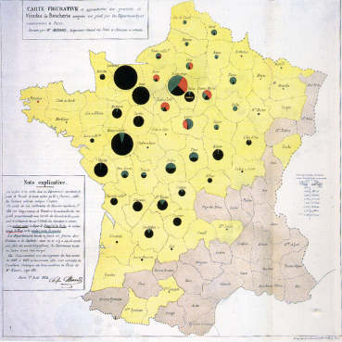
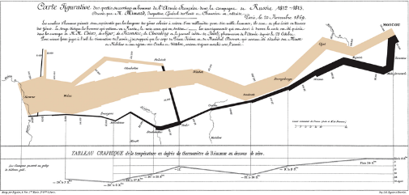
Early 19th Century
Charles Minard (1781-1870)
French civil engineer; produced an array of graphics that combine a many data points into a compelling visual story
Produced 70+ depictions including thematic maps and graphic tables between 1844-1870.⁷
Map of Napoleon’s Russian campaign regarded by some as the “best statistical graphic ever drawn.”⁸
Images used under the Wikipedia Creative Commons license. http://www.wikipedia.com
Notes:
We will discuss the map of Napoleons March in later slides.

Slide 28
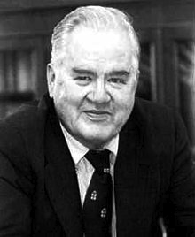
20th Century
John Tukey (1915-2000)
American statistician
Introduced the box plot in Exploratory Data Analysis, published in 1977
Exploratory Data Analysis (EDA) emphasized presentation of the main characteristics of a data set in a visual, easy to understand form, without using a statistical model or hypothesis¹⁰
Images used under the Wikipedia Creative Commons license. http://www.wikipedia.com
Notes:
John Tukey was an American Statistician who worked at Bell Labs. He developed and wrote about Exploratory Data Analysis or EDA. He advocated for showing data in a visual manner as an easy way to understanding, with the need for a statistical model or hypothesis. He invented the box plot, also known as the box and whiskers plot, and also wrote about other plots such as the bag plot and violin plot.
Tukey also coined the term “bit” as a contraction of “binary digit”

Slide 29
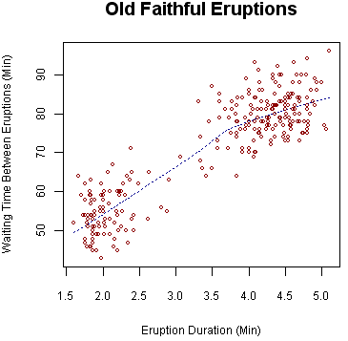
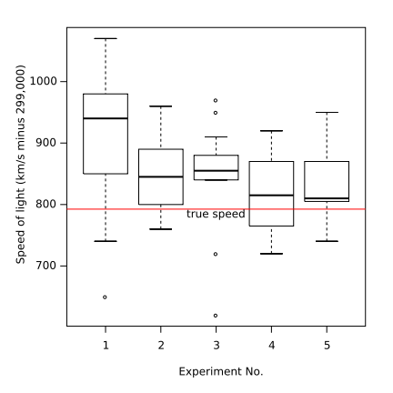
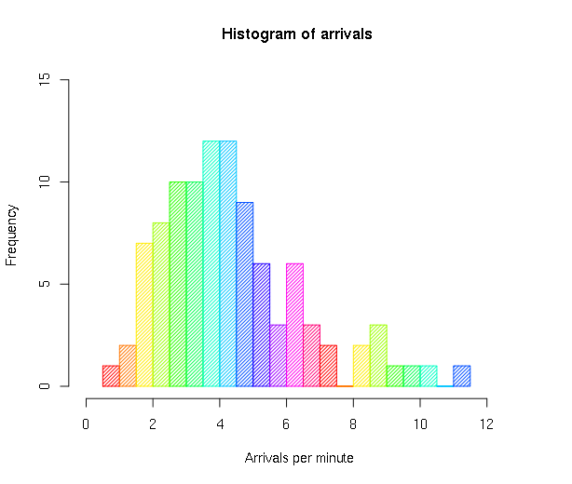
20th Century
Visualization techniques used in EDA include:
Box plot
Histogram
Pareto chart
Scatter plot
Computers set off massive increases in visualization usage and capability.
Sample histogram.
Sample box plot.
Sample scatter plot.
Images used under the Wikipedia Creative Commons license. http://www.wikipedia.com
Notes:
In Exploratory Data Analysis, Tukey used visual techniques such as the box plot, histogram, Pareto Chart and Scatter Plot.

Slide 31
A Picture is Worth a Thousand Words…
A primary reason we use visualization is to make it easier to process data.
We can compare sales totals in a bar graph far quicker than we can read and compare numbers.
We can spot a trend in a stock price easier on a line chart than reading a thousand daily numbers.
Modern companies/scenarios can have a lot of data to deal with.
Visualization reduces friction – it is easier to consume data.

Slide 32
Reducing Friction in Tableau
Tableau has the ability to take in large amounts of data and produce nice visualizations.
We can use the tools in Tableau to make the key info visible.
We have many different types of charts and graphs.
All use some basic concepts of visualization, starting with preattentive attributes.
Things our brain notices and starts to process without conscious thought.
E.g. you see a lion moving out of the side of your eye, you can react immediately.

Slide 33
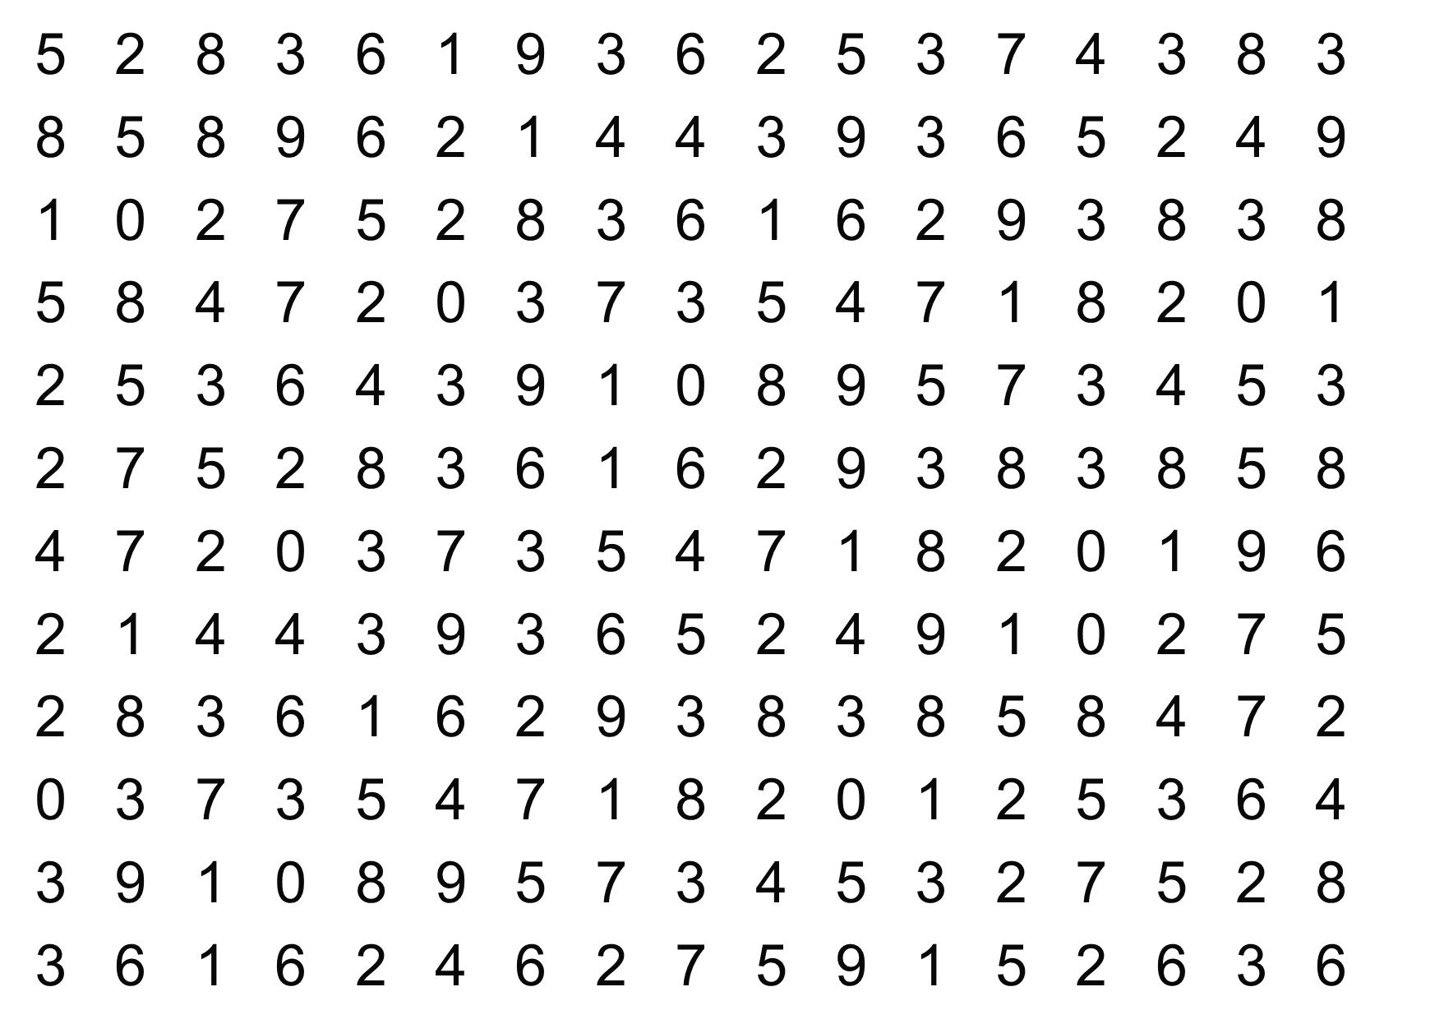
How many times does the digit 7 appear?
Notes:
Try to count the number of times the digit 7 appears in this data set. [give the students about 30 seconds to come up with a number, but don’t let them shout it out. After the exercise, as how many had 15, then 16, 17, 18, 19]. “Notice two things about this exercise. One, it takes a good bit of time to find them. Two, notice the error. Not everyone will come up with the same number.” [we will give the answer in a few slides]

Slide 34
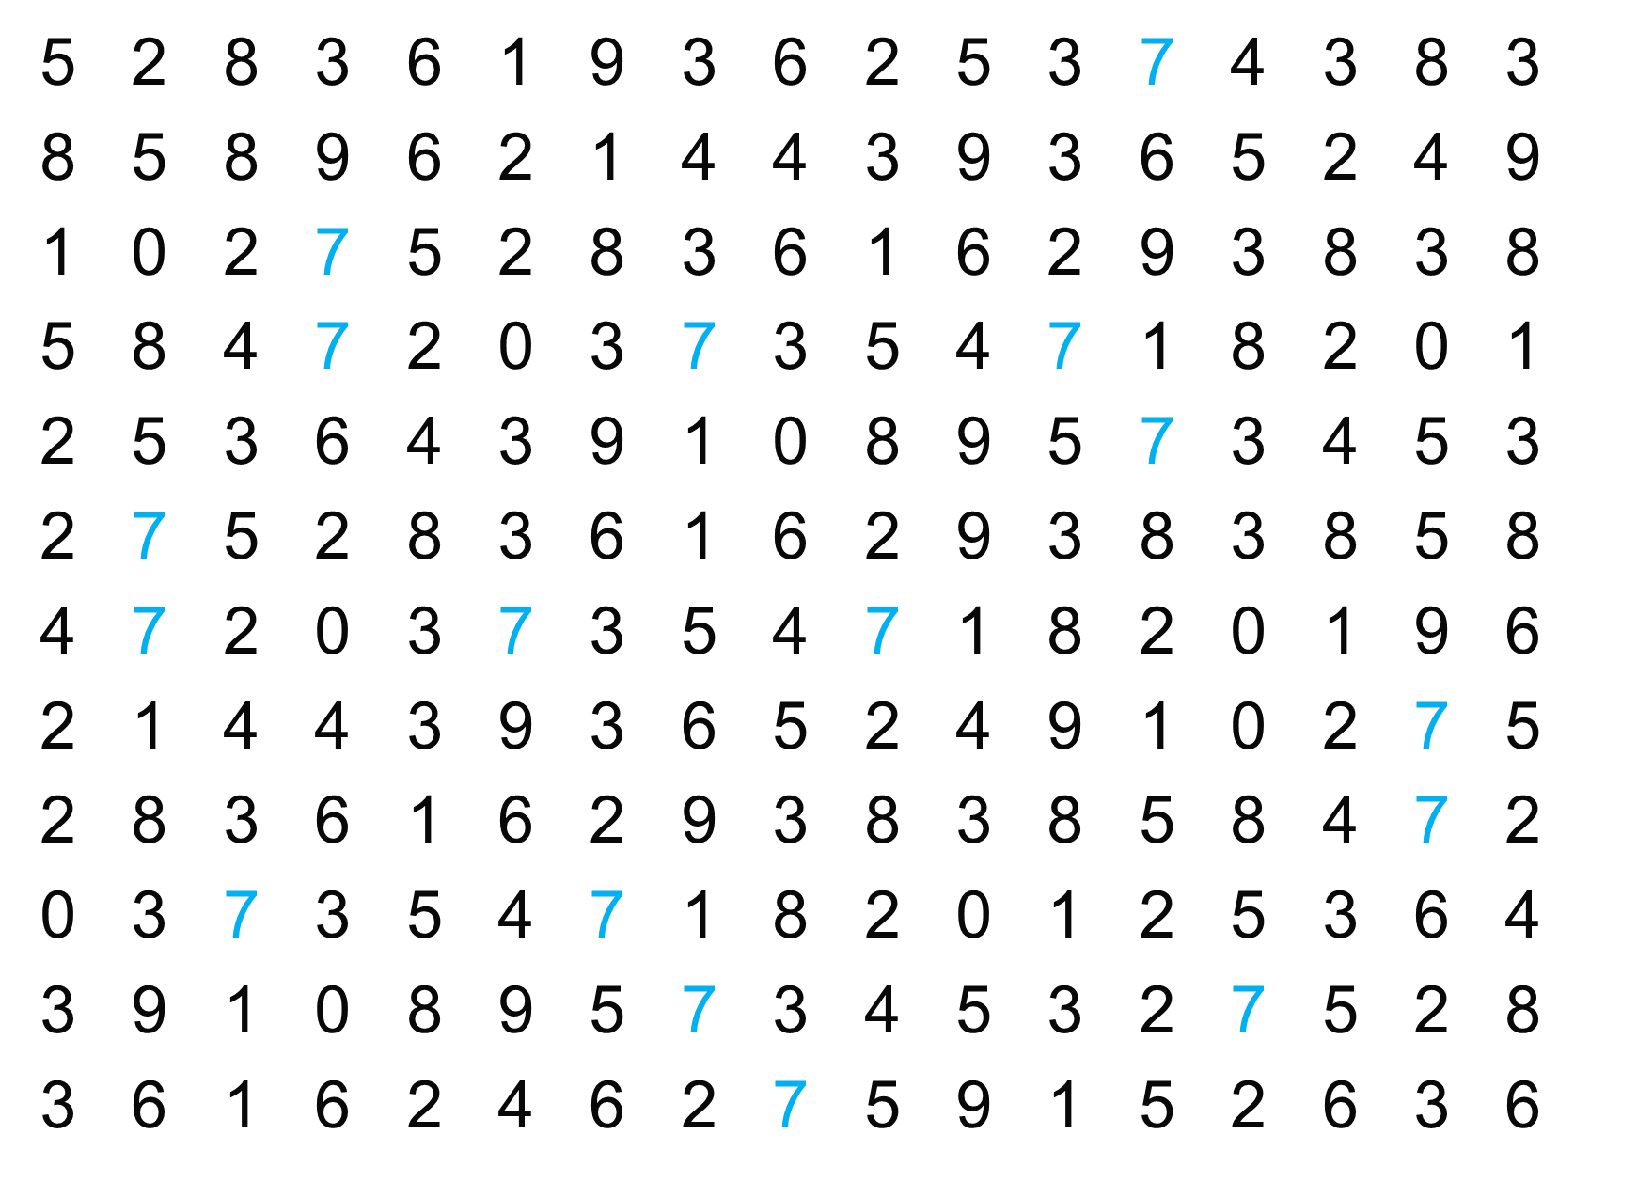
Notes:
“Is it easier now? We simply changed the color of the sevens and now it is easier to find them.”

Slide 35
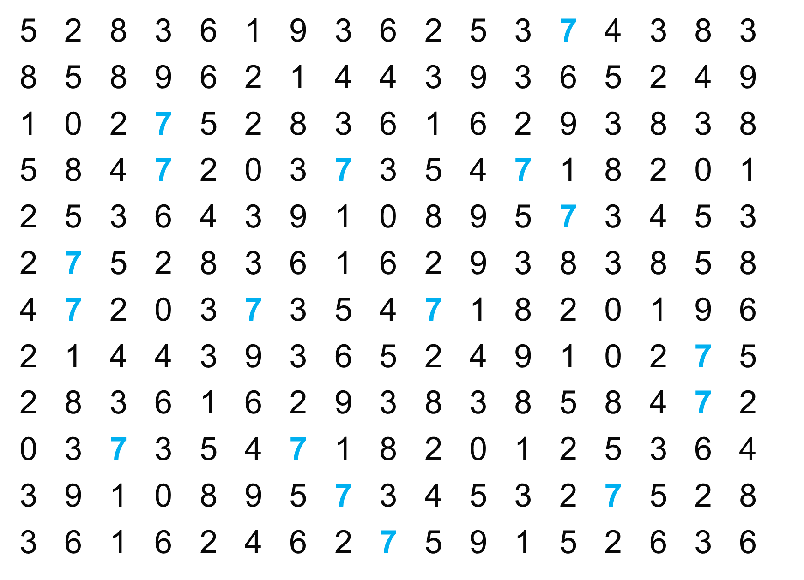
Notes:
“And now? Making it bold is easier.”

Slide 36
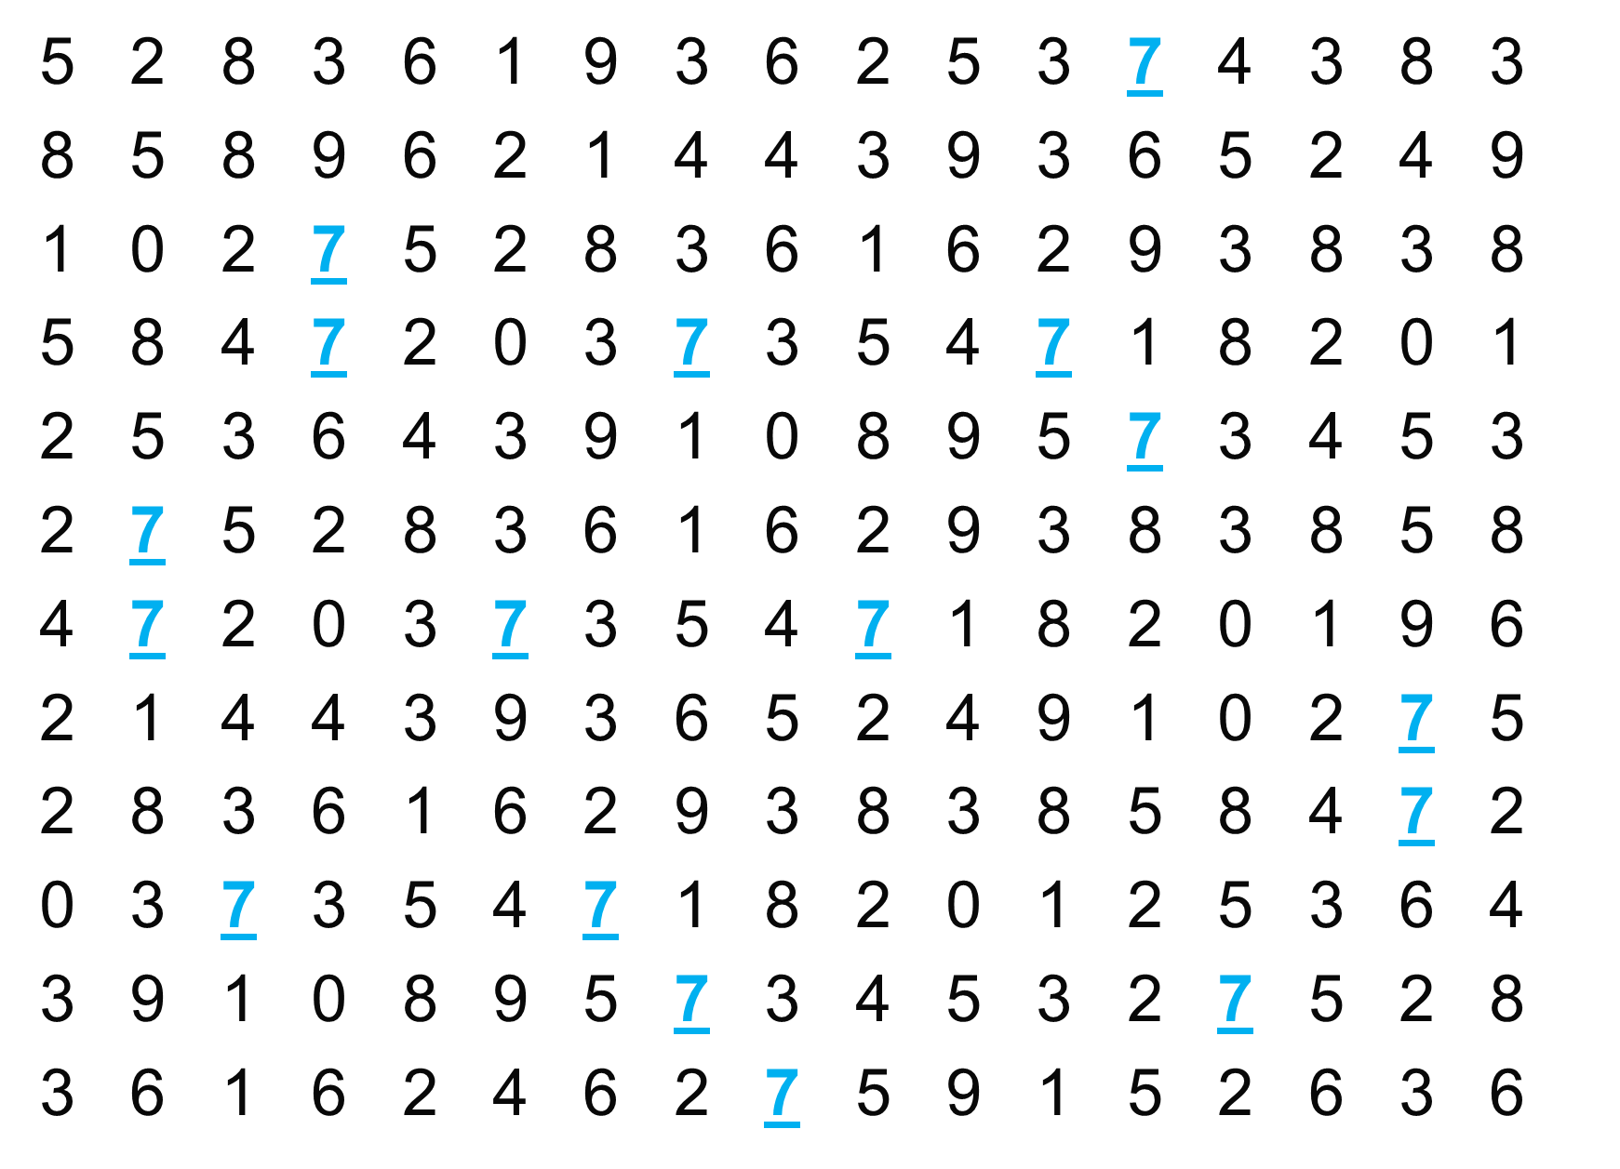
Notes:
“And underlining them.”

Slide 37
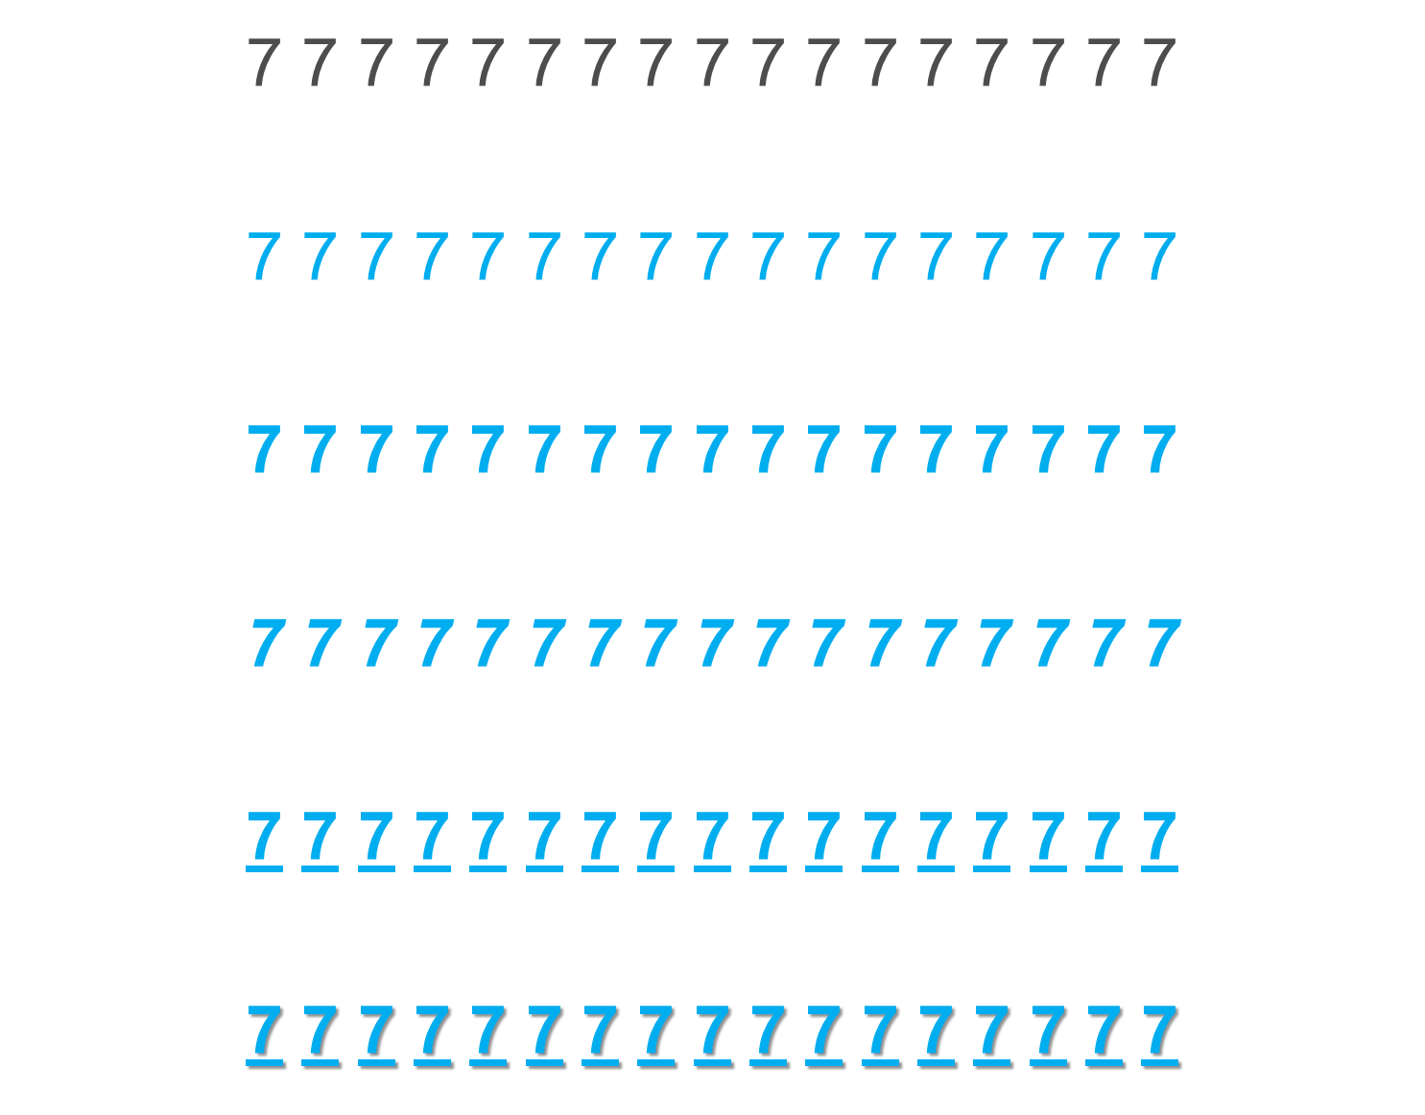
Notes:
“We can do all sort of things to make the sevens easier to see. What we are doing is using the preattentive attributes.”

Slide 38
preattentive Magic
The use of preattentive attributes is a shortcut to building understanding.
We can utilize visual attributes to guide a reader’s attention.
We can do so without forcing them to consciously think about it – no stress!
Doing this well can make reading complex visualizations feel more effortless.

Slide 39
The Building Blocks of Data Visualization

Slide 40
We are born with an enhanced visual path to cognition
Approximately 70% of sense receptors are in our eyes
40% of the cerebral cortex is involved in processing visual information
The visual connection to the brain has more bandwidth than other paths
Visual perception is intimately connected to understanding
This is reflected in language
- “I see what you’re talking about…”
- “Sketch out the idea…”
- “Seeing is believing…”

Slide 41
Our brain is powerful… but working memory is limited
Long-term memory is very important
Working memory limited to a small number of “chunks”
I’ve heard people can typically remember 7 +/- 2 things, but I don’t have a citation.
Visualization allows us to consolidate complex statistics so we can process more data simultaneously (seeing the forest along with the trees)
The picture is not the end goal – It’s what we do with it that is important

Slide 42
Making sense of our visual world…
Shape
Orientation
Color
Texture
Value
Size
^{We}
…and the two planar dimensions (x and y) which are encoded in Position and Order.
Based on the contemporary preponderance of digital technology, these factors have also become critical:
Motion – animated presentation of frames of data
Medium – the physical strata on which data is displayed
Context – the sensory and emotional environment

Slide 43
Use our PreWiring
We are prewired to digest things visually, notably:
Shape, Orientation, Color, Texture, Value, Size and Position (x,y).
Also - Motion, context, and medium.
All of these things are what we can control in a tool like Tableau.
Take in large amounts of data.
Process, filter, organize it to get the valuable bits (info, knowledge) out.
Present that data in a way that is digestible by the user.
Use visual attributes to make that as easy and low effort as possible.

Slide 44
Some Data
Notes:
Shape is a preattentive attribute. Notice in these examples we also see the Hermann Effect with the scintillating grid.

Slide 45
Shape
Notes:
It’s easy to see the different shapes. This could be useful for categorical comparisons, but would not be useful for a quantitative comparison.

Slide 46
Color (Hue)
Notes:
We can draw the reader’s attention or alert them to something important.

Slide 47
Changes to the HUE (color)
Changes to the SATURATION (intensity)
Changes to the Value (brightness)
Notes:
Color is more than just color hue. There are many different color models.
RGB: Red, Green Blue which was maps these colors to the color receptors in the eyes
HSV: Hue, Saturation and Value
HSL: Hue, Saturation and Lightness
RGB, HSV and HSL are all very common color models in computer graphics.

Slide 48
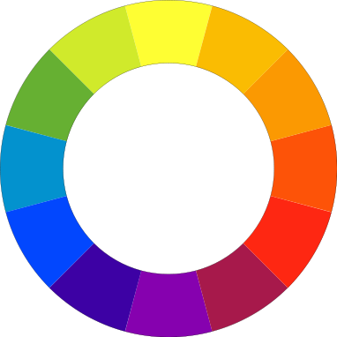
Notes:
“Does anyone know what this is called?”
“This is called a color wheel”
This is actually a RYB, a subtractive color model The primary colors are red, yellow and blue.
The secondary colors are green, orange and purple, which are created by mixing two of the primary colors.
There are then six tertiary colors which are created by mixing the primary and secondary colors together.
The color wheel can also be divided into cool and warm colors.

Slide 49
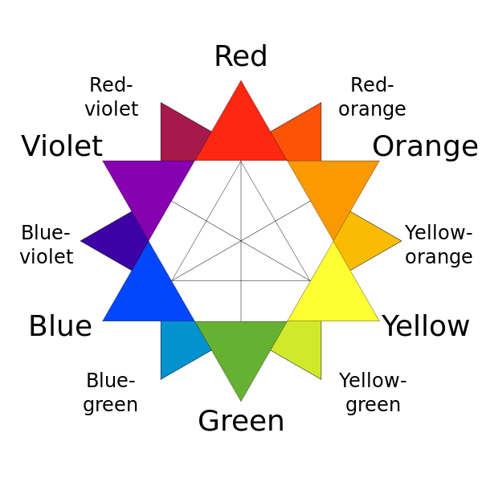
Relationships on a Traditional Color Wheel
The primary colors are red, yellow, and blue. Classical painters would have used this arrangement to find compliments.
Notes:
“This is a variation of the color wheel. Colors across from each other are complimentary colors and colors next to each other are analogous colors.”

Slide 50
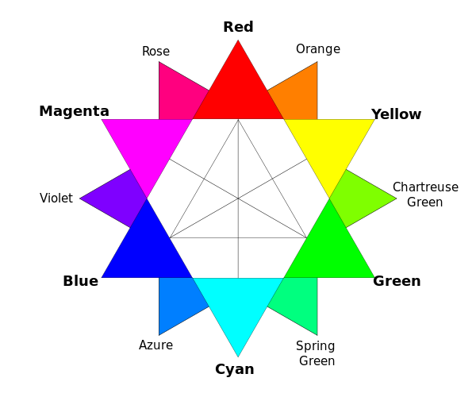
Relationships on a RGB Color Wheel

Slide 51
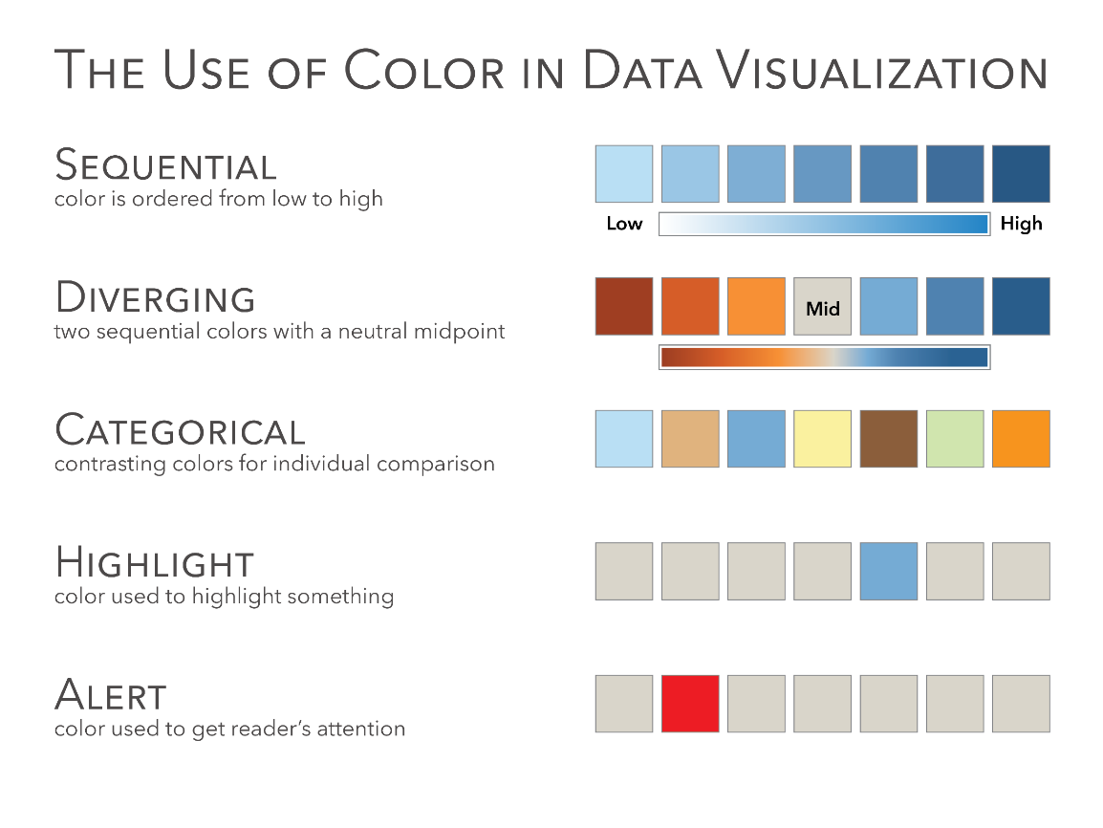
Notes:
“One of the most frequent mistakes in data visualization is the use of color. This is one of the most important slides we will cover in the entire course. It will be very important for you to know this slide, not only for the test questions, but also for your work through the course and in your future data visualization work.
The three primary ways you will use color in data visualization is Sequential, Diverging and Categorical.
Sequential color encodes a quantitative value from low to high. A great example of this is Sales, which goes from zero to infinity.
Diverging color encodes a quantitative value but has a midpoint. The midpoint could be zero, for example, displaying Profit. Profit can be positive, encoded in blue with darker blue higher profit. Profit could also be negative, encoded in orange with the darker orange showing a bigger loss. The midpoints does not have to zero. It could be the average, where it shows the average unemployment rate in the country and then one color showing the states below the average and the other color above the average. It could also be a target value, such as last year’s sales or this years projections and the two colors would encode values above and below that target.
Categorical colors encode categories. Apples, bananas, oranges, pears, or shoes, socks, shirts and ties. It would be very difficult to use a sequential color scheme for categories and trying to figure out which shade of blue means shirst or pants.
A Highlight color is used to highlight one data point or category. For example, if you have 50 lines, each representing one state, then you might highlight one state. This allows the reader to see for example California versus all of the other states.
Alerting colors are used to draw the readers attention, similar to Highlight, but in this case it’s done with an alarming or alerting color to tell the reader that something is wrong. It needs the readers attention. Note that in Western culture that red is often associated with bad. This may not be the case in other countries (ex. China). Bright alerting colors could be red, orange or yellow.

Slide 52
Texture
Notes:
This might be one to just keep in the back of your mind. It could be useful to encode categorical data, but not quantitative data.

Slide 53
Size
Notes:
Notice that it’s easy to see that the one square is smaller than the others, but it’s hard to quantify that amount. Is it one third the size? Or one fourth? [it’s neither]

Slide 54
Position
Notes:
Notice when using position that we can see even the smallest differences between the squares. Which square is positioned further to the right?

Slide 55
Orientation
Notes:
Similar to shape, this could be useful to show a categorical comparison or as a directional icon. For example, an arrow pointing up could mean something has increased and an arrow pointing down could mean something decreased.

Slide 56
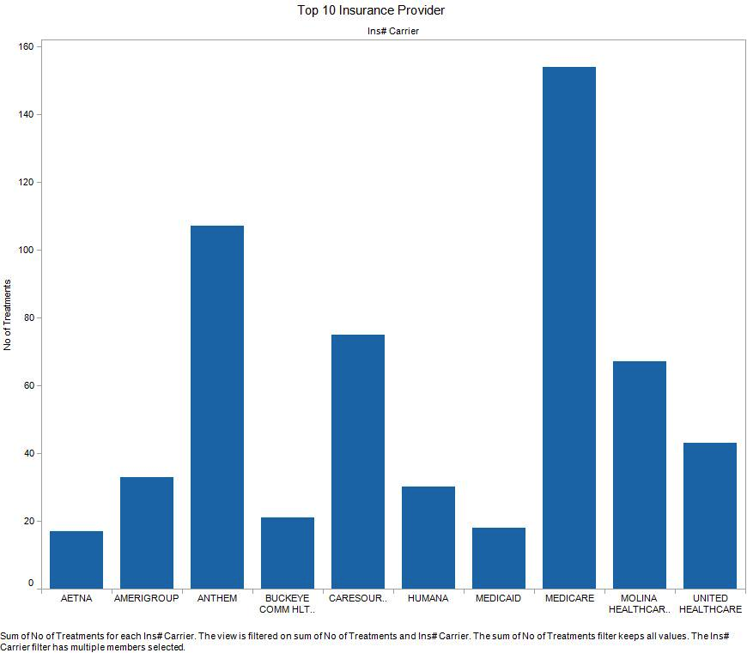
Order
Notes:
This chart is ordered alphabetically. Notice how hard it is to answer these questions quickly and accurately.
What is the top provider?
What is the bottom provider?
What are the top three providers?
What are the bottom three providers?
What rank is Humana?

Slide 57
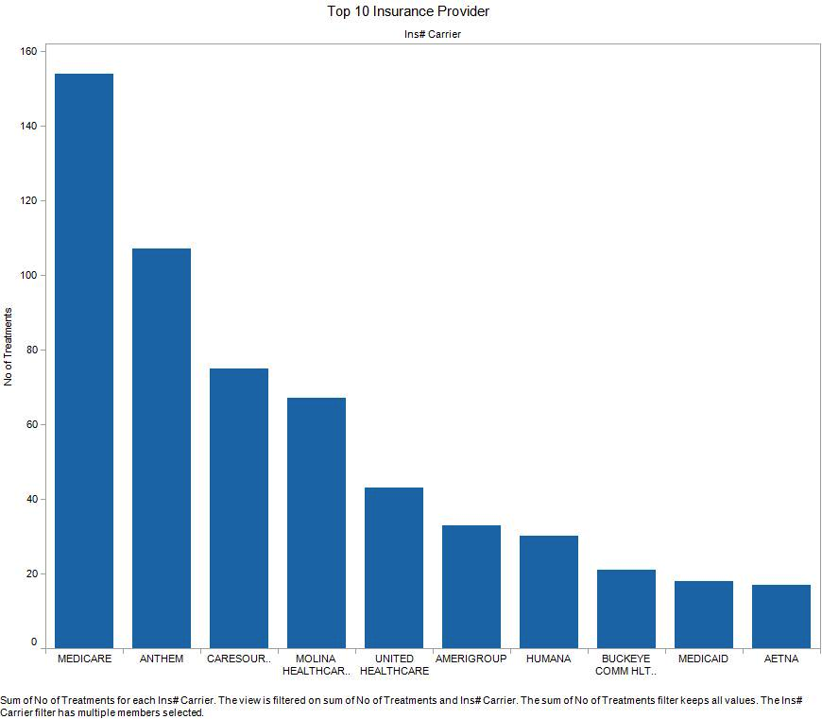
Order
Notes:
Now we order the chart based on the data and ask the same questions.
What is the top provider?
What is the bottom provider?
What are the top three providers?
What are the bottom three providers?
What rank is Humana?
We can answer all of these questions much more quickly and more accurately.

Slide 58
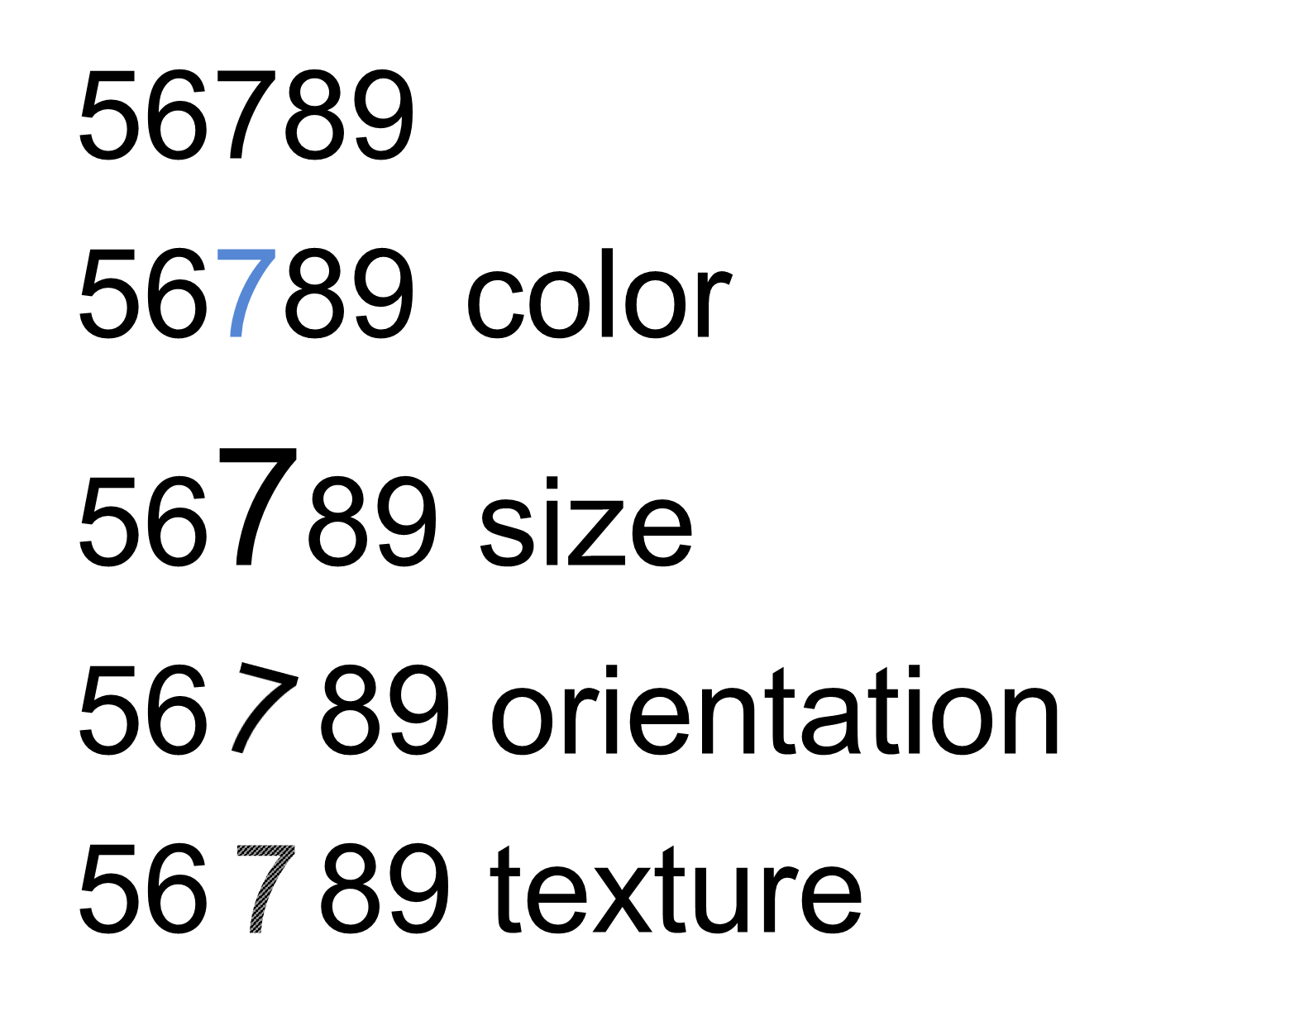
What can We Manipulate?
Notes:
“Things like color, size, orientation and texture are preattentive. It means the brain processes the information prior to focusing attention on anything. This happens in about 250 milliseconds.”

Slide 59
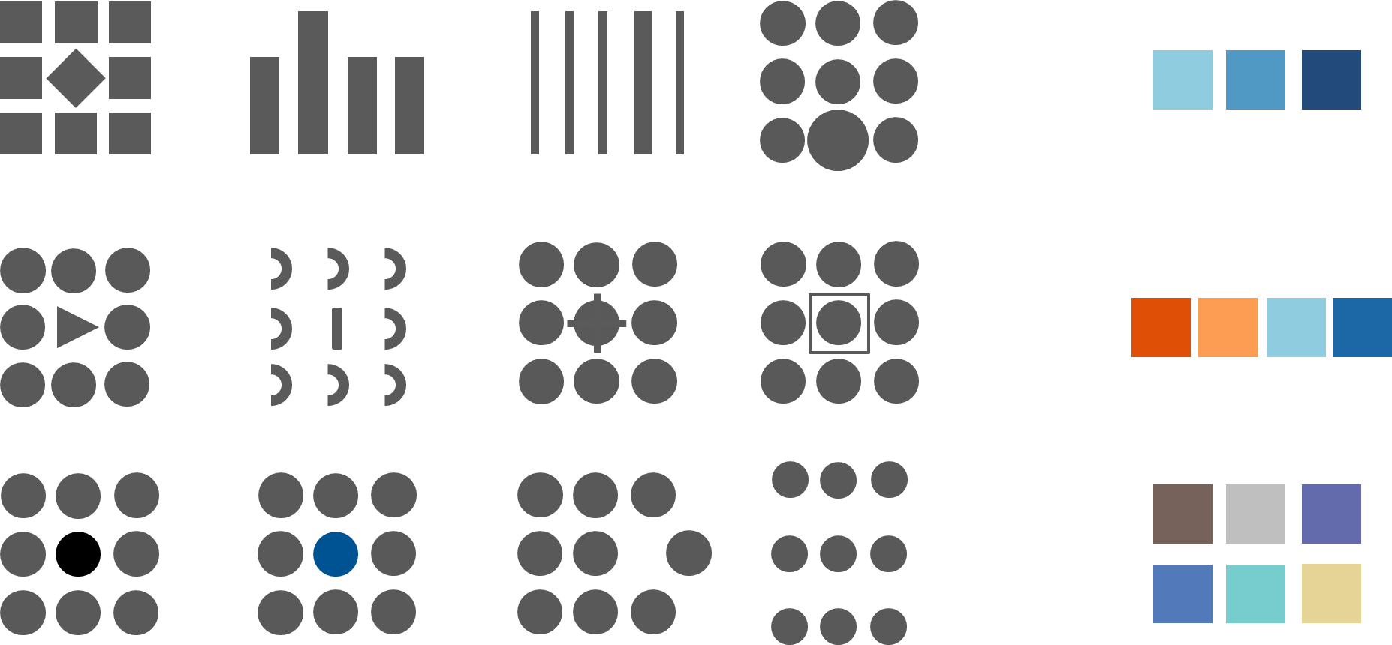
Preattentive attributes of visual perception and use of color
Notes:
“One the left we see a number of different preattentive attributes and on the right we see different ways to encode color. We can’t help but see these things immediately before processing any other information.”

Slide 60
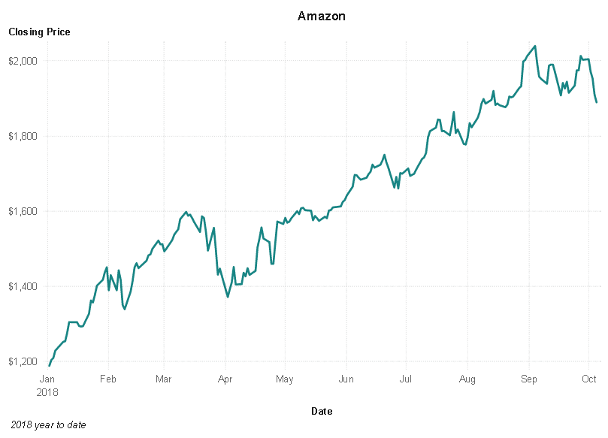
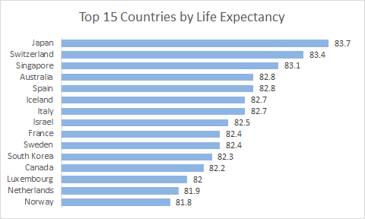
If we do a Good Job, Meaning is Clear

Slide 61
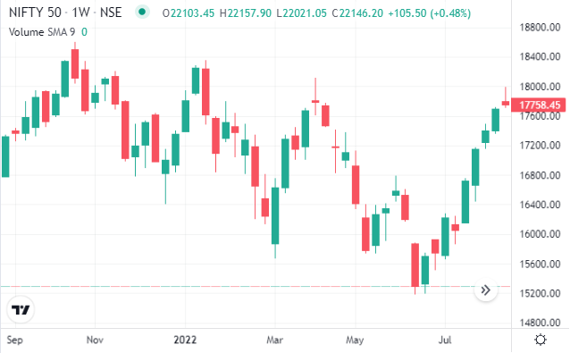
Even as we Add Complexity

Slide 62
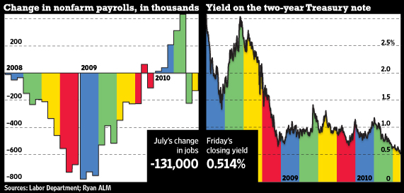
If we do A bad Job…
From http://online.wsj.com - The Wall Street Journal Online, originally published August 7, 2010
Notes:
[ask the class what does color represent. It represents quarters]
Is this the best way to encode color in the data?

Slide 63
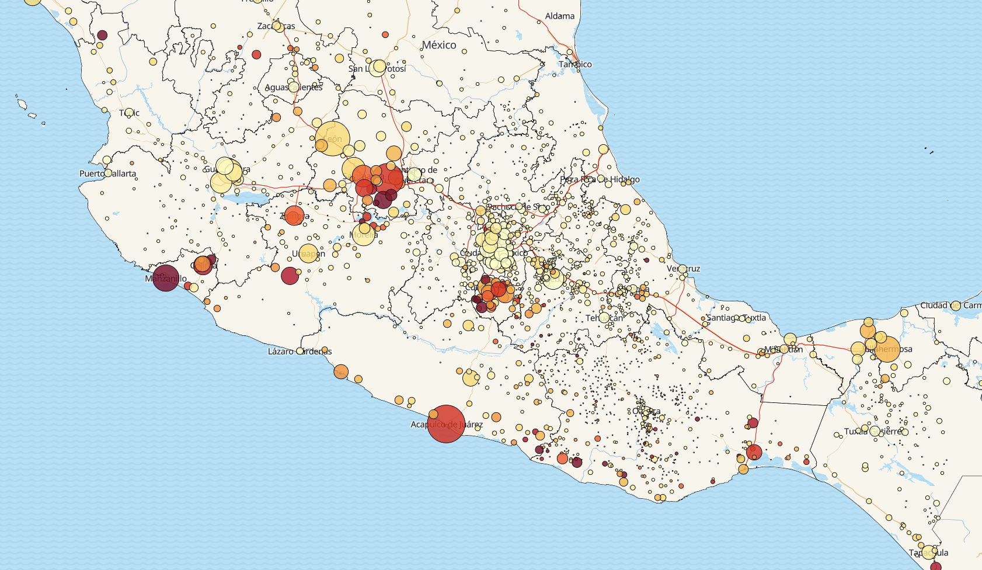
Data Density
These attributes can be used to add density to a visualization.
We can make a chart contain more data than it does in its ‘raw’ form.
Each attribute can represent some variable.
This can make our charts more ‘efficient’.
Density is good, as long as it helps.
Must be clear, relevant, and useful to reader.
Need to be careful to not just use because it is there.
Visualizations can be more flexible in usage.

Slide 64
In Tableau
What would a user of this visualization need to know?
Do I have data needed to show/generate that information?
What is the easiest way to present that information?
Bar chart, map, scatter plot, etc…
What ‘other stuff’ can I use to make things more clear?
Attributes like color/size/shape.
Features like filters, animation, etc…
There’s no set answer, there are good guidelines though…
You can say something with many different words, you can show it with different charts.

Slide 65
The TablAsics
Tableau makes charts and graphs out of data sources.
We need to:
Source and prepare data.
Make sense of it – what do I need to know from this data? Information and knowledge.
How can I show that in charts/graphs?
What can I use to make it better – more dense, lower friction, more clear – preattentive attributes and other features like animation.
Only the last two points are Tableau – the others are just thinking.

Slide 66
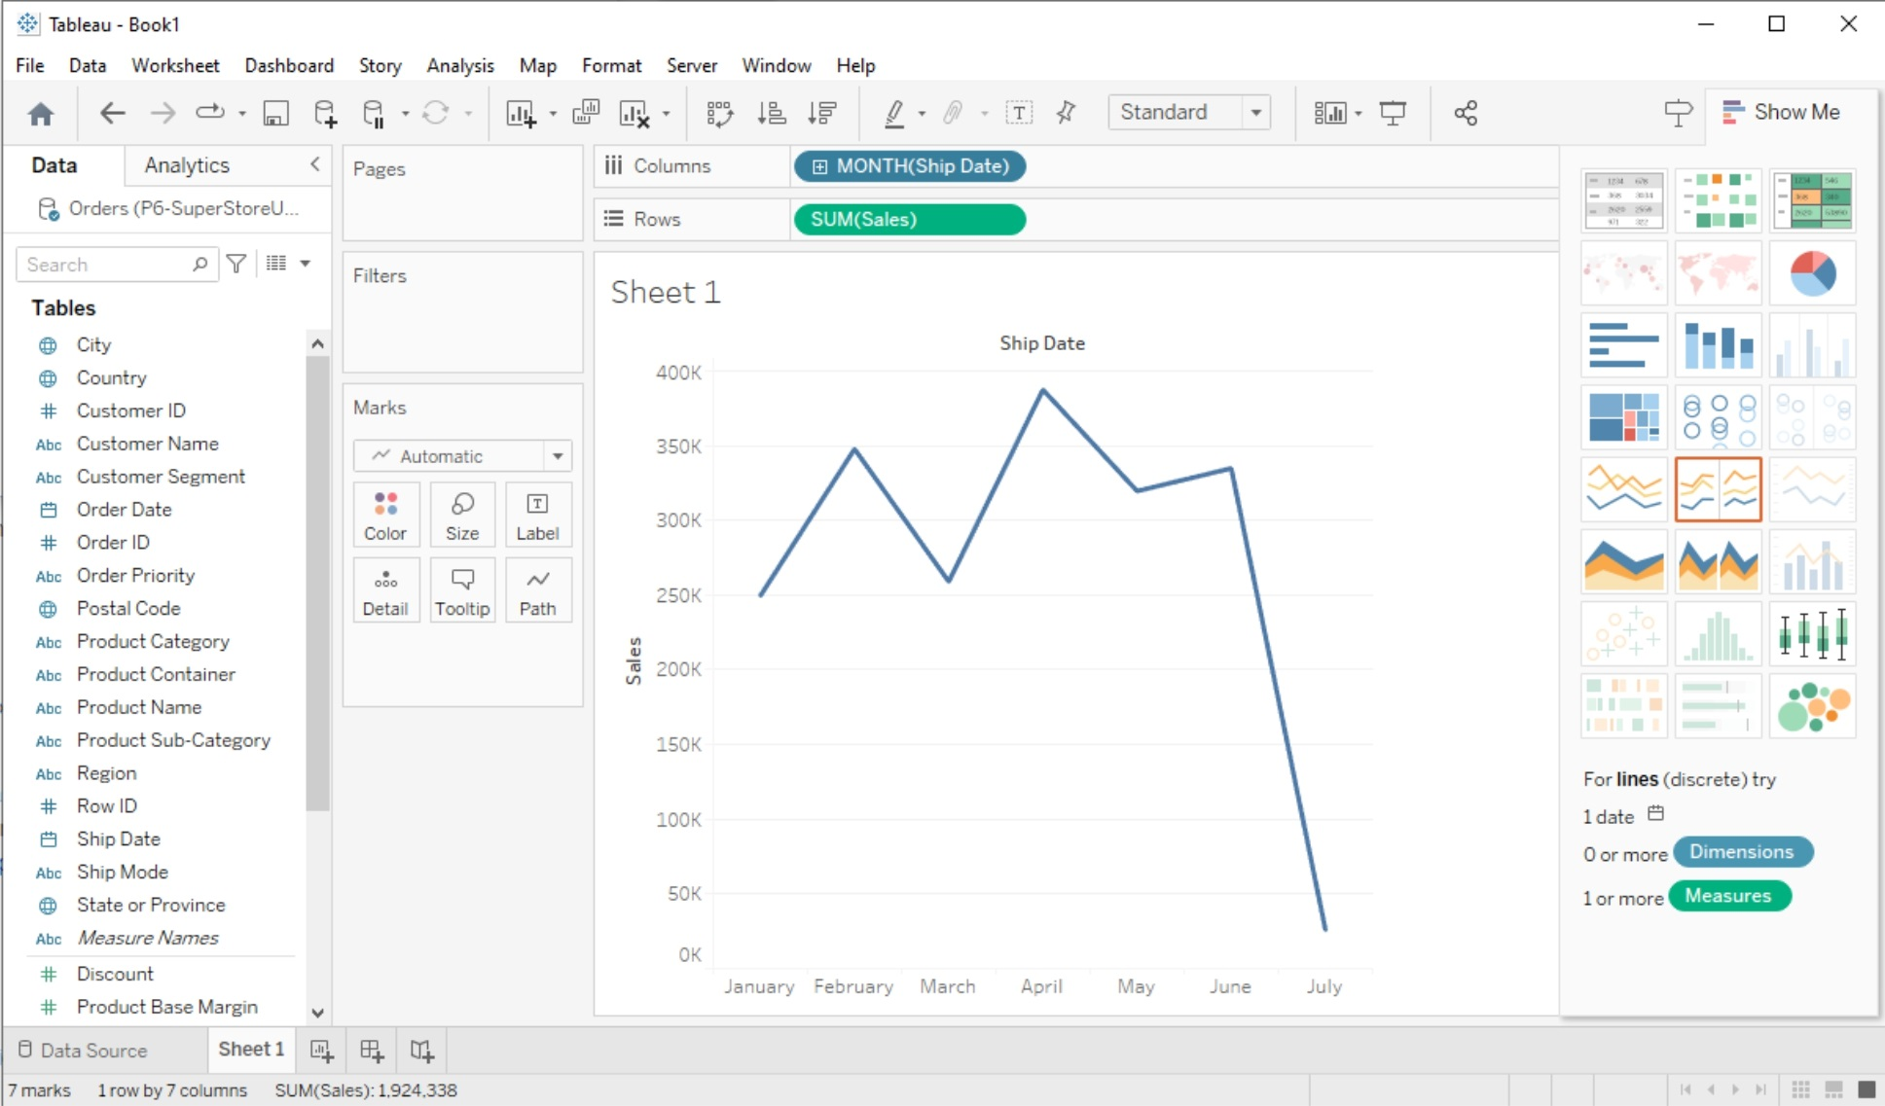

Slide 67
Conclusion
Visualization is a tool to make it easier to present and understand data.
Our visualizations can transform raw data into charts that present info and knowledge in an understandable way.
Tableau is one of several visualization tools that makes this convenient.
We are communicating, just using charts instead of words.
We want to make sure we say what we intended.
We can manipulate attributes to help us do that.

