Slide 1
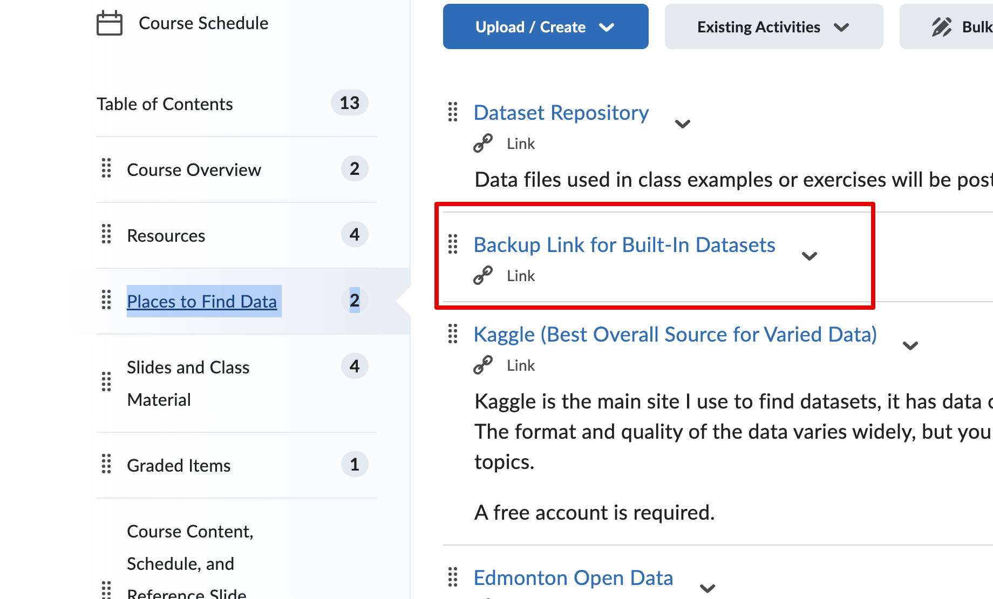
Housekeeping
Today:
Chapter 5 – chart types.
Reach chapter 5, it is very short.
Look at visual vocabulary.
Some more tableau fun!
Filters and counts.
Load external files.
Basic data prep/exploration.
Aggregation, data types, and filter basics.
After this you should be able to start on some of the practice assignments (they’re roughly in order of complexity).

Slide 2

Tableau Certifications
You can probably do 90%+ of the first level Tableau cert by the end of the semester if you feel ok in Tableau.
I did it a few years ago
The certification structure was a bit different.
It is pretty easy.
There was lots of “where is this in the menus…”.
It is probably worth it if you feel you can.
Especially if not an IT-ish person.
Lots of roles/enterprise software involves normal people doing Tableau-like reporting.
Most others are probably incompetent at it, so its an opportunity.

Slide 3
Types of Visualizations

Slide 4
Reducing Friction in Tableau
Tableau has the ability to take in large amounts of data and produce nice visualizations.
We can use the tools in Tableau to make the key info visible.
We have many different types of charts and graphs.
All use some basic concepts of visualization, starting with preattentive attributes.
Things our brain notices and starts to process without conscious thought.
E.g. you see a lion moving out of the side of your eye, you can react immediately.

Slide 5
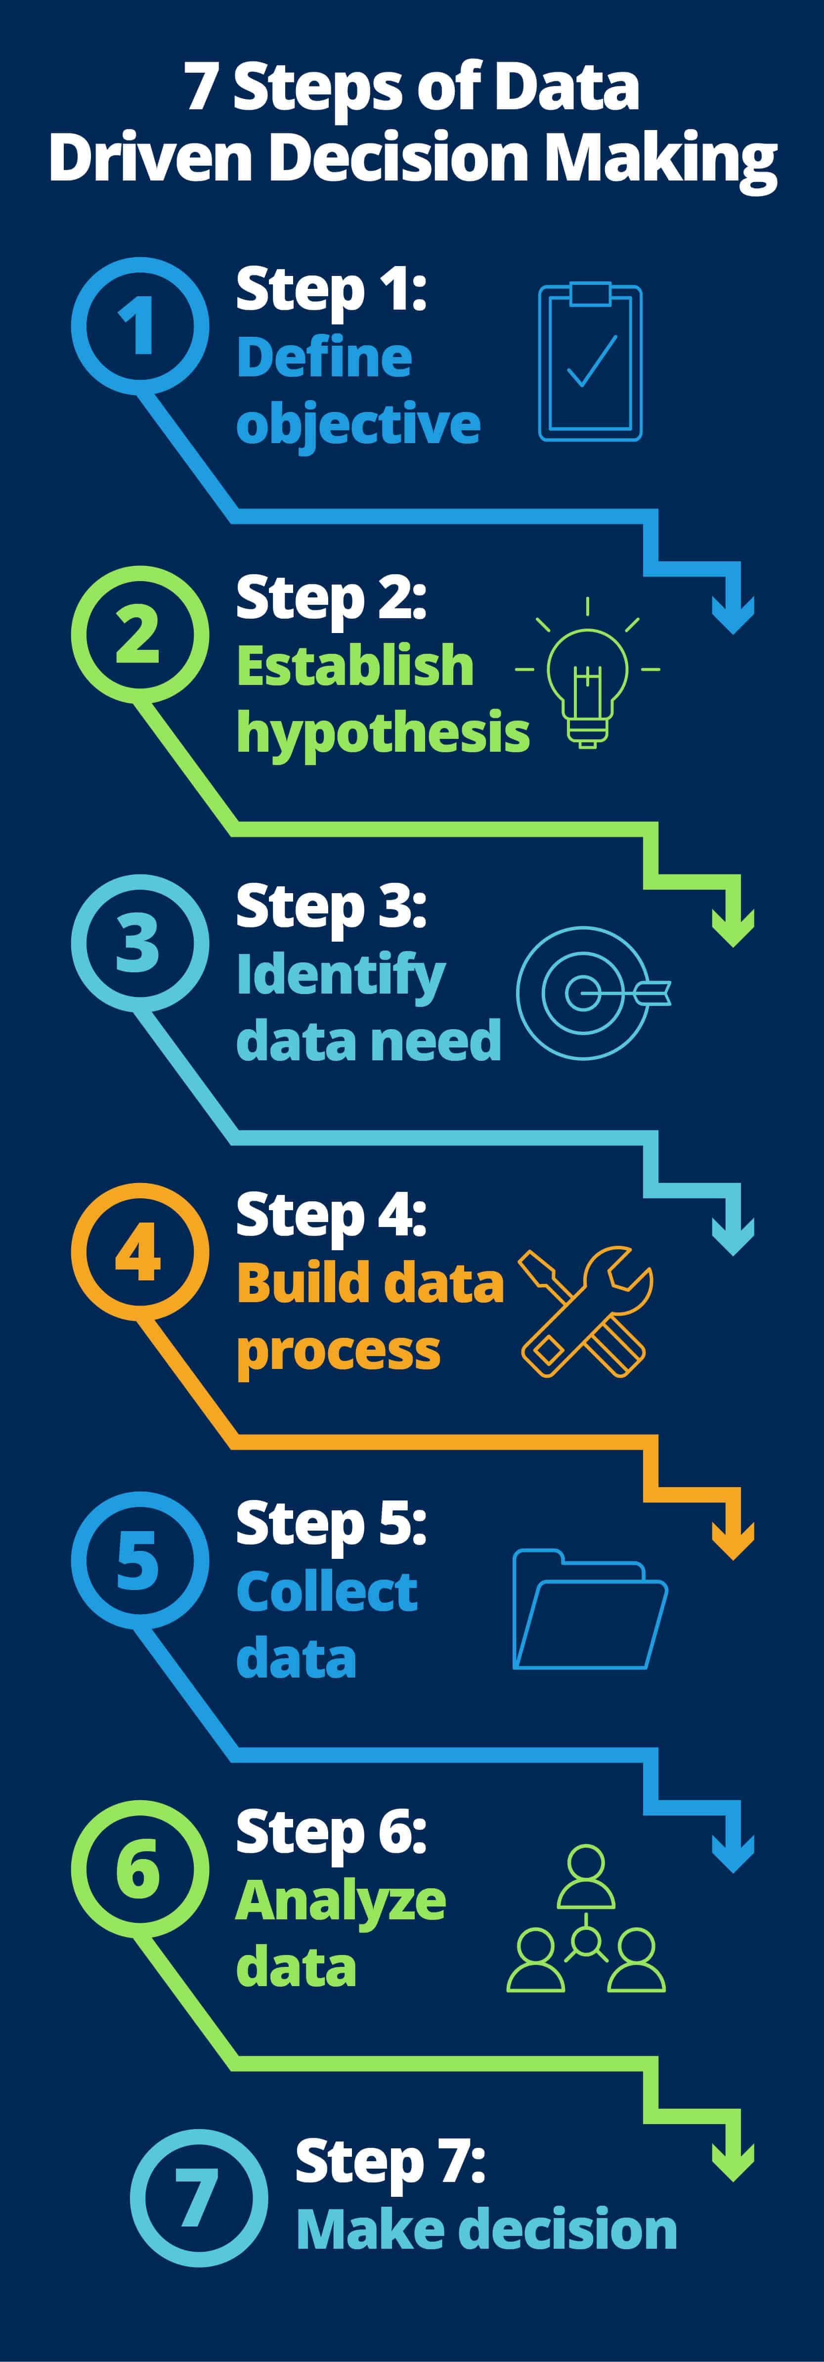

Slide 6
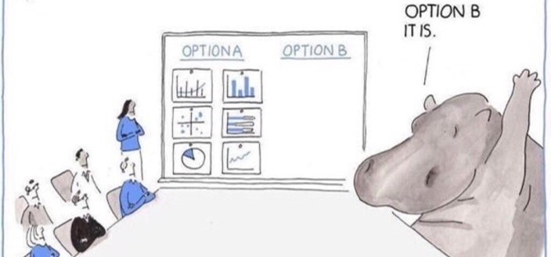
Data Over HIPPOs

Slide 7

A (Brief) History of Visualization

Slide 8
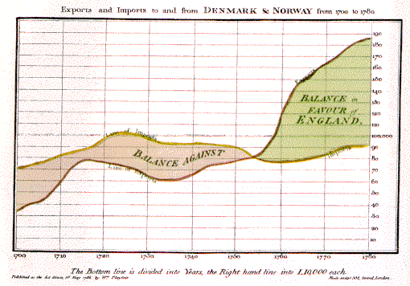
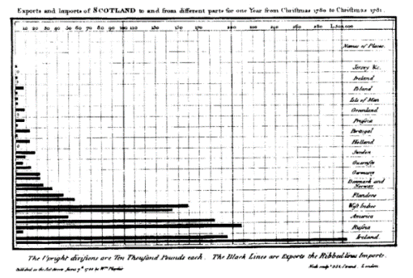
Late 18th – Early 19th Century
William Playfair (1759-1823)
Scottish engineer and political economist⁵
Founder of graphical methods of statistics
Developed new designs and improved existing methods to provide “systematic visual representations of his ‘linear arithmetic.’”⁶
Created the time-series line graph, bar chart, and pie chart.⁷
Images used under the Wikipedia Creative Commons license. http://www.wikipedia.com
Notes:
William Playfair (22 September 1759 – 11 February 1823) was a Scottish engineer and political economist, the founder of graphical methods of statistics.

Slide 9
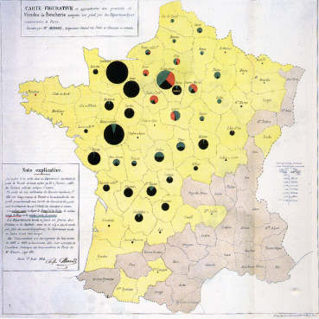
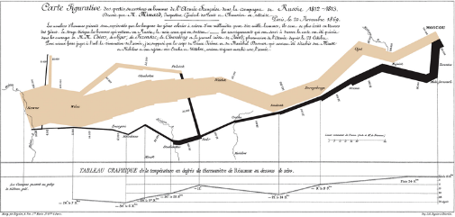
Early 19th Century
Charles Minard (1781-1870)
French civil engineer; produced an array of graphics that combine a many data points into a compelling visual story
Produced 70+ depictions including thematic maps and graphic tables between 1844-1870.⁷
Map of Napoleon’s Russian campaign regarded by some as the “best statistical graphic ever drawn.”⁸
Images used under the Wikipedia Creative Commons license. http://www.wikipedia.com
Notes:
We will discuss the map of Napoleons March in later slides.

Slide 10
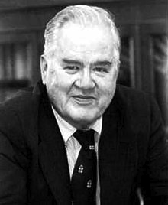
20th Century
John Tukey (1915-2000)
American statistician
Introduced the box plot in Exploratory Data Analysis, published in 1977
Exploratory Data Analysis (EDA) emphasized presentation of the main characteristics of a data set in a visual, easy to understand form, without using a statistical model or hypothesis¹⁰
Images used under the Wikipedia Creative Commons license. http://www.wikipedia.com
Notes:
John Tukey was an American Statistician who worked at Bell Labs. He developed and wrote about Exploratory Data Analysis or EDA. He advocated for showing data in a visual manner as an easy way to understanding, with the need for a statistical model or hypothesis. He invented the box plot, also known as the box and whiskers plot, and also wrote about other plots such as the bag plot and violin plot.
Tukey also coined the term “bit” as a contraction of “binary digit”

Slide 11
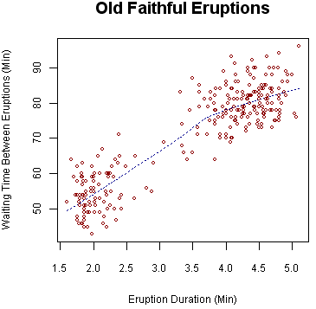
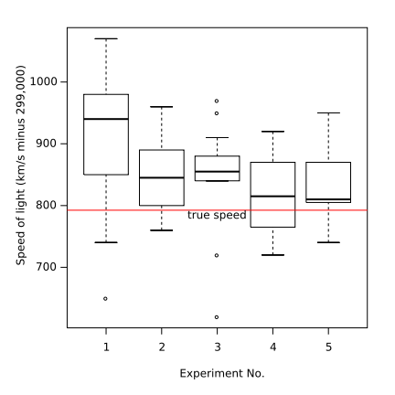
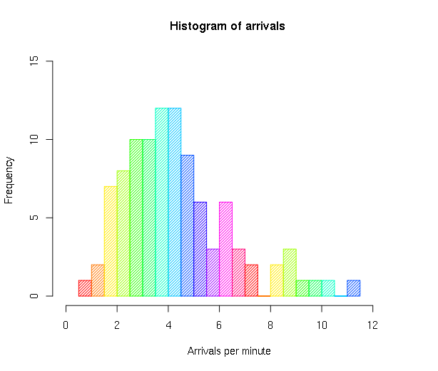
20th Century
Visualization techniques used in EDA include:
Box plot
Histogram
Pareto chart
Scatter plot
Computers set off massive increases in visualization usage and capability.
Sample histogram.
Sample box plot.
Sample scatter plot.
Images used under the Wikipedia Creative Commons license. http://www.wikipedia.com
Notes:
In Exploratory Data Analysis, Tukey used visual techniques such as the box plot, histogram, Pareto Chart and Scatter Plot.

Slide 13
A Picture is Worth a Thousand Words…
A primary reason we use visualization is to make it easier to process data.
We can compare sales totals in a bar graph far quicker than we can read and compare numbers.
We can spot a trend in a stock price easier on a line chart than reading a thousand daily numbers.
Modern companies/scenarios can have a lot of data to deal with.
Visualization reduces friction – it is easier to consume data.

Slide 15
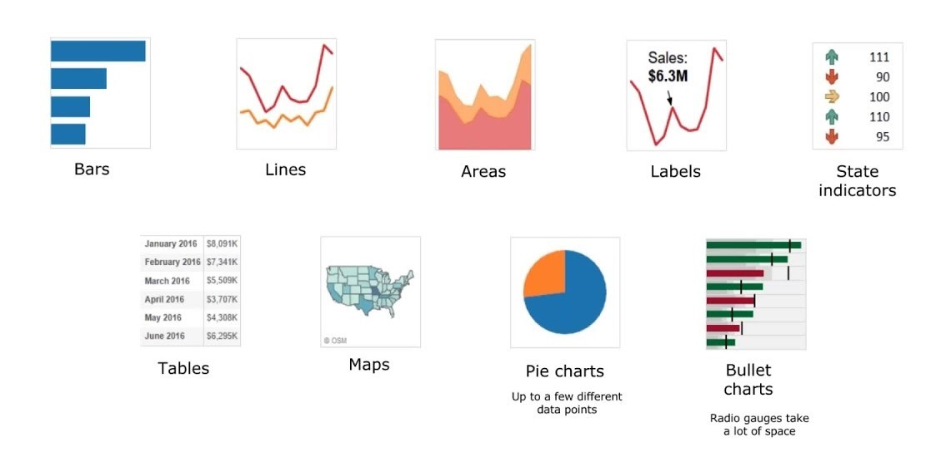
Visualization Choices
Depending on the data and what you need to show, there are many different types of charts that may be useful.
With modern tools we can also make a large number of variations on these charts, and create new ones – sometimes easily, sometimes not.

Slide 16
Choosing Visualization Types
Recall the visual vocabulary, it gave us good examples for common things.
The #1 priority is clearly communicating.
Start with something that we know works.
Add additional stuff (density, features…) incrementally, making sure it still makes sense.
Make large departures only when you can be sure it works.
Doing totally new, creative things might be brilliant.
The farther you depart from the standards, the higher the risk is of it being terrible.

Slide 17
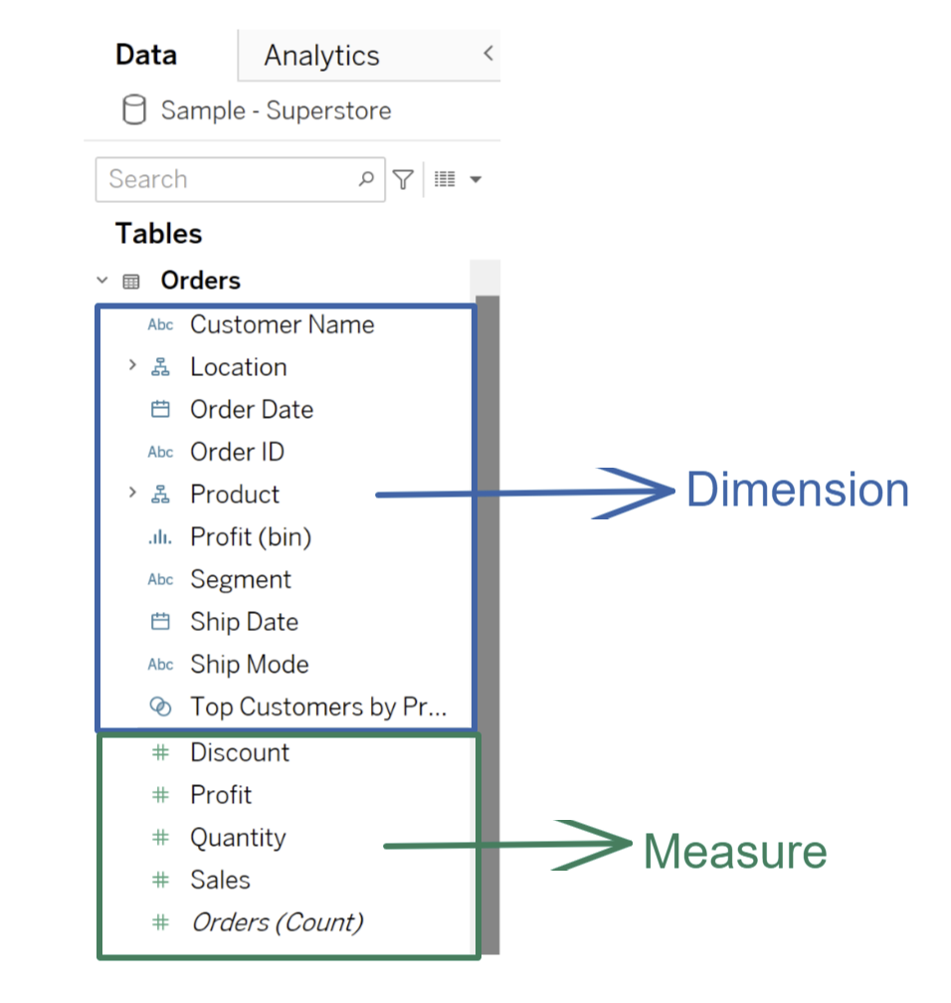
Keep in Mind… Data Type
We’ll cover stats and more details on this next week.
Tableau splits data into two big types:
Dimensions (discreet) – qualitative data. Groups. Names. Labels. E.g. hair color, job, degree major.
Measures (continuous) – quantitative data. Measurements. Numbers. E.g. cost, sales, temperature.
We can convert with a right click.
If it makes sense on a number line, it’s a measure (usually).
Can you add, compare, divide, etc… with a value?

Slide 19
Arbitrary Thing You Need To Know Update
This stuff kind of has a large amount of stuff you need to know up front for it to make sense.
We need to just memorize a few things before diving into the details soon.
Recall the first from last time – data types:
Categorical (dimensions) – qualitative. Group names, labels, descriptors.
E.g. hair color, hometown, degree major, etc…
Numerical (measures) – quantitative. Measurements, values, metrics.
E.g. bank account balance, height, population, etc…
Things that make sense on a number line.
Note: these definitions are slight simplifications.

Slide 20
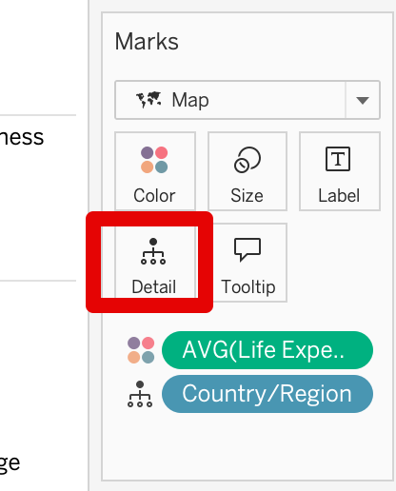
Aggregation Level
We generally need to pay attention to how data is split/grouped, or aggregated.
Sometimes we show unaggregated data – one mark per row.
The ”Details” card shows us what the data is aggregated by:
I.e. we get one mark per whatever is in that card.
In the picture we get one mark per country.
This happens implicitly when we assign color.
This is important, easy to get wrong, and generally not how people think.
I’ll probably not shut up about it, it does get easier over time.
Ask, “I want one mark per…. What?” – include time (per month/year).
There can be more than one level of aggregation, e.g. per person per year.

Slide 21
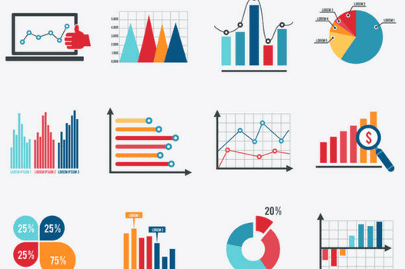
What do you need to Say with that Data?
If we have some value (sales, covid deaths, count of people with each hair color) shown in a plot, we need to think of what we want someone to see from that data.
Do I want to compare the sum of sales for each store, or look at the trend of sales over months?
Or do I want to see the share of sales for each product type?
Also consider the precision needed.
Do you need exact sales, a ranking, a general idea of “bigger”, etc…
Depending on what we want to examine, different charts will help.

Slide 22
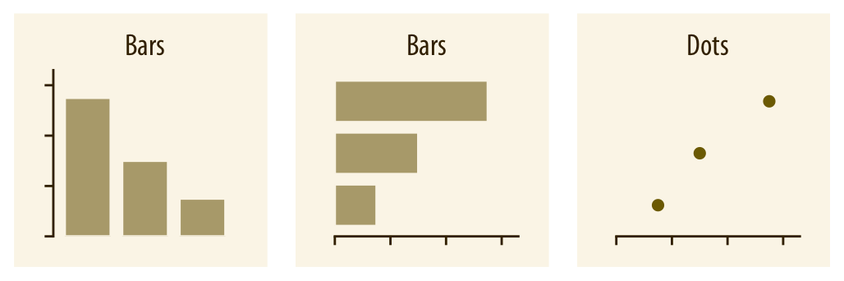
Comparisons
When comparing values, we likely want something that is a bar chart or some derivative.
E.g. replace bars with some other mark.
Position/length communicates main value.
Ordering is usually good.
Consider orientation – readability and logic.
Labels and headers might make more sense one way.

Slide 23
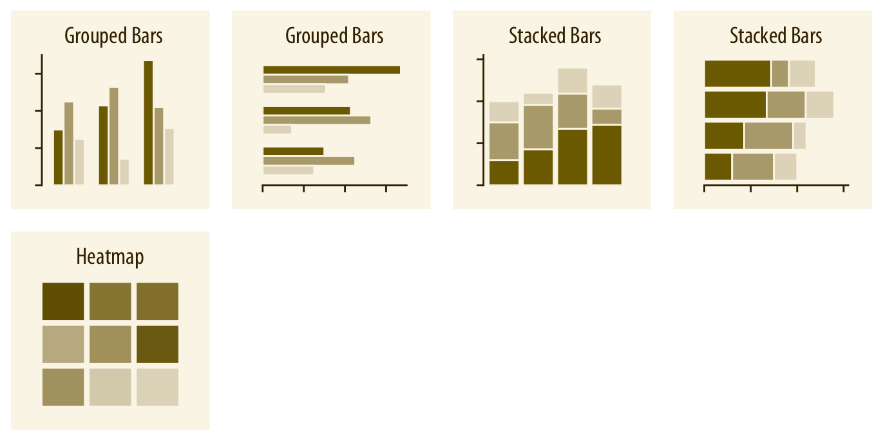
Multi-Comparison
We can also compare multiple things at one time.
Stacked or group bars, or alternate marks.
Color or shape separates one group from another.
Think of what comparisons someone needs.
Can they compare the things they need to easily?
What is the primary thing?
Is combining things like this helpful?
Filters and interactivity (later) may help here…

Slide 24
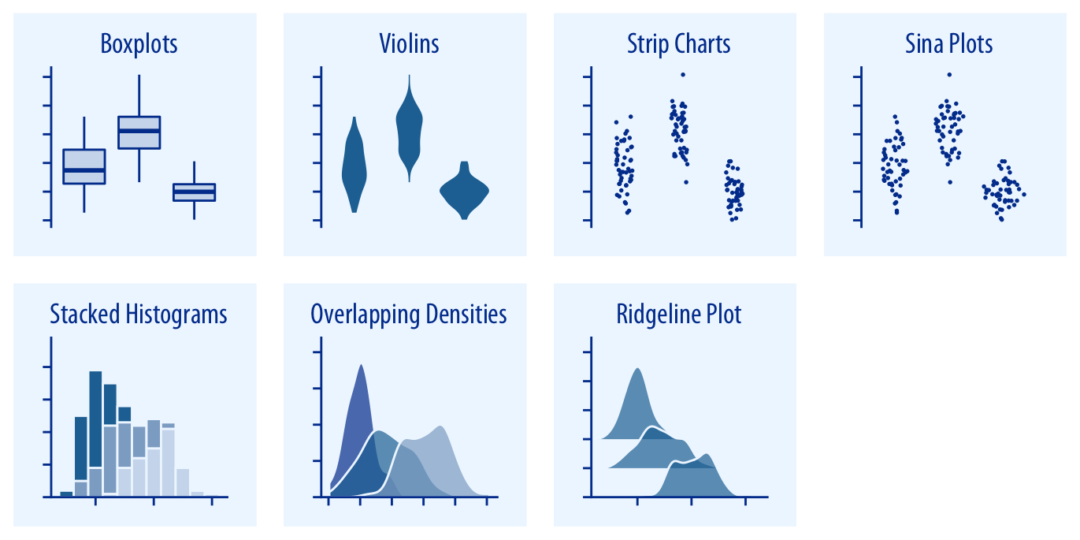
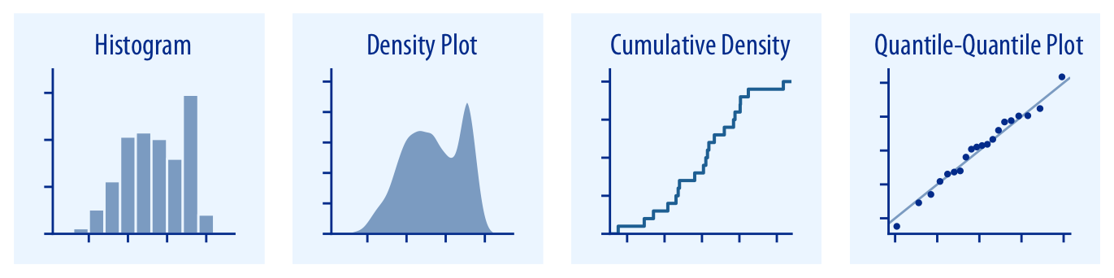
Distributions
A distribution is just a description of where along the range values fall.
E.g. if someone’s height can span from 4’6” to 7’7” or so, where along that are people?
Distributions are important in inferential stats.
Helps us to generalize and predict.
Common for comparisons – split data into M/F, compare income distributions.

Slide 25
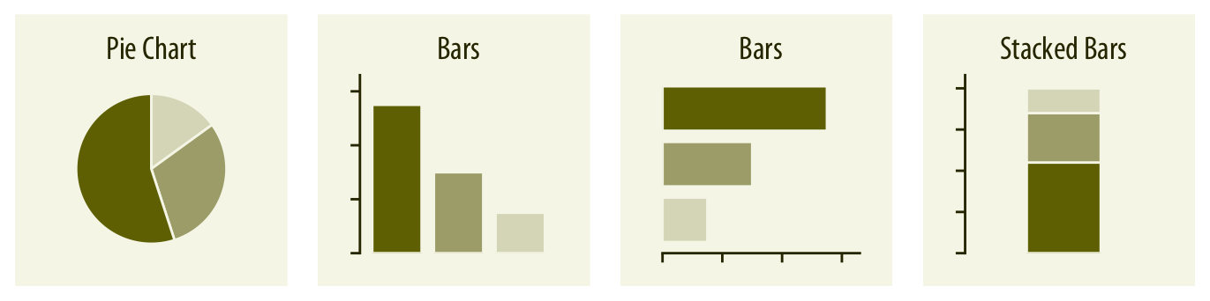
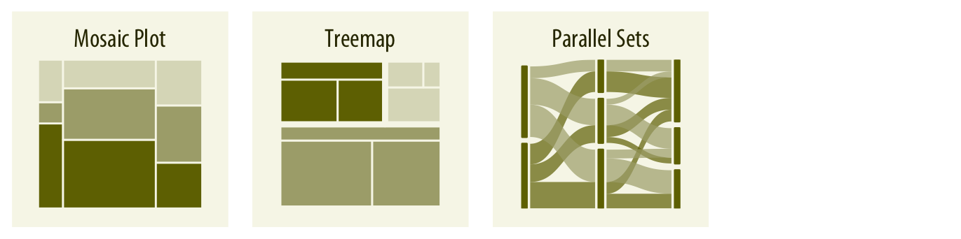
Proportion/Share
Several charts can show ”share of a whole”.
A pie chart is the classic, but it is almost always terrible.
Differentiating between small slice sizes is impractical.
A treemap is better – rectangular pie chart.
What’s most important?
Proportion of whole or relative comparison?
Do specifics matter or only general estimate?
Always consider otherizing infrequent things…

Slide 26
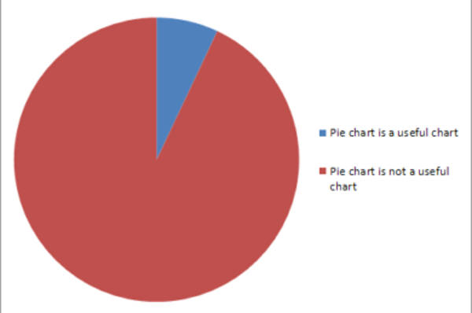
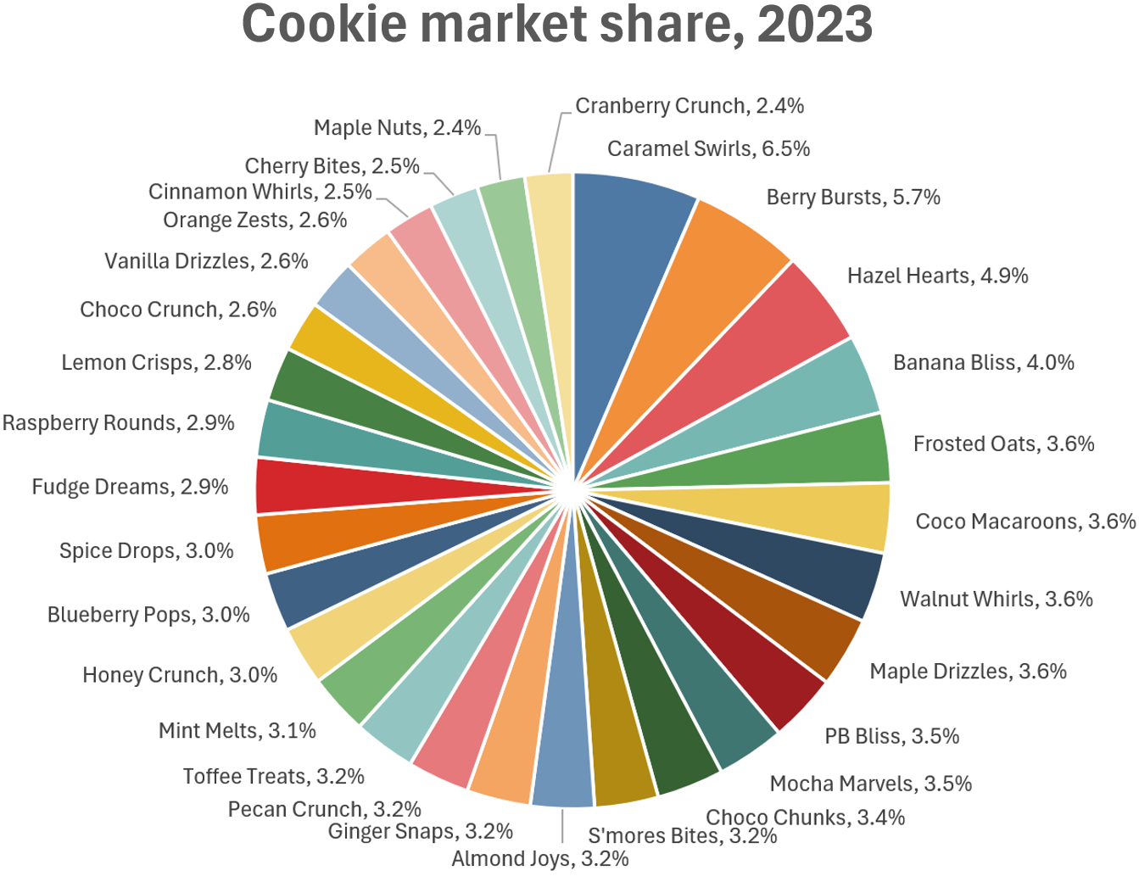
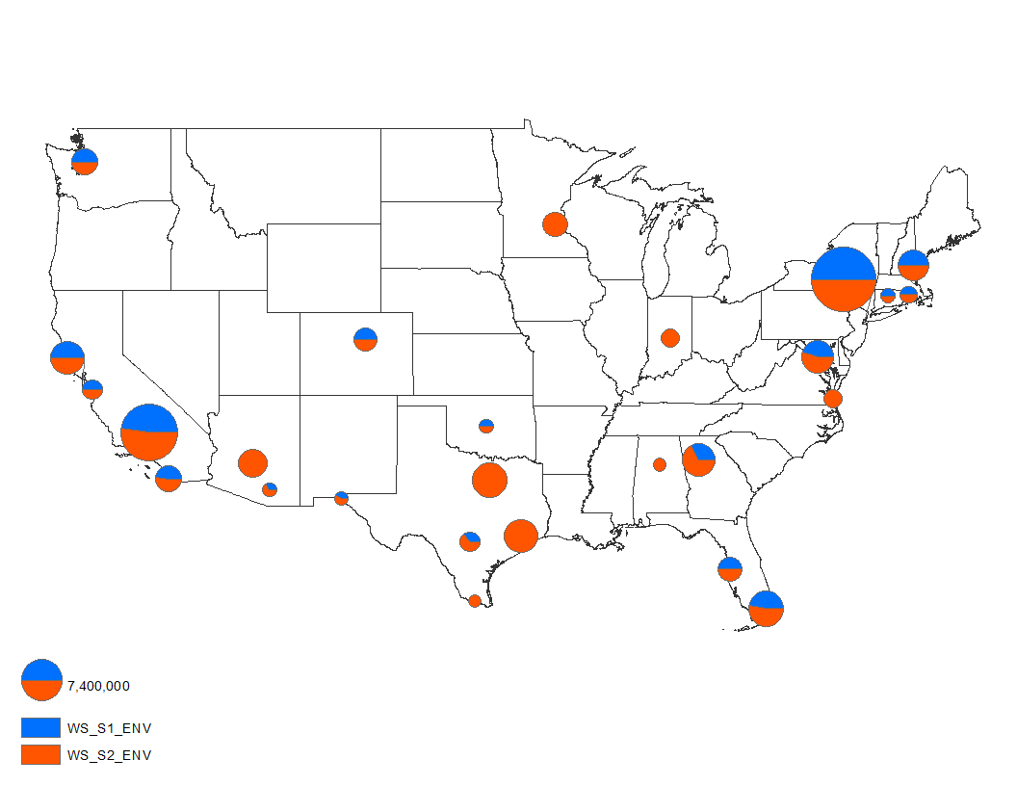
Don’t Be a Pie Guy
Pie charts generally suck.
Seriously, they are usually bad.
With 2 or 3 items, all with large shares, they are passable.
E.g. Dem/rep split in a USA vote, 2 way split as mark on a map, showing rough ‘majority’ instead of specific.
With >3 items, or small shares, they decline in usefulness.

Slide 27
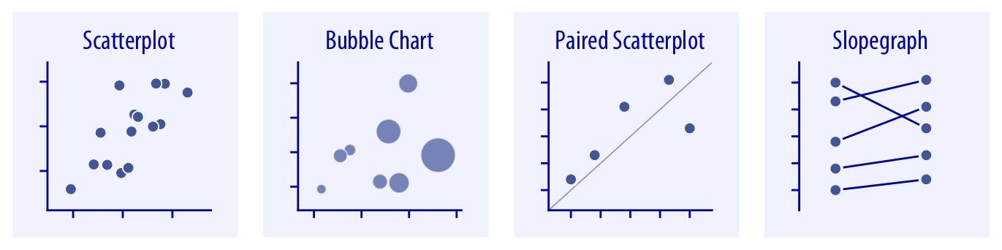
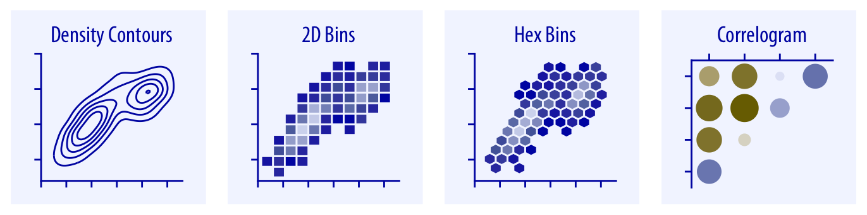
Relationships
Relationships between numeric variables are often best seen on a scatter plot.
For each increase in X, we see this change in Y.
E.g. height vs weight, sq.ft. vs price.
Many variations exist – regression, hex, density.
Changeable on the marks card.
Variations are good examples of ‘does it make sense’ – we make the data less ‘true’ to better show our point.
Can often encode other variables in color, shape, size, etc…
Foundation of ML – predictions via best fit.

Slide 28
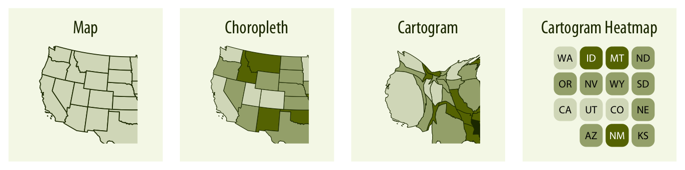
Geospatial Data
Geospatial data has some geographic component, so it can be mapped.
The type of thing we can plot varies with data.
Latitude and longitude – we can plot points on a map.
‘Region’ (state/country) – we can plot a filled (choropleth) map.
Can be reshaped (final two) – what’s actually important to show?
Sometimes the geographical shape of regions isn’t the most import thing to encode (size).

Slide 29
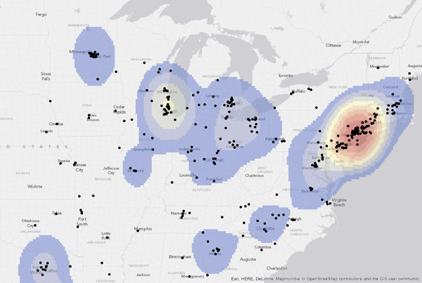
Maps and What I want to see
Density maps are a good example of changing data to make it less ’correct’ and more useful.
Instead of plotting points, we can plot the density of points.
Makes the data less specific – we lose the exact location of each point.
Makes the data more useful – if examining crime, locations of coffee shops, or traffic, this likely does better at communicating the important bit.
Remember, we are generating knowledge for some purpose (even if pretend here).

Slide 30
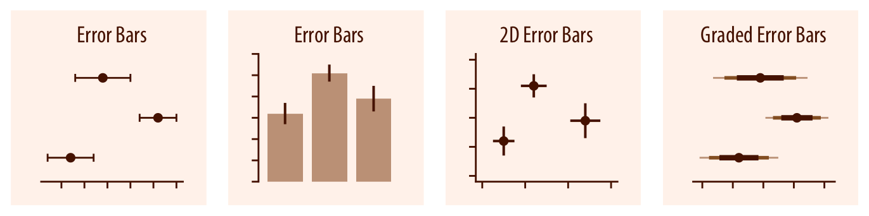
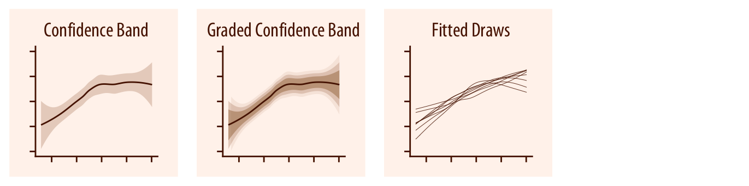
Error and Uncertainty
Many values have some uncertainty to their value.
We can represent that in visualization.
Very common in inferential stats – we are predicting, but how certain are we?
Ask:
Does this matter?
Is not having this here deceptive?

Slide 31
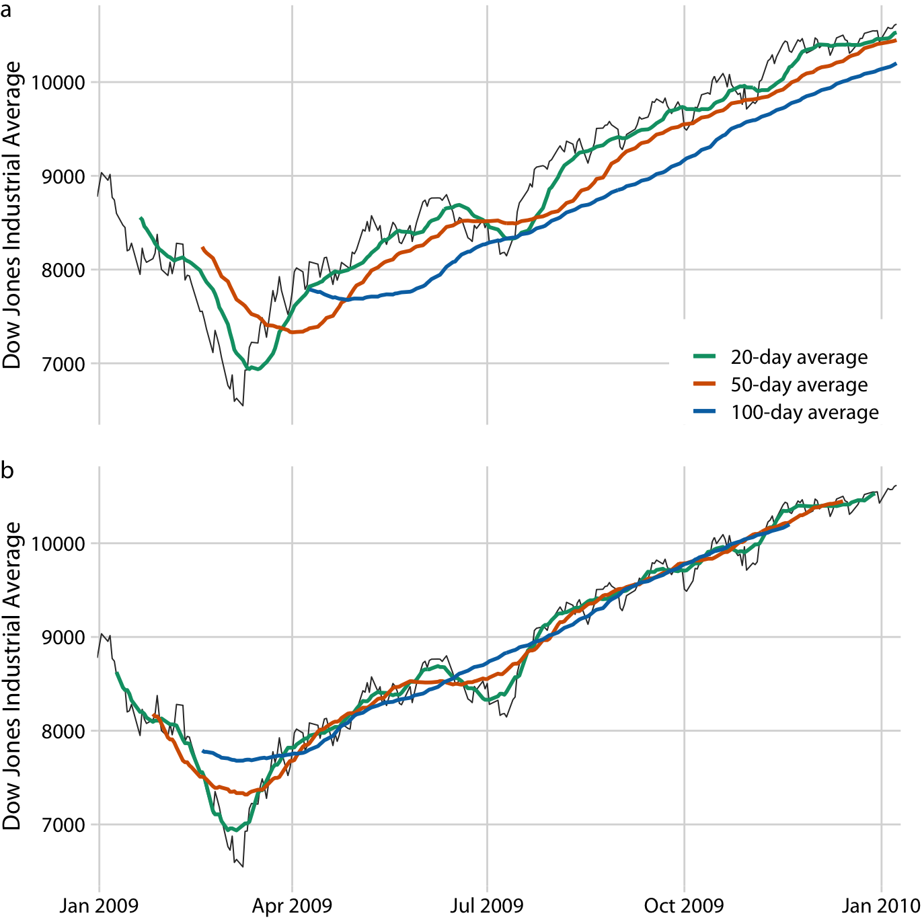
Trends
Trends are almost always best shown via a line chart.
Can compare by using color.
Line charts require a (identified) datetime value.
I.e. I want to see one point on the line every _______ .
Data is aggregated per datetime selection (day, week, etc…)
We can do forecasting to project the future…
A little predictive analytics later on…

Slide 32
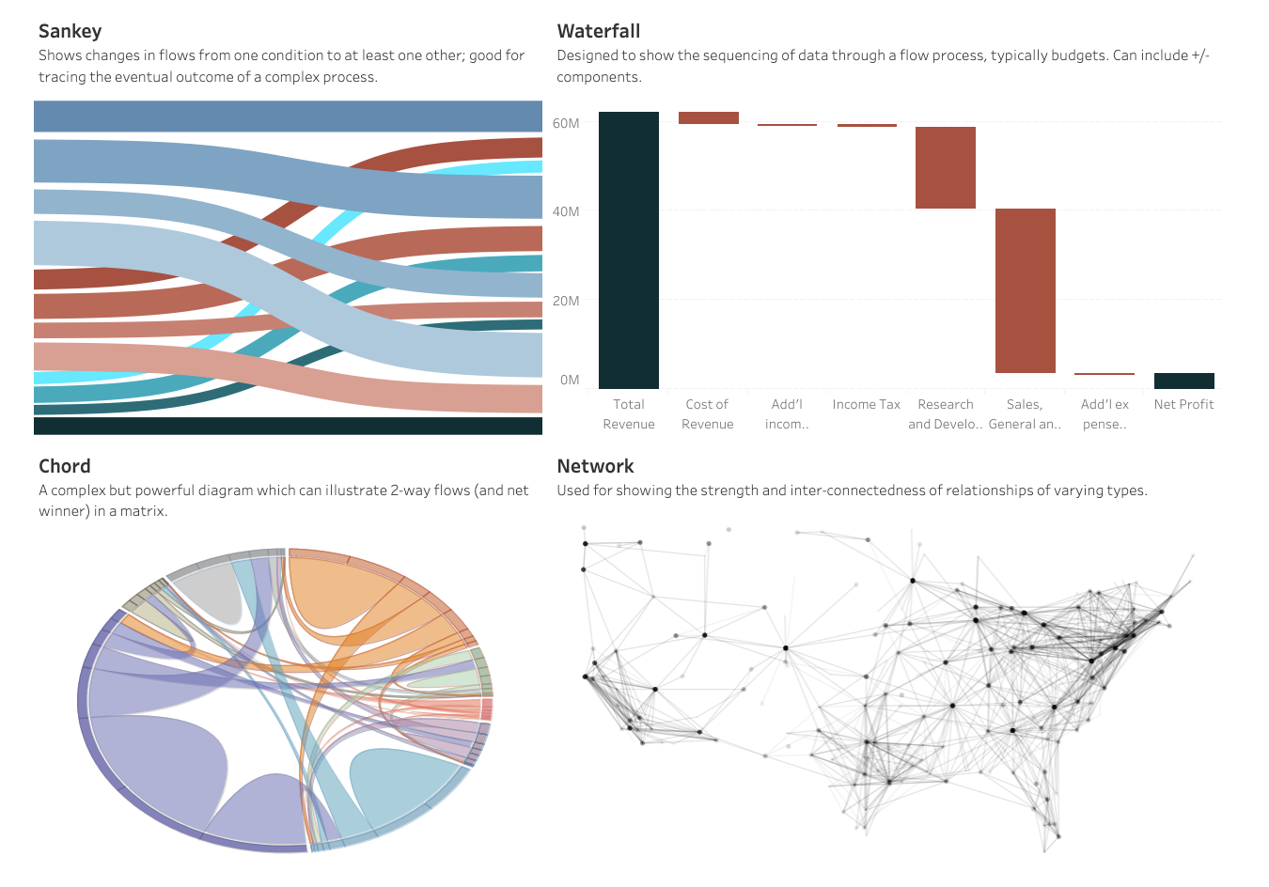
Flow
’Flow’ is showing how things move from A->B.
Starting point and end point.
How many As ended up in B…
Connections and graphs.
Harder to illustrate clearly – generally more for complex visualizations.
Tableau has newish plugins that make some of these a bit easier.

Slide 33
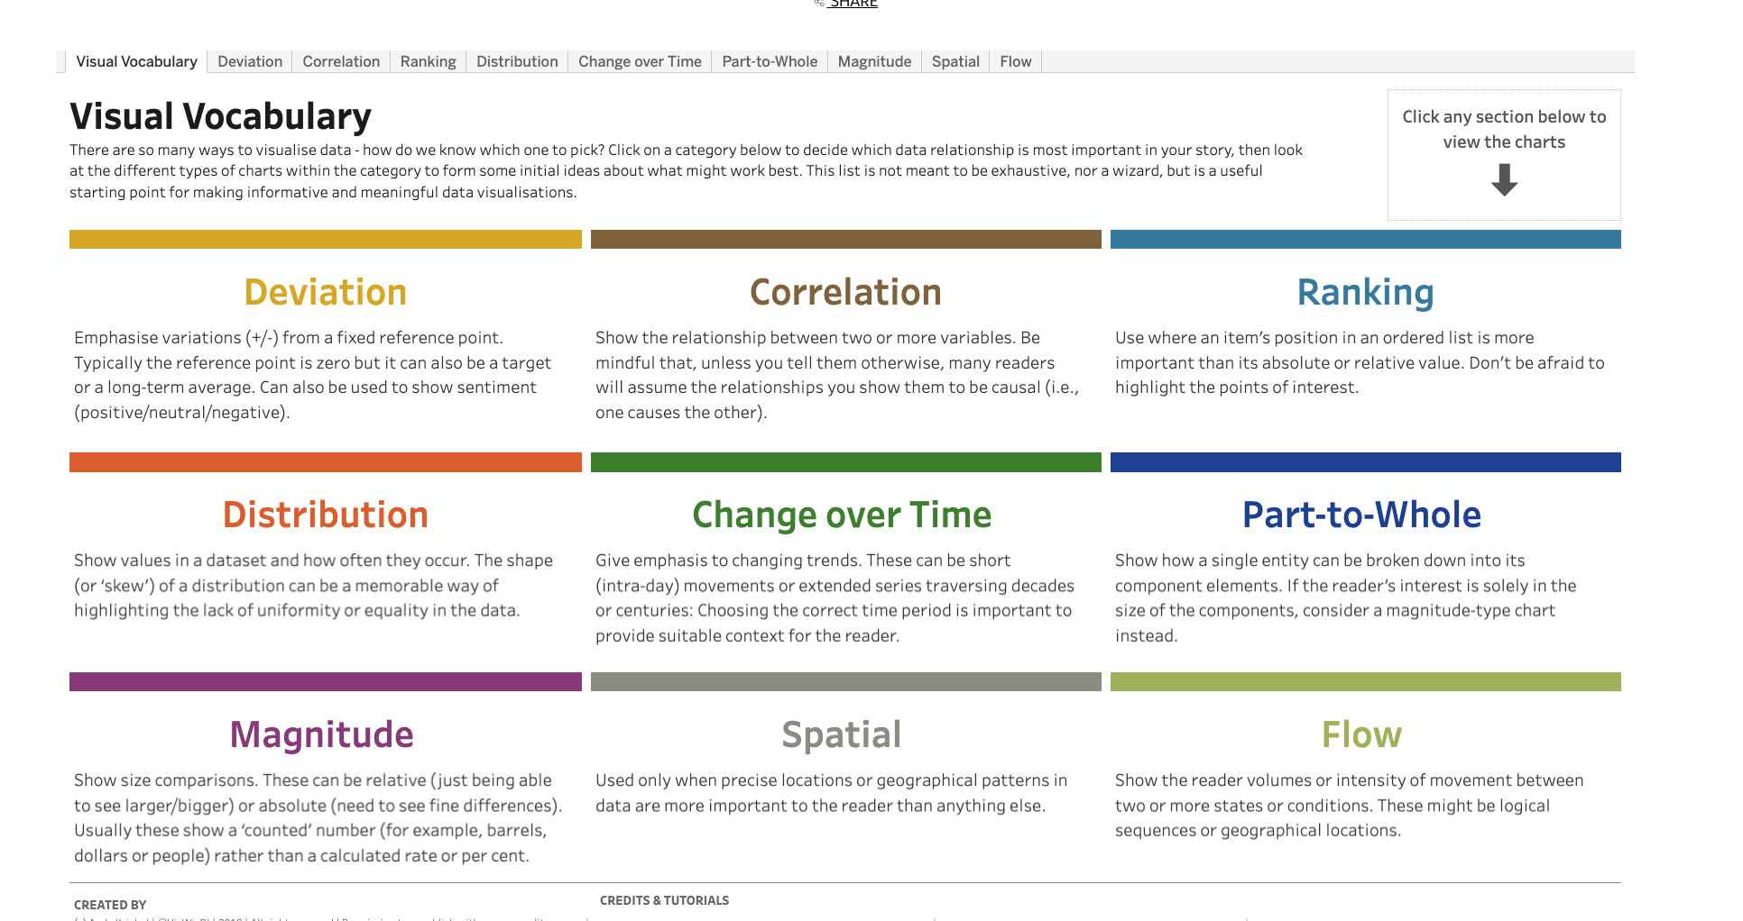
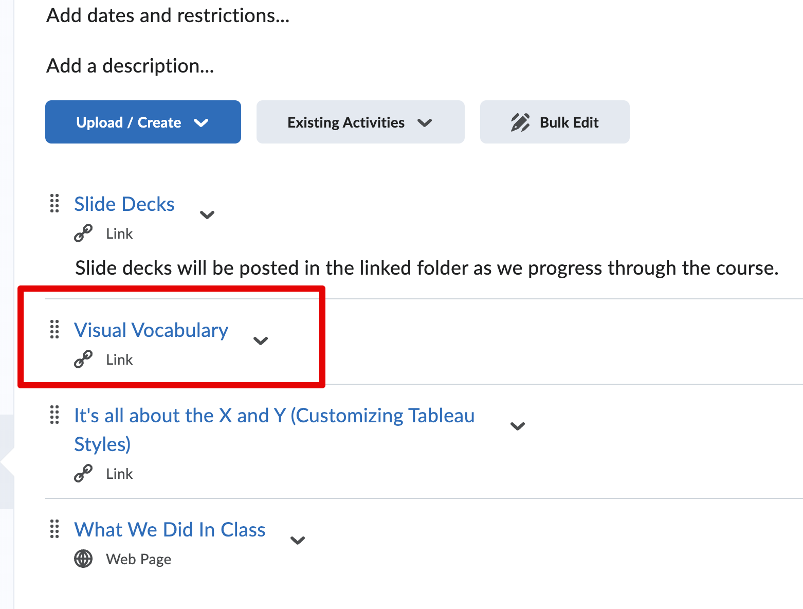
Visual Vocabulary
The Visual Vocabulary page gives more examples of common things we may need to show.
Start here, adjust as needed.

Slide 34
Choosing Chart Type
Start with intent - data can usually show many things, which do we want to show here?
This is tableau-less thought, don’t worry about what you know how to make in a chart.
We want to choose a chart style that matches what we want to communicate.
It’s like fusion food – doing something weird might work, but it is a risk.
Start with something that is “known good” and iterate.
What, specifically, do we want someone to think/do with a value?
Do I want them to compare it, look at a trend in it, see what share of total it makes, etc…
If I look at a chart, does it help this? (If I have bar charts to show a trend, does it work?)
Choosing a good chart type is necessary but not sufficient.
These things aren’t a complete list of what can be made, they’re examples.

Slide 35
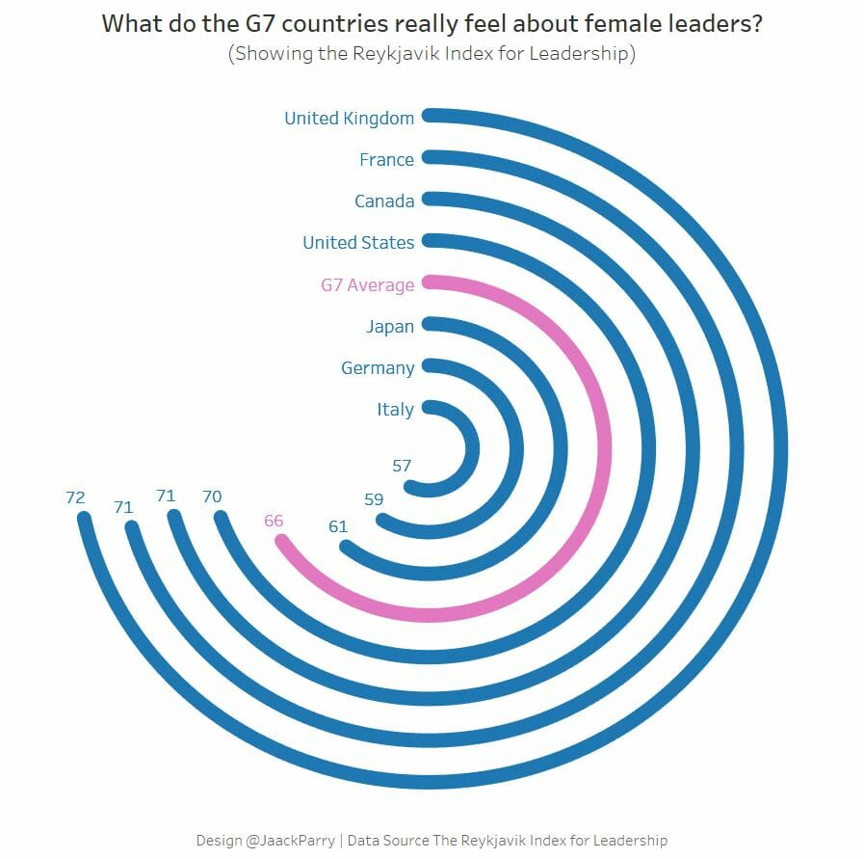
Variations and Changes
Can depart, but don’t ‘break’ the original spirit of the chart.
Add density (additional data) by using some attribute to show some other variable.
Can change mark types.
Add interactivity to allow charts to be useful in combination.
‘Bending’ or reshaping data with something like trig (later).
The further you change things, the riskier it is.
Is a change better and at least as clear as the original?

Slide 36
Complex Tableau Visualizations
To do things that are complex in Tableau typically requires several steps.
Creating odd chart designs off the top of your head is pretty hard.
For you, this will generally involve copying and adjusting some example.
Find something that is similar in terms of what it shows – comparison, trend, share, etc…
Adapt those instructions to your data.
This process is something that you want to get good at if you are doing this for real, it does take several times to get used to and can be frustrating.
If you can do this, you can do anything – practice really is the only teacher.

Slide 37
Conclusion
In each of the chart types, we can add some Tableau fanciness if it makes sense.
We can usually encode some other variable in color/size/shape.
Does it make sense and does it make things better than adding a chart?
We can make charts interactive with each other on a dashboard.
Can we use interactivity (filter, highlighting, etc…) to make things even better?
Do we need/want other additions like filters?
Does what you intend to show come through clearly?
We’ll examine the math-y details more soon, but ‘does it make sense’ is the core idea.
Do you need precision or is a general indication good enough?
Be additive – make something that does the job, then see if it can be better.

