Slide 1
Housekeeping
Types of analysis.
Tableau quiz questions and example solution.
Anything specific you want to see or go over, let me know.
Anything that was unfair in your opinion, let me know.
The 5th chapter. (Richardson ch05).
Next time:
Stories (this is pretty important, and you’ll definitely need it.)

Slide 2
Housekeeping
Data analytics types and examples.
Contextualize how analytics fits in enterprise.
Some examples we can do in Tableau:
Market basket.
Forecasting.
Predictive modelling.

Slide 3
Housekeeping

Slide 4
Types of Analytics

Slide 5
Where we are now
1. Data Analytics
2. Intro to Accounting Data
3. Types of Data
4. Preparing Data for Analytics
5. Types and Tools of Data Analytics
6. Descriptive Analytics
7. Diagnostic Analytics
8. Predictive Analytics
9. Prescriptive Analytics
10. Share the Story
11. Putting it All Together

Slide 6
Learning Objectives
5-1 Explain where ‘Perform the analysis’ fits in the AMPS model.
5-2 Describe the four types of accounting data analytics.
5-3 Define descriptive analytics.
5-4 Explain diagnostic analytics and the types of questions it answers.
5-5 Describe the types of questions addressed using predictive analytics.
5-6 Describe the basics of prescriptive analytics.
5-7 Recall the basics of statistics and statistical testing.
5-8 Describe the various tools used in data analytics and how to access Excel’s Data Analysis Toolpak.

Slide 7
The AMPS Model: Perform the Analysis

Slide 8
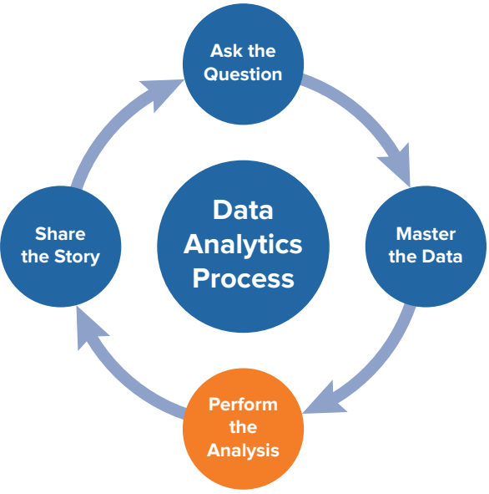
The AMPS Model
The AMPS model is sometimes used to describe data analysis.
It outlines the main steps in performing analysis:
Ask the question – start with something we want to know.
Master the data – explore, clean, prepare the data.
Perform analysis – do “the thing”.
Share the story – communicate the result.
In our usage the ‘perform’ step is 99%+ ‘describe’.
There are many other things we can do to analyze data, some of those are shown here now.

Slide 9
Matching the Analytics With the Question
LO 5-2

Slide 10
Four Types of Questions
What happened?
Why did it happen?
Will it happen in the future?
What should we do, based on what we expect will happen?

Slide 11
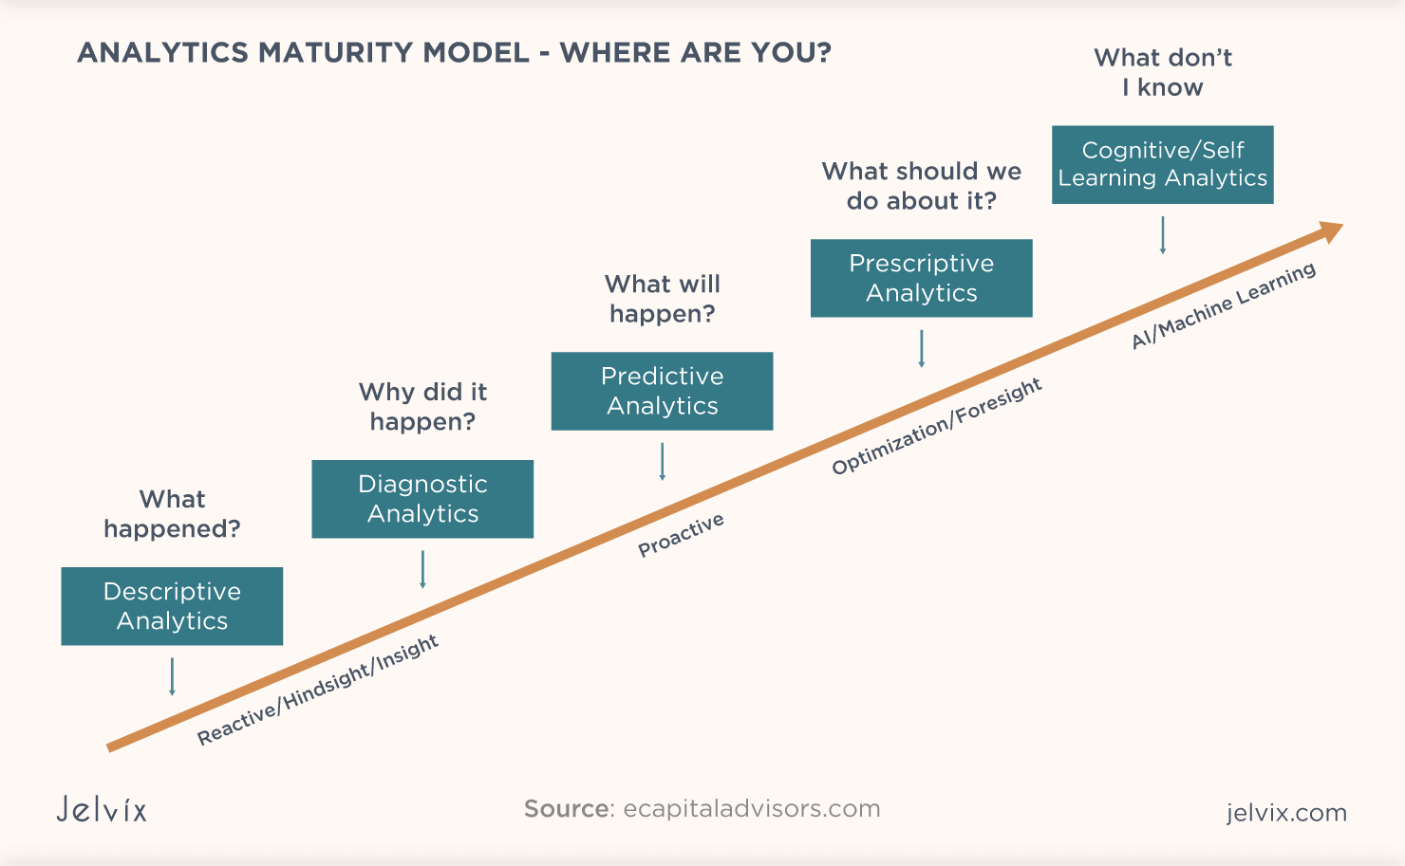

Slide 12
Descriptive Analytics Answers “What Happened?”
Did we make a profit last year?
Did return on assets improve or decline over the past year?
Did the airline company’s on-time departures improve this past month?
How much did we pay in federal taxes last year?
How long have the existing accounts receivable been outstanding?
Which product is the most profitable one for the company?

Slide 13
Diagnostic Analytics Answers “Why Did it Happen?”
Why did advertising expense increase, but sales fall?
Why did sales, general and administrative expenses increase relative to the industry?
Why did overall tax increase even though net income did not?
Can our variance analytics help explain why the labor expenses increased over the past year?
Why were some checks greater than $10,000 signed by two members of management and others of similar size only signed by one?

Slide 14
Predictive Analytics Answers “Will it Happen in the Future?”
What is the chance the company will go bankrupt?
Do we extend credit or not to customers based on customer background (credit score, employment record, existing debt)? Will they be able to pay back their loans?
Can the IRS find those individuals or corporations evading taxes using predictive techniques?
Can we predict when the financial statements might be misstated?

Slide 15
Prescriptive Analytics Answers “What Should We Do Based On What We Expect Will Happen?“
If we have all 12/31 year-end audit clients, how will we organize our audit work in the new year?
How can revenues be maximized (or costs be minimized) if there is a trade war with China?
What is the level of sales that will allow us to breakeven?
Should the company lease or own their headquarters office building?
Should the company make its products or outsource to other producers?

Slide 16
Analytics and Their Related Questions
Descriptive Analytics What happened? What is happening?
Diagnostic Analytics Why did it happen? What are the reasons for past results? Can we explain why it happened?
Predictive Analytics
Will it happen in the future? What is the probability something will happen? Is it forecastable?
Prescriptive Analytics What should we do, based on what we expect will happen? How do we optimize our performance based on potential constraints?

Slide 17
Progress Check 5-2
Q: Why would diagnostic analytics be arguably harder to perform than descriptive analytics, figuring out what happened as opposed to why it happened? What makes them different from each other?

Slide 18
Answer
Descriptive analytics just requires conveying what happened.
Diagnostic requires finding causation.

Slide 20
Descriptive Analytics
LO 5-3

Slide 21
Definition of Descriptive Analytics
Descriptive analytics addresses the questions of “What happened?” or “What is happening?”.
We define descriptive analytics as analytics performed which characterizes, summarizes, and organizes features and properties of the data to facilitate understanding.
Any “report” is descriptive analytics.

Slide 22
Tools Used in Descriptive Analytics
Counts: Show how frequently an attempt occurs.
How many times was taxable income greater than net income over the past five years?
Totals, sums, averages, subtotals: Summarize measures of performance.
What is the balance of finished goods inventory on hand?
Minimums, maximums, medians, standard deviations: Summarize measures showing extreme values to help explain what happened.
What was the greatest $ refund offered by the customer service department and who approved it?

Slide 23
Tools Used in Descriptive Analytics (continued)
Graphs (bar charts), histograms:
How long have receivables been outstanding for our company? Potentially answerable by creating an Accounts Receivable Aging Schedule.
Percentage change from one period to the next using vertical analytics, horizontal analytics, or common-size financial statements.
How much did cost of goods sold as a percent of revenues increase over the past two years?
Ratio analytics like return on assets, return on sales (profit margin), asset turnover ratios, debt-to-equity ratios: Calculate important financial ratios for comparison.
Which retail company (e.g., Amazon, Walmart, Target, Kroger) has the highest return on assets?

Slide 24
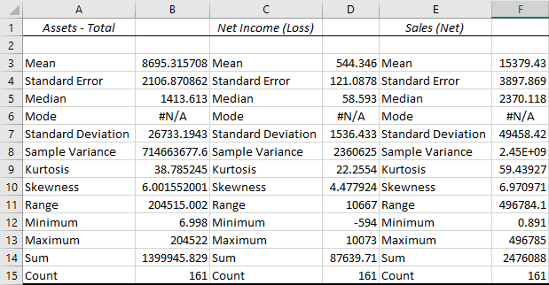
Descriptive (Summary) Statistics for the Retail Industry in 2018
EXHIBIT 5.3 Summary Statistics for the Retail Industry Reported in 2018 (Source: Compustat Database of all retail firms with fiscal years ending in 2018.)

Slide 25
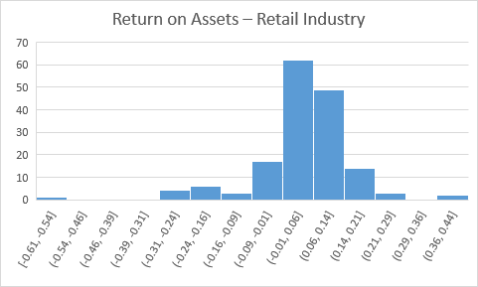
Descriptive Statistics (Histogram) for the Retail Industry in 2018
EXHIBIT 5.4 A Histogram of Return on Assets for the Retail Industry Reported in 2018

Slide 26
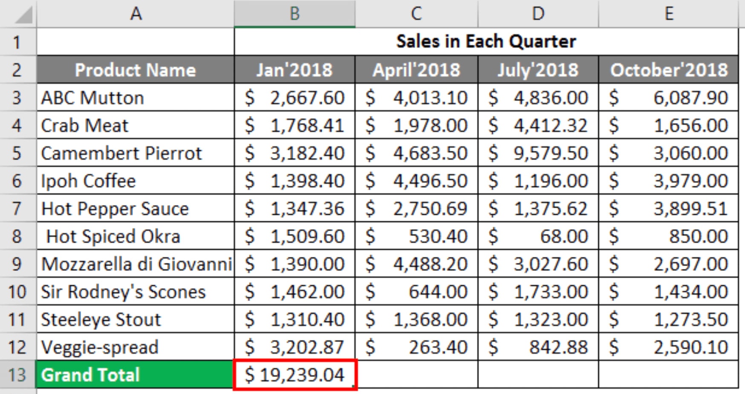
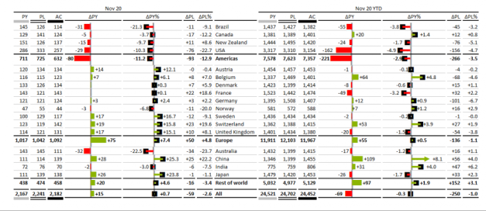
“Old” School Reports

Slide 27
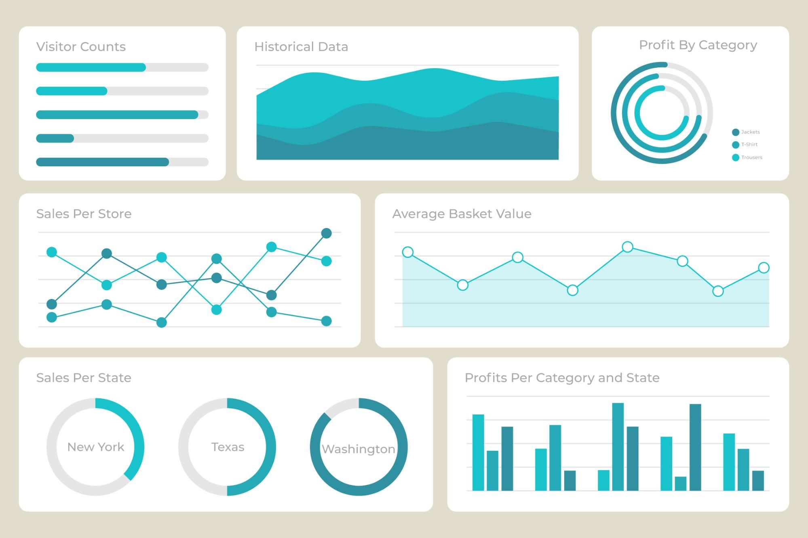
Modern Reporting
Tableau-like dashboards can provide an interactive version of a report, with the benefits of modern web functionality.
Interactivity.
Customization.
Real-time updates.

Slide 28
Benefits of Modern D.A.
Near real-time reporting available.
Live changes and customizations (e.g. Tableau params).
Customize looks at the data.
E.g. Create one report on data. Filter columns and data dynamically based on who is using it.
Easier to interpret data and garner information.
Smart visualization choices add clarity.
Easier to detect trends, exceptions, and areas needing action.
Fewer assumptions and less intuition needed to make business decisions – more facts are knowable.

Slide 29
Examples of Descriptive Analytics
Inventory Management by Customer and SKU Profitability (Lab 2-3, Lab 2-4, Lab 2-5 and Lab 2-6)
Accounts Receivable Aging Schedule (Lab 6-1)
Accounts Receivable Summary by Customer (Lab 6-2)
Horizontal Analytics with Sparklines (Lab 6-3)
Vertical Analytics with Sparklines (Lab 6-4)
DuPont Analytics (Lab 6-5)

Slide 30
Progress Check 5-3
Q. How would summing the total net income over the past 4 years be considered descriptive analytics?

Slide 31
Answer
We are taking data, and presenting it in a way that the user can better understand.

Slide 32
Diagnostic Analytics

Slide 33
Definition of Diagnostic Analytics
Diagnostic analytics addresses the questions of “Why did it happen?”.
We define diagnostic analytics as analytics performed to investigate the underlying cause that cannot be answered by simply looking at the descriptive data but can be answered by various types of diagnostic analyses.
Diagnostic analysis is less prevalent than the others.

Slide 34
Two Broad Types of Diagnostic Analytics
Identifying Anomalies/Outliers – Often a first step in diagnostic analytics is to look for and identify unusual, unexpected results or transactions.
E.g. Control chart from ~ last week.
Finding previously unknown linkages, patterns, or relationships between variables.
Performing Drill-Down Analytics – look for patterns in the underlying data set by summarizing data at different levels and uncovering additional details to understand why something happened.
Determine Relations/Patterns/Linkages between Variables – find the extent to which there are patterns in the data, or data moves together.

Slide 35
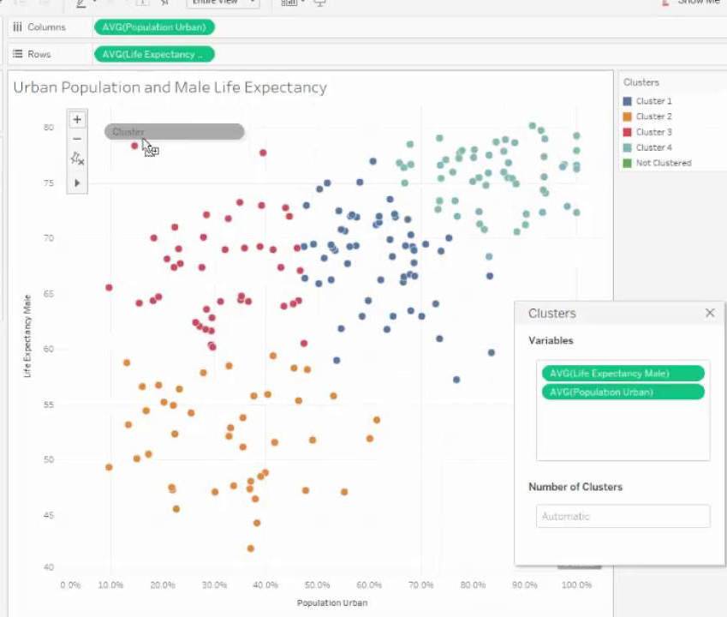
Anomalies with Tableau

Slide 36
Testing/Tools Used in Diagnostic Analytics
Sequence checks and sequence analytics
Why are some check numbers missing documentation? Does it signify errors or fraud or can they be explained?
Duplicate Transactions
Why are there duplicates of some transactions in the financial reporting records? Are they fraud or just errors?
Variance analytics- (typically performed in management accounting), used to identify differences from expectations.
Why is the labor rate and labor use variance for direct labor at the manufacturing plant unfavorable?
Benford’s Law- used to identify fraud or irregular transactions.
Why do some refunds from Verizon offered by customer service representatives depart from the distribution expected by Benford’s Law? Are they associated with fraud?

Slide 37
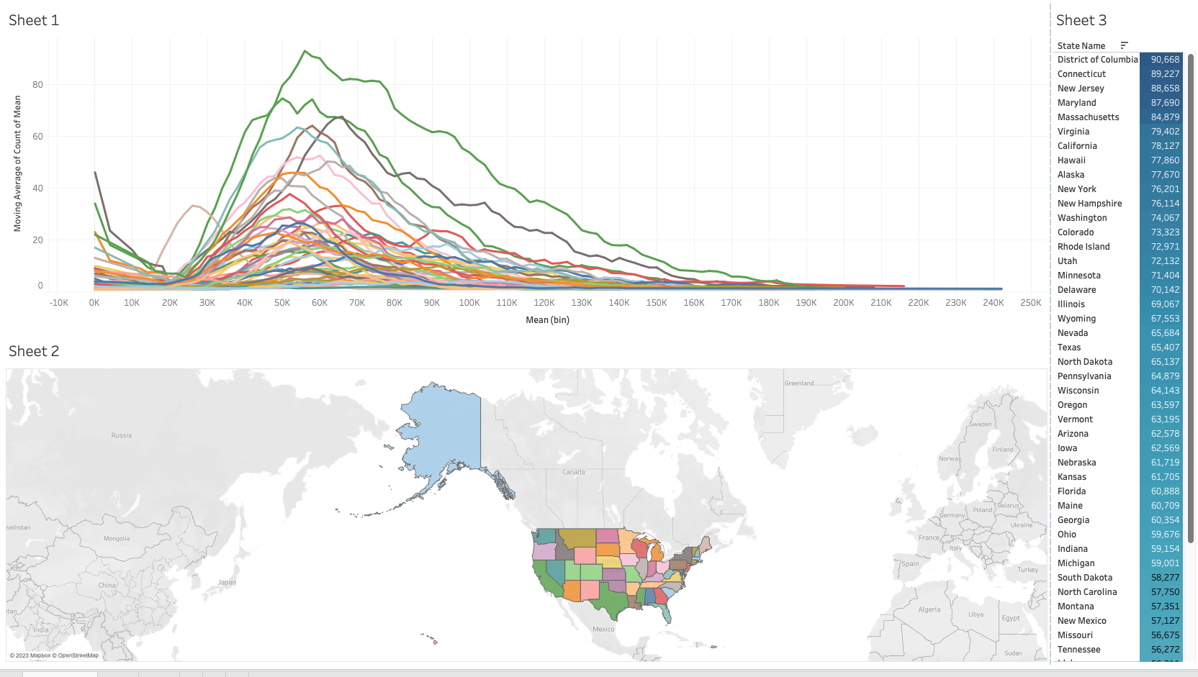
Tableau Example - Distributions

Slide 38
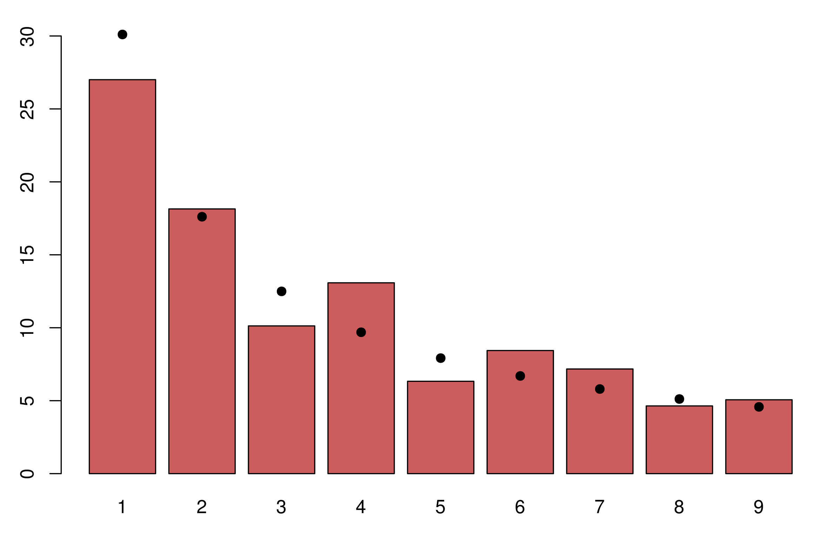
Benford

Slide 39
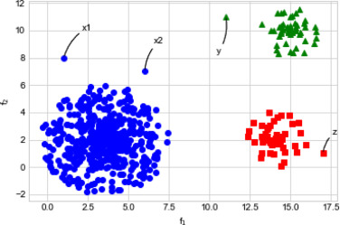
Example – Anomaly Detection
In applications such as fraud detection, analytics can be used to find anomalies.
There are lots of transactions that are “normal”.
There are others that are “weird”.
Anomaly detection looks at the features (variables), groups them, then finds those that are different.
These anomalies need investigation.

Slide 40
Testing/Tools Used in Diagnostic Analytics (continued)
Drill-downs and roll-ups used to get detail when needed
Which customers included in the total accounts receivable owing have the highest balance outstanding? Do some accounts need to be written off due to uncollectibility?
Pivottables (crosstabulations)
Why were some transactions approved and recorded on the weekend?
Correlation/Regression
How are R&D expenses related to future firm profitability?
Hypothesis testing
Are Nordstrom’s sales returns as a percentage of sales higher during the holiday season (e.g., Christmas, New Year’s, Hanukkah, etc.) as compared to non-holidays?

Slide 41
Progress Check 5-4
Q: How would a test of Nordstrom’s sales returns around the holiday season help us determine if and why sales returns are different from the nonholiday season? How would this be an example of diagnostic analytics?
- Try this with Superstore in Tableau.

Slide 42
Predictive Analytics

Slide 43
Definition of Predictive Analytics
Predictive analytics addresses the questions of “Will it happen in the future?”, “What is the probability something will happen?” or “Is it forecastable?”.
We define predictive analytics as analytics performed to provide foresight by identifying patterns in historical data and assessing likelihood or probability.
ML creates a model – something that translates inputs to output(s).
Machine learning is a two-step thing:
We use old data to train the model.
We use the model that we made to make new predictions.

Slide 44
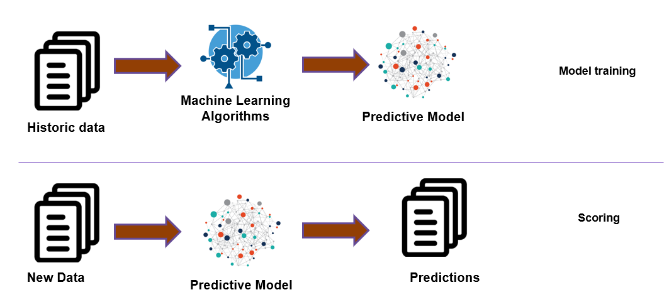
Making a model (behind the scenes)
Using a model (making predictions

Slide 45
Broad Categories of Predictive Analytics
Classification – A predictive analytics technique used to separate or classify a sample (or population) into two or more groups or classes.
Will pay back loan or not?
Regression – A predictive analytics technique used to predict a specific dependent variable outcome value based on independent variable inputs.
What is the value of this house?
Forecasting Using Time Series Analytics – A predictive analytics technique used to predict future values based on past values of the same variable.
What will gas prices be next week?

Slide 46
Predictive Analytics in Reality
Predictive analytics is very commonly used, all over the business world.
Predicting demand for products.
Predicting commodity prices.
Forecasting traffic.
Predicting if someone will repay a loan.
Which students will excel at a college.
If we have…:
Some value that is useful to predict.
Data measuring the things that impact that.
…we can create a predictive model.

Slide 47
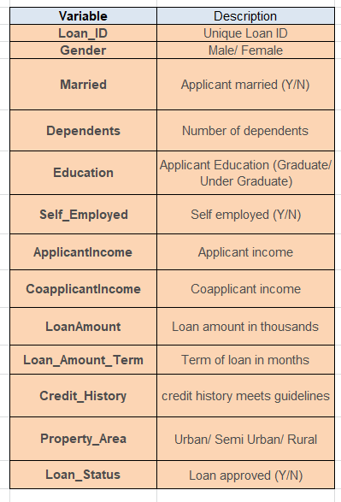
Example - Loans
A bank has a bunch of information about each person’s mortgage application.
The bank also has this data for old loans – including if that person has paid it back.
Predictive model is made by providing many examples of old loans with this data – paid back and not.
The algorithm will ‘learn’ to predict the target (will they pay it back) from the ‘features’ (the info we know before lending, based on patterns in data.
With a large amount of data, this can be very accurate.
Accuracy is estimated by the model making predictions on the old loans, then checking if right.
When a new applicant fills out the form, the model can make a prediction of if they’ll pay or default.

Slide 48
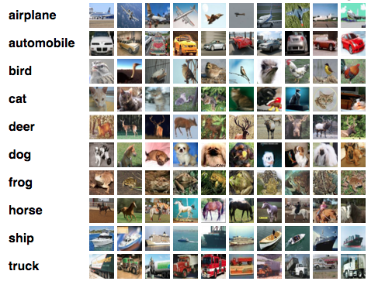

Slide 49
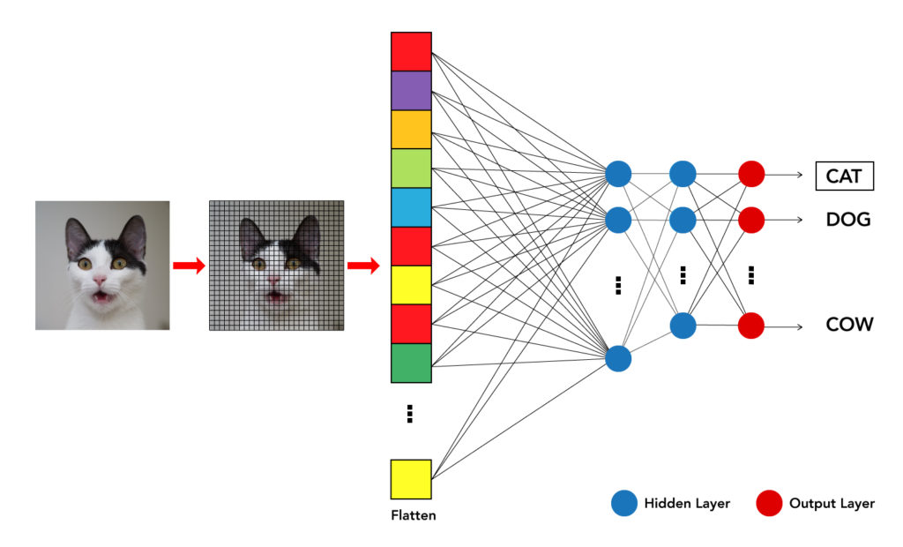

Slide 50
Predictive Modelling
Predictive modelling for classification and regression is where most of the cool AI stuff is based.
Generative AI (e.g. ChatGPT) is based on this as well – learn from lots of text, then predict the next word.
Almost anything where we have data on both a set of inputs that as well as an outcome we want to predict, we can create a predictive model.
Predict sales based on customer and product data.
Predict health outcomes based on MRI scans.
Identify images based on labeled image data.
Predict stock price based on financial data.
Increasingly prevalent in many/most business domains.

Slide 51
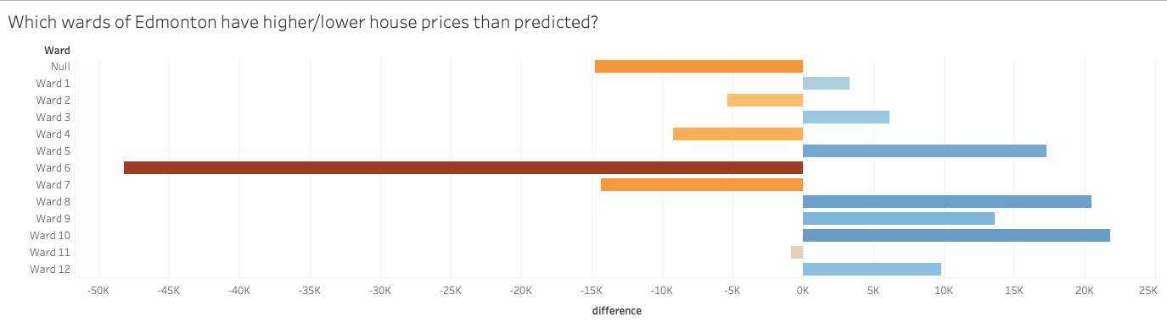
Regression in Tableau
We can do some simple regression in Tableau.
Tableau isn’t really a predictive tool, but for basic cases we can make it work.
The trend line can give us a regression.
We can create regression models:
Given these dimensions/measures, can we predict a target value?

Slide 52
Progress Check 5-5
Q. Why would forecasting future sales, earnings and cash flows be considered predictive analytics?
Tableau Example - Forecasting

Slide 53
Forecasting in Tableau
One predictive use of Tableau is time-series forecasting.
Time series forecasting is something we see in forward projections of something like a stock price.
Tableau has a few tools that can generate a forward-looking forecast from something that we can plot over time on a line chart.
Time series analysis is another branch of predictions:
Based on the idea of a moving average.
Additional factors like trend (up/down) and seasonality (wave-like variation)

Slide 54
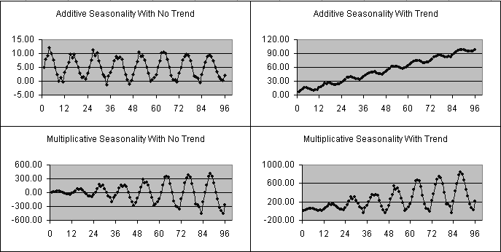

Slide 55
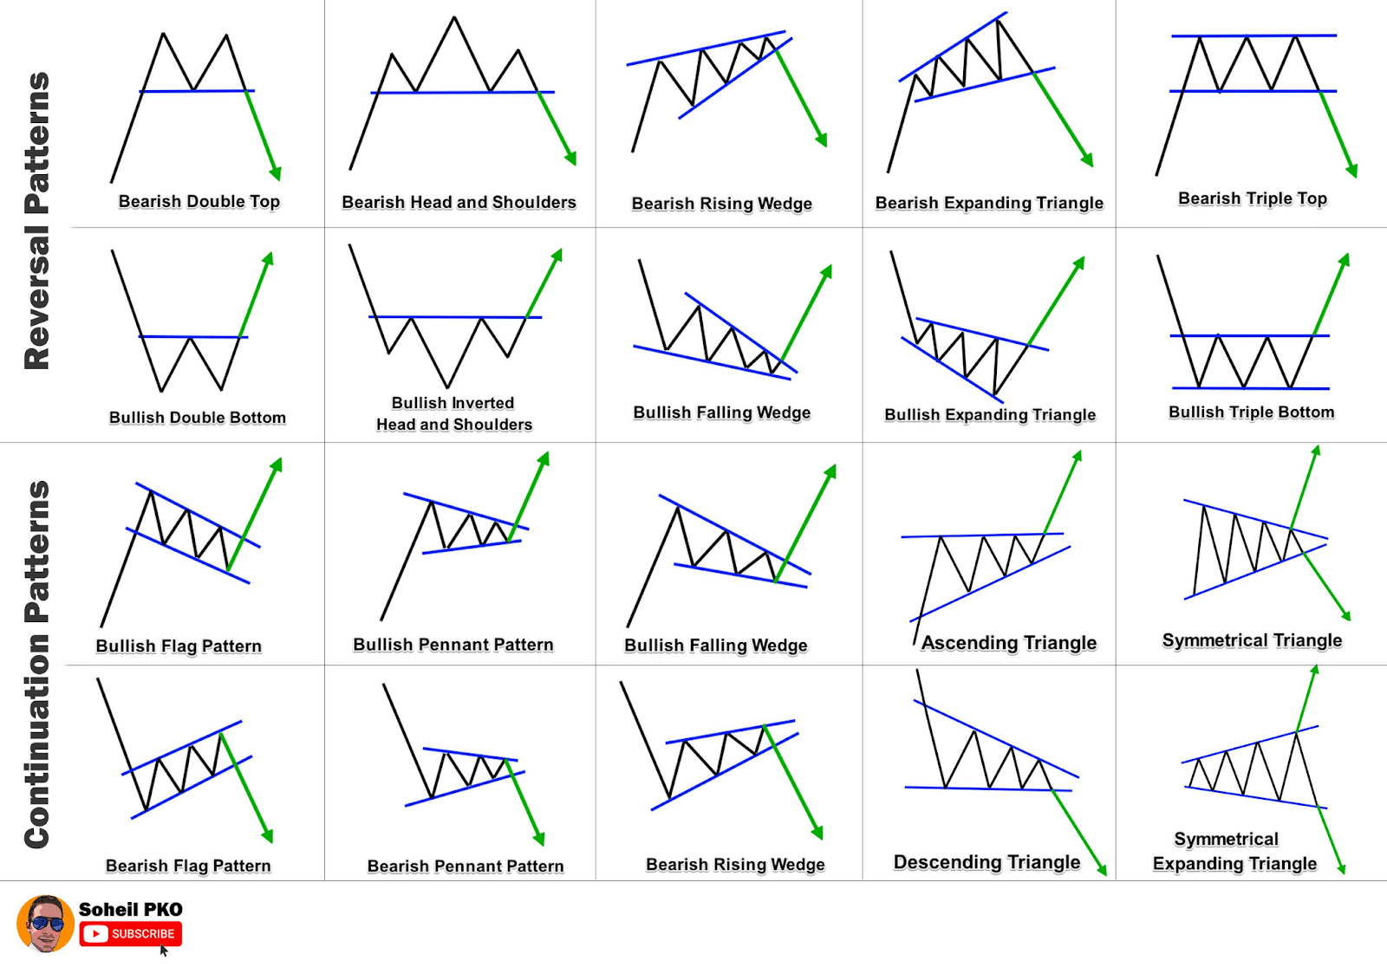
Example – Technical Training

Slide 56
Prescriptive Analytics

Slide 57
Definition of Prescriptive Analytics
Prescriptive analytics addresses the questions of “What should we do based on what we expect will happen?” and “How do we optimize our performance based on potential constraints?”.
We define prescriptive analytics as analytics performed which identifies best possible options given constraints or changing conditions.
(Roughly) a predictive model predicts what will happen, combined with picking the optimal choice.
Highly situation dependent – we need to know “the business” to evaluate options and actions.

Slide 58
Tools Used in Prescriptive Analytics
Sensitivity Analytics - evaluation of outcomes based on uncertainty regarding the inputs.
What happens to Bank of America profits if the interest rates change from 3% to 4% or 5% or more?
Capital Budgeting - evaluating future cash flows using various analytics techniques including net present value and internal rate of return.
What are the cash flows associated with an investment in a new piece of equipment at Boeing, or a new truck at JB Hunt?
Marginal (or incremental) analytics - technique used to determine the change in profit associated typically with the cost or benefit of the next (or the marginal) unit.
Should Tesla make or buy their batteries?
Should Cisco sell its outdated routers at a bargain price?
Should Kellogg’s make new cereal products or stick with the existing ones?

Slide 59
Prescriptive Analytics
Prescriptive analytics builds some logic to mirror the real-world scenario that a business is dealing with.
Then uses predictive model(s) to make predictions for what will happen.
These predictions combine with the “scenario” to produce prescriptions for action.
E.g. an airline can predict when planes will arrive late/early. They can also build some logic to plan for the impact – connecting passengers, airport charges, fuel, etc… to make decisions.

Slide 60
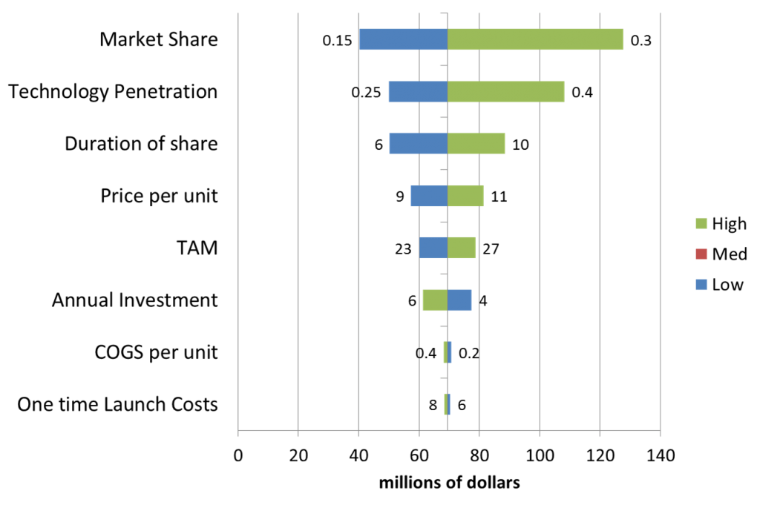

Slide 61
Tools Used in Prescriptive Analytics (continued)
Goal Seek Analytics – a form of what-if analytics that tells us what will need to be done (or assumed) in order to reach a desired outcome, output or result.
For McGraw Hill, what are the needed sales to breakeven on sales of this textbook?
What-if Scenario Analytics - analytics of potential future events by considering potential outcomes.
What is the sensitivity of GM sales to the mix of GM products?

Slide 62
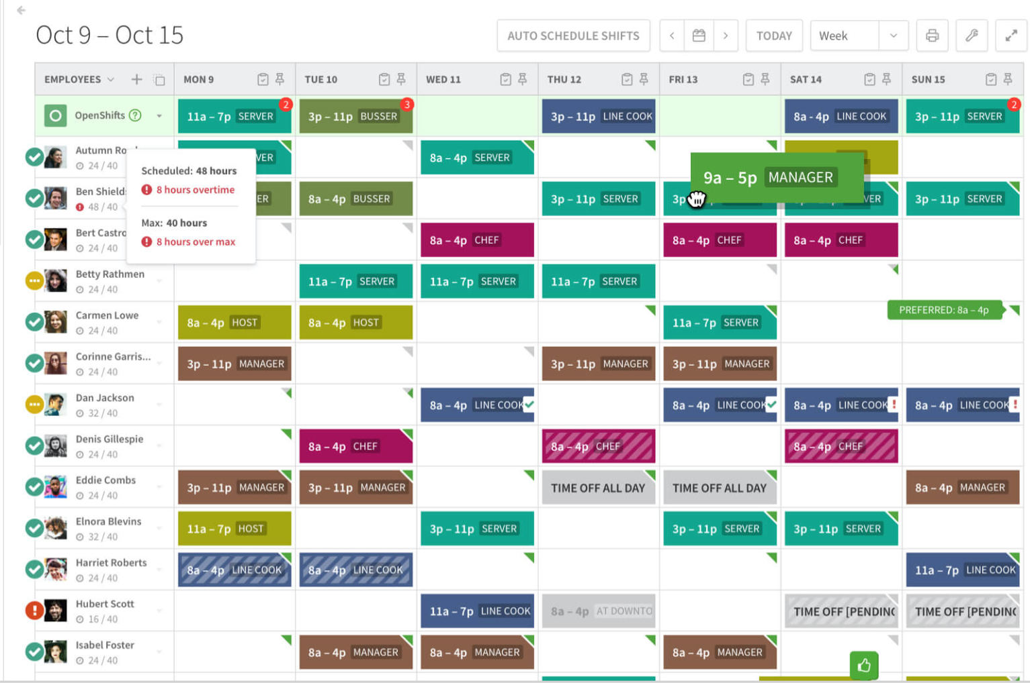
Schedule Optimization
One common example of prescriptive analytics is automatic schedule optimization.
Inputs to creating a schedule:
Predict volume of customers based on past sales.
Estimate workers needed for that “busyness”.
Add “rules” shift lengths, required hours, OT, etc…
Look at employee availability, skills, and hours.
Create a schedule that has optimal coverage.
Less ”waste” of employees at quite times.
If you’ve gotten dumb retail schedules, look here…

Slide 63
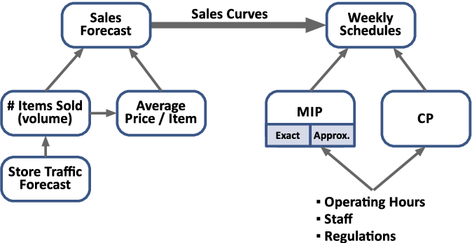
Schedule Optimization

Slide 64
Progress Check 5-6
Q. What is capital budgeting, and why is it considered to be part of prescriptive analytics?

Slide 65
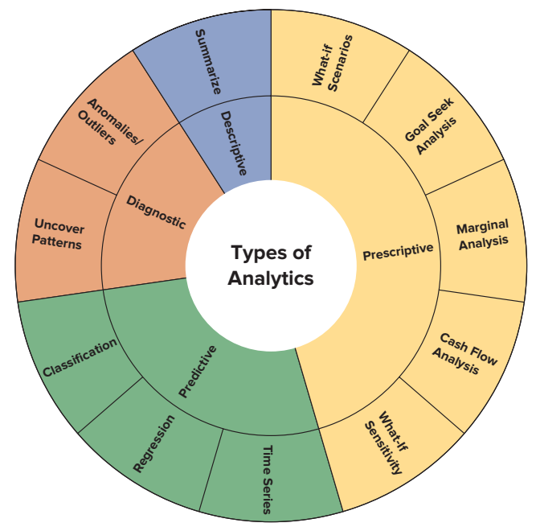
Types of Data Analytics
EXHIBIT 5.11 Circumplex of Descriptive, Diagnostic, Predictive and Prescriptive Analytics and Analytics Techniques

Slide 66
Stats and Analytics in Excel: We’ll Separate This for Later

Slide 67
Review of Basic Statistics
LO 5-7

Slide 68
Population vs. Sample
Population - a group of phenomenon having something in common
Sample - a subset of members of a population selected to represent that population

Slide 69
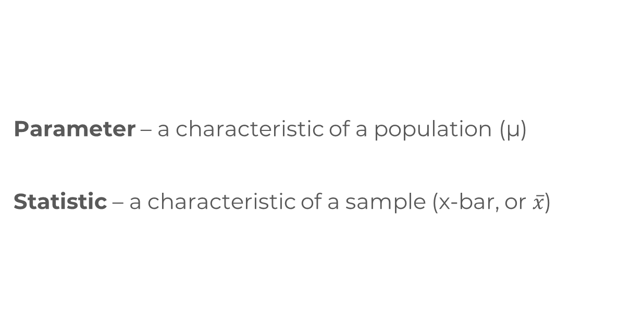
Parameters vs. Statistics
Parameter – a characteristic of a population (μ)
Statistic – a characteristic of a sample (x-bar, or $\overline{x}$)

Slide 70
Probability Distributions
Normal Distribution – bell-shaped curve
Uniform Distribution – every outcome equally likely
Poisson Distribution – low mean and being highly skewed to the right; mean number of events per interval of space or time

Slide 71
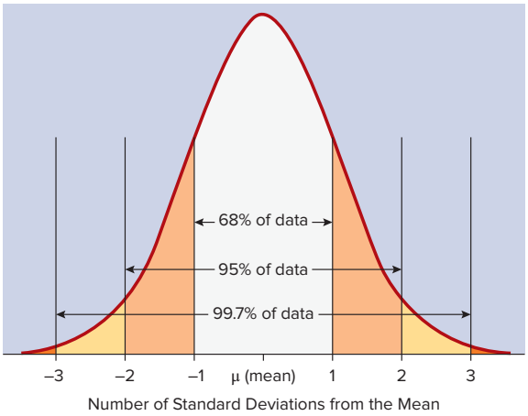
Normal Distribution, Means and Standard Deviations
EXHIBIT 5.13 Normal Distribution and the Frequency of Observations around its Mean

Slide 72
Hypothesis Testing
Null Hypothesis: assumes the hypothesized relationship does not exist, that there is no significant difference between two samples or populations
H₀: We expect that there is no difference in sales returns between holiday and non-holiday season.
Alternative Hypothesis: a hypothesis used in hypothesis testing that is opposite of the null hypothesis, or a potential result that the analyst may expect
H_{A}: We expect that there greater sales returns during the holiday season as compared to the non-holiday season.

Slide 73
Alpha, p-values and Confidence Intervals
There are two types of results from a statistical test of hypotheses that may occur or may be interpreted in different ways: the p-value and/or confidence intervals.
The p-value is compared to a threshold value, called the significance level (or alpha). A common value used for alpha is 5% or 0.05 (as is 1% or 0.01).
If p-value > alpha: Fail to reject the null hypothesis (i.e. not significant result).
If p-value <= alpha: Reject the null hypothesis (i.e. significant result).

Slide 74
Alpha, p-values and Confidence Intervals (continued)
For example, if alpha (α) is 5%, then the confidence level is 95%.
The 95%of the figure represents the confidence interval—we are 95%confident that the true population parameter of Saturday and Sunday sales falls somewhere in that area. Generally, the 95% interval is +/– two standard deviations around the mean.
Therefore, statements such as the following can also be made:
With a p-value of 0.09, the test found that Saturday and Sunday sales are not different than Sunday sales, failing to reject the null hypothesis at a 95 percent confidence level.
This statistical result should then be reported to management, reporting the results of the statistical test.

Slide 75
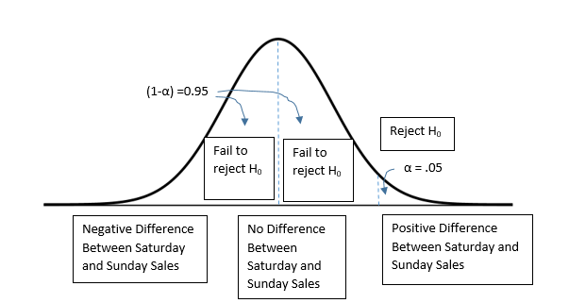
Review of Hypothesis Testing
EXHIBIT 5.14 Statistical Testing Using Alpha, p-Values, and Confidence Intervals

Slide 76
Regression
We can think about this like an algebraic equation where y is the dependent variable and x is the independent variables, where y = f(x).
Let’s imagine we are considering the relationship between SAT scores and the college completion rate for first-time, full-time students at four-year institutions.
In this example y (college completion rate) = f (factors potentially predicting college completion rate), including the independent variable SAT score (SAT_AVG).

Slide 77
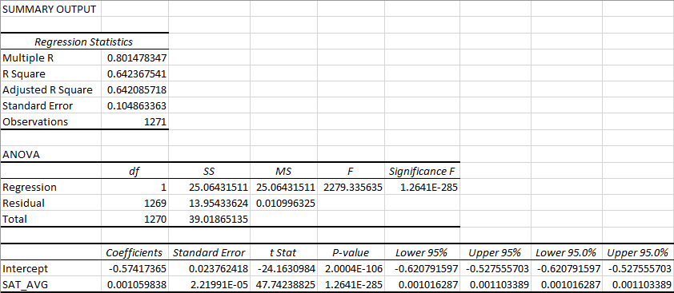
Interpreting the Regression Output
Model Significance
Variable Significance
EXHIBIT 5.16 Regression Results Explaining College Completion Rate

Slide 78
Analytics Types, Examples, and Excel Tools/Functions
Accounting Data Analytics Type | Specific Types of Analytics Employed | Microsoft Excel Tools/Functions
Descriptive | Descriptive statistics such as counts, totals, sums, averages, standard reports, financial statements; histogram, box plots, graphs, charts | SUM(), COUNT(), COUNTIF(), AVERAGE(), SUBTOTAL(), MEDIAN(); Pivottables; quartiles, quintiles, deciles, charts/graphs Analysis toolpak: histogram, descriptive statistics
Diagnostic | Variances, differences from expectations, correlations, identify outliers/anomalies (fuzzy lookup); sequence testing, drill-downs and roll-ups to get detail when needed, pivottables (crosstabulations); principal component analysis clustering, hypothesis testing | Pivottables; Analysis toolpak: Testing of means of various groups (t-test), correlation, rank, and percentile Conditional formatting Excel add-in: Fuzzy lookup
Predictive | Classifications, regressions, time series | Analysis toolpak: correlation, regression, forecasting sheet
Prescriptive | Optimization, what-if scenarios, sensitivity analytics, simulation, machine learning | What-if analytics, sensitivity analytics, scenario manager, goal seek, NPV(), IRR()

Slide 79
Progress Check 5-7
Q. Let’s suppose we are comparing the ROA of retail companies to the ROA of manufacturing companies. We perform a two-sample t-test, resulting in a p-value of 0.11. Assuming an alpha of 0.05, what can we conclude about these companies?

Slide 80
Introduction To Tools Used in Data Analytics

Slide 81
Excel
Basic data analysis can be done in Excel.
Simple statistics are easy to do.
Can use ”if”s and other formulas to create logic.
Analysis tools add more functionality like regression.
Note on Excel usage:
One of the largest problems in many businesses is the misuse of Excel.
Many complex things in Excel should be in a database.
Using Excel in place of a DB/app is less secure and stable.
One easy place to get credit is improving broken Excel.
We’ll do a little Excel analysis towards the end of semester.

Slide 82
Visualization Tools
Tools like Tableau, PowerBI, Qulik, and others can create visualizations from data.
Visualizations are most useful to create better descriptive analytics.
The capabilities of visualization tools have changed reporting:
Many static reports have been replaced with dashboards.
Reporting is available up-to-the-minute.
Have made using large amounts of data more accessible.
Decision makers can better use data to make decisions.
Increasingly prevalent and common in “regular business”.

Slide 83
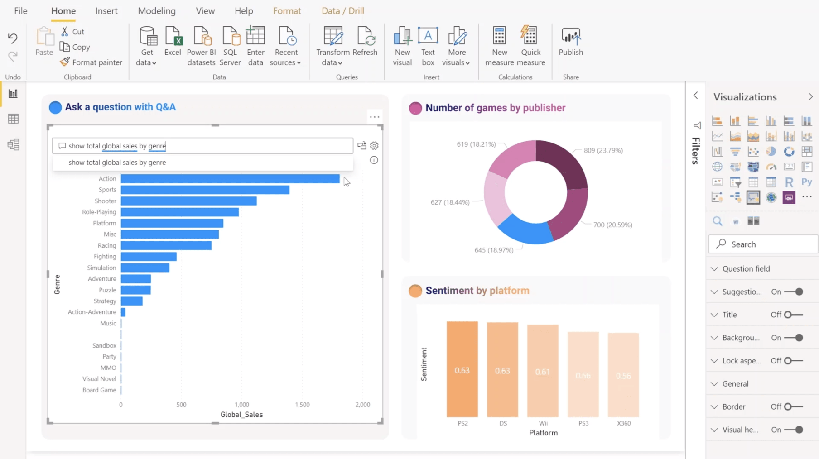

Slide 84
Statistical Software
A large amount of older data analysis is done with statistical software.
E.g. SAS, SPSS, Matlab, etc…
Target made programs to analyze data.
Some similar visualization abilities to Tableau.
Some calculations like Excel.
Some more advanced tools like predictive models.
These tools are common, but less important going forward in many areas.

Slide 85
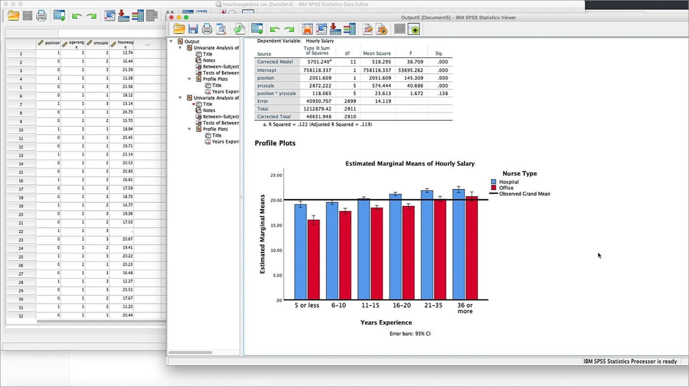

Slide 86
Application Specific Analytics
Many modern applications for “other stuff” have analytics built in.
ERP, account, LMS, Teams, web analytics, etc…
Analytics can take different forms.
Lots of descriptive analytics to report data.
Predictions like sales forecasts or stock estimates.
Prescriptive like optimal pricing.
The use of analytics is often integrating into other roles.
Warehouse people may use stock forecasts to plan.

Slide 87
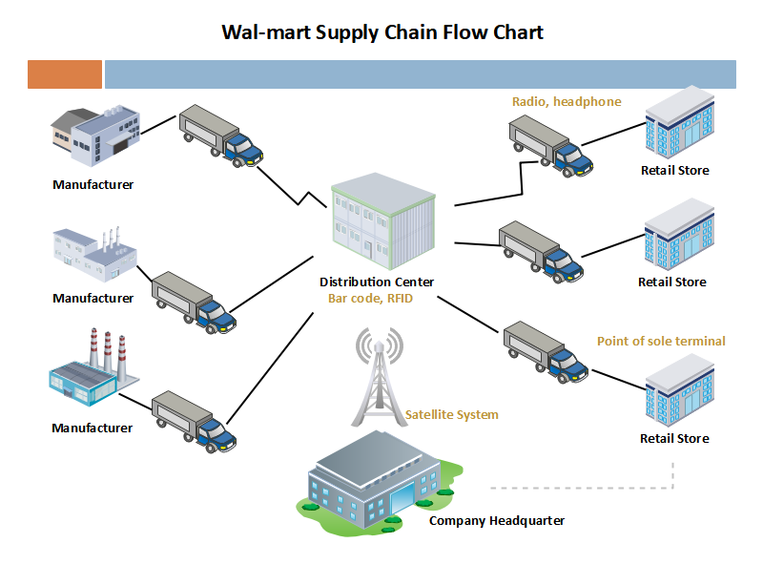

Slide 88
Programming Tools
Most predictive analytics is done through custom written software.
Teaching this stuff is my main job.
Programs can load data, do analysis, and output a model.
The model takes inputs and produces a prediction.
E.g. a model takes applicant info (salary, loan, rate, etc…) and predicts if they will pay it back.
Commonly used programming languages are:
Python – easy, most common, lots of tools.
R – language made to ”do stats”. Less common, slightly fewer tools available.
There are several libraries (packages of premade code) that make this much easier.

Slide 89
Predictive Models from Code
The predictive models are based on applications of some statistical concepts.
Linear regression.
Decision tree.
AI tools like ChatGPT, Alexa, Image Rec. and Seri are all based on large versions of this idea.
Based on a class of models called neural networks.
”Deep learning” models are just large neural networks.
As the availability of data, PC speed, have improved, prediction models have gotten better.
If you are analytics-adjacent, it is a good idea to code at least a little bit. It will likely help.

Slide 90
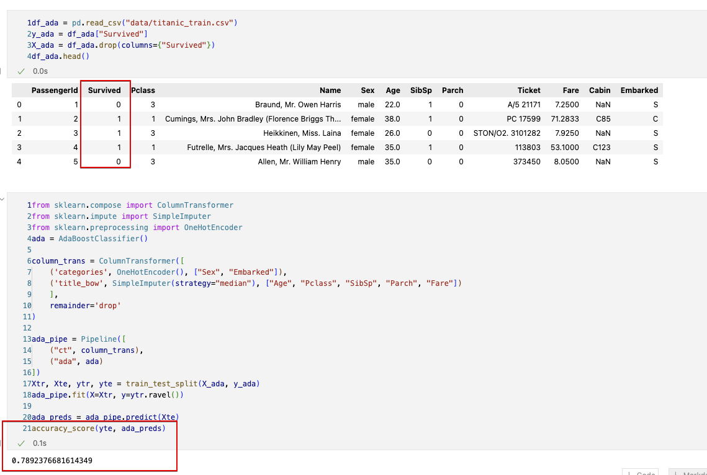

Slide 91
Predictive Modelling Software
There are several GUI based tools that do predictive modelling.
RapidMiner, Orange, etc…
These programs are (potentially) easier to use to do predictive analysis without programming knowledge.
Can do classification (yes/no), regression (guess a number), forecasting, clustering, etc….
Are normally used more for exploration or prototypes in real use, production work is done with programming.
The concepts are the same, this has more hand-holding.

Slide 92
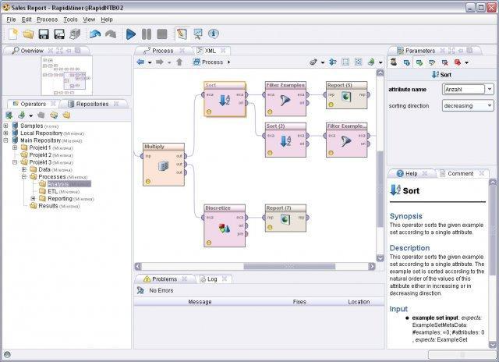

Slide 94
Conclusion
Anywhere that we have data, we likely have analytics.
Data collection is getting more widespread.
Tools are getting better and easier – no need for a math PhD anymore.
Organizations (generally) try to climb the analytics ladder and make more from data.
Many/most companies are shockingly low on this sophistication scale.
Generally gets more complex and more programmer-y as we move up.
Making good use of analytics requires tech skillz as well as domain knowledge.
Need to understand data, tools, processes to do analysis.
Need understanding of how it relates to real life impacts to make it useful.

