Slide 1
Housekeeping
You guys seemed to do much better on the quiz than version 1.
Predictive modelling in Tableau.
Some details on some predictive modelling applications we can use in Tableau.
Time series forecast, regression models.
Depending on time, market baskets.
Data – from repositotory: stock_data.csv, bodyfat.csv
Predictive modelling knowledge needs:
Theory – this is one of the branches of analytics, and we need to understand basics.
Practice – Tableau has some limited predictive tools, if one makes sense, we can use.

Slide 2
Proposal
The project proposal is simple, almost free marks, and important.
You need to write your plan to do the project.
I’ll look at it to see if it sounds reasonable and doable – I’m mostly checking to raise concerns on what might not work out going forward.
Much more importantly, you all need to sketch out and agree on a plan.
Consider backup for anything you don’t know works.
If you plan on making/showing X, make sure you can with the data before settling.
There may be issues with granularity, data types, etc.. That may require work to solve.
Better to start with something that’s a bit too broad and trim if everything works.

Slide 3
More Project Details
There’s a document on Brightspace with some tips on sharing work.
It isn’t as simple as a google doc or something.
Easiest is to setup a starting point with all data added, then each person builds their own sheets from that shared starting point.
At the end someone will need to manually combine the workbooks into one, not super hard, but takes a bit of time as you’ll need to do final layout and such.
I can’t ever emphasize how much easier this is if you do stuff early.
Remember, you need to communicate something with this visualization.
There should be some thesis like statement – this story shows/explains this stuff….
There are multiple aspects that you’ll need to cover, that takes time to organize.
Refer to the storytelling techniques and visual vocabulary for starting points.

Slide 4
Regression Models and Time Series Forecasting

Slide 5
Time Series Data
Time-series data is data that progresses over time.
E.g. gas prices, stock prices, temperature, etc…
The basis of predictions, or forecasts, is by looking at patterns in the data.
Time-series data has a few parts that our forecasts try to separate:
Trend – are we going up or down as time progresses.
Seasonality – do we have regular waves, such as seasonal sales.
Cyclicality – do we have larger waves, spanning several seasons.
Irregularity – how much variation is there that doesn’t fit into the above.
The models generally try to decompose each of these, measure each, and recombine them to create projections.

Slide 6
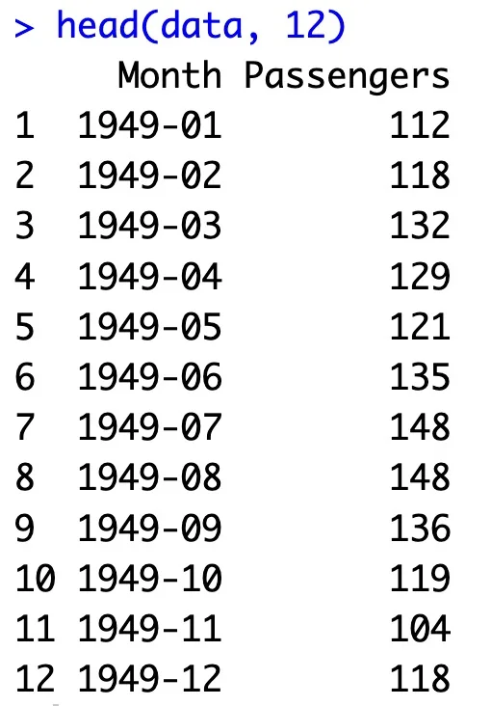
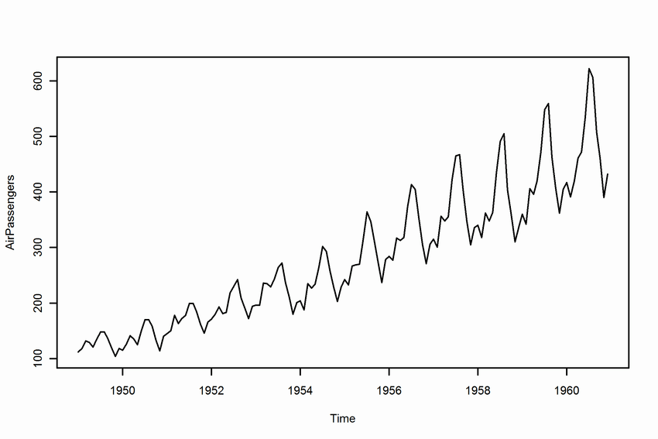

Slide 7
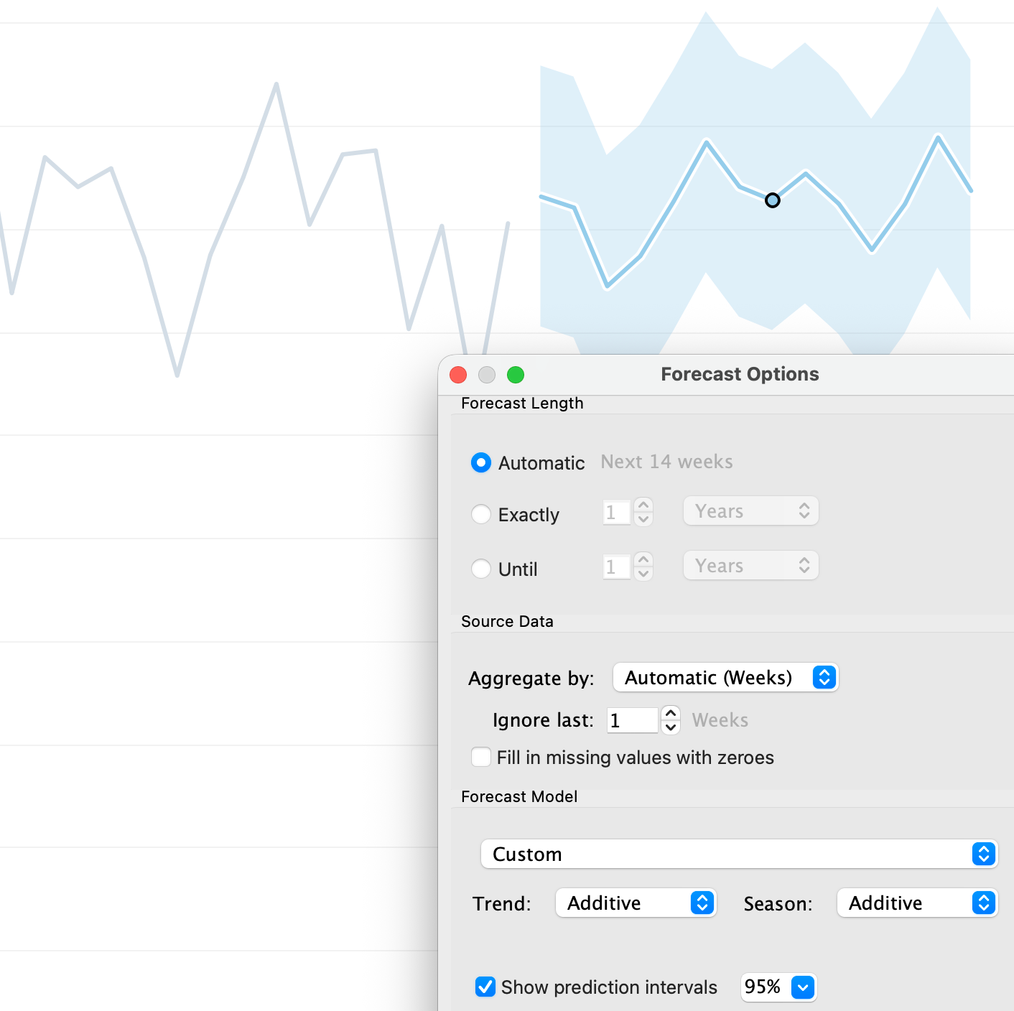
In Tableau…
Our ability to forecast in Tableau is useful but limited.
We can do basic moving average forecasts.
Use the average* of the last several* values as a prediction for the next* value.

Slide 8
Time Series Predictions Are Hard
It is hard to make accurate time series predictions into the future.
If it wasn’t, we’d all have massive stock portfolios.
Simple statistical models (moving average, etc…) can often win out even compared to super sophisticated models (e.g. neural networks).
The large and powerful neural networks have higher ceilings, but more variance.
Relying on a model that is less adaptive to details often works well.
Build up – start with simple, then modify if that works poorly.

Slide 9
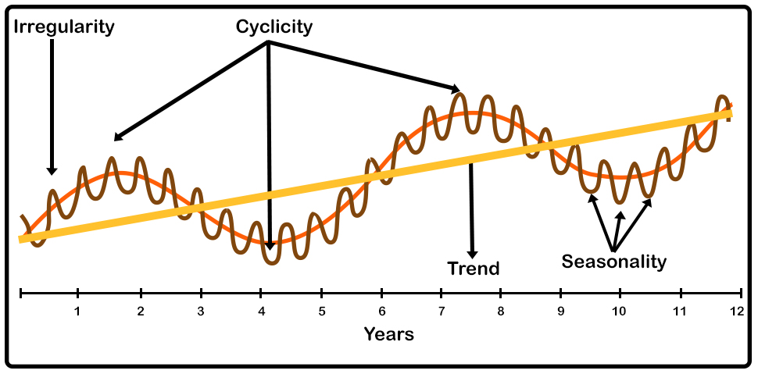

Slide 10
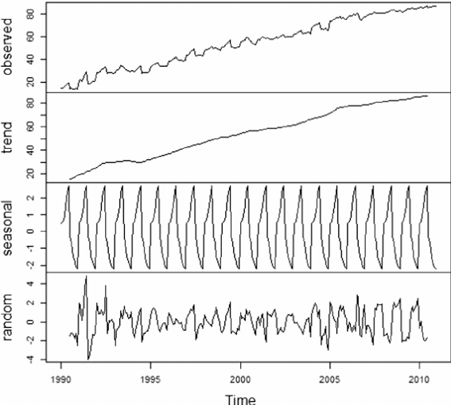
Time Series Components
The basic idea is that if we can extract each component of the time series’ variation, our model can more easily project each.
Example plots:
Trend – linear increase.
Seasonality – predictable waves.
Random – “other” variation.
Note: different models may capture slightly different components.

Slide 11
Exponential Smoothing
Exponential smoothing is one of the simplest forms of time series forecasts.
Weighted averaging with a smoothing term.
Can also incorporate:
Trends – are we moving up or down over time.
Cyclicality – are there seasonal patterns.
Trends and seasonality can be either Additive or Multiplicative:
If every December we sell 10,000 more apartments than we do in November, the seasonality is additive in nature. However, if we sell 10% more apartments in the summer months than we do in the winter months the seasonality is multiplicative in nature.

Slide 12
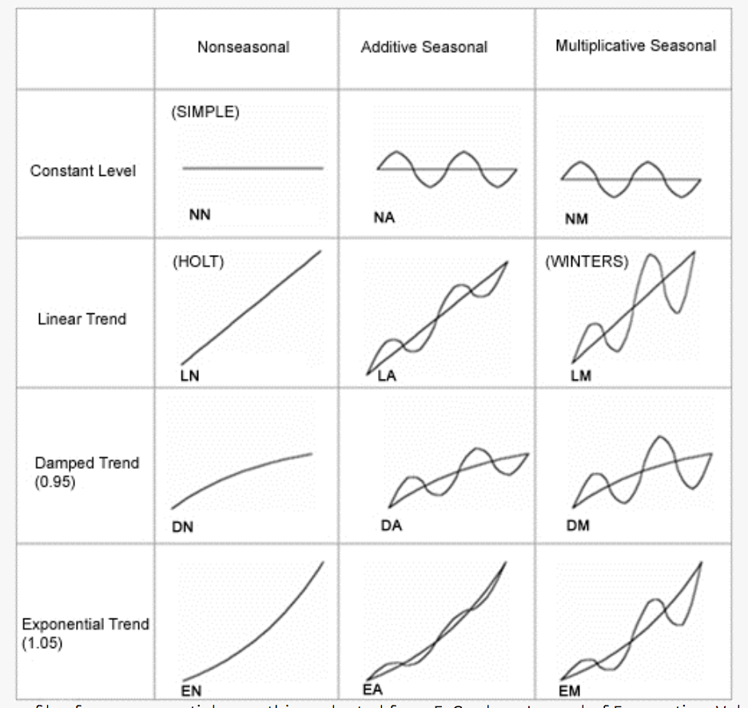

Slide 13
Confidence Intervals and Uncertainty
We predicting the next value in a time series, there’s uncertainty.
E.g. tomorrow’s gas price per litre obviously can’t really be known exactly.
A good model, and certain data, will have predictions that are more reliable.
The model “fits” – the predictions made by a model are similar to the real values.
In data science we call the real values the empirical values/data.
The data is more stable and predictable in its pattern.
We have more data.
A confidence interval tells us how much uncertainty we have…

Slide 14
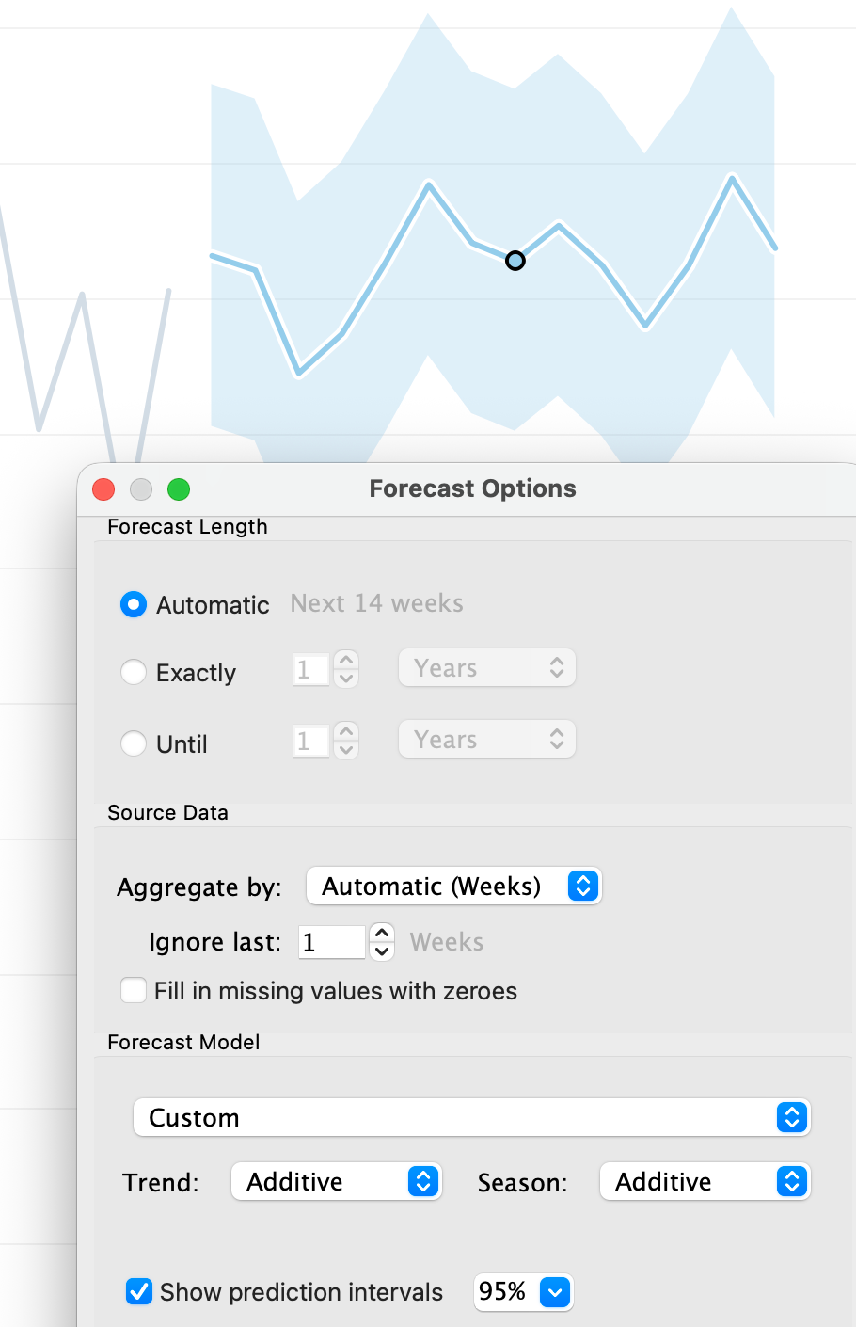
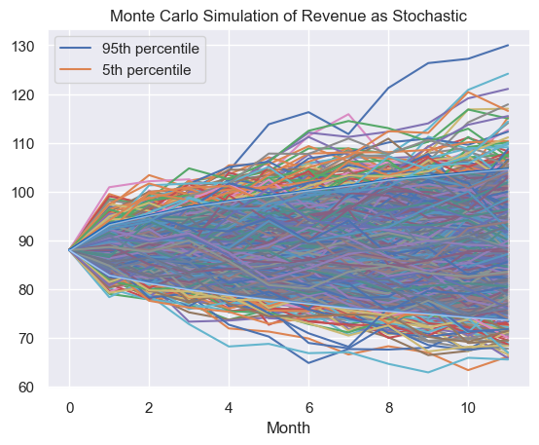
Confidence Intervals
CI is simple – we are X% confident the value will be within Y limits.
95% CI means there is 95% chance the real value happens in range.
The wider this range is the more uncertainty.
Calculated through Monte Carlo simulation (just for context).
Create a model that can predict a value (ml model are probabilistic)
Run a bunch (e.g. 1000) trial runs of making predictions.
Track all the predicted values.
Measure the values where 90/95/99/CI? fall in.
In the image, each 12-month prediction is a line.
95% of those predictions are within blue shading.

Slide 15
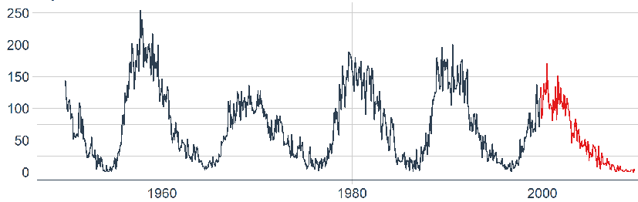
Moving Average Predictions
These moving average models are the most simple we can do.
Need to spot period and add/mult, but very simple to create.
Not really able to handle complex things.
Weird patterns of seasons – e.g. a crop may harvest in June and Sept, and odd yearly pattern.
Weird change patterns – additive and multiplicative are simple patterns.
More complex patterns in data – image is from neural network model that is thousands to millions of times more complex and adaptable than a moving average.

Slide 16
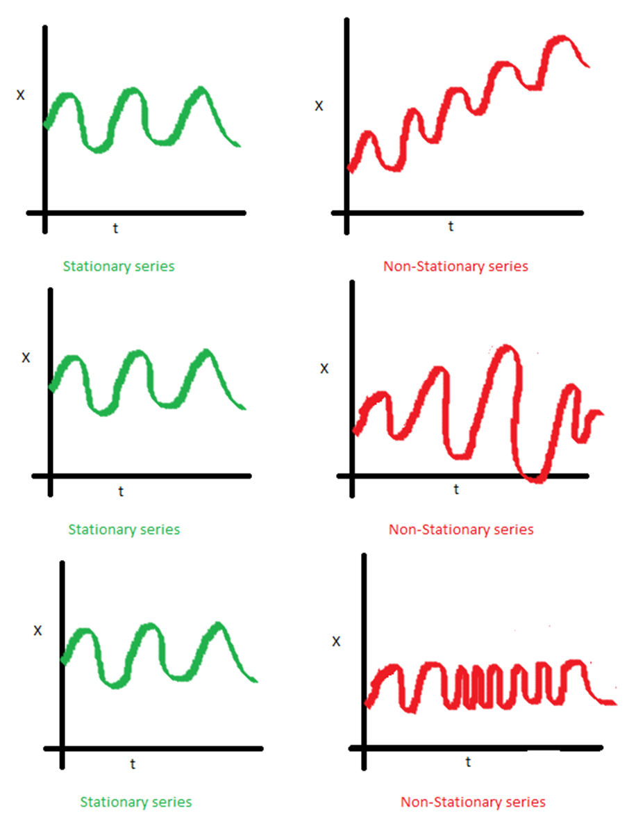
Stationary in Time
A time series being stationary means that its major stats (mean, std) are not changing over time.
We can transform data to make it stationary:
Differencing.
difference(T) = observation(T) – observation(T-1)
Other transformations (e.g. log).
More complex time series analysis generally aims for this.
Make data follow a simple pattern through transformation.
Use simple pattern to predict.
As needed, reverse transformations to get real values.

Slide 17
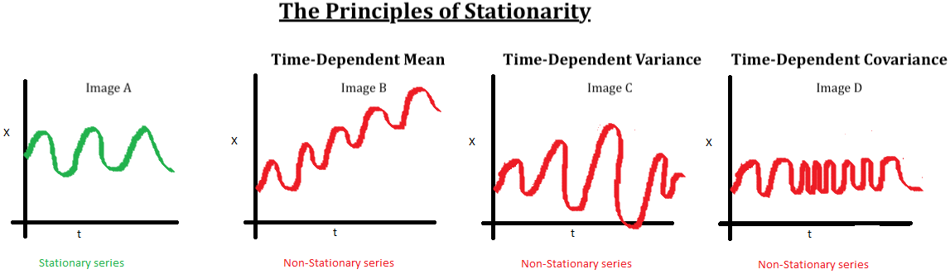
Stationary stats
If we can define some operation to make the data predictable, it’s easy to predict.
The preparation steps aim to remove the red stuff as much as possible.
The transformations (exp, log, differencing, etc..) can all be done/reversed for real/calc. values.

Slide 18
Some Real Life Time-Series Examples
We don’t need to know these deeply, just the basic concept.

Slide 19
ARIMA
ARIMA is a common time series model, it has 3 parts:
AR (p) – Autoregressive. Regresses on its own prior or lagged values.
AKA - it predicts future values based on past values.
I (d) – Integrated. Observes the difference between static data values and previous values.
AKA – aims to achieve stationary data that is not subject to seasonality.
MA (q) – Moving Average.
AKA - A moving average.
ARIMA and similar models are a common approach that is simple, but more complex than averages.

Slide 20
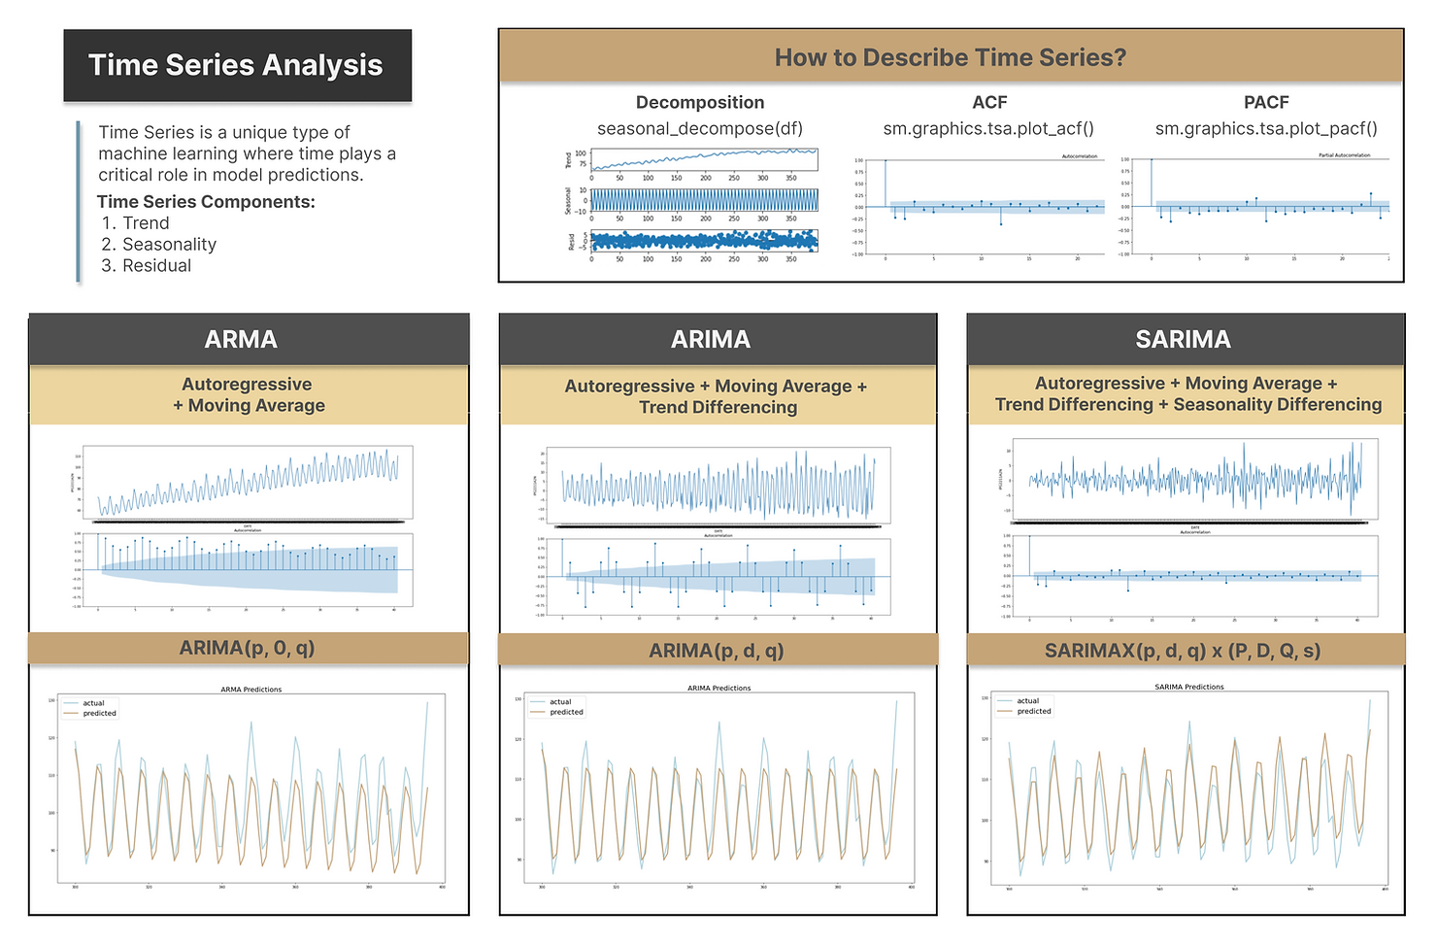
ARIMA Variants
There are several variants on ARIMA depending on the patterns in the data.

Slide 21
ARIMA-d Up
The ARIMA model type is a ‘basic’ one – a more elaborate moving average.
Pros:
Simple, transparent.
Cons:
Potentially too simple, not adaptable to complicated scenarios.
Note – these simpler models with more bias error may perform best, the future is hard to predict accurately. Too much ability of the model to adjust predictions may harm us.

Slide 22
Smarter Time Models
Modern models have much more capability than a simple ARIMA one.
Their capacity to learn is much larger - they have more parameters, can learn complex patterns.
In ds the number of parameters roughly tells us how complicated of a thing can be predicted.
E.g. image recognition is more complex than predicting the number of each shoe size needed for NIKE.
“Regular” simple machine learning models may have 5-100 parameters.
Neural networks (the models that are ‘AI’) will have millions or more.
Very smart models like ChatGPT have tens or hundreds of billions, rapidly growing.

Slide 23
Facebook Prophet
Facebook Prophet is a library that is well setup to handle common time-series problems:
Handles events such as holidays, including custom lists.
Can be set to anticipate change points, e.g. product launches.
Provides useful things like plotting and cross validation.
Can handle additional regressors – more variables.
E.g. can we predict tomorrows gas price with the past prices, as well as temperature, economic metrics, trade numbers, etc…
Uses a neural network internally to be very smart and able to capture patterns.

Slide 24
Checking if Time Series Models are Good
We can create a time series model to make predictions.
A simple moving average, some weighted moving average, arima, something more complex…

Slide 25
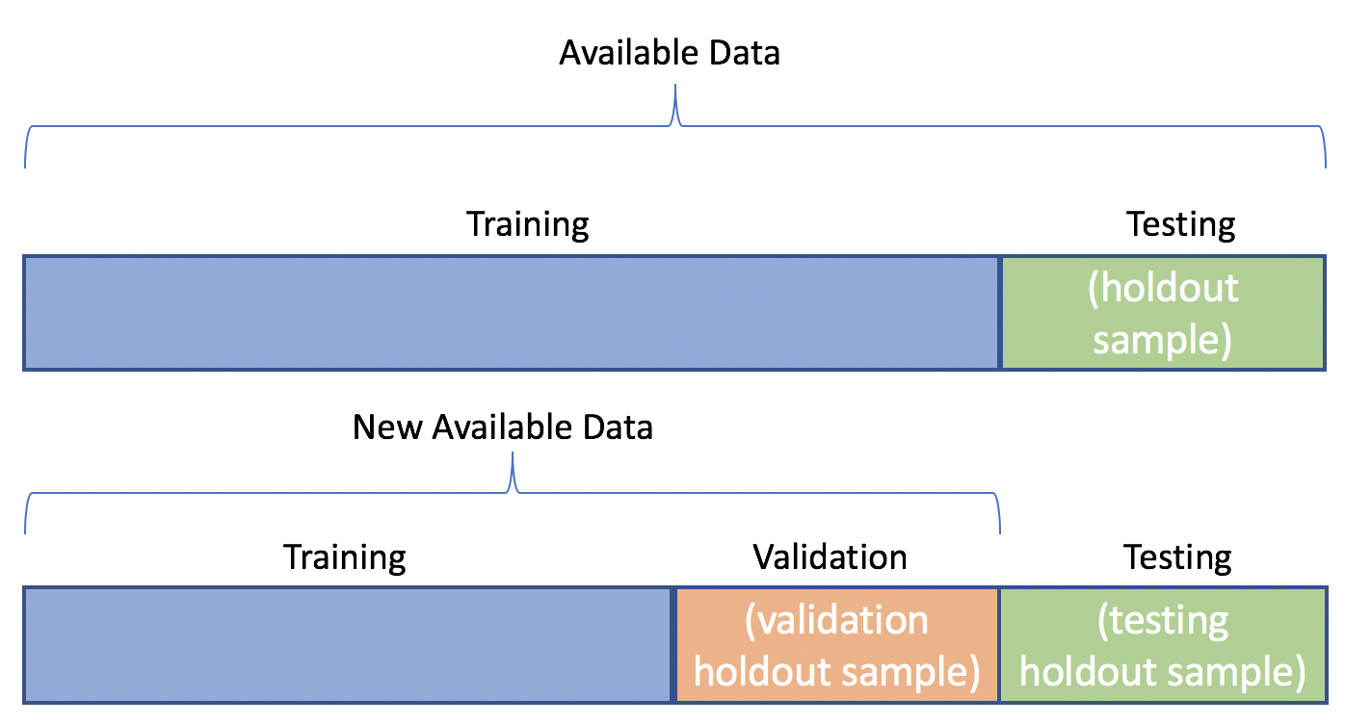
Error Calculations
When time series models are tested, we normally just use the last bunch of records to test.
We use the model as normal to predict these.
I.e. calculate moving average, arima, etc…
Since we know the value, we can compare to pred.
Value is the individual prediction error, a residual.
These are tallied into overall error (e.g. MSE/RMSE)
We’ll do more on error in detail soon.

Slide 26
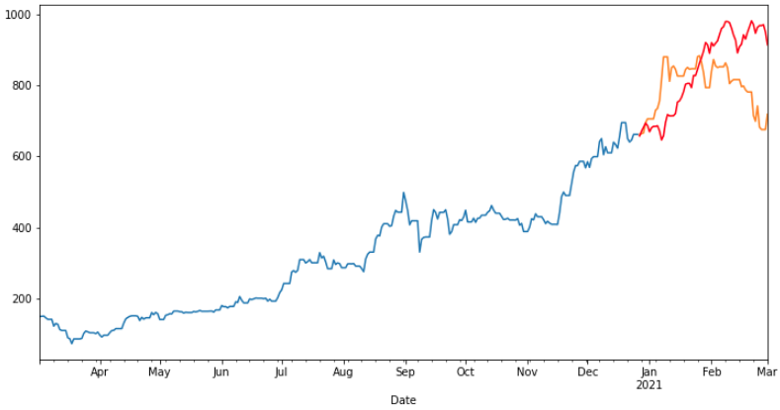

Slide 27
Time Series Conclusion
Time series forecasting is one of the most simple types of predictive models.
Simple ones are just a moving average – and we can do them in Tableau!!!!!!
More complexity can be added to handle more complex scenarios.
Models can be compared by calculating and totaling residuals – test error on old data.
This is generally true for all predictions.
We can show the accuracy of our predictions with a confidence interval.

Slide 28
Regression

Slide 29
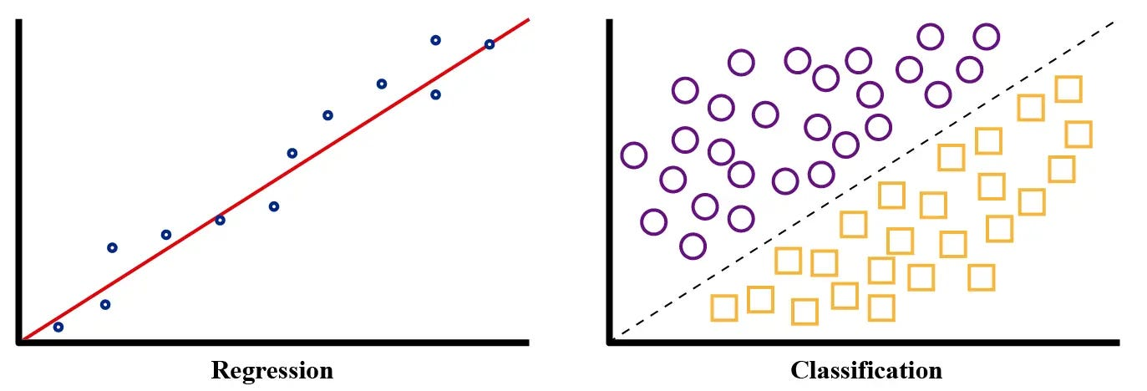
Prelude – Predictive Model Types
Prior to looking at regression models we much clarify a bit on model types.
There are several categories of predictive models, the most common are:
Regression – predicting a value.
Classification – predicting a class (like True/False).
Our tableau stuff does regression.
Classification is almost identical from our perspective, only result is different.

Slide 30
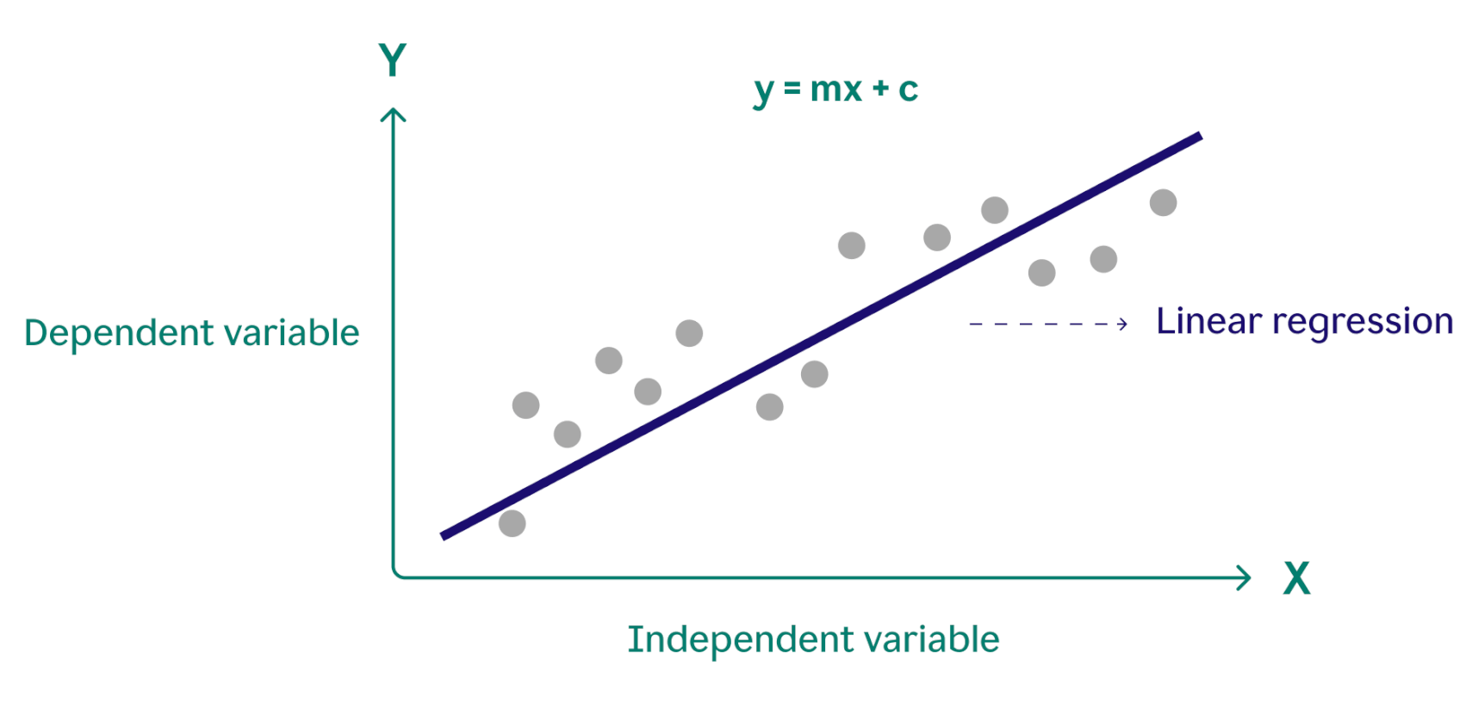
Regression Models
Regression models are something you’ve seen before – lines of best fit.
A regression model:
Allows us to predict Y given X(s).
Is a linear equation – y = mx+b.
The line is down the ‘middle’ of the data.
The ML model is the equation.
M and b are learned by the algorithm.
We can insert any x ang get predicted y.
We can have many Xs, add more terms.

Slide 31
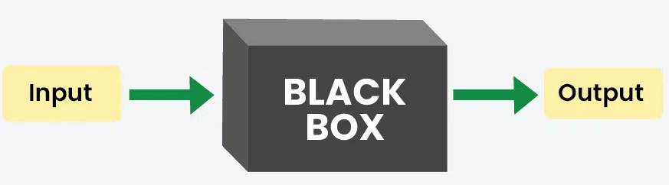
How is a Regression Model Made
Regression models are computed for us by the machine.
We provide old data, the computer uses that to learn the pattern.
In linear regression, the slope and intercept are calculated.
Different types of models do the same thing, with different math.
The model is just a thing that transforms input to output.
We can make different models and compare them to decide which is best.
Key – we don’t tell the computer how to predict Y from X, it finds it.
Computers are able to pick up on very subtle patterns.
If we have lots of data, this can be quite smart and accurate.

Slide 32
Real Life example – Bank Loans.
To get a loan at a bank you fill out information (income, age, job, loan amt etc…), more info (e.g. credit score) is gathered by the bank, and these are the inputs to decide.
Traditionally, this goes to an underwriter (person who evaluates loan risk).
They make a decision on approval and/or interest rate based on many rules.
If income is +/-, credit score is +/-, savings amounts….
It is basically a flow chart of decisions to slot you into a category – how risky are you.
The rules used to decide are made by experts, based on experience.
From all the past loans we gave, what happened? Who paid, who defaulted, what are their stats.
Experts basically translate history and expectations into a model – inputs to output.
They need to know/identify what’s associated with good/bad loans.

Slide 33
But What if A machine Could do that?
I was part of a project to replace the banking system with one that (can) automate that.
Overall decision is identical – take in financial inputs, predict if we loan.
Start with same inputs (or more similar ones) – financial info, loan details, etc…
Instead of people making rules, the machine makes a model.
Provide old loan data: target of did they pay it back, inputs of the financials.
We don’t provide how to predict target from inputs, just give examples.
The learning process (where m and b are calculated) will find an optimal solution.
Machine can spot patterns and trends in what indicates loan quality far better than us.
If we have lots of data, this can be quite accurate.
Real banks sometimes use this (with large amounts most/all involve human approval).

Slide 34
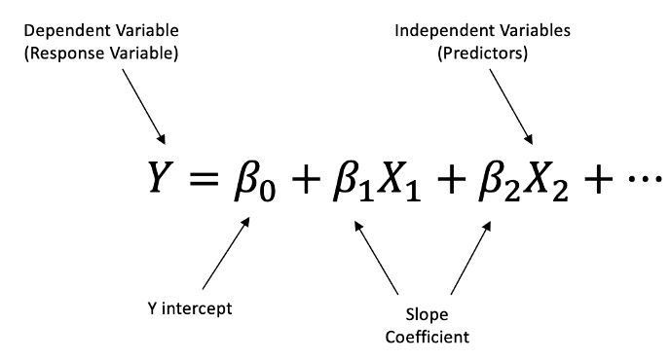
Result of Multiple regression
The output of the training process is a model – something that predicts output given input.
Model can predict Y if we give a set of inputs, Xs.
Prediction is effectively a weighted average of the inputs:
Each x is a real metric (income, age, job, etc…)
Each coefficient (m, slope) weights it’s importance.
Each new prediction takes new xs, balances them by their weight, combines them all, that’s the predicted y.

Slide 35
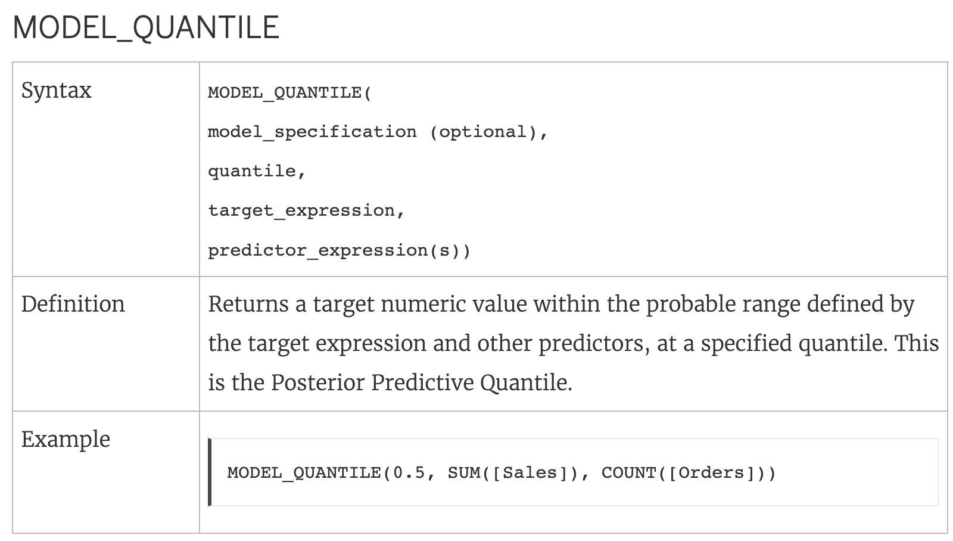
In Tableau…
In Tableau we can make some simple models.
Model quintile:
Can use to predict the expected value of K percentile, e.g. .5 predicts median.
Model percentile:
Based on the expected distribution, where does this value lie.
I.e. is it at the top end of what we’d expect, the bottom, or in line with expectations.
Both of these are with respect to some inputs (features, x values):
We provide what we want to predict (target) as well as what data to use to do it.
Machine figures out how to translate from in->out by doing some math.

Slide 36
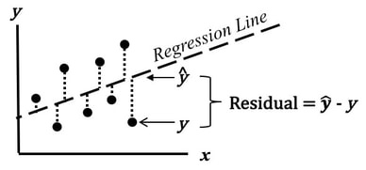
How accurate are those Predictions?
The predicted values for the target are just that, predictions.
These predictions aren’t perfect, we hope that they are close.
We can evaluate a model for its quality in a few ways, based on the residuals.
The residual is the error for an individual prediction.
We can make a prediction from our model, compare to real value.
E.g. the stock price in reality is $37.45, our prediction is $37.50, the residual is .05.
We usually square and average these – the MSE.
The root of that is RMSE, on the same scale as our original data.

Slide 37
Association
One other type of analysis we can do is association analysis.
Which things are tied/connected to each other?
Commonly used to find preferences.
If people who listen to artists A or B usually listen to both, suggest one to the rest.
If someone buys certain products, what else are they likely to buy.
Market basket analysis – look at patterns in a purchase to target actions.
Measure how ‘connected’ certain items are – if someone buys one, do they get the other.
E.g. how many laptop buyers get a new mouse or extra power adapter.
If someone fits the patten that they’re likely to get something else, target them.

Slide 38
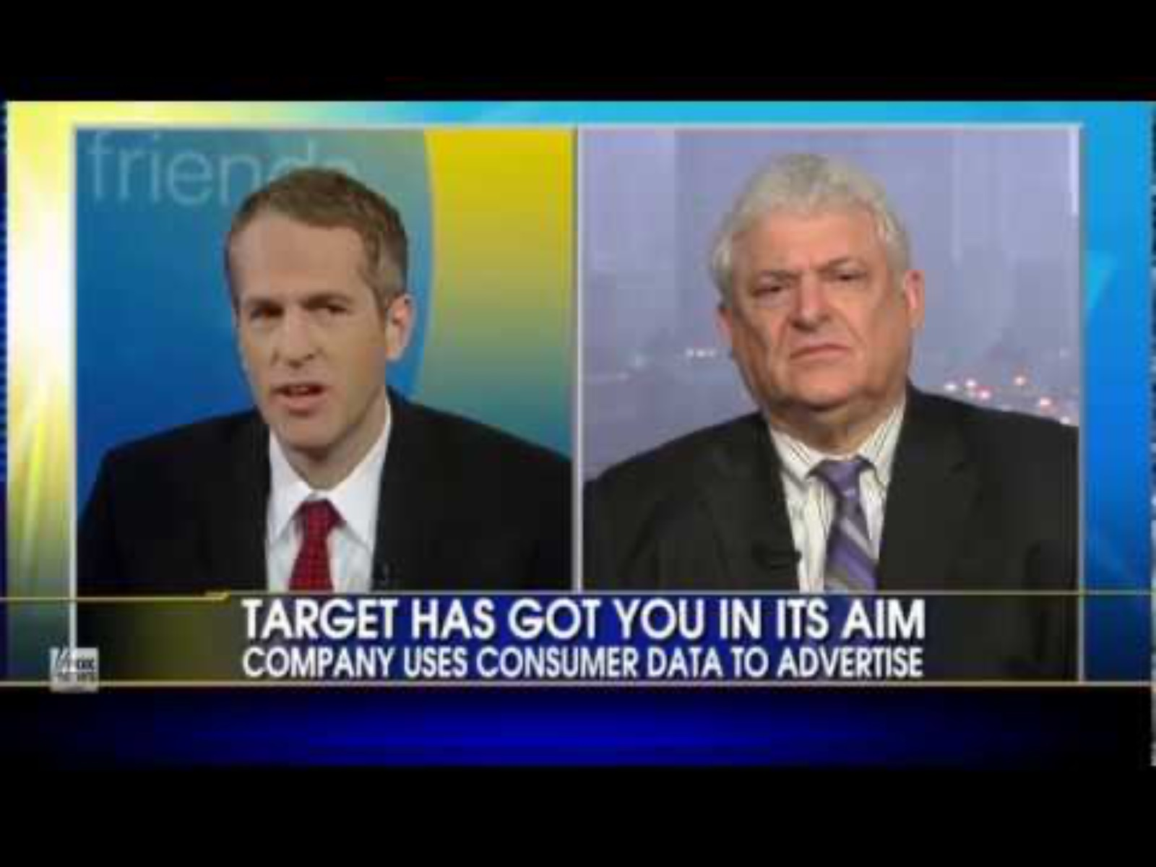
Famously… Target

Slide 39
Target was too Targeted
Target made a system to score customers for ‘pregnancy score’.
Patterns were found by looking at people on the baby registry.
Females on baby registry can be assumed to be pregnant.
Due to loyalty cards (or cc, or other ways) we can identify this person always.
People on the baby registry changed their shopping patterns somewhat.
E.g. more lotion, vitamins, less smokes, etc…
Pregnancy score looks at each person’s purchases, and measures similarity to preggos.
If what you buy is very similar to registry people, you are likely pregnant.
Target targeted adds for strollers, cribs, etc… to these people as valuabe customers.
Some data got really mad, yelled at the manager for them calling his kid pregnant – she was.

Slide 40
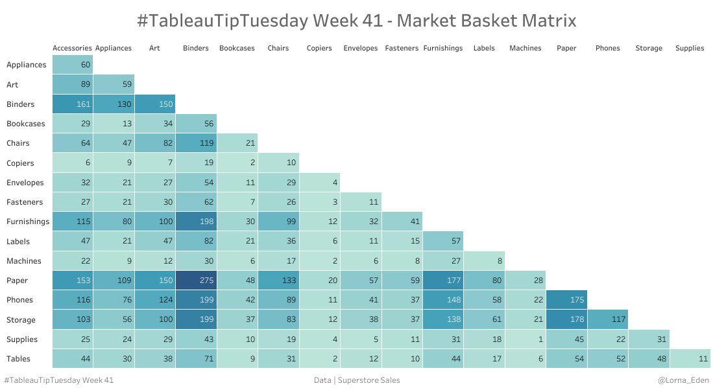
In Tableau
We can do market basket analysis.
The values measure how frequently these items are bought together.
For many associations, this works.
Often need longitudinal tracking – e.g. a customer over several transactions.
Not causation, only correlation.

Slide 41
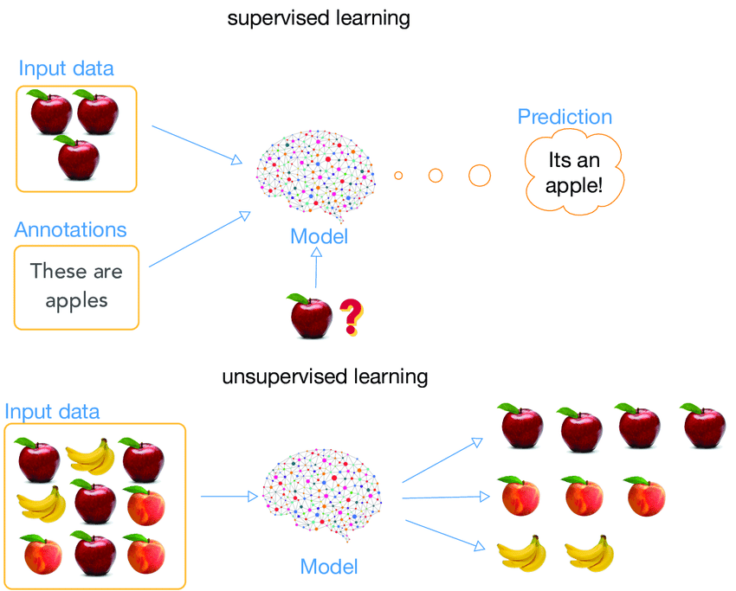
I want To Speak to Your Supervisor!
Regression vs association highlights a split.
Supervised learning models:
We know the specific outcomes just not count.
Customer yes/no, stock price, temperature.
Regression and classification fall here.
Unsupervised learning models:
We don’t know the specific outcomes.
Finds relationships within data.
Clustering and association fall here.

Slide 42
Why Predict?
Prediction models are very common.
Most common use of machine learning, we want to predict some unknown.
We can predict what we need from what we have.
Loan – have applicant info, want to know if they’ll pay.
Stock levels – we have past sales info, how many jars of pickles will we sell?
Since modern business generates data on everything, this can be quite powerful.
Many/most AI/ML related things are based on this concept.
E.g. ChatGPT is (roughly) a stack of a billion linear regressions (kind of, not literally).

