Slide 1
Housekeeping
Today:
  Color (chapter 4).
    Map types
    Data type review and grouping/aggregation review.
  Intro to Maps exercise (Intro to maps zip file in repository).
    If anyone wants to try to make an account at mapbox.com and see if it is still possible to make a free account, that’d be amazing and your classmates will love you forever.
If lots of time, we’ll look at Gestalt’s Principles.

Slide 2
Assignment
Remember – you need to clearly communicate something useful/interesting.
  The main goal is communication, the charts are just the tools.
  The number and style of charts you should make depends – what is needed to communicate?
You’ll do some peer review in the class after (Monday):
  I’ll send a breakdown of the details tomorrow.
  Basically, break into group, evaluate the other people’s vis’ via the rubric, provide comments/feedback.
  I’ll tally and aggregate the marks for your grade.
  If you feel the grade is off, you can appeal and I’ll grade and override (can go up or down).
  Participating in doing the reviews is worth 5% (basically a gimmie mark).

Slide 4
Discreet vs Continuous
One key consideration in color is discreet vs continuous data.
  Discreet – takes on only certain specific values.
  Continuous – takes on any value in a range.
This relates to another, slightly broader, division in data:
  Categorical – groups, labels, or descriptors.
  Numerical – measurements.
These aren’t a perfect match (we can have a discreet numerical value) but they are close.
  Most commonly – discreet value of a number, like shoe size.

Slide 5
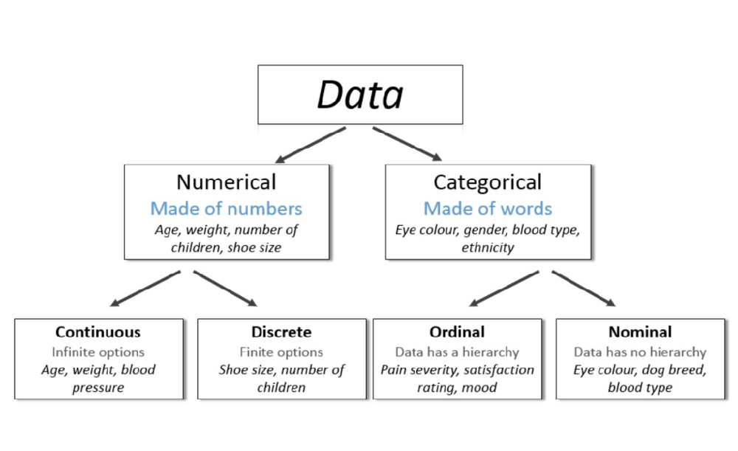

Slide 6
Discreet vs Continuous in Tableau
In Tableau we have two types of variables:
  Dimensions – discreet values.
  Measures – continuous values.
Tableau usually identifies these correctly, but not always.
We can manipulate the way Tableau interprets the type as needed.
  Right click -> options for discreet/continuous and measure/dimension.

Slide 7
Less Formally…
There is some possibility for confusion, especially with discreet number values.
In general…
  If it makes sense on a number line, it is a continuous value.
  If we want to ”group by” something, it is a discreet value.
We are often (usually??):
  Dividing (segmenting, grouping) data into groups by some categorical value.
  For each of those groups, calculating some aggregate value – sum, count, mean, etc…
  E.g. divide census data by province, calculate avg wage. Divide student data by major, calculate number of students. Group covid tests by occupation, calculate infection rate.

Slide 8
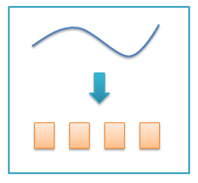
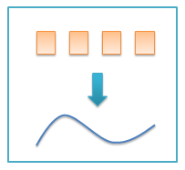
Translation between Discreet/continuous
Binning: numerical to categorical.
Encoding: categorical to numerical.
E.g. your GPA goes from continuous (percents) to discreet (letters) back to continuous GPA number, before being averaged.
Used regularly-ish in data science.
For us – does either help us represent what we want better?
  E.g. if we are looking at career success of middle class residents, it may make more sense to bin income and use that.
  E.g. banks loan based on credit score category, not number.

Slide 9
Aggregation
Aggregation is a general term for combining things – in this case many rows of data.
An aggregation just summarizes many values in on value.
We can use this one value to ‘represent’ that group in analysis.
Aggregate values include mean, median, count, min, max, std dev, sum.
  When aggregating categorical, just count based things for aggregation.
Often (usually??):
  Divide data up into subgroups using some dimension(s).
  Calculate an aggregate value for each group.
  Compare those values to learn something actually useful.

Slide 10
Focus (excessively) on the “per” part of Groups
(Granularity)
When grouping data, focus on what each group is.
  E.g. if you want to know the profit, what do you want to know the profit for?
  This is usually implicit and easy to ignore in normal conversation.
E.g. ”profit” for a store you work at could mean many things.
  Most likely, per location, per year -> implicit understanding.
  Per store, per quarter?
  Per store, per department, per year? (Different from per department, per year).
  Per week, per store?
This is one of the most overlooked things – be explicit and excessively detailed.

Slide 11
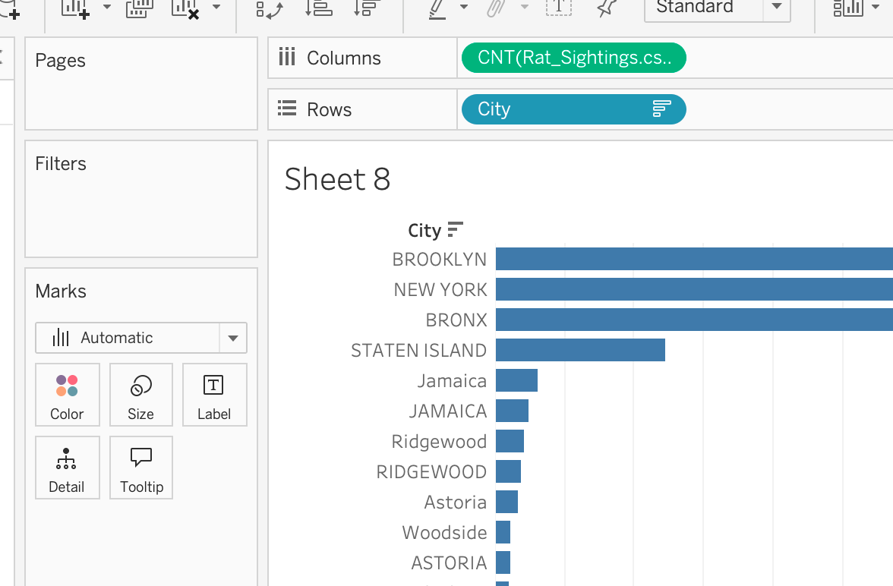
In Tableau
Many rows of data, each row represents some instance (a thing).
When we add a variable to the vis shelf:
  If dimension (categorical): divide up all the rows into groups, one per value in that dimension.
  If measure (numerical): calculate some aggregation (one number) from that measure, and provide one value per ‘split’ (if any).
If we add a value to filters, it’ll exclude whatever matches.
If we add a value to marks card, it’ll vary that thing with the values.
Some values have different granularity – per city, prov, country…

Slide 12
For mapping…
When mapping, we are always showing some spatial data (e.g. lat/long).
What else do we want to show?
  Depending on the map, we can show 1+ other value via a marks attribute.
  We must calculate data to be “one vale per MAPPED THING”.
    (Constrained and obvious, so this is good practice).

Slide 13
Color

Slide 14
Color in Visualization
Color is a primary feature in visualizations.
  Most visualizations can have color added pretty easily.
We can encode, or represent data from variables via color:
  Numeric variables can be represented with a gradient.
  Categorical variables can be represented with different colors.
Color is one of the most prevalent preattentive attributes.
  We have preexisting understanding of many color things – red/green, dark/light, etc…
  We notice color quickly and our brain categorizes/orders based on it.

Slide 15
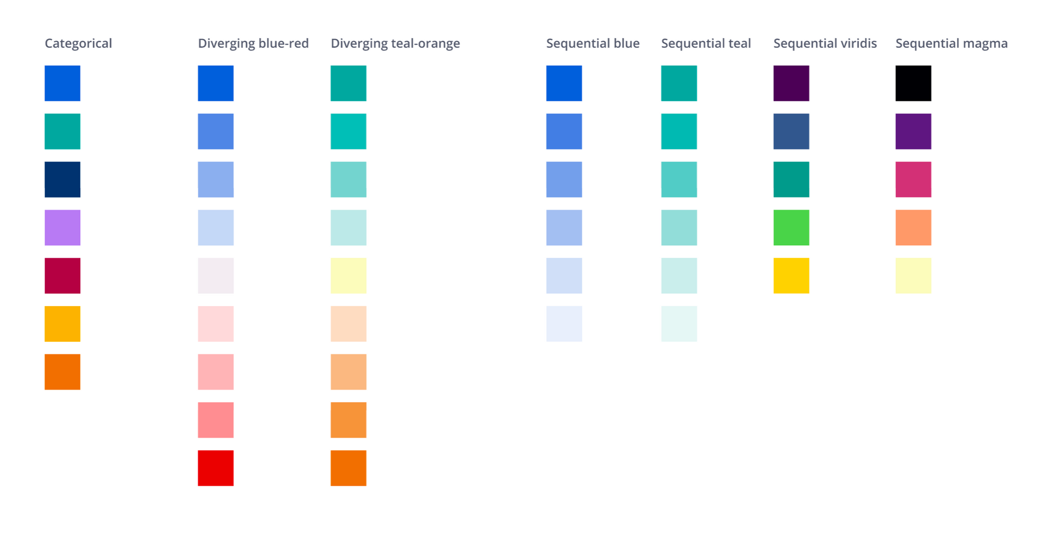

Slide 16
Scales and Color Choices
Color choice and visual design is a massive area of study.
We don’t need to be experts, but we need to be competent.
Think – we want to convey some info, does adding color make that clearer.
  Always ask this.
Two main things that we use color for:
  Differentiation – showing different categories with different colors. E.g. province map.
  Gradient – showing progress of a numerical value over a range. E.g. crime map.
  Gradients can be both diverging and sequential, roughly – is there a middle?

Slide 17
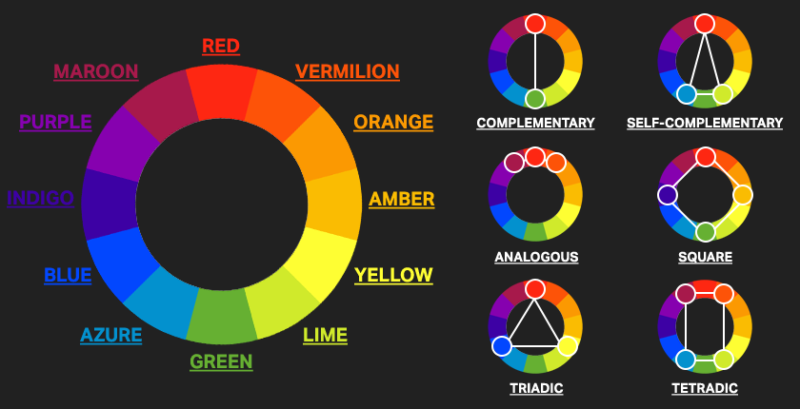

Slide 18
Tableau Helps us Out here…
The default color schemes that Tableau assigns are generally good.
Some things to pay attention to:
  If there’s more than one chart with the same data, make sure color is consistent.
  If something’s categorical, limit number before assigning color.
  If the data is discreet vs continuous it’ll get colored differently, you may need to adjust.
Some cases for departing from defaults:
  Preexisting meaning for a certain color scheme – e.g. sports teams, politics.
  Style guidelines demand – e.g. fitting into a larger visual thing, such as a drawing.
  Internal consistency – we don’t want the same thing represented by several colors.
  Clarity – always must ensure it clearly conveys the intent, so if it doesn’t, change it.

Slide 19
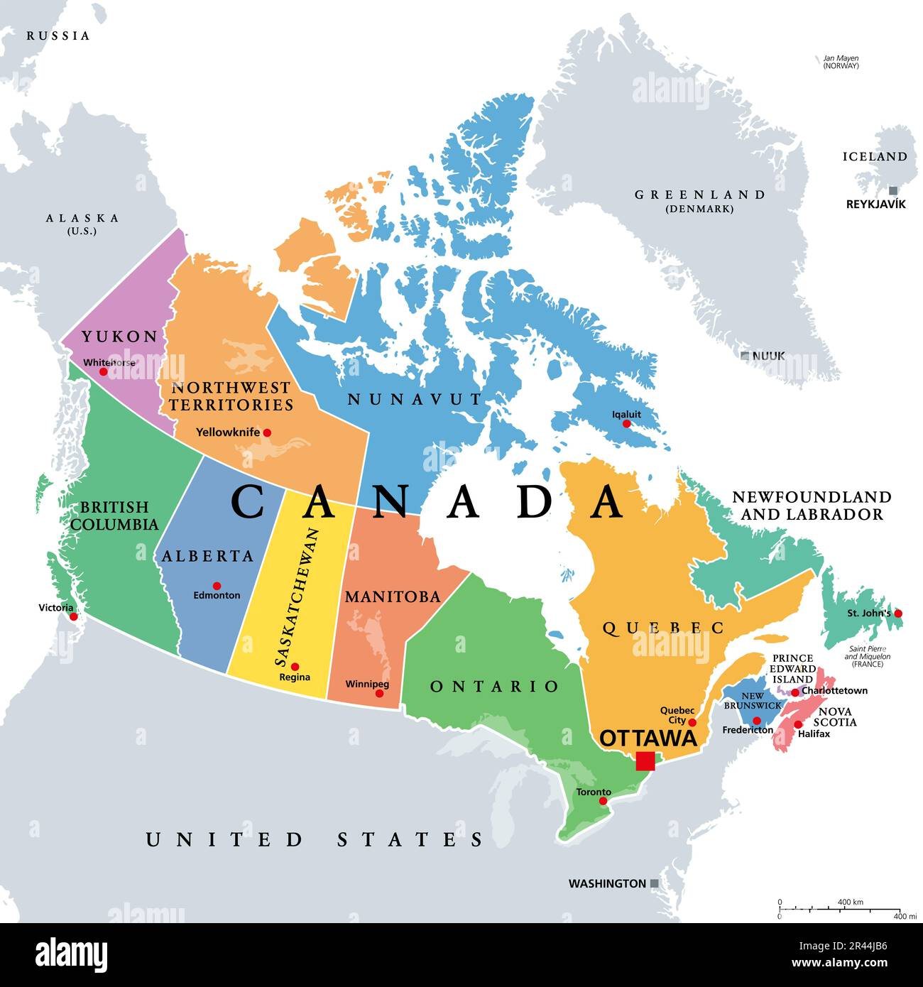
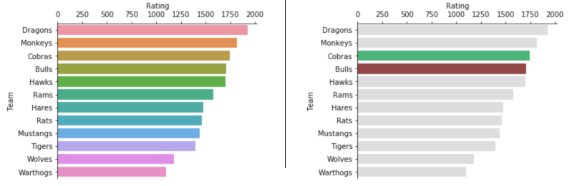
Think about what Color is For
Colors obviously differentiate things, but think about it deeper.
What, specifically do you want a reader to be able to get from a chart?
  Sometimes color can be targeted at it directly.
Example - emphasis on one thing, or a subset of things.
  ”Other” groups for coloring might make sense.
  The color group can be made dynamic with actions.
Use color purposefully.
Always ask – is it clear? Does it help?

Slide 20
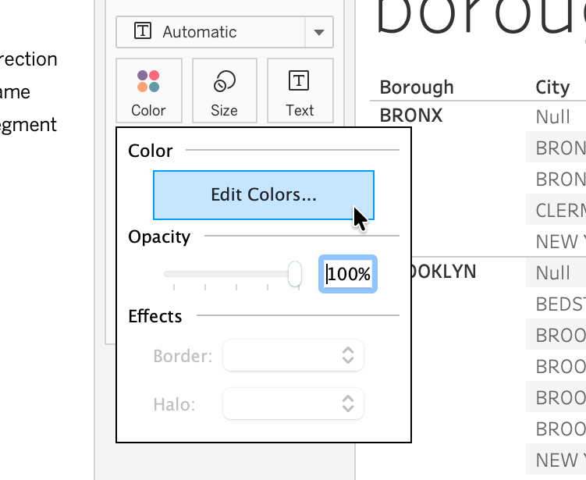
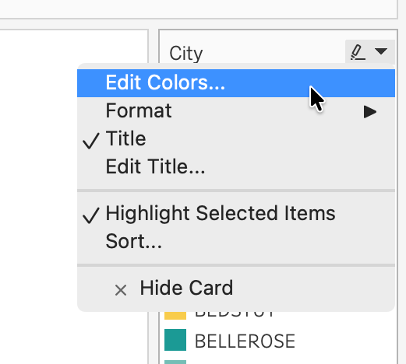
Edit Colors in Tableau
We can edit color usage in Tableau easily.
Drag whatever variable that will control color onto the marks card ‘color’.
Edit Colors will bring up an editing window, where we can:
  Set the color scale used.
  Set scaling metrics – start, middle, end of gradient.
  Set color per category value.
  Reverse the scale.

Slide 21
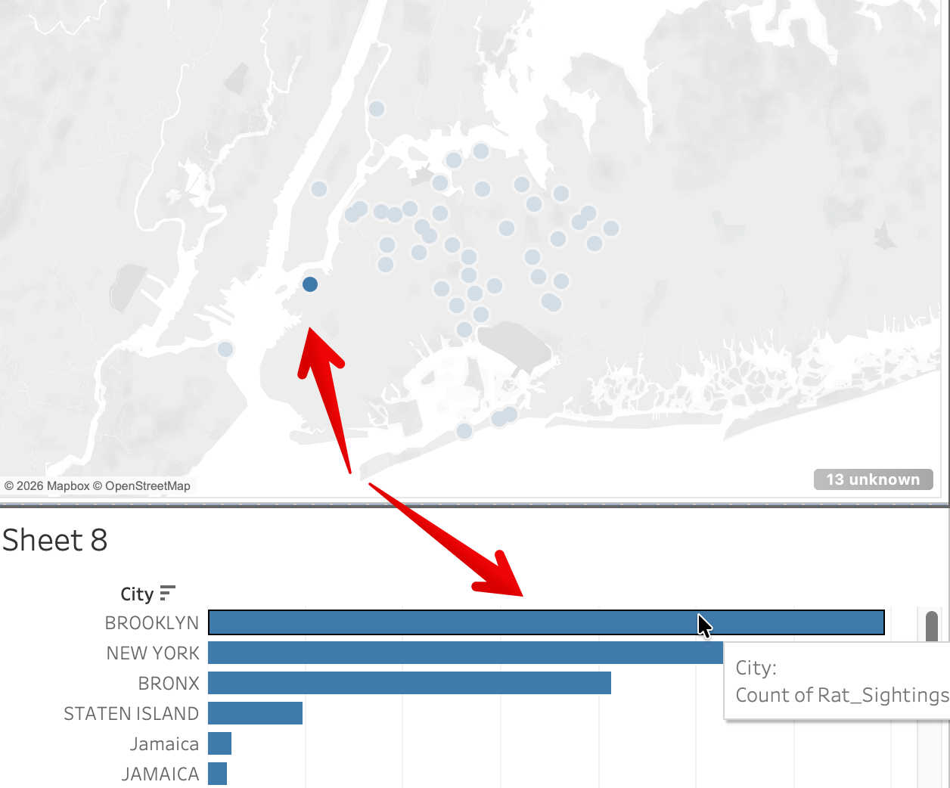
Dynamic Colors
Since Tableau is interactive, we can also use colors dynamically.
Highlights – focus on something, when something else is clicked/moused.
Set/group membership:
  Set a color value based on set/group.
  Make something else change what’s in set/groups.
Color based on other attribute (more complex):
  E.g. change color based on ranking or similar.

Slide 22
Maps (and Color)
One common usage of colors are maps.
We can map stuff whenever we have either:
  A set of locations – latitude and longitude.
  A set of geographical regions – city, state, province, country.
We can map some other stuff (like neighborhoods) but that requires more:
  Spatial data files (~data defining geographical things).
  Joins

Slide 23
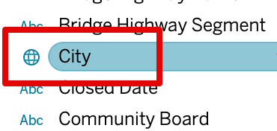
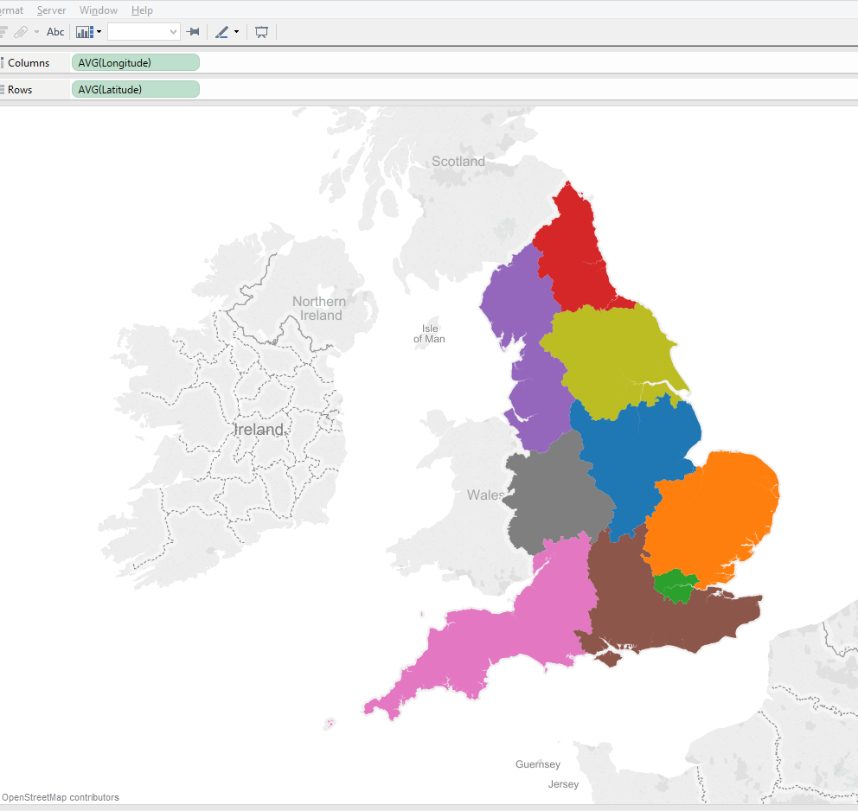
Filled Maps
If we have some region, we can make a filled map.
  State/province/country.
  That geographical value needs to have a globe icon in Tableau.
  We can set the “geographical role” if misidentified.
Doesn’t need lat/lon, will use the generated ones.
  Preview: Tableau includes some spatial data that basically defines “the outline of alberta is…”, ”the border of NYC is…”

Slide 24
Discreet Values – Discreet Colors
When dealing with discreet values, we can color code with arbitrary colors.
Color itself has no meaning, only to differentiate.
  If a color is used in multiple places, we want consistency.
Note: we may have categories labeled 1,2,3,4…, which will have a gradient by default.

Slide 25
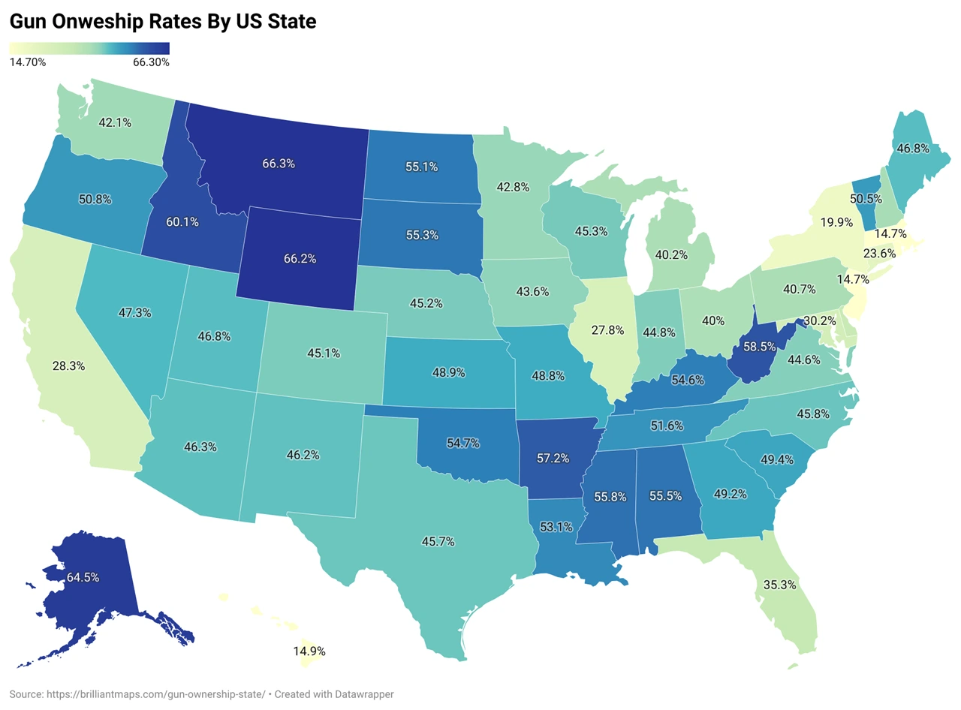
Continuous Values – Color Scales
With continuous values, we can use a scale to represent the value.
Filled maps can really only show one thing at a time well, via the color.

Slide 26
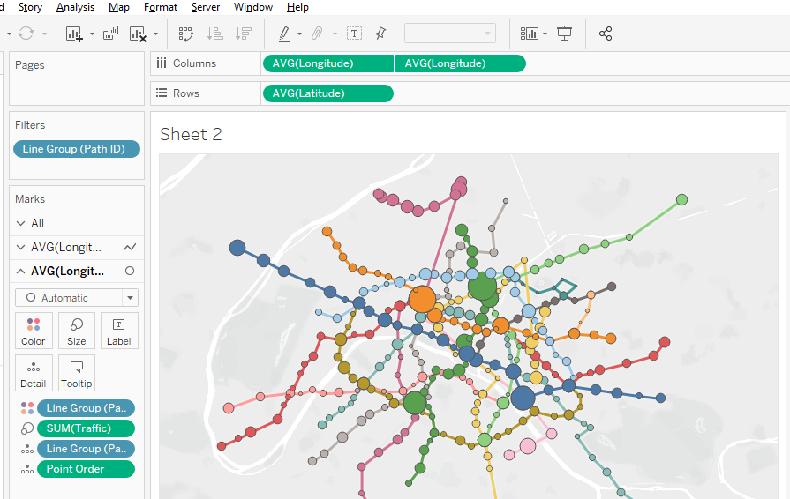
Point Maps
If we have latitude and longitude, we can map those points.
Note that Tableau doesn’t (by default) “know” where the points are in context, outside their spot on the map.
  # of stores within Alberta isn’t doable w/o other data.
  We can add spatial data to make this possible.
  Lat/lon is like x/y coordinates on a plot, they don’t know what is “under” them (city, country, region, etc…).

Slide 27
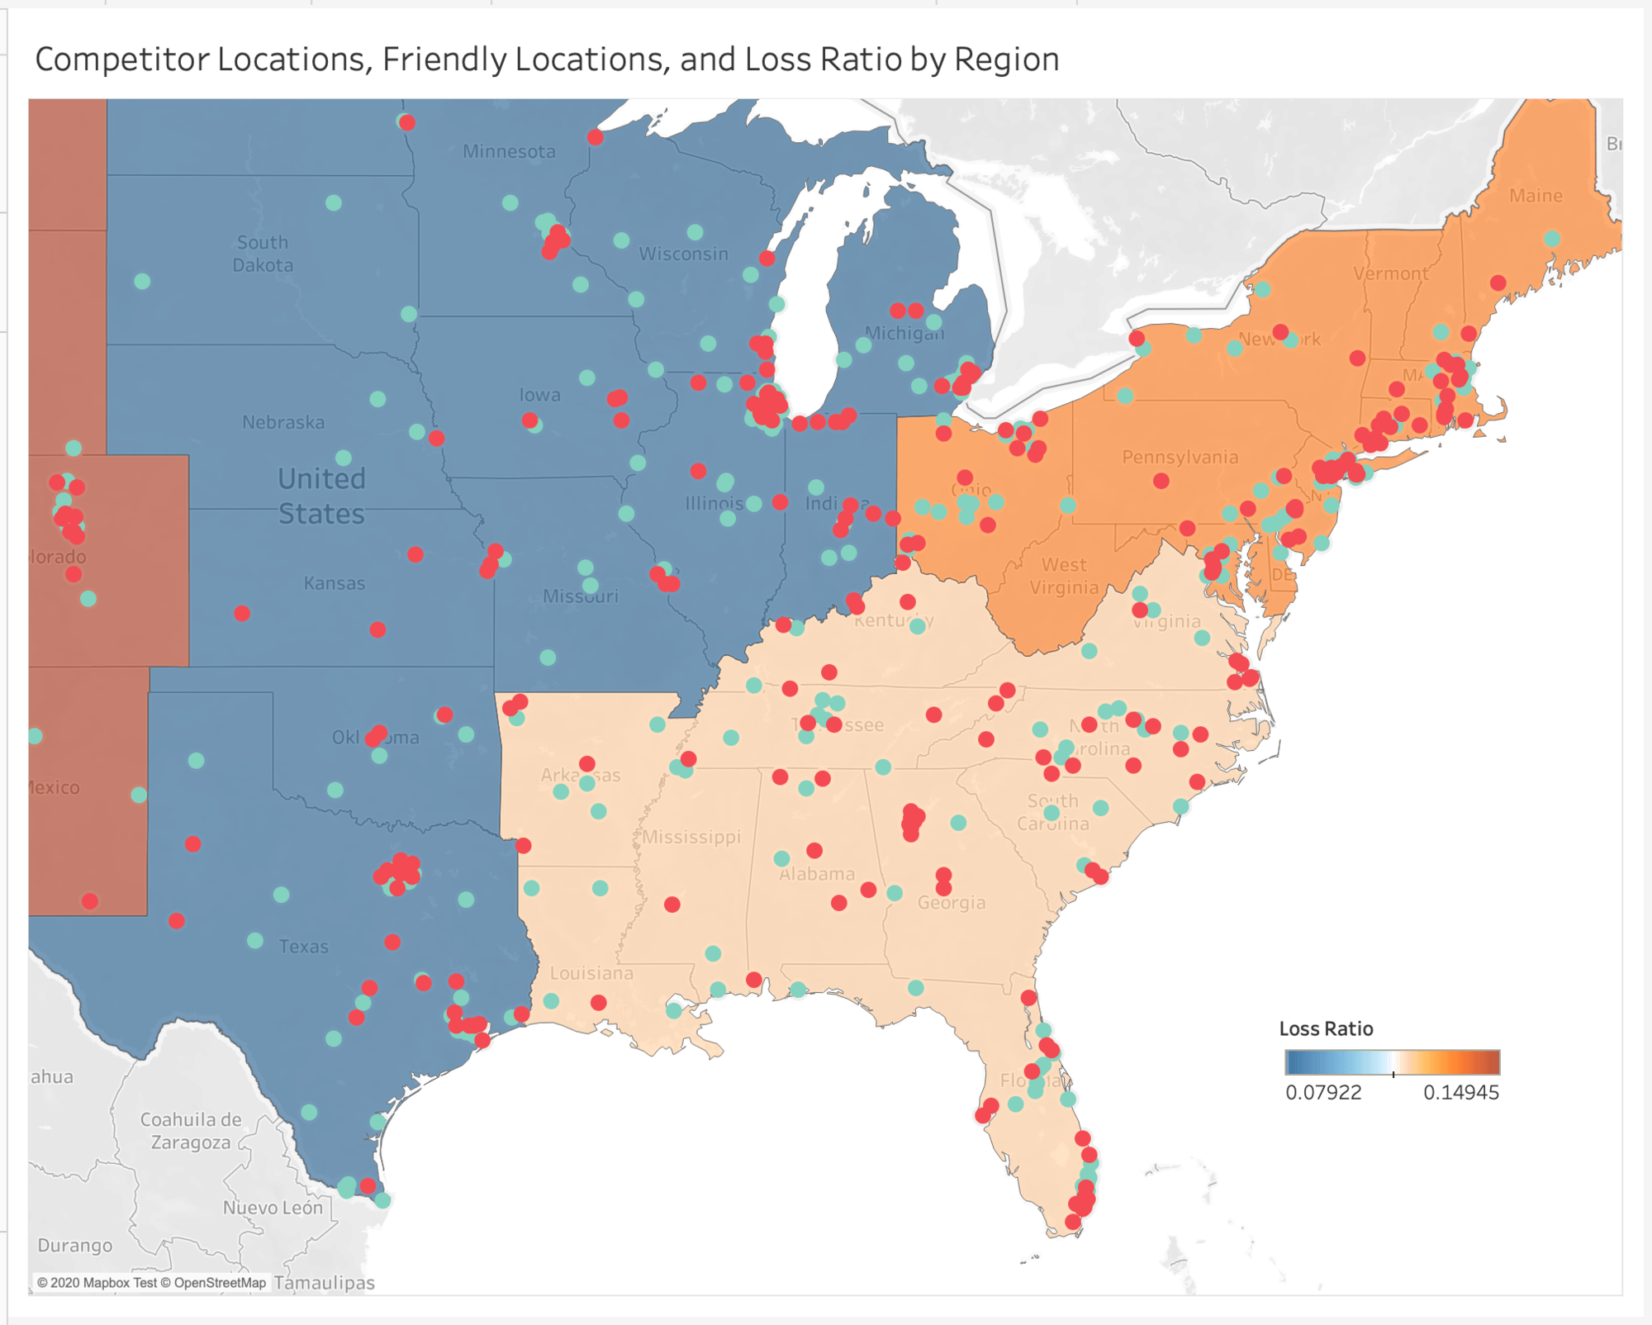
Layered Maps
We can stack more than one layer of map on top of each other.
  E.g. a filled map showing a gradient for “profits per state” with points of “store location”.

Slide 28
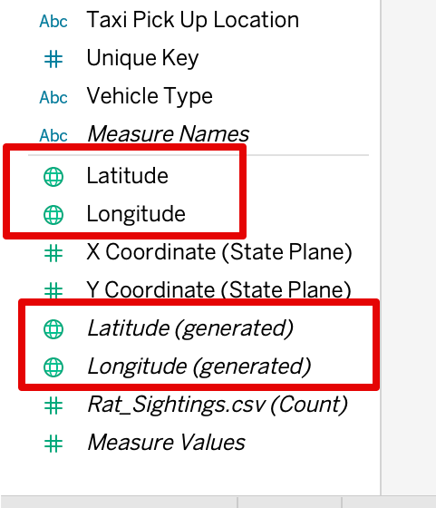
Beware Tableau’s Italic Deception!
In Tableau, we need to be careful on what we are mapping.
Latitude/Longitude (non-italicized):
  Actual latitude and longitude values, comes from dataset.
  Real location of a point on a map.
Latitude/Longitude (italicized):
  Generated latitude and longitude that Tableau makes (e.g. filled maps).
  Not from the data.
  We don’t use this directly, it will automatically appear sometimes when we use some geographic value like city or country.
If you want to make a point map, we need non-italic lat/lon.

Slide 29
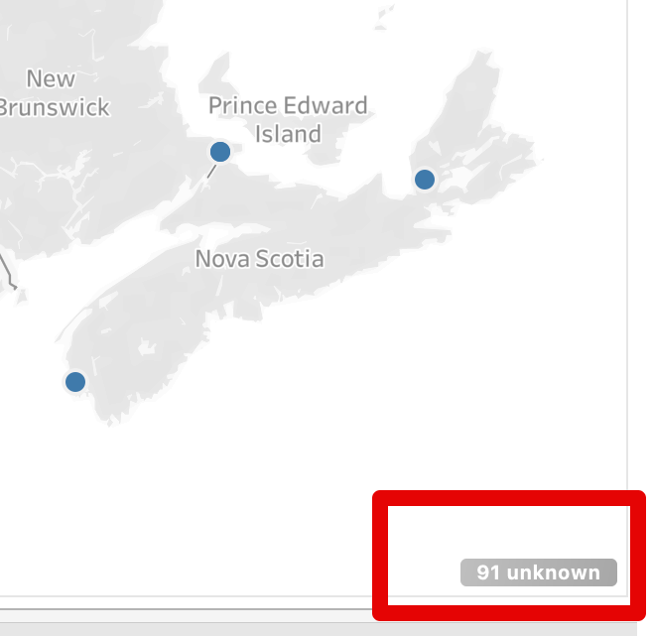
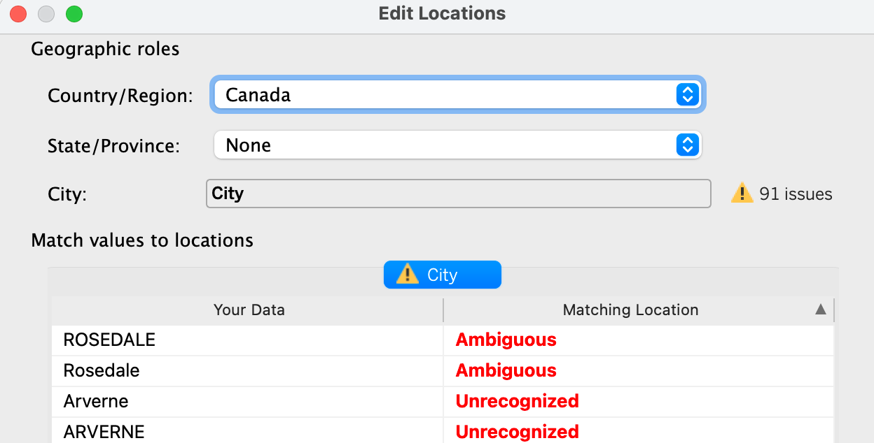
More Trickery
Sometimes when mapping we get an “unknown” marker in the bottom right.
This is due to ambiguous location data.
  Usually something like city names w/o provinces.
To resolve it:
  Click unknown marker to open window, then “edit locations”.
  Manually ”aim” the data at the correct country/state.

Slide 30
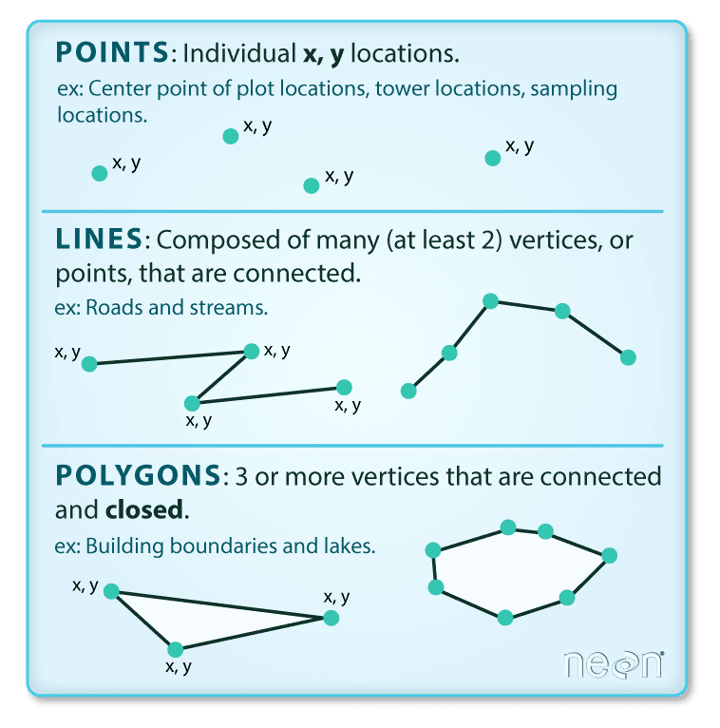
Points, Lines, and Map Math
We’ll do more of this when we do spatial joins (connecting map data to normal data).
Special data types that work with spatial (mapping) data.
  Points, lines, areas (and more).
Represent spatial data and allow easy geometric calculations.
  Can calculate distance between points, if a line intersects an area, if a point is in an area, if something is within X km of something…

Slide 31
TabMaps
Mapping is generally pretty easy in Tableau, as long as a few requirements are met:
  To make a filled map, your data must have a region (state/prov/country)*.
  To make a point map, your data must have latitude and longitude (or point).
  *You can do some translation here if joining with other spatial files, more later.
Mapping data is usually identified correctly, but you may need to fix:
  Right click menu from the variable has options to change interpreted type.
  Lat/lon – may need to manually label them.
  State/Province/Country – may need to separate parts, label, or correct missing data interpretation.
Neighborhoods, regions, areas – not filled mappable, unless you add another spatial file.
  If using City data, pay attention to this if you want to map something like a ‘hood or ward.

Slide 32
Colorblindness
When choosing color schemes we want to consider colorblindness.
Red/green tends to be the most common issue.
  Things like financial data – things with red/green also have brackets or negatives to be clear.
Default color schemes in Tableau (blue/orange) is colorblind friendly.
Even outside of colorblind concerns, color schemes should be clear:
  Don’t have colors that are hard to see/differentiate.
  Make sure that color use is consistent if you have more than one usage of color.
  Don’t accidentally imply things with colors (red=bad, green=good, darker=higher, same color=same thing, etc…)

Slide 33
Color and Concerns Adding Density
Color is a common thing we can change to add some density to a chart.
Most chart types can have another metric added to the color.
  Commonly: use a color to show a continuous value on something like scatter plot mark.
Ensure the color scheme you pick makes sense and is clear.
Depart from known–good color schemes with caution.
Using color is good, except for where it is bad!

Slide 34
Conclusion
Color is a primary tool in visualization.
We can use it in several way to embed information.
  Categorical label, diverging gradient, sequential gradient.
Color also has common meaning.
  Red is stop, green is go, blue is water…
Color is easy to add to virtually any mark.

