Slide 1
Housekeeping
Gestalt’s Principles – concepts to consider wrt how we process information.
  Guidelines for designing things, like your assignments.
Intro to Maps exercise - we’ll make some maps!
  Map types.
  Layers.
  Paths and more!!

Slide 2
Gestalt’s Principles

Slide 3
Who’s Gestalt
"Gestalt" is German for "unified whole” and was discovered in Germany in the 1920s.
  Examine how people interpret parts as a unified whole.
The brain will attempt to fill in the gaps to make partial information make sense.
Gestalt principles are observations of how we tend to perceive visual data.
  Knowing these can inform our design -> make it how people will perceive it.

Slide 4
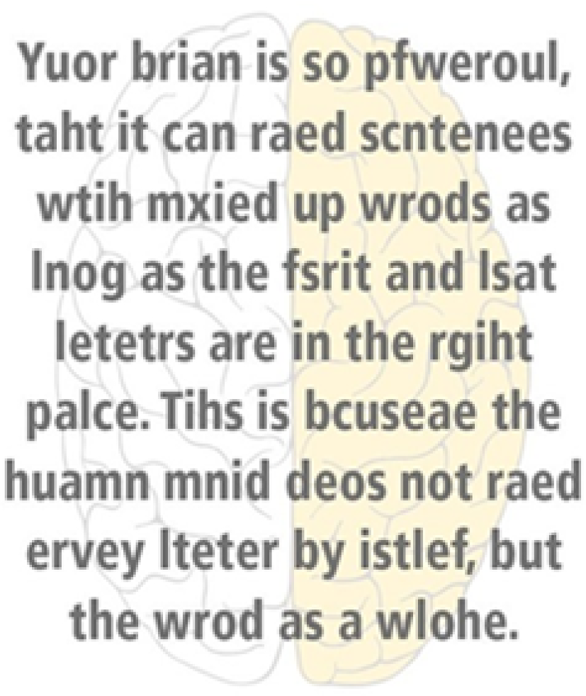

Slide 5
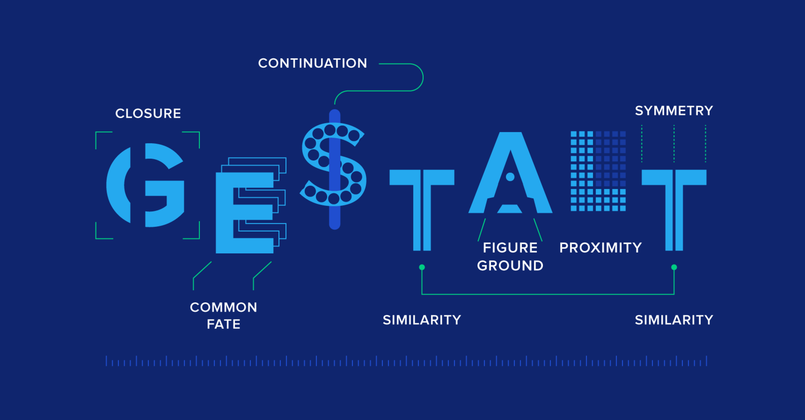

Slide 6
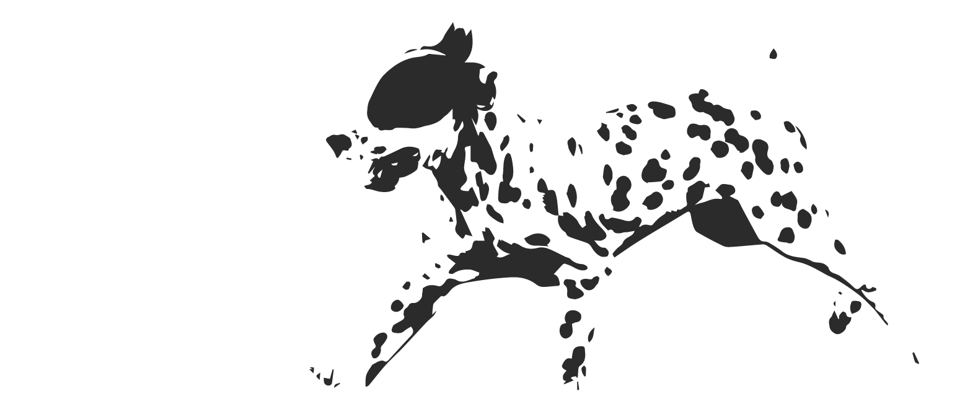
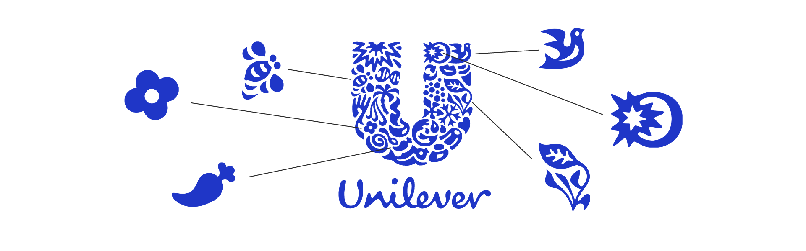
Emergence
We will assemble orderly shapes out of disconnected items.

Slide 7
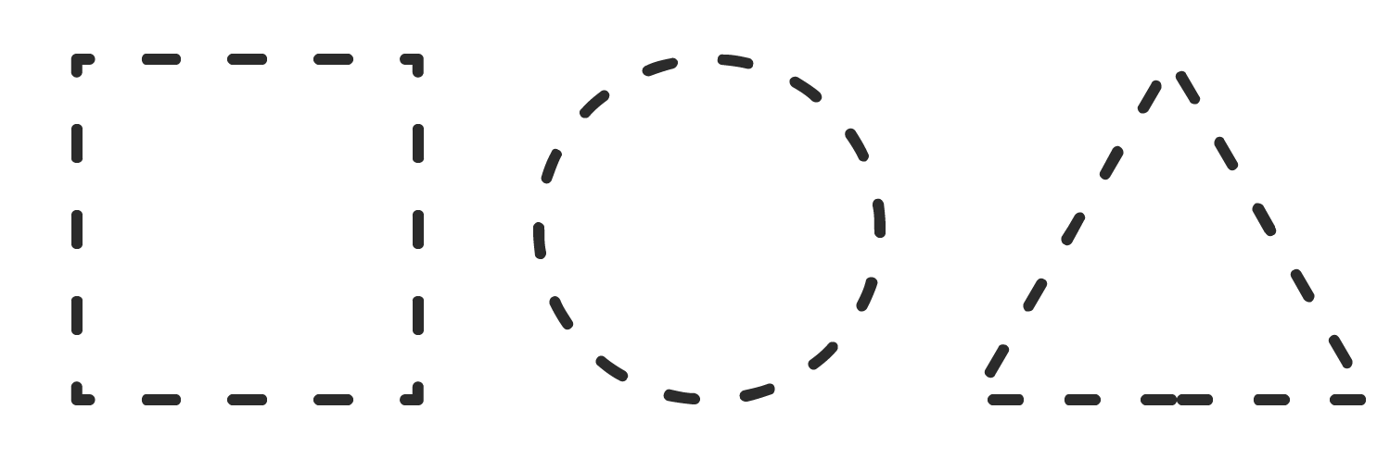

Closure or Reunification
We prefer complete shapes, so we automatically fill the gaps between elements to perceive a complete image.

Slide 8
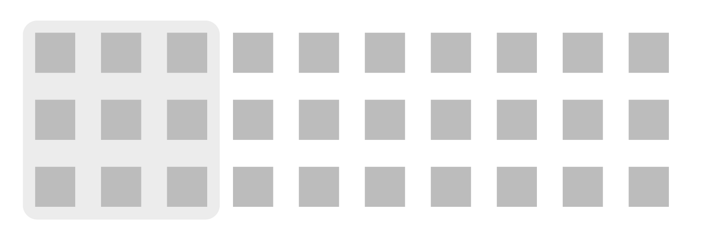
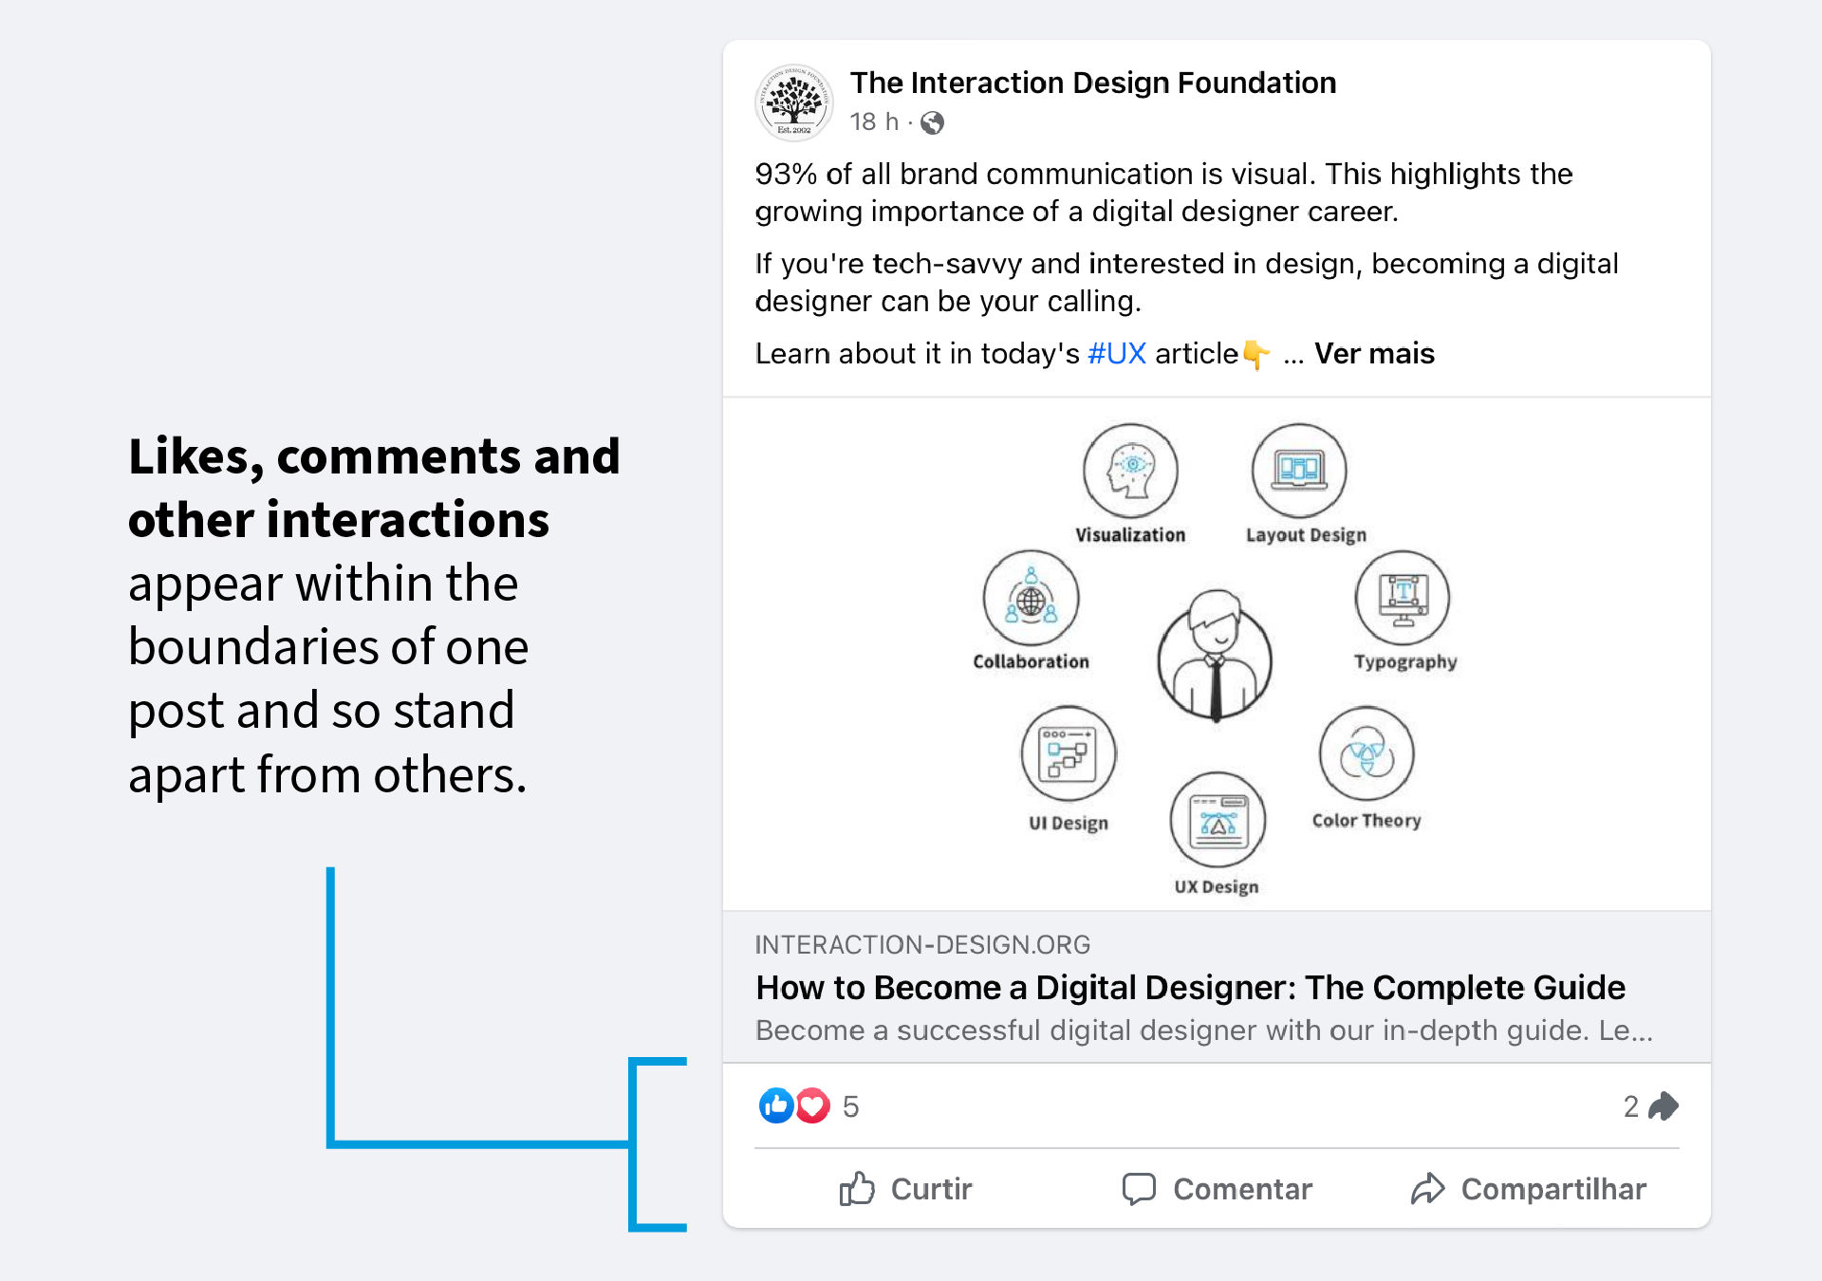
Common Region
We perceive things that share a region to be a group.

Slide 9

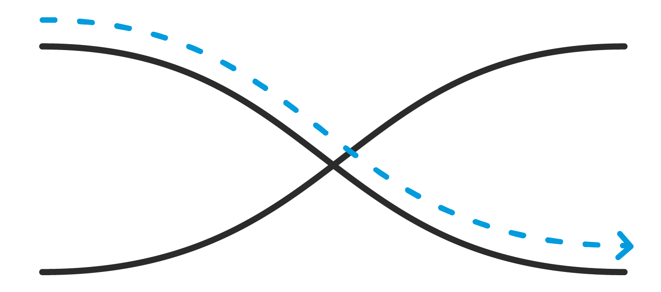
Continuity
Things that appear to be following a path are interpreted as continuous.

Slide 10
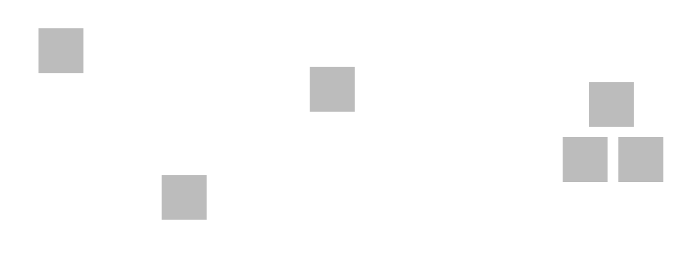

Proximity
Things that are closer together than the ‘average’ are interpreted to be grouped.

Slide 11
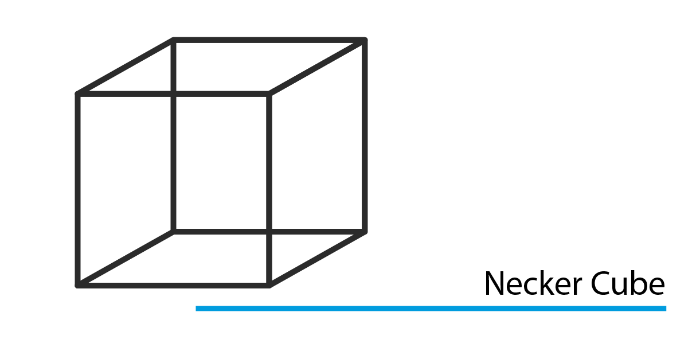
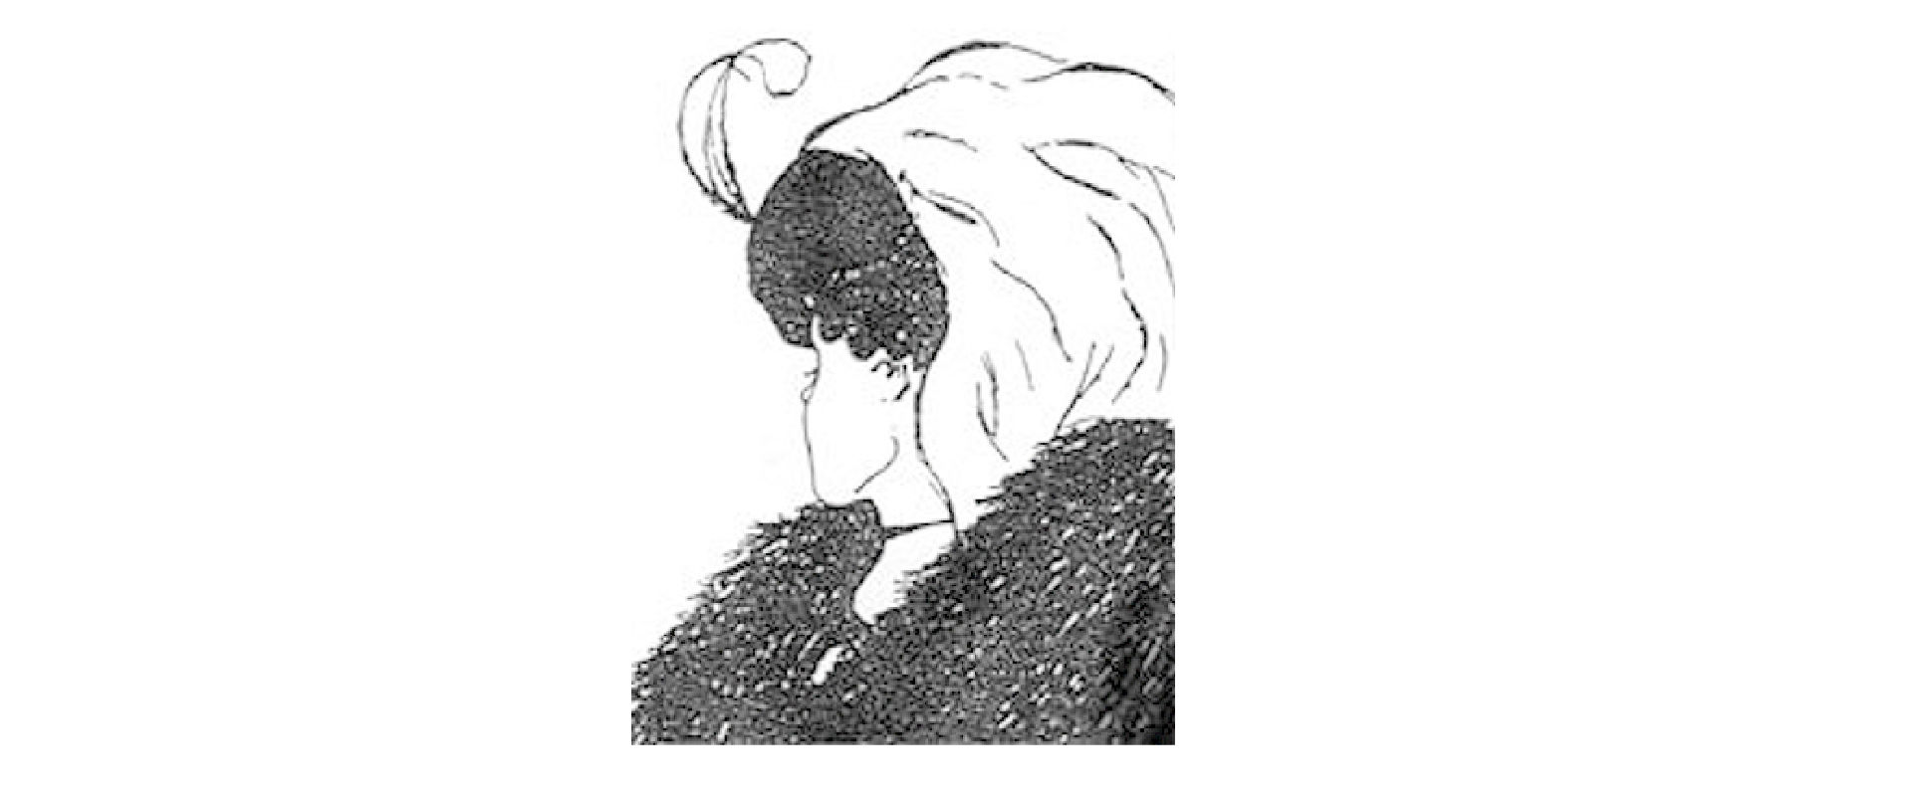
Multistability
When images are ambiguous, we perceive one interpretation at a time and can also perceive the switch between interpretations.

Slide 12
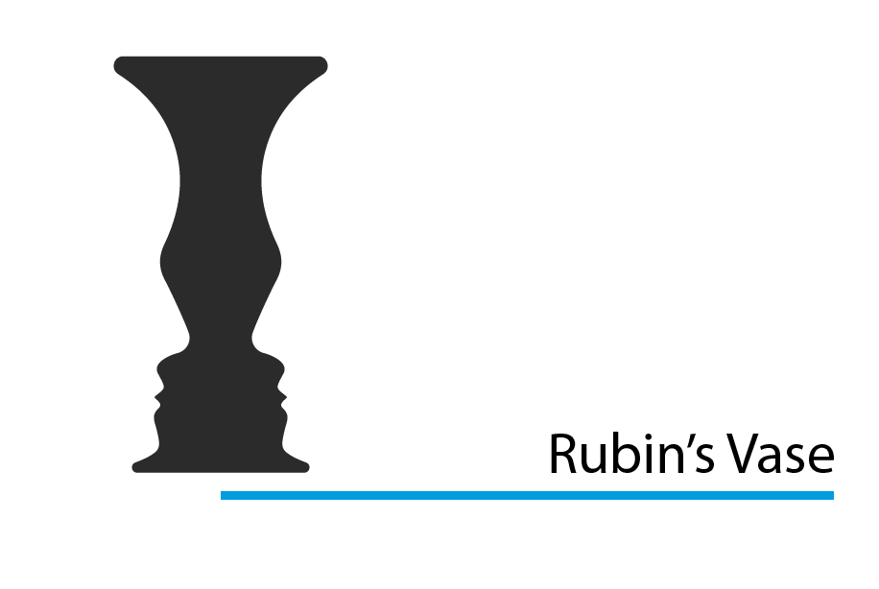
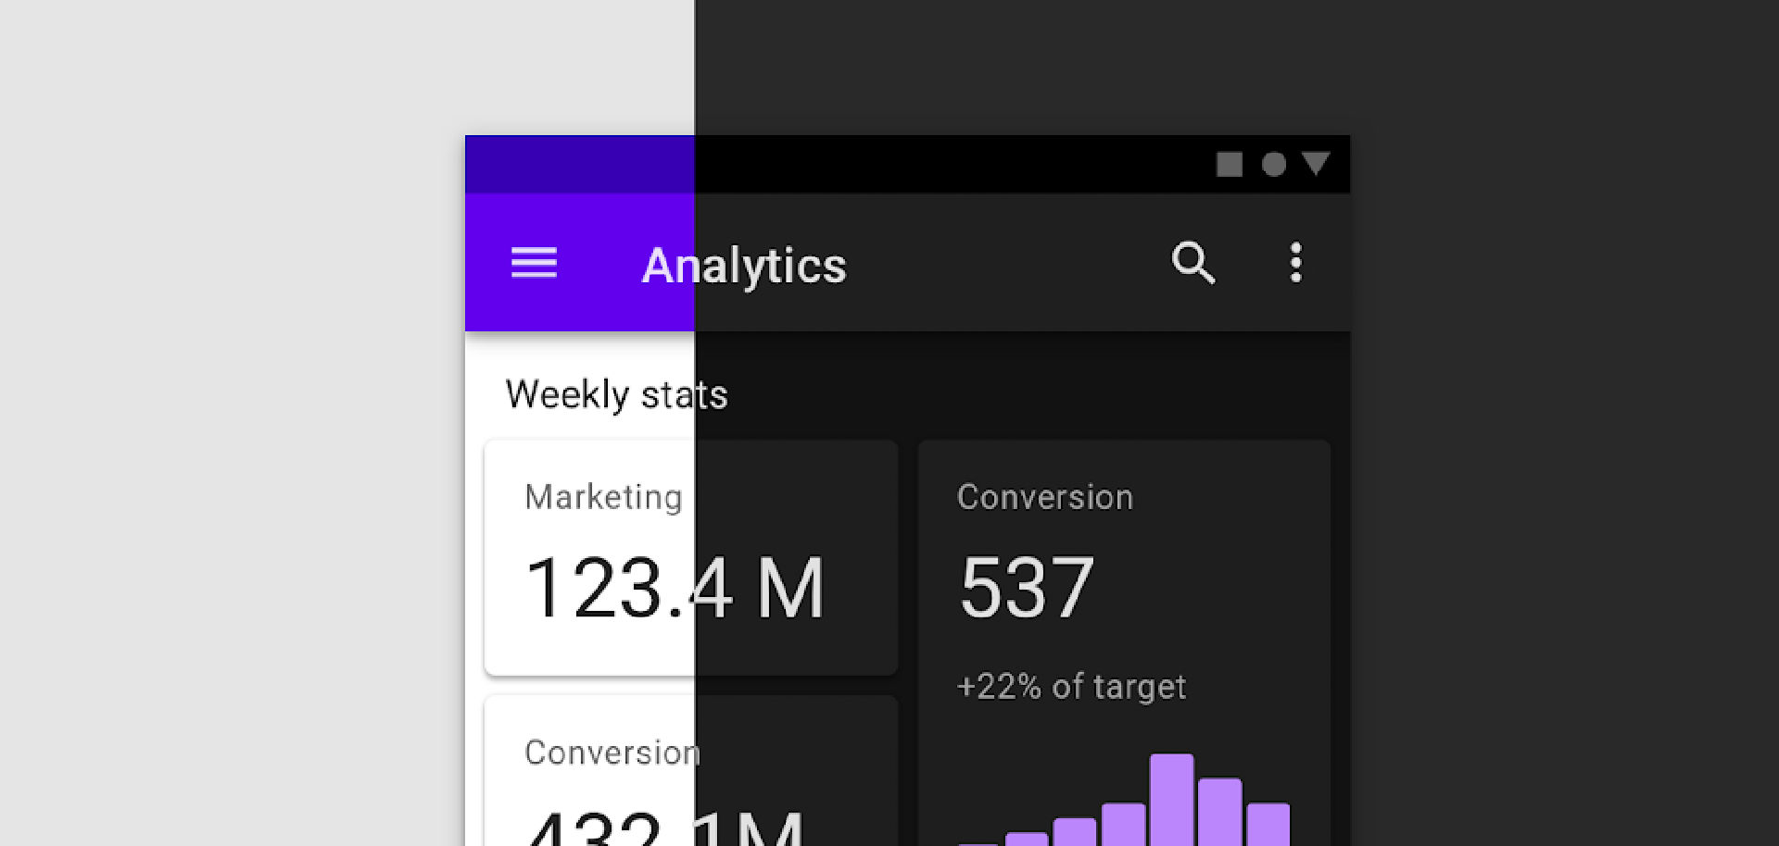
Figure/Ground
We see foreground elements first unless something is ambiguous.

Slide 13
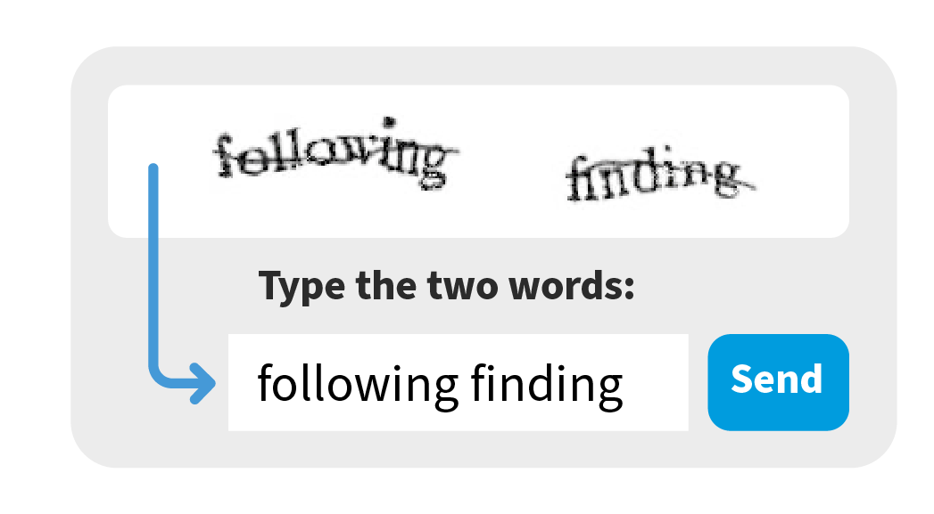
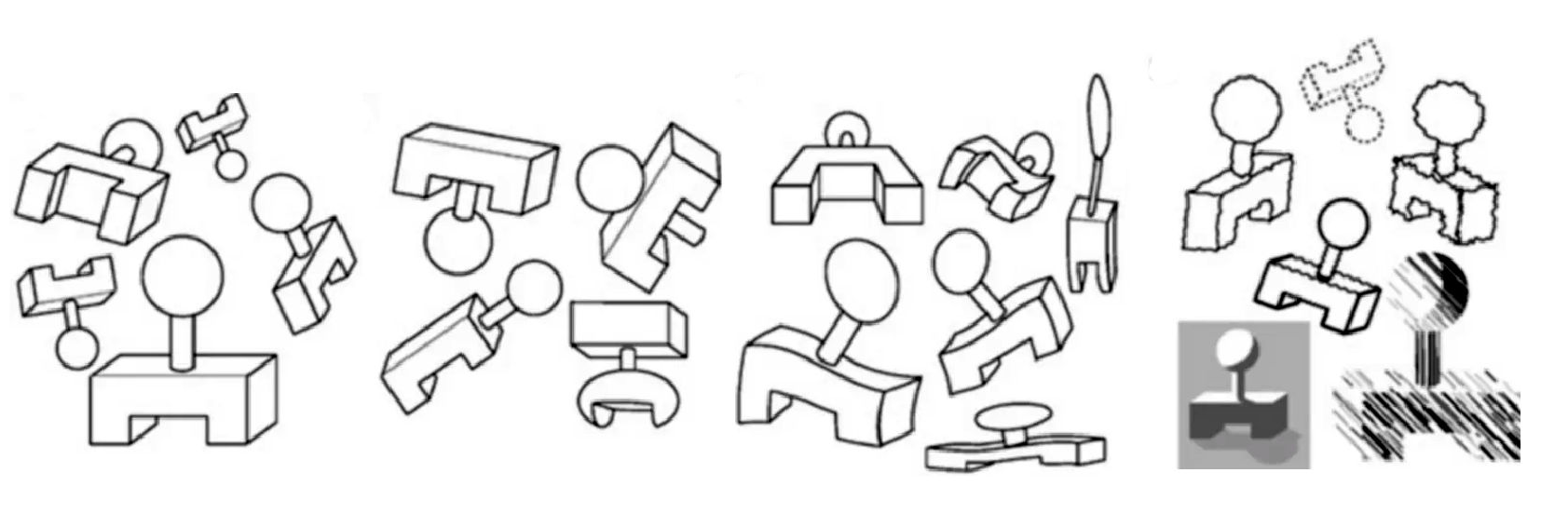
Invariance
We perceive shapes as being the same despite transformations such as position, rotation, stretching, resizing, etc…
For example, you recognize a face no matter the angle, if it is in a little driver’s license picture, if it is in the dark, etc…

Slide 14
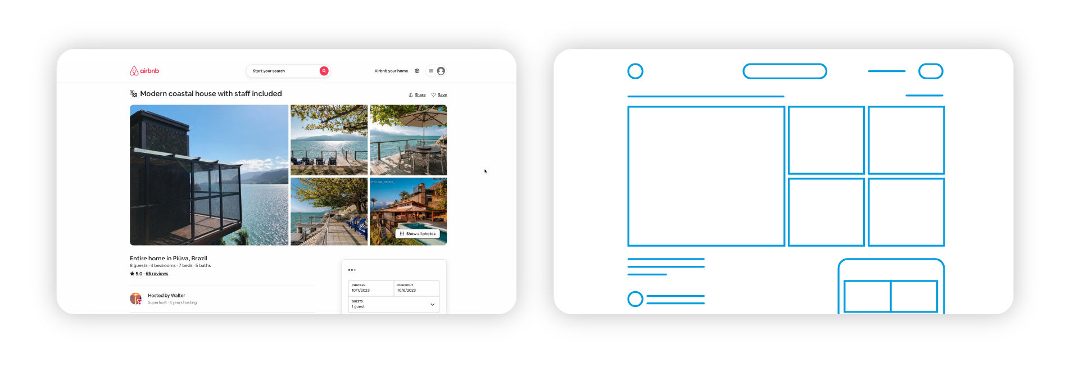
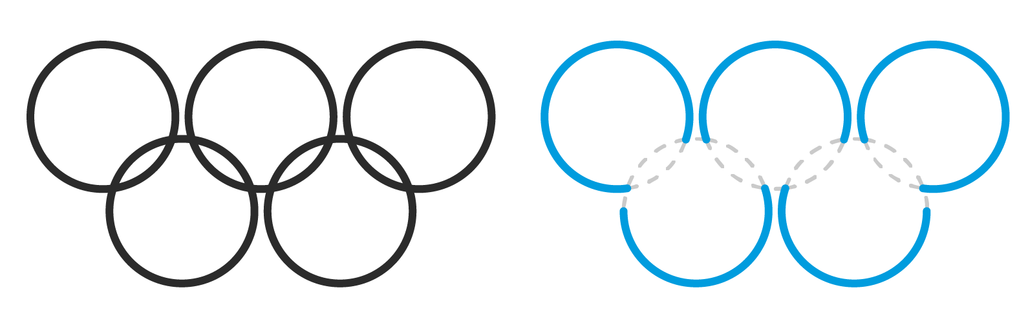
Pragnanz
Pragnanz describes the human tendency to simplify complexity, in this case we’ll tend to interpret visual items in a simple way to save on mental processing requirements.
In our case, using visual designs that are simple instead of complex can make it easier for the brain to process.

Slide 15

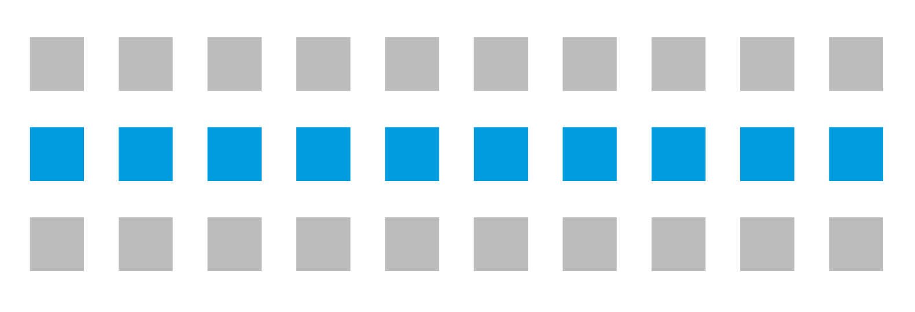
Similarity
We interpret things that share characteristics, like color or shape, as being grouped.

Slide 16
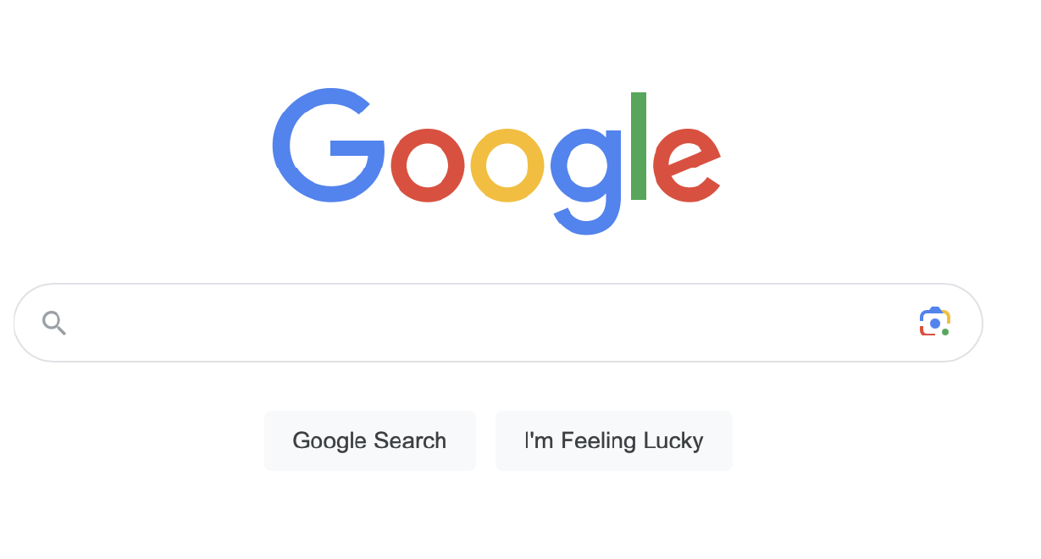
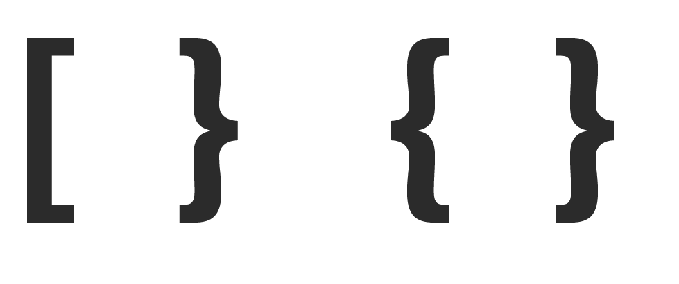
Symmetry
The brain processes things that are symmetrical as being grouped.

Slide 17
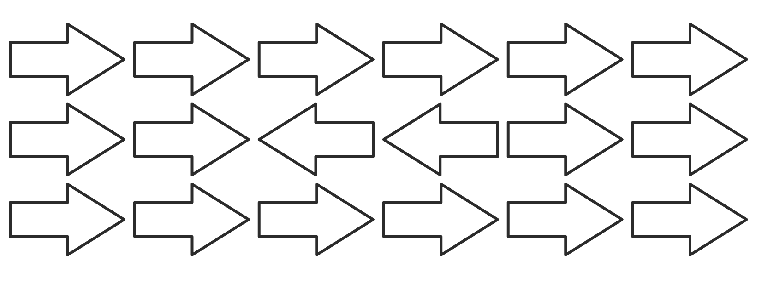
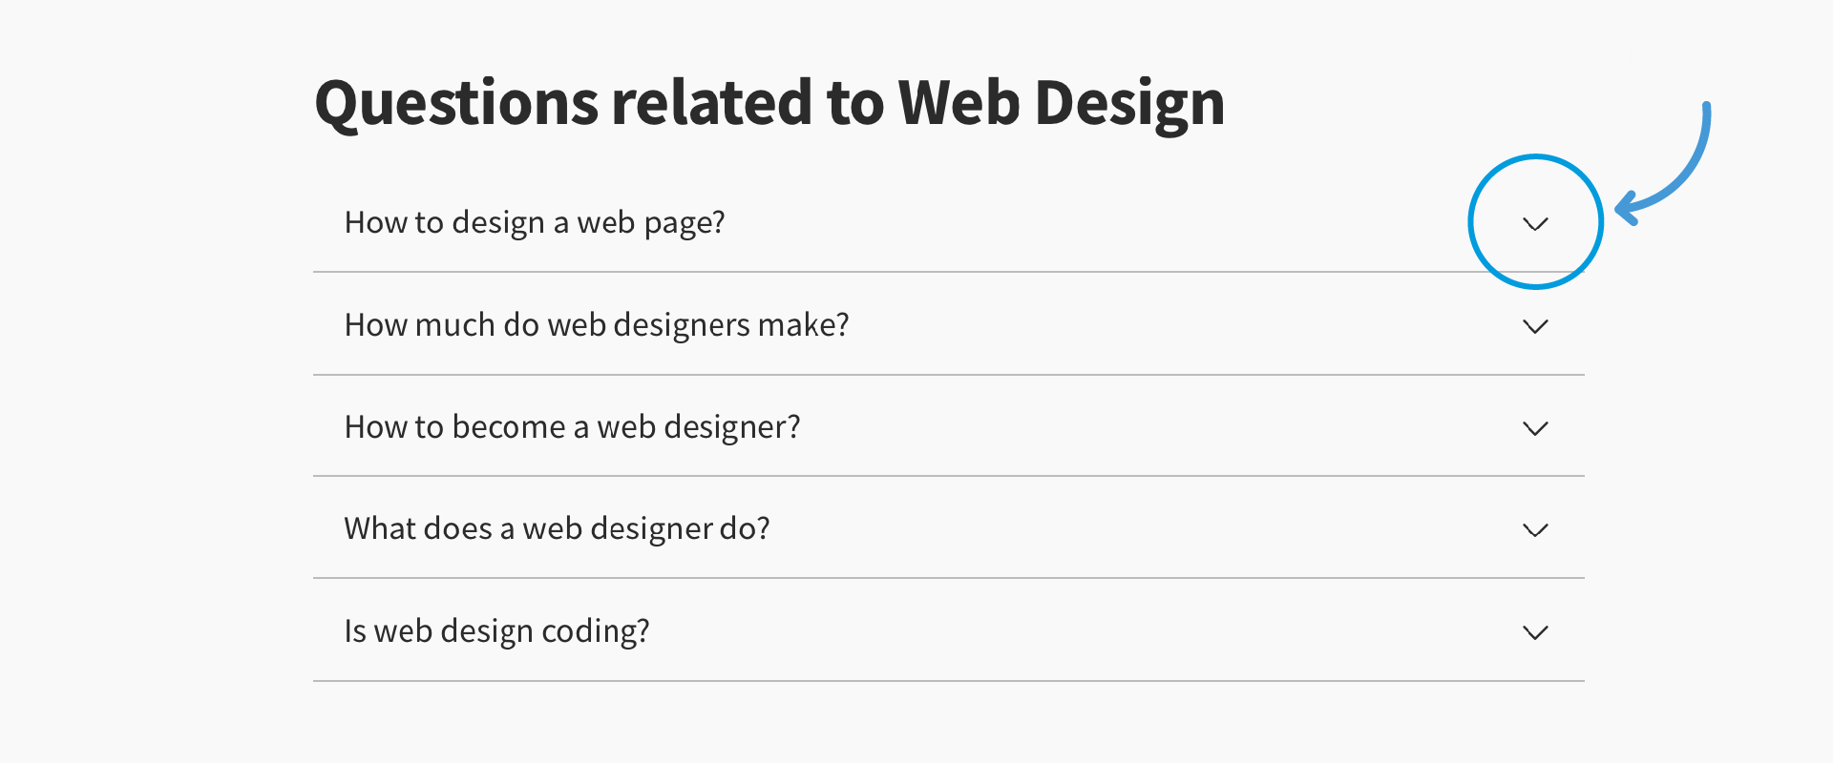
Common Fate
We tend to perceive things that are aligned or moving in the same direction as grouped.

Slide 18
Using GEstalt
These principles aren’t really things that you do, they’re things you consider.
A reader of your visualization will have these tendencies activate when looking.
We want to use them to direct attention or convey what we intend.
  Orderly design can guide user interaction, imply ‘instructions’, and reduce friction.
We want to avoid doing something that conflicts with what these principles indicate.
  Conflicting will lead to user confusion and potentially misinterpretation.
  E.g. have you ever clicked on something you thought was a button?
How a reader will perceive what we make should be a key consideration.
  Also consider the opposite, we don’t want to accidently introduce info.

