Slide 1
Housekeeping
Today:
  A closer look at datasheets.
  Data warehousing and ETL theory.
  Joining datasets.
  Depending on time, adding mappable data to map-less data.
There’s an exam soon – a week!
  As we noted last time, I pushed it a week due to the quiz being pushed for the holiday.
  Open book, theory only (no tableau activities), M/C and short answer.
  There’s a guide on Brightspace.
Link on Brightspace with example quiz 1 solution.

Slide 2
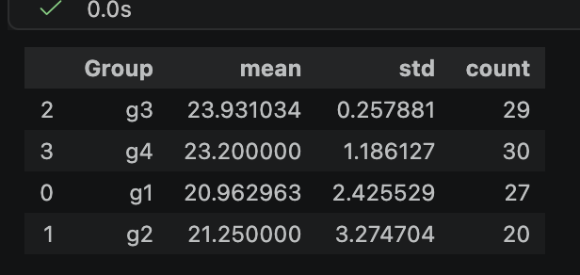
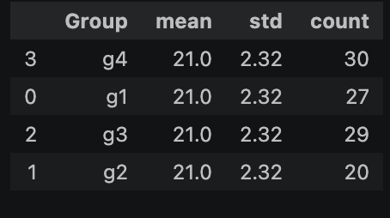
Assignment Grades
Grades are posted. I noticed some small issues:
  Some people had 0 or near zero variance in the scores they gave.
    I.e. every vis’ they scored got the same mark, generally 100%.
  This isn’t really indicative of an honest evaluation.
So, to compensate for that:
  I gave the non-varying evaluators 50% for the evaluation score.
  I rescaled the grades so each group had the same distribution.
  This will have the effect of lowering some of those grades so all the groups have an even distribution of grades given out.
You can protest this if you think it is unfair, I’ll argue for it though.

Slide 3
Assignment – Some things to consider…
I have no context or prior knowledge, all I know is what I see on the charts.
  Ensure that whatever you want to show is what comes through.
  There should be a clear title/thesis that says what your viz does.
  Asking another person what they get is a good idea.
Check simple details.
  Check labels, titles, axis, etc… to make sure they make sense.
  Ensure things are readable and aligned clearly.
Easy improvements – can I change a Tableau thing to make it better?
  Highlights, filtering, adding info to tooltips, etc…

Slide 4
Joins

Slide 5
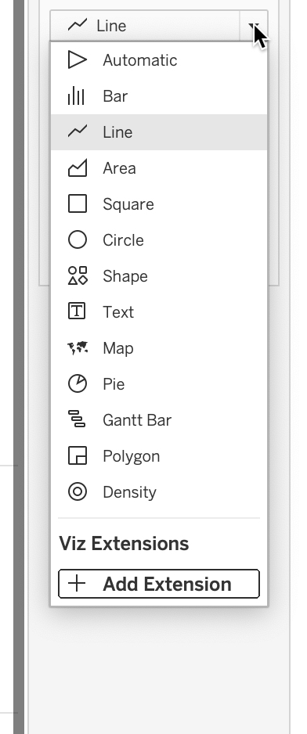
Chapter 7 Challenges
Chapter 7 is on visualizing distributions.
We looked at histograms and box and whisker plots in chart types.
Several variants, particularly the line versions, can be made with the marks card.
Try some…
  Different granularities, different mark types, multiple distributions.
  In an example soon, there’s a good candidate to use…

Slide 6
Data Management
The relational database environment provides businesses with an efficient and effective way to manage data.
Most applications will have their own database for their stuff.
  Every system generates data as stuff happens – sales, products, views…
  This is the OLTP stuff, processing transactions are storing data.
Each app’s database will have tables for each entity.
  Each entity* has a key, aka ID number – there’s some overlap here.
  Sales list a customer id, class registrations list student id, etc…

Slide 7
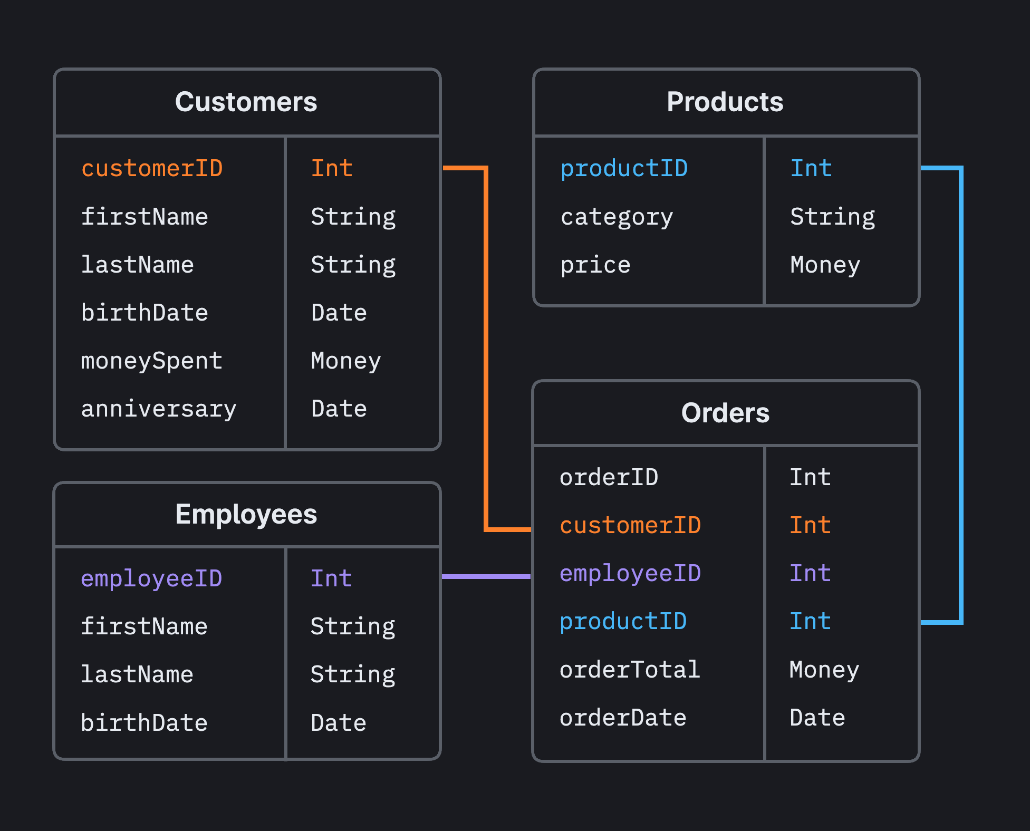
Relationships are Serious Business
A RDBMS contains tables, one for each entity.
They model reality by building relationships.
  E.g. an order includes a customer.
Relationships use (usually) keys to connect tables.
  The primary key is a unique ID, like a DL number.
  A foreign key is another table’s primary key, that acts as a reference.
    E.g. an order table will have a “customer” field holding the Customer ID key.
    We can “grab” the customer data via the ID as needed.

Slide 8
Database Benefits
One copy of data.
  Can’t have multiple values for one thing.
  Changes to values don’t require tracking down many copies of data.
Enforcement of integrity rules.
  Mandate that data meets certain rules.
Access control.
  Allow read/write access to only those allowed.
Data sharing and access.
  Creation, storing, and access to data are separate.
  E.g. One program makes data, another uses it…

Slide 9
Organizing and Archiving Data

Slide 10
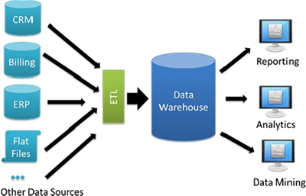
ETL and Warehousing
We generally work off of centralized repositories for data to analyze.
Large organizations have data from many sources.
  Website.
  Equipment like factory machines.
  HR, finance, marketing, etc…
  External data sources.
Consolidating this data is non-trivial.
  Date formats, prov/state abbreviations, currency…
  We want consistency so we can use all data together.
  Data mining source – massive dump of data, some gold.

Slide 11
ETL – Extract Transform Load
ETL is a process to move data from one location to another.
  In this case it is to gather and centralize data from multiple sources into a central warehouse.
Extract – gathers data from multiple sources.
  Includes all the OLTP doing sources of business data, pos systems, web stores, production…
  Each source can be totally different in type, data structure, etc…
Transform – process and clean the data into a standardized format.
  Make all the data fit the format you want, and remove anything not needed.
  Can include correcting mistakes, missing data, date formats, spelling, granularity, etc…
Load – store the consistent data in a data warehouse for analysis.

Slide 12
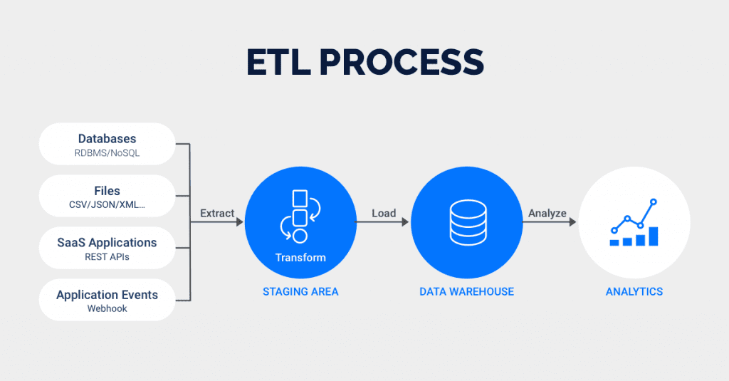

Slide 13
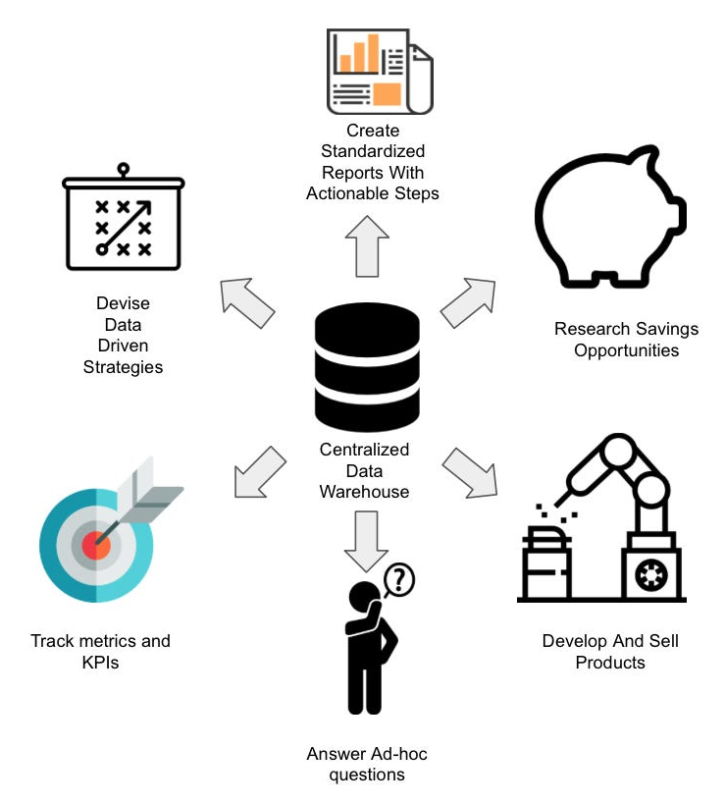
Data Warehouse
The ETL process normally loads our data into a special database - the data warehouse.
  Usually periodically – hourly, nightly, etc…
The data warehouse is a large db that is intended for archiving and analysis.
  Not used with live transactions or current data.
  Stores (ideally) all historical data that the organization needs – central source o’ truth.
  Allows for data from different sources to be integrated for analysis.
  All the data is consistent and clean once it gets here, so analyst and just analyze.
Data is stored with many entities and must be connected for analysis.
  ER diagrams and dicts show layout, and we must join to make usable data.

Slide 14
Data Management
A data warehouse is usually highly dimensional, or has data on many things.
  Entity: person, places, things, events
  Instance: a single occurrence of an entity; represented as a record in a database
  Entities have relationships with one another: either 1:1, 1:M, M:N
  Primary key: attribute that uniquely identifies each instance of the entity; used to create a data structure called an index for fast data retrieval and searches
    Composite primary key: primary key that consists of more than one attribute; used when none of the individual attributes alone can uniquely identify each instance of the entity. (Not critical).
  Foreign key: a primary key of a related entity.
Most ‘real’ things require connection of data from several tables (entities).

Slide 15
Our Data Life
At this point we’ve touched on most of the infrastructure related to our data.
Data is generated in many places, include those that process transactions – OLTP.
  Each of these system normally has a DB that stores those transactions.
That data is consolidated and cleaned in an ETL process and stored centrally.
We connect to that warehouse to get data.
  The database uses entity-relationship model to store data on many different things.
  We need to navigate the db structure and join to make useful data.
  We can get data on almost anything, but it comes separated. (CSVs we use are the ~output).
In practice, what we are normally using now is an export csv of several joined tables.

Slide 16
Interacting with Databases

Slide 17
SQL
Once data are stored in a relational database, we can retrieve them using database queries.
SQL is how we “talk” to a database.
We specify what we want, the database figures out how to get it.
  SELECT -> Give me all the records that match these criteria…
In Tableau, there are SQL queries generated behind the scenes when we manipulate data.
  You don’t need to know sql but you need to understand and use the concepts.
Like a many dimension OLAP cube – we select fields to include, slice and dice for values.
All access goes through these questions to the RDBMS, it allows it to control the data.

Slide 18
Data Management
The most popular query language used is Structure Query Language (SQL).
  Manipulate data using a relatively simple and intuitive approach
  Specify the attributes, tables, and criteria the retrieved data must meet
  Uses three key words: SELECT, FROM, and WHERE
  SELECT: specifies the attributes
  FROM: specifies the tables (more than one)
  WHERE: specifies selection criteria and/or conditions

Slide 19
Data Management
Simple:
More complex:

Slide 20
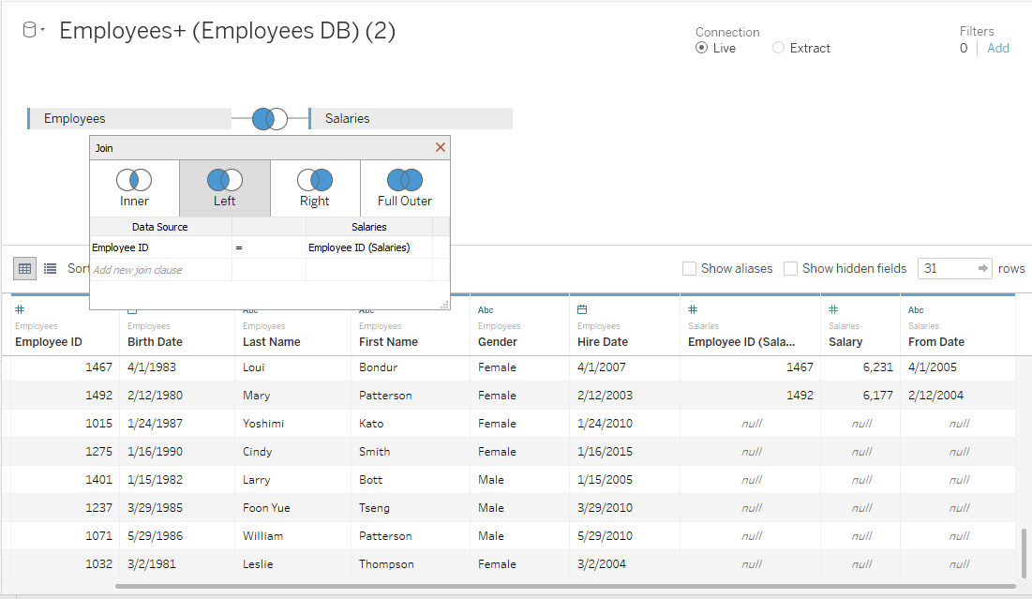

Slide 21
Data Management
Data must be integrated from different databases in different departments.
  Extraction, transformation, and load (ETL) process is used
  Retrieve, reconcile, and transform data into a consistent format
  Load the final data into the data warehouse
A data mart is a small-scale data warehouse.
  A subset of the enterprise data warehouse
  Focuses on one particular subject or decision areas
  Conforms to a multidimensional data model called a star scheme.
  Two types of tables: dimension and fact tables
    Dimension table: describes business dimensions such as customer, product, location, and time
    Fact table: facts about the business operation, often quantitative format

Slide 22
Data Management
Each of the dimension tables has a 1:M relationship with the fact table.
  Primary keys of the dimension table are also the foreign keys in the fact table
  Combination of the primary keys of the dimension tables forms the composite primary key of the fact table
The fact table is usually depicted at the center surrounded by multiple dimension tables, forming the shape of a star.
Not uncommon to see multiple fact tables sharing relationships with a group of dimension tables in a data mart.
Star schemas can ”slice and dice” data based on different dimensions.

Slide 23
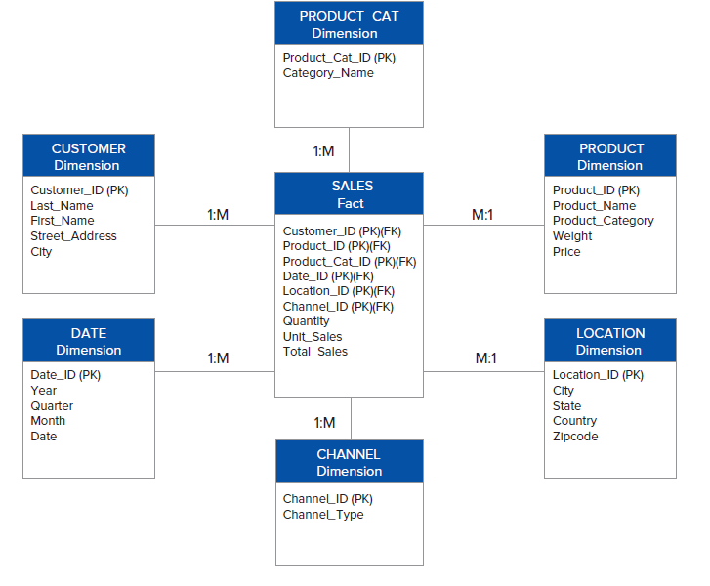
Data Management

Slide 24
Data Management
New forms of databases to support big data have emerged.
NoSQL: “Not Only SQL” database
  Nonrelational database that supports the storage of a wide range of data types.
  Structured, semi-structured, and unstructured
  Flexibility, performance, and scalability to handle extremely high volumes of data.
NoSQL will likely be implemented alongside relational databases to support organization data needs.
Driven by unstructured data – how to store videos in a database table?

Slide 25
Remember the Key
Recall the special database field called the primary key.
This is a unique identifier – often just an arbitrary ID value.
  Never duplicated, always refers to exactly one row.
Most tables have a key:
  Nait’s student list has your student ID.
  Registries have your driver’s license number.
  It could just be 1, 2, 3, 4…

Slide 26
SQL Joins
A join in SQL connects two tables (or datasheets) together.
Based (usually) on a key – a unique ID:
  Each row has a unique ID value. (Primary Key)
  We can refer to it to “grab” that row of data.
  Other tables have a foreign key – the key from another table.
E.g. at NAIT:
  Students are in the student DB table.
  Registrations are in the registration table.
  Join says, “grab this list of registrations, look at the student ID, and get the name… from the Student table”.

Slide 27
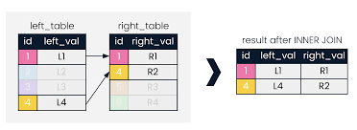
Join Mechanics
Joins connect tables together horizontally.
Rows from each table are matched when whatever you’re joining on (e.g. key).
  Select a row from left table.
  Scan through right table for matching key.
  If there’s a match, join these two rows and add it to the results.
  Do this for every row of left table.

Slide 28
Joins
We use the same logic in Tableau:
  Specify the two tables to connect.
  Find the key (id number, maybe name, something unique) that exists in each.
  Set the join criteria to make those two match (usually).
  Choose Left/Right/Inner to control what is included.
You will need to do (relatively simple) joins in Tableau.

Slide 29
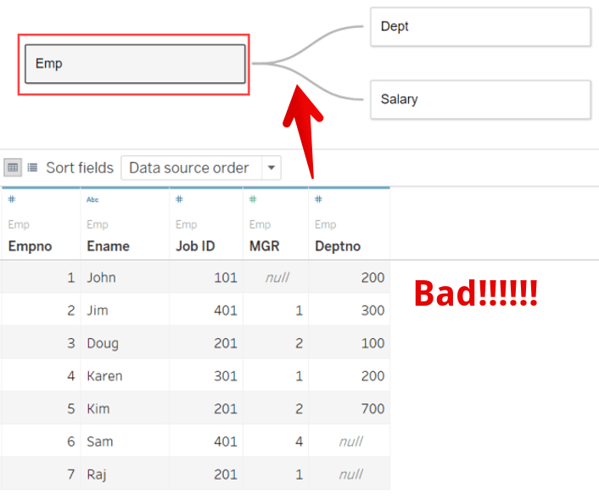
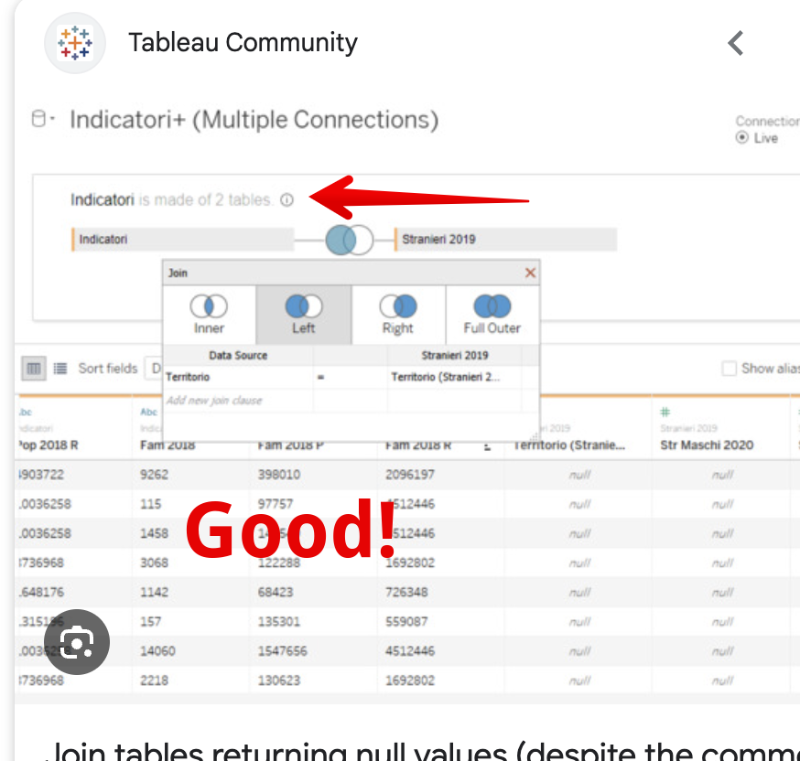
Remember this more than anything

Slide 30
Join ”Template”
Joins can be complex, but not all…
One (either) dataset is left, one is right.
The records are (usually) joined when these two values are equal. Typically, an ID.
  One side is a primary key, the other is foreign.
Do you want to see:
  Every record on left, with the right stuff added where the keys match.
  Every record on right, with the left stuff added where the keys match.
  Only the records where the keys match.

Slide 31
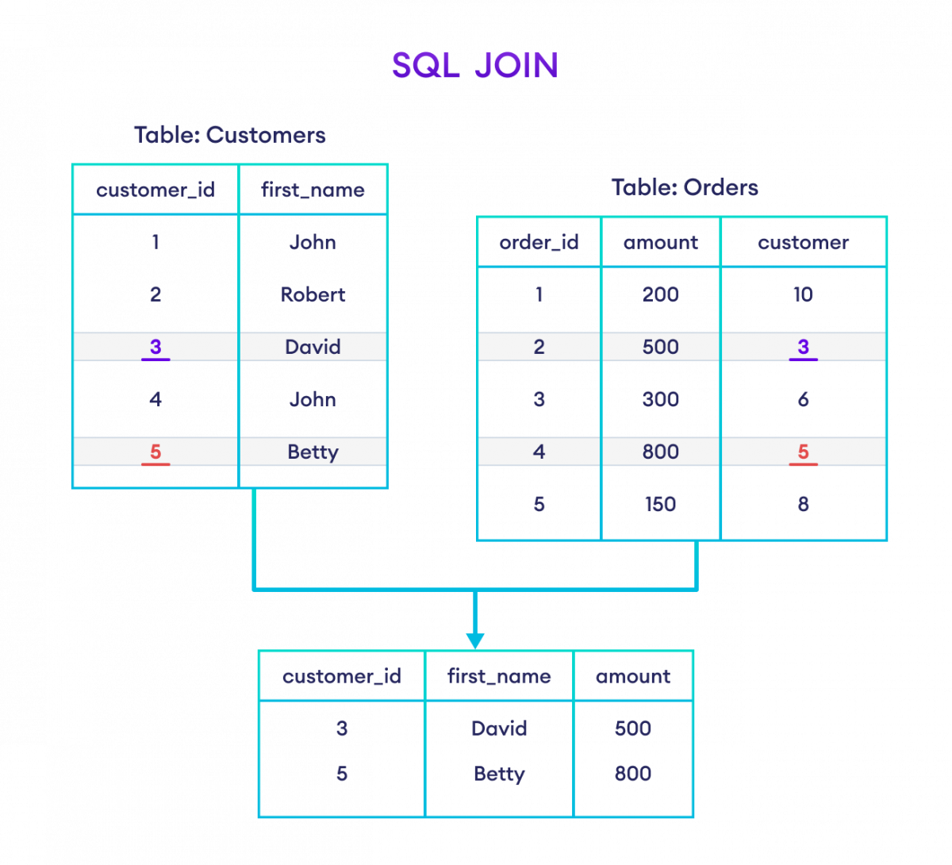
Inner Join – Keys Must Match

Slide 32
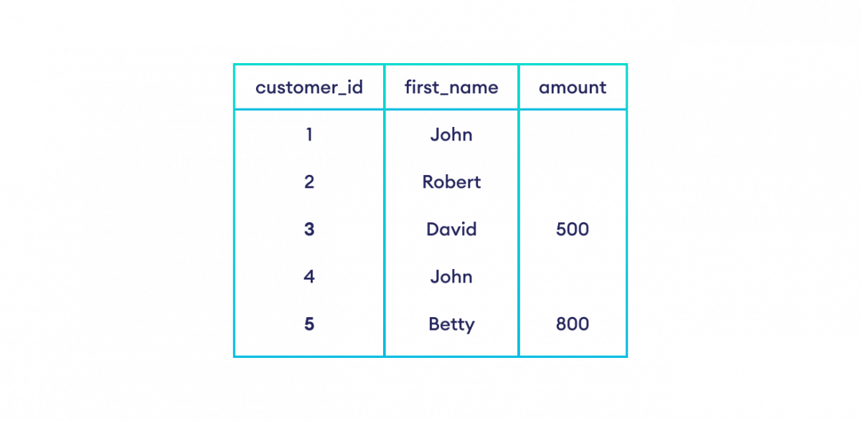
Left Join – All of the Left
With Only what matches from the Right

Slide 33
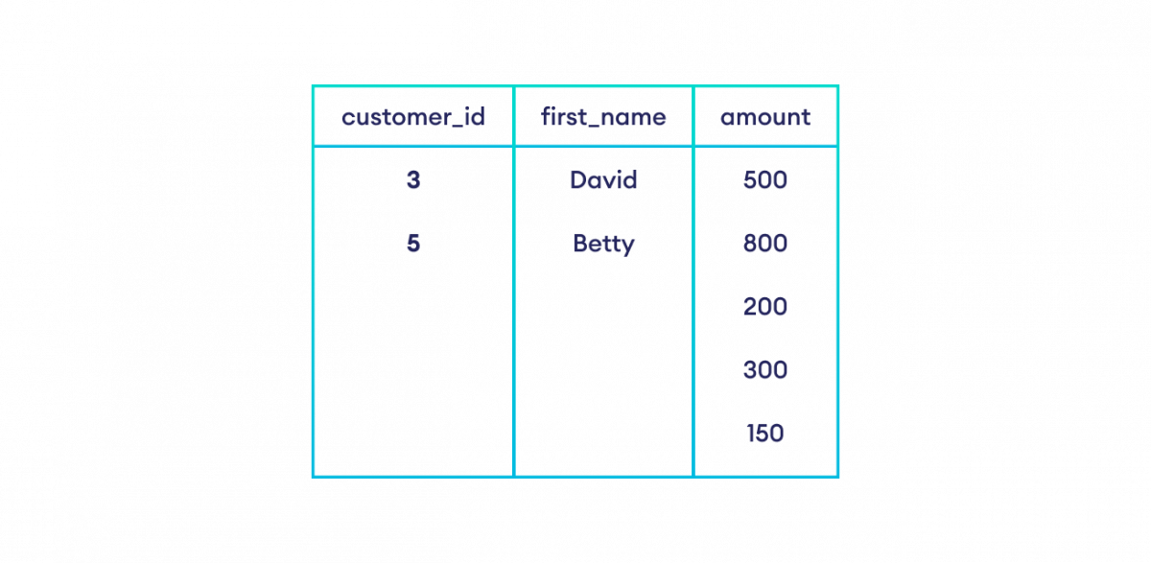
Right Join – All of the Right
With only what Matches from the Left

Slide 34
Right Join
Left Join

Slide 35
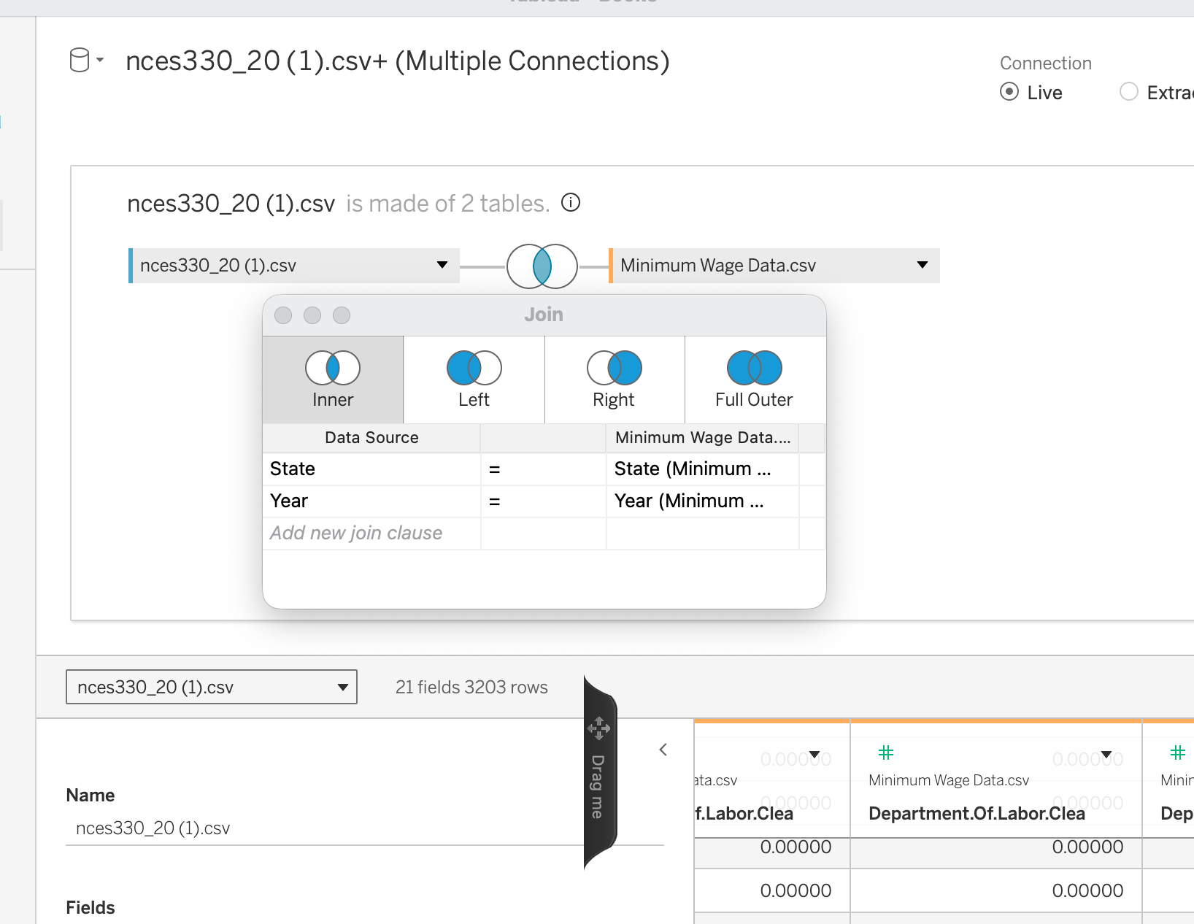
Multiple Criteria
Some scenarios require more than one join criteria.
The most common case is data with time-based iterations.
  I.e. the same data each year, month, hour, etc…
  Screenshot is data per state per year.
We may need to specify 2+ criteria to make things work.
  One join condition for each ‘per’.
  Joining only on state means every year for California matches with every other year for California.
  Adding year means those Californias only join when same year.
ALL matches are included, you must specify all restrictions.

Slide 36
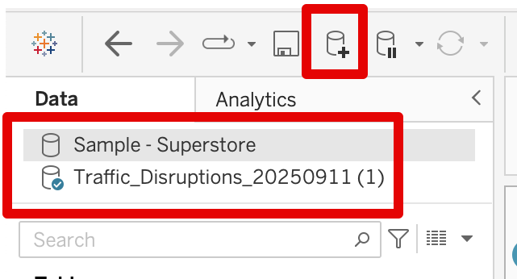
Unjoined Datasets
If we want to use multiple datasets in one sheet or calculation we must join them.
We are able to use more than one dataset in one workbook without joins.
  The datasets must be used independently, you can’t mix datasets.
  You can put sheets made with different on the same dashboard or story.
  Filters, actions, legends, calculations, etc… are separate.
  This is easy and takes about one second.
If you need both sides for one vis (or one calc…), join, if not, add separately.

Slide 37
Remember this more than anything

Slide 38

Get your Join On, Get Your Data Right
Joins are common and we’ll use them semi-regularly. (Ask for help if needed).
  Can get very (sadistically) complex in real life, but most of ours are pretty simple.
Process to join:
  Identify the shared value to join on (usually key).
  Label one table as left, one as right. If 3+, join 2 and repeat. (In tab, make sure join window is open).
  Determine type – do you want matches, all left side, or all right side.
    What is the goal outcome – draw out a line or a few on paper to confirm.
  Check, is it right? Especially if there’s more than one of anything.
    Estimate number of results after and check, it can explode with errors.
    Check a couple of specific rows.
  You can think of physically cutting and pasting the rows.

