Slide 2
Housekeeping
Test marks up, let me know if issues.
Today – parameters, control charts, waterfall charts.
  Some table calculation basics.
  Parameters and calculating with them.
  Customizing marks.
Next time – spatial joining.
  If we don’t have “regions”, like a neighborhood, how can we make filled maps?
  More table calculations.
  Join directly based on location instead of a key.

Slide 3
Assignment
Assignment – you want to do something “good” and I am going to evaluate that when marking.
  You have practice making basic dashboards, that should be easy for you.
You want to and are expected to make things nice, useful, and interesting:
  Based on your topic, are you actually showing something plausibly useful?
  Is that data being displayed in a way that makes sense (not just T/F, are there better choices?)
  Have you used some of Tableau’s features to make the dash better – interactivity, filters, highlights, etc…
  Are there clear opportunities where improvements could have been made?
    ”If I’m a manager/researcher/whatever, what might I want need to do with this data”?
  I am going to be asking this stuff in grading, technically meeting requirements != good.
  You will probably need to learn something new as it comes up, as you build.

Slide 4
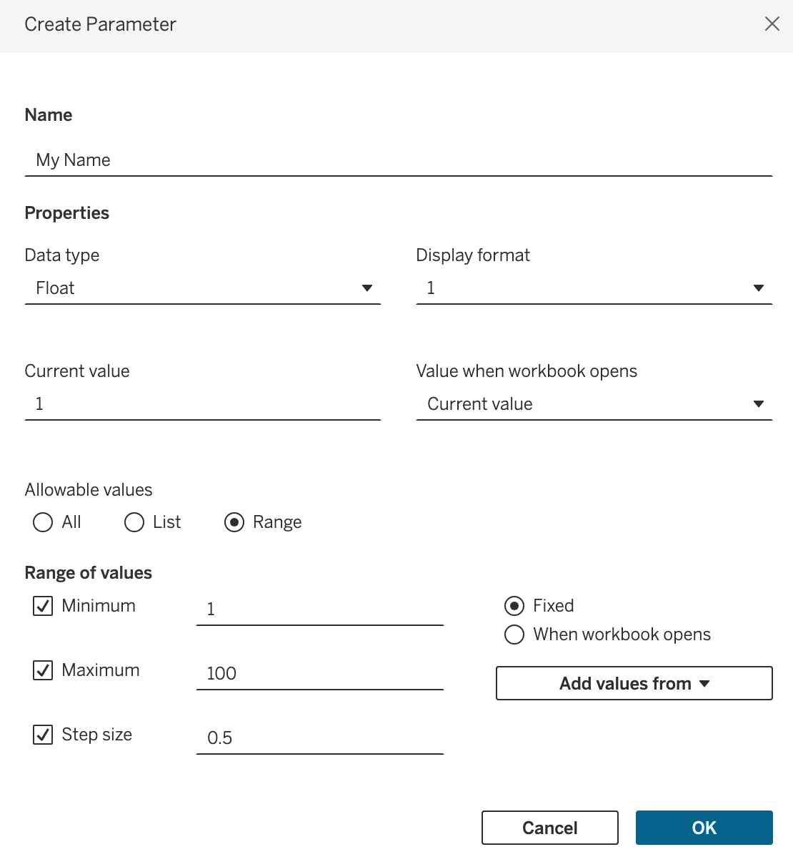
Parameters
Parameters allow us to get input from a user.
Similar mechanics to a filter, but flexible.
We can capture numbers, strings (text), selection from list, Boolean (T/F), etc…
Once captured, the parameter values are usable just like any other variable.
  Show up in list of variables*.
  Can be used in a calculation.

Slide 5
What can Parameters do?
Parameters allow us to take in user input and do something with it.
This is very flexible:
  Text searching – capture something and use that to highlight or use some subset of values.
  Customization – take in something like an interest rate and term for mortgage calculator.
  Interactive elements – base calculations off some user inputted value.
Parameters can do all kinds of different things.
  If we want some info from a user, a parameter probably does it.
Allows for greater flexibility as well – one visualization may serve several groups/people.

Slide 6
Real Life Examples
I used to create many reports for training at ATB.
  These were originally random spreadsheet checklists per region/branch.
  Mainly centered around “how many people are in training and when will they be done?”
  This was unknowable when I started, my first task was to call every branch and say, “got any trainees”.
Different stakeholders/regions had different exact requirements.
  Percentages, counts, expected grad dates, on track/off track, “concerns”, level of detail, etc….
  This originally had dozens of reports on basically the same stuff (list of course completions).
Solution – base reports that are customized via parameters.
  Use different selections to show/hide data on demand.
Way better in the long term – if things change only one report to update.
  The report/dashboard is more complex, but we only have one of it.

Slide 7
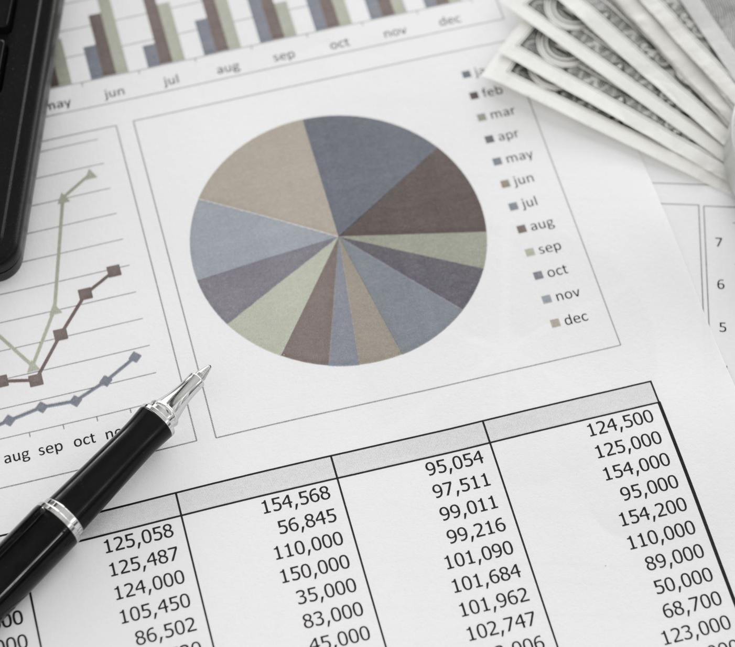
Finance Adjacent Charts

Slide 8
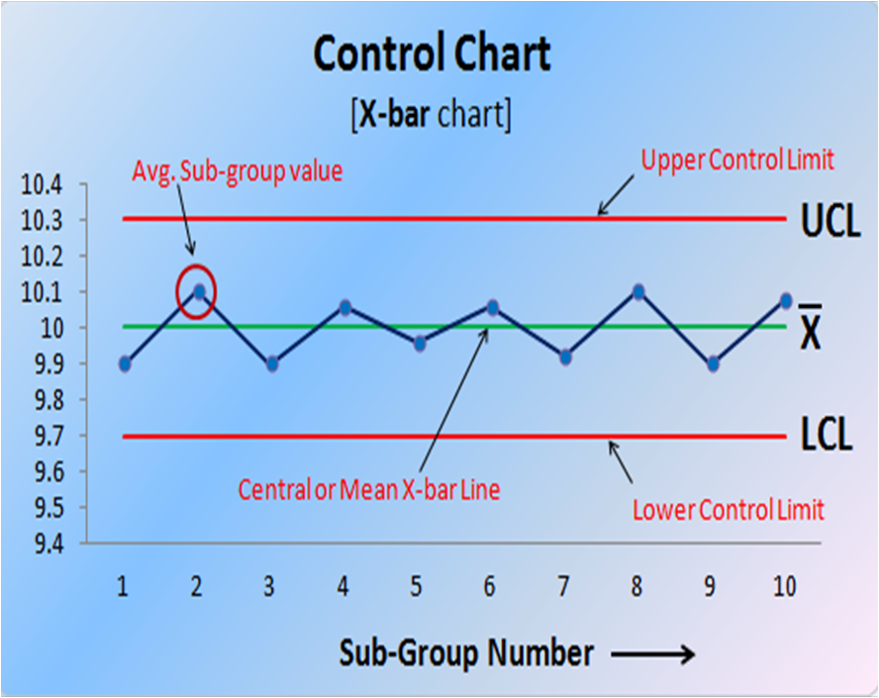
Example – Control Chart
One place where we can use a parameter is a control chart.
Control charts are common where we have:
  An “acceptable” range of values where things are ok.
  An alarm/error/alert where values leave that range.
Common examples:
  Temp gauge on your car – in range is fine, too hot/cold is issue.
  Similar industrial things – pressure, temperature, rate, etc…
  Technical investing.

Slide 9
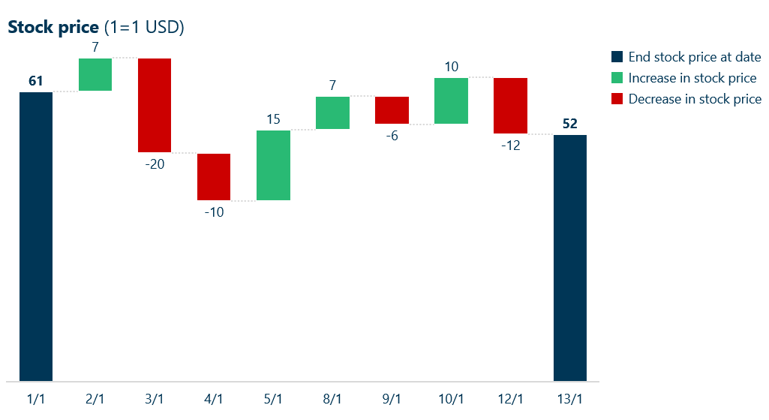
Waterfall (Candlestick) Chart
Waterfall charts show two things:
  A value, similar to a line chart.
  The per period (e.g. daily) change.
Good application of data density.
  Change is added to a ”regular” line chart.
Commonly seen in:
  Stock price quotes.
  Summary of things like sales/profit totals.

Slide 10
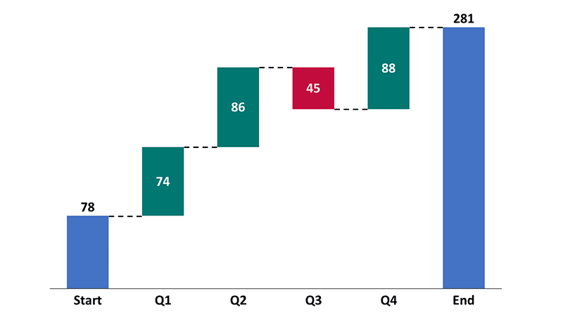
Waterfall Chart Pieces
A waterfall chart has a few basic components.
  The value – where the mark is on the Y axis.
  The change – difference between previous value and this value, shown by size of mark.
  The x-axis – usually time, but could be other thing (e.g. product type).
The change is signified by size and color of mark:
  Normally have discreet color for up/down.
  Size of bar “goes from” start to finish of time period.
Sometimes have start/end total bars.

Slide 11
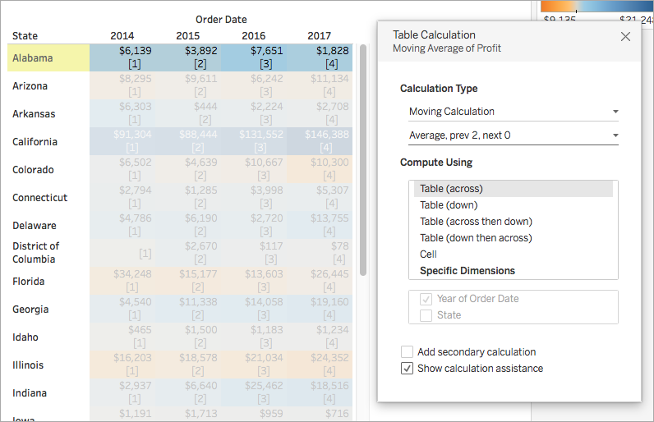
Waterfall Requirements – Table Calculations
Table calculations allow us to do more complex math in some ways.
Table calculations are based on the aggregates in the visualization.
  Remember – what do we want and how do we want it aggregated.
  A table calc takes those agrégations and calculates them.
Examples:
  Ranking of profit by location – aggregate profits by location, then rank the aggregates.
  Moving average – average together previous N aggregated values.
  Percentage of total – aggregate total sales, then convert to percent.
Also frequently seen in trying to do “fancy” stuff.

Slide 12
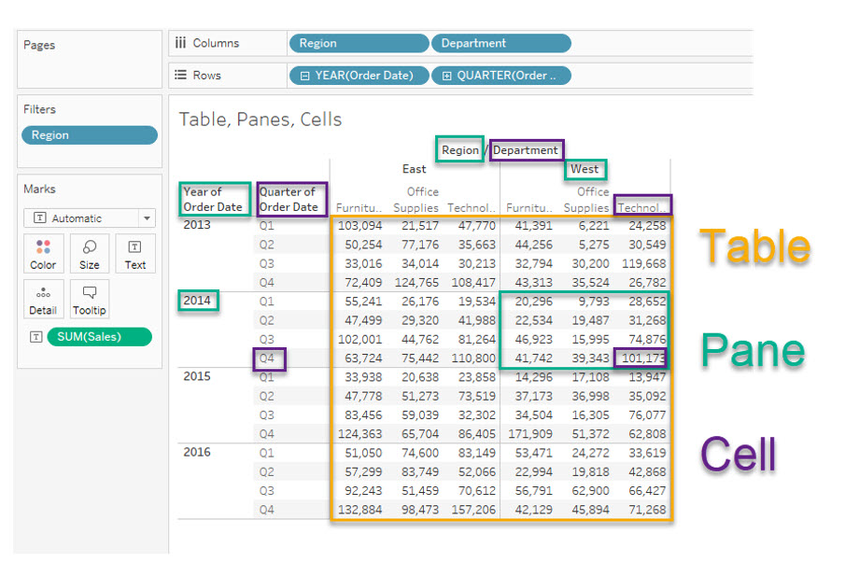
Table Calculation Previewer
For simple things, the table calculation window gives us help.
  We need to be ok with the parts of the data.
The way calculations are done are based on how the data is displayed in the visualization.

Slide 13
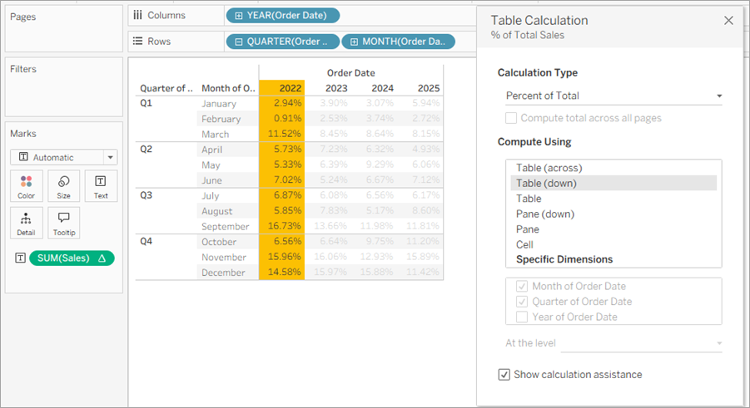
How to Calculate your Tables
The yellow highlight is one “thing”.
  An aggregate per “thing” is calculated.
We will need table calculations to do several things:
  Simple things – you should be able to do rank or similar on your own.
  Complex things – as a step in some complex how-to, can you replicate/adapt.
Table calculations have some more things to (re)consider:
  How do I want this thing aggregated.
  I want an answer “for each”.

Slide 14
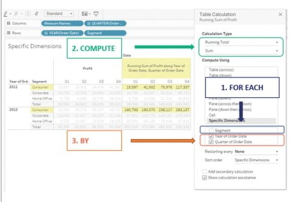
Tables and You!
The Specific Dimensions are complex:
  Specify exactly how to calculate what we need.
  This is common in complex examples.
  May require T&E to get – check 1.
For each segment, compute running sum, by quarter and year.
  Each unchecked thing gets a grouping.
  That value is calculated per q/year.
We can also have secondary calcs.
  Calculate totals then rank them.

Slide 15
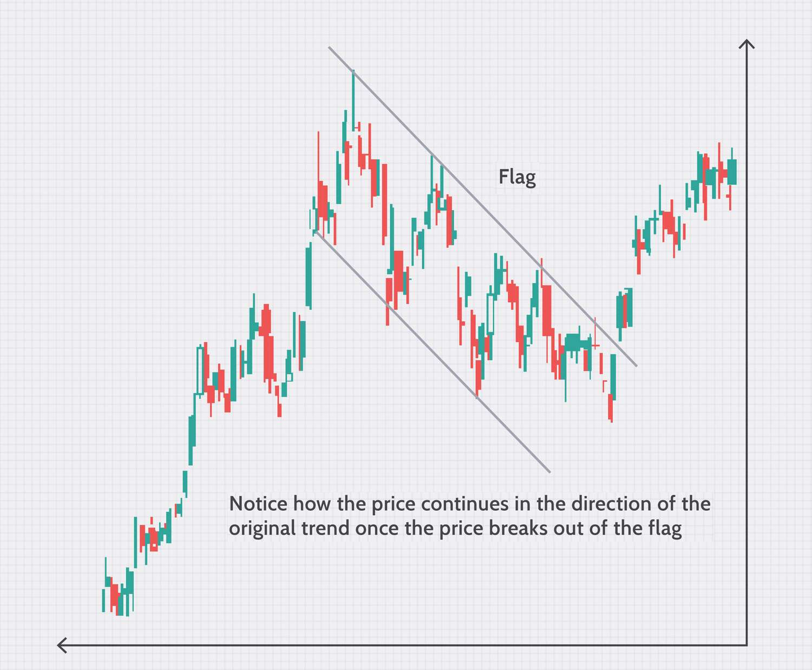
Technical Stock Investing
Technical investing is based on patterns in stock price rather than value of underlying company.
  We should invest because based on patterns in price it appears this stock will go up/down.
  Rather than, we should invest because this is a good business that’ll grow in the future.
Based on looking at movement patterns in price.
  The core idea is that stock prices move in repeatable patterns that we can follow if we notice them.
  Fast computers have made this more powerful.

Slide 16
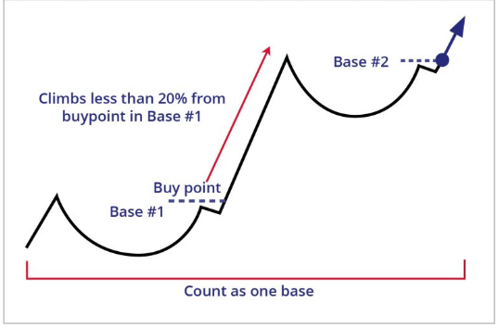
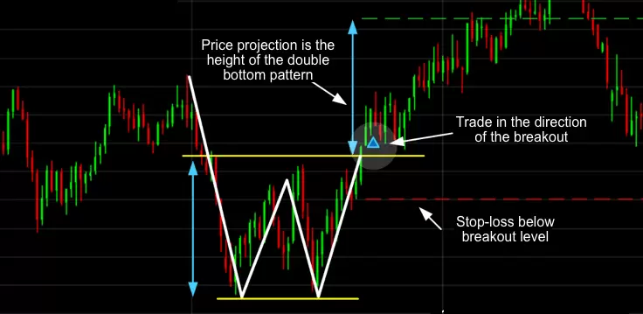
Patterns in Prices
There are several patterns that people have noticed in how stock prices move.
Investors look for stocks at the start of the pattern, and invest assuming the stock may follow that pattern further.

Slide 17
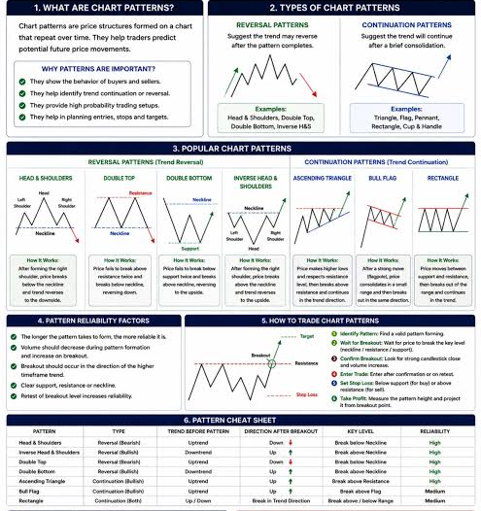

Slide 18
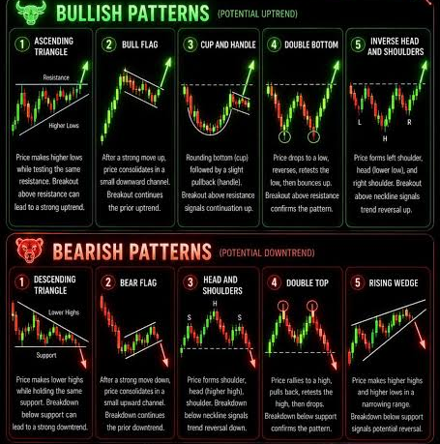
Patterns
There are many existing patterns.
These are not certainties.
Computers can allow us to check all stocks for all patterns very quickly.
Can base decisions strictly on technical data or as a factor with ”normal” data.

Slide 19
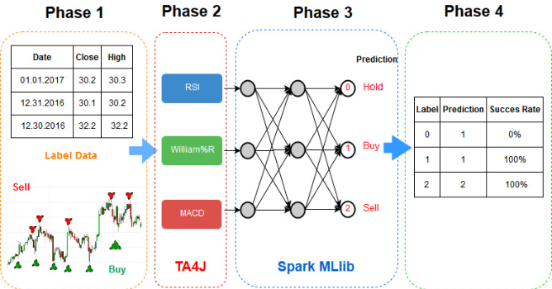
Even Smarter Versions
Modern ML is more powerful.
Can feed model all data.
Model will learn more subtle patterns in data.
Can screen all stocks.
Trained by making “old” preds.
  Using data before today, predict today’s prices.
  What is error in each prediction?
  Repeat and adjust to lower – models have billions of parameters (numbers) that can be tuned.

Slide 20
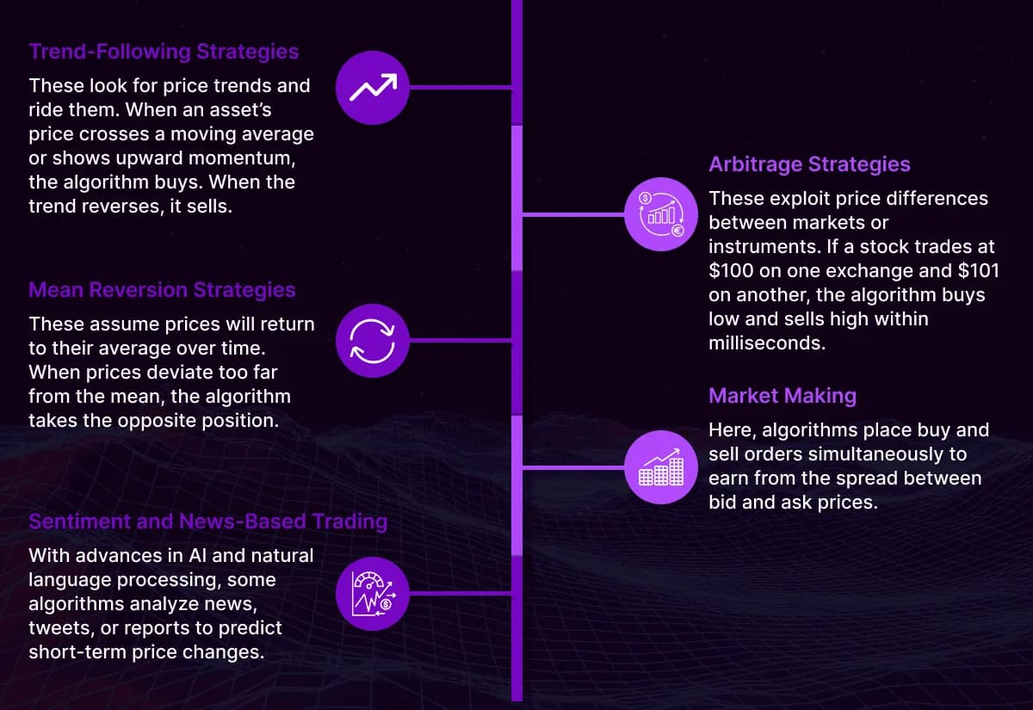
In Reality
In the real world, this is one type of investing, and is pretty widespread.
Large amounts of investing is now algorithmic:
  Decisions are made automatically, via computers, immediately as things happen.
  Large hedge funds, private equity have very fast systems to try to front-run this.
  With massive volumes, lots of money can be made from small advantages.
If you like this and want to get a math Ph.D., this can pay in the millions.

Slide 21
Conclusion
These two chart types are common in the real world and frequently useful.
Parameters are powerful, especially as things get more complex.
Don’t stop with what you can directly do, think about what’s needed, then learn how:
  We can modify and customize the calculations we create to get exactly what’s needed.
  We can manipulate marks to show exactly what we care about.
  You want/need to spend time here to make things good.
For the next assignments, you want to think about this kind of stuff.
  Is what I’m calculating what is best, or does a person need to do other steps mentally?
  Is the way data is displayed the best, or would another mark type/style be better?
  Can I change anything to make it more useful?
  You need to think of this stuff, I’m going to ask it when looking at your visualizations.

