Slide 1
Analytical Distribution

Slide 2
Empirical Distributions
We’ve used empirical distributions, or distributions we observe from collecting and analyzing data, up until now.
Empirical distributions are the distributions of our actual data sample.
Empirical:
Collect data.
Look at it to see what the distribution is.
Problem - you need to collect data first.

Slide 3
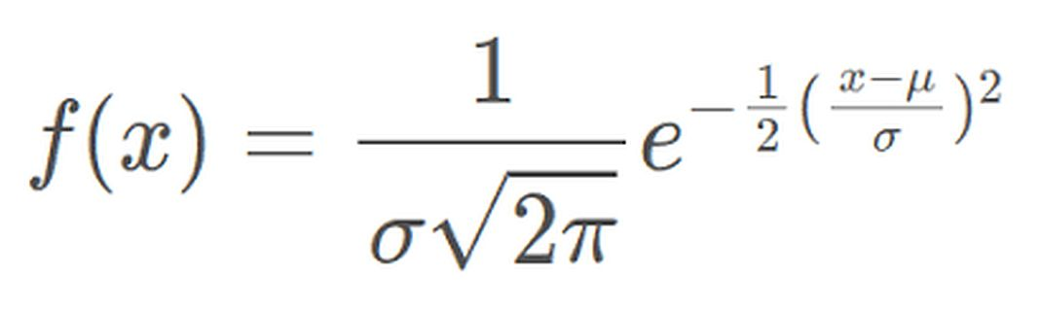
Analytical Distributions
Analytical distributions are mathematical formulas, or models, that describe a distribution with an equation.
Allow for analysis and inference without collecting all that data*.
* More on this later.
The models of analytical distributions are simplifications of the distributions we can observe in data.
E.g. a normal distribution is:

Slide 4
Approximation
Using a simplified model instead of real raw data requires that the model closely fits, or can be made to closely fit the distribution of the real-world data.
The closer an analytical distribution is in shape to the empirical data, the more accurate and better that analytical distribution will be.
The normal distribution on the previous slide is defined by mean and standard dev.
If our empirical distribution is normal, we can make a “matching” one from the mean and std.
Generalizing from our sample to a broad definition of the distribution.
Note: The book looks mainly at CDFs. I think it is a little easier/more intuitive to look at the the histogram/pmf perspective at first.

Slide 5
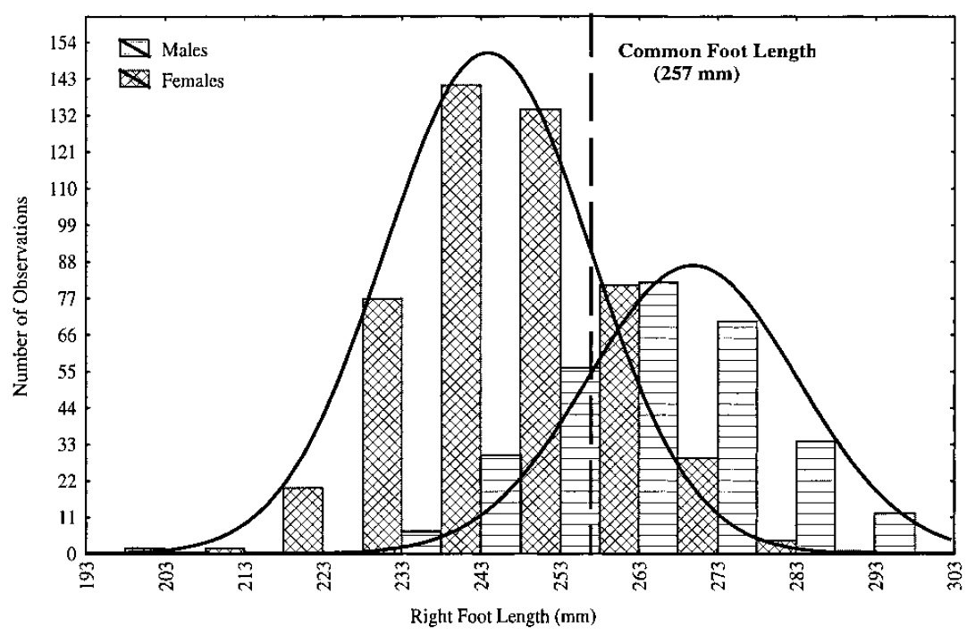
Are you Normal?
The normal distribution is used to model many real-world distributions.
E.g. shoe size - most people are close to the mean size, as you get bigger and smaller, there’s fewer people there.
A normal dist. “fits” the shape of the dist. so we can analyze that mathematical curve and infer that real data will follow that pattern.

Slide 6
Normal Distribution
Many phenomena can be modeled with a normal distribution.
Shoe size, weight, grades in school…
Most things where people tend to be close to average, and values farther away are more rare, are often normal (or close).
Key normal distribution facts:
Symmetrical on either side of the mean.
Median and mean are equal.
Defined by standard deviation and mean.
Known amounts fall within X standard deviations (~68%, 97%, 99%, etc…)
We can use this to estimate how many records we can expect to fall in a range.

Slide 7
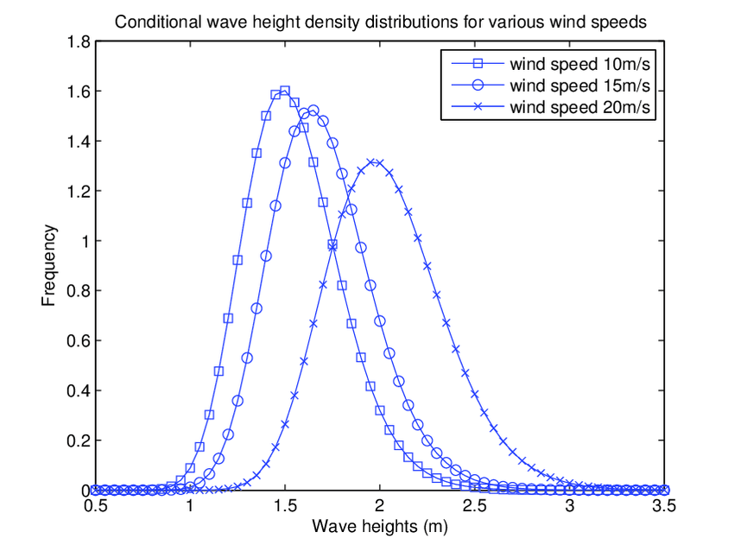
Other Distributions - LogNormal
Lognormal distributions are similar to normal, but slightly ‘tweaked’.
They have a longer right side tail.
It is “skewed”.
E.g. Wave heights – there are a few that are really large.
People’s heights are slightly more lognormal than normal.

Slide 8
Other Distributions - Exponential
Topical – viral spread can be modeled exponentially.
The “R” value often quoted is a measure of how many people an average infected person will infect. If it is greater than one, the virus spreads; if lower, it eventually dies out.
E.g. an R value of 1.1 would mean that 100 infected people generate 110 infections, who in turn generate 121 infections, etc…
Real world models are more complex – vaccine penetration, population behavior, restrictions, etc… all complicate the math.
Note: The book looks at a slightly different exponential distribution, more on that next time.

Slide 9
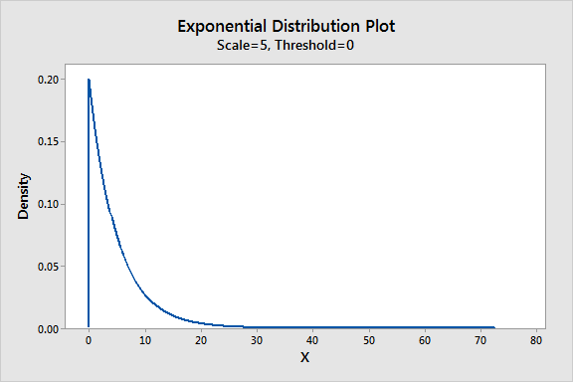
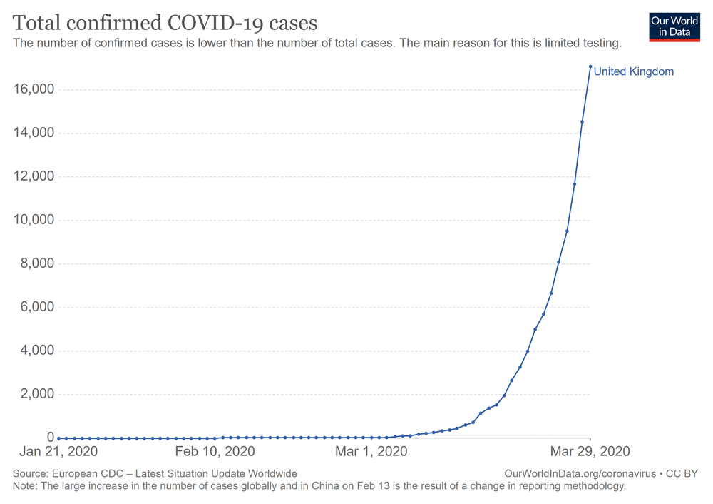
Exponential
Exponential are often seen in a time-series plot, as seen on the right.

Slide 10
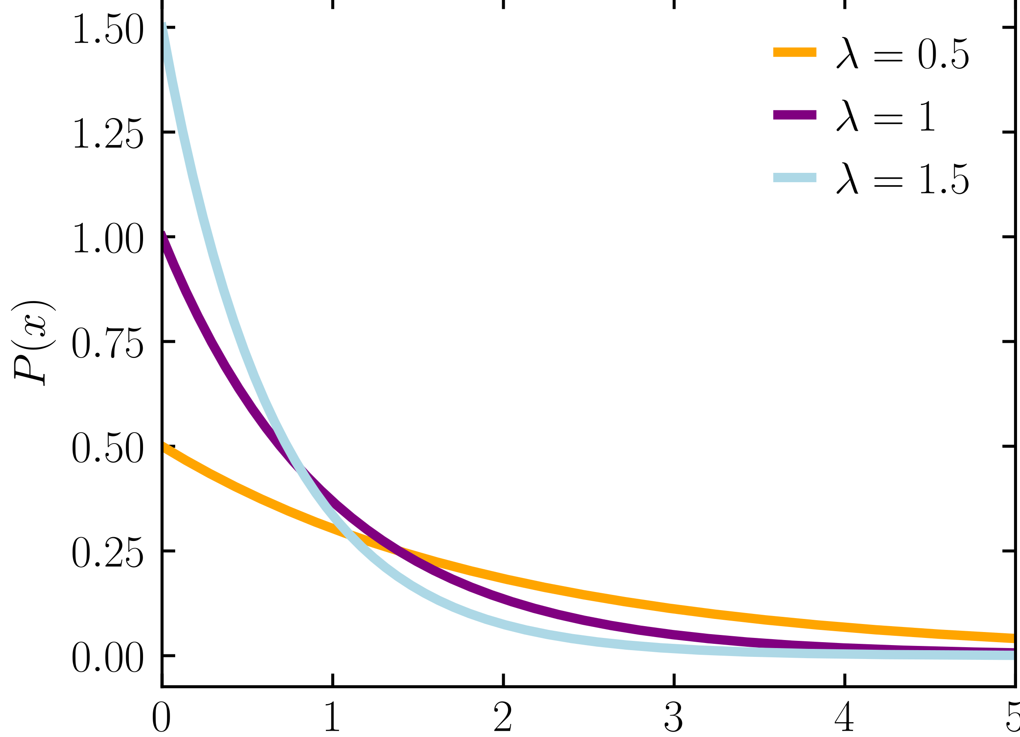
Exponential Distribution
The plot of exponential growth (normally shown over time) looks like a hockey stick.
The histogram/pmf/pdf function is the “opposite”:
Lots of small values. (The flat, early part).
A few large values. (The “climbing” part).

Slide 11
Other Distributions - Pareto
Pareto was an Italian economist from way back.
Created the 80/20 rule or Pareto Principle – 80% of the results come from 20% of the inputs.
Original – 80% land belongs to 20% of people.
Wealth – 80% of wealth belongs to 20% of people.
Customers – 80% of revenue comes from 20% of customers.
The 80/20 split varies, but the idea applies in many situations:
Microsoft – 80% errors from 20% bugs.

Slide 12
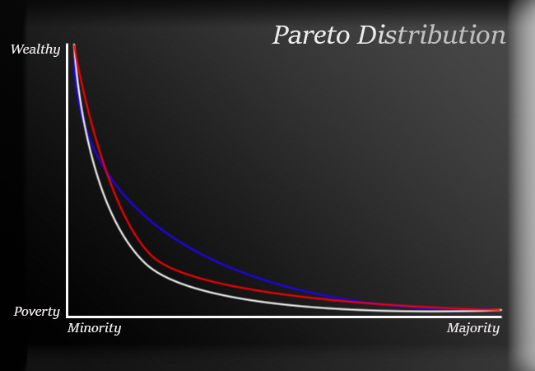

Slide 13
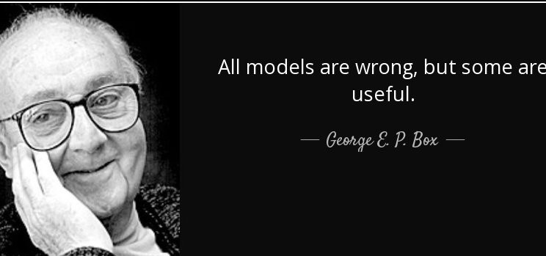
Why Bother?
All models are wrong, some are useful.
Models give a simplified picture of complex and noisy real-world scenarios.
Model assumptions fill gaps in knowledge.
If a model fits something, we can use it to do calculations and draw inference.
Ex. We can try to “fit” a model to explain the spread of COVID.

Slide 14
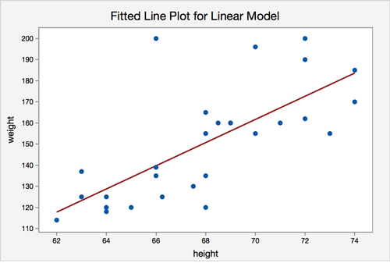
Example – Use model to Predict
If someone is 67 inches tall, how much do they weigh?
Blue dots are the empirical data.
Red line is model (best fit).
We don’t have empirical data on the weight of a 67 inch person.
We do have a model that gives us an estimate, based on the empirical data.

Slide 15
Analytical Models and Inference
Analytical models are a key foundation of inferential statistics and machine learning.
The model provides us with a set of expectations.
The empirical data provides us with the parameters shaping those expectations.
Generalization in statistics also relies on analytical models.
The parameters come from a small subset, where ‘all’ is impractical.
The model projects those expectations to an entire population.
We aren’t assured that an analytical distribution will fit our data, but they commonly do.
ML allows us to be more flexible in making complex models for prediction.
’Old school’ stats is limited to things we can eyeball/calculate by hand.

