Slide 1
Survival and Hazards

Slide 2
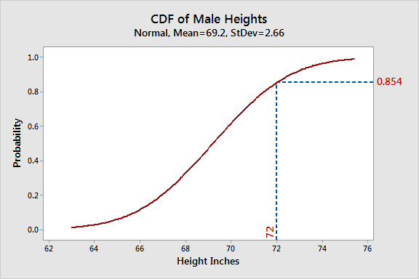
Think CDF
Recall the cumulative distribution functions.
Show the proportion of values that are less than a certain point.

Slide 3
Think Backwards
Now, think about the opposite – what is left to happen and when will it happen?
This is survival analysis.
We are examining an event, and when it happens.
  Event – the “thing”, patient dies, person quits, thing explodes…
  Time – how many time periods have elapsed.

Slide 4
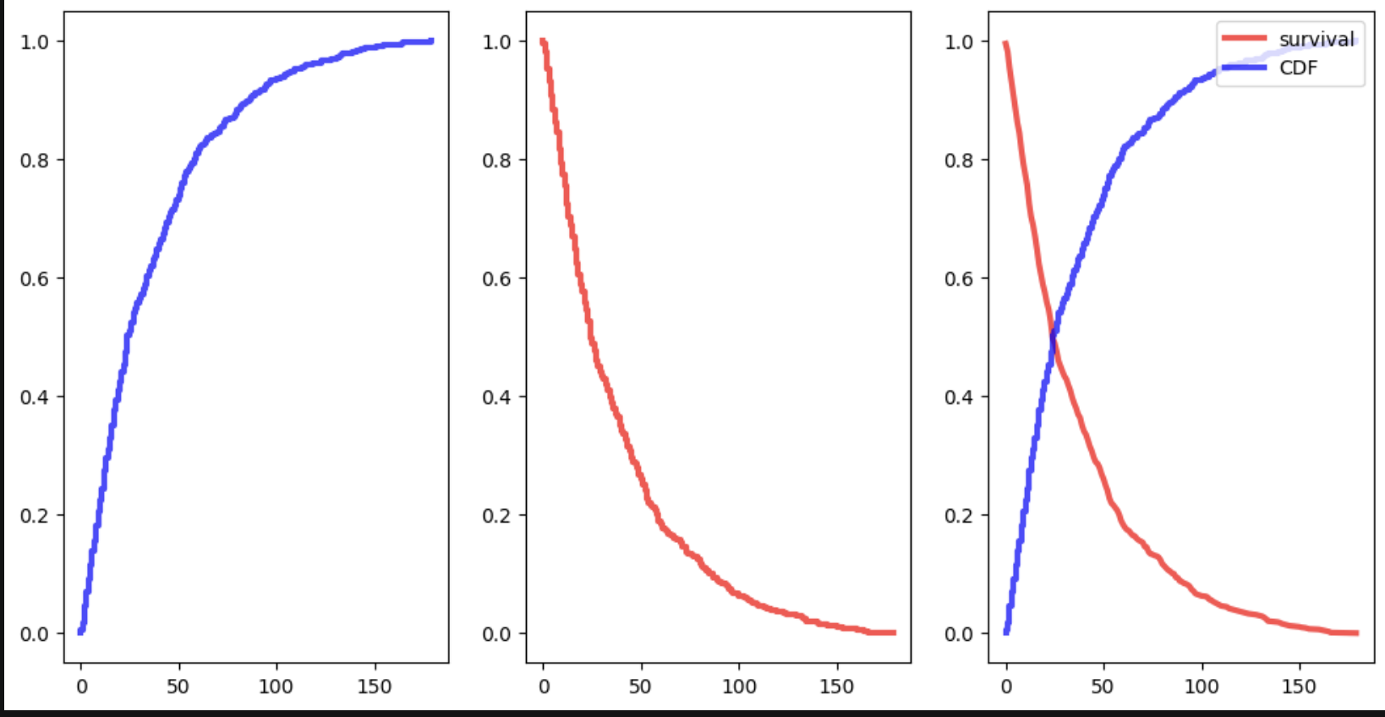
Survival Basics – Survival Function
The survival function defines the probability of survival beyond a time point.
  S(t) = P(T > t)
  T is one survival time, t is a time point.
The survival function can be estimated by:
  Number remaining / total number.
It is also:
  S(t) = 1 – CDF(t)

Slide 5
Survival Data and Tools
The data in survival needs two things:
  Has the event happened?
  The time period.
Can also be frames as the birth and death of a datapoint.
Libraries and tools:
  We’ll use a library called “survival”, there are others, “lifelines” is probably most popular.
  Libraries can do lots of heavy lifting for us.

Slide 6
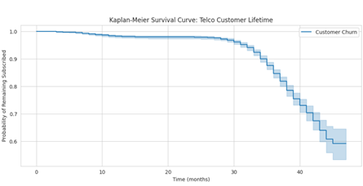
Survival Functions
Survival functions look like this(–ish) when plotted.
Track total up to that point.
  How many are left?

Slide 7
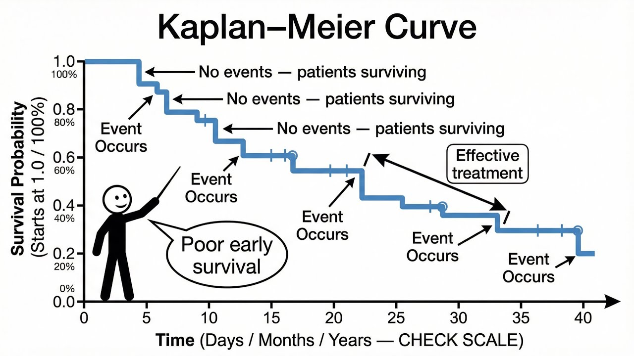
Kaplan Meier Curve
This type of plot is a KM curve, and is common in survival.
  Y – probability.
  X – time scale.

Slide 8
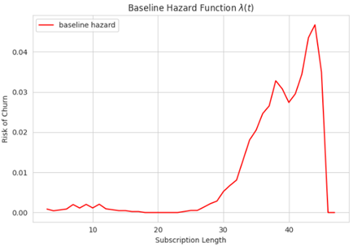
Survival’s Buddy - Hazard
We can also think of things in terms of hazard.
  How likely is it that the event will happen at this point in time?
Hazard function:
  H(t) = ( S(t) – S(t-1)) / S(t)
  H(t) = F(t)/S(t), F=pdf.
Survival = CDF: cumulative.
Hazard = PDF: at this time.

Slide 9
Usefulness of Libraries
In general, we can use library functions to swap between hazard and survival.

Slide 10
If we have formulas…
If we have formulas for PDF/CDF/whatever, we can calculate the survival/hazard.
In many (and probably most real life) cases we don’t have this.
  Data is something like “how long have they been customers at Telus”.
Survival analysis often uses estimation from empirical.
  Have partially complete data.
  Use estimation process to create survival/hazard functions.
  Roughly similar to KDE – have data, want function.
  Libraries can do most of the hard work for us.
In general, we can use library functions to swap between hazard and survival.

Slide 11
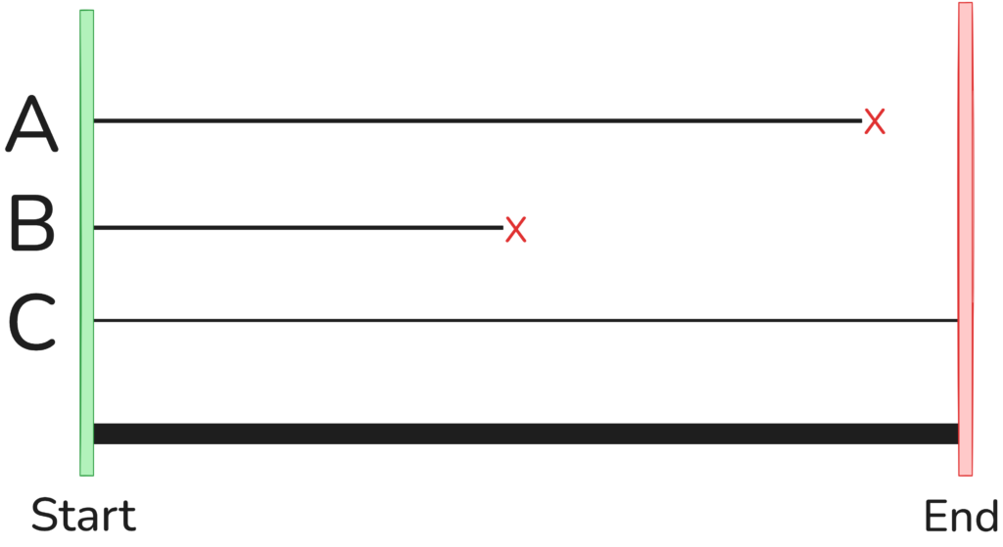

Censorship
In survival analysis, some events haven’t happened yet.
Data points where we don’t have a death are censored.
There are different arrangements:
  Left censored – event happened before our data.
  Right censored (normal) – event happens after our data.
This allows us to deal with data of incomplete things.
  Something like life expectancy would be impossible/impractical otherwise.

Slide 12
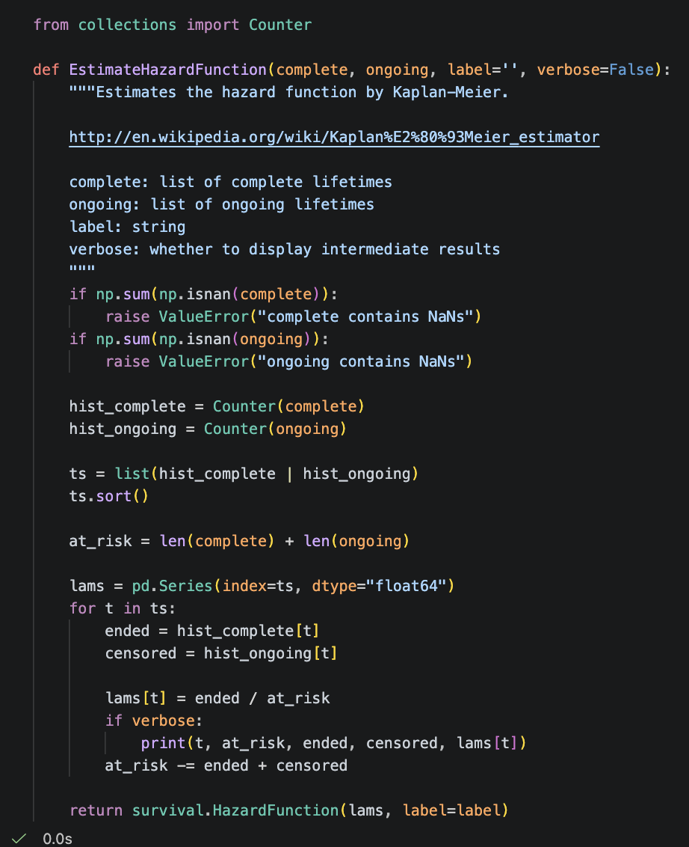
Kaplan-Meier
KM creates an estimate of survival/hazard functions.
  Non-parametric.
This simple example gets hazard that we can convert.
Libraries will get survival directly.
We can get the functions from this process.
Once we have functions, we can calculate!
There are other estimation methods as well.

Slide 13
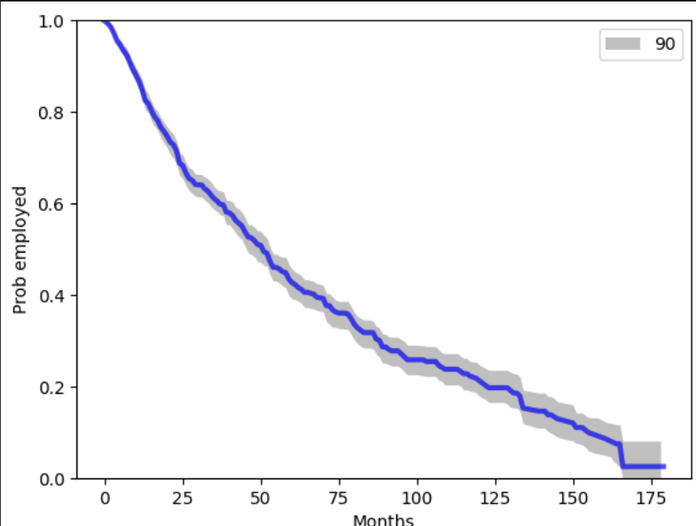
Confidence Intervals and Simulation
Survival is, obviously, something where we don’t have all the info.
Our survival projections have error.
We can show the confidence with CI.
We can generate CI via monte carlo processes.
  Take the data, resample with replacement, calculate survival.
  Do many times, calculate where 99/95/90% of results lie.

Slide 14
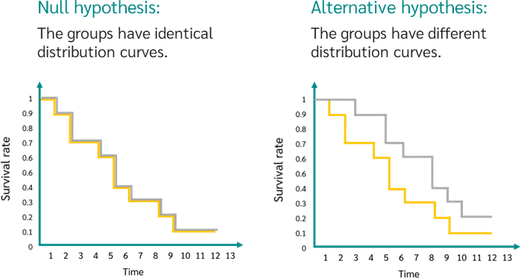
Application – Log-Rank Test
A log-rank test is roughly analogous to a hypothesis test for a distribution.
  Do these two samples appear to come from the same population.
  Null hypothesis: The groups have the same survival function over time.
  Alternative hypothesis: At least one group has a different survival function.
E.g. are employees quitting this McD for some reason, or just normal turnover?

Slide 15
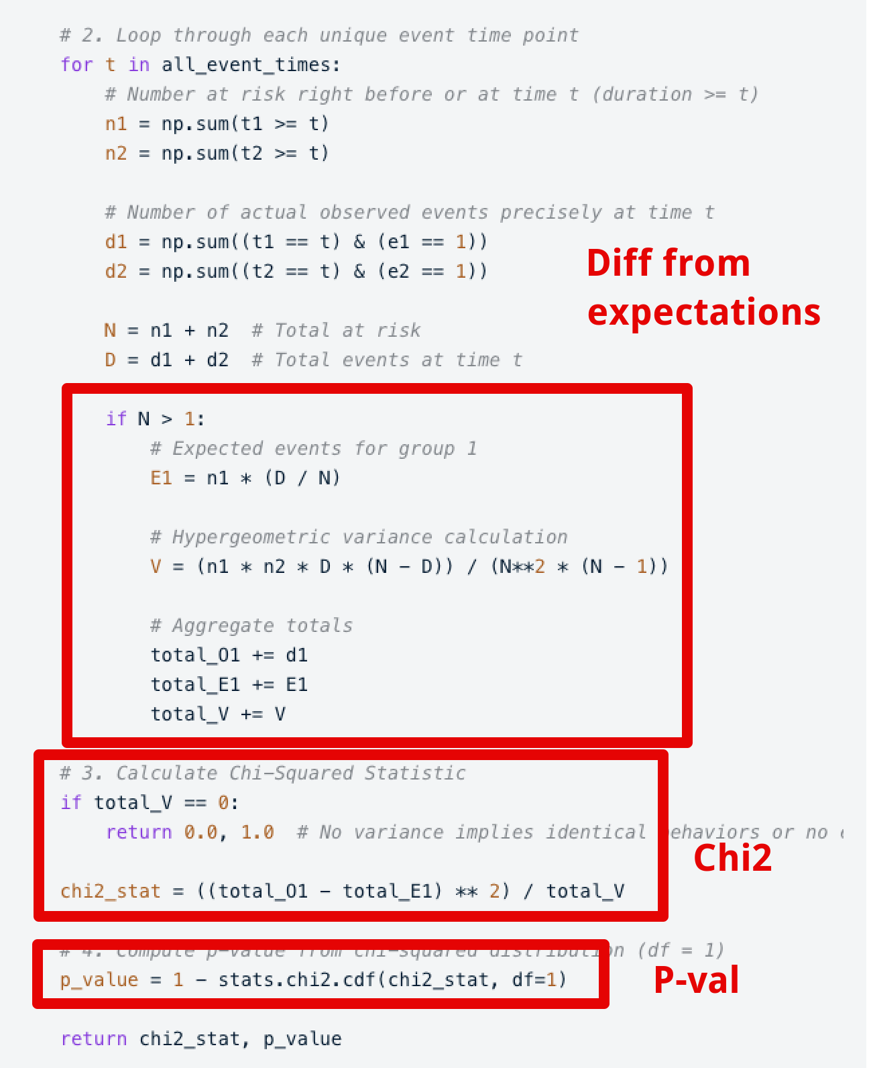
Log Ranking
We don’t need to worry about implementation of this.
Similar in concept to chi2 – diff from expectation.
The final p-value check is the same as Chi2:
  The difference from expectation is calculated differently.
  The idea is identical – quantification of diff.
If this big of a difference rarely (low p) happens randomly, then there is probably a difference in the datasets.

Slide 16
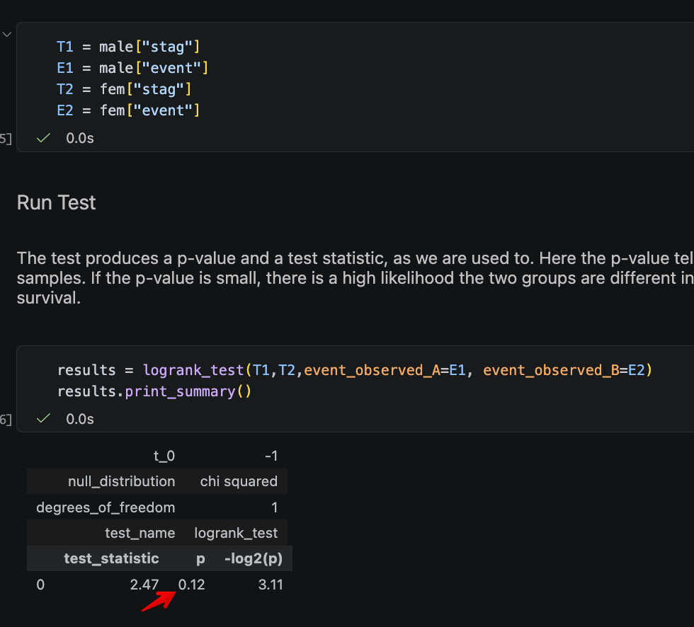
Log-Rank Usage
Performing a log-rank test is relatively simple.
Assumptions:
  Events are independent.
  Events over time are similar between groups.
  No/low crossing – if which survives better switches after the start, may lower accuracy.
We must provide the data as two groups of times and events.

Slide 17
Drive to Survive
The workbook contains several examples done by hand, this is for info, use libraries.
  Some are slightly simplified, all are more annoying than using premade functions.
Survival is relevant in many real-world applications.
May need to prep data, but after that most things are easy.
  Time/event may not exist in that format in original data – e.g. “end date” needs math.
Not critically important to most other topics we need, but may come up…
  Put the basics in your toolbox and be ready to expand on details as needed.
  The project in the next semester might have some survival relevant stuff…

