Slide 1
Keeping of House
Quiz:
Corrections made for my mistakes, should be reflected in the grade now.
I updated the percentage ones to give %50 marks for percent vs decimal.
Test:
Guide on Moodle.
Theory, no calculations.
Assignment 2:
Description is up. Largely analytical distributions and correlation.
Today:
Error (workbook 012…). First part of chapter 8.
Peek at time series data.

Slide 2
Logistics
Today – Errors and basic time series data. (Not directly from a chapter. Read 8 soon).
Residuals, RMSE, MSE.
Might do an intro to estimating if there’s time, it’s more complex.
You’re supposed to have a quiz next time!
Pretty similar to the last one that everyone did well on.
Up to last week – pmf, cdf, distributions, analytical distributions…
There’s a test in a couple of weeks.
This will involve some code stuff.
Cover up to this week

Slide 3

Assignment
There’s a quiz for GitHub Usernames, please do it.
I need to match github to lms accounts to enter marks.
Once I have a list to translate, I can enter the marks.
Some notes (we can look pre-quiz in more detail)…
Some people had only one commit, if there’s some logistics issue I’m all ears…
Github can be annoying, but it’s the same every time, so lets sort it now.
Don’t move/copy the functions into the notebook, they are imported.
I kind of wish more people tried to expand the test bits.

Slide 4
Be OCD to Find Problems
If in doubt, write pseudocode.
In English, in as much detail as possible, what do I need to do?
For each thing, we can look up how in code.
If there’s errors, be systemic to identify.
Errors will have both a message and an indicator of line triggering it.
Localize the error to one operation or function call, then look at docs or search.
If something is wrong, be even more systemic.
Print/variable viewer/debug to check values line-by-line if needed.
Narrow down what line isn’t working.
It is boring, frustrating, slow, and dull, but this is how you program.

Slide 5
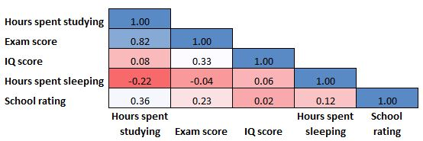
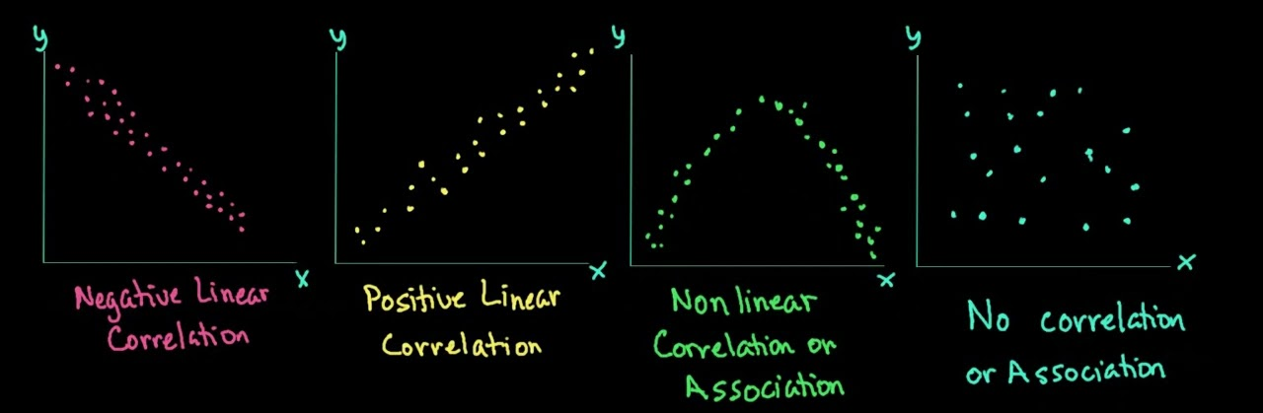
Correlation

Slide 6
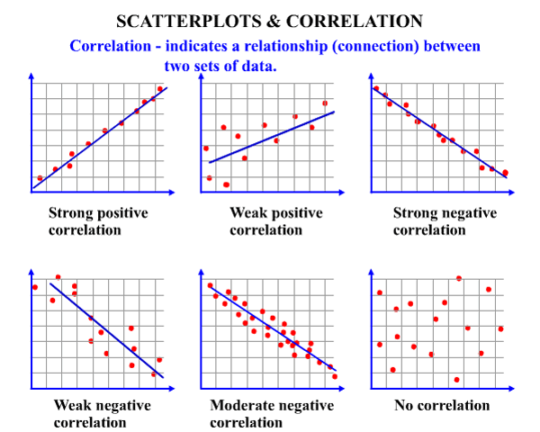
Review - Correlations
Last time we looked at relationships between two numerical variables.
We can measure covariance – how much Y varies as X varies.
This can be translated into correlation.
0 is none, -/+ 1 is perfect.
Can spot visually on scatter or calculate.
Pearson or spearman.
Predictively – if we know X, how well do I know Y?
How much of the variance in Y is explained?

Slide 7
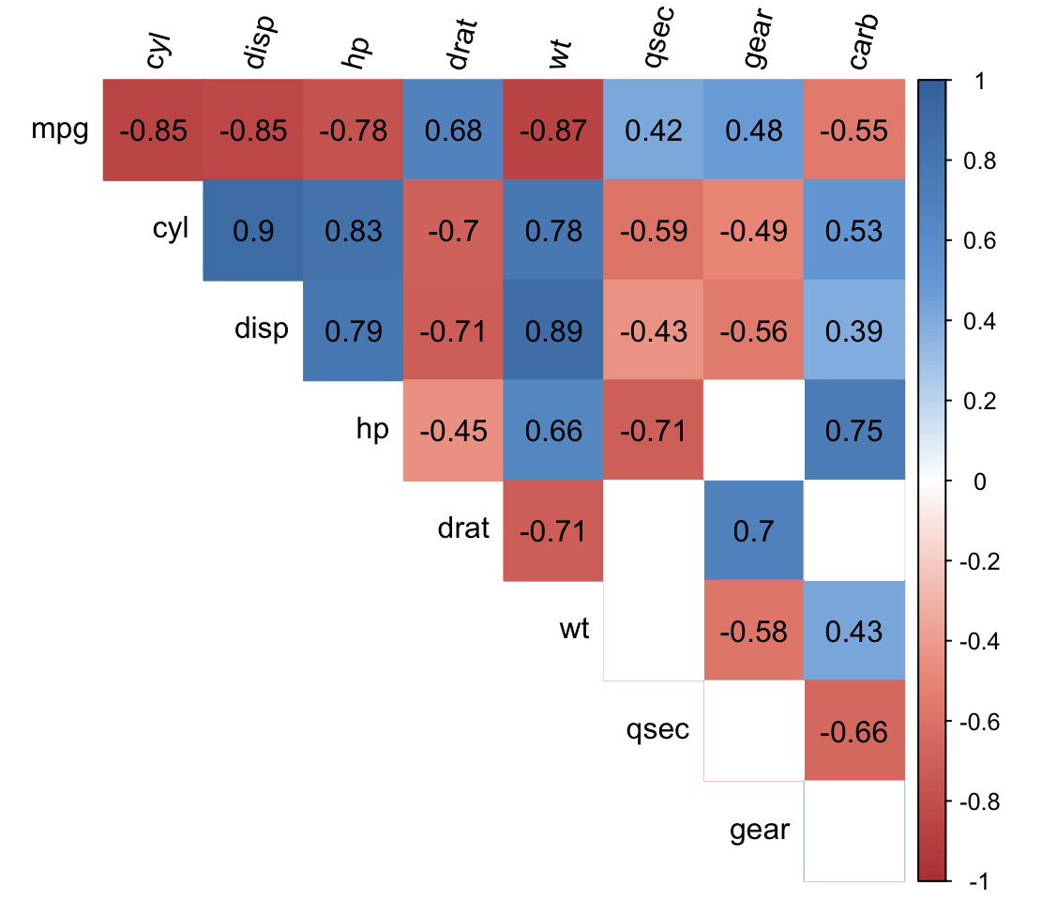
Correlation Strength
Knowing correlation is important for several reasons.
We can see things that have a connection.
We can validate new measures.
We can predict trends.
In exploring data for ML, we want to know:
Things correlated with target.
Things correlated with each other.
Later in ML – how do several Xs explain Y.

Slide 8
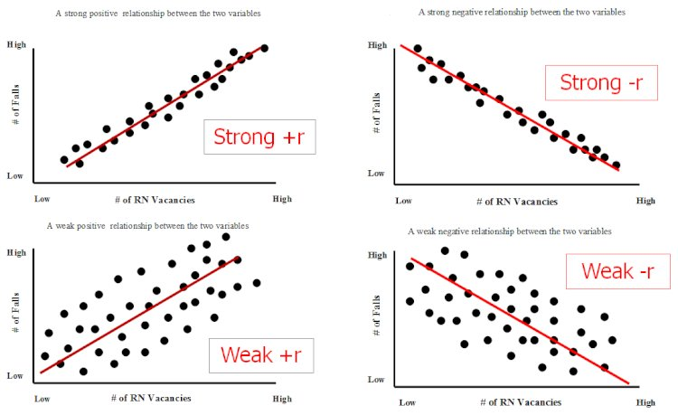
Explained Variance
I think its easiest to frame in terms of Variance Explained.
Each variable varies (literally) in value.
Unchanging variable is easy to explain – just the mean.
Variable that varies is harder – mean +/- some variation.
Correlation tells how much of that variance is explained.
I want to know Y, Y data varies in value some amount.
X gives us (explains) some information on Y’s value.
If correlation is 1, X explains all of Y’s variance – we know 100% of Y’s value (no ambiguity).
Y is target, X is input – how well can we get Y from X.

Slide 9
Errors

Slide 10
Data and Estimates
So far we’ve looked at two main types of ”things”:
Empirical data – real values. Generally a sample of a population.
Models – a representation of some data. Analytical distributions and the line of best fit (regression line) are both models.
A model is a simplified representation of the data.
How good is a model? So far, we’ve mainly looked to eyeball it.
The models always differ from the empirical data somewhat.
How do we evaluate how good a model is?

Slide 11
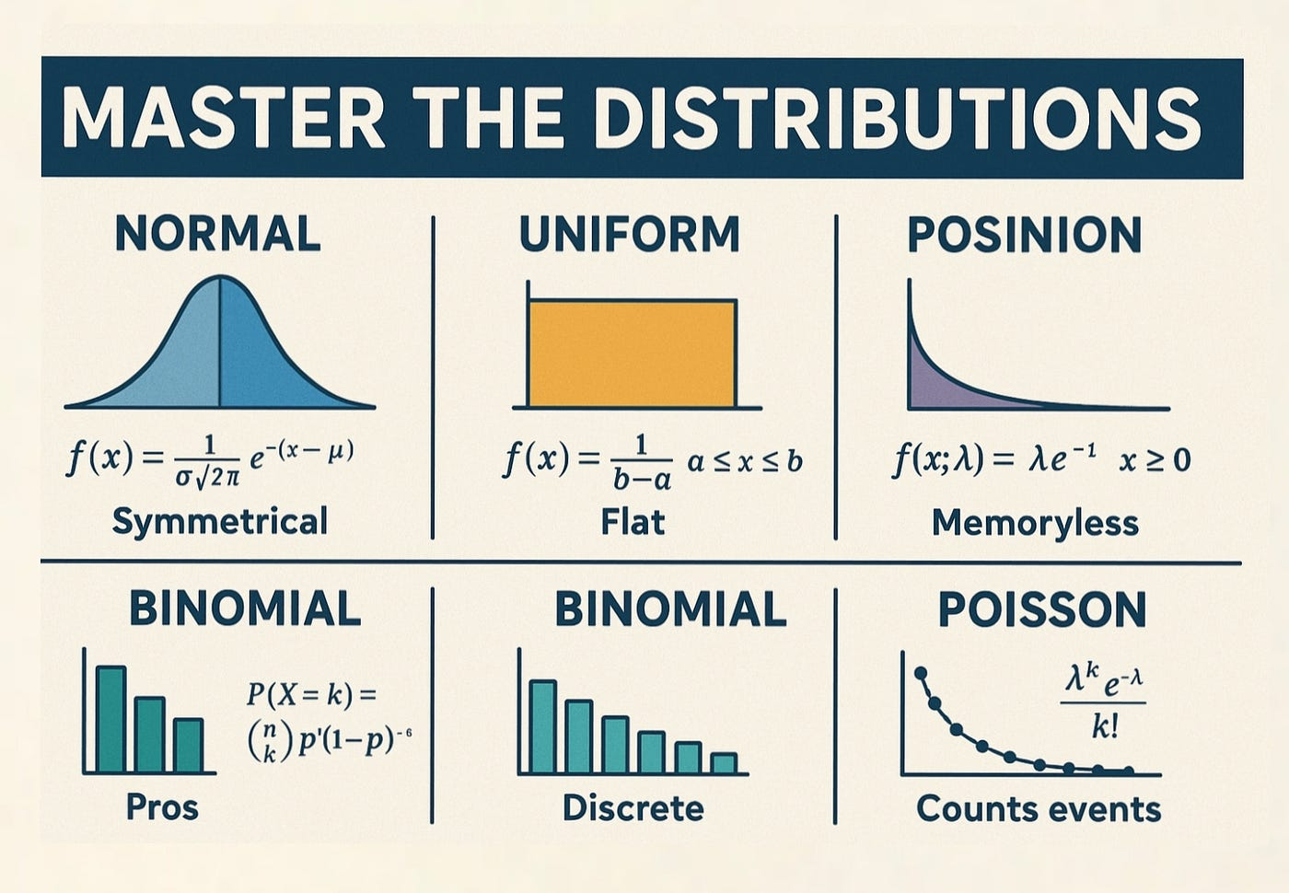
Analytical Distributions And Models
Our analytical distributions are models.
Mathematical representation of our data.
Defined by some equation rather than collection of data.
Define how we expect data to fall.
Models aren’t perfect, they’re simplifications.
We expect some difference between data and model.
Any other model works the same way.
It gives a simple version of what we see in data.
The model can ‘predict’ new values.

Slide 12
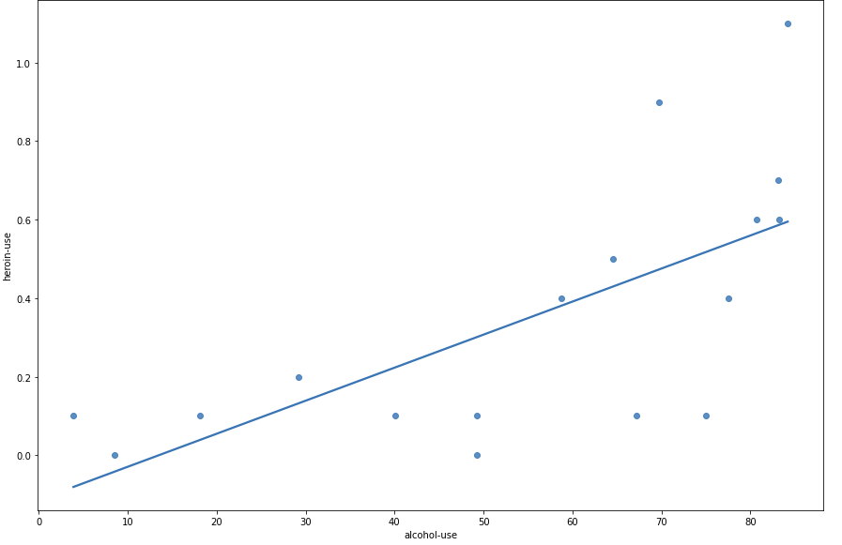
Another model:
Data – The dots.
Model – the line: y = m*x + b

Slide 13
Errors
When matching empirical data to analytical distributions our match is never perfect.
Each point is “off” the analytical distribution by some amount.
The less the total amount of “off” is, the more closely matched the distribution.
Predictions work the same way:
Predict what a value should be.
Measure our error.
Summarize these errors to estimate overall accuracy.

Slide 14
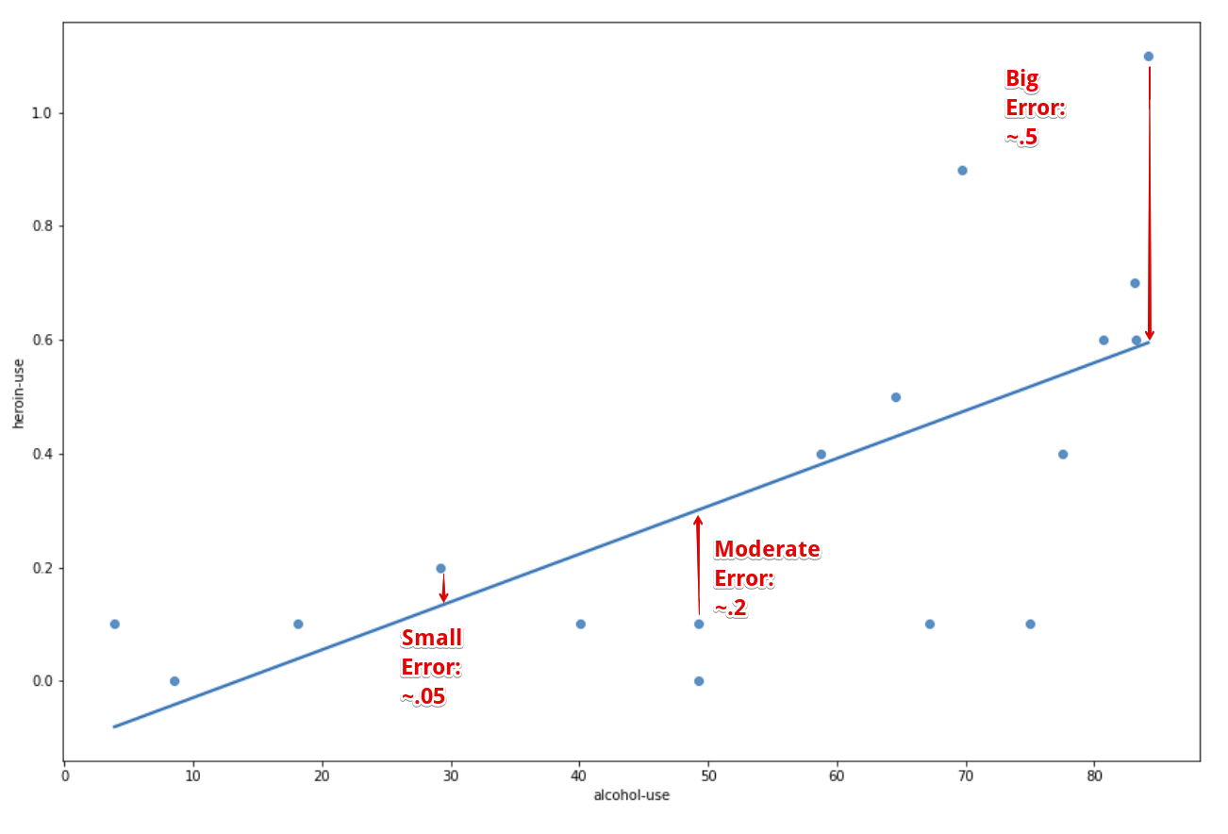
Residuals
A residual is how much one value is off from reality.
Each point in our data has its own residual – how “off” was the model vs that real value.
Here – LoBF is a model of the data.

Slide 15
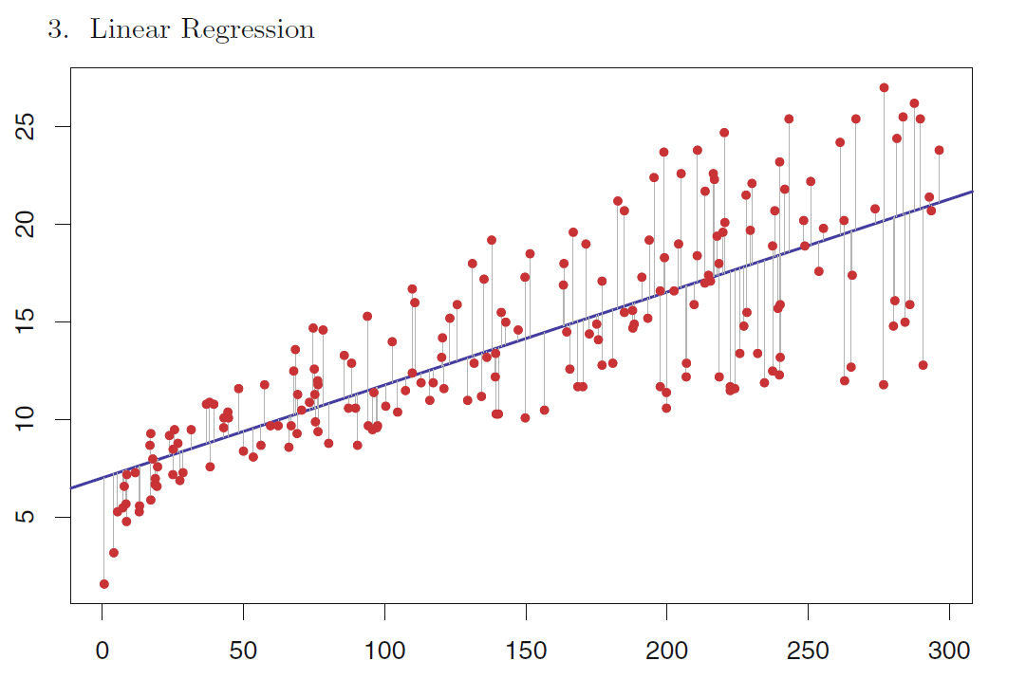

Slide 16
In Analytical Distributions
The idea of error works in the same way when matching empirical vs analytical distributions.
Empirical is the real data.
The analytical distribution is the prediction.
E.g. Consider matching a lognormal looking distribution to the lognorm analytical one:
Empirical data tells us how many values we have in a bin.
The analytical distribution tells us how many we expect (if the data follows that dist).
The difference between the two is the residual, or amount of error.
This error is the ‘miss’ of the model – it isn’t capturing the empirical pattern accurately.
This could be due to the model not fitting, or due to actual variation from normal in data.

Slide 17
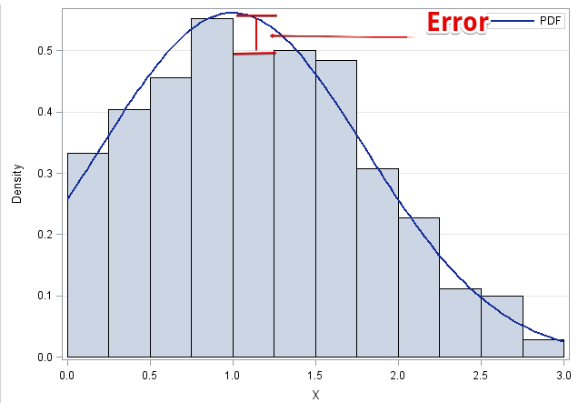

Slide 18
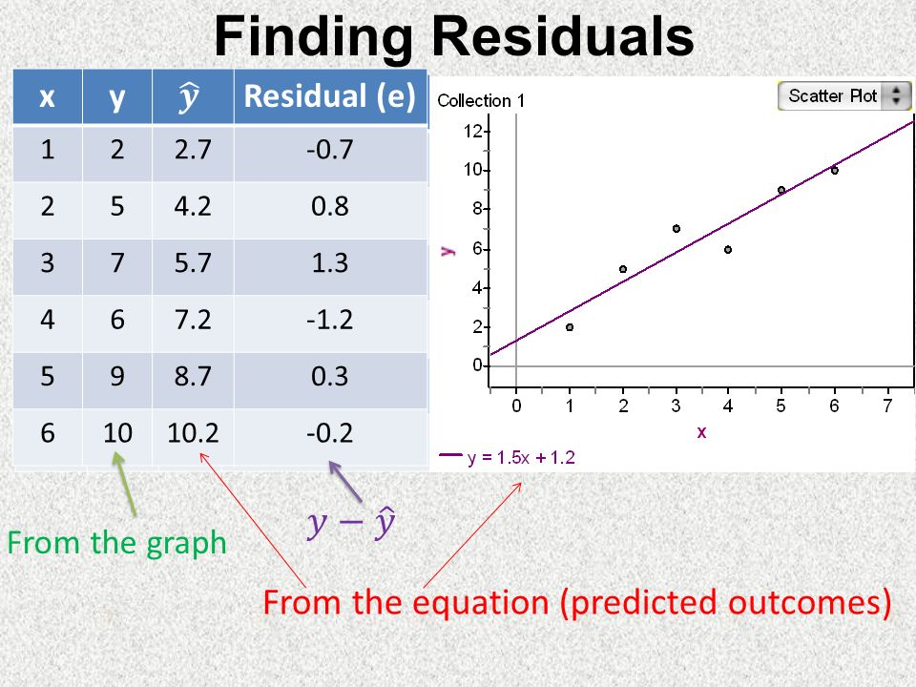
Calculating Residuals
If we have an expectation (analytical model, ML prediction, guess) and a true (empirical) value, we can calculate the residual.
At each empirical point, how accurate is the model?
We get one residual for each row of data (point):
Y_predicted – Y_actual

Slide 19
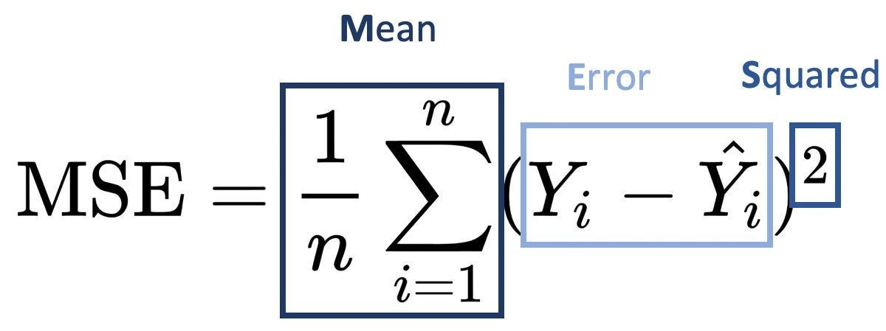
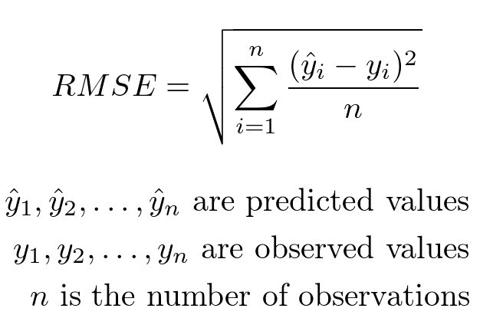
Summarization of Errors
When dealing with many points, a list of residuals is impractical.
Think of a dataset with 10,000,000 rows – a list of that many residuals is impractical.
We can summarize residuals into one measure of error.
There are several ways to summarize error, e.g.
MSE – Mean squared error. Square residuals and average them.
RMSE – Root mean squared error. Take the square root of MSE.
MAE – Mean absolute error. Average the absolute values of the residuals.
RMSE (or MSE) is the most common error measure for us.
Lower error amounts tell us that the model and the empirical are similar.

Slide 20
Why Squared?
The error measures either squared or took the absolute value of the residual.
Squaring does a couple of things:
Eliminates negatives. We get a measure of the magnitude. (MAE* also does this.)
Penalizes large residuals.
Having residuals that are small are good, even though they’ll never be perfect.
Having large residuals indicates massive misses.
MSE/RMSE tends to reward models without many large residuals.
Few large misses.
*Absolute values make for weird math, which is one reason it is less common.

Slide 21
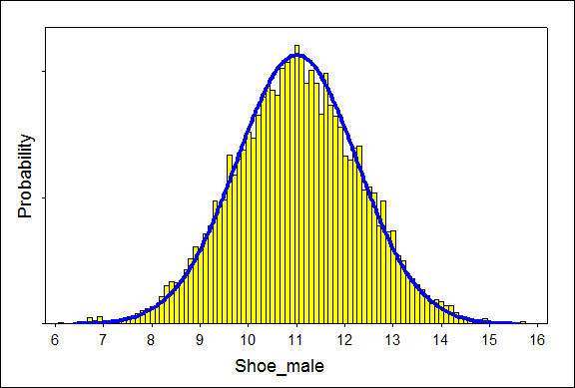
Where’s the Error From?
Error is just the difference between model and empirical.
This isn’t an absolute statement of ‘truth’.
Models are always approximations.
A.k.a difference between expectation and empirical.
Still need judgement.
Is model good and data odd, or do we have wrong model?
E.g. are there actually more 9.5 and 12-13 people in reality or did we just randomly get a few more in our sample.
Maybe model should be slightly fatter.

Slide 22
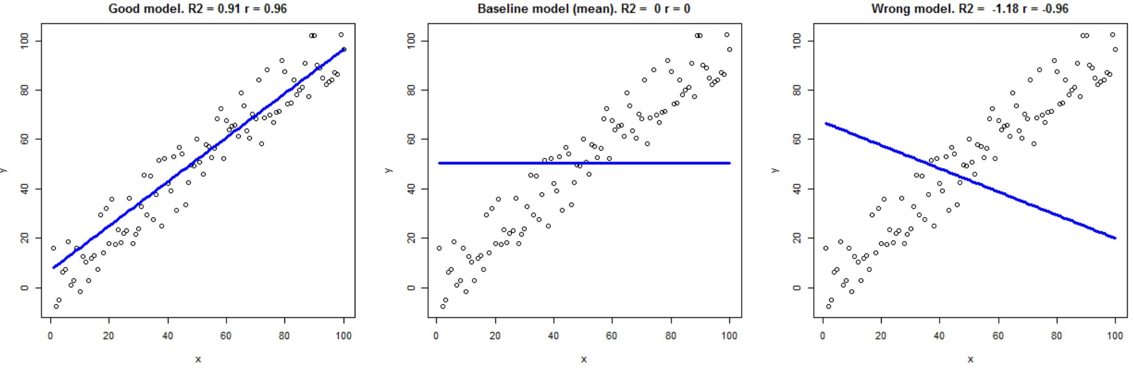
R-Squared
R-squared is another measure of model quality.
Likely to pop-up if searching about this stuff.
Correlation squared.
We’ll deal with it later.
It is a measure of “how much” the model captures.

Slide 23
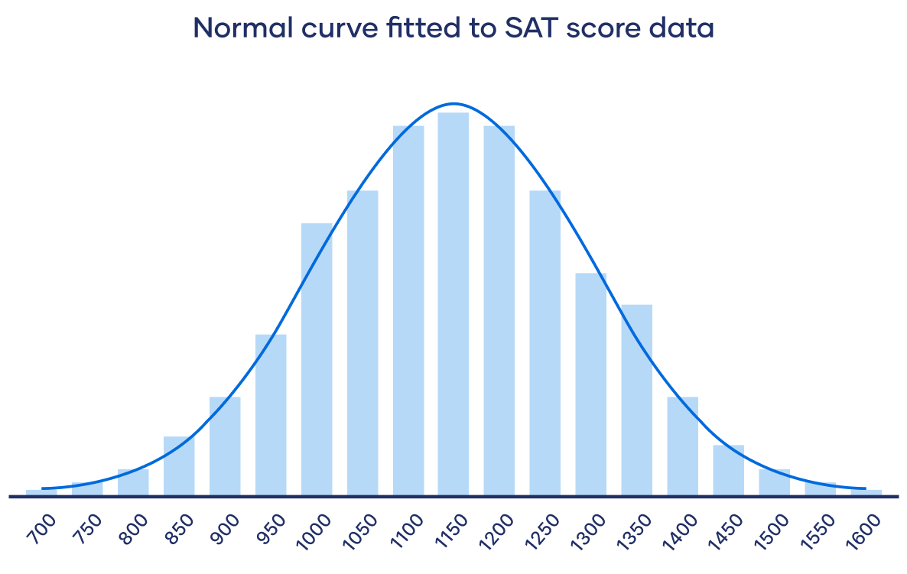
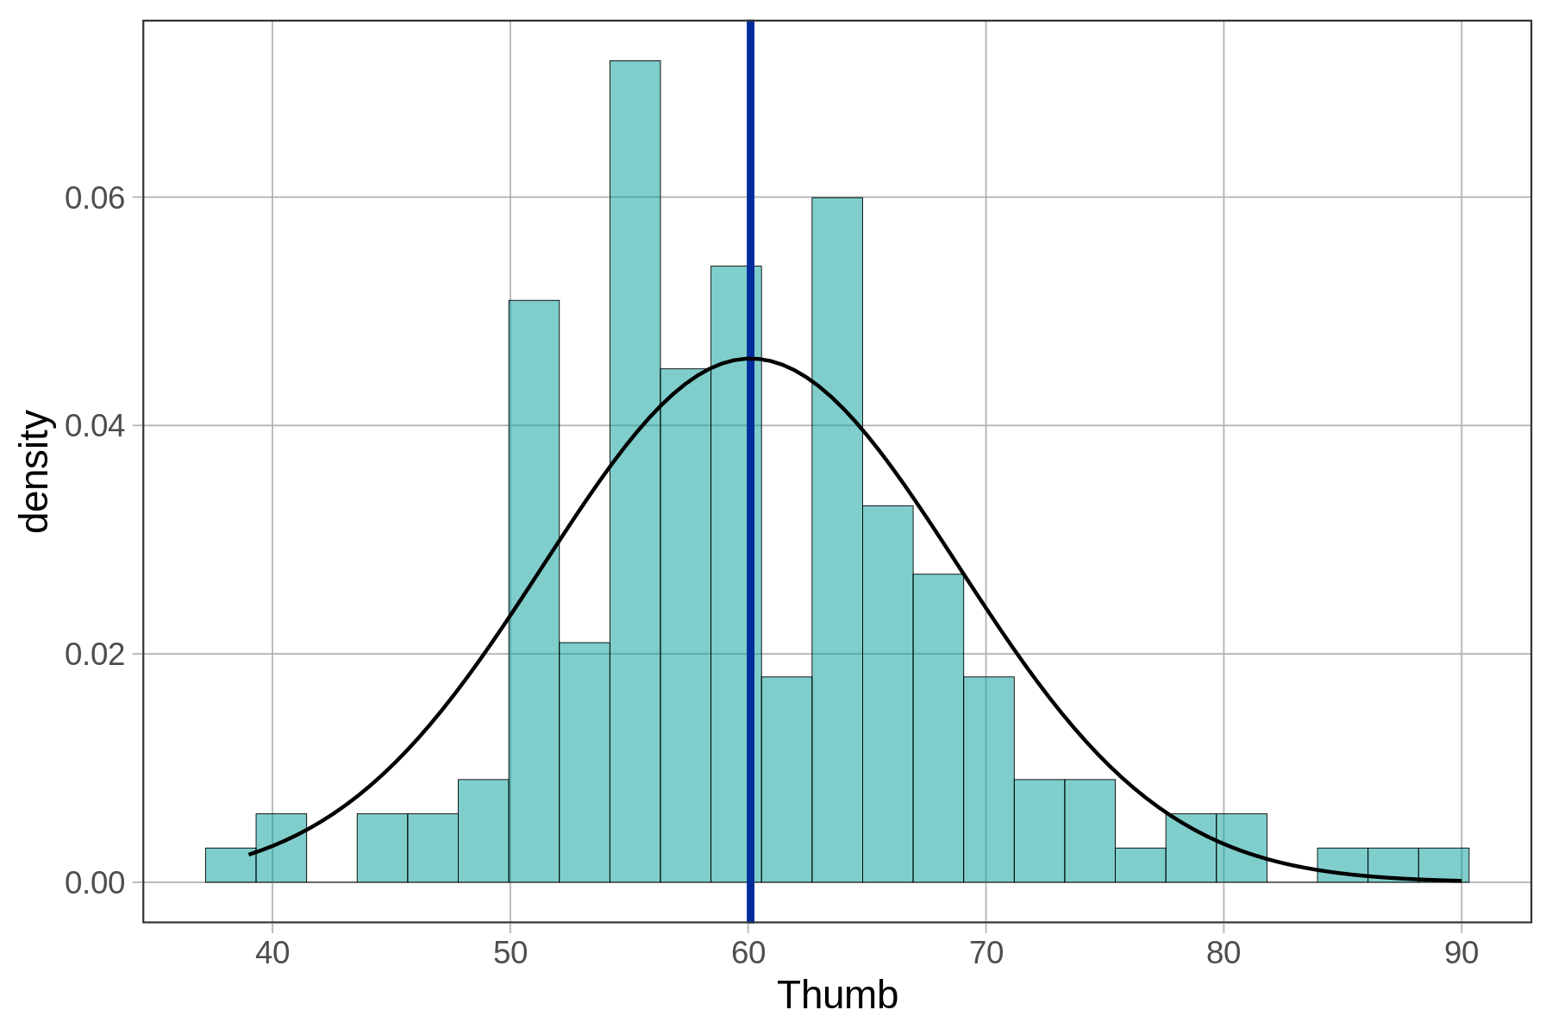
Fit and Approximation
In stats, these distribution patterns are the basis of inference.
Allow us to create an ‘expectation’ for how the data should be.
These models are only approximations.
We make a judgment of ‘good enough’ – can vary.
That error is inherent to the model choice.
We need one so we pick the best fit we have.
One benefit of ML is we can develop more ‘fitted’ models.
Can capture odd patterns in data as ‘expectation’.
More complex pattern for more complex problems.

Slide 24
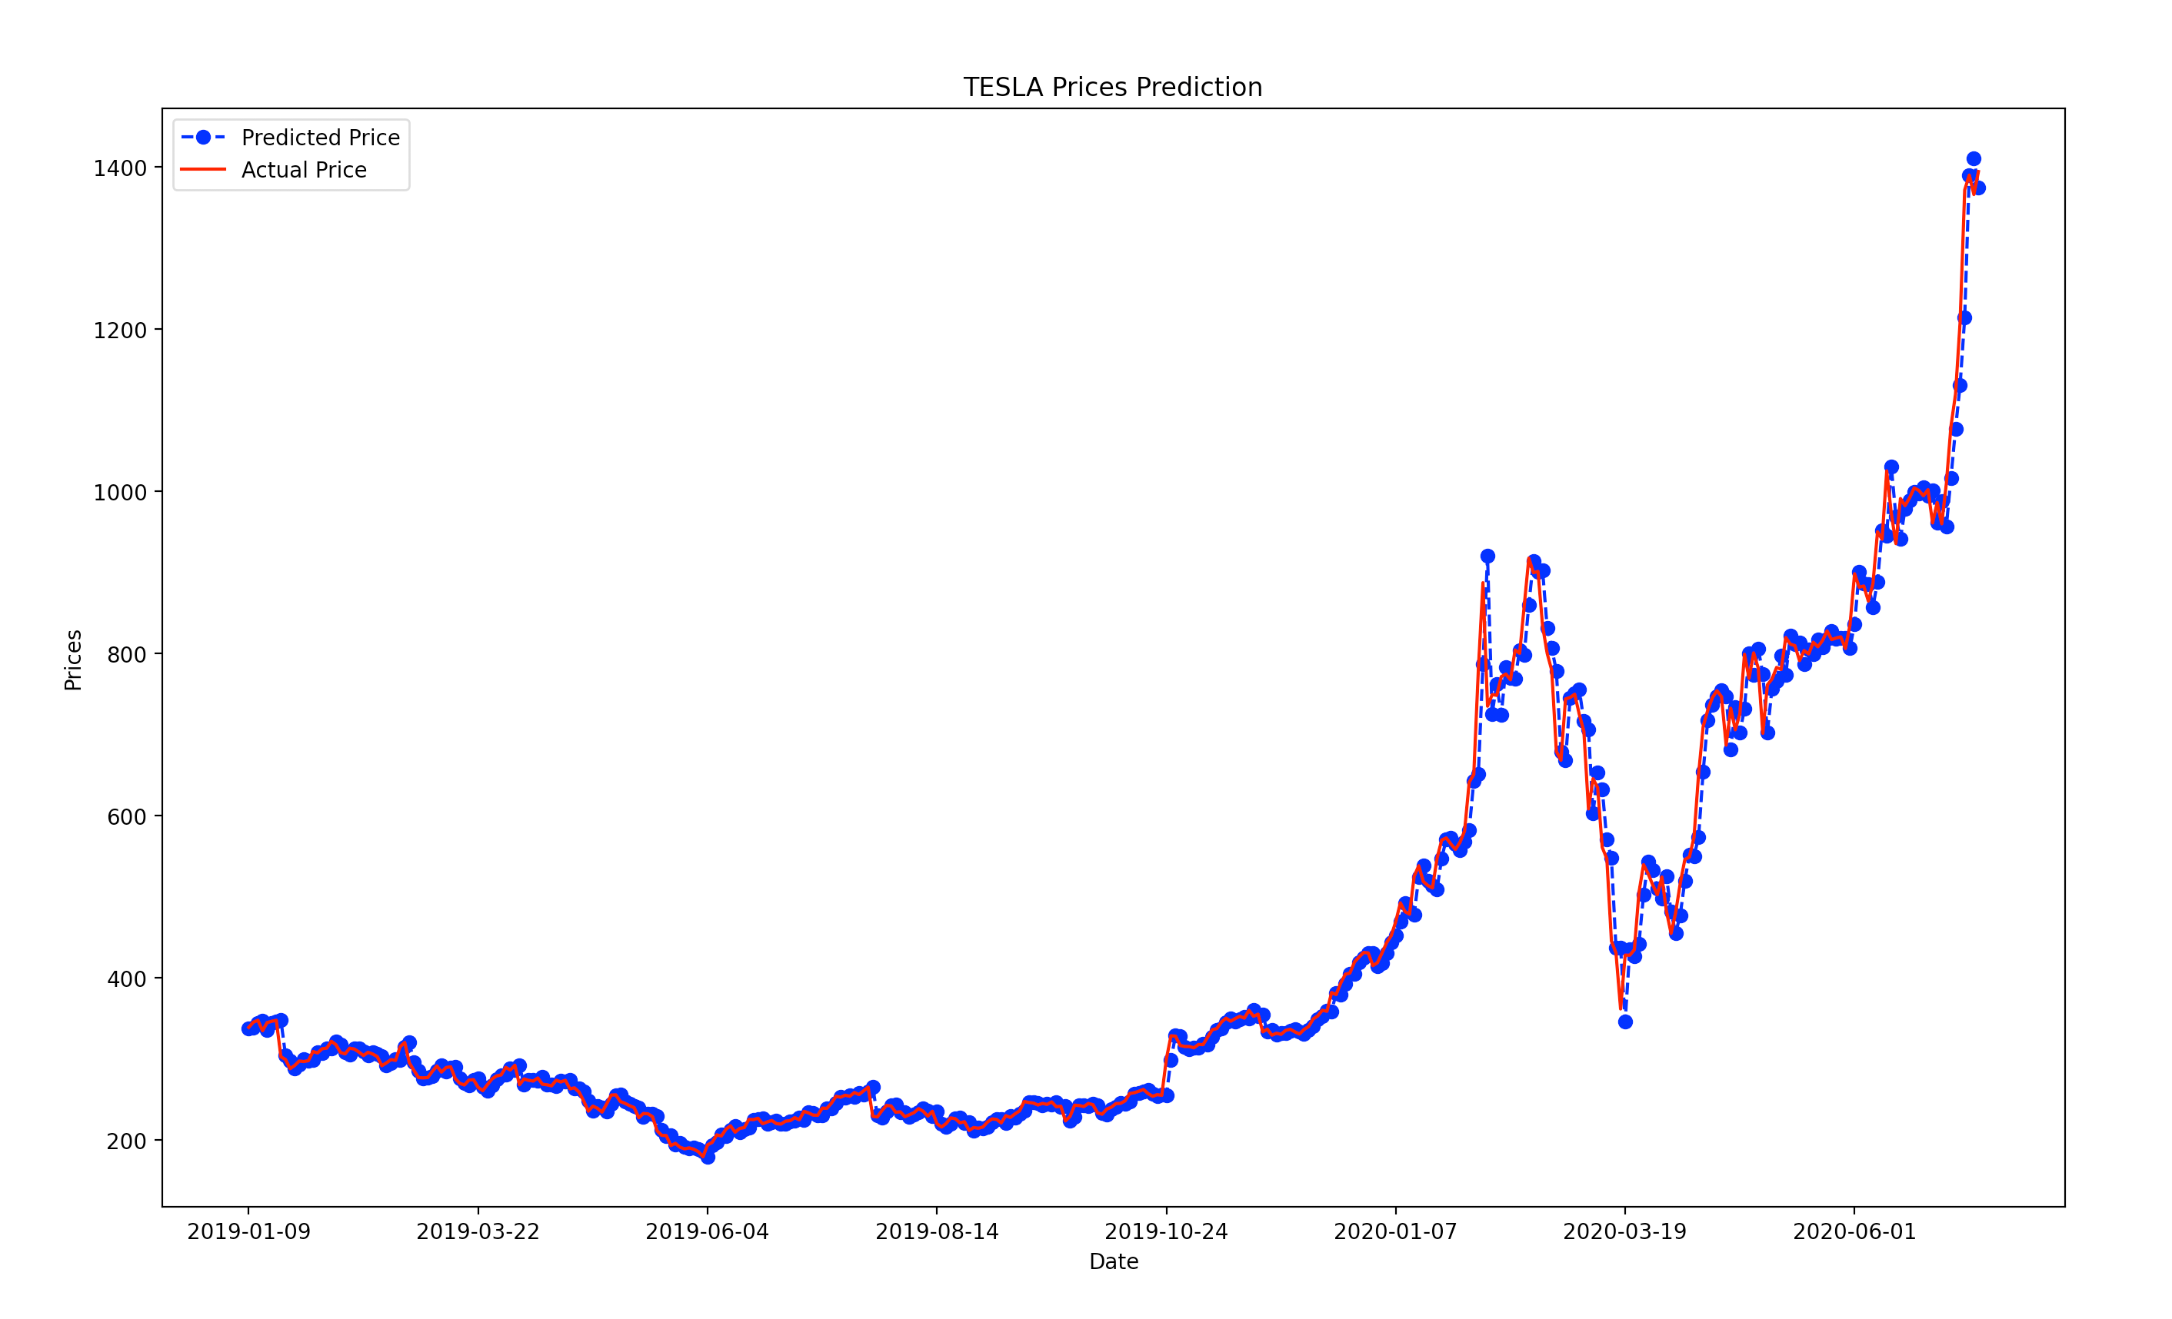
Calculating Errors and Time Series Data
Error calculations are the same no matter what we are dealing with.
Residual = expectation – empirical, then we collect the residuals.
We’ll explore it with some time series data.
Time series data just has one result every N time periods.
It is often only one value, like a stock price.
We can make a model that calculates stock price expectation and evaluate it.
Moving average is the analytical model.
Amount of error is a measure for fit, or how good it is.

Slide 25
Errors
Moving forwards, error is a critical metric for us.
We want to build models to make estimates and predictions.
Error indicates how well we are doing.
Data isn’t cosmically bound to follow a distribution, we are approximating.
Less error = closer match between expectations and reality.
We’ll build an error calculation from scratch and look at the library functions.
This stuff carries over directly to the error calculations we need for ML.

