Slide 1
Stuff to Do!
Today – regression. (We’ll do workbook 21 and maybe 23, 22 after)
Pull from repository, there are several small errors I fixed (mean_squared_error function).
Read chapter 10 and 11 this week.
R-squared.
Multiple input regression.
Multicolinearity.
Sklearn and statsmodels intro.
The statsmodels stuff is mostly needed now because we’ll look at the p-values a bit.
If you’re going to neglect anything, make it statsmodels. We won’t use much later.
If you do book examples, sklearn is generally a better choice.

Slide 2
More Regression – R2 and Statsmodels

Slide 3

But Why Statistical Models?
Inferential stats uses models to allow for predictions.
An analytical distribution is a model of empirical data.
E.g. Generalizing w/ distribution model.
Probability (vote, coin) MC estimation.
Machine learning models extend this.
Model some prediction (will be customer, temperature, stock price, will survive surgery…)
A model tells us expectations, we can use that to make predictions.

Slide 4
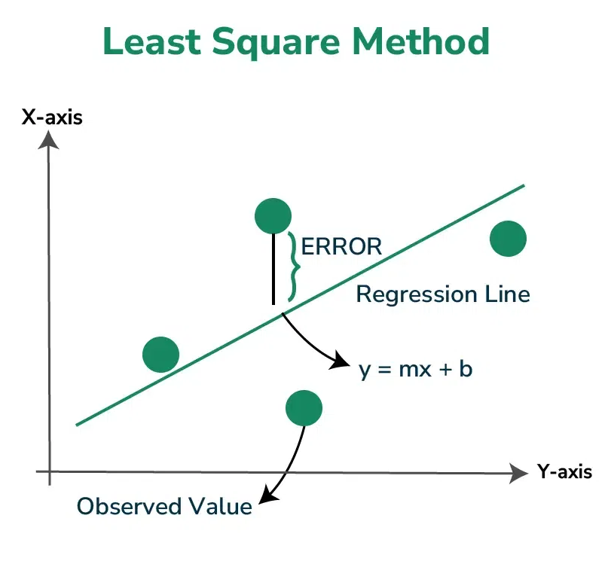
Remember regression Models
Our linear regression models are the simplest ML model.
The prediction is Y, given X (or more Xs…).
The ‘learning’ is simple – LLS calculation.
Optimal m and b can be calculated directly.
Any process that makes m and b is valid.
Residuals can be aggregated to measure model quality.
MSE – square and average residuals, common in calcs.
RMSE – root of MSE, most common, in scale of values.
A model that is a good ‘fit’ has small residuals.

Slide 5
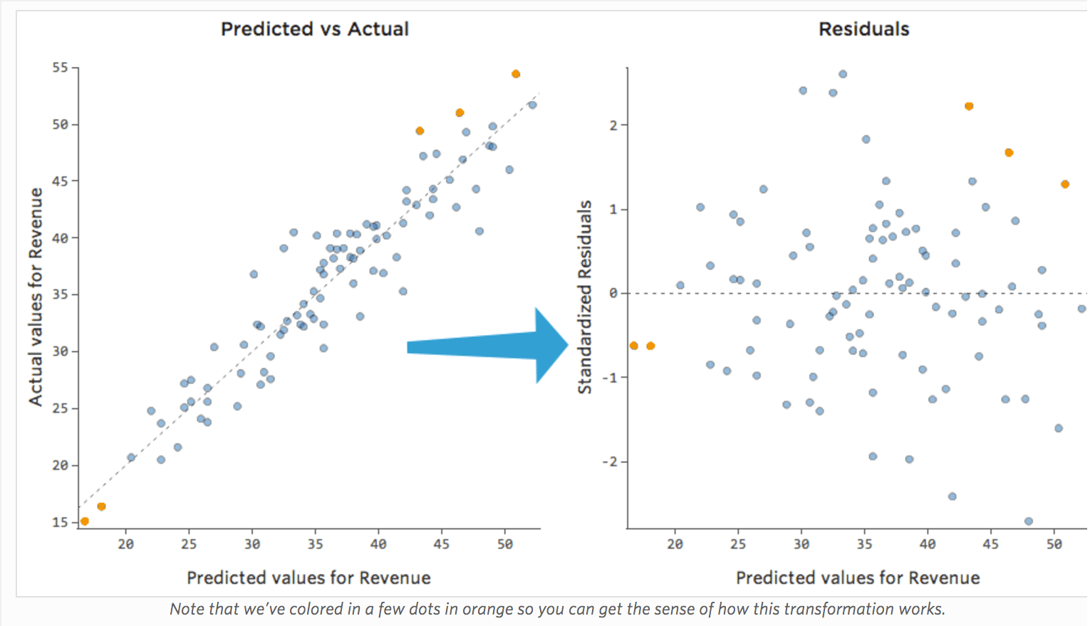
Residual Drama
We can average our residuals to get MSE.
MSE/RMSE expresses accuracy of model.
We can also look at residuals.
If there’s a pattern in residuals, it wasn’t captured by the model.
Ideally the model should ‘explain’ all of the variance in Y.

Slide 6
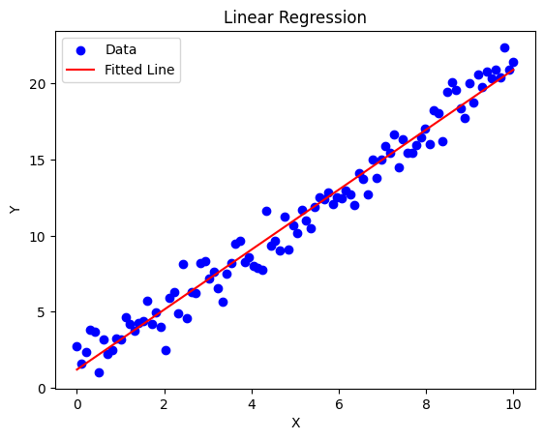
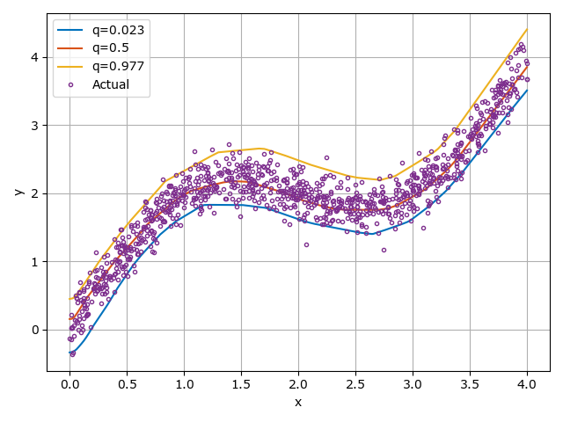
Models need to fiT!
A model is a good fit if it follows the data.
A model that fits gives good predictions!

Slide 7
Reexamining Fit – R Squared
In predictive modeling we often use a different metric for quality along with RMSE – R2.
R squared, or R2 is the coefficient of determination.
This measures the amount of variance that is explained by the model.
It is also the square of the correlation.
I think it is easiest to think of it in terms of variance, in a few steps.

Slide 8
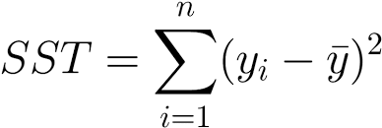
Variance – Our data varies
We can think of our target, y, in terms of its variance.
Y varies – it literally has different values for different x inputs.
We can measure that amount of varaiance by measuring how far values are from the mean.
This is known as SST or sum of squares total.
It’s also the top of the variance calculation.
This measures how much the real values vary from the mean – a baseline.
I.e. (thought model, not def.) the model is attempting to tell us Y, think of the default value for Y that it tells us to be the mean, this tells us how much the model must ‘move’ from that default.

Slide 9
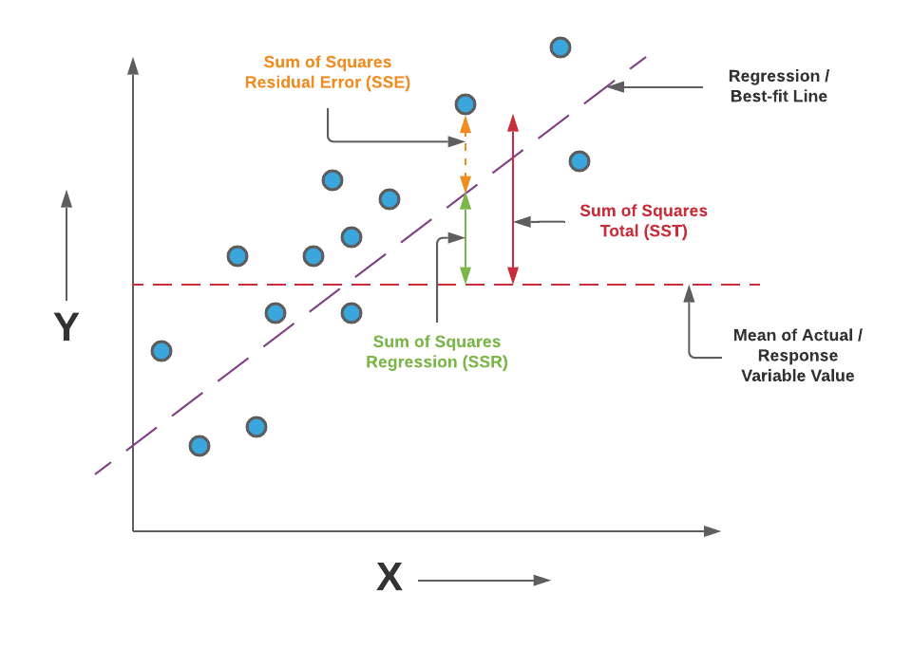
Break that apart
The data varies from the mean – SST.
Mean is baseline, departures vary away.
Some variance ’explained’ by the model.
Model gets us close to the value.
The rest is the residual – error.
The model got us closer, but we are still this far away.
The closer the model is, the more SSR.

Slide 10
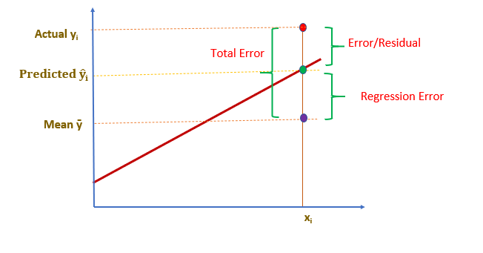
You can Frame it in Terms of Error as well
Deviation from mean is ‘wrong’.
Some error is captured by model.
The rest is residual.
I don’t like this thought model, personally.

Slide 11
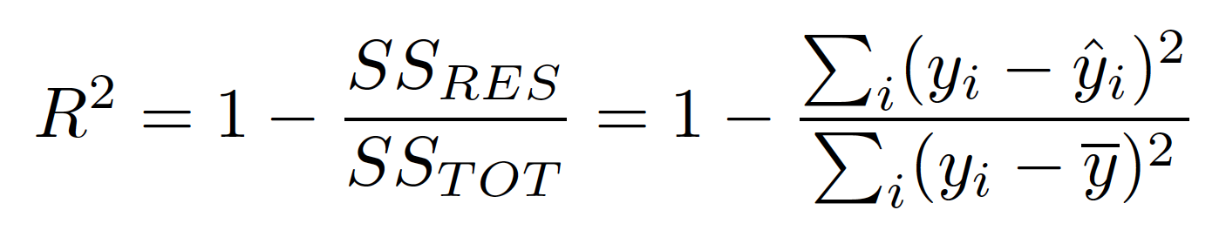
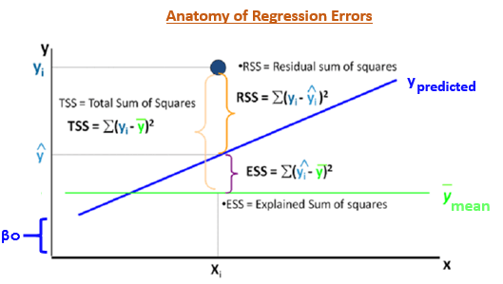
So, R2…
R2 is the percentage of the total variance in Y (SST) that the model explains (SSR).
I.e. the value of Y varies this much, our model explains this portion, the rest of the variance is stuff that we can’t explain.
Our model tells us “this percentage” of the departure from the mean.
Between 0 and 1.
Comparable between scenarios/models.

Slide 12
Using R Squared
R2 is the most common default metric to score a model.
Result of score function in sklearn, default value in statsmodels.
We can compare anything, since it is a percentage. Error measures depend on scale.
The (1-R2, SSE) variance is what our model doesn’t capture.
Variables that we don’t have in the model (e.g. h vs w probably has more factors).
Some things can’t really be embedded into a model easily as a variable.
Noise or randomness that we fundamentally can’t predict.
Adding more inputs can help us capture more things that determine outcome…

Slide 13
Multiple Inputs for X
In most cases, we have several inputs to predict one output.
E.g. a loan may take in income, age, profession, credit… to predict interest rate.
Real scenarios can have thousands or millions (image, language, genetics…)
The more X inputs we have (assuming relevance), the higher our ceiling is.
We can capture more of the SST into the model.
For us, not all that much changes:
Data is prepared and shaped the same, X is just wider.
Sklearn will handle the details for us.
We often call the x values features, and the y value the target.

Slide 14
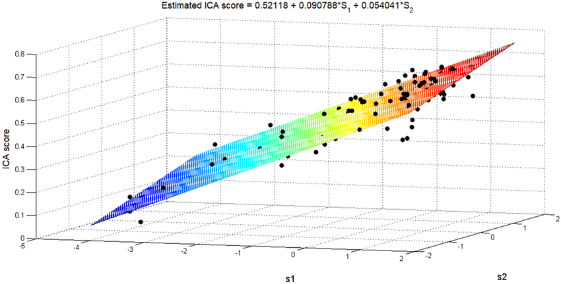
What’s going on in Multiple Regression?
The concepts are identical to 1 X.
We are still predicting Y.
The line becomes a plane.
The equation gains a term.
This extends to N dimensions.
The higher dimension, the more complex a thing we can predict.
We can see why outliers can hurt!

Slide 15
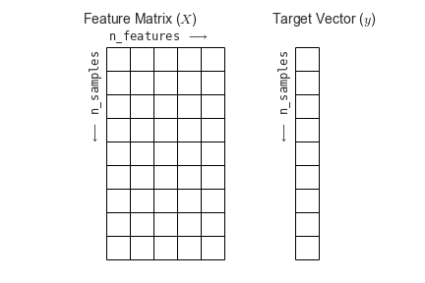
In practice
In code very little needs to change.
If we did it with 1 x, this is just wider.
The general process is identical.
Exact steps that we need to do to process and prepare the data may change.
Number of features could be ~unlimited.

Slide 16
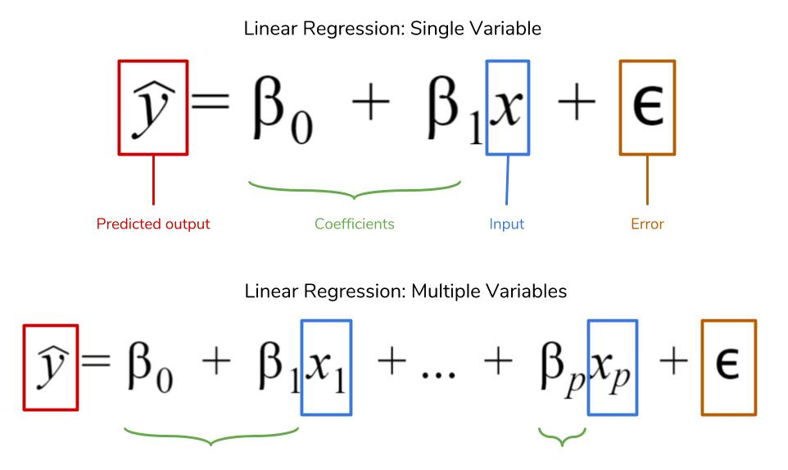
The Regression Magic
These simple linear regression models let us see some of the logic.
This often isn’t possible with the models we use later.
Prediction for Y is just a weighted combination of X.
The machine learns what those should be. (LLS)
The combo yields the least SSE possible (best fit).
Based on these inputs, what’s the most accurate combination to predict y?

Slide 17
Multicollinearity
If we have many relevant X inputs, our prediction for Y can be quite accurate.
Model can take in many relevant factors and weight each appropriately.
What if we want to tune our model - make it more accurate or efficient?
(We’ll do this commonly later for accuracy.)
We may have many X inputs, but perhaps not all are needed…

Slide 18
Example – Medical Screening
Suppose we have a model predicting bodyfat percentage for patients.
Measuring bodyfat is slow and expensive for large numbers of people.
It can be important for forecasting health outcomes.
Several other metrics can tell us about bodyfat percentage, partially.
Weight, height, waist size, thigh size, calf size, hip size, chest size…
These are all easier and faster to take and log.
Each of these metrics give us some information about bf%.
There’s a lot of overlap in the information given.
Waist size, hip size, thigh size aren’t the same, but they tend to tell us almost the same info.

Slide 19
So, What’s the Problem?
If we have X values that are largely the same we call that multicollinearity.
I.e. several things are highly correlated with each other.
This isn’t fatal, but can give us some issues.
If multiple inputs have the same info, the model can’t figure out how to weight each.
The assumption is inputs are orthogonal, they have nothing to do with each other.
A model can’t be sure how to change coefficients as several are almost the same.
The learning can be hard (not with LLS) and can swing with small changes.
Ideally, we want each thing measured exactly once.

Slide 20
Managing M.C.
Having some m.c. won’t break things on its own.
In high-dimensional models, training may be slow or not converge.
In cases like our linear regression, we can’t know which inputs matter.
Our first tuning step can be to remove, so model can fit accurately.
The model is trying to weight importance, if the same thing comes from many sources, that’s hard.
Generally, the simpler the model, the better.
Similar performance with fewer inputs is cheaper.
In the bf% example, we literally need less work and tools.
Other whys and hows to come later.

Slide 21
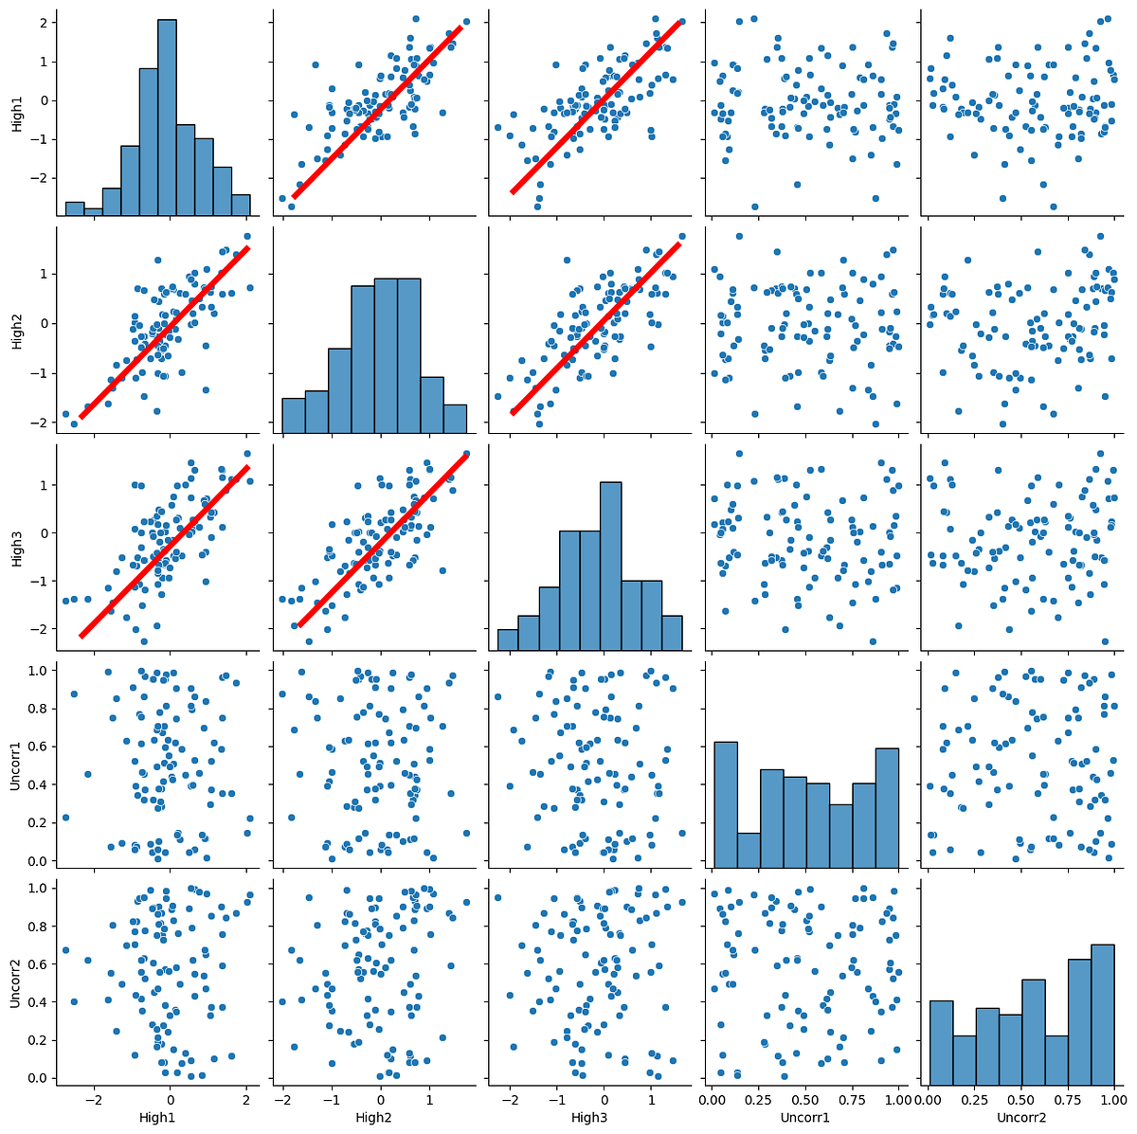
Detecting M.c.
We can usually spot it in a pairplot.
Pairs of variables that appear highly correlated.

Slide 22
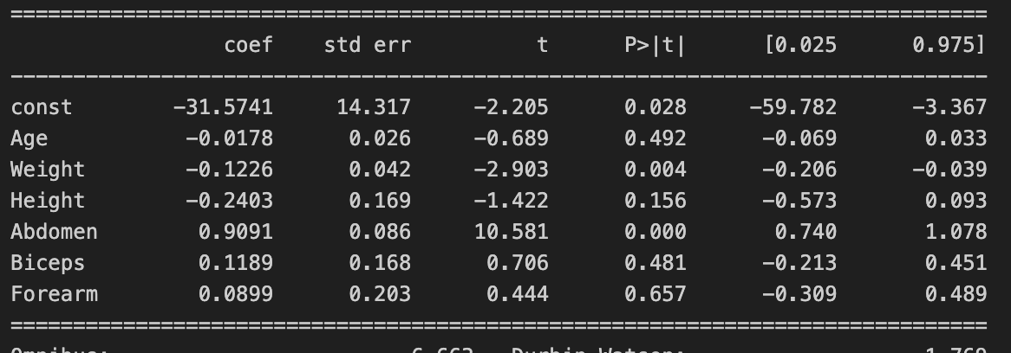
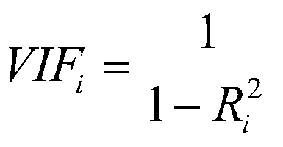
Measuring M.C.
We can also calculate a metric called the VIF – variable inflation factor.
VIF measures how much of this variable’s info is explained by others.
We get a value for each input variable.
1 means there is no multicollinearity.
Over about 10 are ones that require real investigation.
We can remove redundant ones with the help of the p values.
Statsmodels will give us per variable p-values.
Roughly a hypothesis test of “is this variable significant”.
Be aware, there can be odd swings when m.c. is there – model can’t weight properly.

Slide 23
Multicollinearity Process
We can do an iterative process to deal with m.c.:
Run the VIF values.
Run a model via statsmodels.
Remove some variables based on VIF, p-value, and domain knowledge (i.e. which measures actually overlap in real life.)
Repeat as needed.
Tuning a model is largely a judgment call, don’t obsess over where to draw line now.
No high p-values is a good rule of thumb for now.

Slide 24
R2 and Multiple Regression
We can measure the ‘completeness’ of our model with R2.
How much of the variance of Y do we capture, and how much do we miss?
Default score is easy to use and compare to others.
We can build a more complete model by adding inputs to X.
Most things are determined by many factors.
Little changes, other than it becomes harder to visualize and do by hand.

Slide 25
Applying the Stats Stuff
The first way that we’ll directly use the stats in ML is EDA – exploratory data analysis.
This is both art and science, there isn’t a specific set of steps.
We do EDA up front to basically look for stuff in our data that may matter.
Missing values.
Outliers.
Errors.
Patterns in data – numeric that is categorical, odd distributions, correlation, etc…
Things that don’t vary.
Exactly what we are looking for varies, generally anything that may impact model accuracy.

Slide 26
EDA Process
Doing EDA is something that will feel more natural with time.
We generally want to look graphically and arithmetically.
Info, describe, and head/sample can give us a look at the stats.
Pairplot, box plot, count plot can give us a visual look.
Usually need to do some iteration.
Clean something you notice, e.g. outliers.
Check again to see how the data looks.

Slide 27
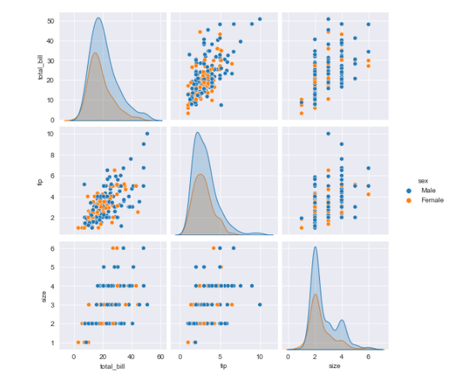
Example – Nothing of interest
This is some data with nothing obvious to address.
No odd patterns.
No clear outliers.
Variables seem to have a ‘normal’ amount of variance.
This data is ready to be used by a model.

Slide 28
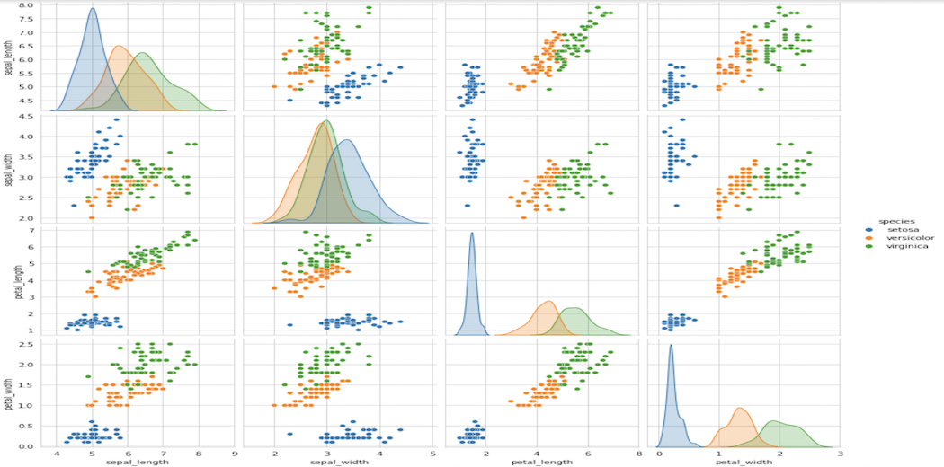
Something Weird!
This dataset shows a clear separation of one class from the other two.
This may guide us…
If we want to classify, that division helps.
If that value is a feature, maybe it is better categorical. (??)

Slide 29
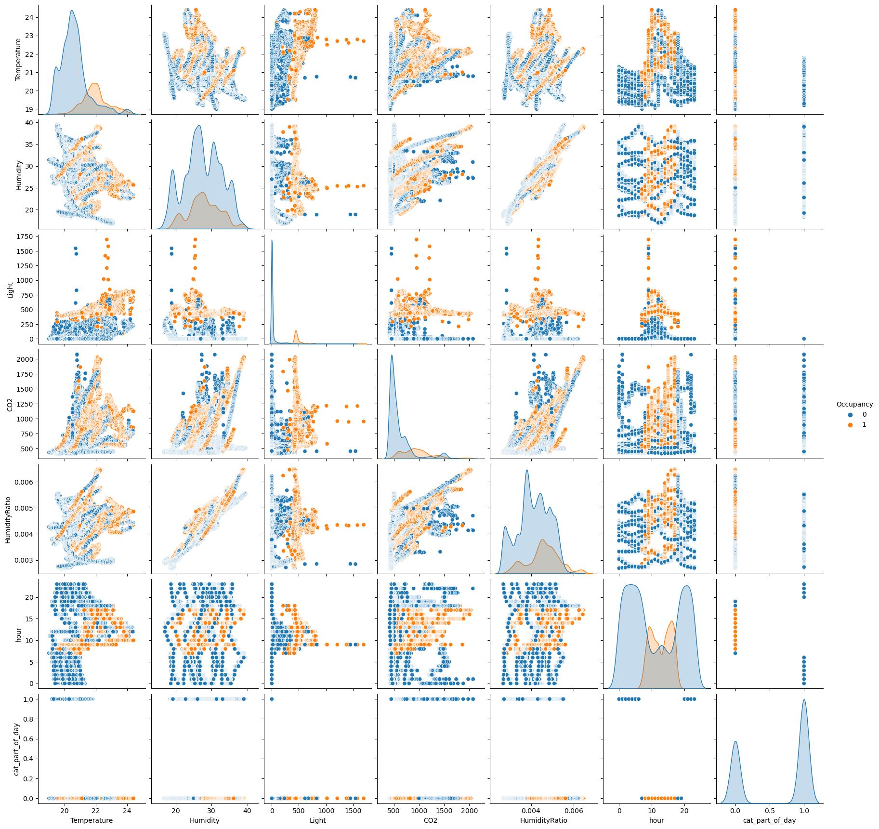
Outliers and Categorical
This data appears to have outliers.
The last column appears to be better as categorical.
The ‘hour’ column has a weird distribution – depending on what I am doing, this might matter.

Slide 30
Get EDA-ing
This EDA process is something we want to do when we load any data.
ML intended datasets often have few errors or issues to find.
When using real world data this process is usually more involved.
We want a dataset with no ‘junk’, so we need to find it in EDA.
Some domain knowledge is required to do a really good job here.
The EDA process will guide future behaviors.
Do we see anything in the data that we want to investigate further?
What cleaning/preparation steps do we need to build into our pipeline?

