Slide 1
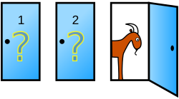
A Fun Game…
Suppose you're on a game show, and you're given the choice of three doors:
Behind one door is a car.
Behind the others, goats.
Game:
You pick a door.
The host, who knows what's behind the doors, opens another door to reveal a goat.
You are given the choice to swap to the remaining door, or hold your pick.
The doors are opened, you get what was behind the door you settled on.
Do you switch?

Slide 2
Housekeeping
Probability, conditional probability, and (potentially) Bayes.
Please be honest about what makes sense, we’ll see how far we can get.
Largely example based, the core theory of probability is pretty simple.
For test things, conditional probability is fair game, after that is off.
We’ll finish the topic next Monday, the last class.
We’ll cover the actual sklearn model then.
We (probably) won’t get to deriving it, that’s worth a read through (w.b.32).
You can try Bayes for project stuff if you want. I’ll post that Wednesday.
Might require a little data prep and/or documentation reading.

Slide 3
Housekeeping

Slide 4
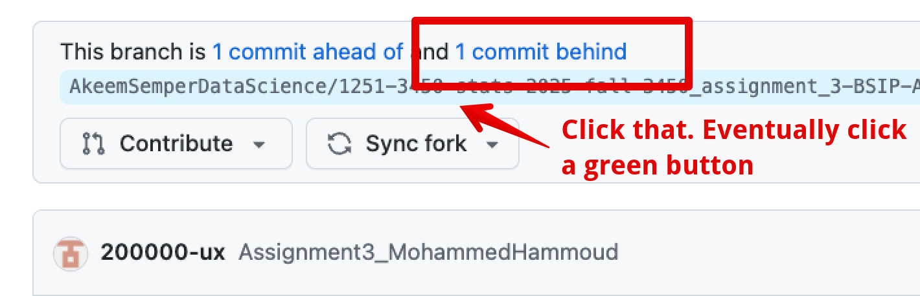
Assignment
Overall, looked pretty good. Small notes only:
I’m not sure a normal distribution for vote totals is best?
Small sample, asserting vote totals are normal is an assertion (that may be correct).
Can’t estimate purple/yellow independently – they sum to 1.
Could get both at 52% in one simulation round.
If you do something like multicolinierity, test the model after.
Consider grids of images if you have many. (Is the fig, ax stuff familiar?)
I’ll finish the test stuff on Wednesday.

Slide 6
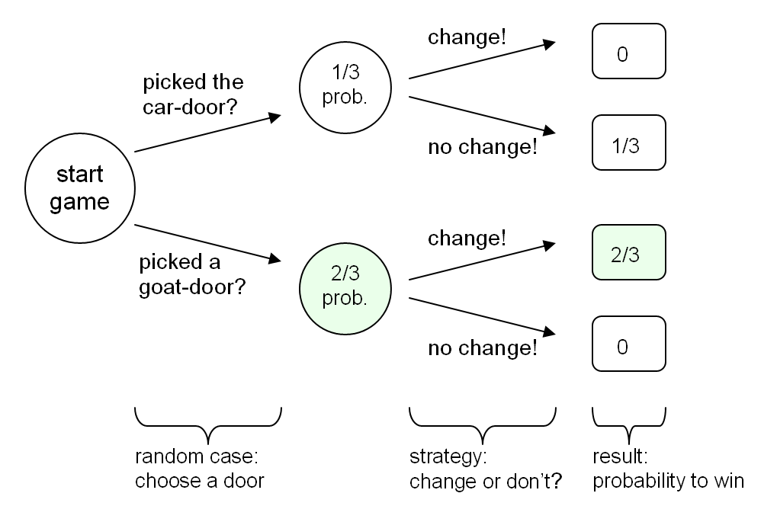

Slide 7
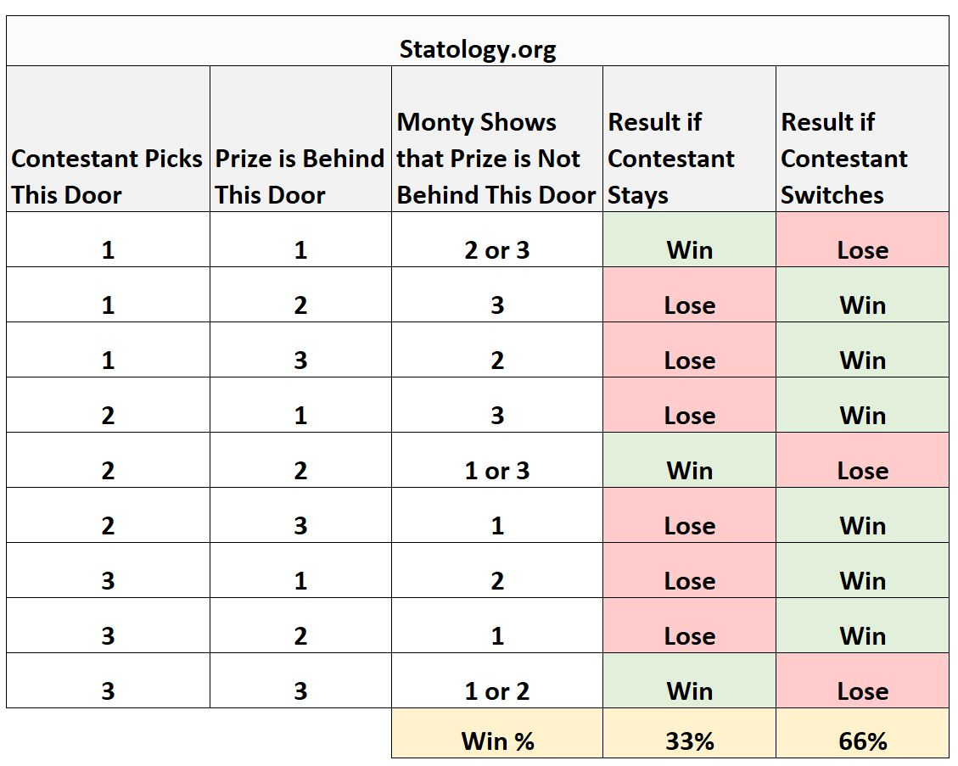

Slide 8
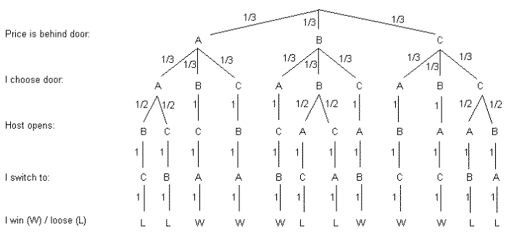

Slide 9
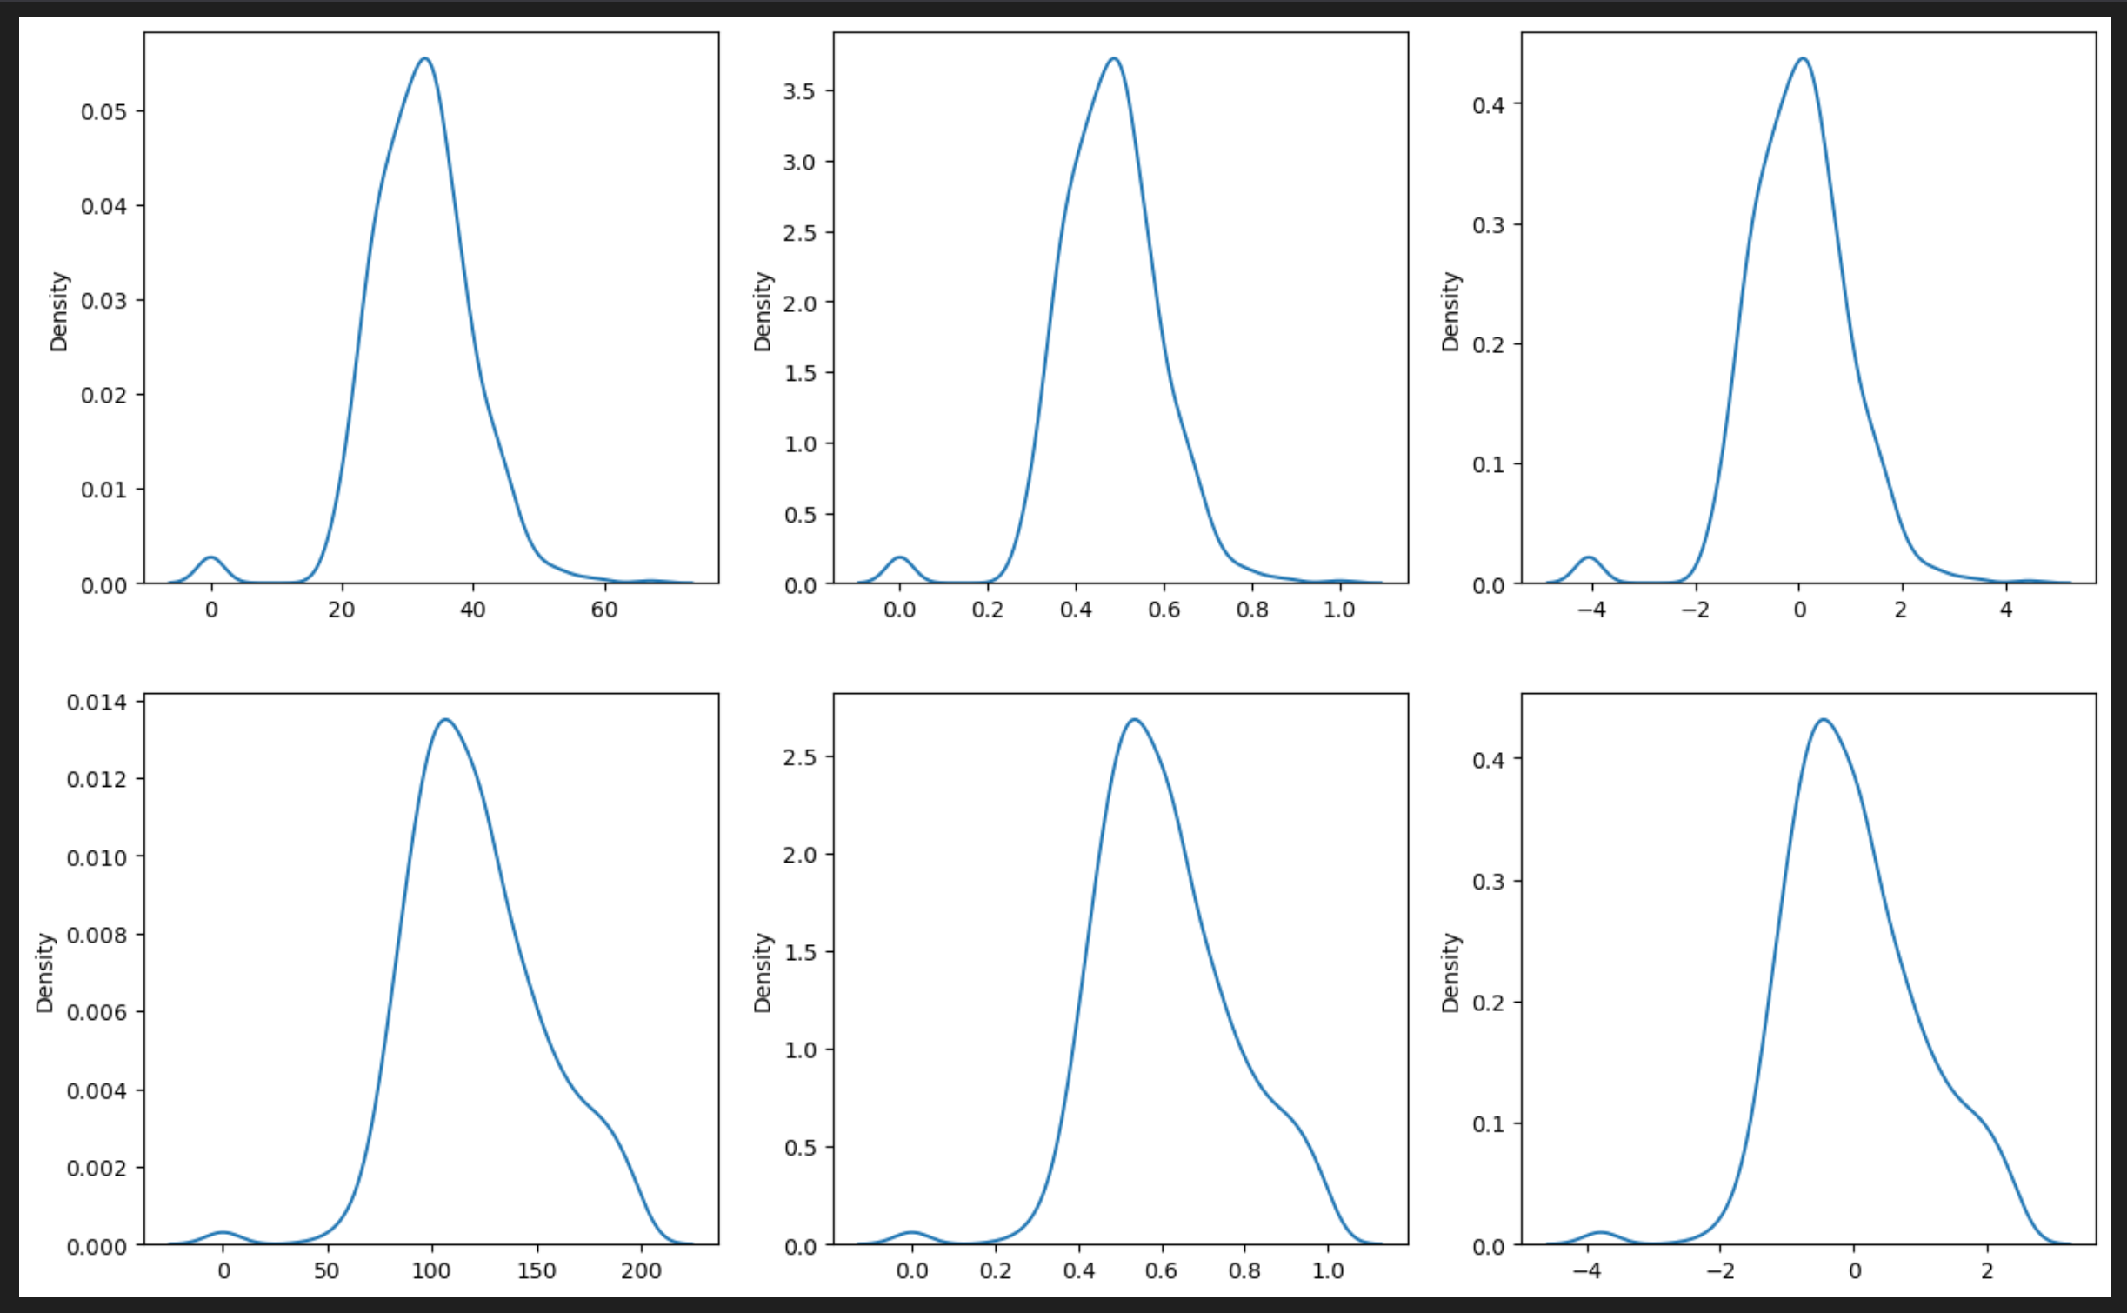
Why Are densities so Weird?

Slide 10
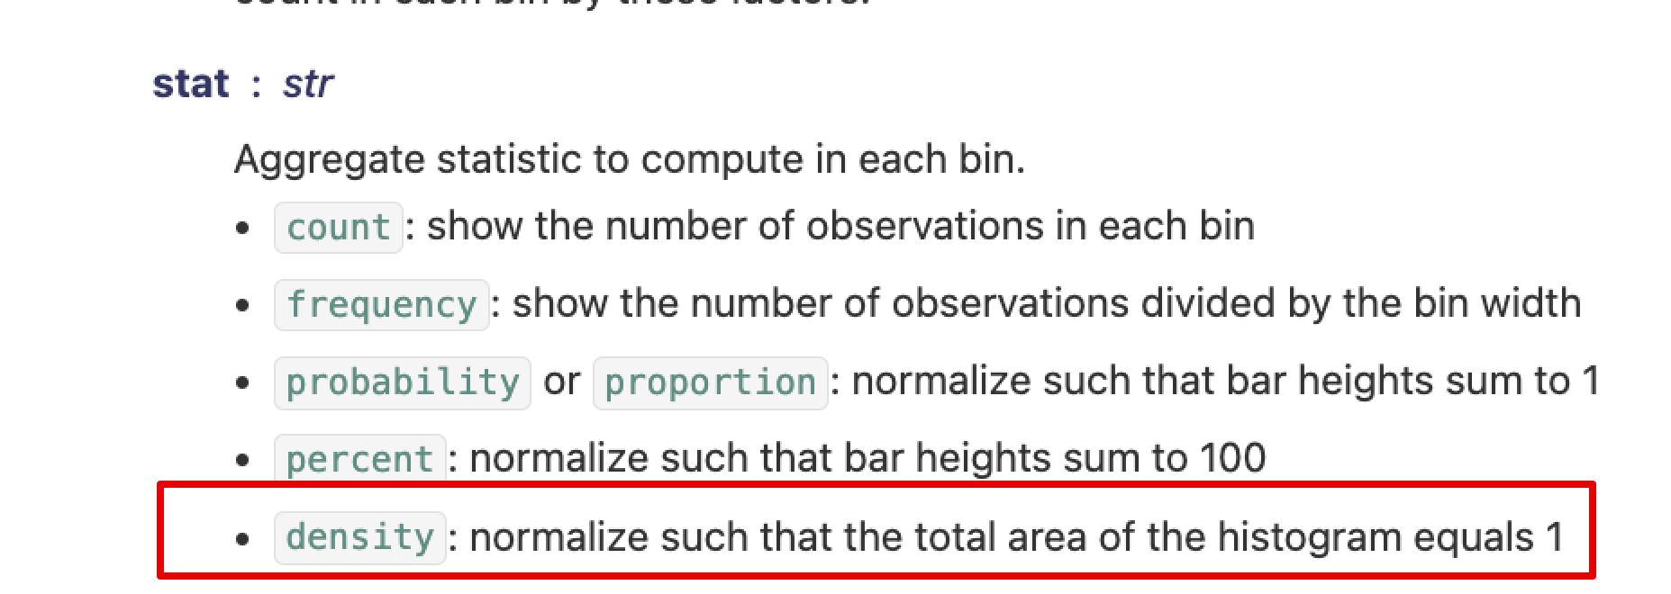
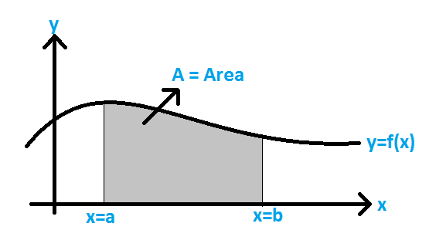
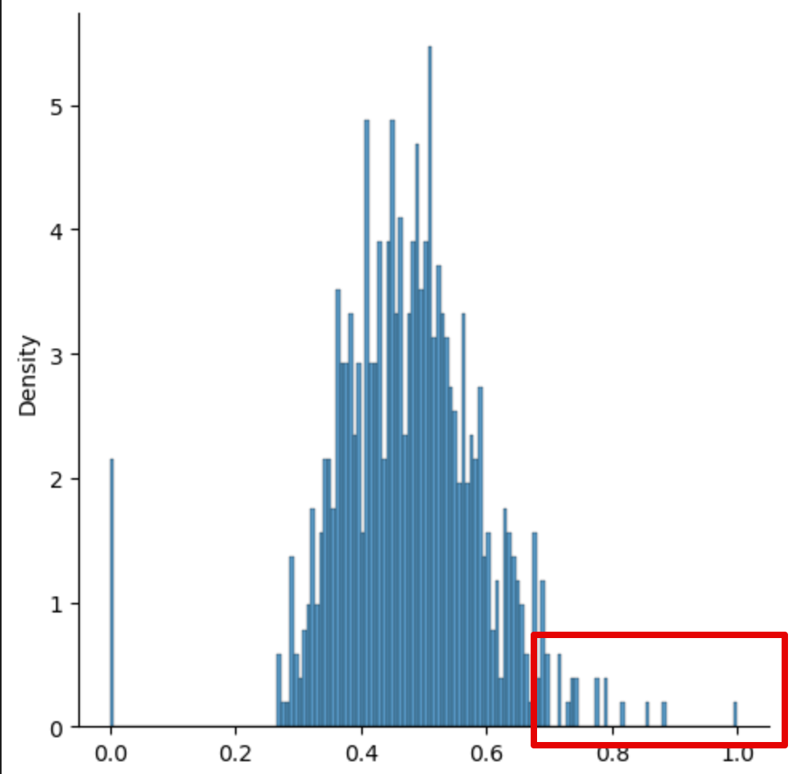
What’s the Density… Really…?
Density means the total area under curve is 1.
If we have a continuous dataset, this works, but…
The area is the integral, not a count.
Works over an area, not a point (like a bin w/ discreet).
Sparse discreet data can make this weird.
We don’t get a ‘rectangle’ we get stalagmites.
With discreet data there’s estimating going on.
The KDE line is an approximation of the actual data.
There is a smoothing parameter that can help.
Fundamentally a mismatch data/visual tool.

Slide 11
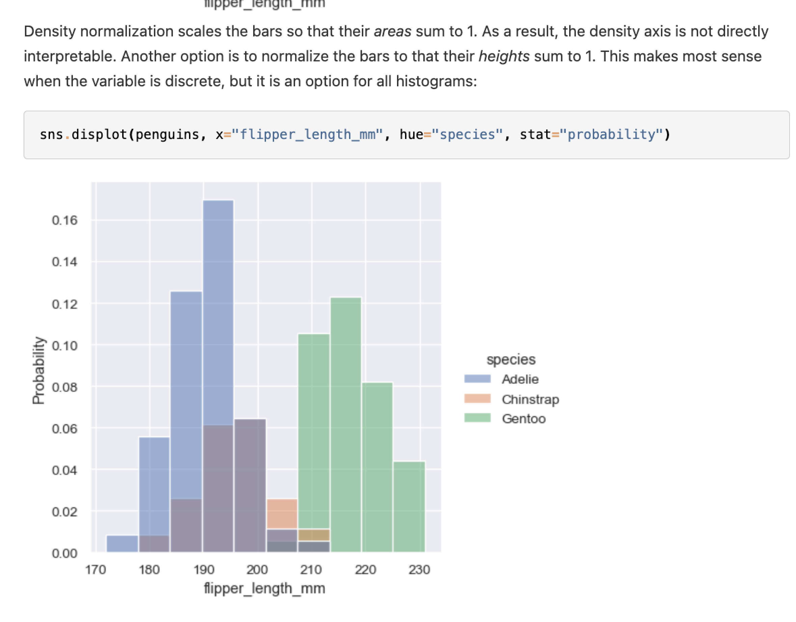
Discreetness
With discreet data, those y values can be odd.
’Area’ is not the most meaningful concept.
Discreet data is ‘meant’ for a histogram.
Change to ‘probability’ to get something more readable.
Height of bars sums to 1.
In practice this isn’t really an issue often.
Only if you need to read Y value from KDE.
Pattern, comparisons, etc.. Still work fine.
Bigger and smoother data lessens impact.
Seaborn has a “visualizing distributions” page.

Slide 12
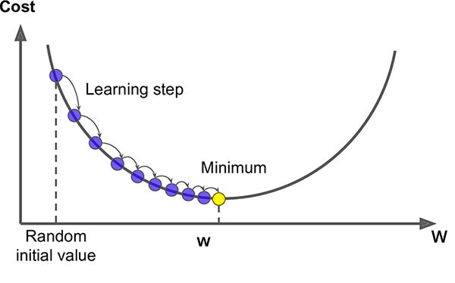
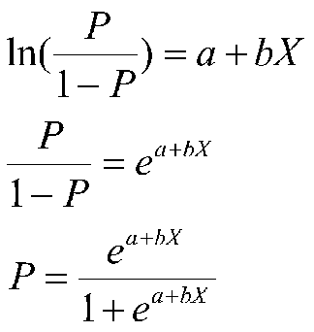
Review - Gradient Descent and Logistic Regression
Last week we looked at classification using logistic regression.
Instead of predicting a value we predict T/F, a class membership.
Still a linear calculation, but the details differ – need to predict probability not value.
Uses a regression to the logit to get (something convertible to) probabilities.
Sigmoid calculation converts any logit to a probability.
The slope and intercepts can’t be calculated directly here like with LLS.
Need an alternative way to find best coef – gradient descent.
Guess some coefficients, calculate cost, adjust coef (using gradient), repeat until done.
This process is very common, coefficients can rarely be directly calculated.

Slide 13
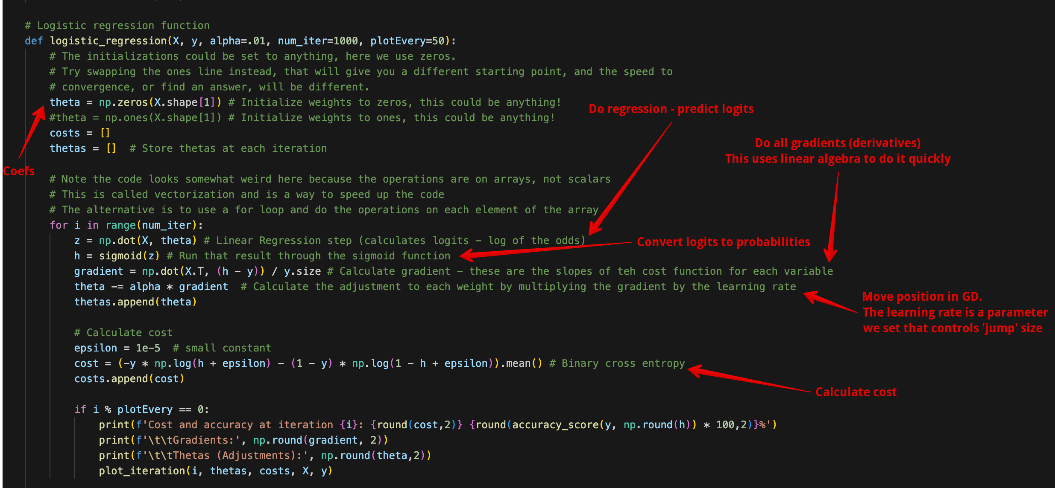
At bottom of Logistic Regression Code

Slide 14
Naïve Bayes

Slide 15
Probability – Remember it!
Recall the idea of probability.
P(A) – what is the likelihood that A will happen.
Probability comes up directly in several inferential things:
Monte Carlo simulation and hypothesis testing.
Odds and logit for gradient descent and logistic regression.
We can understand all* of the stats we’ve done from the perspective of probability.
We track what happens in data (assume categorical features/targets for this).
These happenings can be converted into probabilities.
Bayesian statistics explains the ideas we’ve covered, but looking at probability.
Log. Reg. Classification models predict the probability something will happen!

Slide 16
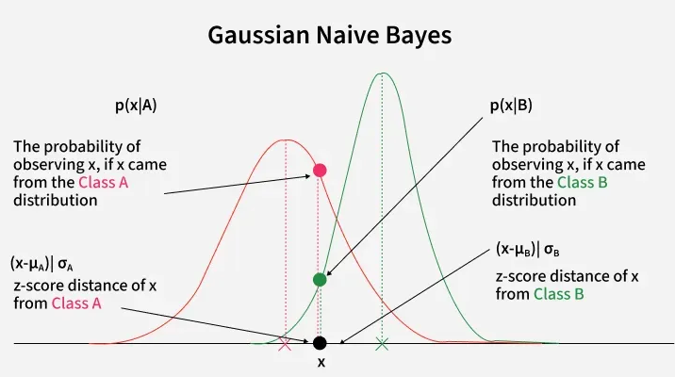
Note on Features
In this stuff we’ll use totally categorical data.
Classification of categorical target.
Features are all categorical.
We can use numeric features, but we won’t now.
Practically, this is very easy to do, follows most sklearn conventions.
Several model types just make more sense to explain with one or the other.
This is one where the model assumes normal distribution of features.
Probability calculations are similar to hypothesis test probabilities.
The closer the features are to normal, the better the results.

Slide 17
Conditional Probability
Using probabilities for prediction relies on conditional probabilities.
Given this fact, what is the probability.
E.g. if you have high blood pressure, what is the likelihood of a stroke.
We can express conditional probabilities like this:
P(A | B) – probability of A, given that B is true.
In datasets, this conditional probability could be calculated for any combo. E.g.
P( stroke | high blood pressure)
P( stroke | high BMI)
P( stroke | high BMI and high blood pressure)
The A is our Y, what we want; Bs are our Xs, what we know (features).

Slide 18
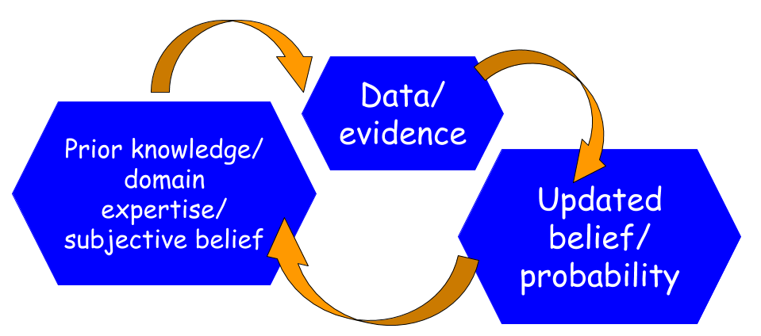
Updates
We can think of the probability as conditional, and progress through ‘learning’ things.
Pretend you learn each feature one-by-one and change the estimate each time.
We start with a baseline – what is the probability?
As we ‘learn’ each feature, the probability becomes conditional on that. P( Y | X1)…
These ‘updates’ make our prediction more accurate as we learn each one.
Each adds another X to the prediction.
If that X is useful, we’ve ‘learned more’.
Will they live… if young, obese, family history, etc…
We can the probabilities as prior and posterior.

Slide 19
Check the Code
Look to code for an example of some updating…

Slide 20
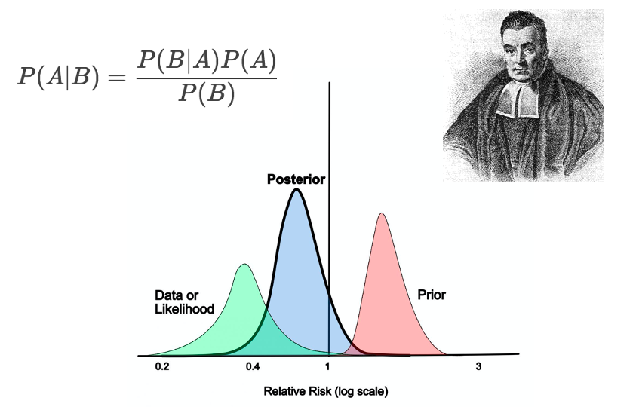
Don’t Be lazy, We’re Getting Bayesy!

Slide 21
Bayes and Conditions
Bayesian statistics is based on conditional probability.
If this thing happens, then how likely is this other thing?
P(A) – how likely (percentage wise) is A to happen.
P( A | B) – how likely is A, given that B has happened.
Our datasets (with categorical columns) can provide this with some counting.
The probability of something, like a target, being True is the # of times it happens / total.
E.g. the original prior probability of getting skin cancer is # of skin cancer / total people.
We can use each feature to add ‘quality’ to this prediction, more info:
If we add “family history of cancer” to the original prior probability, our prediction gets better.
After the update, this posterior probability includes info on family history…

Slide 22
Bayesian Updates
With a multi-feature dataset, we can make a predictive-ish process to predict target.
Initial prediction is raw probability, each feature adjusts this a little.
The target is golf – are we going to golf in these conditions?
Start with the prior probability – likelihood of playing golf overall.
”Learn” one feature at a time, which ”updates” our prediction.
If it is sunny, how does that impact it – in play/no play scenarios, how likely is sunny?
This likelihood gives the model more info on probability, based on this feature.
Prior probability and new information combine to posterior probability.
Each feature updates our understanding, or adjusts our prediction to be better.
Once we’ve included all features, our prediction is as smart as it’ll get.

Slide 23
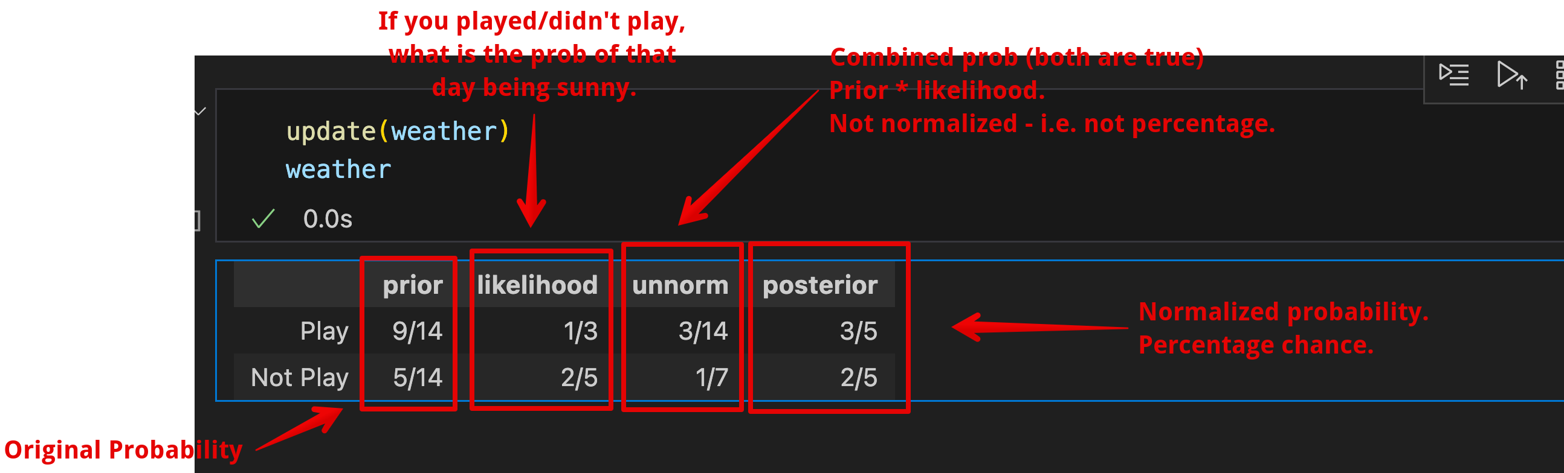
In Numbers
The combined prob is the probability both are true.
Golf/not and sunny.
More features just repeat steps.
Learning:
Start with baseline model prediction.
Feature adds new information.
This info changes prediction.
This prediction is now equiv. to baseline.

Slide 24
Normalization
Normalization has come up twice recently:
Scaling variables to between (usually) 0 and 1.
Changing these probabilities (to 0 to 100 scale).
The concept is the same, values are on non-standard scale.
Normalized probabilities are out of 100 – happens or not.
Unnormalized probabilities are out of “things that are the same” – a subset.
Here they are the probability of play/not and sunny – 5 out of 14 records.
There are more records outside this (overcast, rainy) that are the other 9.
3/14 are play sunny, 2/14 are no play sunny, the percents out of all days are the values in the unnorm column. The values after normalized are per 100 – (e.g. 3/14, then div by 5/14).

Slide 25
Updates and Us
This idea can be built into a normal machine learning algorithm.
Predict probability, just like logistic regression.
Take in features (just categorical for now) and combine them for model.
Bayes, logistic regression, and any other classification model are equivalent in purpose.
The way they build the model (inputs->outputs) can be totally different.
The math and logic behind this are very different, but it does the same thing.
Model types have strengths and weaknesses – fit to data, types of problems they excel at, size of data needed to train, training or testing speed, etc…

Slide 26
A Real-ish Example
We are predicting if students will pass an exam.
Original prior probability – what is the overall pass rate?
Bayes-y updates with features.
Did they study.
Did they attend class.
Did they do the review exercise.
Each of these adds new info, and updates our predicted probability of passing.
Add info on studying – for people who pass/not, did they study?
This likelihood then modifies the prior probability, generating the posterior (unnorm).
We now have the probability of passing, including impact of studying. Repeat…

Slide 27
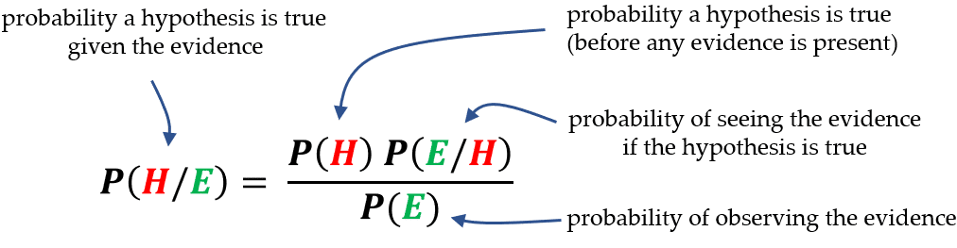
Back to Bayes
Bayes’ allows us to update the probability of something happening as we gain information.
The hypothesis is what we want to know.
The evidence is the feature set.
As we incorporate features, the prediction gets modified from where it started.

Slide 28
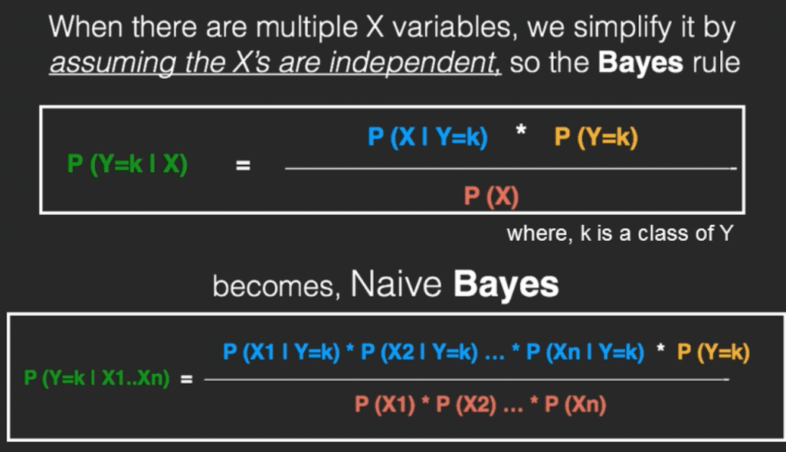
Naïve Bayes
Naïve bayes is an algorithm that is built on the Bayes’ Theorem calculation.
Naïve – each feature is treated as independent.
Bayes – uses Bayes’ Theorem.
Classifier is a “Big Bayes’ Theorem” where each feature is another term.
Y is the target – what we predict.
Xs are (categorical) feature set.
Pedantic note, it’s one step in reality, just easier to imagine one feature at a time.

Slide 29
Not so Naive After All…
Models all want to predict Y given several Xs.
Model starts with baseline – no X in prediction.
Each X ’adds’ its impact.
The ‘flipped’ probability – given Y, how likely is X.
For example:
Predicting if we golf based on rain, clould, and wind.
Baseline is likelihood of golfing at all.
‘Add’ impact of rain – if golfing, likelihood of rain; if not, likelihood of rain.
‘Add’ impact of cloud – if golfing, likelihood of cloud’ if not, likelihood of cloud.

Slide 30
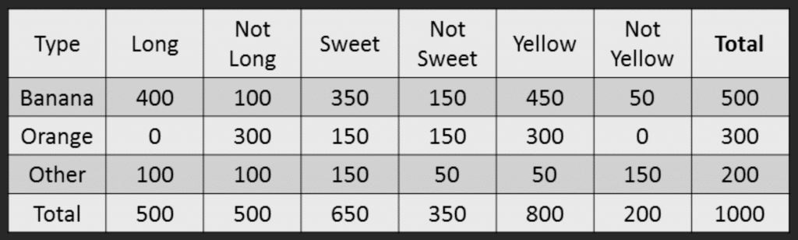
Example by Hand
A fruit is Long, Sweet, and Yellow – what fruit is it?
Below is our training data.

Slide 31
Naïve Bayes Process
Calculate prior probabilities:
P (Banana) = .5
P (Orange) = .3
P (Other) = .2
Compute denominator:
P (Long) = .5
P (Sweet) = .65
P (Yellow) = .8
P(L)*P(S)*P(Y) = .26
This is needed for the full calculation, but doesn’t matter in the prediction.

Slide 32
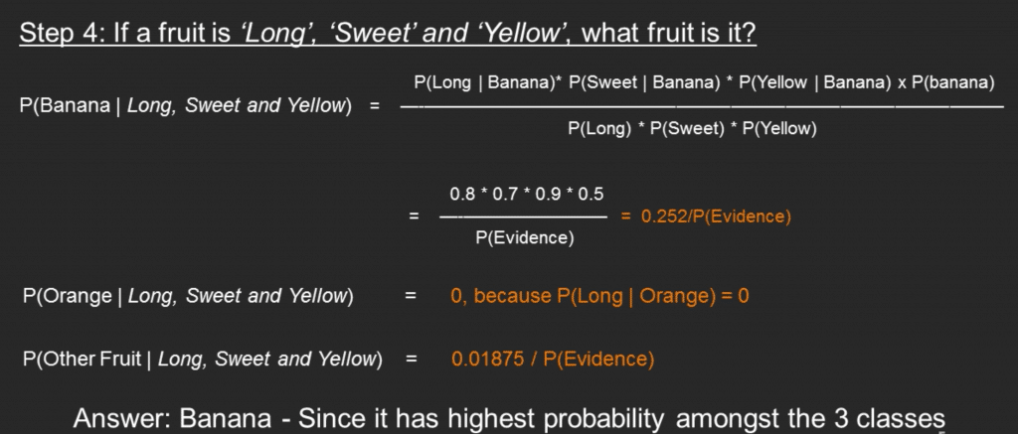
Naïve Bayes Process 2
Calculate numerator:
P (Long | Banana) = .8
P (Sweet | Banana) = .7
P (Yellow | Banana) = .9
P (Banana) = .5
Product = .252
Classify – Calculate probability for all potential classes.
P (Banana | Long, Sweet, Yellow) = .252/.26
P (Orange | Long, Sweet, Yellow) = 0 (There are no long oranges)
P (Other | Long, Sweet, Yellow) = .01875/.26

Slide 33
Naïve Bayes
Those final probabilities could be normalized to get the probability on a percentage scale.
As we did with the Bayesian tables – it’d be like 99%+ banana here.
As a classifier, Bayes is:
Interpretable – we can illustrate how predictions are made.
Simple – the math is just what we did by hand. Data can be small.
Fast – due to the simplicity, training and predicting are usually fast.
However, Bayes is also:
Limited – the independence assumption is often untrue. Making its applications limited.
Probability estimates aren’t reliable*, even if classifier is accurate.
The raw percentages from calculations shouldn’t be relied on. (Independence and completeness).

Slide 34
Bayes Model

Slide 35
Interpretability
One metric, outside of accuracy, that a model may be evaluated on is interpretability.
Can we understand how the model made a decision.
We’ve seen parts that go both

Slide 36
Non-Linear Relationships
One cool thing about Bayes is that it isn’t linear.
There’s no y=mx+b type equation anywhere.
The decisions it makes are the same as a logistic regression, but the method is different.
Still predict group A/B, still use X feature set, still use same error analysis.
Logistic regression requires some linear decision boundary to separate A/B.
Bayes doesn’t – things can be classified without a linear relationship.
Different types of models can handle different types of relationships in data.
If there is a linear correlation, regression may excel, if not Bayes (or others) may excel…
Real scenarios may have non-linear relationships.
Is there a linear relationship between dining options and cancer occurrences – maybe?

Slide 37
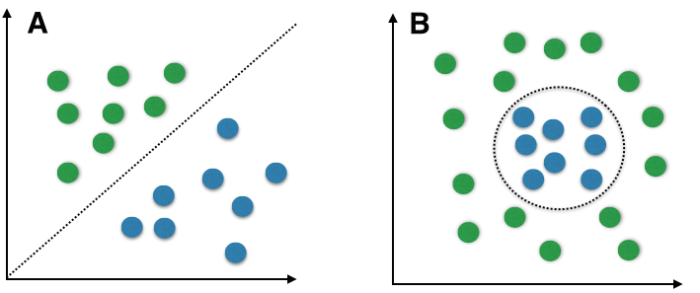
Non-linearity
Capturing non-linear relationships is great.
Lots of data may not have a linear relationship.
Especially true in ‘unstructured’ problems.
Unstructured data is non-tabular. Images, etc…
Linear models can’t adapt to the relationship.
Pattern of our model should ‘fit’ data pattern.
Bayes can fit where log. Reg. can’t, inherently.
We’ll worry more about this next semester.

Slide 38
Bayes and Sklearn Implementation
Using bayes models is normally pretty simple, everything is just sklearn standard.
There are a couple of specific (potential) things to be aware of:
Bayes theoretically doesn’t require encoding of variables, implementations may.
From docs: “It is further assumed that all categories of each feature are represented by the numbers 0, …, n - 1, where n refers to the total number of categories for the given feature. This can, for instance, be achieved with the help of OrdinalEncoder.”
Bayes requires categorical features, implementations may do something to automatically handle numeric features or may have some different variant.
In sklearn there are several Bayes varieties for different applications – Gaussian for numerical.
Overall, this can be true in several places:
ML libraries have a pretty standard way to use algorithms, for ease of use.
The exact requirements of the theoretical algorithm change to match.

Slide 39
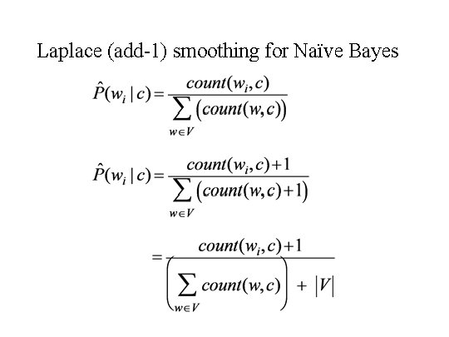
Smoothing
One issue Bayes can have is if there is an example to predict that was not in the training data.
E.g. what if a fruit is green?
Introduces a divide by 0, which is impossible.
Laplace smoothing is the solution:
Add 1 (or another value) to the observations.
Built into any implementation, usually as a parameter.
Common as you’ll get an error if things are missing.
The larger the data is, the less this matters.
Big data = fewer missing values from train.
Big data = this change is numerically irrelevant.

Slide 40
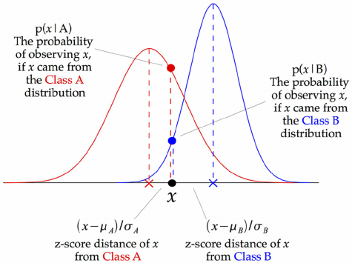
Flexible Bayes
By default, Bayes only works with categorical features.
When dealing with numerical features we need to adapt the algorithm.
Gaussian Bayes does so by replacing the probability calculation with a probability calculation based on a gaussian distribution.
These probabilities replace the probabilities in Bayes and everything else works in the same way.
This is one example of wanting normalized data for features based on model assumptions.
Note: the details are handled by sklearn.

Slide 41
Real Life Bayes
Bayes models are used in several real-life places, often unstructured.
Spam detection.
Markov chain type of things. You don’t need details, but these are probabilistic things that depend only on previous states.
Other probabilistic “state-needing” things. E.g. modelling one customer’s behavior, finance.
Optimization – when doing other ML stuff, Bayes can help narrow down option choices.
Bayes has tended to perform well on unstructured (non-tabular) problems (like spam).
Bayes used to be best, but newer (xgb, neural networks) models can be good/better.
For something like spam, fast processing of Bayes can really matter. (Est 130 billion gmails/day)
The relationship of words in text and spam status probably isn’t linear…

Slide 42
Naïve Bayes Conclusion
Bayes is one of the simpler classifiers that we can create.
Bayes regression exists, but is not super common so we don’t worry about it.
Bayesian models have different logic than regression – no linear dependance, no residual.
There is still a model (inputs->output), but how it works is totally different.
Strengths:
It is fast, both making predictions and in training – probability calcs are quick.
Often performs well on “unstructured” things, like email spam detection (more in NLP part).
Weaknesses:
Handling mixed data (num and cat) can be very annoying.
Independence of features isn’t perfect in most real-life scenarios*.
Limited ability to make model better through tuning (next semester).
Bayes is good at specific tasks, but other models beat it in general.

Slide 43
Build-A-Bayes
In workbook 032 we have an example of a Bayes model, made by hand.
We don’t need to do this by hand, but can we read through and follow…
This is generally a decent self-check.
We know what the model does – calculate probs, likelihoods, combine them, etc…
We can use a simple example and track it through the algorithm.
You can try-a-bayes for the project, your call. You might need to do some data prep.

Slide 44
For the Future…
In January we’ll start roughly where we left of here.
More EDA, use a different model type, evaluate models better, more data prep (pipeline).
Things that are really important:
Code – similar to what we’re doing now, but we’ll have more functions/classes/complexity.
Data – manipulating 2D data in assorted ways, convert types, loops, vector opps.
Sklearn – most things use the sklearn libraries, get used to code and docs.
Basic stats (understand idea and relate to data) – distribution, variance, correlation, etc…
Idea of gradient descent, weights/parameters being modified, iterative solutions.
Errors – theory and usage, for classification and numeric values.
Probability, odds, conditional probability.
Inference/generalization – we have some data, how can we estimate more/all.

